Slide 1
Class 6: Bayesian Methods
In this class we will review Bayesian likelihood methods for solving statistical problems, determining the posterior probabilities of model parameters, and selecting between two models

Slide 2
Class 6: Bayesian Methods
At the end of this class you should be able to …
… understand the application of Bayes’ theorem in model-fitting and the role of priors
… obtain parameter values and confidence ranges via likelihood methods
… search parameter space with MCMC algorithms
… apply model selection tests using the Bayes factor or Akaike information criteria

Slide 3
Bayesian Methods
Recall from Class 1 that Bayesian statistics is a framework that allows us to assign probabilities to a model
It makes use of conditional probabilities, $P(A|B)$, meaning “the probability of $A$ on the condition that $B$ has occurred”
Remember that $P(A|B)≠P(B|A)$ in general!
Image credit:
analyticsvidhya.com

Slide 4
Bayesian Methods
An important role in Bayesian statistics is played by Bayes’ theorem, which can be derived from elementary probability:
Small print: this formula can be derived by just writing down the joint probability of both $A$ and $B$ in 2 ways:
$$P\left(A | B\right)=\frac{P\left(B | A\right) P(A)}{P(B)}$$
$$P(A∩B)=P\left(A | B\right) P\left(B\right)=P\left(B | A\right) P(A)$$

Slide 5
Bayesian Methods
The chance of a certain medical test being positive is 90%, if a patient has disease $D$. 1% of the population have the disease, and the test records a false positive 5% of the time. If you receive a positive test, what is your probability of having $D$?
We are told: $P\left(+ | D\right)=0.9$, $P\left(D\right)=0.01$, $P\left(+ | no D\right)=0.05$
We want to know: $P(D|+)$
Bayes’ Theorem: $P\left(D | +\right)=\frac{P\left(+|D\right) P(D)}{P(+)}=\frac{P\left(+|D\right) P(D)}{P\left(+|D\right) P\left(D\right) + P\left(+|no D\right) P(no D)}$
Substituting in the data: $P\left(D | +\right)=\frac{0.9×0.01}{0.9×0.01+0.05×0.99}=0.15$
Interpretation: although the test is correct 90% of the time, the probability of having $D$ after a positive test is only 15%. This is because only a small fraction of the population have the disease.

Slide 6
Bayesian Methods
A Frequentist might argue “either the person has the disease or not – it is meaningless to apply probability in this way”
A Bayesian might argue “there is a prior probability of $1\%$ that the person has the disease. This probability should be updated in the light of the new data using Bayes’ theorem”

Slide 7
Bayesian Methods
Bayes’ theorem can be usefully re-written for science as:
Likelihood function
of the data given the model
Posterior probability
of the model in light of the data
Prior probability
of the model
$$P\left(model | data\right)=\frac{P\left(data | model\right) P(model)}{P(data)}$$
Evidence [can typically be absorbed into the normalization of the posterior]

Slide 8
Role of the prior
Bayesian statistics cannot determine probabilities of a model without assigning a prior probability
The importance of the prior probability is both the strong and weak point of Bayesian statistics
A Bayesian might argue: “the prior probability is a logical necessity when assessing the probability of a model. It should be stated, and if it’s unknown you can use an uninformative (wide) prior”
A Frequentist might argue “setting the prior is subjective – two experiments could use the same data to come to two different conclusions, just by taking different priors”

Slide 9
Role of the prior
Let’s take the example of fitting a parameter $a$ to some data. Bayes’ Theorem now reads:
We do not need the denominator, since we will normalize the posterior $P\left(a | data\right)$ such that $\int{P\left(a | data\right) da=1}$
In the absence of other information, a uniform (or constant) prior is often assumed for $P(a)$. This is effectively equivalent to the fitting range of a parameter
Assuming Gaussian variables, the likelihood $P\left(data | a\right)$ is:
$$P\left(a | data\right)∝P\left(data | a\right) P(a)$$
$$P\left(data | a\right)∝e^{−χ^{2}/2}$$
Hence: $P(a|data)∝e^{−χ^{2}/2}$

Slide 10
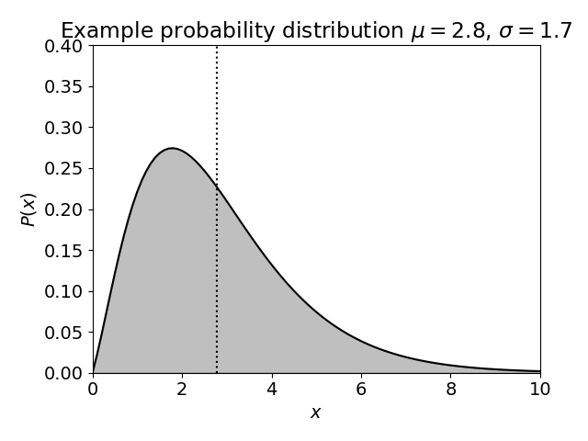
Posteriors and confidence limits
We can use the posterior probability distribution $P(a)$ to determine summary statistics and confidence intervals for the parameter $a$:
Mean: $μ_{a}=\int_{−∞}^{∞}{a P\left(a\right) da}$
Variance: ${σ_{a}}^{2}=\int_{−∞}^{∞}{{\left(a−μ_{a}\right)}^{2} P\left(a\right) da}$
[Small print: only if the probability distribution is Gaussian is the mean equal to the best-fitting value, and the standard deviation equal to the $68\%$ confidence region]

Slide 11
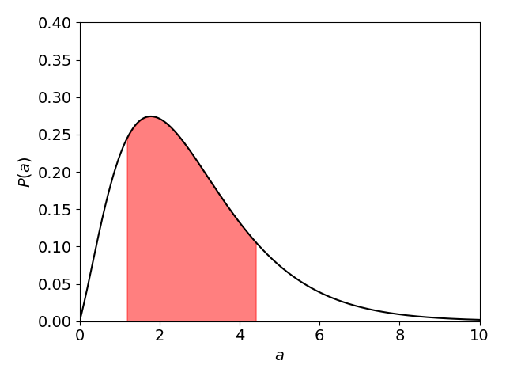
Posteriors and confidence limits
For a general probability distribution, we can determine the confidence intervals by integration:
$$\int_{−∞}^{a_{bot}}{P\left(a\right)}da=0.16 \int_{a_{bot}}^{a_{top}}{P\left(a\right)}da=0.68 \int_{a_{top}}^{∞}{P\left(a\right)}da=0.16$$
68% area
16% area
16% area
$$a_{bot}$$
$$a_{top}$$

Slide 12
Marginalization
Now suppose we have determined the 2D posterior probability distribution of a 2-parameter fit, $P_{2D}(a,b)$
What is the probability distribution for parameter $a$, considering all possible values of parameter $b$? This is known as marginalization of parameter $b$
Marginalization can be performed by summing (integrating) over one axis of the probability distribution:
[Small print: if $P_{2D}(a,b)$ is normalized, then $P_{1D}\left(a\right)$ will also be normalized]
$$P_{1D}\left(a\right)=\sum_{b}{P_{2D}(a,b)}$$

Slide 13
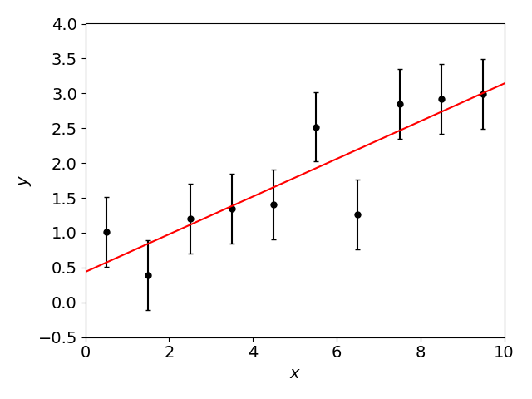
Use of likelihood for parameter fitting
Let’s apply these methods to our example from Class 3, fitting a straight line $y=ax+b$ to some data…

Slide 14
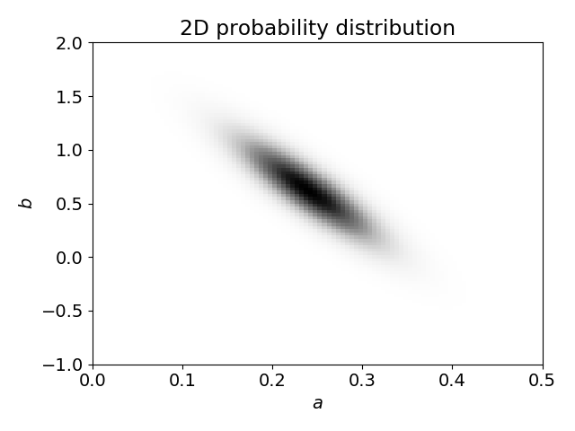
Use of likelihood for parameter fitting
We determine the values of $χ^{2}$ over a grid of $(a,b)$ and convert to 2D probability $P(a,b)∝e^{−χ^{2}/2}$

Slide 15
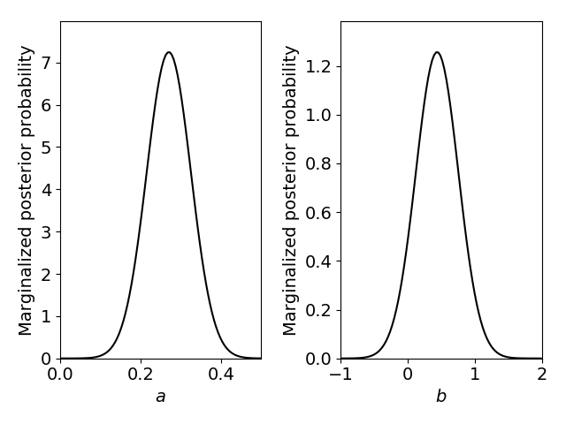
Use of likelihood for parameter fitting
Then we marginalize to obtain the posterior probability distributions for each parameter, $P(a)$ and $P\left(b\right)$ …

Slide 16
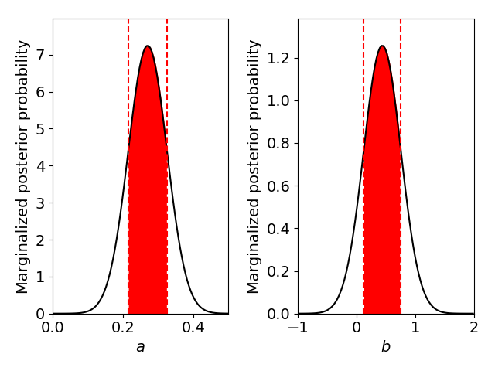
Use of likelihood for parameter fitting
By integrating under these distributions, we identify the $68\%$ confidence regions …

Slide 17
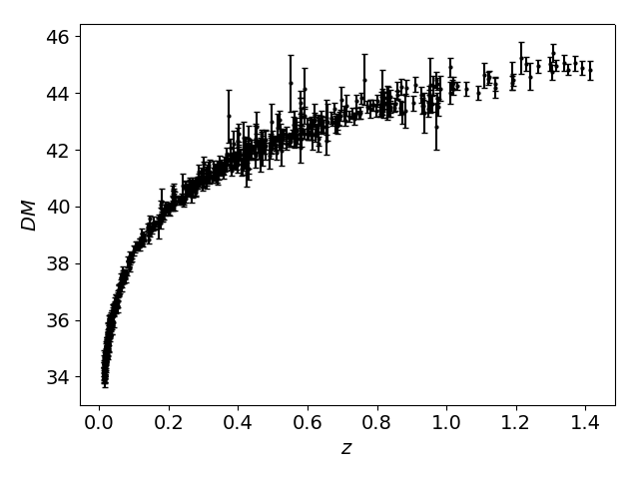
Supernova cosmology (continued)
Let’s return to the same supernova distance-redshift dataset we were using in Class 3:
Convert the $χ^{2}$ values into a joint 2D probability distribution in $\left(Ω_{m},Ω_{Λ}\right)$
Marginalize this probability distribution to obtain the 1D posterior probability distributions for $Ω_{m}$ and $Ω_{Λ}$
Determine the 68% confidence regions for $Ω_{m}$ and $Ω_{Λ}$

Slide 18
Monte Carlo Markov Chains
The grid method becomes inefficient as the number of parameters increases. A powerful alternative is to generate a Monte Carlo Markov Chain (MCMC) in the parameter space
There are various algorithms to do this such as python emcee (we won’t go into details here), but the end result is a “chain” (distribution of parameter values) which samples the underlying probability distribution
Image credit: www.newton.ac.uk
Image credit: www.essenceps.com

Slide 19
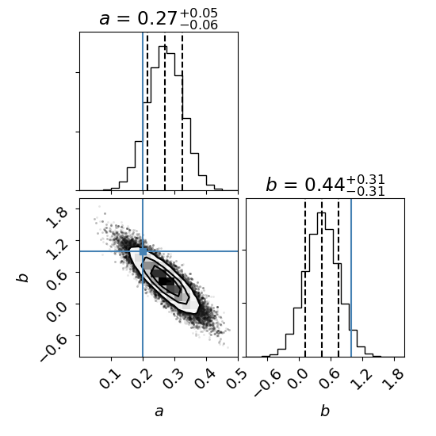
Monte Carlo Markov Chains
Here is a worked example of using python’s emcee algorithm to sample the probability distribution of the straight-line fit:

Slide 20
Supernova cosmology (continued)
Let’s return to the same supernova distance-redshift dataset again:
Run an MCMC analysis for parameters $\left(Ω_{m},Ω_{Λ}\right)$
Determine the 68% confidence regions for $Ω_{m}$ and $Ω_{Λ}$

Slide 21
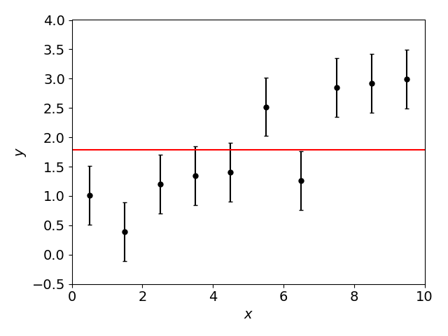
Model selection
Since Bayesian statistics is related to the probability of models, it allows us to perform model selection
A common example: how many model parameters does a dataset justify including in a fit?

Slide 22
Model selection
In general, given models $M_{1}$ (parameter $p_{1})$ and $M_{2}$ (parameter $p_{2})$ and a dataset $D$, we can determine the Bayes factor:
The size of $K$ quantifies how strongly we can prefer one model to another, e.g. the Jeffreys scale:
$$K=\frac{P(M_{1}|D)}{P(M_{2}|D)}=\frac{\int{dp_{1} P(D|p_{1})}P(p_{1})}{\int{dp_{2} P(D|p_{2})}P(p_{2})}$$
$$K$$ | Strength of evidence
$$1−3$$ | “barely worth mentioning”
$$3−10$$ | “substantial”
$$10−30$$ | “strong”
$$>30$$ | “very strong”

Slide 23
Model selection
This quantity is usually difficult to compute, and we can instead use an approximation to this ratio
A common approach is to calculate the Akaike information criteria for each model:
This penalizes models with more parameters (and the final term corrects for sample size)
The model with the smaller value of $AIC$ is preferred [the likelihood ratio is $e^{({AIC}_{1}−{AIC}_{2})/2}$]
$$AIC=χ_{min}^{2}+2p+\frac{2p(p+1)}{N−p−1}$$
$p=$ number of parameters
$N=$ number of bins

Slide 24
Flat or curved Universe?
Let’s return to the same supernova distance-redshift dataset again:
Compute the Akaike information criteria for a flat model (where $Ω_{m}+Ω_{Λ}=1)$ and a curved model (where $Ω_{m}$, $Ω_{Λ}$ can take any value). Which model is preferred, by this metric?

Slide 25
Summary
At the end of this class you should be able to …
… understand the application of Bayes’ theorem in model-fitting and the role of priors
… obtain parameter values and confidence ranges via likelihood methods
… search parameter space with MCMC algorithms
… apply model selection tests using the Bayes factor or Akaike information criteria

