Slide 1
Class 3: Model-fitting
In this class we will describe the use of the $χ^{2}$ statistic as a hypothesis test of a model, and in determining best-fitting parameters

Slide 2
Class 3: Model-fitting
At the end of this class you should be able to …
… apply the $χ^{2}$ statistic as a hypothesis test
… understand the probability distribution of the $χ^{2}$ statistic and its interpretation as a $p$-value
… apply the $χ^{2}$ statistic in parameter fitting
… determine parameter errors and joint confidence regions using intervals of $Δχ^{2}$

Slide 3
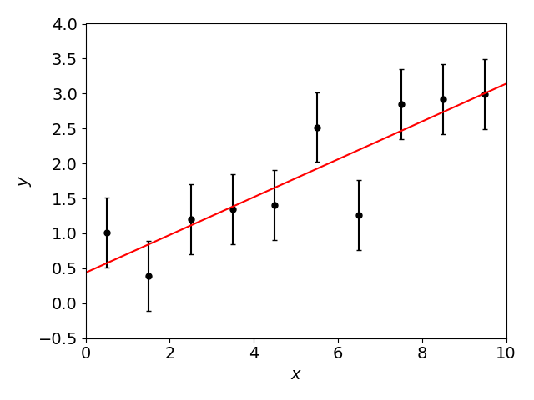
Comparing data and models
A key task in statistics is to build models which describe our data:

Slide 4
Comparing data and models
When comparing data and models, we are typically doing one of two things …
Hypothesis testing: we have a set of $N$ measurements $x_{i}±σ_{i}$, which a theorist says should have values $μ_{i}$. How probable is it that these measurements would have been obtained, if the theory is correct?
Parameter estimation: we have a parameterized model which describes the data, such as $y=ax+b$. What are the best-fitting parameters and errors in those parameters?

Slide 5
The $χ^{2}$ statistic
The most important statistic to help with these tasks is the $χ^{2}$ statistic between the data $x_{i}±σ_{i}$ and model $μ_{i}$:
$$χ^{2}=\sum_{i=1}^{N}{{\left(\frac{x_{i}−μ_{i}}{σ_{i}}\right)}^{2}}$$
$χ^{2}$ is a sum over the data points
This point is 2-$σ$ away from the model, so increments $χ^{2}$ by 4.0
This point is 1-$σ$ away from the model, so increments $χ^{2}$ by 1.0
This point is on the model, so increments $χ^{2}$ by 0.0
Model

Slide 6
The $χ^{2}$ statistic
The most important statistic to help with these tasks is the $χ^{2}$ statistic between the data $x_{i}±σ_{i}$ and model $μ_{i}$:
We accumulate the statistic according to how many standard deviations each data point lies from the model
$χ^{2}$ is a measure of the goodness-of-fit of the data to the model
If the data are numbers taken as part of a counting experiment, we could use the Poisson error ${σ_{i}}^{2}=μ_{i}$
[Small print: this equation assumes the data points are independent]
$$χ^{2}=\sum_{i=1}^{N}{{\left(\frac{x_{i}−μ_{i}}{σ_{i}}\right)}^{2}}$$

Slide 7
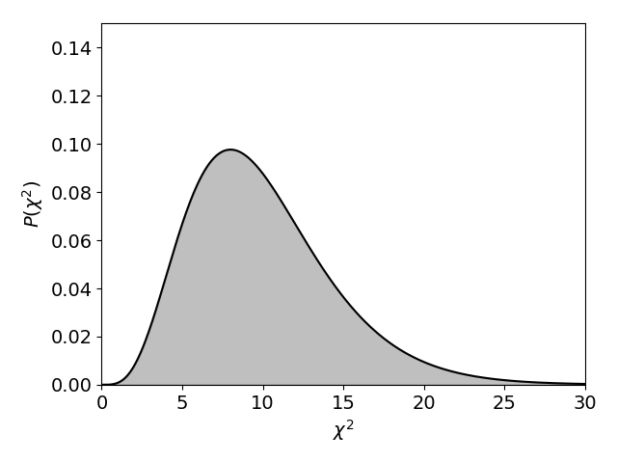
$χ^{2}$ probability distribution
Sampling many realizations of $N$ data points from a particular model, using Gaussian statistics, the $χ^{2}$ statistic has a probability distribution:
(For $N=10$ data points)
This allows us to quantify the likelihood of $χ^{2}$ taking on a particular (range of) values, given the number of data points

Slide 8
$χ^{2}$ probability distribution
Sampling many realizations of $N$ data points from a particular model, using Gaussian statistics, the $χ^{2}$ statistic has a probability distribution
$ν$ is the number of degrees of freedom
If the model has no free parameters, then $ν=N$
If we are fitting a model with $p$ free parameters, we can “force the model to agree exactly with $p$ data points” and the degrees of freedom are reduced to $ν=N−p$
$$P\left(χ^{2}\right)∝{\left(χ^{2}\right)}^{\frac{ν}{2}−1}e^{−χ^{2}/2}$$

Slide 9
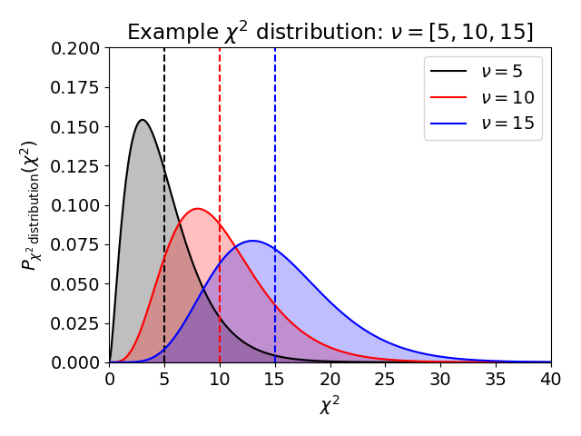
$χ^{2}$ probability distribution

Slide 10
$χ^{2}$ probability distribution
The $χ^{2}$ distribution:
The mean of the distribution: $\overline{χ^{2}}=ν=N−p$
This makes intuitive sense, because each data point should lie about $1σ$ from the model and hence contribute $1.0$ to the $χ^{2}$ statistic
The variance: $Var\left(χ^{2}\right)=2ν$
If the model is correct, we expect $χ^{2} \sim ν±\sqrt{2ν}$
$$P\left(χ^{2}\right)∝{\left(χ^{2}\right)}^{\frac{ν}{2}−1}e^{−χ^{2}/2}$$

Slide 11
Reduced $χ^{2}$
As a way of summarizing the model fit, we can quote the reduced $χ^{2}$ statistic, ${χ_{r}}^{2}=χ^{2}/ν$
For a good fit, ${χ_{r}}^{2} \sim 1$ (because $\overline{χ^{2}}=ν$)
However, the true probability of the data being consistent with the model depends on both $χ^{2}$ and $ν$
Do not just quote the reduced $χ^{2}$ value

Slide 12
Use of $χ^{2}$ statistic as a hypothesis test
We can use the $χ^{2}$ statistic to construct a hypothesis test describing the “goodness of fit” between data and model
Null hypothesis: the data are consistent with the model
Test statistic: $χ^{2}$
Distribution of values: The $χ^{2}$probability distribution
Confidence statement: What is the probability that this value of $χ^{2}$, or a larger one, could arise by chance?
If the $p$-value is not low, the data are consistent with the model, which is “ruled in”
If the $p$-value is low, the model is “ruled out”

Slide 13
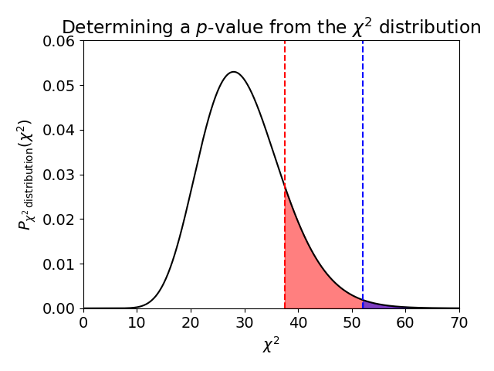
Use of $χ^{2}$ statistic as a hypothesis test
Suppose that $ν=30$ and we have 2 datasets with $χ^{2}=37.5$ and $χ^{2}=52.1$. What are the corresponding $p$-values?
$p=0.16$ for $χ^{2}>37.5$
$p=0.007$ for $χ^{2}>52.1$

Slide 14
Cautionary words
Let’s recall our discussion in Class 2 on the meaning of $p$
Suppose a $χ^{2}$ hypothesis test yields $p=0.01$
This means: there is a $1\%$ chance of obtaining a set of measurements at least this discrepant from the model, assuming the model is true. It does not mean:
“the probability that the model is true is $1\%$”
“the probability that the model is false is $99\%$”
“if we reject the model there is a $1\%$ chance that we would be mistaken”
Frequentist statistics cannot assess the probability that the model itself is correct

Slide 15
Cautionary words
When using $χ^{2}$ we’re assuming that the errors in the data are Gaussian and reliable. This is not guaranteed!
If the errors have been under-estimated, then an improbably high value of $χ^{2}$ can be obtained
If the errors have been over-estimated, then an improbably low value of $χ^{2}$ can be obtained
Since errors are often approximate, a model is typically only rejected for very low values of $p$ such as $0.001$

Slide 16
Cautionary words
An issue in using the $χ^{2}$ statistic is binning of data
For example, suppose we have a sample of galaxy luminosities. To compare the data with a Schechter function model, we would bin it into a luminosity function
Warning: if the numbers in each bin are too small the probabilities can become non-Gaussian
As a rule of thumb, $80\%$ of bins must have $N>5$

Slide 17
Modification for correlated data
If the data are correlated, the $χ^{2}$ equation must be modified:
Here, $C$ is the covariance matrix of the data, such that
Note that $C_{ii}=\left\langle {x_{i}}^{2}\right\rangle −{\left\langle x_{i}\right\rangle }^{2}$ is the variance ${σ_{i}}^{2}$
The number of degrees of freedom is unchanged (for anything less than complete correlation)
$$χ^{2}=\sum_{i=1}^{N}{\sum_{j=1}^{N}{\left(d_{i}−m_{i}\right) {\left(C^{−1}\right)}_{ij} \left(d_{j}−m_{j}\right)}}={\left(d−m\right)}^{T}C^{−1}\left(d−m\right)$$
$$C_{ij}=\left\langle x_{i} x_{j}\right\rangle −\left\langle x_{i}\right\rangle \left\langle x_{j}\right\rangle$$

Slide 18
Use of $χ^{2}$ statistic for parameter fitting
A model typically contains free parameters. How do we determine the most likely values of these parameters and their error ranges?

Slide 19
Use of $χ^{2}$ statistic for parameter fitting
A model typically contains free parameters. How do we determine the most likely values of these parameters and their error ranges?
Suppose we are fitting a model with 2 free parameters $(a,b)$
The most likely (“best-fitting”) values of $(a,b)$ are found by minimizing the $χ^{2}$ statistic
The joint error distribution of $(a,b)$ can be found by calculating the values of $χ^{2}$ over a grid of $(a,b)$ and enclosing a particular region $χ^{2}<χ_{min}^{2}+Δχ^{2}$

Slide 20
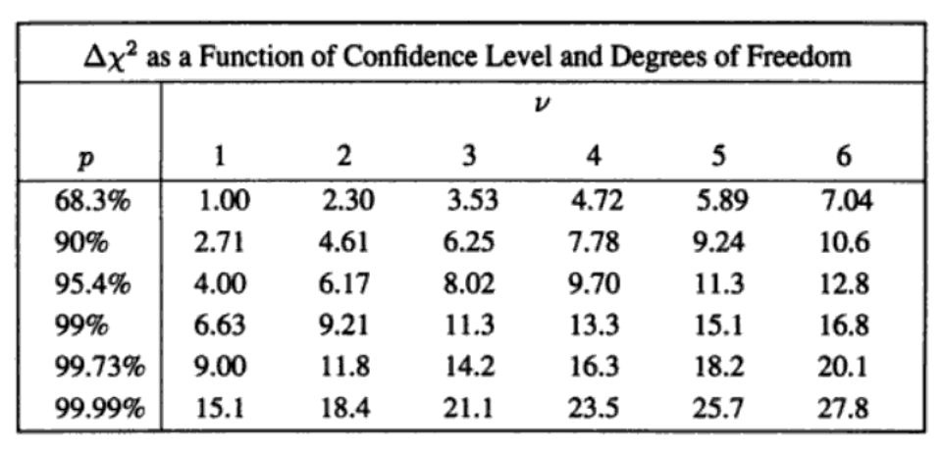
Joint confidence regions
We plot 2D contours of constant $χ^{2}=χ_{min}^{2}+Δχ^{2}$
A joint confidence region for $(a,b)$ can be defined by the zone which satisfies $χ^{2}<χ_{min}^{2}+Δχ^{2}$
The values of $Δχ^{2}$ depend on the number of variables and confidence limits:
[Small print: assumes the variables are Gaussian-distributed]
2 parameters varying
(Table taken from Numerical Recipes Chapter 15)
1-$σ$ confidence

Slide 21
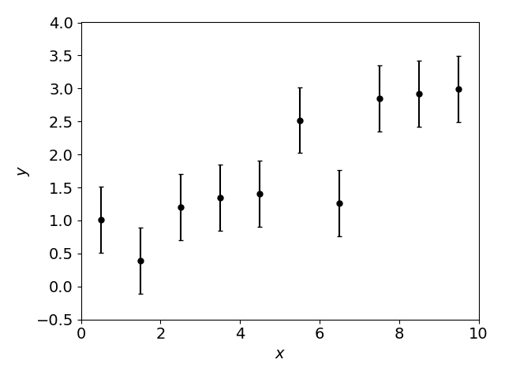
Use of $χ^{2}$ statistic for parameter fitting
Here is an example dataset containing $N=10$ points:

Slide 22
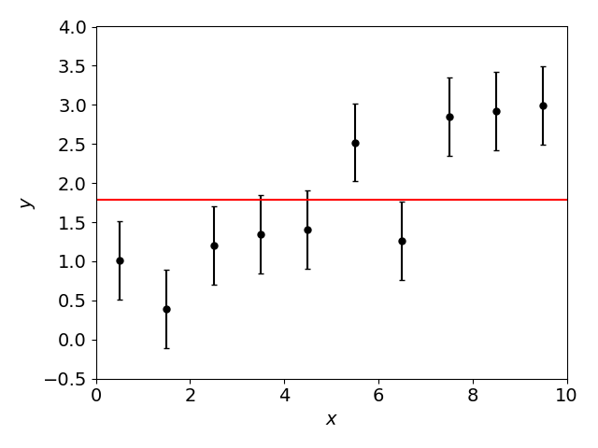
Use of $χ^{2}$ statistic for parameter fitting
Could these points be fit by a constant $y=b$? Minimizing $χ^{2}$, we find $χ_{min}^{2}=31.6$ for $b=1.79$

Slide 23
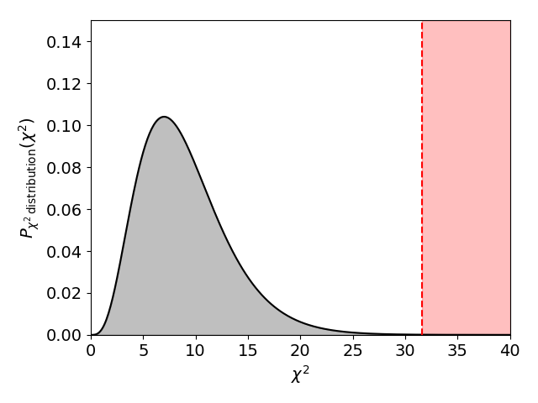
Use of $χ^{2}$ statistic for parameter fitting
Is the minimum $χ^{2}$ likely given the model? Consider the $χ^{2}$ probability distribution for $χ^{2}>31.6$ and $ν=N−1=9$:
Probability in tail $=0.0002$ – the model is ruled out

Slide 24
Use of $χ^{2}$ statistic for parameter fitting
Could these points be fit by a straight line $y=ax+b$? Minimizing $χ^{2}$, we find $χ_{min}^{2}=7.5$ for $a=0.27$ and $b=0.44$

Slide 25
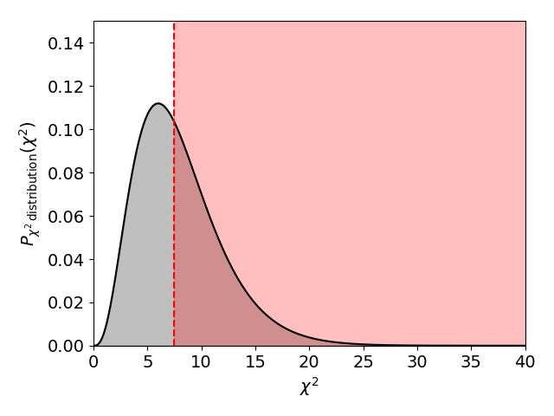
Use of $χ^{2}$ statistic for parameter fitting
Is the minimum $χ^{2}$ likely given the model? Consider the $χ^{2}$ probability distribution for $χ^{2}>7.5$ and $ν=N−2=8$:
Probability in tail $=0.48$ – the model is ruled in

Slide 26
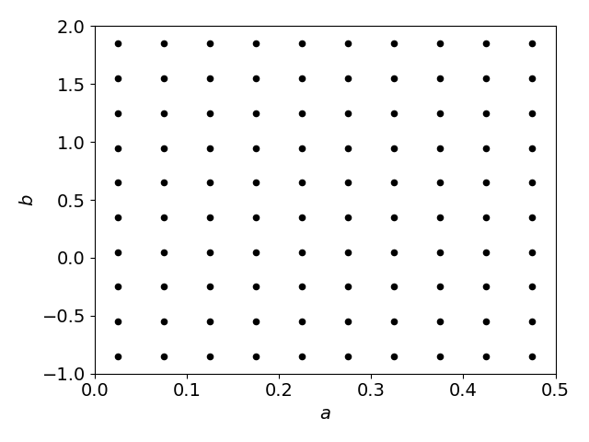
Use of $χ^{2}$ statistic for parameter fitting
Now let’s determine the error ranges. What is the distribution of $χ^{2}$ values across the $(a,b)$ grid?

Slide 27
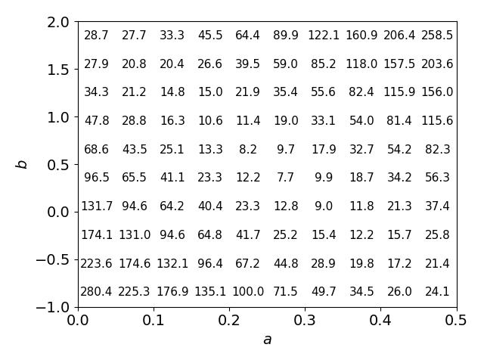
Use of $χ^{2}$ statistic for parameter fitting
Now let’s determine the error ranges. What is the distribution of $χ^{2}$ values across the $(a,b)$ grid?

Slide 28
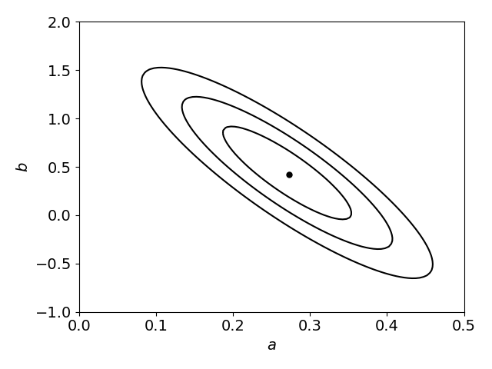
Use of $χ^{2}$ statistic for parameter fitting
Set confidence regions using $∆χ^{2}$ intervals: for 2 parameters, the $\left(68,95,99\right)\%$ regions are $∆χ^{2}=(2.30,6.17,11.8)$

Slide 29
Use of $χ^{2}$ statistic for parameter fitting
What about errors in individual parameters? For each value of parameter $a$, find the minimum $χ^{2}$ varying parameter $b$:
For each value of $a$, what is the minimum $χ^{2}$ along this line?

Slide 30
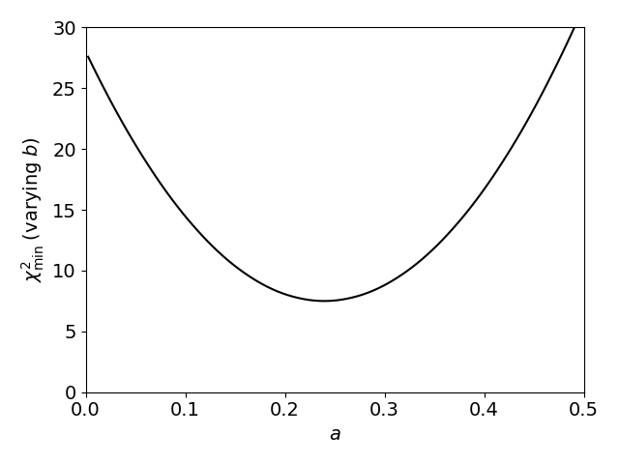
Use of $χ^{2}$ statistic for parameter fitting
What about errors in individual parameters? For each value of parameter $a$, find the minimum $χ^{2}$ varying parameter $b$:
“+1” for 68% confidence for 1 parameter
$$χ_{min}^{2}+1$$
68% confidence region
$$χ_{min}^{2}$$

Slide 31
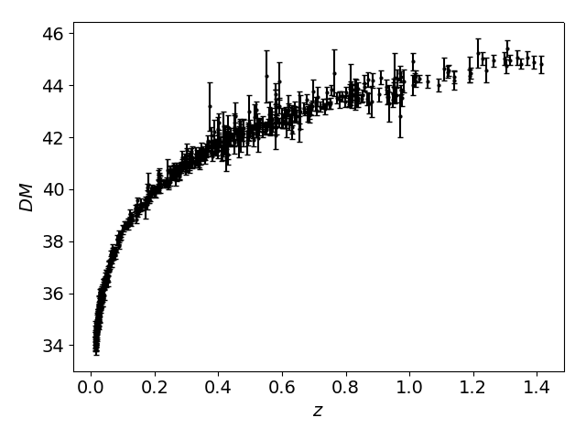
Supernova cosmology
In this Activity we will use a recent supernova distance-redshift dataset to determine the parameters $\left(Ω_{m},Ω_{Λ}\right)$
Minimize $χ^{2}$ and find the best-fitting $\left(Ω_{m},Ω_{Λ}\right)$
Construct the 2D confidence regions in $\left(Ω_{m},Ω_{Λ}\right)$
Determine the individual errors in $Ω_{m}$ and $Ω_{Λ}$

Slide 32
Summary
At the end of this class you should be able to …
… apply the $χ^{2}$ statistic as a hypothesis test
… understand the probability distribution of the $χ^{2}$ statistic and its interpretation as a $p$-value
… apply the $χ^{2}$ statistic in parameter fitting
… determine parameter errors and joint confidence regions using intervals of $Δχ^{2}$

