Slide 1
Class 1: Probability & Statistics
In this class we will review how statistics are used to summarize data, special probability distributions, their use in simple applications using Frequentist and Bayesian methods, and Monte Carlo techniques

Slide 2
Class 1: Probability & Statistics
At the end of this class you should be able to …
… determine summary statistics for datasets and their errors
… optimally combine data
... apply probability distributions for Gaussian, Binomial and Poisson statistics
… compare the Frequentist and Bayesian frameworks for statistical analysis
… solve statistical problems using Monte Carlo techniques

Slide 3
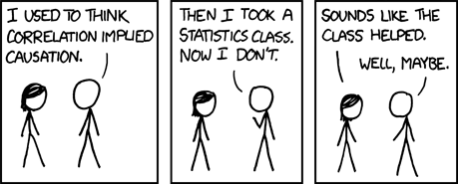
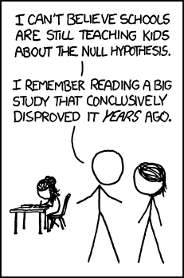
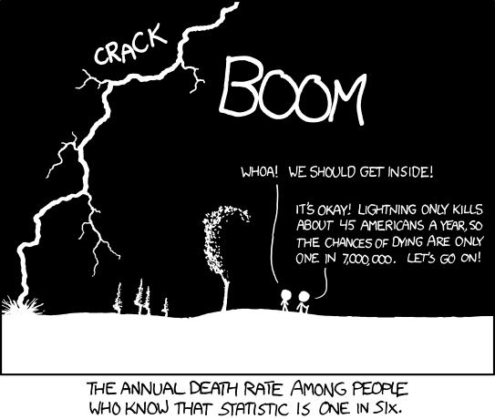
Class 1: Probability & Statistics
Credit: xkcd.com

Slide 4
The process of science
Obtain
measurements
Design a question
Analyze data
Conclude
(test hypothesis,
change probabilities)

Slide 5
The point of statistics
“If your experiment needs statistics, you ought
to have done a better experiment” (E.Rutherford)
“A body of methods for making wise decisions
in the face of uncertainty” (W.Wallis)
Statistics allows us to formulae the logic of what we are doing and why. It allows us to make precise statements.
Statistics allows us to quantify the uncertainty in any measurement (which should always be stated)
Statistics allows us to avoid pitfalls such as confirmation bias (distortion of conclusions by preconceived beliefs)

Slide 6
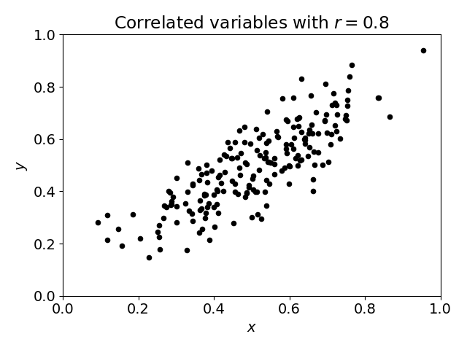
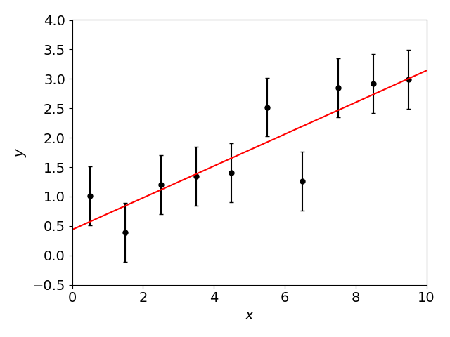
Common uses of statistics
Measuring a quantity (“parameter estimation”): given some data, what is our best estimate of a particular parameter? What is the uncertainty in our estimate?
Searching for correlations: are two variables we have measured correlated with each other, implying a possible physical connection?
Testing a model (“hypothesis testing”): given some data and one or more models, are our data consistent with the models? Which model best describes our data?

Slide 7
Summary statistics and their errors
A statistic is a quantity which summarizes our data
Image credit: pythonstatistics.net

Slide 8
Summary statistics and their errors
A statistic is a quantity which summarizes our data
I have a sample of $N$ independent estimates $x_{i}$ of some quantity, how can I summarize them?
The mean (typical value): $\overline{x}=\frac{1}{N}\sum_{i=1}^{N}{x_{i}}$
The median (middle value when ranked)
The standard deviation $σ$ (spread) or variance:
[Small print: Watch out for factor of $N−1$! (see below)]
$$Var\left(x\right)=σ^{2}(x)=\frac{1}{N−1}\sum_{i=1}^{N}{{\left(x_{i}−\overline{x}\right)}^{2}}$$

Slide 9
Summary statistics and their errors
We can quote an error in each of these statistics:
Error in the mean is standard deviation divided by $\sqrt{N}$ (as I increase the sample size, the error in the mean improves)
Error in the median $=1.25 \frac{σ}{\sqrt{N}}$
Error in the variance $=σ^{2}\sqrt{\frac{2}{N−1}}$
[Small print: the error in the mean holds for all probability distributions. The other two relations assume a Gaussian distribution.]
$$Error in mean=\frac{σ}{\sqrt{N}}$$

Slide 10
Estimators and bias
These formulae are a good example of estimators, combinations of data which measure underlying quantities
E.g., the estimator $\hat{V}=\frac{1}{N−1}\sum_{i=1}^{N}{{\left(x_{i}−\overline{x}\right)}^{2}}$ measures the underlying variance $V$ [notice “hat” notation meaning “estimate of”]
If an estimator is unbiased, then it recovers the true value on average over many realisations of the data, $\left\langle \hat{V}\right\rangle =V$ [notice notation $\left\langle …\right\rangle$ meaning “average over many experiments”]
[Small print: we can show that the $\frac{1}{N−1}$ factor in $\hat{V}$ is needed to ensure it is unbiased (because $\overline{x}$ is estimated from the data itself).]

Slide 11
Optimal combination of data
A common statistical task is to combine different input data into a single measurement
In this process we may give inputs different weights

Slide 12
Optimal combination of data
Suppose we have $N$ independent estimates $x_{i}$ of some quantity $y$, which have varying errors $σ_{i}$. What is our best combined estimate of $y$?
A simple average, $\hat{y}=\frac{1}{N}\sum_{i=1}^{N}{x_{i}}$?
This is not the optimal combination, because we want to give more weight to the more precise estimates. Let’s weight each estimate by $w_{i}$:
[Small print: this estimate is unbiased, since $\left\langle \hat{y}\right\rangle =\frac{\sum_{i}{w_{i} \left\langle x\right\rangle }}{\sum_{i}{w_{i}}}=\left\langle x\right\rangle =y$]
$$\hat{y}=\frac{\sum_{i=1}^{N}{w_{i} x_{i}}}{\sum_{i=1}^{N}{w_{i}}}$$

Slide 13
Optimal combination of data
The weights which minimize the combined error are inverse-variance weights $w_{i}=1/{σ_{i}}^{2}$
In this case, the variance in the combined estimate is:
[Small print: this approach is only helpful if the errors in the data are dominated by statistical, not systematic errors]
$$\hat{y}=\frac{\sum_{i=1}^{N}{x_{i}/{σ_{i}}^{2}}}{\sum_{i=1}^{N}{1/{σ_{i}}^{2}}}$$
$$\frac{1}{Var(\hat{y})}=\sum_{i=1}^{N}{\frac{1}{{σ_{i}}^{2}}}$$

Slide 14
Worked examples
We have $N=10$ measurements of a variable $x_{i}=(7.6, 5.8, 8.0, 6.9, 7.2, 7.5, 6.4, 8.1, 6.3, 7.0)$. Estimate the mean, variance and median of this dataset. What are the errors in your estimates?
We have $N=5$ measurements of a quantity: $(7.4±2.0, 6.5±1.1, 4.3±1.7, 5.5±0.8, 6.0±2.5)$. What is the optimal estimate of this quantity and the error in that estimate?
A further measurement $3.0±0.2$ is added. How should our estimate change?
How can we check the reliability of the initial 5 measurements?

Slide 15
Probability distributions
A probability distribution, $P(x)$, is a function which assigns a probability for each particular value (or range of values) of a continuous variable $x$
Must be normalized: $\int_{−∞}^{∞}{P\left(x\right) dx}=1$
Probability in range $\left[x_{1},x_{2}\right]=\int_{x_{1}}^{x_{2}}{P\left(x\right) dx}$
A probability distribution may be quantified by its …
Mean $μ=\overline{x}=\left\langle x\right\rangle =\int_{−∞}^{∞}{x P\left(x\right) dx}$
Variance $σ^{2}=\int_{−∞}^{∞}{{\left(x−μ\right)}^{2} P\left(x\right) dx}=\left\langle x^{2}\right\rangle −{\left\langle x\right\rangle }^{2}$

Slide 16
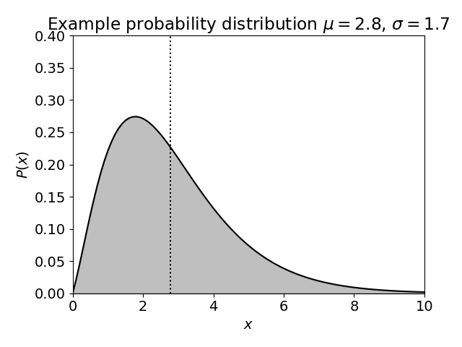
Probability distributions
For a general skewed distribution:
The mean is not necessarily the peak
$μ±σ$ does not necessarily contain 68% of the probability

Slide 17
Probability distributions
Certain types of variables have known distributions:
Binomial distribution
Poisson distribution
Gaussian or Normal distribution

Slide 18
The Binomial distribution
Applies in problems where there is a random process with two possible outcomes with probabilities $p$ and $1−p$
Example: tossing a coin
If we have $N$ trials, and the probability of success in each is $p$, then the probability of obtaining $n$ successes is:
The mean and variance of this distribution are $\overline{n}=pN$, $Var\left(n\right)=Np(1−p)$
$$P_{Binomial}\left(n\right)= \frac{N!}{n!\left(N−n\right)!} p^{n} {(1−p)}^{N−n}$$

Slide 19
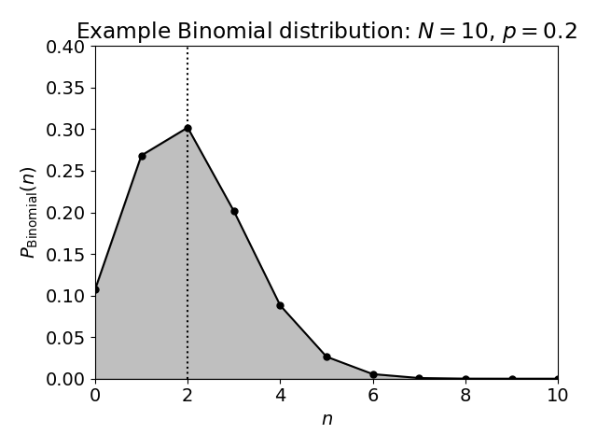
The Binomial distribution
“In a process with a 20% chance of success, how many successes would result from 10 tries?”

Slide 20
The Poisson distribution
Applies to a discrete random process where we are counting something in a fixed interval
Example: radioactive decay, photons arriving at a CCD
If the mean number of events expected in some interval is $μ$, the probability of observing $n$ events is
The mean and variance of this distribution are equal, $\overline{n}=Var\left(n\right)=μ$
$$P_{Poisson}\left(n\right)= \frac{μ^{n} e^{−μ}}{n! }$$

Slide 21
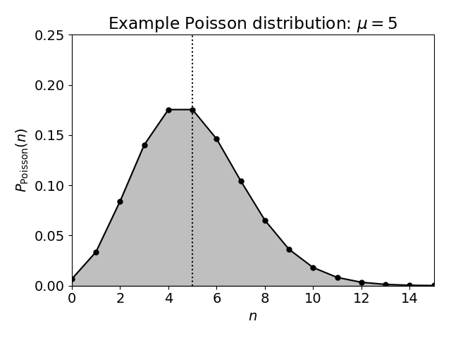
The Poisson distribution
“In an interval where I expect 5 events to occur on average, how many occur in practice?”

Slide 22
Poisson errors
The ultimate limit to any counting experiment
If an individual bin of data contains $N$ events (for example, a CCD pixel contains $N$ photons), we can use the Poisson variance $σ^{2}=μ$ to place a Poisson error $\sqrt{N}$ in that bin
$$Count=N±\sqrt{N}$$
Small print: Assumes the mean count is the observed count
Bad approximation for low numbers (e.g. $N=0$)
Bad approximation if the fluctuations are dominated by other processes (e.g. read noise, galaxy clustering)

Slide 23
The Gaussian distribution
The Gaussian (or “normal”) probability distribution for a variable $x$, with mean $μ$ and standard deviation $σ$ is:
$$P_{Gaussian}\left(x\right)= \frac{1}{σ\sqrt{2π} }e^{−\frac{1}{2}{\left(\frac{x−μ}{σ}\right)}^{2}}$$
Why is this such an ubiquitous and important probability distribution?
It is the high-$N$ limit for the Binomial and Poisson distributions
The central limit theorem says that if we average together variables drawn many times from any probability distribution, the resulting average will follow a Gaussian!

Slide 24
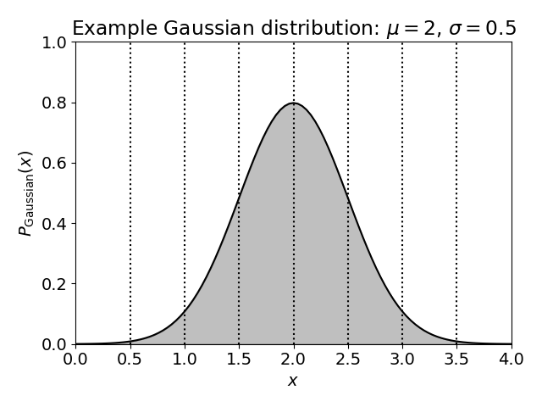
The Gaussian distribution
Dashed vertical lines are spaced every 1 standard deviation

Slide 25
Confidence regions and tails
The Gaussian (or “normal”) probability distribution for a variable $x$, with mean $μ$ and standard deviation $σ$ is:
The probability contained within $±1,2,3$ standard deviations is $\left(68.27, 95.45, 99.73\right)\%$ (etc.)
This is often used as shorthand for the confidence of a statement: e.g., $3$-$σ$ confidence implies that the statement is expected to be true with a probability of $99.73\%$
$$P_{Gaussian}\left(x\right)= \frac{1}{σ\sqrt{2π} }e^{−\frac{1}{2}{\left(\frac{x−μ}{σ}\right)}^{2}}$$

Slide 26
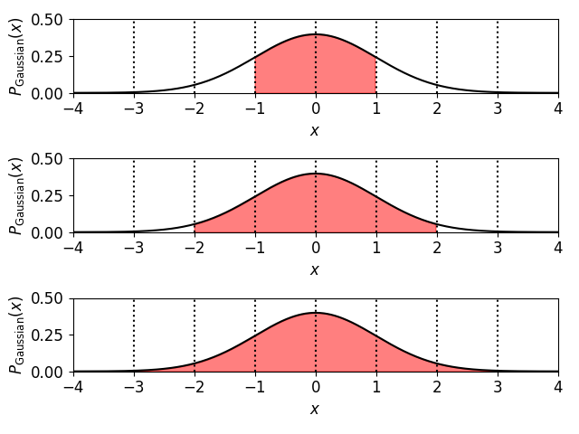
Confidence regions and tails

Slide 27
Frequentist and Bayesian frameworks
In the framework of statistics, we will often hear about “Frequentist” or “Bayesian” methods. In the next few slides we’ll discuss what this means.
Neither framework is “right” or “wrong”, as such
As usual with statistics, it comes down to the question we want to answer …
Credit: xkcd.com

Slide 28
Frequentist and Bayesian frameworks
Frequentist statistics assign probabilities to a measurement, i.e. they determine $P(data|model)$
We are defining probability by imaging a series of hypothetical experiments, repeatedly sampling the population (which have not actually taken place)
Philosophy of science: we attempt to “rule out” or falsify models, if $P(data|model)$ is too small
Assuming these dice are unbiased, what is the probability of rolling different values?

Slide 29
Frequentist and Bayesian frameworks
Bayesian statistics assign probabilities to a model, i.e. they give us tools for calculating $P(model|data)$
We update the model probabilities in the light of each new dataset (rather than imagining many hypothetical experiments)
Philosophy of science: we do not “rule out” models, just determine their relative probabilities
Assuming I roll a particular spread of different values, what is the probability of the dice being unbiased?

Slide 30
Frequentist and Bayesian frameworks
The concept of conditional probability is central to understanding Bayesian statistics
$P(A|B)$ means “the probability of $A$ on the condition that $B$ has occurred”
Adding conditions makes a huge difference to evaluating probabilities
On a randomly-chosen day in CAS, $P\left(free pizza\right) \sim 0.2$
$P\left(free pizza|Monday\right) \sim 1$, $P\left(free pizza|Tuesday\right) \sim 0$

Slide 31
Frequentist and Bayesian frameworks
The important formula for relating conditional probabilities is Bayes’ theorem:
$$P\left(A | B\right)=\frac{P\left(B | A\right) P(A)}{P(B)}$$
(Obligatory portrait of the Reverend Bayes!)
Small print: this formula can be derived by just writing down the joint probability of both $A$ and $B$ in 2 ways:
Re-writing Bayes’ theorem for science:
$$P(A∩B)=P\left(A | B\right) P\left(B\right)=P\left(B | A\right) P(A)$$
$$P\left(model | data\right)=\frac{P\left(data | model\right) P(model)}{P(data)}$$

Slide 32
Worked example
I observe 100 galaxies, 30 of which are AGN. What is the best estimate of the AGN fraction and its error?
Solution 1: Estimate AGN fraction $p=\frac{N_{AGN}}{N_{total}}=\frac{30}{100}=0.3$
There are 2 possible outcomes (“AGN” or “not an AGN”) so the binomial distribution applies
Estimate the error in $N_{AGN}$ as the standard deviation in the binomial distribution $=\sqrt{N_{total} p(1−p)}=\sqrt{100×0.3×0.7}=4.6$, so error in $p=\frac{4.6}{100}=0.046$
Answer: $p=0.3±0.046$

Slide 33
Worked example
I observe 100 galaxies, 30 of which are AGN. What is the best estimate of the AGN fraction and its error?
Solution 2: Use Bayes’ theorem $P\left(p | D\right)∝P\left(D | p\right) P(p)$
$P\left(p | D\right)$ is the probability distribution of $p$ given the data $D$, the quantity we aim to determine
$P(D|p)$ is the probability of the data for a given value of $p$, which is given by the Binomial distribution as $P_{Binomial}(n=30|N=100,p)$
$P\left(p\right)$ is the prior in $p$, which we take as a uniform distribution between $p=0$ and $p=1$
Determining $P\left(p | D\right)$ and normalising we obtain …

Slide 34
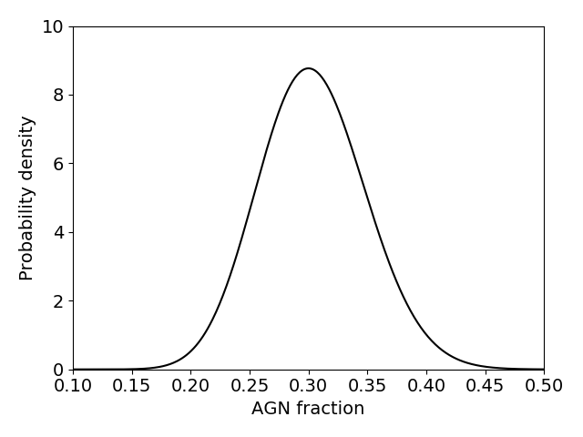
Worked example
I observe 100 galaxies, 30 of which are AGN. What is the best estimate of the AGN fraction and its error?

Slide 35
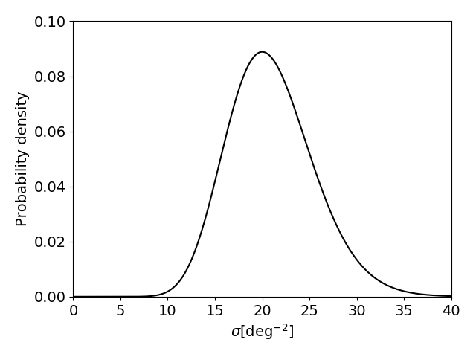
Activity
A survey of area $A=1 \deg^{2}$ finds $N=20$ quasars. What is the number of quasars per square degree, $σ$?

Slide 36
Monte Carlo simulations
A Monte Carlo simulation is a computer model of an experiment in which many random realizations of the results are created and analysed like the real data

Slide 37
Monte Carlo simulations
A Monte Carlo simulation is a computer model of an experiment in which many random realizations of the results are created and analysed like the real data
This is the most useful statistical tool you’ll learn!
It allows us to determine the statistics of a problem without any analytic calculations (if we can model it)
Statistical errors can be obtained from the distribution of fitted parameters over the realizations
Systematic errors can be explored by comparing the mean fitted parameters to their known input values

Slide 38
Activity: Monte Carlo methods
Solve the following problem by Monte Carlo methods: I’m dealt 5 playing cards from a normal deck (i.e. 13 different values in 4 suits). What is the probability of obtaining “three of a kind” (i.e. 3 of my 5 cards having the same value?)

Slide 39
Activity: central limit theorem
Write a code that draws $n$ values of $x$ from an exponential distribution $P(x)∝e^{−x}$ (where $0<x<∞)$, and computes their arithmetic mean $μ$. Repeat this process $m$ times, and plot the probability distribution of $μ$ across the $m$ realisations. Run this experiment for values $n=1, 2, 5, 10, 20, 50$.
Hint: to do a single draw, select a uniform random number $y$ in the range $0<y<1$, then $x=−\ln{y}$ [why does this work?]

Slide 40
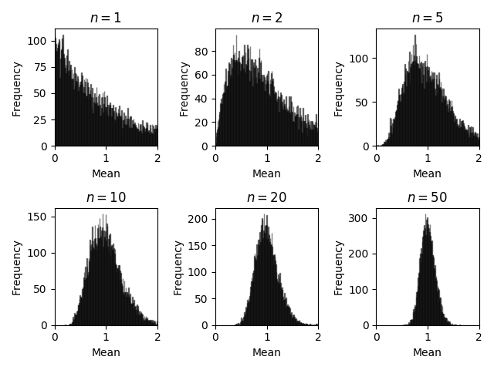
Activity: central limit theorem

Slide 41
Summary
At the end of this class you should be able to …
… determine summary statistics for datasets and their errors
… optimally combine data
... apply probability distributions for Gaussian, Binomial and Poisson statistics
… compare the Frequentist and Bayesian frameworks for statistical analysis
… solve statistical problems using Monte Carlo techniques

