Slide 1
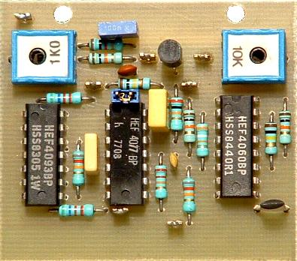
Chapter 25 : Electric circuits
Voltage and current
Series and parallel circuits
Resistors and capacitors
Kirchoff’s rules for analysing circuits

Slide 2
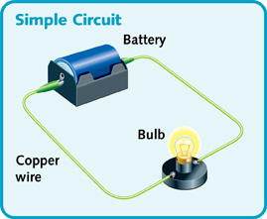
Electric circuits
Closed loop of electrical components around which current can flow, driven by a potential difference
Current (in Amperes A) is the rate of flow of charge
Potential difference (in volts V) is the work done on charge

Slide 3
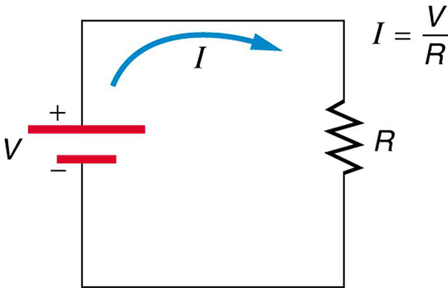
Electric circuits
May be represented by a circuit diagram. Here is a simple case:
R is the resistance (in Ohms $Ω$) to current flow

Slide 4
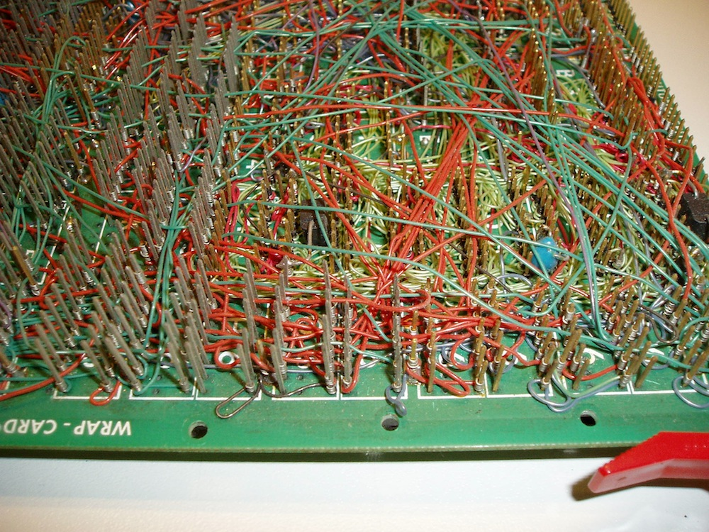
Electric circuits
Same principles apply in more complicated cases!

Slide 5
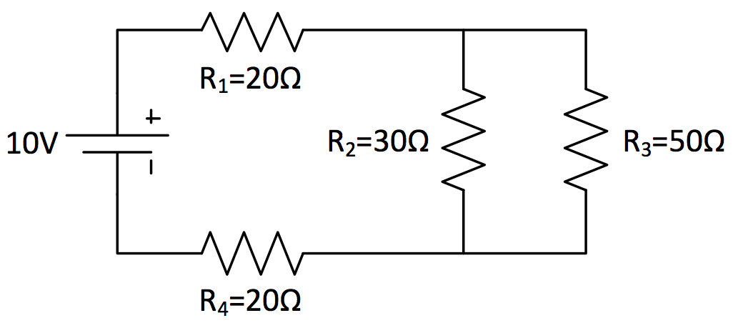
Electric circuits
How do we deal with a more complicated case? What is the current flowing from the battery?

Slide 6
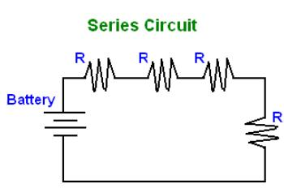
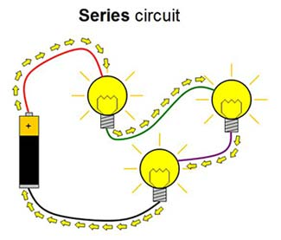
Electric circuits
When components are connected in series, the same electric current flows through them
Charge conservation : current cannot disappear!
$$I$$
$$I$$

Slide 7
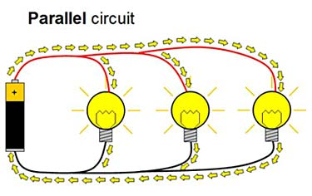
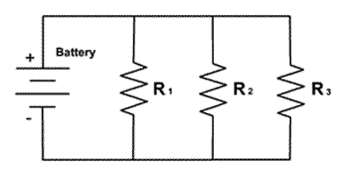
Electric circuits
When components are connected in parallel, the same potential difference drops across them
Points connected by a wire are at the same voltage!
$$V$$
$$V$$
$$V$$

Slide 8
Electric circuits
When there is a junction in the circuit, the inward and outward currents to the junction are the same
Charge conservation : current cannot disappear!
$$I_{2}$$
$$I_{1}$$
$$I_{1}=I_{2}+I_{3}$$
$$I_{3}$$

Slide 9
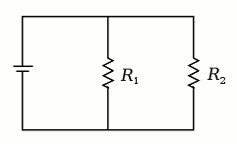
Consider the currents I₁, I₂ and I₃ as indicated on the circuit diagram. If I₁ = 2.5 A and I₂ = 4 A, what is the value of I₃?
I₁
I₂
I₃
6.5 A
1.5 A
−1.5 A
0 A
The situation is not possible

Slide 10
Consider the currents I₁, I₂ and I₃ as indicated on the circuit diagram. If I₁ = 2.5 A and I₂ = 4 A, what is the value of I₃?
I₁
I₂
I₃
current in = current out
$$I_{1}=I_{2}+I_{3}$$
$$I_{3}=I_{1}−I_{2}$$
$$I_{3}=2.5−4=−1.5 A$$
(Negative sign means opposite direction to arrow.)

Slide 11
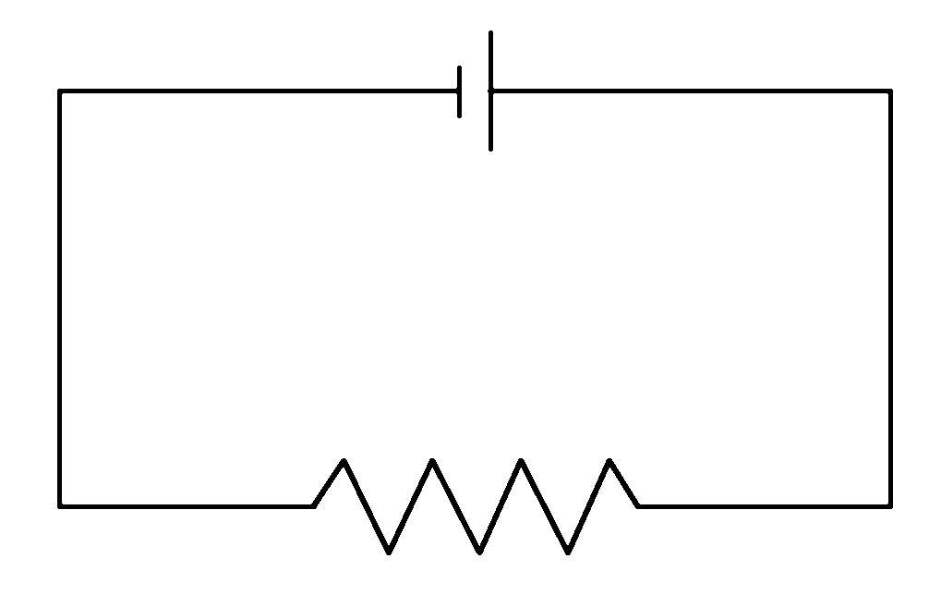
A 9.0 V battery is connected to a 3 Ω resistor. Which is the incorrect statement about potential differences (voltages)?
a
b
d
c
V_{b} – V_{a} = 9.0 V
V_{b} – V_{c} = 0 V
V_{c} – V_{d} = 9.0 V
V_{d} – V_{a} = 9.0 V

Slide 12
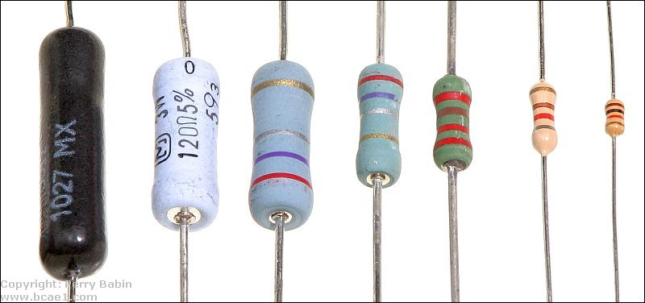
Resistors in circuits
Resistors are the basic components of a circuit that determine current flow : Ohm’s law I = V/R

Slide 13
Resistors in series/parallel
If two resistors are connected in series, what is the total resistance?
$$R_{1}$$
$$R_{2}$$
same current
$$I$$
$$I$$
Potential drop $V_{1}=I R_{1}$
Potential drop $V_{2}=I R_{2}$
Total potential drop $V=V_{1}+V_{2}=I R_{1}+I R_{2}=I (R_{1}+R_{2})$

Slide 14
Resistors in series/parallel
If two resistors are connected in series, what is the total resistance?
Total resistance increases in series!
$$R_{total}$$
$$I$$
Potential drop $V=I R_{total}=I (R_{1}+R_{2})$
$$R_{total}=R_{1}+R_{2}$$

Slide 15
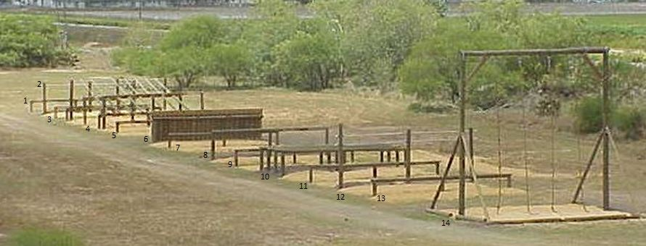
Resistors in series/parallel
Total resistance increases in series!

Slide 16
Resistors in series/parallel
If two resistors are connected in parallel, what is the total resistance?
$$R_{1}$$
$$R_{2}$$

Slide 17
Resistors in series/parallel
If two resistors are connected in parallel, what is the total resistance?
$$R_{1}$$
$$I_{1}$$
$$R_{2}$$
$$I$$
$$I$$
$$I_{2}$$
$$V$$
Total current $I=I_{1}+I_{2}=\frac{V}{R_{1}}+\frac{V}{R_{2}}=V\left(\frac{1}{R_{1}}+\frac{1}{R_{2}}\right)$

Slide 18
Resistors in series/parallel
If two resistors are connected in parallel, what is the total resistance?
Total resistance decreases in parallel!
$$R_{total}$$
$$I$$
Current I $=\frac{V}{R_{total}}=V\left(\frac{1}{R_{1}}+\frac{1}{R_{2}}\right)$
$$\frac{1}{R_{total}}=\frac{1}{R_{1}}+\frac{1}{R_{2}}$$

Slide 19
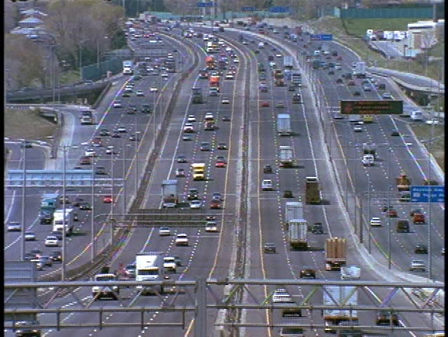
Resistors in series/parallel
Total resistance decreases in parallel!

Slide 20
Resistors in series/parallel
What’s the current flowing?
(1) Combine these 2 resistors in parallel:
$$\frac{1}{R_{pair}}=\frac{1}{30}+\frac{1}{50}$$
$$R_{pair}=18.75 Ω$$
(2) Combine all the resistors in series:
$$R_{total}=20+18.75+20=58.75 Ω$$
(3) Current $I=\frac{V}{R_{total}}=\frac{10}{58.75}=0.17 A$

Slide 21
If an additional resistor, R₂, is added in series to the circuit, what happens to the power dissipated by R₁?
R₁
Increases
Decreases
Stays the same
$$P=VI=I^{2}R=\frac{V^{2}}{R}$$
$$V=IR$$

Slide 22
If an additional resistor, R₃, is added in parallel to the circuit, what happens to the total current, I?
I
V
Increases
Decreases
Stays the same
Depends on R values
Parallel resistors: reciprocal effective resistance is sum of reciprocal resistances
$$\frac{1}{R_{total}}=\frac{1}{R_{1}}+\frac{1}{R_{2}}+\frac{1}{R_{3}}+…$$

Slide 23
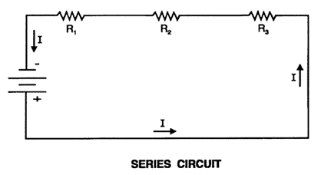
Series vs. Parallel
CURRENT
Same current through all series elements
Current “splits up” through parallel branches
VOLTAGE
Voltages add to total circuit voltage
Same voltage across all parallel branches
RESISTANCE
Adding resistance increases total R
Adding resistance reduces total R
String of Christmas lights – connected in series
Power outlets in house – connected in parallel

Slide 24
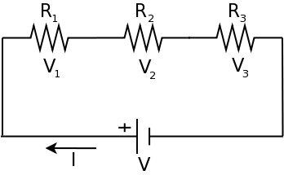
Voltage divider
Consider a circuit with several resistors in series with a battery.
$$I{=\frac{V}{R_{total}}=\frac{V}{R_{1}+R_{2}+R_{3}}}_{}$$
Current in circuit:
The potential difference across one of the resistors (e.g. R₁)
$$=V\frac{R_{1}}{R_{1}+R_{2}+R_{3}}$$
$$V_{1}=IR_{1}$$
The fraction of the total voltage that appears across a resistor in series is the ratio of the given resistance to the total resistance.

Slide 25
What must be the resistance R₁ so that V₁ = 2.0 V?
R₁
$$V_{1}$$
12 V
6.0 Ω
0.80 Ω
1.2 Ω
6.0 Ω
30 Ω
Notes:
R1/(6 + R1) = 1/6, so R1 = 1.2

Slide 26
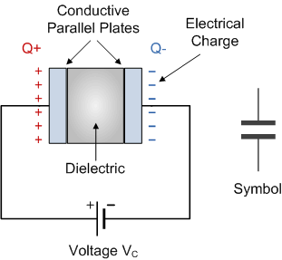
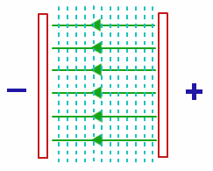
Capacitors
A capacitor is a device in a circuit which can be used to store charge
It’s charged by connecting it to a battery …
A capacitor consists of two charged plates …
Electric field E

Slide 27
Capacitors
A capacitor is a device in a circuit which can be used to store charge
Example : store and release energy …

Slide 28
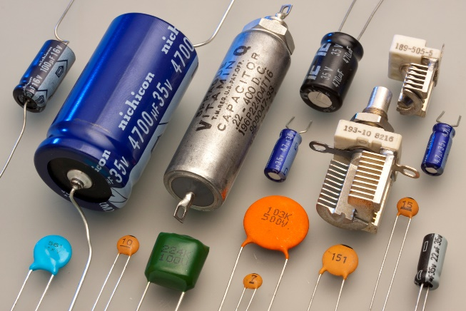
Capacitors
The capacitance C measures the amount of charge Q which can be stored for given potential difference V
Unit of capacitance is Farads [F]
+Q
-Q
$$C=\frac{Q}{V}$$
$$Q=C V$$
(Value of C depends on geometry…)
V

Slide 29
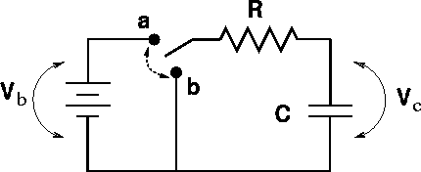
Resistor-capacitor circuit
Consider the following circuit with a resistor and a capacitor in series
V
What happens when we connect the circuit?

Slide 30
Resistor-capacitor circuit
When the switch is connected, the battery charges up the capacitor
Move the switch to point a
Initial current flow I=V/R
Charge Q flows from battery onto the capacitor
Potential across the capacitor V_{C}=Q/C increases
Potential across the resistor V_{R} decreases
Current decreases to zero
V

Slide 31
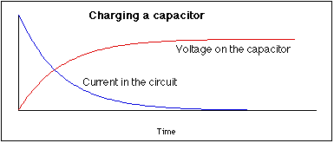
Resistor-capacitor circuit
When the switch is connected, the battery charges up the capacitor
V

Slide 32
Resistor-capacitor circuit
When the battery is disconnected, the capacitor pushes charge around the circuit
Move the switch to point b
Initial current flow I=V_{C}/R
Charge flows from one plate of capacitor to other
Potential across the capacitor V_{C}=Q/C decreases
Current decreases to zero
V

Slide 33
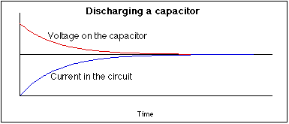
Resistor-capacitor circuit
When the battery is disconnected, the capacitor pushes charge around the circuit
V

Slide 34
Capacitors in series/parallel
If two capacitors are connected in series, what is the total capacitance?
$$+Q$$
$$−Q$$
$$+Q$$
$$−Q$$
Same charge must be on every plate!
$$Q=C V$$
$$C_{1}$$
$$C_{2}$$
Potential drop $V_{1}=Q/C_{1}$
Potential drop $V_{2}=Q/C_{2}$
Total potential drop $V=V_{1}+V_{2}=\frac{Q}{C_{1}}+\frac{Q}{C_{2}}=Q\left(\frac{1}{C_{1}}+\frac{1}{C_{2}}\right)$

Slide 35
Capacitors in series/parallel
If two capacitors are connected in series, what is the total capacitance?
Total capacitance decreases in series!
$$+Q$$
$$−Q$$
$$Q=C V$$
$$C_{total}$$
$$\frac{1}{C_{total}}=\frac{1}{C_{1}}+\frac{1}{C_{2}}$$
Potential drop $V=\frac{Q}{C_{total}}=Q\left(\frac{1}{C_{1}}+\frac{1}{C_{2}}\right)$

Slide 36
Capacitors in series/parallel
If two capacitors are connected in parallel, what is the total capacitance?
$$+Q_{1}$$
$$−Q_{1}$$
$$C_{1}$$
$$Q=C V$$
$$+Q_{2}$$
$$−Q_{2}$$
$$C_{2}$$
$$V$$
Total charge $Q=Q_{1}+Q_{2}=C_{1}V+C_{2}V=\left(C_{1}+C_{2}\right) V$

Slide 37
Capacitors in series/parallel
If two capacitors are connected in parallel, what is the total capacitance?
Total capacitance increases in parallel!
$$+Q$$
$$−Q$$
$$Q=C V$$
$$C_{total}$$
Total charge $Q=C_{total}V=\left(C_{1}+C_{2}\right)V$
$$C_{total}=C_{1}+C_{2}$$

Slide 38
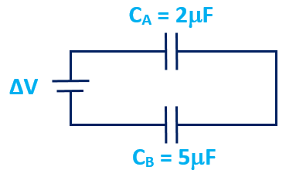
Two 5.0 F capacitors are in series with each other and a 1.0 V battery. Calculate the charge on each capacitor (Q) and the total charge drawn from the battery (Q_{total}).
5 F
1 V
5 F
Q = 5.0 C, Q_{total} = 5.0 C
Q = 0.25 C, Q_{total} = 0.50 C
Q = 2.5 C, Q_{total} = 2.5 C
Q = 2.5 C, Q_{total} = 5.0 C
$$\frac{1}{C_{total}}=\frac{1}{C_{1}}+\frac{1}{C_{2}}+\frac{1}{C_{3}}+…$$
$$Q=CV$$

Slide 39
Two 5.0 F capacitors are in series with each other and a 1.0 V battery. Calculate the charge on each capacitor (Q) and the total charge drawn from the battery (Q_{total}).
5 F
1 V
5 F
Potential difference across each capacitor = 0.5 V
Charge on each capacitor $Q=CV=5×0.5=2.5 C$
$$\frac{1}{C_{total}}=\frac{1}{C_{1}}+\frac{1}{C_{2}} → \frac{1}{C_{total}}=\frac{1}{5}+\frac{1}{5}=\frac{2}{5} → C_{total}=2.5 F$$
$$Q_{total}=C_{total} V=2.5×1=2.5 C$$

Slide 40
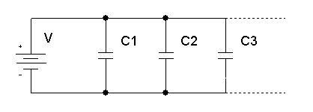
Two 5.0 F capacitors are in parallel with each other and a 1.0 V battery. Calculate the charge on each capacitor (Q) and the total charge drawn from the battery (Q_{total}).
1 V
5 F
5 F
Q = 5.0 C, Q_{total} = 5.0 C
Q = 0.2 C, Q_{total} = 0.4 C
Q = 5.0 C, Q_{total} = 10 C
Q = 2.5 C, Q_{total} = 2.5 C
$$Q=CV$$
$$C_{total}=C_{1}+C_{2}+C_{3}+…$$

Slide 41
Two 5.0 F capacitors are in parallel with each other and a 1.0 V battery. Calculate the charge on each capacitor (Q) and the total charge drawn from the battery (Q_{total}).
1 V
5 F
5 F
Potential difference across each capacitor = 1 V
Charge on each capacitor $Q=CV=5×1=5 C$
$$Q_{total}=10 C$$

Slide 42
Resistors vs. Capacitors
$$R_{1}$$
$$R_{2}$$
$$R_{total}=R_{1}+R_{2}$$
$$\frac{1}{C_{total}}=\frac{1}{C_{1}}+\frac{1}{C_{2}}$$
$$C_{1}$$
$$C_{2}$$

Slide 43
Resistors vs. Capacitors
$$R_{1}$$
$$\frac{1}{R_{total}}=\frac{1}{R_{1}}+\frac{1}{R_{2}}$$
$$R_{2}$$
$$C_{1}$$
$$C_{total}=C_{1}+C_{2}$$
$$C_{2}$$

Slide 44
Kirchoff’s rules
Sometimes we might need to analyse more complicated circuits, for example …
Kirchoff’s rules give us a systematic method
$$R_{1}=4 Ω$$
$$V_{1}=9 V$$
Q) What are the currents flowing in the 3 resistors?
$$R_{2}=1 Ω$$
$$V_{2}=6 V$$
$$R_{3}=2 Ω$$

Slide 45
Kirchoff’s rules
What are the currents flowing in the 3 resistors?
$$4 Ω$$
$$I_{1}$$
Kirchoff’s junction rule : the sum of currents at any junction is zero
$$9 V$$
$$1 Ω$$
$$I_{2}$$
$$2 Ω$$
$$I_{3}$$
$$6 V$$

Slide 46
Kirchoff’s rules
The sum of currents at any junction is zero
Watch out for directions : into a junction is positive, out of a junction is negative
$$I_{2}$$
$$I_{1}−I_{2}−I_{3}=0$$
$$I_{1}$$
$$I_{1}=I_{2}+I_{3}$$
$$I_{3}$$

Slide 47
Kirchoff’s rules
What are the currents flowing in the 3 resistors?
$$4 Ω$$
$$I_{1}$$
Kirchoff’s junction rule : the sum of currents at any junction is zero
$$9 V$$
$$1 Ω$$
$$I_{2}$$
$$I_{1}$$
$$2 Ω$$
$$I_{3}$$
$$6 V$$
$$I_{1}+I_{2}+I_{3}=0$$
$$I_{2}$$
$$I_{3}$$

Slide 48
Kirchoff’s rules
What are the currents flowing in the 3 resistors?
$$4 Ω$$
$$I_{1}$$
Kirchoff’s loop rule : the sum of voltage changes around a closed loop is zero
$$9 V$$
$$1 Ω$$
$$I_{2}$$
$$4 Ω$$
$$I_{1}$$
$$9 V$$
$$2 Ω$$
$$I_{3}$$
$$6 V$$
$$1 Ω$$
$$I_{2}$$

Slide 49
Kirchoff’s rules
Sum of voltage changes around a closed loop is zero
Consider a unit charge (Q=1 Coulomb) going around this loop
It gains energy from the battery (voltage change +V)
It loses energy in the resistor (voltage change - I R)
Conservation of energy : V - I R = 0 (or as we know, V = I R)

Slide 50
Kirchoff’s rules
What are the currents flowing in the 3 resistors?
$$4 Ω$$
$$I_{1}$$
Kirchoff’s loop rule : the sum of voltage changes around a closed loop is zero
$$9 V$$
$$1 Ω$$
$$I_{2}$$
$$4 Ω$$
$$I_{1}$$
$$9 V$$
$$2 Ω$$
$$I_{3}$$
$$6 V$$
$$1 Ω$$
$$I_{2}$$
$$9−4 I_{1}+1 I_{2}=0$$

Slide 51
Kirchoff’s rules
What are the currents flowing in the 3 resistors?
$$4 Ω$$
$$I_{1}$$
Kirchoff’s loop rule : the sum of voltage changes around a closed loop is zero
$$9 V$$
$$1 Ω$$
$$I_{2}$$
$$2 Ω$$
$$I_{3}$$
$$−6−1 I_{2}+2 I_{3}=0$$
$$6 V$$

Slide 52
Kirchoff’s rules
What are the currents flowing in the 3 resistors?
We now have 3 equations:
$$4 Ω$$
$$I_{1}$$
$$I_{1}+I_{2}+I_{3}=0 (1)$$
$$9 V$$
$$9−4I_{1}+I_{2}=0 (2)$$
$$1 Ω$$
$$I_{2}$$
$$−6−I_{2}+2I_{3}=0 (3)$$
To solve for $I_{1}$ we can use algebra to eliminate $I_{2}$ and $I_{3}$ :
$$2 Ω$$
$$I_{3}$$
$$6 V$$
$$\left(1\right)→ I_{3}=−I_{1}−I_{2}$$
$$Sub. in \left(3\right)→I_{2}=−2−\frac{2}{3}{ I}_{1}$$
$$Sub. in \left(2\right)→I_{1}=1.5 A$$

Slide 53
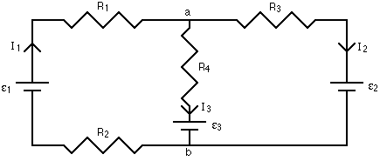
Consider the loop shown in the circuit. The correct Kirchoff loop equation, starting at “a” is
$I_{1}R_{1}+ε_{1}+I_{1}R_{2}+ε_{2}+I_{2}R_{3}=0$
${−I}_{1}R_{1}−ε_{1}−I_{1}R_{2}−ε_{3}−I_{3}R_{4}=0$
$I_{1}R_{1}−ε_{1}+I_{1}R_{2}−ε_{2}−I_{2}R_{3}=0$
$I_{1}R_{1}−ε_{1}+I_{1}R_{2}+ε_{2}+I_{2}R_{3}=0$

Slide 54
Chapter 25 summary
Components in a series circuit all carry the same current
Components in a parallel circuit all experience the same potential difference
Capacitors are parallel plates which store equal & opposite charge Q = C V
Kirchoff’s junction rule and loop rule provide a systematic method for analysing circuits

