Slide 1
This week in the physics course
Lectures will cover Chapter 16 (Temperature and Heat) and start Chapter 17 (Thermal Behaviour of Matter)
Tutorial class will practise problems from last week’s lectures on Chapter 15 (Fluid Motion)
Laboratory class will perform buoyancy experiments
Physics help available in MASH centre (Wayne Rowlands, Tuesday 10.30-12.30 and Thursday 2.30-4.30)
Don’t hesitate to get in touch with any questions – cblake@swin.edu.au

Slide 2
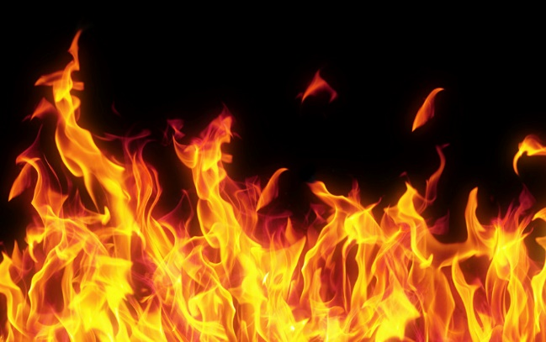
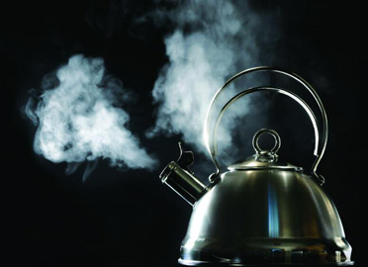
Chapter 16 : Temperature and Heat
Difference in temperature causes heat energy to flow
Measuring temperature with thermometers
Heat capacity of a material determines temperature rise
Heat transfer by conduction, convection and radiation

Slide 3
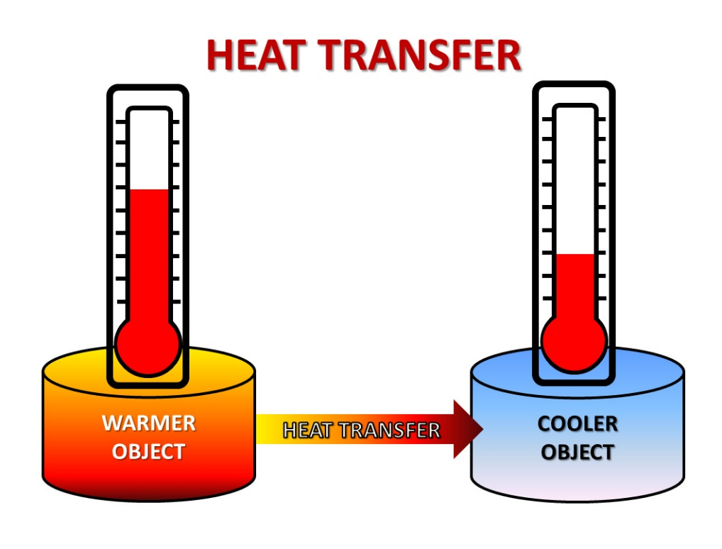

Temperature and Heat Energy
A temperature difference causes heat energy to flow to bring systems into equilibrium

Slide 4
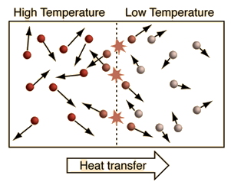
Temperature and Heat Energy
Temperature is associated with the internal molecular energy of a substance

Slide 5
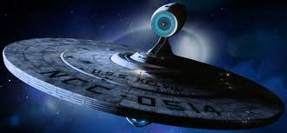
Units of temperature
Absolute temperature is measured in units of Kelvin (K) where 0 K is absolute zero (at which a gas has zero pressure)

Slide 6
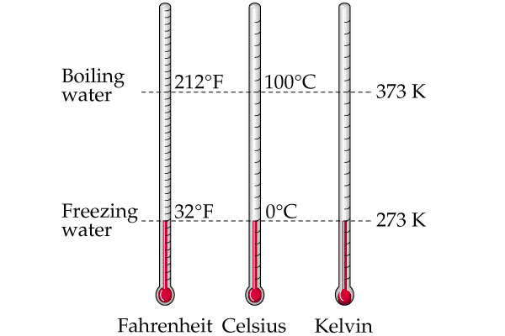
Units of temperature
Absolute temperature is measured in units of Kelvin (K) where 0 K is absolute zero (at which a gas has zero pressure)
The Celsius temperature scale is offset such that the melting point of ice at standard atmospheric pressure is 0 ºC
$$T_{Celsius}=T_{Kelvin} −273.15$$
1 degree change in Celsius =
1 degree change in Kelvin

Slide 7
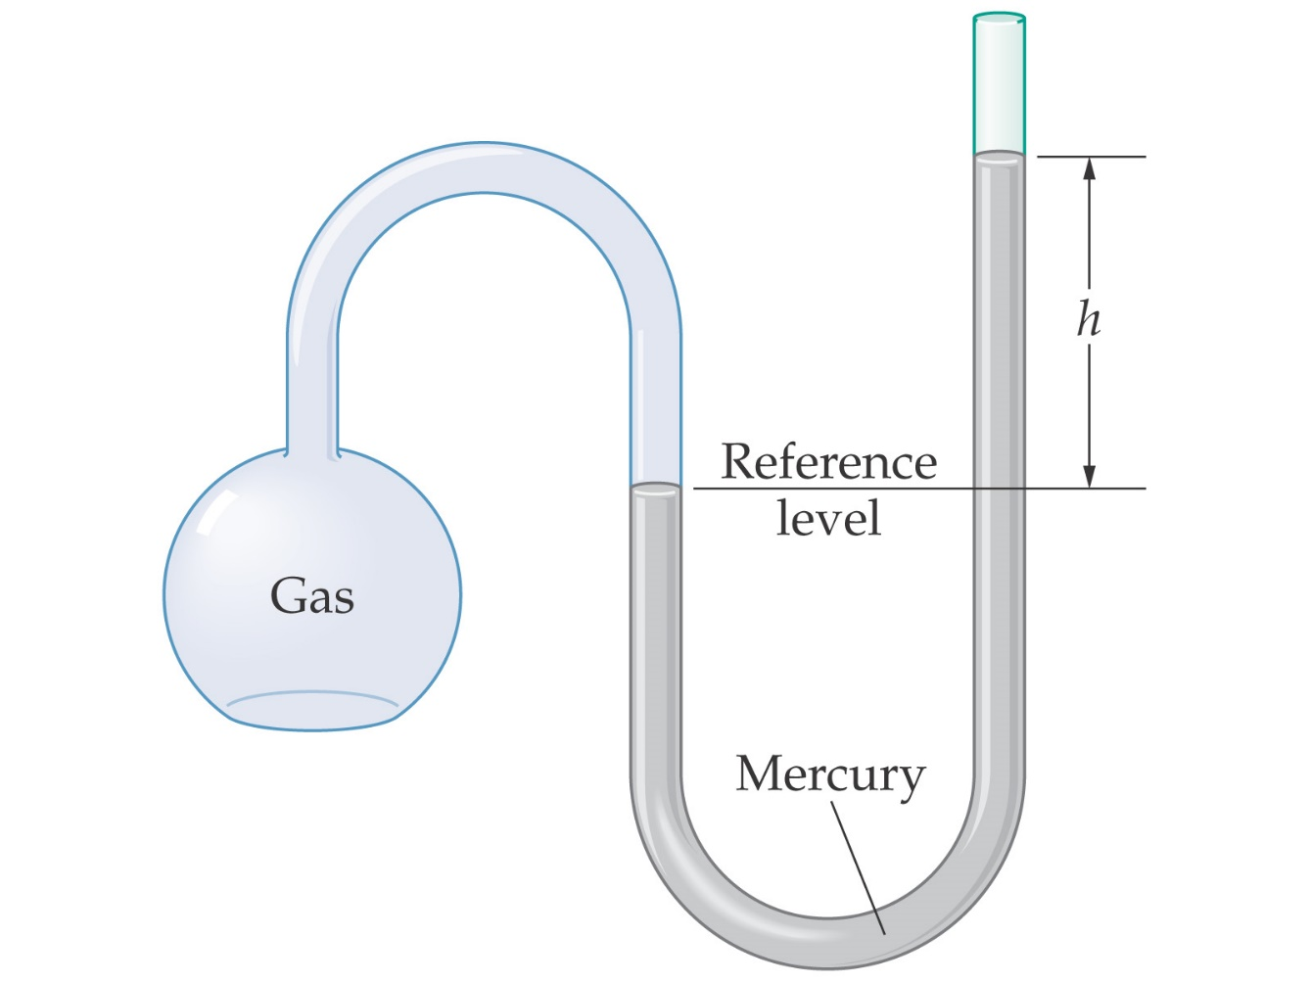
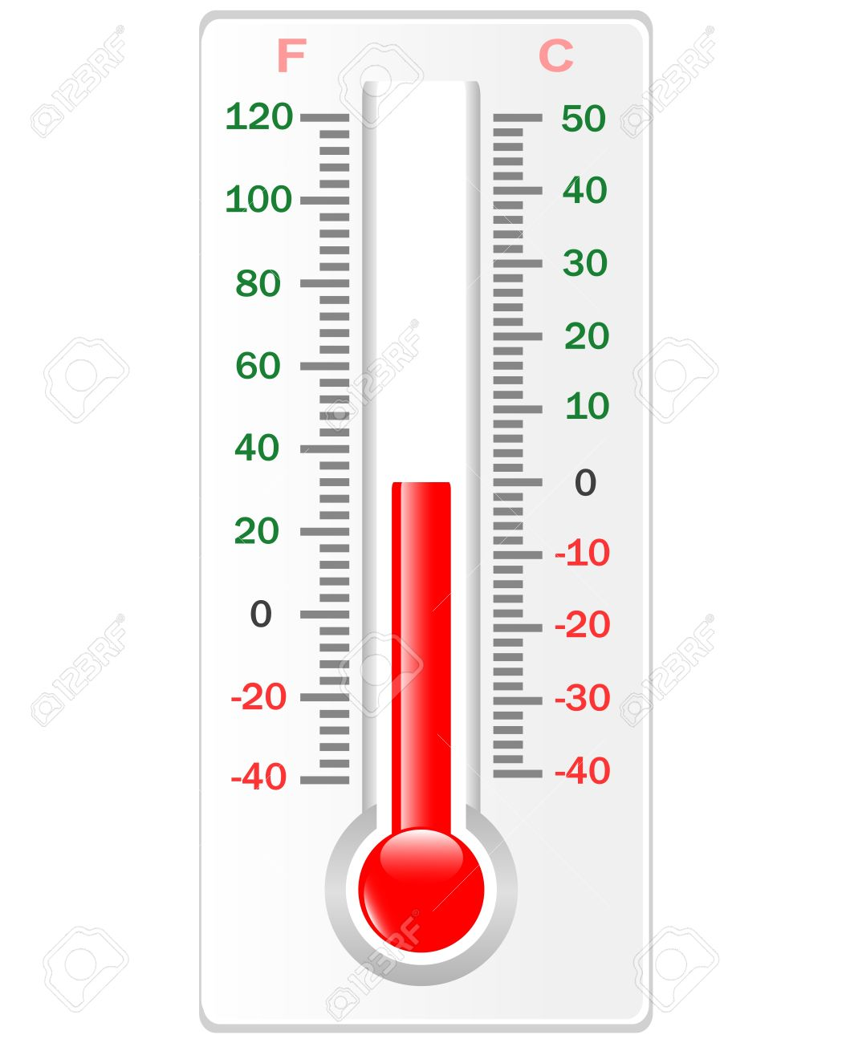
Units of temperature
Temperature is measured by thermometers which are brought into thermal equilibrium with the system
Using expansion …
Using gas pressure …

Slide 8
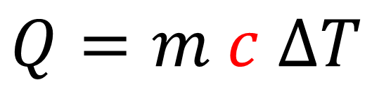
Heat Capacity and Specific Heat
When heat energy flows into a substance, its temperature will increase
The specific heat capacity is the heat energy (in J) needed to raise the temperature of 1 kg of the substance by 1 K
$$Q=m c ∆T$$
Heat energy in J
Temperature change in K
Mass in kg
Specific heat capacity in J/K/kg

Slide 9
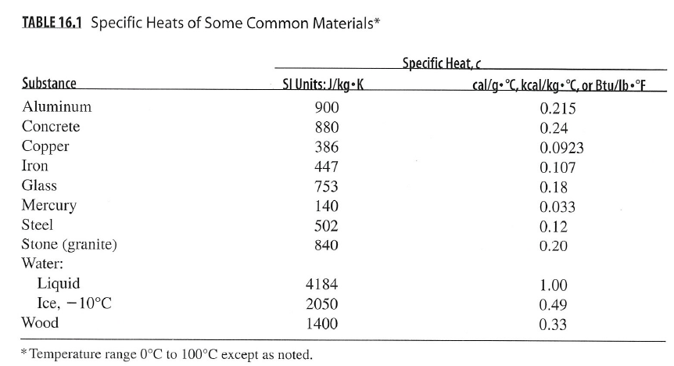
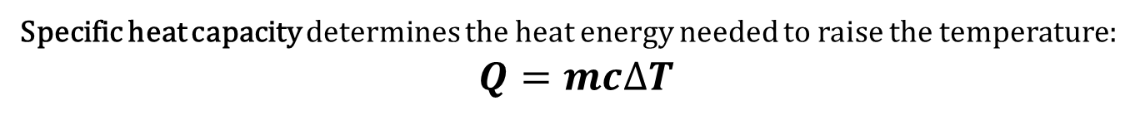
Heat Capacity and Specific Heat
Values given in Table 16.1 of the textbook (page 306 of 3rd ed.)
Specific heat capacity determines the heat energy needed to raise the temperature:
$$Q=mc∆T$$

Slide 10
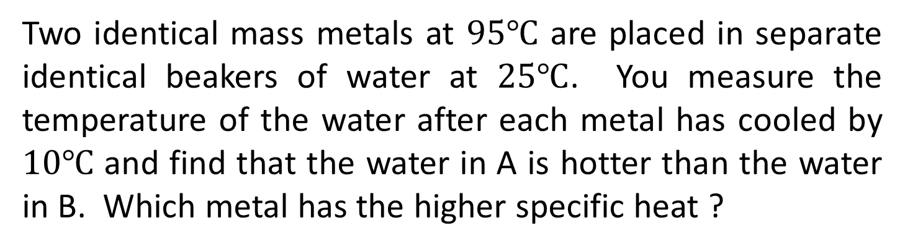
Two identical mass metals at $95℃$ are placed in separate identical beakers of water at $25℃$. You measure the temperature of the water after each metal has cooled by $10℃$ and find that the water in A is hotter than the water in B. Which metal has the higher specific heat ?
A
B
Metal A
Metal B
They are the same
Can’t tell since not in equilibrium
Notes:
Metal A since delta T is the same, a higher specific heat will add more energy to the water, raising its temperature.

Slide 11

Two identical mass metals at $95℃$ are placed in separate identical beakers of water at $25℃$. You measure the temperature of the water after each metal has cooled by $10℃$ and find that the water in A is hotter than the water in B. Which metal has the higher specific heat ?
A
B
Heat energy lost by metal = heat energy gained by water
$$Metal A :m_{metal} c_{A} {∆T}_{metal}= m_{water}{ c}_{water}{ ∆T}_{A}$$
$$Metal B :m_{metal} c_{B} {∆T}_{metal}= m_{water}{ c}_{water}{ ∆T}_{B}$$
$${∆T}_{A} > {∆T}_{B} →c_{A}>c_{B}$$
Notes:
Metal A since delta T is the same, a higher specific heat will add more energy to the water, raising its temperature.

Slide 12

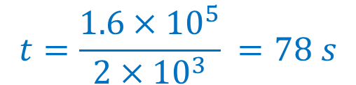


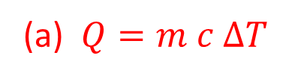
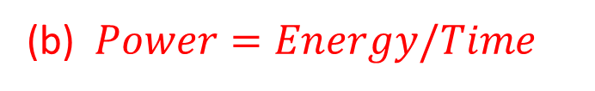

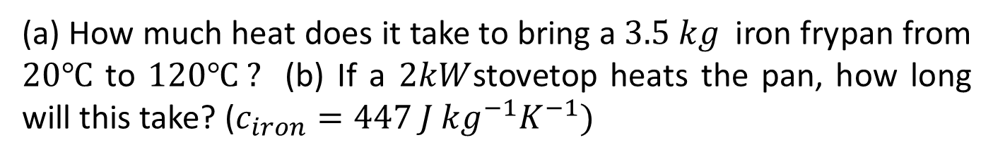


Heat Capacity and Specific Heat
(a) How much heat does it take to bring a $3.5 kg$iron frypan from $20℃$ to $120℃ ?$ (b) If a $2kW$stovetop heats the pan, how long will this take? ($c_{iron}=447 J {kg}^{−1}K^{−1})$
(a) $Q=m c ∆T$
(b) $Power=Energy/Time$
$$m=3.5 kg$$
$$Time=Energy/Power$$
$$c=447 J{ kg}^{−1}K^{−1}$$
$$Energy=0.16 MJ=1.6×{10}^{5} J$$
$$∆T=100 K$$
$$Power=2 kW=2×{10}^{3}W$$
$$t=\frac{1.6×{10}^{5}}{2×{10}^{3}} =78 s$$
$$Q=3.5×447×100=0.16 MJ$$
Specific heat capacity determines the heat energy needed to raise the temperature:
$$Q=mc∆T$$

Slide 13
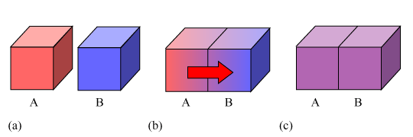
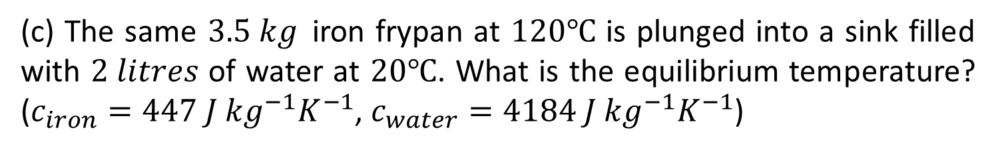
(c) The same $3.5 kg$iron frypan at $120℃$ is plunged into a sink filled with $2 litres$ of water at $20℃$. What is the equilibrium temperature? ($c_{iron}=447 J {kg}^{−1}K^{−1}$, $c_{water}=4184 J {kg}^{−1}K^{−1}$)
Heat energy flows until equilibrium is reached
Heat energy lost by frypan = Heat energy gained by water
Total heat energy change = 0 (conservation of energy)

Slide 14
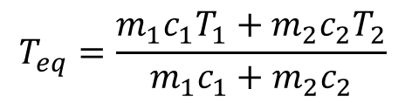

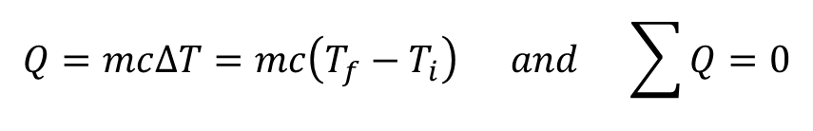

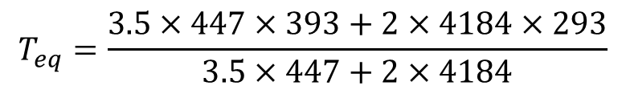
(c) The same $3.5 kg$iron frypan at $120℃$ is plunged into a sink filled with $2 litres$ of water at $20℃$. What is the equilibrium temperature? ($c_{iron}=447 J {kg}^{−1}K^{−1}$, $c_{water}=4184 J {kg}^{−1}K^{−1}$)
$$Q=mc∆T=mc\left(T_{f}−T_{i}\right) and \sum{Q=0}$$
$$m_{1}c_{1}\left(T_{eq}−T_{1}\right)+m_{2}c_{2}\left(T_{eq}−T_{2}\right)=0$$
$$T_{eq}\left(m_{1}c_{1}+m_{2}c_{2}\right)=m_{1}c_{1}T_{1}+m_{2}c_{2}T_{2}$$
$$T_{eq}=\frac{m_{1}c_{1}T_{1}+m_{2}c_{2}T_{2}}{m_{1}c_{1}+m_{2}c_{2}}$$
$$T_{eq}=\frac{3.5×447×393+2×4184×293}{3.5×447+2×4184}$$
$$T_{eq}=308.75°K=36℃$$

Slide 15

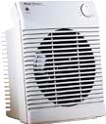

Heat Transfer
How is heat energy transferred from one place to another?
conduction
convection
radiation
Usually for a given situation one mechanism will dominate however in some cases all three need to be considered simultaneously.

Slide 16
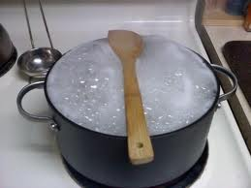
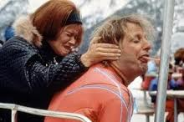
Conduction
Heat transfer by direct molecular contact

Slide 17
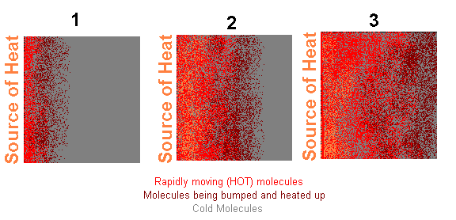
Conduction
Heat transfer by direct molecular contact

Slide 18
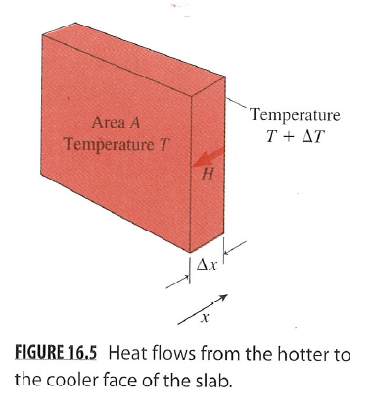
Conduction
Heat flow rate (H) increases with area and temperature drop
heat flows from high T to low T
temperature
gradient
thermal conductivity (W/m ˚C)
Heat flow is the rate of heat transfer by conduction. The larger the area the greater the heat flow. The higher the thermal conductivity the greater the heat flow. Heat flow is driven by a temperature gradient, so the larger the temperature difference the greater the heat flow.

Slide 19
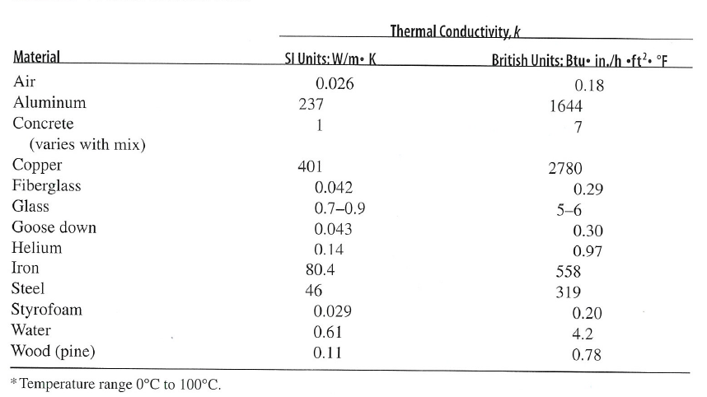
Conduction
Conduction is heat transfer through direct physical contact. Materials are quantified by their thermal conductivity $k (W m^{−1}K^{−1})$.
Values given in Table 16.2 of the textbook (page 308 of 3rd ed.)

Slide 20
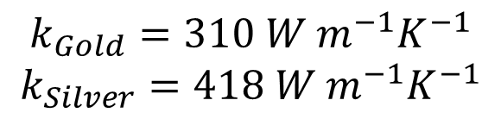
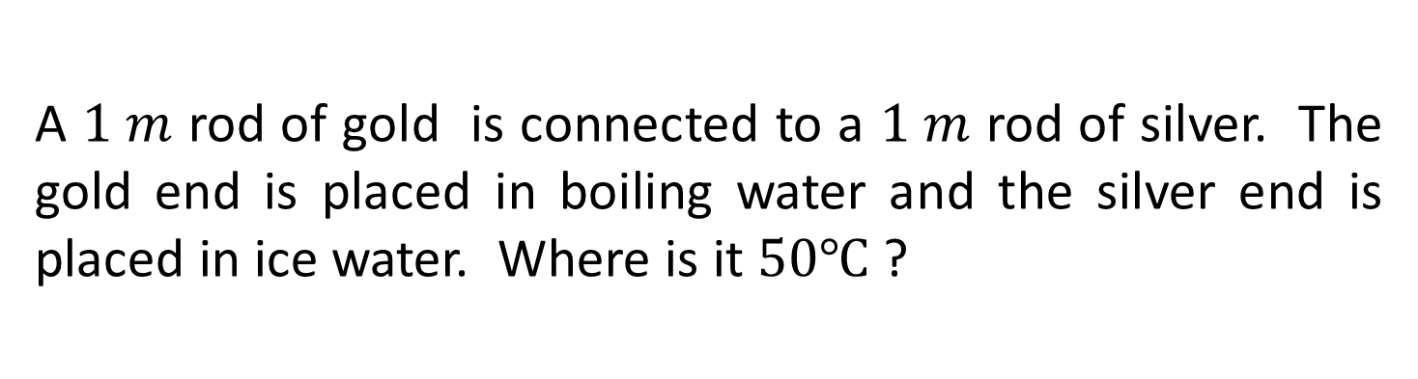
A $1 m$ rod of gold is connected to a $1 m$ rod of silver. The gold end is placed in boiling water and the silver end is placed in ice water. Where is it $50℃$ ?
At the midpoint
Near the midpoint but closer to the gold end
Near the midpoint but closer to the silver end
$$k_{Gold}=310 W m^{−1}K^{−1}$$
$$k_{Silver}=418 W m^{−1}K^{−1}$$
Heat flow
Notes:
Answer: greatest temperature drop over the smallest thermal conductivity i.e gold. So 2 is the correct answer.

Slide 21
A $1 m$ rod of gold is connected to a $1 m$ rod of silver. The gold end is placed in boiling water and the silver end is placed in ice water. Where is it $50℃$ ?
Heat energy is flowing from the boiling water to the ice at a rate H
Larger conductivity k implies smaller temperature gradient dT/dx
Temperature drop is smaller over the silver than the gold
Temperature passes 50 degrees in the gold
$$k_{Gold}=310 W m^{−1}K^{−1}$$
$$k_{Silver}=418 W m^{−1}K^{−1}$$
Heat flow
Notes:
Answer: greatest temperature drop over the smallest thermal conductivity i.e gold. So 2 is the correct answer.

Slide 22
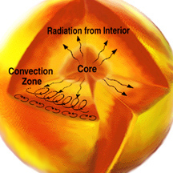
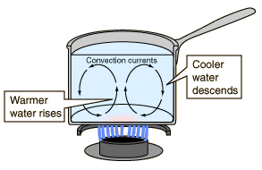
Convection
Heat transfer by bulk motion of a fluid

Slide 23
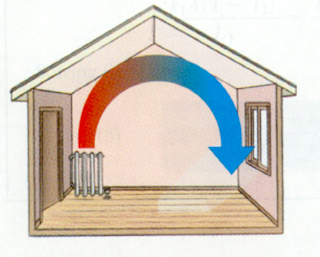
Convection
Natural convection relies on the buoyancy effect alone to move the fluid.
Forced convection drastically increases the fluid movement by using a fan or pump.
Calculations for convection are extremely complicated due to fluid dynamics and remains one of the important unsolved problems in science.

Slide 24
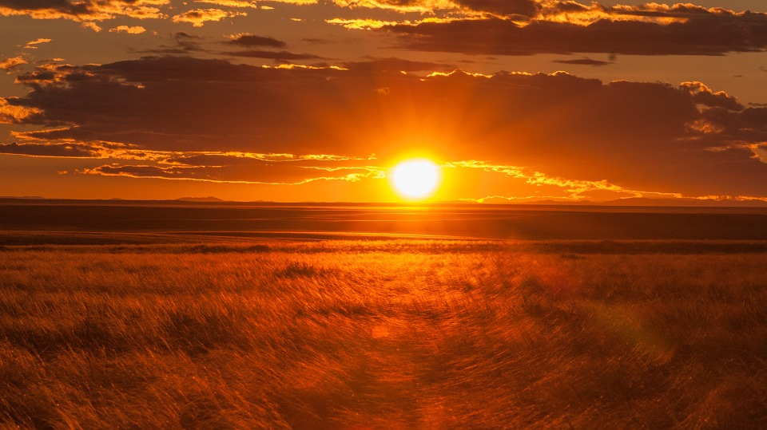

Radiation
Heat transfer by electromagnetic radiation

Slide 25
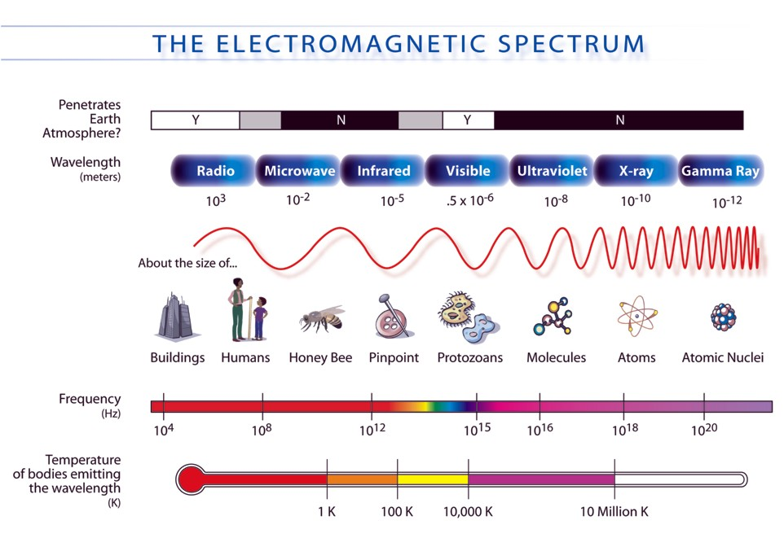
Radiation
Electromagnetic radiation?

Slide 26
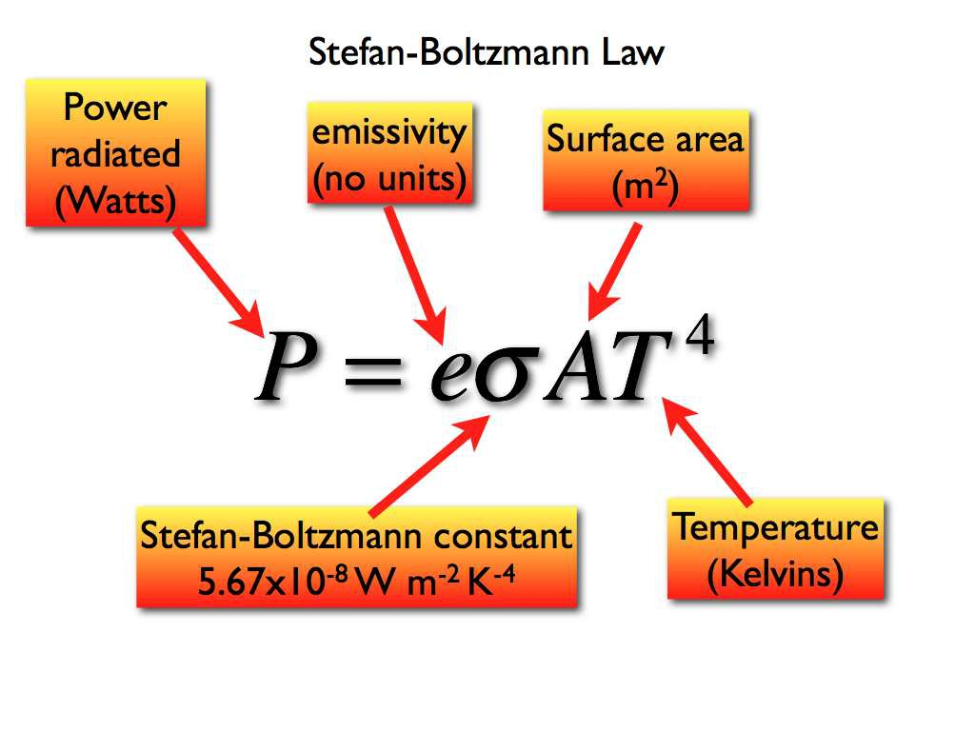
Radiation

Slide 27
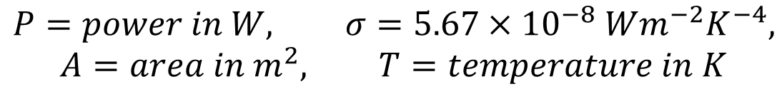


Radiation
Emissivity usually assumed to be e=1 in our problems – sometimes called “black body emission”
Objects also absorb energy from surroundings at a rate given by the same law
$$P_{emitted}=σ A{ T}_{body}^{4}$$
$$P_{absorbed}=σ A{ T}_{ambient}^{4}$$
$$P=power in W, σ=5.67×{10}^{−8} Wm^{−2}K^{−4},$$
$$A=area in m^{2}, T=temperature in K$$

Slide 28

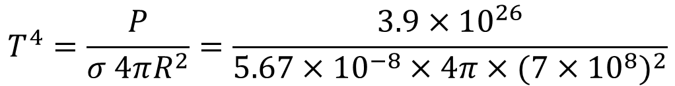




Radiation
The Sun radiates energy at the rate P = 3.9 x 10²⁶ W, and its radius is R = 7 x 10⁸ m. Assuming the Sun is a perfect emitter (e=1), what is its surface temperature?
$$P= σ A T^{4}$$
$$A=4 π R^{2}$$
$$P= σ 4πR^{2} T^{4}$$
$$T^{4}=\frac{P}{σ 4πR^{2}}=\frac{3.9×{10}^{26}}{5.67×{10}^{−8}×4π×{(7×{10}^{8})}^{2}}$$
$$→T=5800 K$$

Slide 29
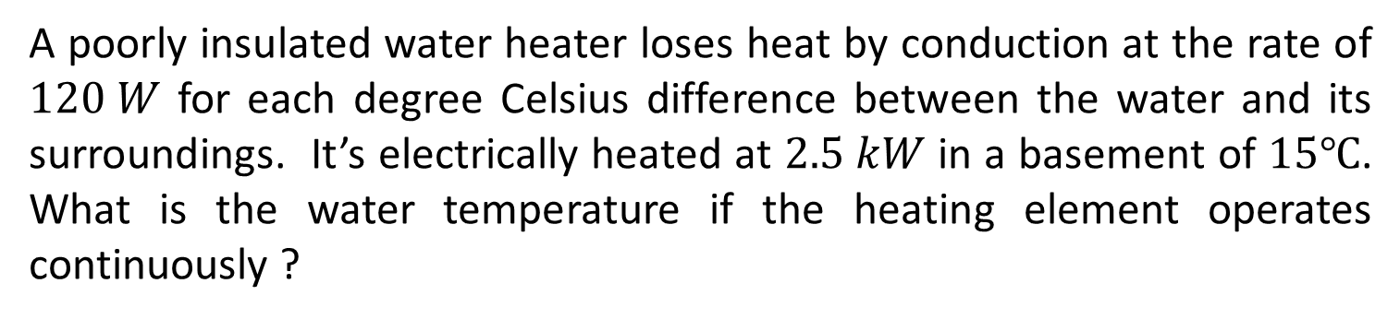
Thermal Energy Balance
A poorly insulated water heater loses heat by conduction at the rate of $120 W$ for each degree Celsius difference between the water and its surroundings. It’s electrically heated at $2.5 kW$ in a basement of $15℃$. What is the water temperature if the heating element operates continuously ?
Water receives energy from heating element, and loses it by conduction at the same rate
Gain rate = 2500 W, Loss rate = (T – 15) x 120 W
Gain rate = Loss rate when T = 36 ºC
Thermal Energy Balance is where the heat gains are equal to the heat losses and the system stays in equilibrium.

Slide 30



Temperature and Heat - Summary
Difference in temperature T causes heat energy Q to flow
Specific heat capacity of a material
Heat energy flow by conduction
Heat energy flow by radiation
$$Q=m c ∆T$$
$$\frac{∆Q}{∆t}=−k A \frac{∆T}{∆x}$$
$$P= σ A T^{4}$$

Slide 31
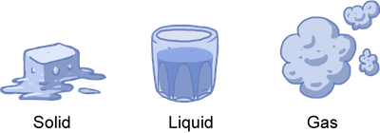
Chapter 17 : Thermal Behaviour of Matter
How does matter respond to heating?
A gas may undergo changes in pressure or volume
These may be understood in terms of molecular motion
A material may change phase, releasing energy
A material may undergo thermal expansion

Slide 32
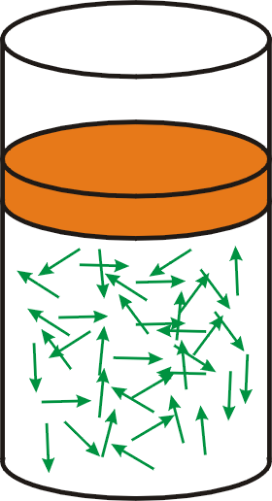

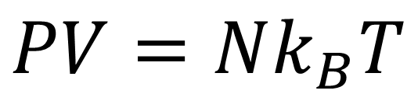
Ideal gas law
Pressure P
Volume V
Temperature T
N molecules
$$PV=Nk_{B}T$$
Boltzmann’s constant
$$k_{B}=1.38×{10}^{−23} JK^{−1}$$

Slide 33




Ideal gas law
Ideal gas law with Boltzmann’s constant:
The number of molecules N may be measured in moles n using Avogadro’s number N_{A}
The ideal gas law may also be expressed in terms of number of moles n using the universal gas constant R
$$PV=Nk_{B}T$$
$$k_{B}=1.38×{10}^{−23} JK^{−1}$$
$$1 mole= N_{A}=6.022×{10}^{23} molecules$$
$$PV=nRT$$
$$R=8.314 JK^{−1}{mol}^{−1}$$

Slide 34


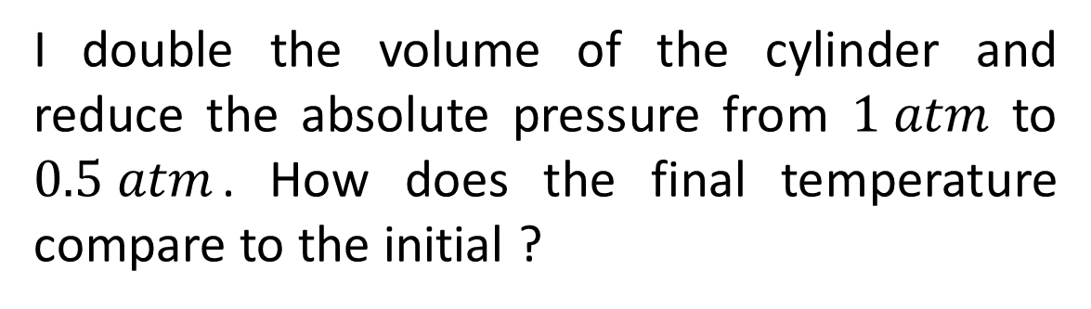
I double the volume of the cylinder and reduce the absolute pressure from $1 atm$ to $0.5 atm$. How does the final temperature compare to the initial ?
$T_{f}>T_{i}$
$T_{f}=T_{i}$
$T_{f}<T_{i}$
Can’t tell without n
If quantity of gas is fixed (n, m or N constant) then the equation of state relating initial and final properties reduces to
$$\frac{P_{i}V_{i}}{T_{i}}=\frac{P_{f}V_{f}}{T_{f}}$$

Slide 35
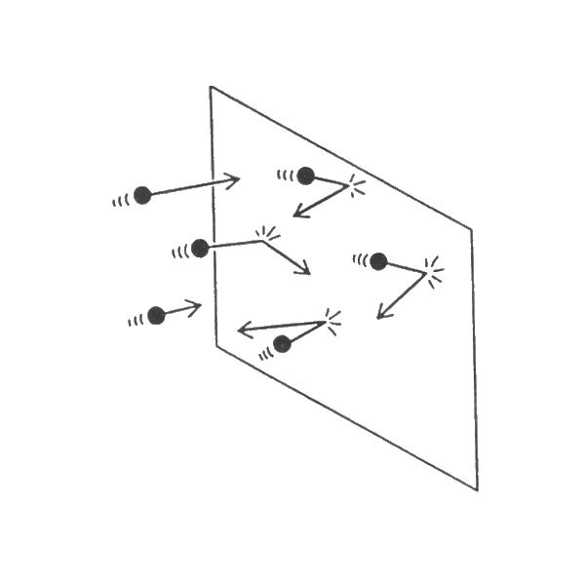
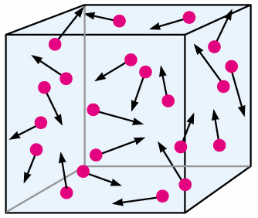
Kinetic theory of gases
On a microscopic level, a gas consists of moving molecules
Pressure is generated by molecules colliding with the walls
Temperature is described by the molecules’ kinetic energy

Slide 36
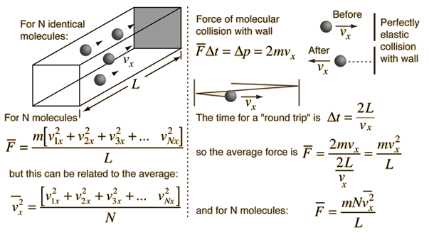


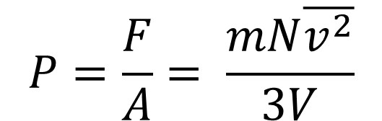
Kinetic theory of gases
We can relate the pressure to the molecular velocity!
(calculation in textbook)
$$P=\frac{F}{A}= \frac{mN\overline{v^{2}}}{3V}$$
$$But: PV=Nk_{B}T$$
$$So: \frac{1}{2}m\overline{v^{2}}=\frac{3}{2}k_{B}T$$
Temperature measures the average kinetic energy!

Slide 37
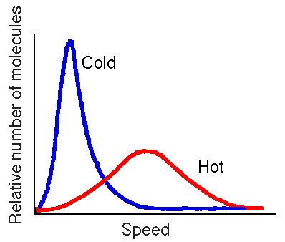

Kinetic theory of gases
Temperature measures the average kinetic energy associated with random translational motion of an atom

Slide 38


Two identical cylinders, one with $H_{2}$ and one with $N_{2}$, have different gauge pressures but the same temperature. Which cylinder has the fastest molecules.
The high pressure vessel
The low pressure vessel
The one with Hydrogen
The one with Nitrogen
Insufficient information to tell

Slide 39

Two identical cylinders, one with $H_{2}$ and one with $N_{2}$, have different gauge pressures but the same temperature. Which cylinder has the fastest molecules.
$$\frac{1}{2}m\overline{v^{2}}=\frac{3}{2}k_{B}T$$
Temperature and mass dictate velocity
Temperature is the same, but mass(H₂) < mass(N₂)
So speed(H₂) > speed(N₂)

Slide 40


Molecular Energy and Speed
Find the average kinetic energy of a molecule of air at room temperature ($T=20℃$) and determine the speed of a nitrogen molecule ($N_{2}$) with this energy.
$$Average kinetic energy=\frac{1}{2}m\overline{v^{2}}=\frac{3}{2}k_{B}T$$
$$T=293K→\overline{KE}=\frac{3}{2}×1.38×{10}^{−23}×293=6.07×{10}^{−21} J$$
$$KE=\frac{1}{2}mv^{2}→v=\sqrt{2×KE/m}$$
$$m=2×14×1.66×{10}^{−27} kg=4.65×{10}^{−26} kg$$
$$→v=\sqrt{2×6.07×{10}^{−21}/4.65×{10}^{−26}}=511 m/s$$

Slide 41






Molecular Energy and Speed
Sun (~6000K)
Ice (273K)
Liquid Nitrogen (77K)
Liquid Helium (4K)
Temperature (Kelvin)
Cryogenic Fridge (100mK)
Laser cooling (10μK)
Evaporative
cooling
Velocity (m/s)
World record (50μm/s, 450pK)

Slide 42

Phase Changes
Phase changes (solid, liquid, gas) are accompanied by release or absorption of heat energy

Slide 43


Phase Changes
The amount of energy involved, per unit mass, is known as the latent heat
$$Q=m L$$
Q = heat energy absorbed/released [J]
m = mass of substance [kg]
L = latent heat [J/kg]

Slide 44

Phase Changes
eg. adding heat to ice, initially with T=-20 ˚C at 1 atm.
T (˚C)
heat of
vaporization L_{v}.
100
heat of
fusion L_{f}.
0
ice + water
water
+
steam
water
steam
ice
Q (Heat added)
The energy per unit mass to change a phase is called the latent heat of transformation $L$. For solid-liquid change its heat of fusion $L_{f}$, for liquid-gas change its heat of vaporisation $L_{v}$.

Slide 45


Phase Changes
Values given in Table 17.1 of the textbook (page 326 of 3rd ed.)
$$Q=mL$$

Slide 46







Take the energy required to melt $1 kg$of ice and instead heat $1 kg$of water. How much has the temperature of the water changed by ?
$80℃$
$539℃$
$13℃$
$2℃$
Insufficient Information
$$Q=mc∆T$$
$$c_{water}=4184 J{ K}^{−1}{ kg}^{−1}$$
$$Q=mL$$
$$L_{v}=2257 kJ {kg}^{−1}$$
$$L_{f}=334 kJ {kg}^{−1}$$

Slide 47

Take the energy required to melt $1 kg$of ice and instead heat $1 kg$of water. How much has the temperature of the water changed by ?
Energy required to melt 1 kg of ice = 334 kJ
$$Q=mc ∆T→∆T=\frac{Q}{c}=\frac{334,000}{4,184}=80 K$$
However, it depends on initial T, since water may boil!
$$Q=mc∆T$$
$$c_{water}=4184 J{ K}^{−1}{ kg}^{−1}$$
$$Q=mL$$
$$L_{v}=2257 kJ {kg}^{−1}$$
$$L_{f}=334 kJ {kg}^{−1}$$

Slide 48



Phase Changes
$A 20 g$ice cube at $–3℃$is placed in a polystyrene cup containing $0.20 kg$water at $T = 20 ˚C$). What is the final temperature of the water?
Energy is required to: (1) heat the ice cube to 0ºC, (2) melt the ice cube
$$Q_{1}=mc_{ice}∆T=0.02×2050×3=123 J$$
$$Q_{2}=mL=0.02×334,000=6680 J$$
Total energy = 123 + 6680 = 6803 J
$$Q_{tot}=mc_{water}∆T→∆T=Q_{tot}/mc_{water}$$
$$∆T=\frac{6803}{0.2×4184}=8K→T_{final}=12℃$$

Slide 49

Thermal Expansion
Solids expand when heated

Slide 50



Thermal Expansion
The fractional change in length or volume as T increases is described by coefficients of expansion
Fractional length change:
$$\frac{∆L}{L}=α ∆T$$
[coefficient of linear expansion]
Fractional volume change:
$$\frac{∆V}{V}=β ∆T$$
[coefficient of volume expansion]

Slide 51



Thermal Expansion
Values given in Table 17.2 of the textbook (page 328 of 3rd ed.)
C$oefficient of linear expansion α=\frac{∆L/L}{∆T}$
C$oefficient of volumetric expansion β=\frac{∆V/V}{∆T}$
Often only care about the change in 1 dimension or looking at long thin objects (railway).

Slide 52





A bimetallic strip is made of dissimilar metals with different coefficients of volumetric expansion (shown). When heated the strip bends
$$β={0.5×10}^{−5}$$
$$β={10}^{−5}$$
$upwards$
$downwards$
$it stays level and lengthens$
Insufficient information
$$∆V=V β ∆T$$

Slide 53
A bimetallic strip is made of dissimilar metals with different coefficients of volumetric expansion (shown). When heated the strip bends
$$β={0.5×10}^{−5}$$
$$β={10}^{−5}$$
The lower metal will expand more, causing the strip to bend upwards
$$∆V=V β ∆T$$

Slide 54






Thermal Behaviour of Matter - Summary
Ideal gas law
Gas may be analysed in terms of molecular motion
Latent heat of transformation of phases
Coefficients of thermal expansion
$$PV=Nk_{B}T$$
$$PV=nRT$$
$$\frac{1}{2}m\overline{v^{2}}=\frac{3}{2}k_{B}T$$
$$Q=m L$$
$$\frac{∆L}{L}=α ∆T$$
$$\frac{∆V}{V}=β ∆T$$

