Slide 1
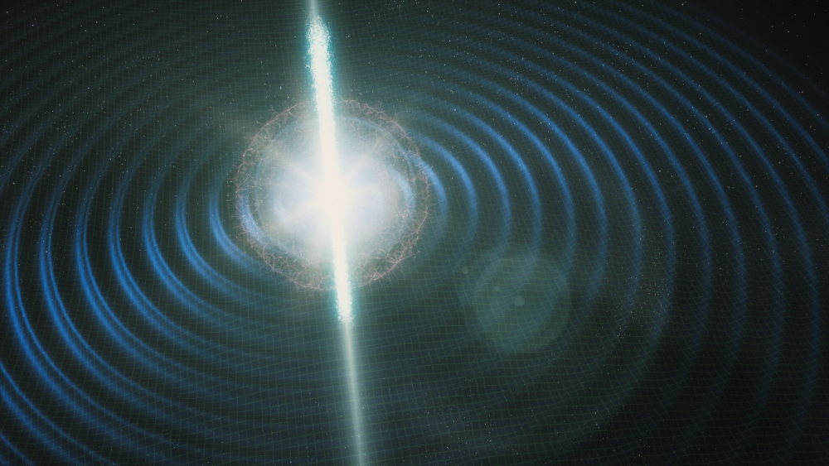
Standard sirens update, 10 October 2024

Slide 2
Where do we fit within OzGrav?
From the OzGrav-2 proposal, we have a Cosmos Key Program (KP5) which aims to:
“Determine fundamental properties of the Universe”
The three themes of the Cosmos Key Program are:
Cosmology with Standard Sirens
Astrophysics of Gravitational Wave sources
Cosmology with Fast Radio Bursts

Slide 3
OzGrav Key Project 5: COSMOS
Peculiar velocities
Chris B, Tamara, Khaled, Ryan T, Spencer
Detection and localisation
Adam, Ryan S, Kelly
Inclination angles
Adam, Kelly
Dark sirens /
LSS correlations
Chris B, Andy, Paul, Khaled, Liana
Optical redshift catalogues
Cullan
Cosmic web evolution
Manisha
STANDARD SIRENS
FAST RADIO BURSTS
Bayesian inference pipelines for $H_{0}$
Tamara, Paul, Spencer, Liana, Simon G
Spectral sirens
Eric, Hui, Simon S
Astrophysics priors
Nandita, Liana, Chris L
Optical follow-up
Anais, Chris L, Liana, Ryan S, Katie
$H_{0}$ forecasting and follow-up optimisation
Nandita, Chris L
Binary evolution modelling
Jarrod, Simon S, Ilya, Robert
Calibration of distance ladder
Khaled
ASTROPHYSICS OF GW SOURCES
Dynamical origin of mergers
Evgeni, Ilya
Should update this ☺
Connection to host galaxy evolution
Anais
Formation and evolution of progenitors
Eric, Simon S, Jade, Katie
Full population inference
Ilya

Slide 4
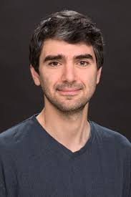
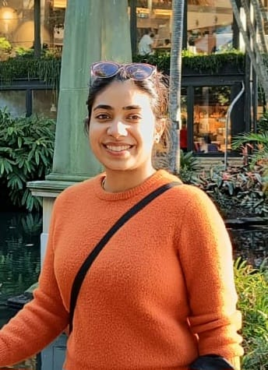
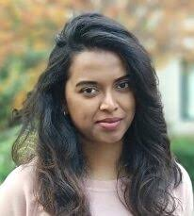
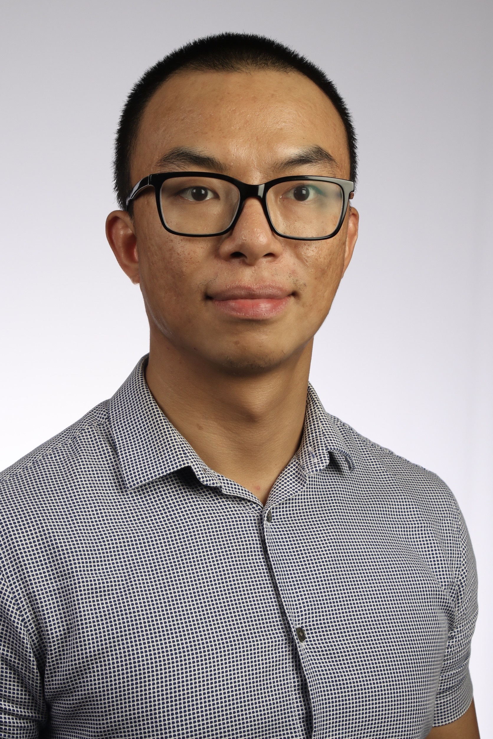
Your CIs and Program Scientists for KP5
Chris Blake
(CI)
Ilya Mandel
(CI)
Nandita Khetan
(Standard Sirens PS)
Manisha Caleb (FRBs PS)
Robert Song (Astrophysics PS)
Please get in touch with any of us if you have questions about our Key Program or would like to discuss where your work fits in!

Slide 5
Standard sirens topic – organization
We use #h0-project channel on the OzGrav Slack
We maintain a standard sirens project list linked from #h0-project
Our goals of sharing this project list:
Increase awareness and sharing of information across the team
In this way, identify collaborative opportunities and/or research overlaps
Help with organising updates at telecons
Assist with reporting our activities and outcomes to OzGrav and the ARC
We hold monthly standard siren videocons (thanks Nandita!) including project updates, short talks, journal clubs, etc. – second Thursday in the month at 2pm AEST
All are welcome to join our team!

Slide 6
Standard sirens topic – science
Effect of galaxy peculiar velocities
Improved redshift catalogues for dark sirens
Simulation-based population studies
Improving inclination angles
Developing the spectral siren method
Joint inference of neutron star equation of state

Slide 7
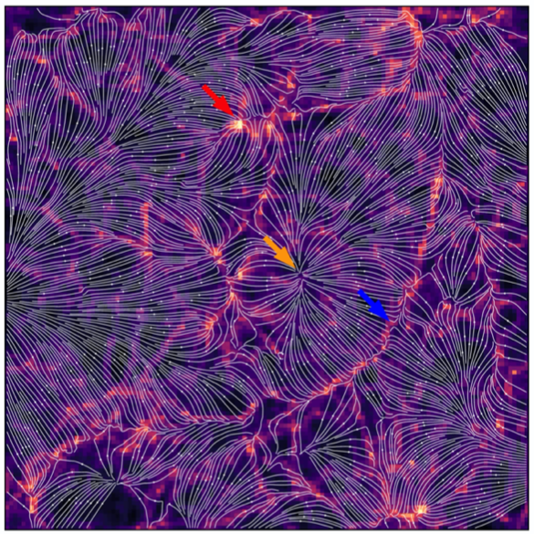
Role of peculiar velocities
See work by: Ryan Turner, Khaled Said, Simon Goode, Chris Blake
Talks given at July standard sirens meeting – slides on Slack
Peculiar velocities change the redshifts of standard sirens and hence affect determinations of $H_{0}$
Relative effects are largest at low redshift and are correlated between different objects by “bulk flows”
Goal 1: propagate PV errors into $H_{0}$analysis
Goal 2: improve current velocity reconstruction maps of the local Universe

Slide 8
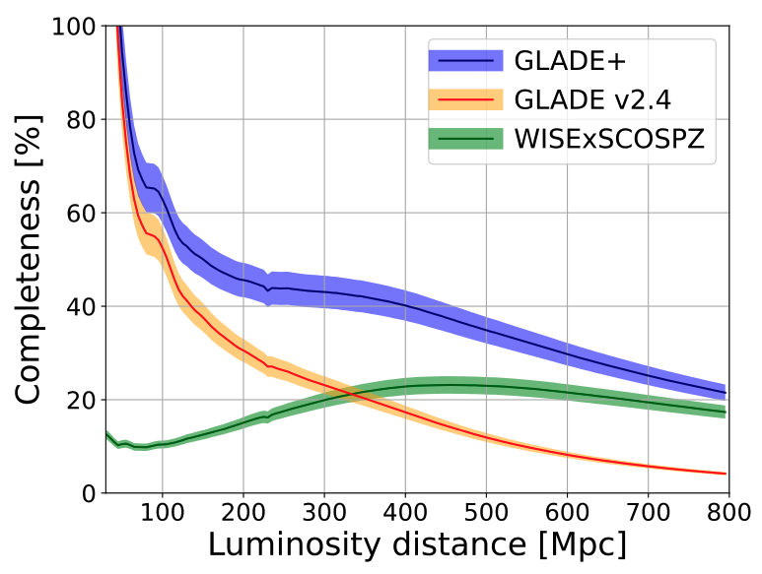
Improved optical redshift catalogues for dark sirens
See work by: Cullan Howlett
Talk given at June standard sirens meeting – slides on Slack
Dark siren analyses rely on catalogues of potential host galaxies for probabilistic analysis and cosmological inference
The current GLADE+ catalogue can be updated in the light of new observational surveys (DES, DESI, 4MOST, LSST, etc.)
Goal: data curation, characterisation of completeness, value-added data products

Slide 9
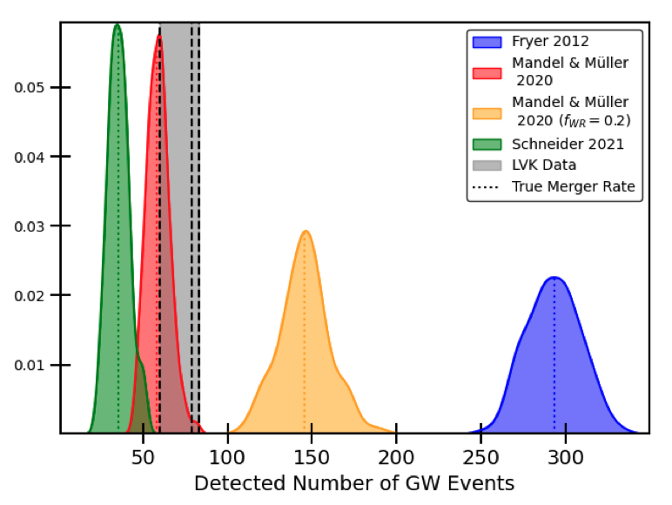
Simulation-based studies
See work by: Nandita Khetan, Liana Rauf, Cullan Howlett
Talk given by Liana at OzGrav videocon in July
Map the link between GW mergers and host galaxies
Goal: Integrate simulations, semi-analytical and population models
Goal: optimise weights for dark sirens and implication for $H_{0}$ analysis
Goal: Can dark siren analyses be undertaken with photometric redshifts?
Goal: What is the optimal strategy for wide-field spectroscopic follow-up?

Slide 10
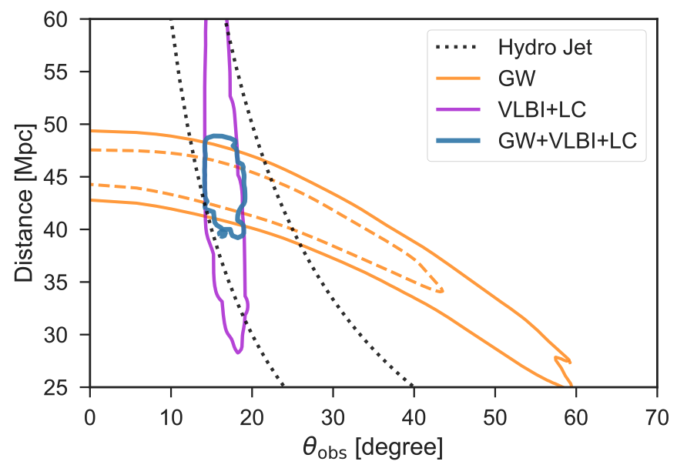
Improving bright siren inclinations
See work by: Kelly Gourdji, Adam Deller
Talk given by Kelly at June standard sirens meeting – slides on Slack
Inclination angle is a significant source of error in standard siren luminosity distances
High-resolution VLBI studies of GW mergers improve jet models hence constrain the GW source geometry
Goal: improved measurement of $H_{0}$ from GW170817

Slide 11
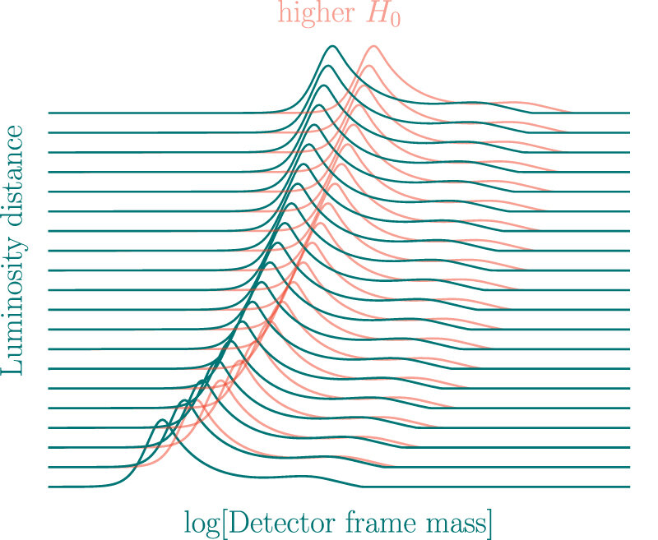
Spectral sirens
See work by: Hui Tong, Eric Thrane
Can the information in the GW source population distributions (such as the mass) be used to improve cosmological fits?
Goal: investigate the potential of the spectral siren method and any biases introduced by incomplete population models

Slide 12
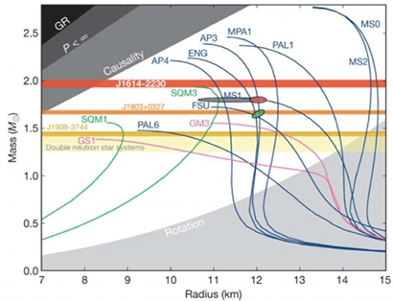
Neutron star equation of state
See work by: Spencer Magnall, Paul Lasky
Talk given by Spencer at OzGrav videocon in September
Develop infrastructure for joint inference of $H_{0}$ and the neutron star equation of state from the GW signal
Goal: what joint constraints are possible from future GW detectors?

Slide 13
Standard sirens topic – organization
We use #h0-project channel on the OzGrav Slack
We maintain a standard sirens project list linked from #h0-project
Our goals of sharing this project list:
Increase awareness and sharing of information across the team
In this way, identify collaborative opportunities and/or research overlaps
Help with organising updates at telecons
Assist with reporting our activities and outcomes to OzGrav and the ARC
We hold monthly standard siren videocons (thanks Nandita!) including project updates, short talks, journal clubs, etc. – second Thursday in the month at 2pm AEST
All are welcome to join our team!

Slide 14
Standard sirens update, 10 October 2024

