Slide 1
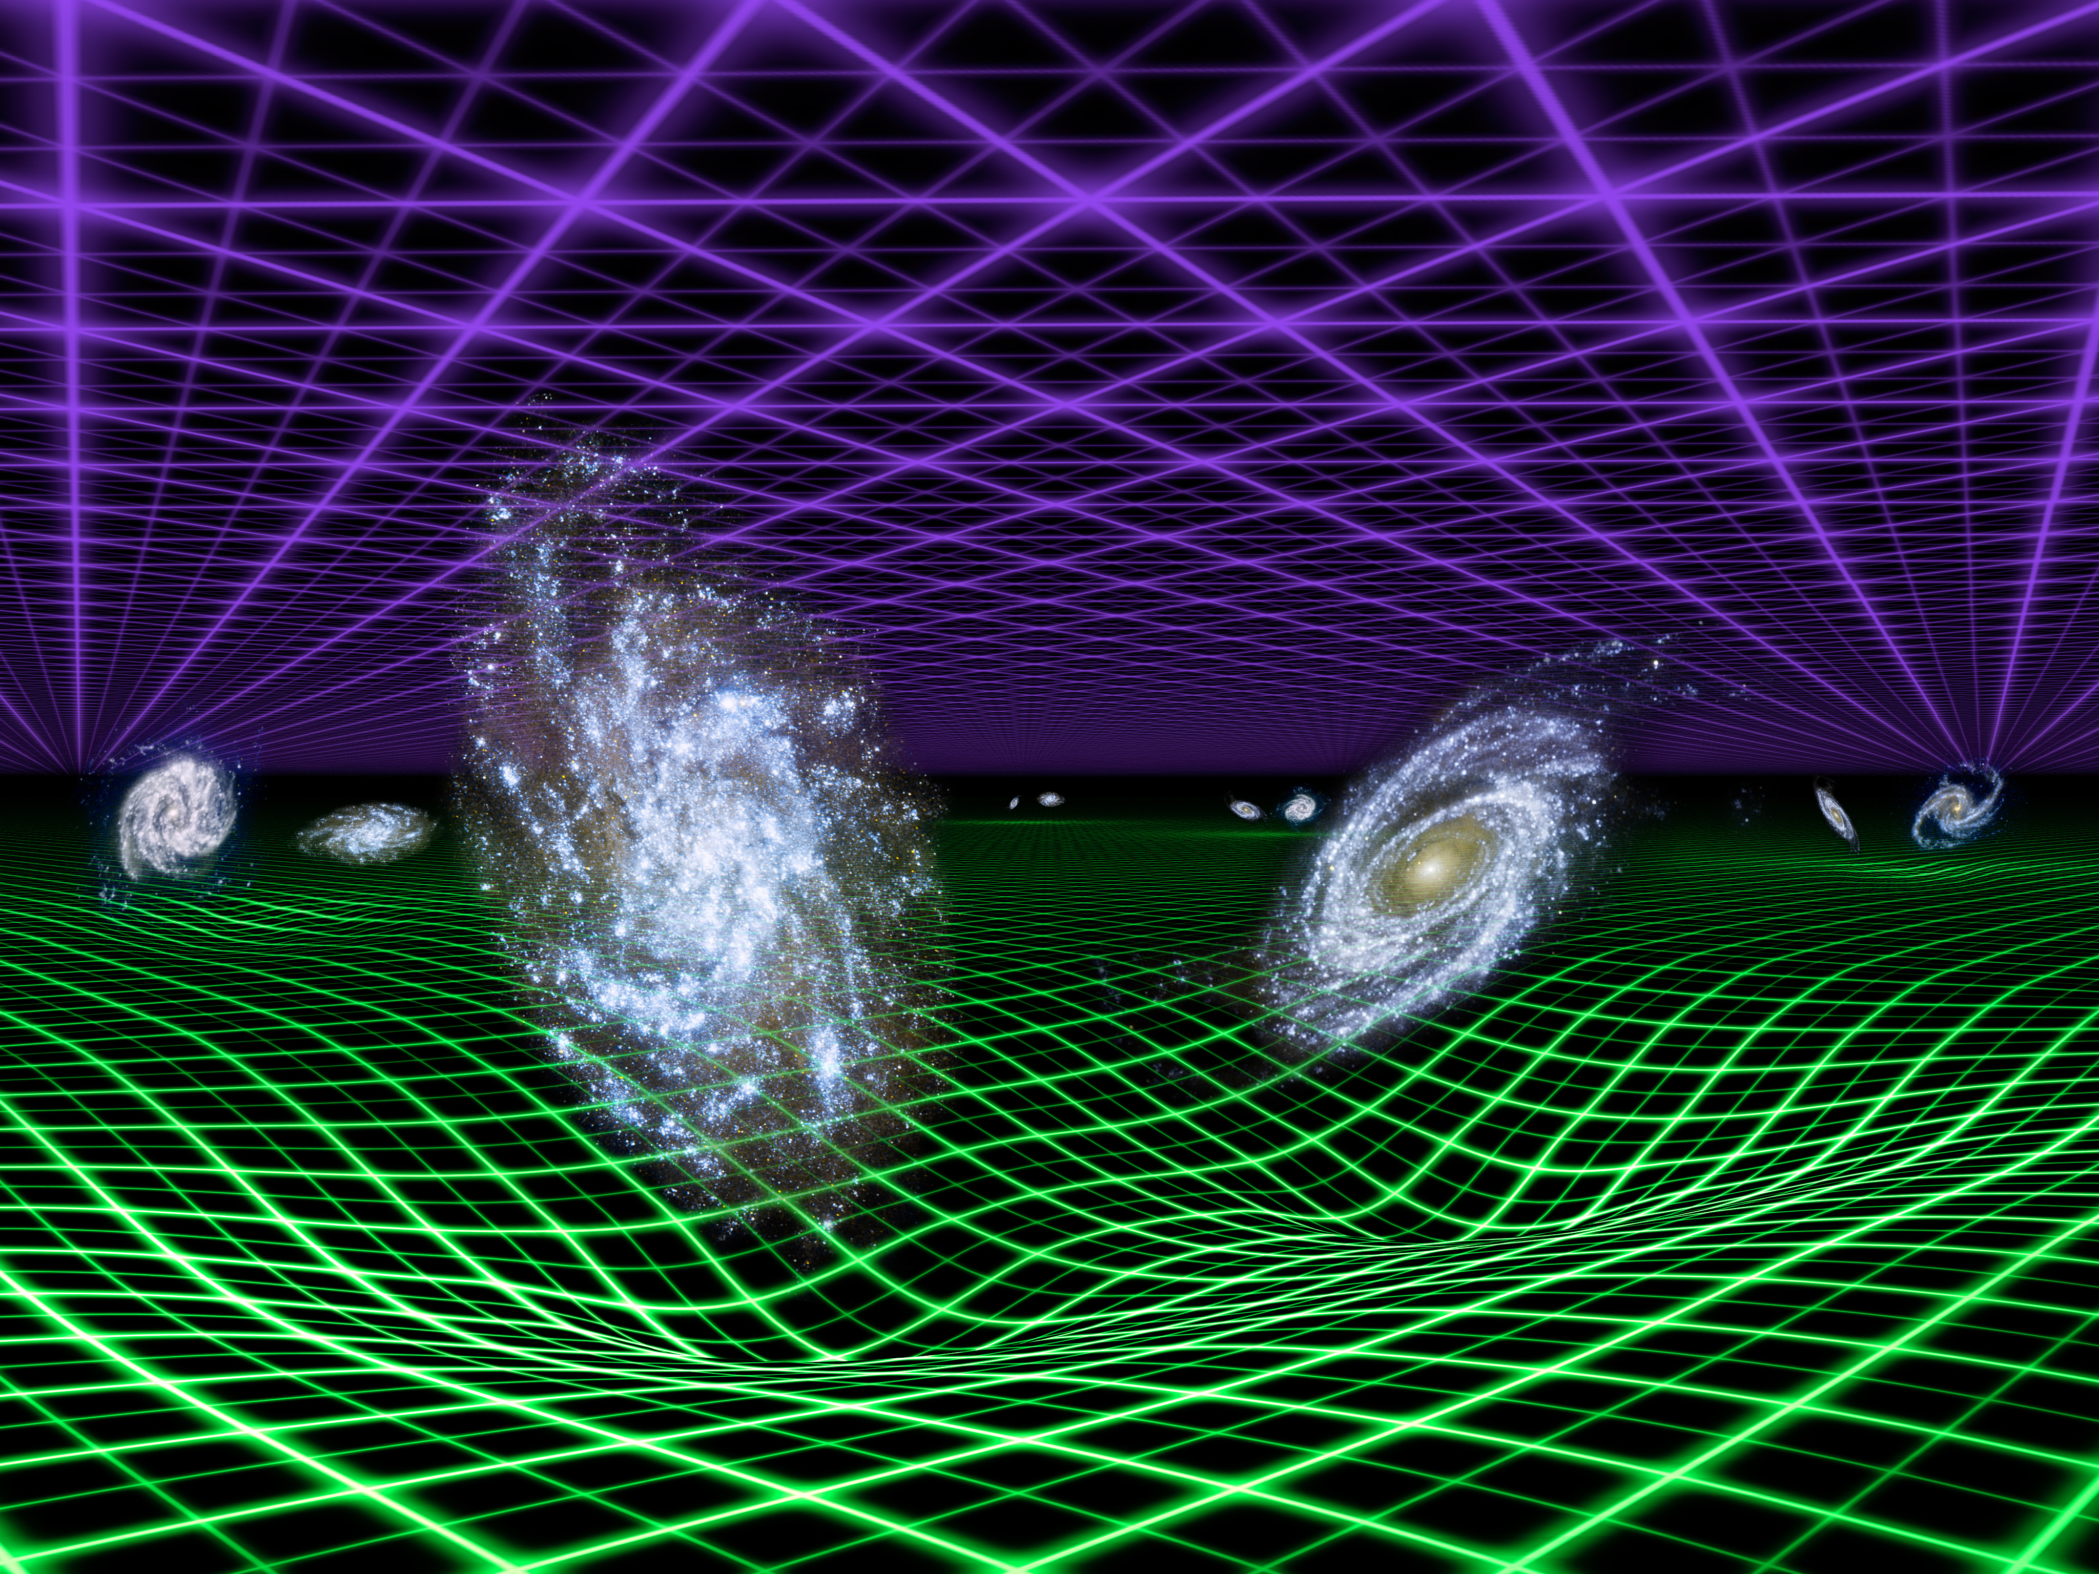
Cosmological tests using lensing and clustering amplitudes in KiDS-1000
Chris Blake (Swinburne)

Slide 2
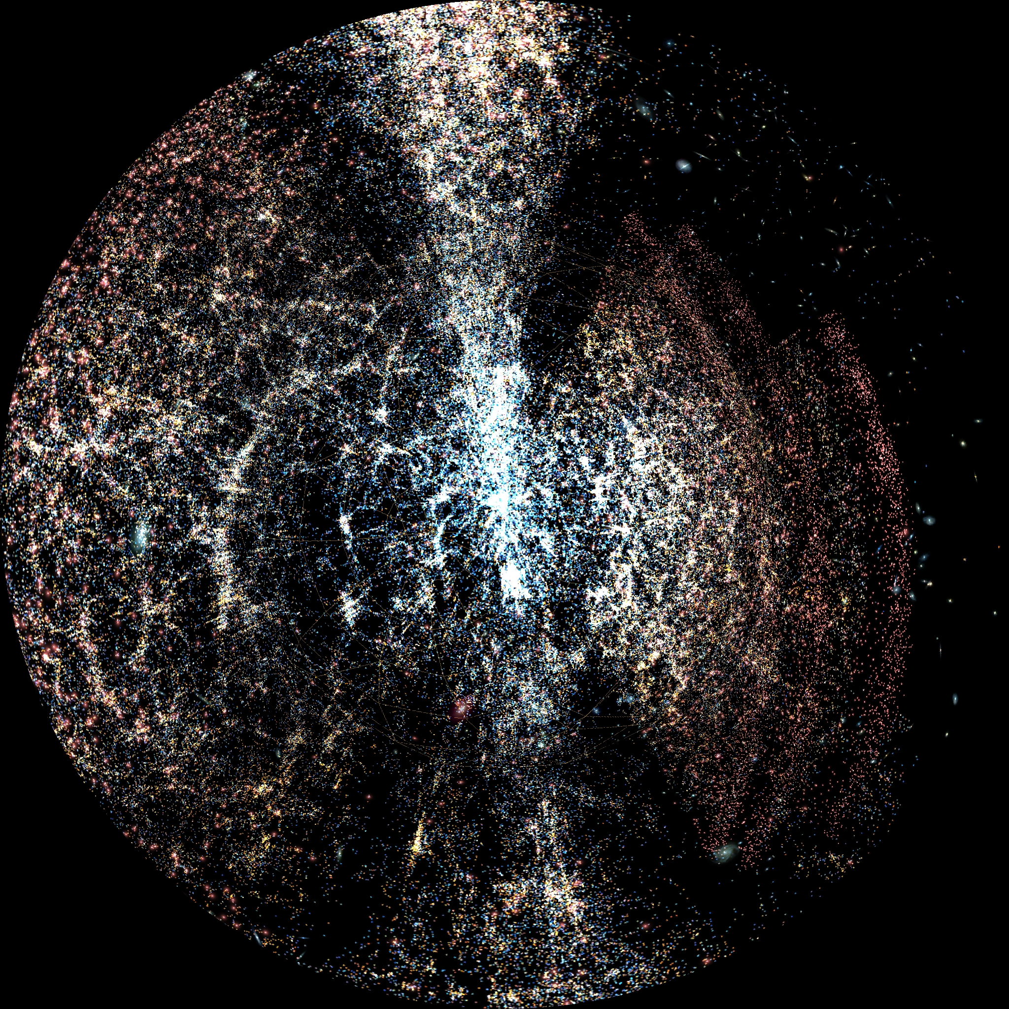
The science of cosmology has been transformed by a remarkable growth in data over the past 2 decades …

Slide 3

… which we have used to build a detailed model of the history of the Universe
Image credit: D.Aguilar, Harvard CFA

Slide 4
The most startling discovery is that the cosmic expansion seems to be accelerating!
Image credit: The Cosmic Perspective

Slide 5
This is the “dark energy problem”: the attempt to understand the physics of cosmic acceleration, and its implications

Slide 6
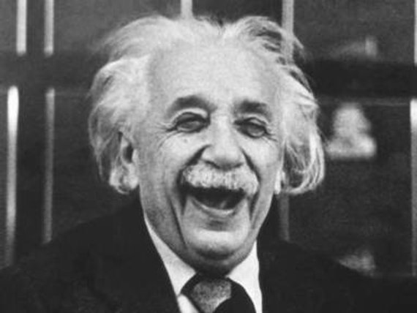
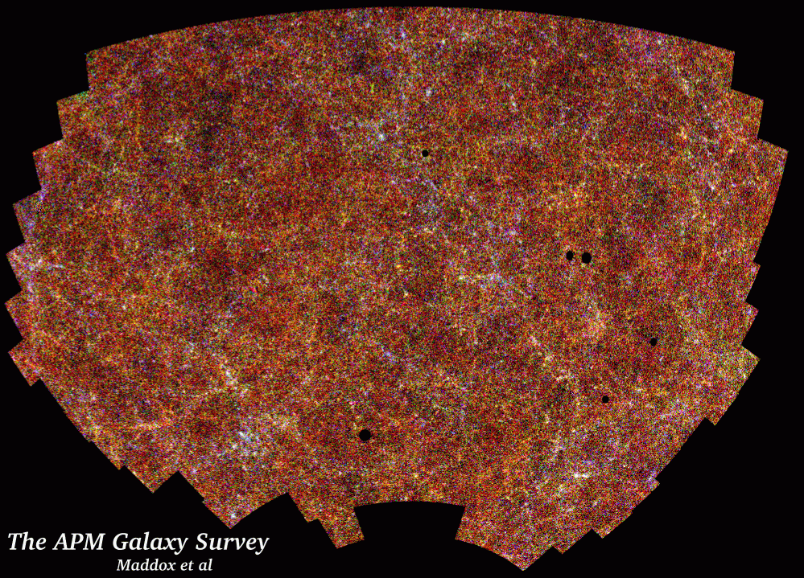
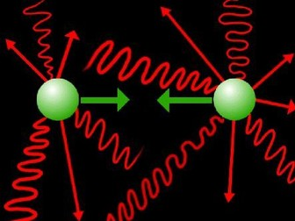
The dark energy problem
$$G_{μν}=\frac{8πG}{c^{4}}T_{μν}$$
The accelerating cosmic expansion cannot be produced by applying General Relativity to a homogeneous and isotropic Universe containing matter and radiation

Slide 7
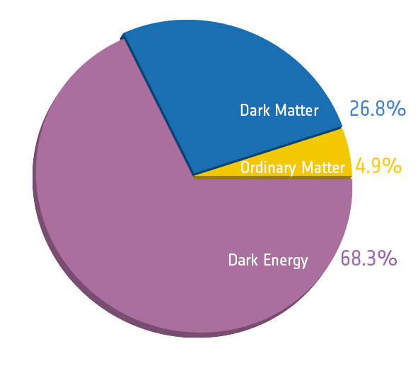
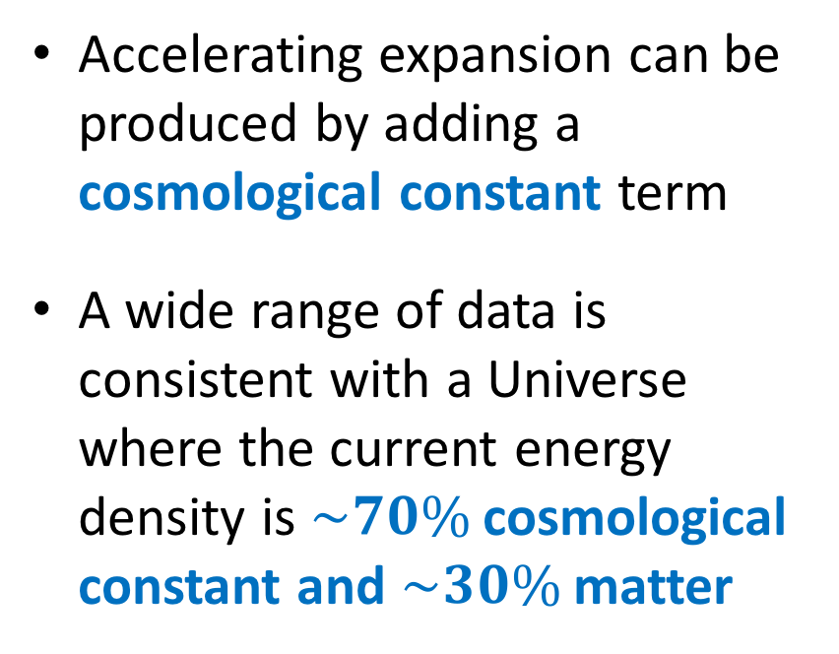
The dark energy problem
$$G_{μν}=\frac{8πG}{c^{4}}T_{μν}−Λg_{μν}$$
Accelerating expansion can be produced by adding a cosmological constant term
A wide range of data is consistent with a Universe where the current energy density is $\sim 70\%$ cosmological constant and $\sim 30\%$ matter

Slide 8
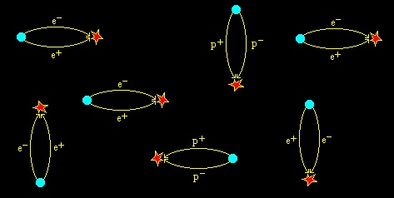
Why is this a problem?
$$Λ_{obs}\sim {\left({10}^{−30} M_{Planck}\right)}^{4}$$
Why is the energy density in the cosmological constant “unnaturally low”? [many tens of orders of magnitude lower than expected from quantum mechanical processes involving standard particles]
Why are the energy densities in cosmological constant and matter roughly equal today? [“coincidence problem”]
Is the cosmological constant a sign of new physics?

Slide 9
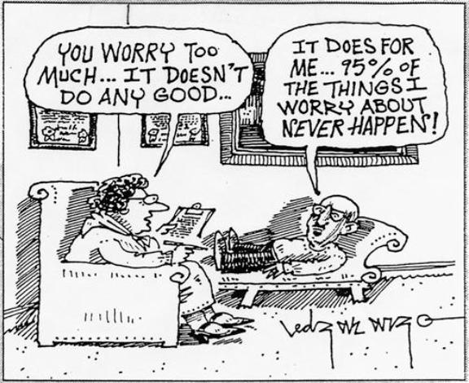
Other explanations?
Let’s not worry about cosmological constant and seek another solution!
“Accelerating cosmic expansion cannot be produced applying GR to a homogeneous/isotropic Universe containing matter and radiation”
Modify gravitational physics? [e.g. Einstein-Hilbert action]
Allow for effects of inhomogeneity? [very hard!]
Add extra “source”? [e.g. dynamical scalar field]

Slide 10
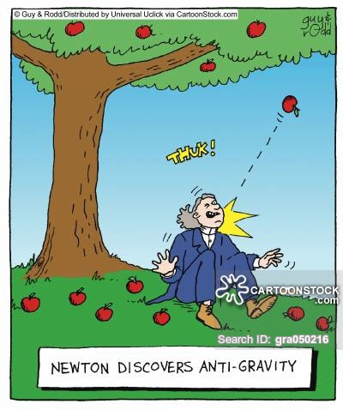
What does it mean to “modify gravity”?
Add some kind of “fifth force” [to the four we already have]
But we have extremely accurate laboratory and solar system tests of General Relativity!
Add a “screening mechanism” which allows the fifth force to vary with environment

Slide 11
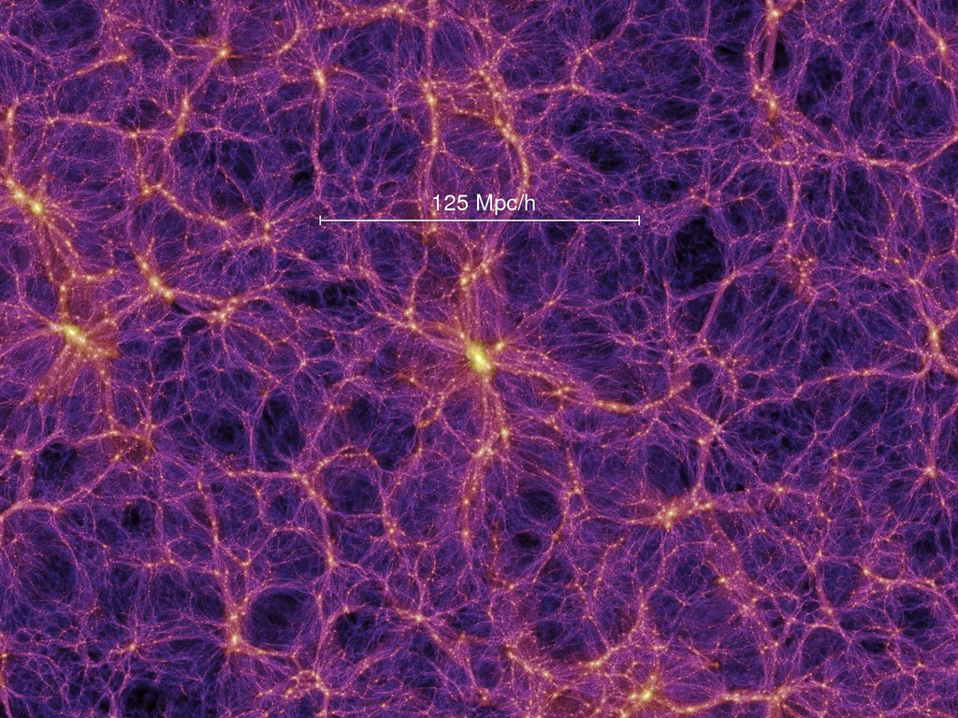
Cosmological observations
Image credit: Millennium simulation
Homogeneous expansion of the Universe
Growth of perturbations within the expanding background

Slide 12
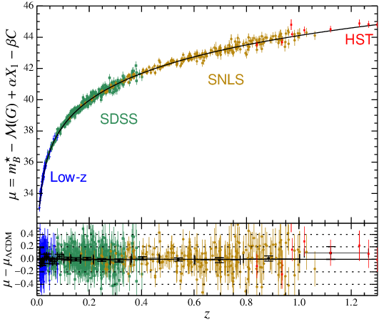
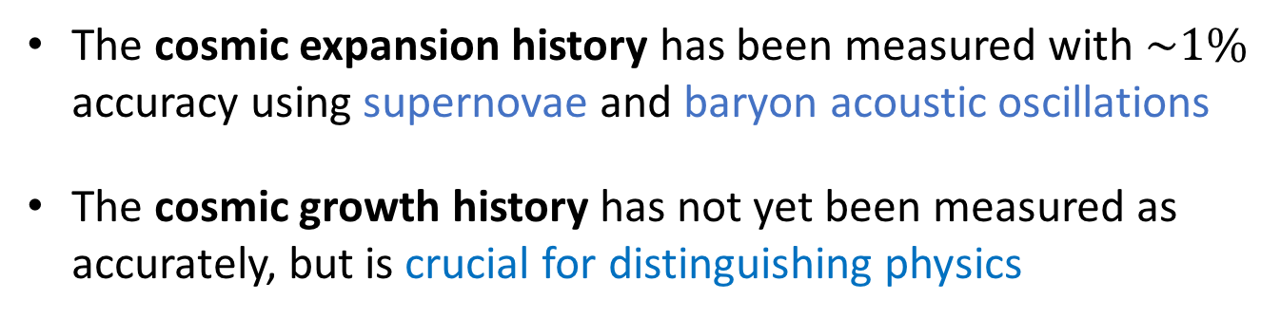
Cosmological observations
Credit: Alam et al. (2017)
Credit: Betoule et al. (2014)
The cosmic expansion history has been measured with $\sim 1\%$ accuracy using supernovae and baryon acoustic oscillations
The cosmic growth history has not yet been measured as accurately, but is crucial for distinguishing physics

Slide 13
Cosmological observations
There are a rich variety of observable signatures of the clumpy Universe …
Clustering of galaxies
Velocities of objects
Gravitational lensing
Abundance/properties of objects
Environmental effects
Image credit: Sloan Digital Sky Survey

Slide 14
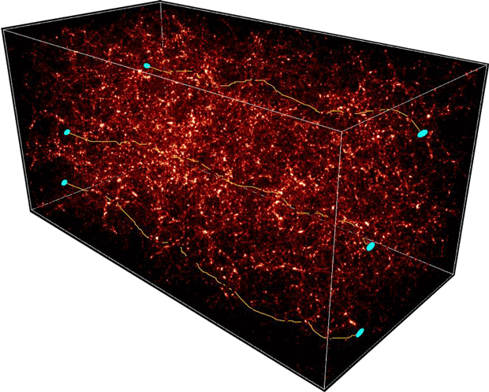
Lensing and large-scale structure
Gravitational lensing refers to the deflections of light from distant galaxies as it travels through the cosmic web …
Image credit: S.Colombi

Slide 15
Lensing and large-scale structure
Clump of matter (unknown density)

Slide 16
Galaxy-galaxy lensing
Background sources behind the clump

Slide 17
Galaxy-galaxy lensing
These sources are lensed!

Slide 18
Galaxy-galaxy lensing
Galaxy-galaxy lensing means the “lensing of background galaxies around foreground galaxies”
Coherent tangential alignment
average tangential shear
Turn into galaxy-lensing cross-correlation function
projected separation
(I’ve also added some noise here)
The amplitude of this function tells us the effect of gravity on light

Slide 19
Redshift-space distortion
Galaxies around the clump

Slide 20
Redshift-space distortion
These galaxies are in motion!

Slide 21
Redshift-space distortion
Result from 2dFGRS (Hawkins et al. 2002)
Coherent decrease in redshifts
Turn into galaxy correlation function
Apparent redshift-space separation
Coherent increase in redshifts
Apparent projected separation
Observer
The “amount of squashing” tells us the effect of gravity on velocities

Slide 22
Lensing and large-scale structure
Effect of the clump’s gravity on light (relativistic)
Tangential shear
Do these have the ratio predicted by GR??
Projected separation
Redshift-space separation
Effect of the clump’s gravity on velocities (non-relativistic)
Projected separation

Slide 23
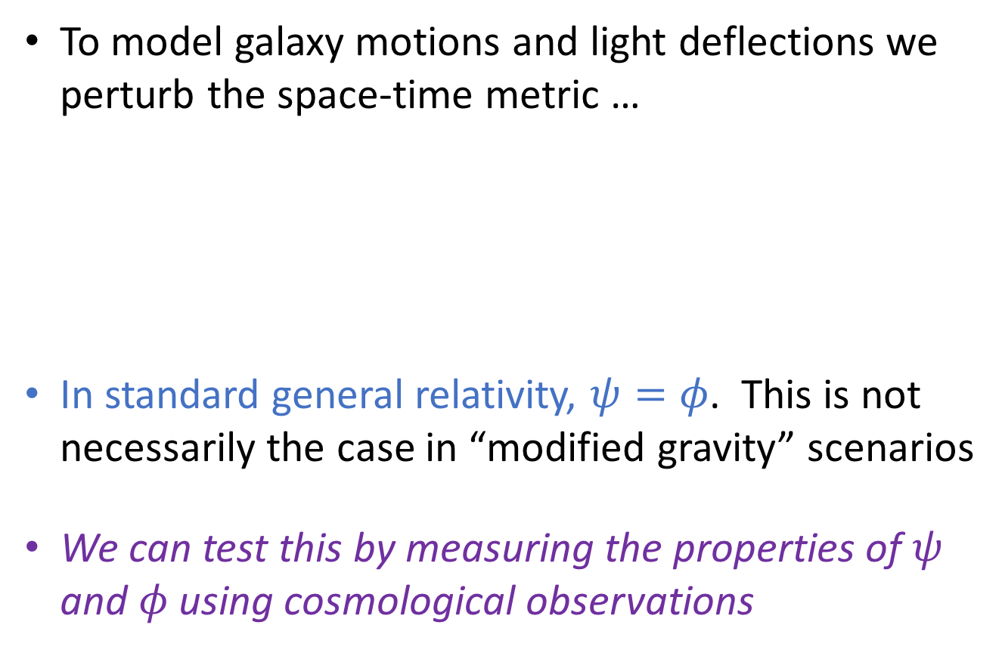
Mathematical interlude …
To model galaxy motions and light deflections we perturb the space-time metric …
In standard general relativity, $ψ=φ$. This is not necessarily the case in “modified gravity” scenarios
We can test this by measuring the properties of $ψ$ and $φ$ using cosmological observations
$${ds}^{2}=−c^{2}\left[1+2ψ\left(\vec{x},t\right)\right]{dt}^{2}+{a(t)}^{2}\left[1−2φ(\vec{x},t)\right]{d\vec{x}}^{2}$$
These are the “metric gravitational potentials”

Slide 24
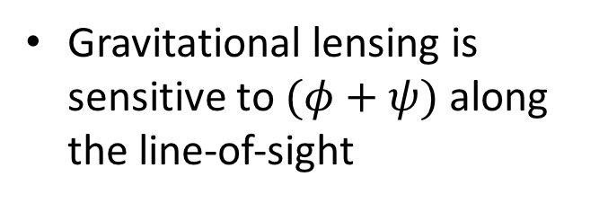
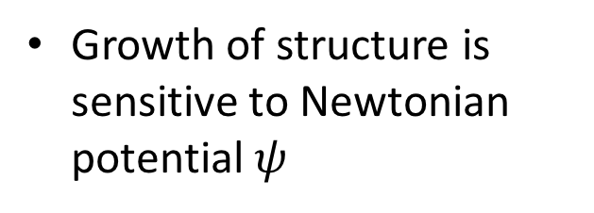
Mathematical interlude …
$${ds}^{2}=−c^{2}\left[1+2ψ\left(\vec{x},t\right)\right]{dt}^{2}+{a(t)}^{2}\left[1−2φ(\vec{x},t)\right]{d\vec{x}}^{2}$$
Gravitational lensing is sensitive to $(φ+ψ)$ along the line-of-sight
Growth of structure is sensitive to Newtonian potential $ψ$
We need to measure both in order to test whether $ψ=φ$

Slide 25
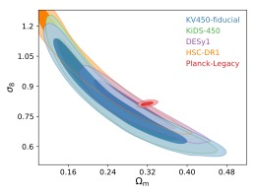
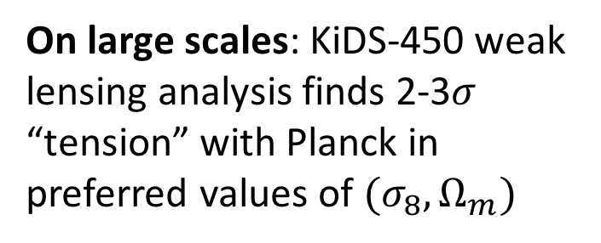
Intriguing current results!
On large scales: KiDS-450 weak lensing analysis finds 2-3$σ$ “tension” with Planck in preferred values of $(σ_{8},Ω_{m})$
On small scales: measured lensing signature around Luminous Red Galaxies is significantly lower than predicted
Hildebrandt et al. (2020)
Leauthaud et al. (2017)
Whether these discrepancies result from statistics, systematics, astrophysics or new cosmological physics remains to be seen!

Slide 26
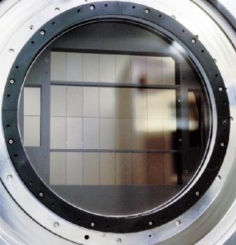
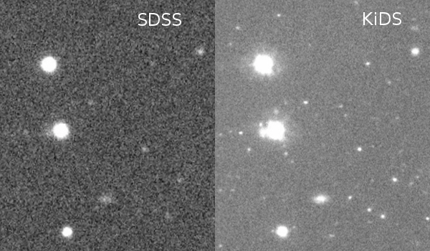
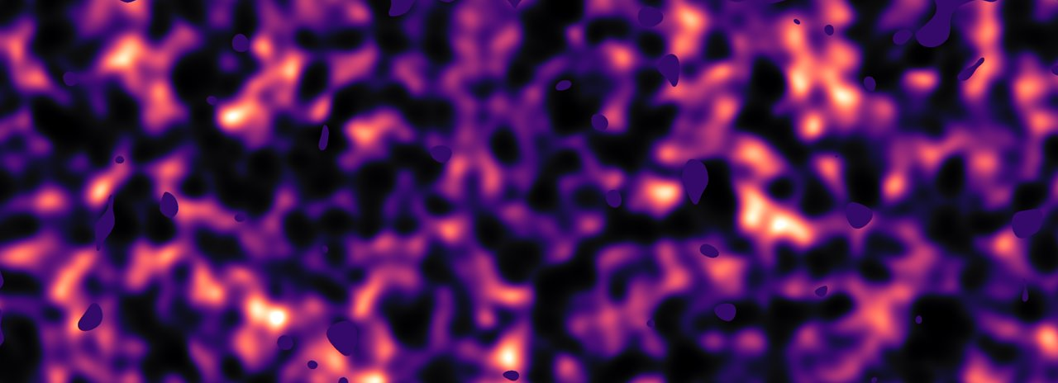
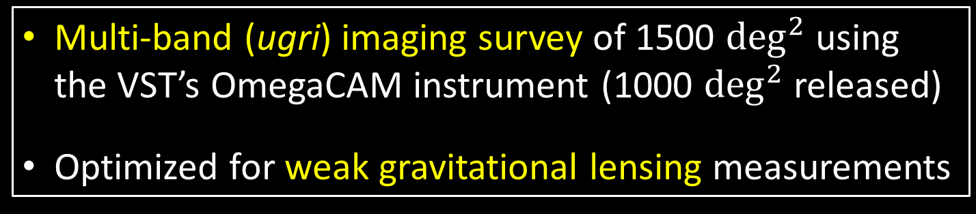
Kilo-Degree Survey (KiDS)
Image credit: H.Hildebrandt
Multi-band (ugri) imaging survey of 1500 $\deg^{2}$ using the VST’s OmegaCAM instrument (1000 $\deg^{2}$ released)
Optimized for weak gravitational lensing measurements

Slide 27
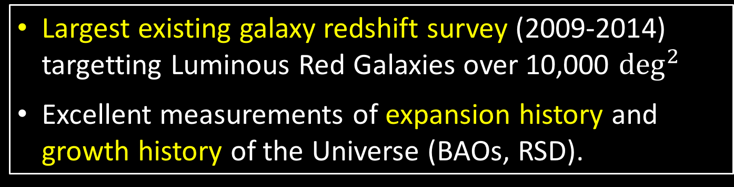
Baryon Oscillation Spectroscopic Survey (BOSS)
Image credits: Sloan Digital Sky Survey
Largest existing galaxy redshift survey (2009-2014) targetting Luminous Red Galaxies over 10,000 $\deg^{2}$
Excellent measurements of expansion history and growth history of the Universe (BAOs, RSD).

Slide 28
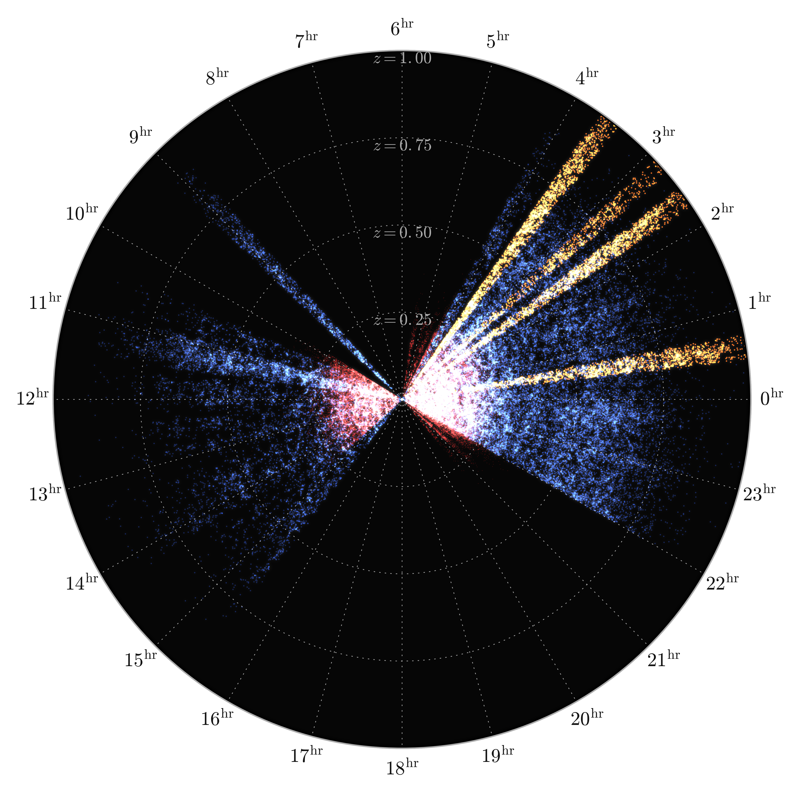
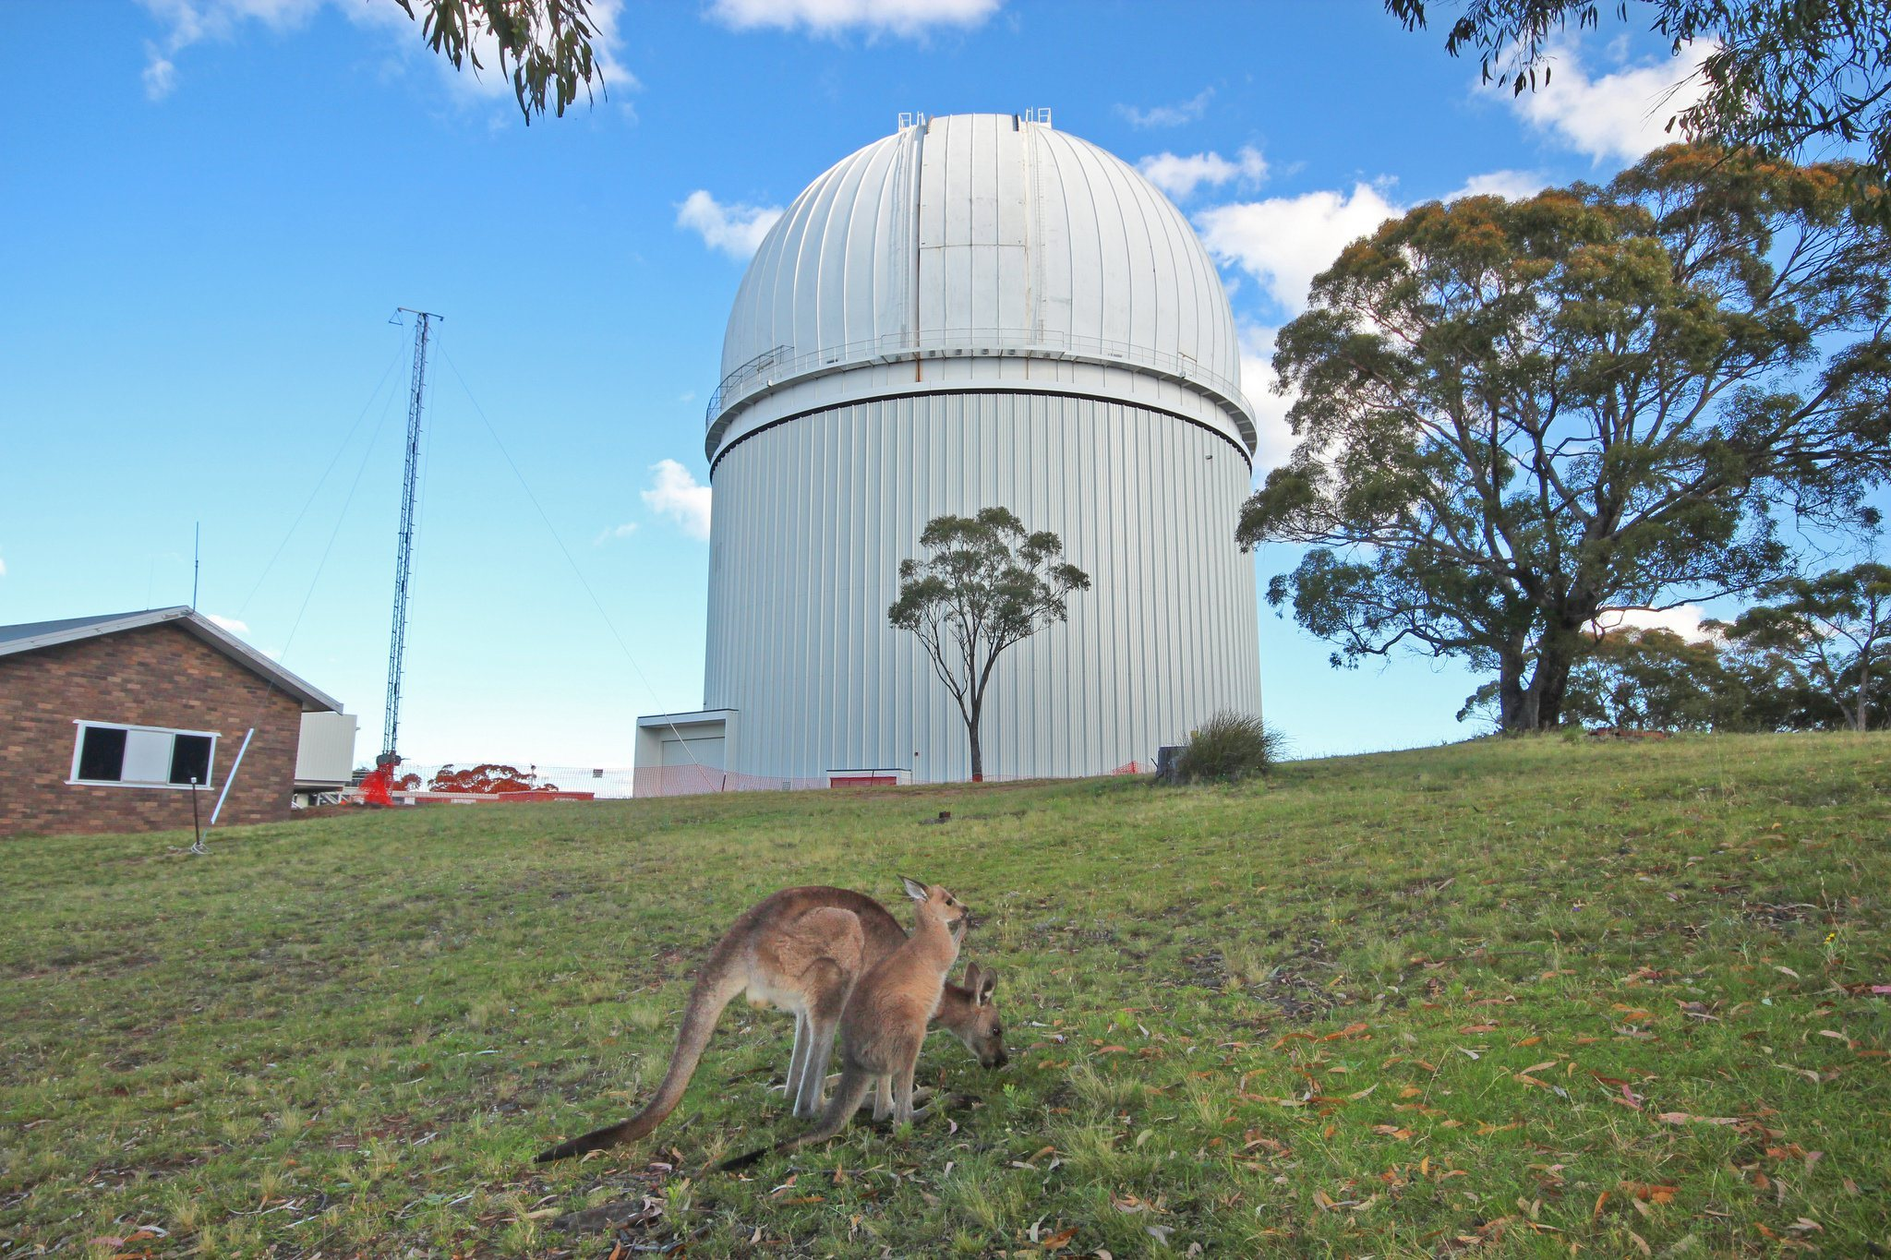
2-degree Field Lensing Survey (2dFLenS)
Image credit: Sam Hinton
Image credit: Angel Lopez-Sanchez
Spectroscopic follow-up of KiDS and other lensing surveys over 50 AAT nights (Sep 2014 – Jan 2016)
Sample of 70,000 LRGs/bright galaxies for cross-correlations with weak lensing and photo-z calibration

Slide 29
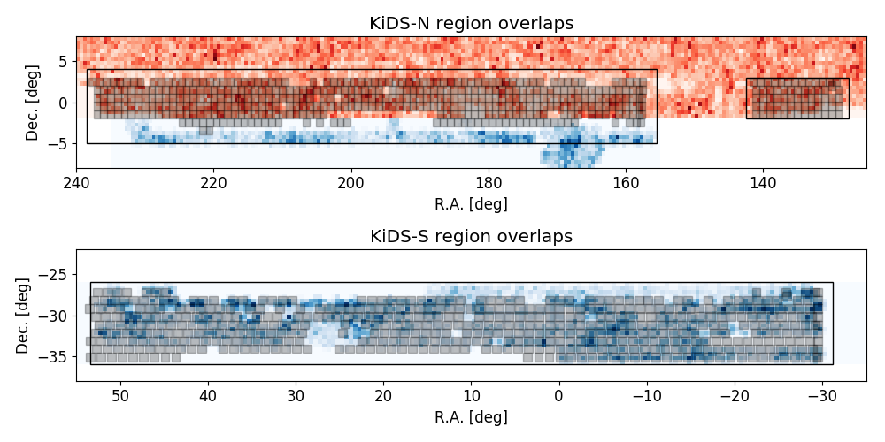
Overlap areas
Analyse lensing/clustering measurements in overlap areas
KiDS-1000
2dFLenS
BOSS

Slide 30
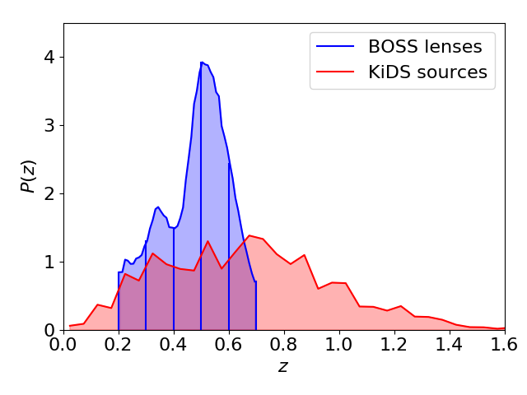
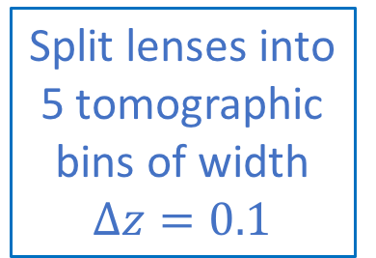
Redshift tomography
Split lenses into 5 tomographic bins of width $∆z=0.1$

Slide 31

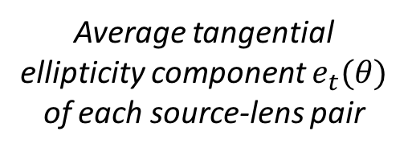
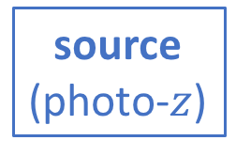
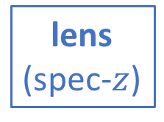
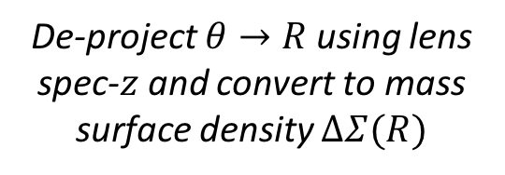
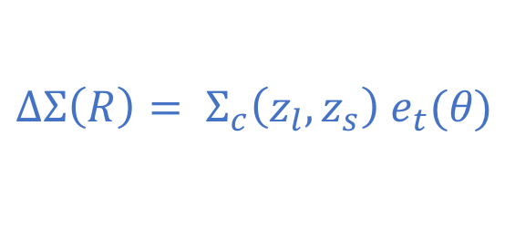
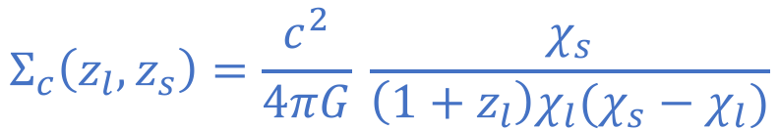
Galaxy-galaxy lensing
Lensing measures the differential projected mass density relative to the background …
source (photo-$z$)
lens (spec-$z$)
$$θ$$
Average tangential ellipticity component $e_{t}(θ)$ of each source-lens pair
De-project $θ→R$ using lens spec-$z$ and convert to mass surface density $∆Σ(R)$
$$Σ_{c}\left(z_{l},z_{s}\right)=\frac{c^{2}}{4πG} \frac{χ_{s}}{\left(1+z_{l}\right)χ_{l}(χ_{s}−χ_{l})}$$
$$∆Σ\left(R\right)= Σ_{c}\left(z_{l},z_{s}\right) e_{t}(θ)$$

Slide 32
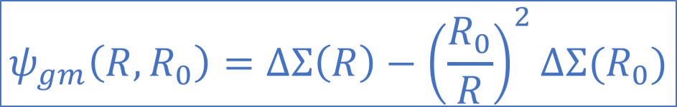

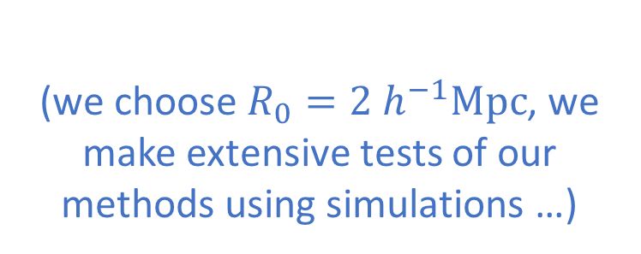
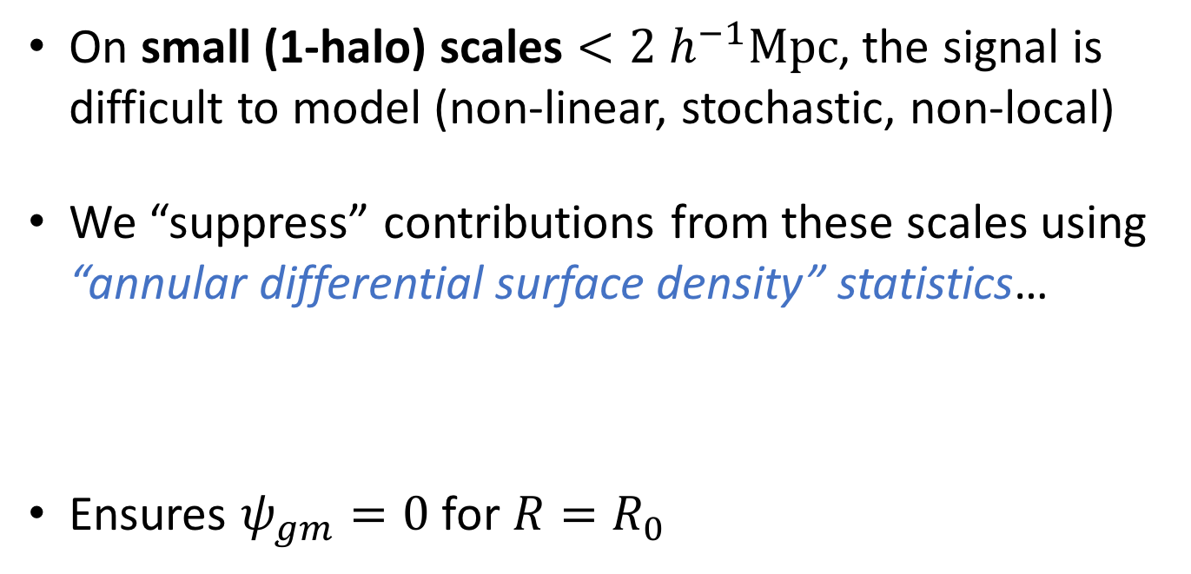
Galaxy-galaxy lensing
On small (1-halo) scales $<2 h^{−1}Mpc$, the signal is difficult to model (non-linear, stochastic, non-local)
We “suppress” contributions from these scales using “annular differential surface density” statistics…
Ensures $ψ_{gm}=0$ for $R=R_{0}$
$$ψ_{gm}\left(R,R_{0}\right)=∆Σ\left(R\right)−{\left(\frac{R_{0}}{R}\right)}^{2}∆Σ{(R}_{0})$$
$$R_{0}$$
(we choose $R_{0}=2 h^{−1}Mpc$, we make extensive tests of our methods using simulations …)

Slide 33
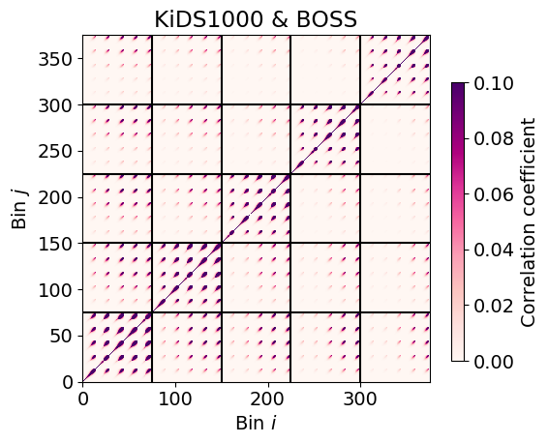
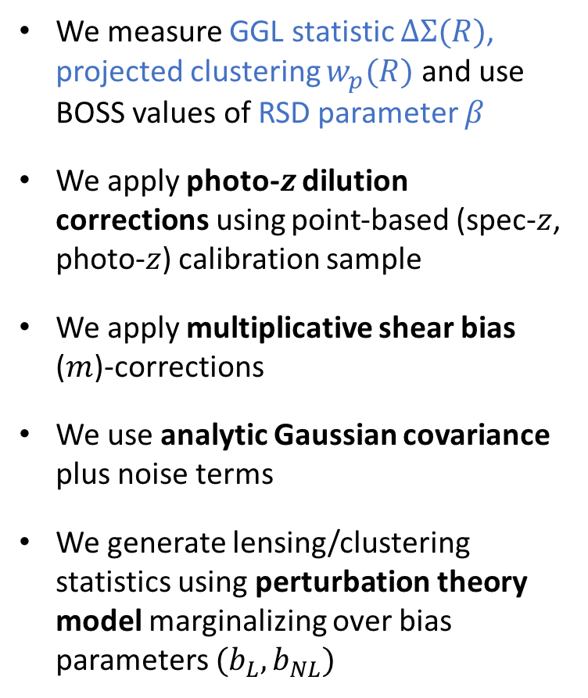
Methods (fine print)
We measure GGL statistic $∆Σ(R)$, projected clustering $w_{p}(R)$ and use BOSS values of RSD parameter $β$
We apply photo-$z$ dilution corrections using point-based (spec-$z$, photo-$z$) calibration sample
We apply multiplicative shear bias ($m$)-corrections
We use analytic Gaussian covariance plus noise terms
We generate lensing/clustering statistics using perturbation theory model marginalizing over bias parameters $(b_{L},b_{NL})$
Covariance across the bins of lens redshift, source tomographic sample and scale

Slide 34
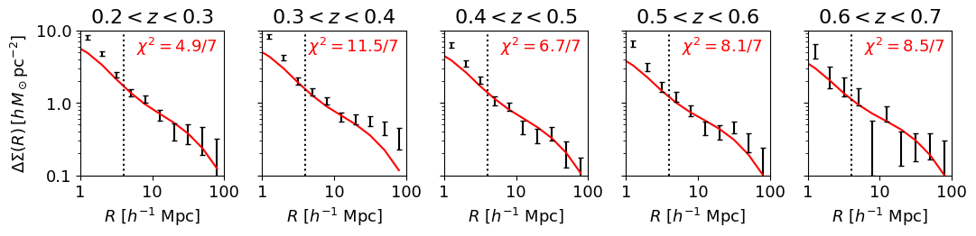
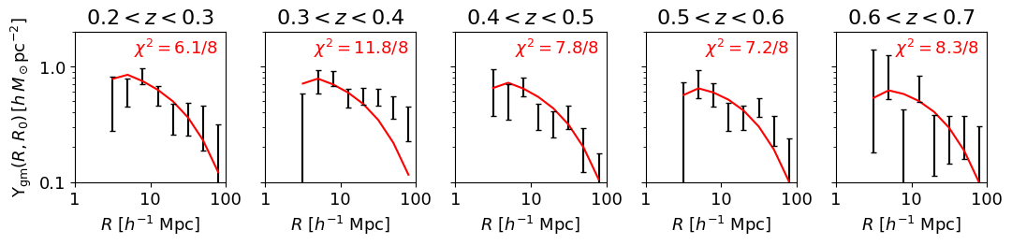
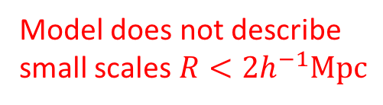
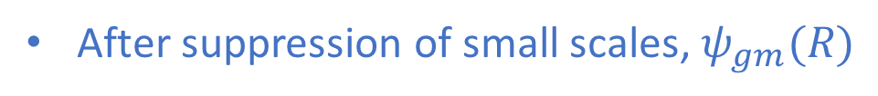
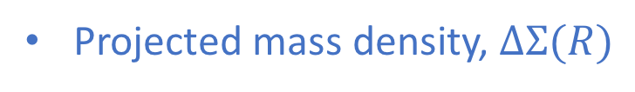
Galaxy-galaxy lensing
Projected mass density, $∆Σ(R)$
Model does not describe
small scales $R<2h^{−1}Mpc$
Model is a GR prediction calibrated by the clustering, containing no free parameters
After suppression of small scales, $ψ_{gm}(R)$

Slide 35
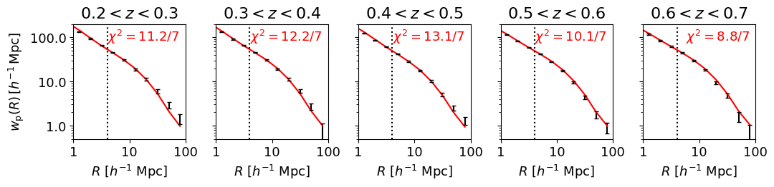
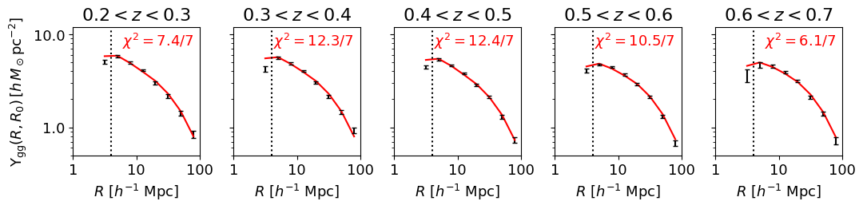
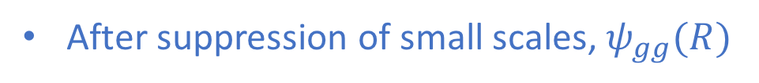
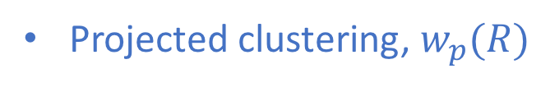
Clustering
Projected clustering, $w_{p}(R)$
After suppression of small scales, $ψ_{gg}(R)$

Slide 36
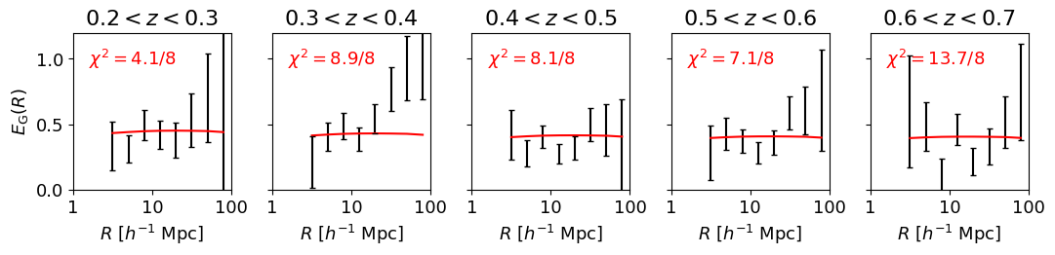

Amplitude ratio test
Lensing amplitude
We now construct the amplitude ratio test:
$$E_{G}\left(R\right)=\frac{Amplitude of galaxy−galaxy lensing}{Amplitude of galaxy velocities}=\frac{1}{β}\frac{Υ_{gm}(R)}{Υ_{gg}(R)}=\frac{Ω_{m}}{f}$$
In GR models (with some approximations!), $E_{G}(R)$ is scale-independent and has a predicted redshift dependence $Ω_{m}/f(z)$ where $f=$ growth rate of structure
Redshift-space distortion amplitude (from BOSS papers)
Projected clustering amplitude

Slide 37


Amplitude ratio test
If $E_{G}\left(R\right)$ is scale-independent, we can optimally combine measurements for each lens redshift bin into an average $\left\langle E_{G}\right\rangle$ …

Slide 38


Amplitude ratio test
This is the prediction of the Planck (2018) CMB analysis for $E_{G}=Ω_{m}/f$

Slide 39


Amplitude ratio test
Here are the scale-averaged KiDS-1000 measurements
Assuming a flat $Λ$CDM model, we find $Ω_{m}=0.27±0.04$

Slide 40


Amplitude ratio test
Comparing to the literature …
KiDS-1000 allows $\sim 15−20\%$ measurements in $∆z=0.1$ bins

Slide 41


Prospects for the future!
Image credit: M.Chung, LBL
Image credit: LSST corporation
Dark Energy Spectroscopic Instrument (DESI)
Rubin Observatory (LSST)
Upcoming facilities such as DESI, 4MOST, LSST and Euclid will enhance the precision of these tests by a factor of 10
$→$ Further, precise tests of gravitational physics

Slide 42

Prospects for the future!
Fisher matrix forecasts for current and future datasets …

Slide 43


Summary
Complementary tests for gravity can be constructed using large-scale structure and weak gravitational lensing
New datasets from KiDS-1000, in conjunction with BOSS and 2dFLenS, have allowed us to perform an accurate “amplitude ratio test” on scales up to $100 h^{−1} Mpc$
The scale- and redshift-dependence of the results are consist with GR in a Universe where $Ω_{m}=0.27±0.04$
Upcoming facilities such as DESI, 4MOST, LSST and Euclid will enhance the precision of these tests by a factor of 10
Image credit: G.Poole

Slide 44

Extra slides

