Slide 1
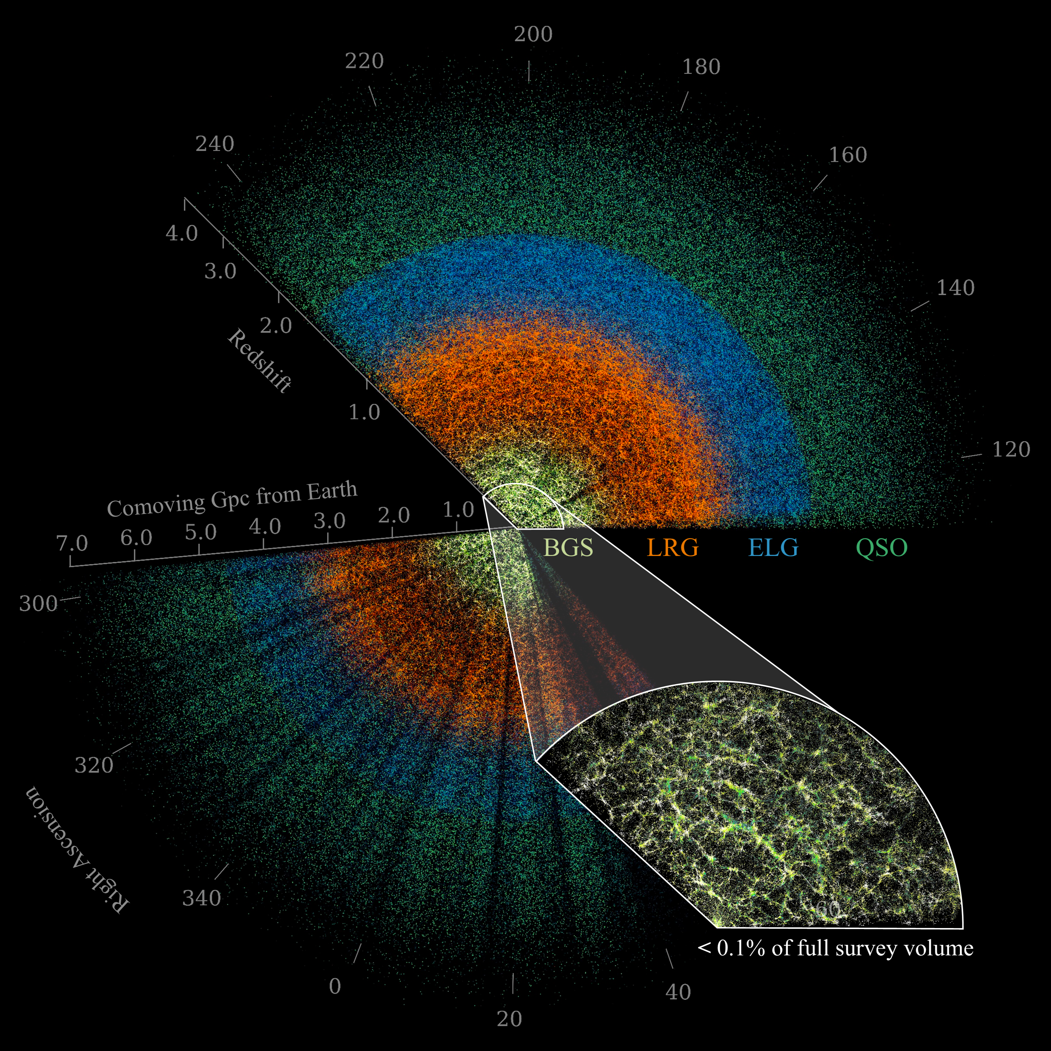
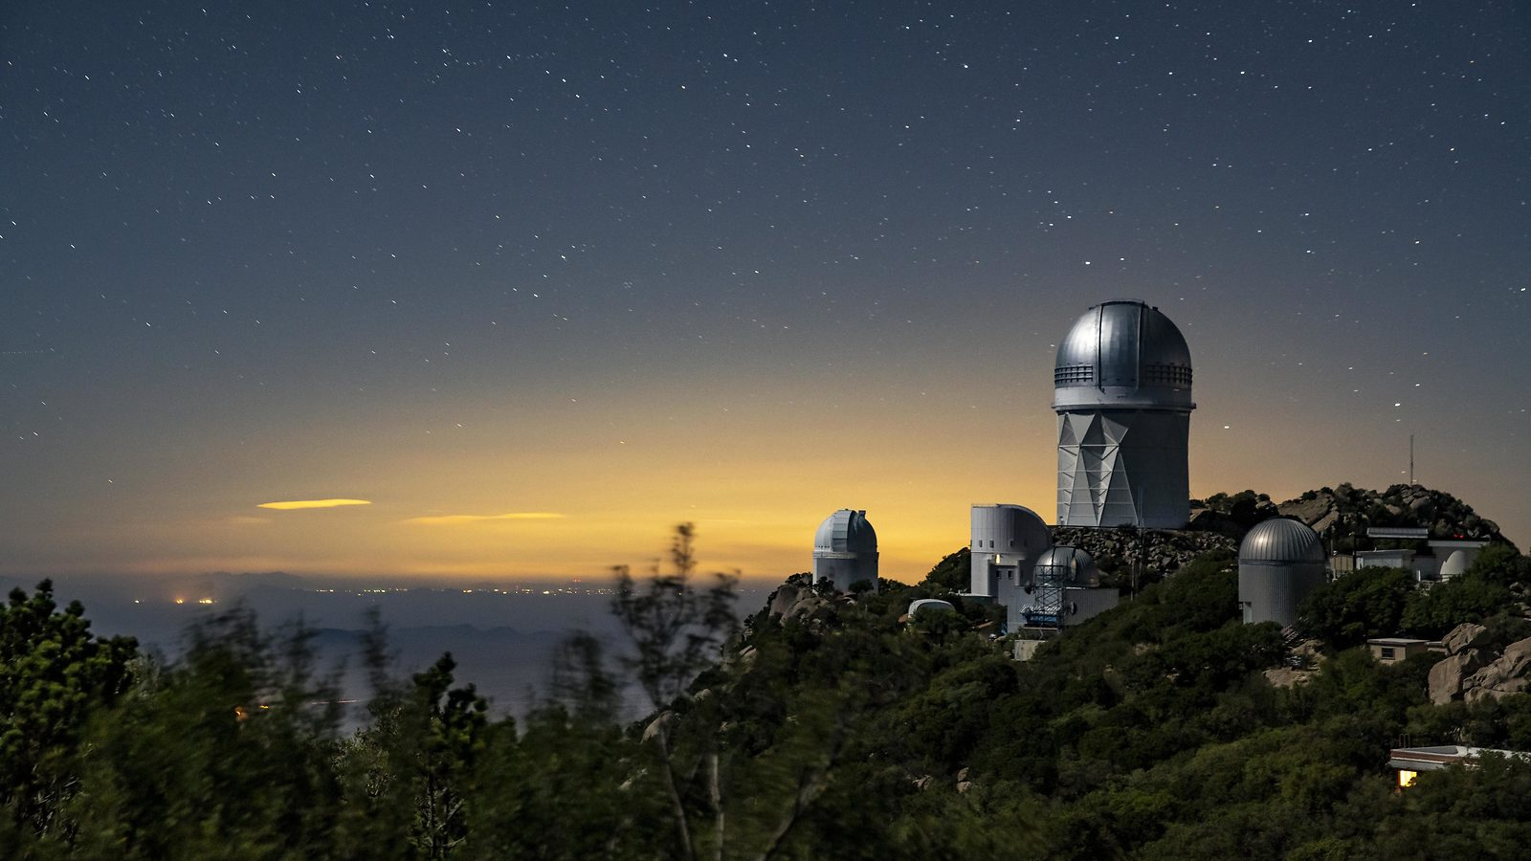
What’s the deal with dark energy?
New results from the Dark Energy Spectroscopic Instrument
Chris Blake (Swinburne)

Slide 2

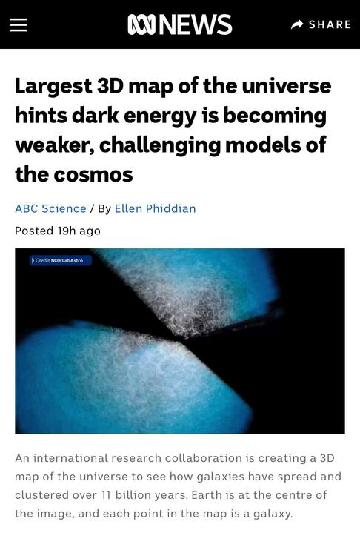
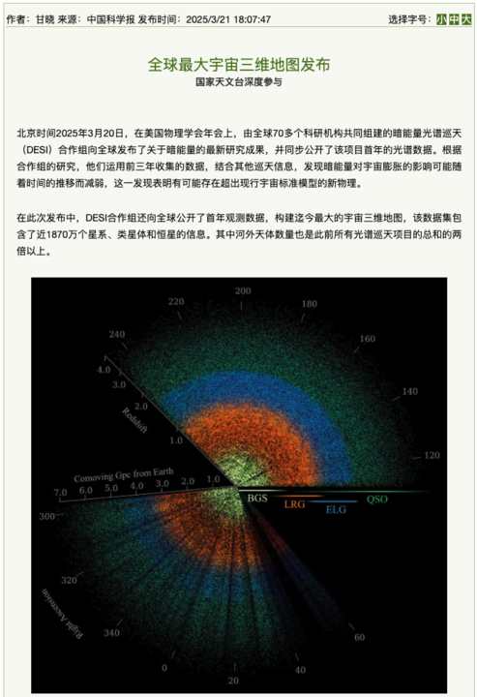
In the news recently …

Slide 3
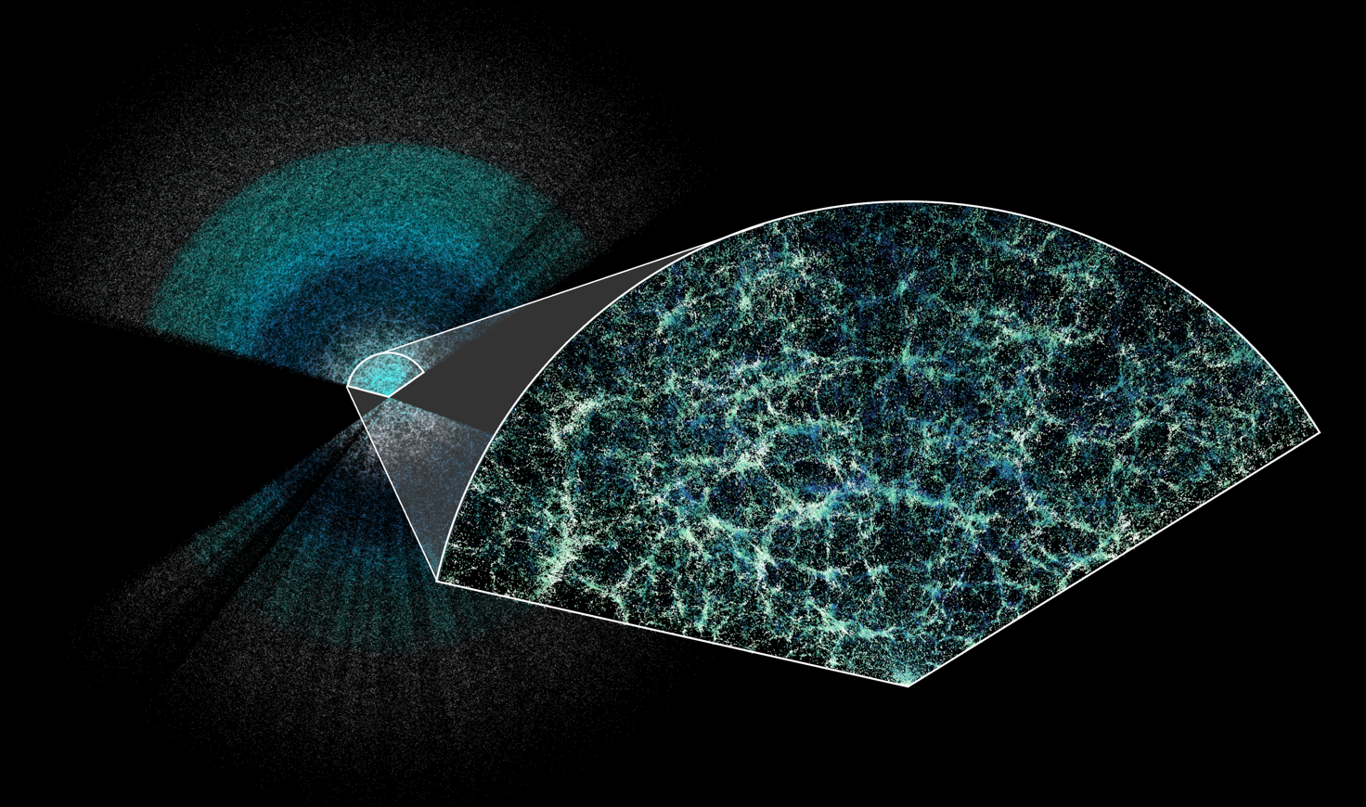
Talk outline
What is DESI?
Why do we think dark energy exists?
How does DESI measure dark energy?
The physics of dark energy
DESI results
What does it all mean?

Slide 4
What is DESI*?
*The Dark Energy Spectroscopic Instrument

Slide 5
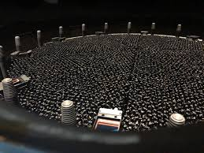

What is DESI? (Dark Energy Spectroscopic Instrument)
A spectroscopic instrument at the Mayall Telescope (Kitt Peak) which can position 5000 optical fibres across an $8 \deg^{2}$field-of-view in $\sim 1$ minute
An international collaboration which is conducting a large spectroscopic survey using this instrument between 2021 and 2026 (… now 4 years in!)

Slide 6





Our amazing DESI team at Swinburne!
Ryan Turner
Agne Semenaite
Nimas
Andy Nguyen
Sera Rauhut

Slide 7
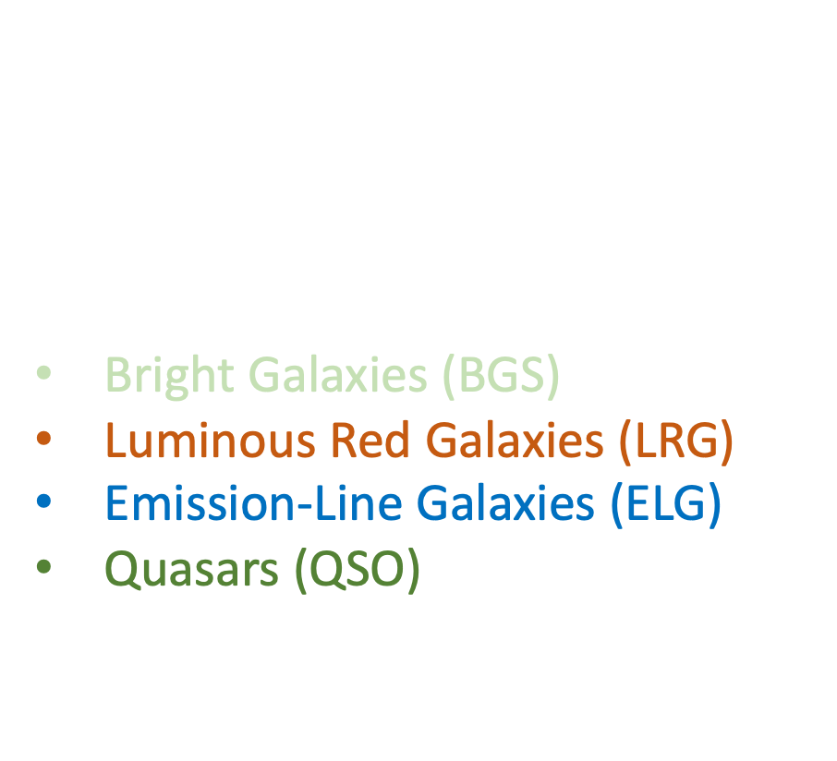
What is the DESI survey?
A spectroscopic survey of $14,000 \deg^{2}$ which plans to measure $≈60$ million redshifts
Extragalactic component includes:
Bright Galaxies (BGS)
Luminous Red Galaxies (LRG)
Emission-Line Galaxies (ELG)
Quasars (QSO)
across redshifts $z<4$, selected from photometric imaging surveys

Slide 8
What is the science goal of DESI?
Use the large-scale structure of the Universe to test cosmological models for the expansion of the Universe and the growth of cosmic structure
Baryon acoustic oscillations
Redshift-space distortions
Galaxy peculiar velocities
Weak lensing cross-correlations
CMB cross-correlations

Slide 9
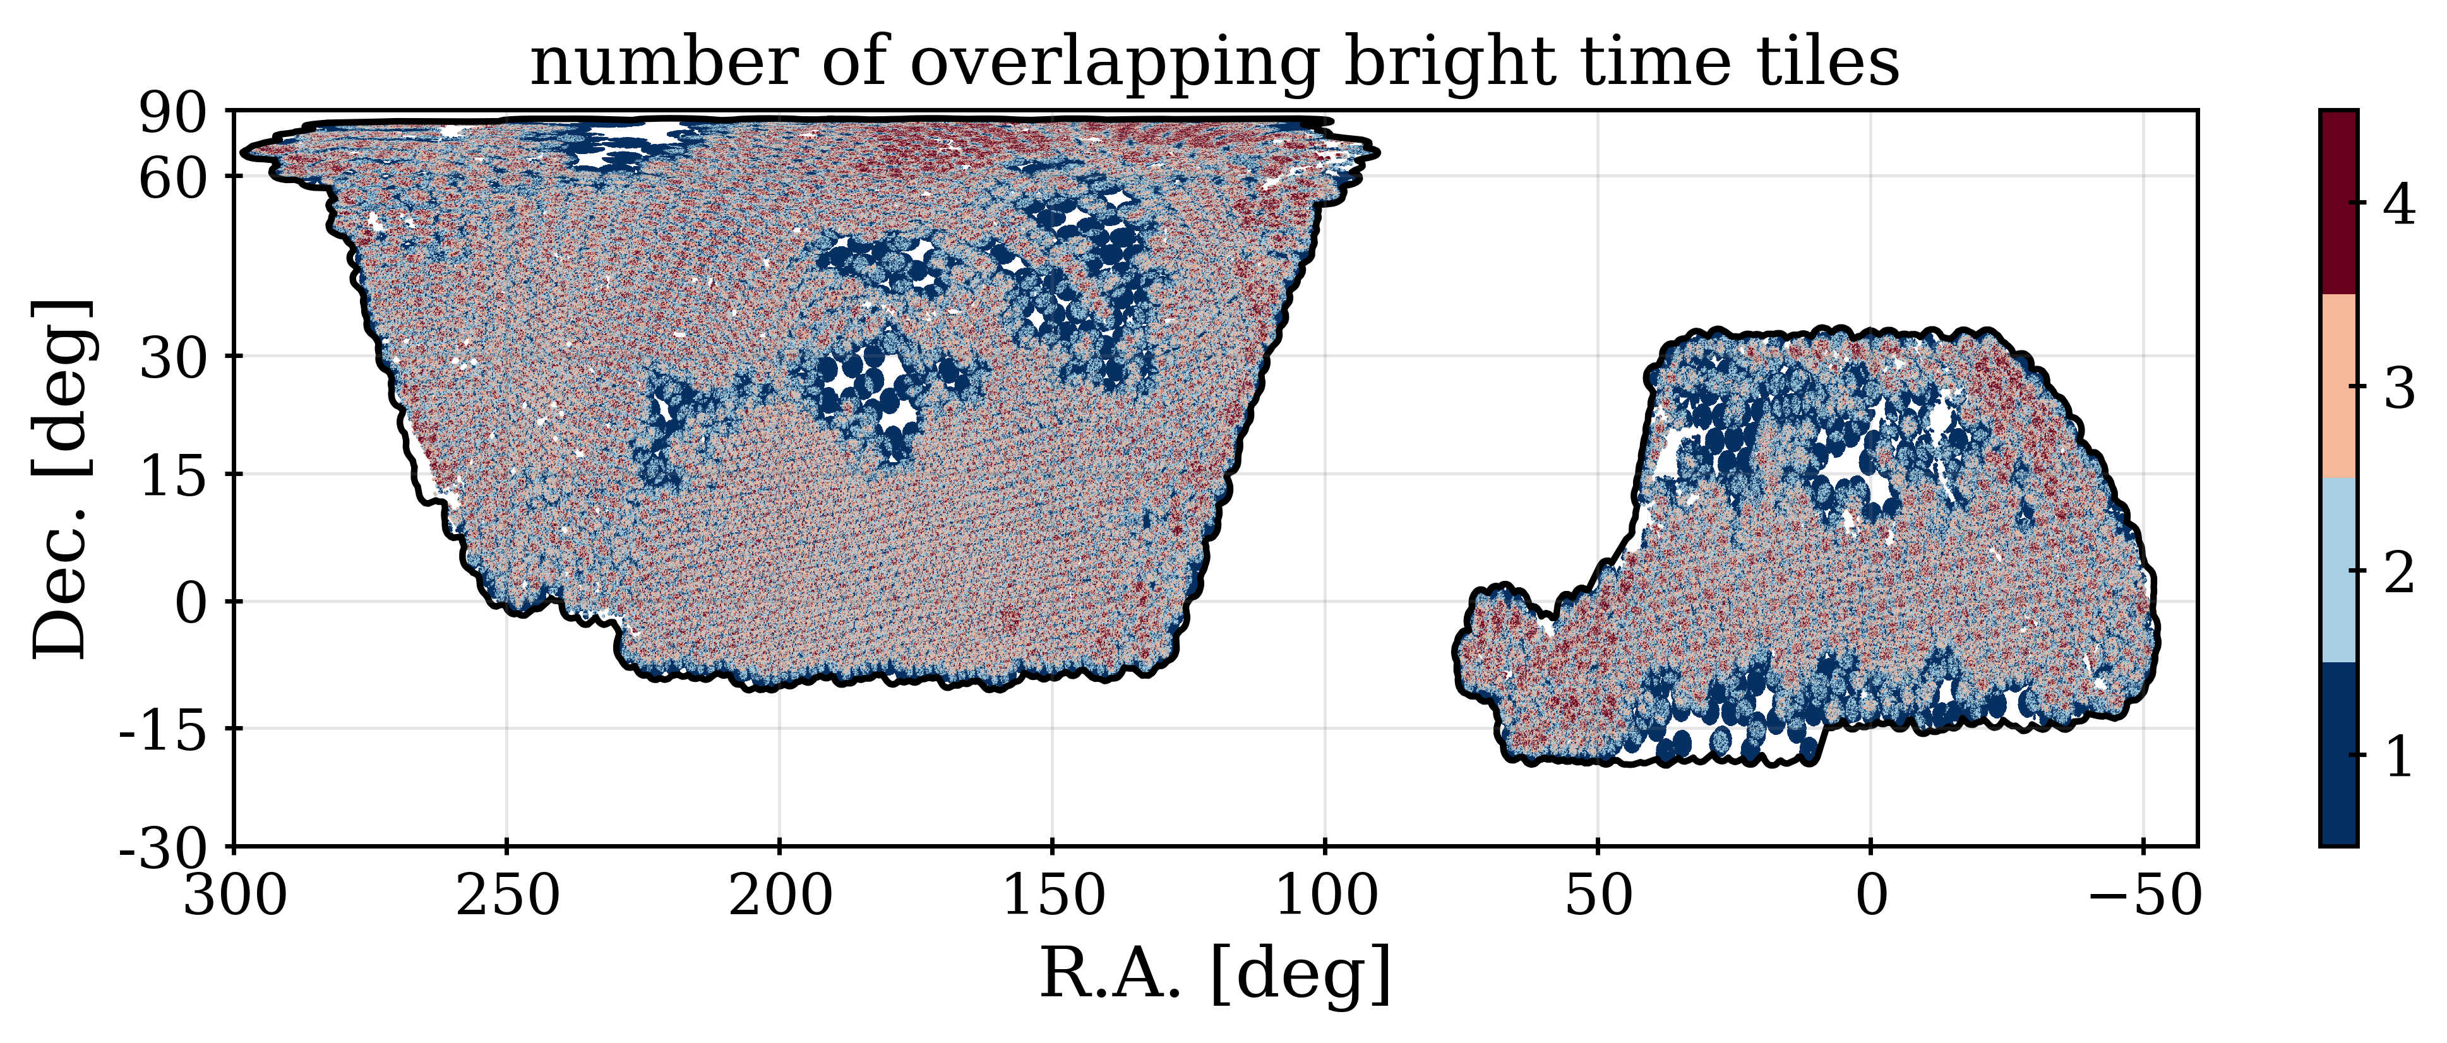
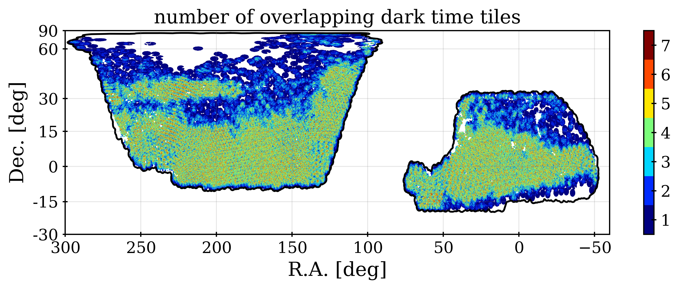

DESI survey coverage
DESI has already observed $≈10,000 \deg^{2}$ above $Dec=−30°$
DESI Data Release 1 is publicly available, containing $≈20$ million redshifts up to and including Year 1 of the survey
Today I’m going to show you results from the latest DESI samples up to and including
Year 3 of the survey

Slide 10
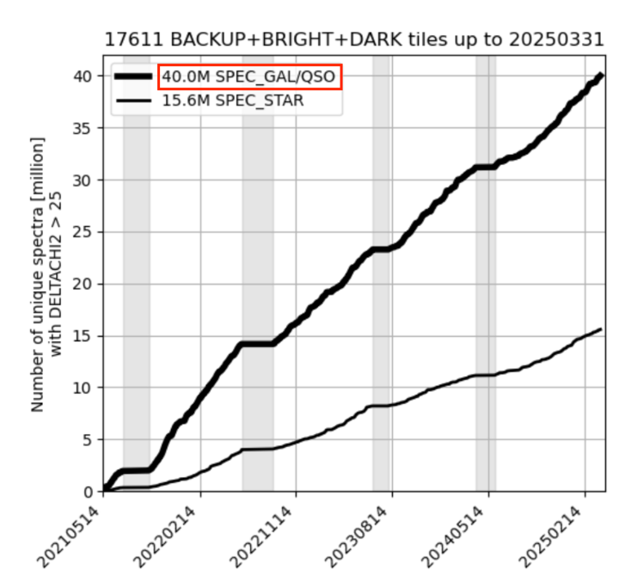
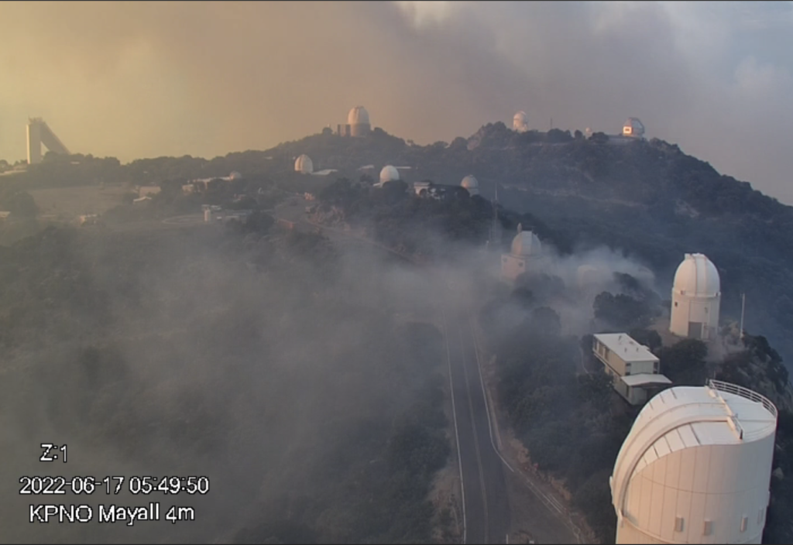


Progress has been amazing,
all things considered!

Slide 11
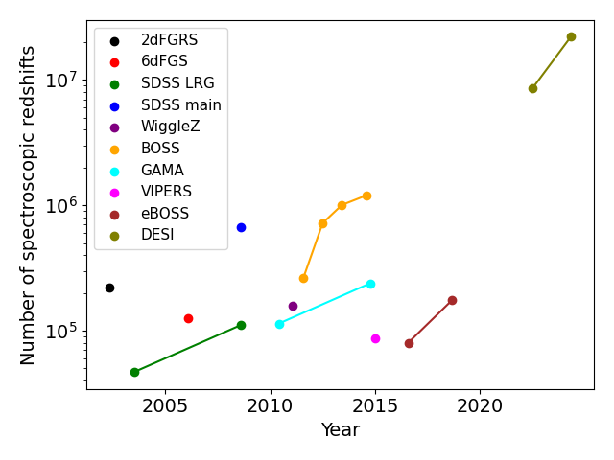
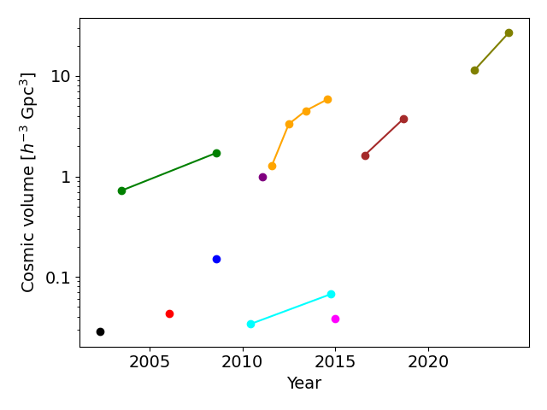


Brief history of spec-$z$ surveys
DESI has assembled the largest sample of extragalactic redshifts, exceeding previous surveys by an order of magnitude in number and cosmic volume
DESI !

Slide 12
Why do we think
dark energy exists?

Slide 13
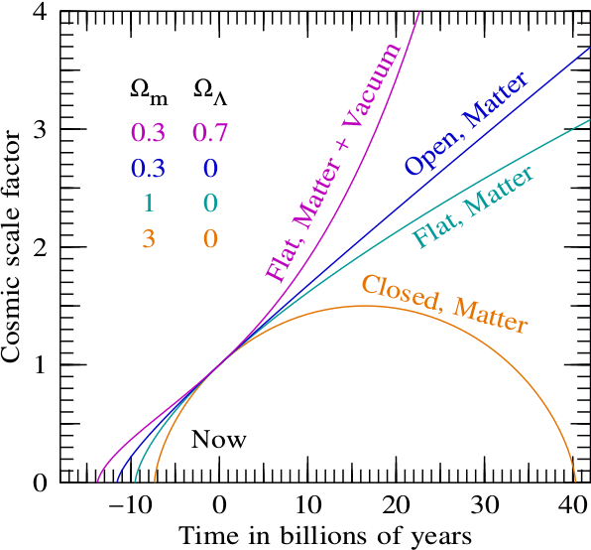
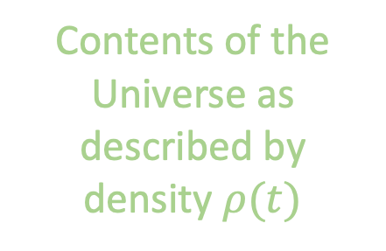

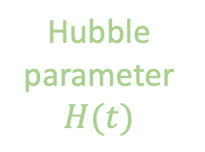
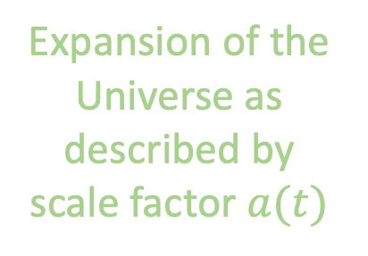
Why do we think dark energy exists?
Cosmology class 1: the contents of the Universe determine its expansion!
$${\left(\frac{\dot{a}}{a}\right)}^{2}=H^{2}=\frac{8πGρ(t)}{3}$$
Hubble parameter $H(t)$
Expansion of the Universe as described by scale factor $a(t)$
Contents of the Universe as described by density $ρ(t)$

Slide 14
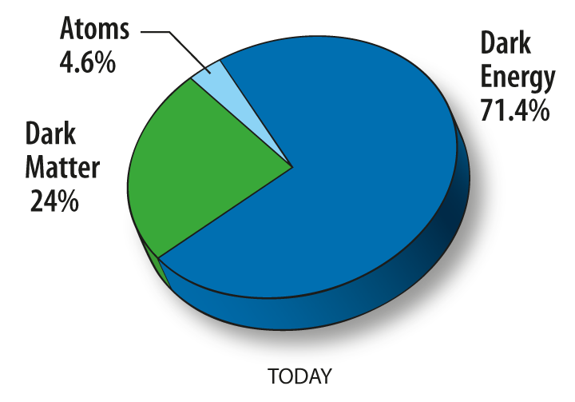
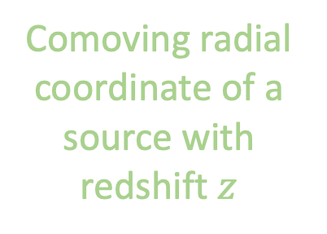

Why do we think dark energy exists?
Cosmology class 2: the expansion determines the distance-redshift relation!
$$r(z)=\int_{0}^{z}{\frac{c dz′}{H(z′)}}$$
Comoving radial coordinate of a source with redshift $z$
Integral of the Hubble parameter over the light path
Cosmological observations cannot be described by applying General Relativity to a homogeneous and isotropic Universe containing only matter
Mapping the distance-redshift relation measures the contents!

Slide 15
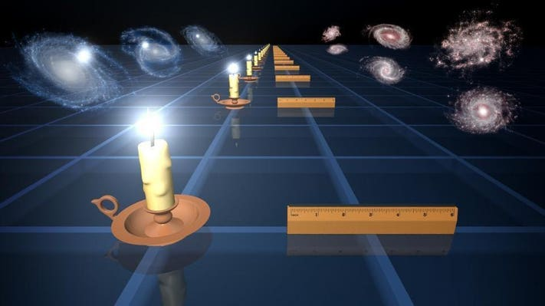
Why do we think dark energy exists?
We map the distance-redshift relation using standard candles and rulers!

Slide 16
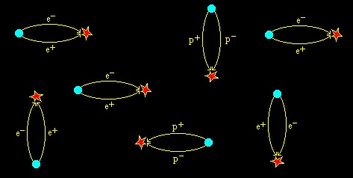

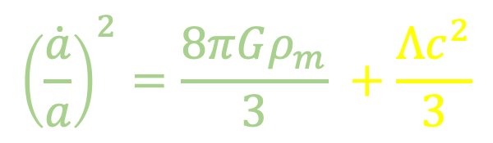
So, what could dark energy be?
Our leading model for dark energy is the cosmological constant $Λ$ (constant density)
$${\left(\frac{\dot{a}}{a}\right)}^{2}=\frac{8πGρ_{m}}{3} +\frac{Λc^{2}}{3}$$
Astronomer view: Empirical evidence
It has kind-of worked so far
Physicist view: Theoretical inevitability
The Heisenberg uncertainty principle allows particle-antiparticle pairs to appear and disappear. The vacuum is not “empty space” but contains a constant energy associated with these “virtual particles”.

Slide 17

The problem with $Λ$
Quantum theory allows us to estimate $ρ_{vacuum}$. Unfortunately, these estimates disagree with observations by many tens of orders of magnitude!
Quintessence
Chaplygin gas
Phantom models
Dark energy - dark matter interaction
Extra-dimensional models
Modified gravity
Holographic models
Oscillating models
Scalar-tensor models
We want to distinguish between these models!

Slide 18
How does DESI
measure dark energy?

Slide 19

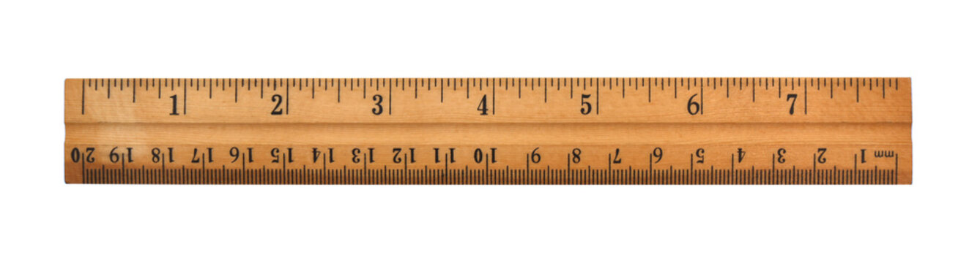
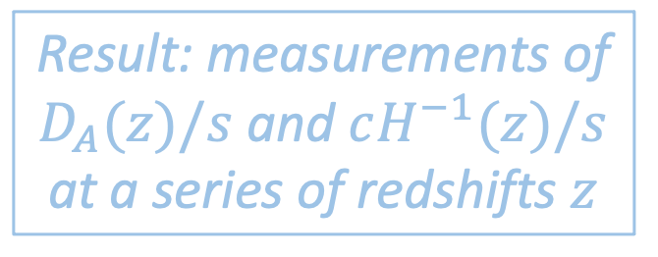
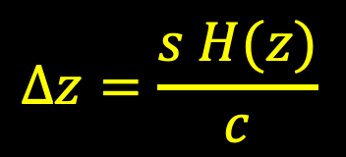


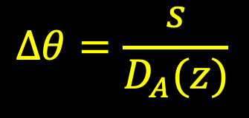
What are baryon acoustic oscillations?
Baryon acoustic oscillations (BAOs) are a cosmological standard ruler that can be used to measure cosmic distances and expansion across a range of redshifts
Measure angular extent
Object at redshift $z$ with known comoving size $s$
$$∆θ=\frac{s}{D_{A}(z)}$$
Observer
Result: measurements of $D_{A}(z)/s$ and $cH^{−1}(z)/s$ at a series of redshifts $z$
Measure redshift extent
$$∆z=\frac{s H(z)}{c}$$
$$∆z$$

Slide 20
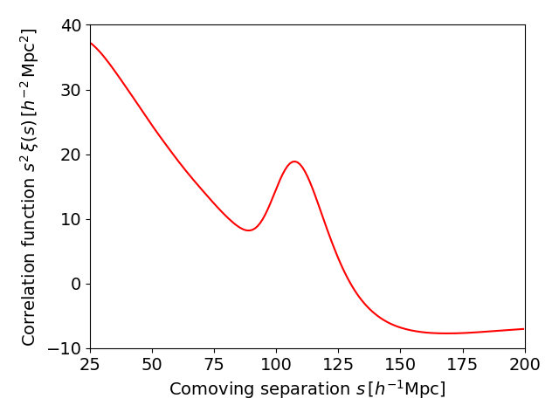
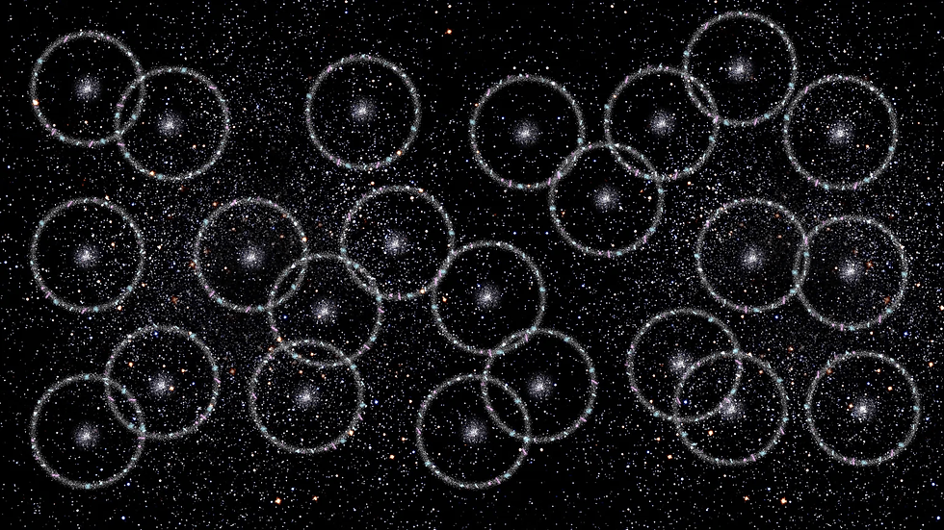

What are baryon acoustic oscillations?
Baryon acoustic oscillations are not a physical object but a statistical feature in the pattern with which galaxies cluster together
The pattern is quantified using the galaxy correlation function …
Galaxies prefer to form in both the densest regions of the Universe, and in spherical shells of radius $≈100 h^{−1}Mpc$ around those dense regions
Excess of galaxy pairs

Slide 21
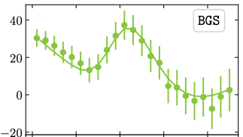
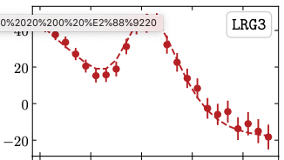
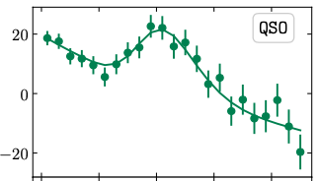
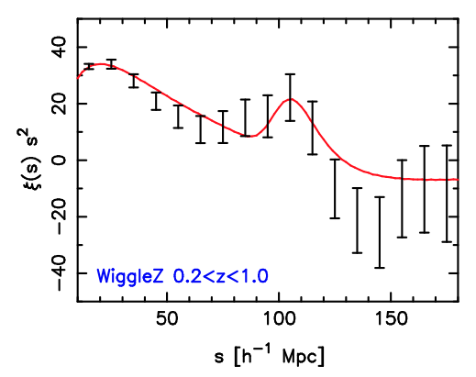
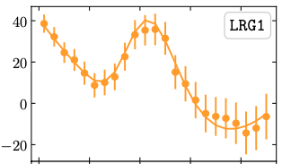
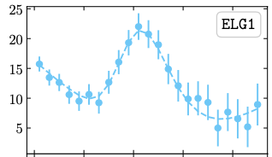
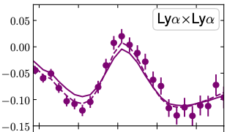
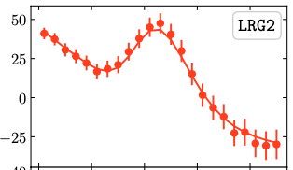
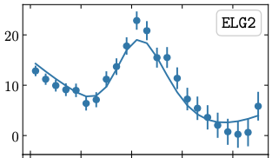

These measurements from DESI look amazing!
DESI has provided the most accurate correlation measurements from which the peak can be determined
Our work at the AAT 15 years ago!
It’s annoying when 4 years of work can be repeated in 1 week ☺

Slide 22

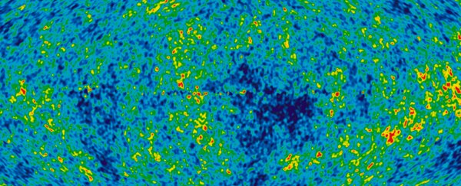
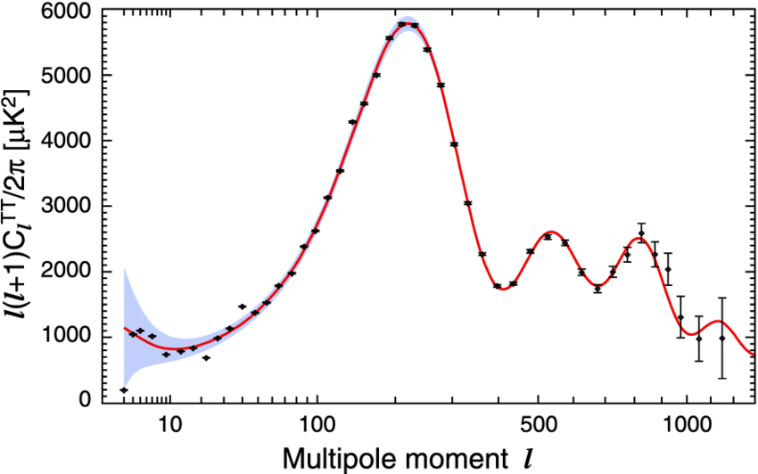


Why?? Why is this acoustic peak appearing?
Baryon acoustic oscillations are the sound waves from the early Universe imprinted in the distribution of baryons in the late Universe
Dark matter clump in the early Universe attracts the photon-baryon gas
Gas is compressed, launching outward sound waves
Sound waves travel a distance $s$ until recombination, which breaks photon-baryon coupling
Baryon overdensity frozen-in at radius $s$
We see these same sound waves imprinted in the CMB photons!
$$s$$
The preferred scale $s$ is known from CMB physics

Slide 23

The physics of
dark energy

Slide 24

How should we think about dark energy?
Let’s consider some common phrases associated with dark energy:
Accelerating expansion
Negative pressure
??????????
Why does dark energy have such weird properties? And what’s the best analogy for it?
“Repulsive gravity”
$$w=−1$$

Slide 25
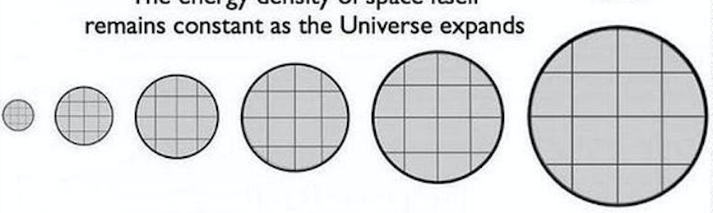
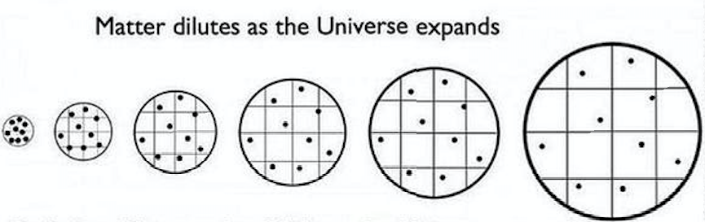
How should we think about dark energy?
Dark energy is a substance smoothly filling the Universe, that doesn’t dilute as the Universe expands
As a volume of space expands, the amount of dark energy within it increases …
Dark energy is hence something associated with “space” rather than with “particles”
Dark energy comes to dominate the Universe as the other components dilute
… unlike ordinary particles, which dilute!
Fun fact: a sphere of 100 parsec radius would contain dark energy equal to the rest mass of the Sun!

Slide 26


How should we think about dark energy?
The fact that dark energy doesn’t dilute as space expands leads to some weird properties when we apply the laws of physics!
Energy added within the expanding sphere??
We understand stuff like this using the 1st law of thermodynamics!
A volume of gas loses energy (cools) as it expands, by doing work on the surroundings through the positive pressure it exerts
A volume of dark energy gains energy as it expands, hence is receiving work from the surroundings, such that the pressure it exerts is negative !! Aaargh!

Slide 27


What is “$w=−1$”?
Substances can be characterized by their equation of state,
the ratio of the pressure they exert to their energy density, $w=P/ρc^{2}$
The 1st law of thermodynamics provides a direct relation between the pressure of a substance in the expanding Universe, and how its energy dilutes away:
If $ρ∝a^{n}$ , then $w=−1−\frac{n}{3}$
For normal matter, $n=−3$ and hence $w=0$ (pressureless)
For cosmological constant, if $n=0$ then $w=−1$

Slide 28


How should we think about dark energy?
Let’s meet some more weird properties which come from the fact that dark energy doesn’t dilute as space expands!
“Accelerating expansion??”
Gravitational effect?
$${\left(\frac{\dot{a}}{a}\right)}^{2}=\frac{8πGρ(t)}{3}$$
A constant $ρ(t)$means a constant value of $\dot{a}/a$, so as $a$ increases, so does $\dot{a}$ ! Hence, the expansion is accelerating ($\ddot{a}>0$)
As the mass inside increases, the particle becomes more tightly bound !

Slide 29
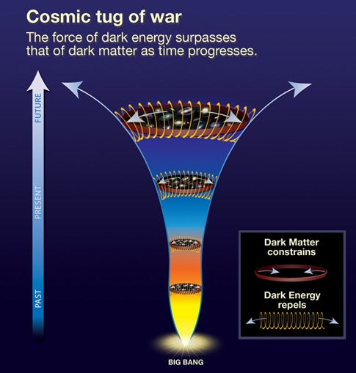
So, how should we think about dark energy?
Dark energy is a “repulsive force”? –
No, the force is gravity. Dark energy is a substance!
Dark energy is an “anti-gravity”? –
No, normal gravity.
Dark energy is a “negative pressure”? – Technically yes, but that’s a hard phrase to understand. Doesn’t pressure push outwards? Wouldn’t negative pressure pull inwards? Aargh!
Dark energy is like “coiled springs”? –
I like this analogy, because it conveys that as space expands, the energy within this volume increases

Slide 30
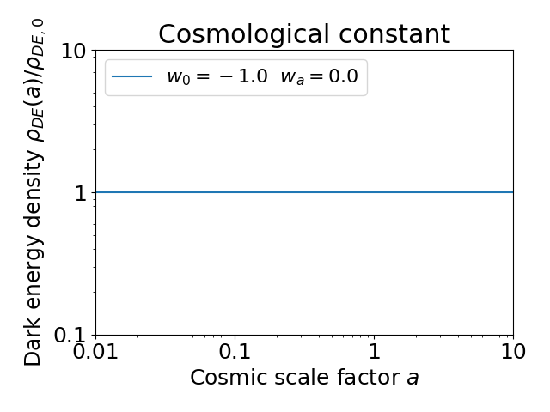
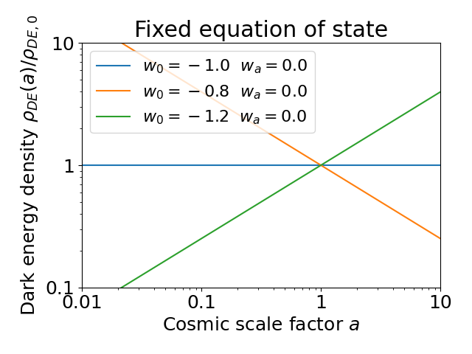
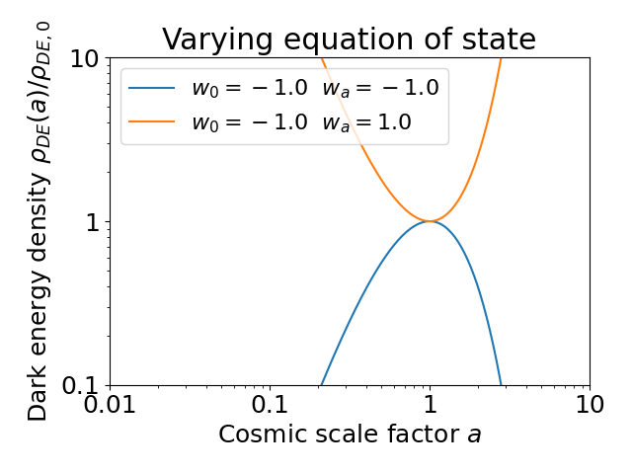
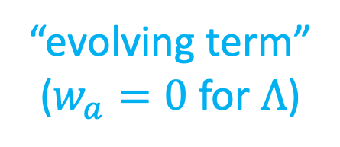
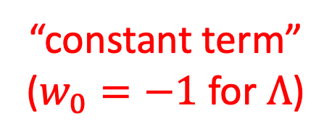

How to make progress?
Let’s try fitting a general model as a function of scale factor (time) $a(t)$:
“constant term”
($w_{0}=−1$ for $Λ$)
$$w\left(a\right)=w_{0}+w_{a}\left(1−a\right)$$
“evolving term”
($w_{a}=0$ for $Λ$)
Although this equation doesn’t itself come from a physical model, it’s a flexible parametrization matching a range of models that are physically motivated

Slide 31


“Phantom” dark energy
Dark energy with the property $w<−1$ at some time is called a phantom. Theorists have particular difficulties modelling phantoms!
Since $ρ∝a^{−3(1+w)}$ , then if $w<−1$ the density is increasing with time as space expands
Acceleration exponentially increasing, heading for “Big Rip” scenario if sustained!
Violates the “Null Energy Condition” satisfied by any conventional physics description

Slide 32
Now I am finally getting to the …
DESI results!

Slide 33
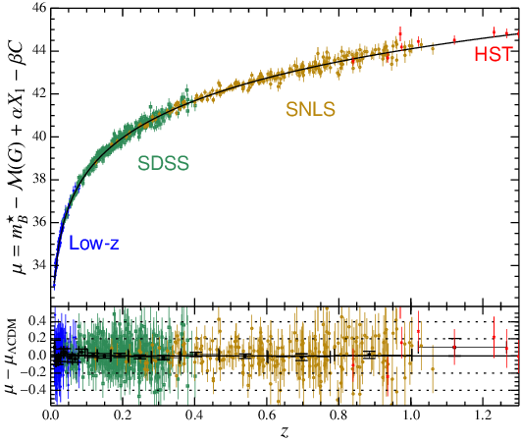
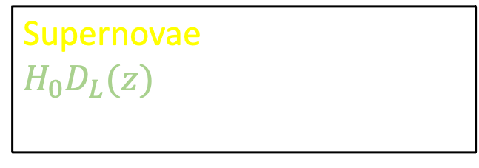



Recapping on the data …
Baryon acoustic oscillations: measure $D_{A}(z)/s$ and $H^{−1}(z)/s$ by standard ruler technique for $z<3$
Supernovae: measure $H_{0}D_{L}(z)$ by standard candle technique for $z<1$
CMB: calibrate $s$ and measure $D_{A}(z=1100)$ through angular position of 1st acoustic peak
These quantities all have different dependences on $w_{0}$ and $w_{a}$ which help break degeneracies and improve the measurements

Slide 34




Measurements from DESI
Here are the DESI distance and expansion rate measurements from the galaxy types across redshift, compared to the $Λ$CDM prediction
We can determine the scale of the Universe to $<1\%$ !!
Hmmm, do some of these data points disagree??

Slide 35

Statistics to the rescue!
What are the dark energy parameters $w\left(a\right)=w_{0}+w_{a}\left(1−a\right)$?
The standard model of dark energy (constant energy density)

Slide 36

Dark energy results
What are the dark energy parameters $w\left(a\right)=w_{0}+w_{a}\left(1−a\right)$?
The standard model of dark energy (constant energy density)
Data favour evolving equation of state of dark energy
The significance of rejection of $Λ$CDM is $4.2σ$ in this case
(< 1 in 10,000 by chance)

Slide 37
Dark energy results
Converting to other quantities …
Phantom crossing!
Dark energy behaves as phantom??
$$\frac{ρ_{DE}(z)}{ρ_{DE,0}}$$
Dark energy density peaks in the past and is now “weakening”
time

Slide 38



DESI results
Deceleration parameter
Dashed line is $Λ$CDM model
$$q\left(z\right)=−\frac{\ddot{a}a}{{\dot{a}}^{2}}$$
Onset of cosmic acceleration
Acceleration appears smaller than expected in today’s Universe
Acceleration appears larger than expected in the past

Slide 39
What does it all mean?

Slide 40


Have we disproven the $Λ$CDM model??
Not yet!
We have a suggestive result, but the statistical significance is still $<5σ$
The result relies on DESI, SNe and CMB data, all of which will continue to be analysed

Slide 41

Does evolving dark energy affect the Hubble tension?
Unfortunately, no!
The Hubble tension remains, even after fitting evolving dark energy models
$$H_{0}=66.7±0.6 km s^{−1} {Mpc}^{−1}$$
Now we have another cosmological tension !?!

Slide 42
What’s next … more DESI!
DESI has at least two more years of data to analyse … will they reinforce these hints of dark energy behaviour?
We are using DESI for many other cosmological analyses including weak gravitational lensing and galaxy peculiar velocities
Whatever emerges, DESI is providing one of the key cosmological datasets of this decade!

Slide 43
What’s the deal with dark energy?
New results from the Dark Energy Spectroscopic Instrument
Chris Blake (Swinburne)

Slide 44
Bonus slides

Slide 45


Why “repulsive gravity”?
Normal matter slows expansion due to attractive gravity. Does accelerating expansion mean repulsive gravity? Let’s try a Newtonian analogy!!
Consider a particle of mass $m$ on the edge of an expanding sphere, that feels a gravitational force $F_{G}$
The particle feels a gravitational force from the mass enclosed by the sphere, $F_{G}=\frac{GMm}{r^{2}}$
For normal matter, $M$ stays constant as the sphere expands, so $F_{G}∝\frac{1}{r^{2}}$, and the particle becomes less tightly bound (inward force)
For dark energy, $M∝r^{3}$ as the sphere expands, so $F_{G}∝r$, and the particle becomes more tightly bound (outward force)
$$F_{G}$$
$$r$$
Expanding sphere of total mass $M$

Slide 46













Evolving dark energy
$$w_{a}$$
$ρ_{DE}$ drops to minimum then climbs again
Special place where $ρ_{DE}$ is a constant
$$+1$$
$$0$$
$ρ_{DE}$ steadily rising
$ρ_{DE}$ steadily dropping
$$−1$$
$ρ_{DE}$ climbs to maximum then drops again
$$−1.5$$
$$−1$$
$$−0.5$$
$$w_{0}$$

Slide 47
Results are similar for different SNe surveys

Slide 48
Does evolving dark energy improve the distance fit?

Slide 49

Stepwise fit for $w(z)$

Slide 50

Weird $Ω_{m}$ tension under $Λ$CDM

