Slide 1
Revision :
Thermodynamics

Slide 2
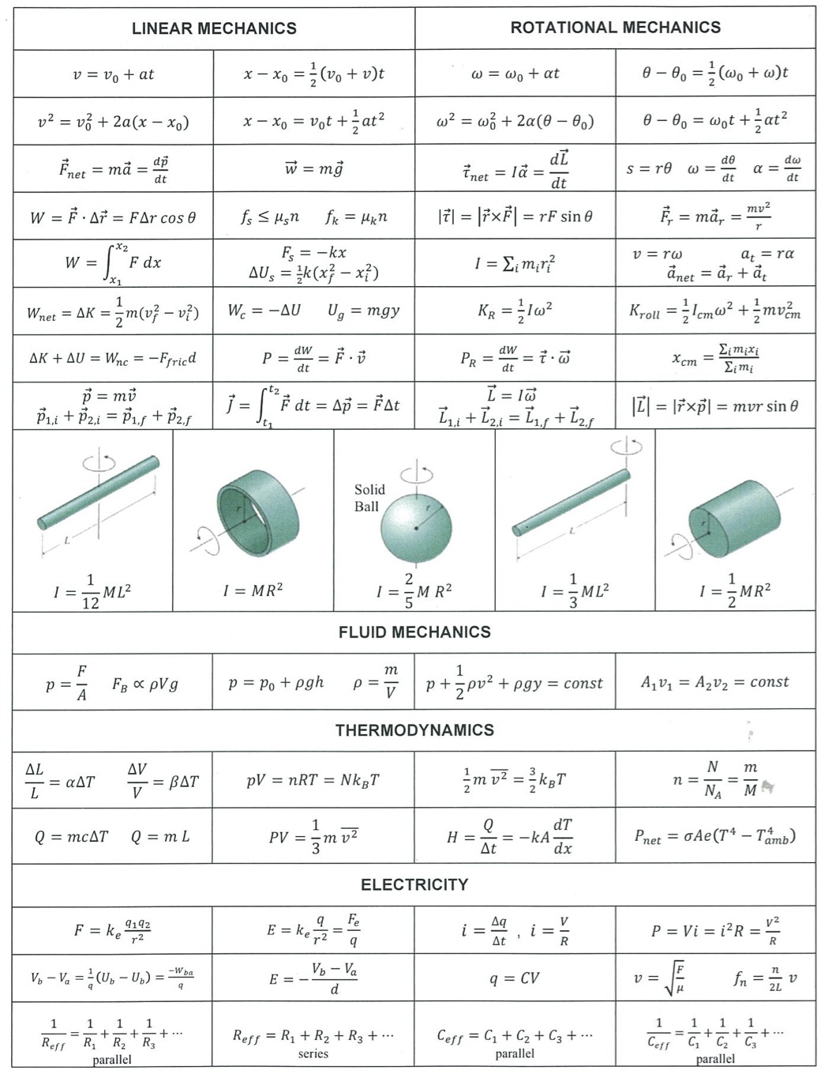
Formula sheet

Slide 3
Formula sheet

Slide 4
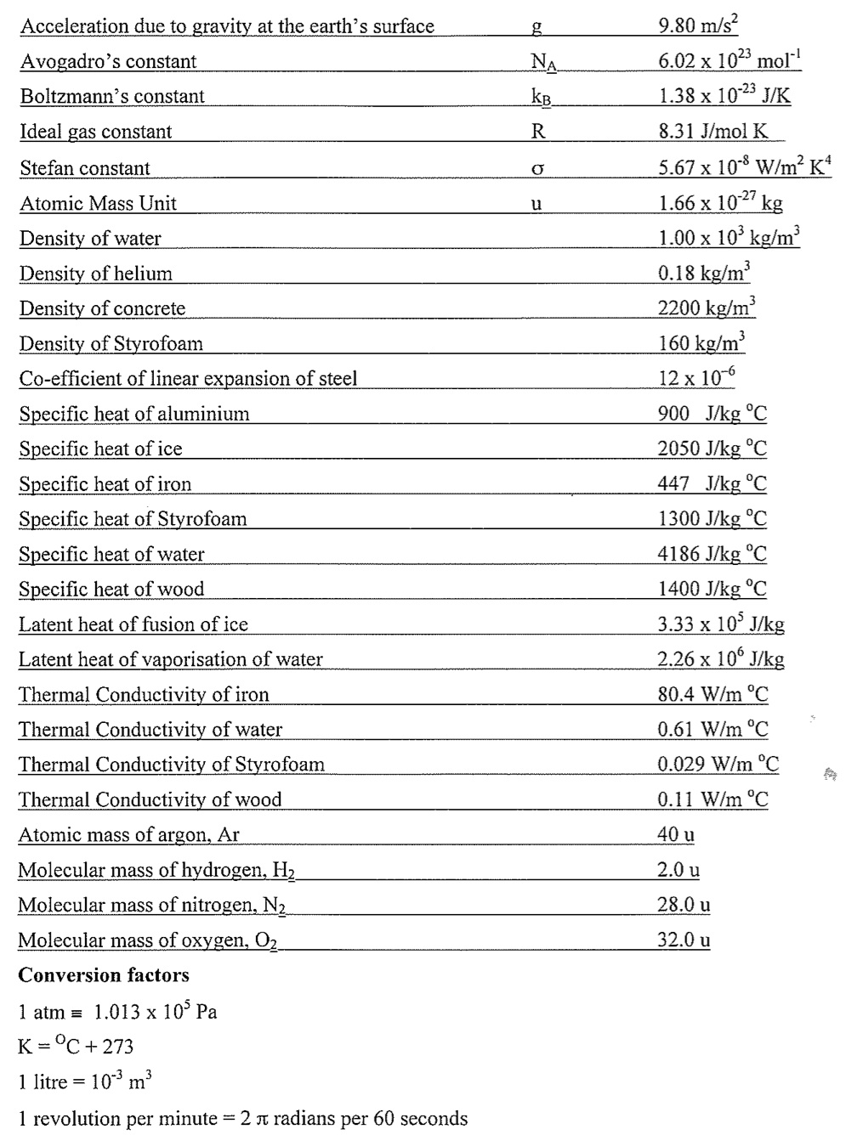
Formula sheet

Slide 5
Thermodynamics key facts (1/9)
Heat is an energy [measured in $J$] which flows from high to low temperature
When two bodies are in thermal equilibrium they have the same temperature
The S.I. unit of temperature is Kelvin $(K)$. This is related to degrees Celsius $\left(℃\right)$ by
Temperature difference $ΔT$ is the same in both units
$$T\left(K\right)=T\left(℃\right)+273$$

Slide 6
Thermodynamics key facts (2/9)
Heat energy needed to raise a temperature
The specific heat capacity $c$ determines the energy $Q$ needed to raise the temperature of mass $m$ of a substance by $∆T$
Units of $c$ will be $J {kg}^{−1} K^{−1}$
$$Q=m c ∆T$$

Slide 7
Thermodynamics key facts (3/9)
Heat energy needed to change phase
The latent heat $L$ determines the energy $Q$ needed to change the phase of a mass $m$
Units of $L$ will be $J {kg}^{−1}$ - can be fusion or vaporization
This energy is either absorbed (solid $→$ liquid $→$ gas) or released (gas $→$ liquid $→$ solid)
A phase change takes place at constant temperature
$$Q=m L$$

Slide 8
Thermodynamics key facts (4/9)
Conduction is heat energy transfer by direct molecular contact
Heat transfer
Power $=\frac{∆Q}{∆t}=κ A \frac{ΔT}{Δx}$
$$T+∆T$$
$$T$$
Area $A$
$κ=$ thermal conductivity
Thickness $∆x$

Slide 9
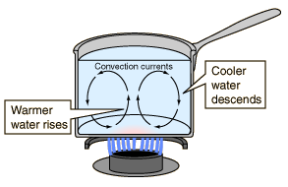
Thermodynamics key facts (5/9)
Convection is heat energy transfer by the bulk flow of material

Slide 10
Thermodynamics key facts (6/9)
Radiation is heat energy transfer by emission of electromagnetic radiation
Power $=\frac{∆Q}{∆t}=σ A T^{4}$
$σ=$ Stefan-Boltzmann constant, $A=$ surface area of emitter, $T=$ temperature of emitter (assumes emissivity=1)

Slide 11
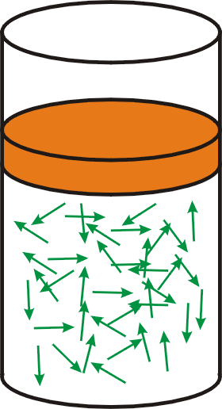
Thermodynamics key facts (7/9)
Ideal gas law
1st form : $P V=N k_{B} T$
$P=$ Pressure, $V=$ Volume, $N=$ number of molecules, $k_{B}=$ Boltzmann’s constant, $T=$ temperature [in K]
2nd form : $P V=n R T$
$n=$ number of moles, $R=$ gas constant

Slide 12
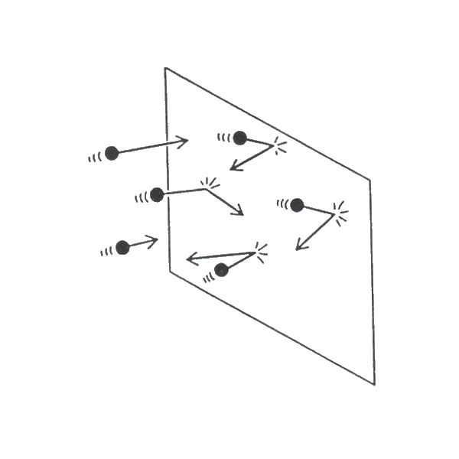
Thermodynamics key facts (8/9)
Kinetic theory of ideal gas
Pressure is due to molecular collisions
Average kinetic energy of molecules depends on temperature
$m=$ mass of molecule, $\overline{v^{2}}=$ average square speed, $T=$ temperature
$$\overline{\frac{1}{2}mv^{2}}= \frac{3}{2}k_{B}T$$

Slide 13
Thermodynamics key facts (9/9)
Thermal expansion
Materials expand due to temperature rise $∆T$
Length $L$ increases by $∆L=α L ∆T$ where $α=$ coefficient of linear expansion
Volume V increases by $∆V=β V ∆T$ where $β=$ coefficient of volume expansion

Slide 14
Practice exam questions: Section A
$$\overline{KE}=\overline{\frac{1}{2}mv^{2}}=\frac{3}{2}k_{B}T$$
Option C
$$Q=m c ∆T$$
$$Q=m_{water}c_{water}{∆T}_{water}=1×4186×5=20930 J$$
$${∆T}_{Al}=\frac{Q}{m_{Al}c_{Al}}=\frac{20930}{2×900}=12 K$$
Option B

Slide 15
Practice exam questions: Section A
Heat energy loss is by conduction – option B

Slide 16
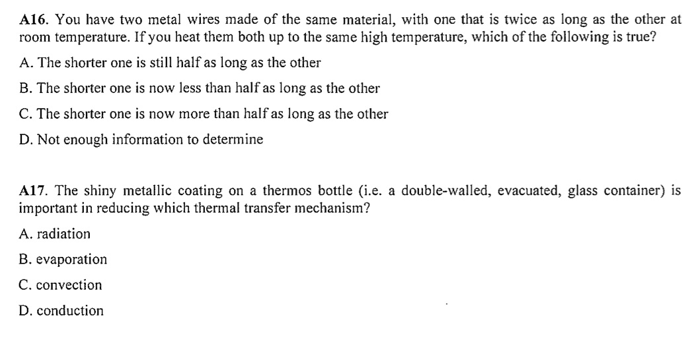
Practice exam questions: Section A
$$\frac{ΔL}{L}=α ΔT$$
Fractional expansion is the same – option A
Reflects radiation – option A

Slide 17
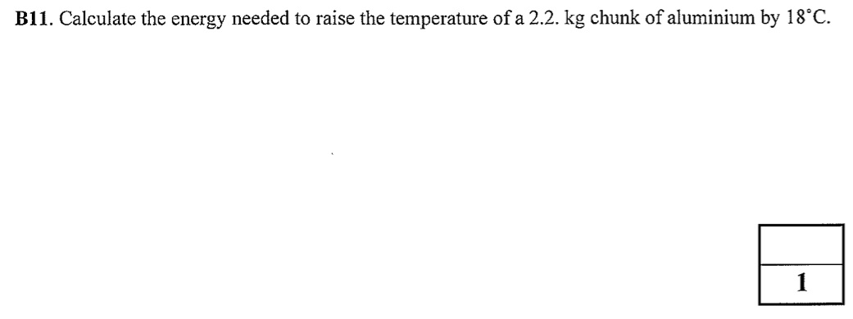
Practice exam questions: Section B
$$Q=m c ∆T=2.2×900×18=3.6×{10}^{4} J$$

Slide 18
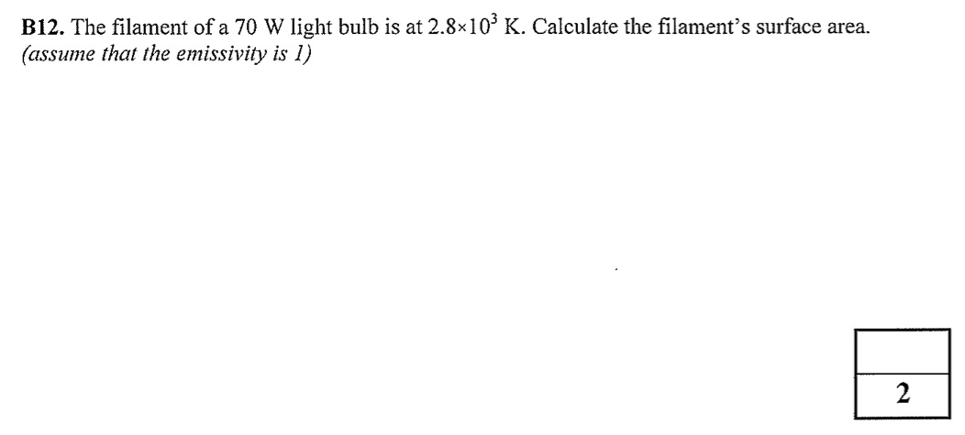
Practice exam questions: Section B
Stefan-Boltzmann law: $P=σ A T^{4}$
Re-arranging: $A=\frac{P}{σ T^{4}}=\frac{70}{5.67×{10}^{−8}×{\left(2800\right)}^{4}}=2.0×{10}^{−5} m^{2}$

Slide 19
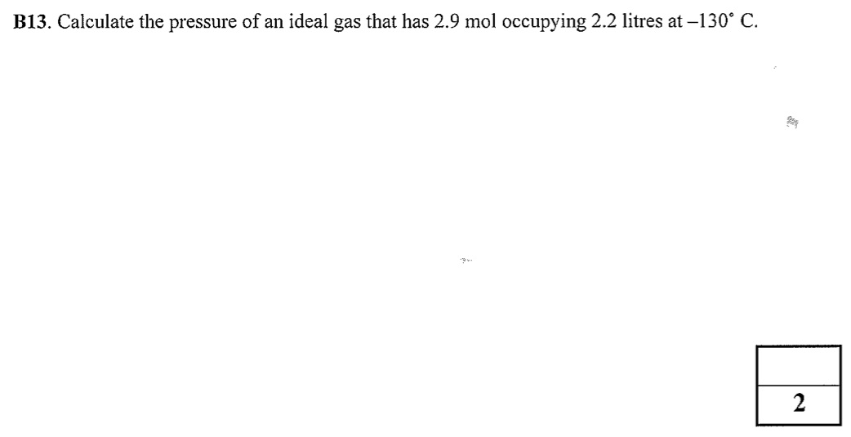
Practice exam questions: Section B
Ideal gas law (using moles): $PV=nRT$
$$V=2.2 litres=2.2×{10}^{−3} m^{3}$$
$$T=−130+273=143 K$$
$$P=\frac{nRT}{V}=\frac{2.9×8.31×143}{2.2×{10}^{−3}}=1.6×{10}^{6} Pa$$

Slide 20
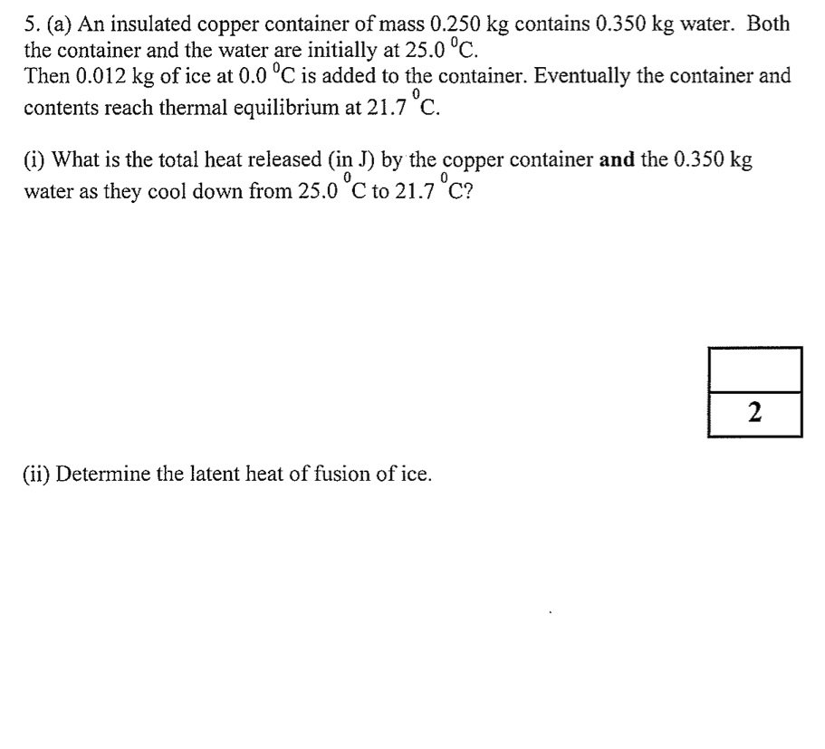
Practice exam questions: Section C
$$Q=m_{water}c_{water}∆T+m_{copper}c_{copper}∆T$$
$$Q=0.35×4186×3.3+0.25×387×3.3=5150 J$$
$$Q=m_{ice}L_{f}+m_{ice}c_{water}∆T=5150 J$$
$$L_{f}=\frac{5150−(0.012×4186×21.7)}{0.012}=3.39×{10}^{5} J/kg$$

Slide 21
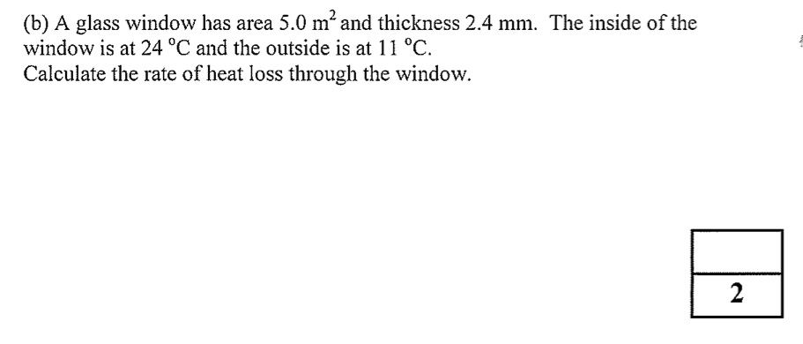
Practice exam questions: Section C
Heat loss rate $=κ A \frac{ΔT}{∆x}=0.80×5.0×\frac{13}{2.4×{10}^{−3}}=2.2×{10}^{4} W$

Slide 22
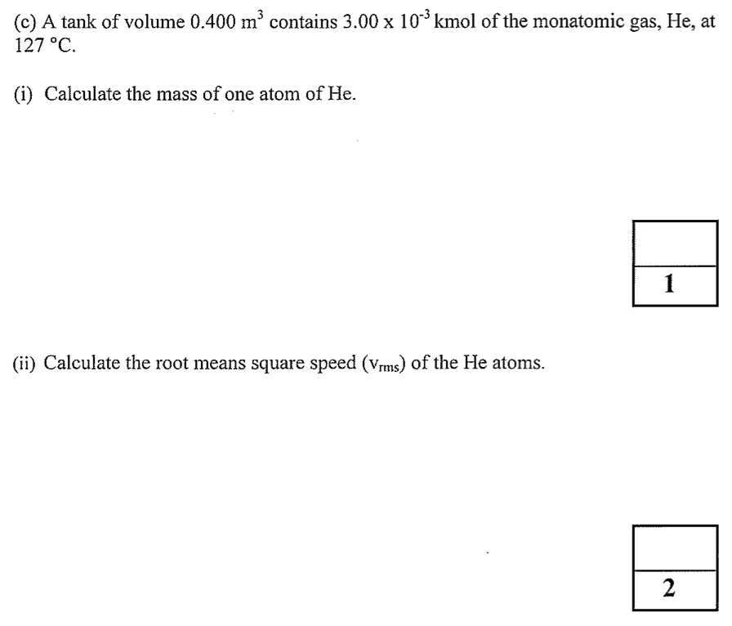
Practice exam questions: Section C
Atomic mass $=4.0×1.66×{10}^{−27}=6.64×{10}^{−27} kg$
$$\frac{1}{2}m{v_{rms}}^{2}=\frac{3}{2}k_{B}T$$
$$T=127+273=400 K$$
$$v_{rms}=\sqrt{\frac{3k_{B}T}{m}}=\sqrt{\frac{3×1.38×{10}^{−23}×400}{6.64×{10}^{−27}}}=1.58×{10}^{3} m s^{−1}$$

Slide 23
Practice exam questions: Section C
$$Q=Power×Time=2.2×{10}^{3}×5.9×60=7.8×{10}^{5} J$$
$$Q=m c ∆T$$
$$m=\frac{Q}{c ∆T}=\frac{7.8×{10}^{5}}{4186×79}=2.4 kg$$

Slide 24
Next steps
Make sure you are comfortable with unit conversions
Review the thermodynamics key facts
Familiarize yourself with the thermodynamics section of the formula sheet
Try questions from the sample exam papers on Blackboard and/or the textbook

Slide 25
Revision :
Electricity

Slide 26
Formula sheet

Slide 27
Formula sheet

Slide 28
Electricity key facts (1/9)
Electric charge $Q$ is an intrinsic property of the particles that make up matter, and can be positive (e.g. proton) or negative (e.g. electron)
The S.I. unit of charge is Coulombs ($C$)
The elementary charge (on a proton or electron) is $± 1.6×{10}^{−19} C$
Electric current $I$ is the rate of flow of charge
$$I=\frac{∆Q}{∆t}$$
$I$ is measured in Amperes ($A$)

Slide 29
Electricity key facts (2/9)
Coulomb’s Law gives the force felt by two charges $Q_{1}$ and $Q_{2}$ separated by distance $r$
Like charges repel, opposite charges attract
$$F$$
$$F$$
$$r$$
$$Q_{1}$$
$$Q_{2}$$
$$F=\frac{k Q_{1} Q_{2}}{r^{2}}$$
$$k=9×{10}^{9} N m^{2} C^{−2}$$

Slide 30
Electricity key facts (2/9)
Superposition principle for Coulomb’s Law : if there are multiple charges, the forces from individual charges sum like vectors
+ve
$$\vec{F_{1}}$$
$$\vec{F_{total}}=\vec{F_{1}}+\vec{F_{2}}$$
+ve
$$\vec{F_{2}}$$
+ve

Slide 31
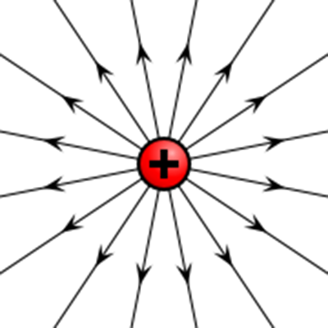
Electricity key facts (3/9)
The electric field at a point is the force a unit charge ($q=1 C$) would experience there
Can be represented by electric field lines
$$\vec{E}=\frac{\vec{F}}{q}$$
$$\vec{F}=q \vec{E}$$
Positive charge feels force along electric field line
Negative charge feels force the other way

Slide 32
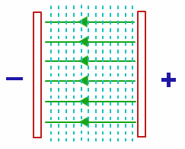
Electricity key facts (4/9)
The electric potential difference $ΔV$ [in volts] is the work needed to move unit charge ($q=1 C$) between 2 points
Electric field is the potential gradient :$E=−\frac{∆V}{∆x}$
Work done = Potential Energy difference $=q ΔV$
If capacitor with plate separation $D$ is connected to battery with potential $V$, then $E=V/D$

Slide 33
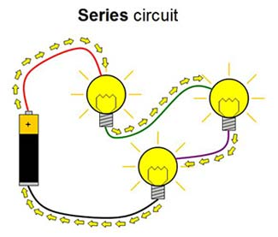
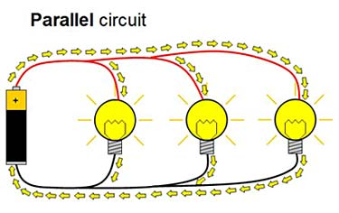
Electricity key facts (5/9)
Basic circuit principles : current $I$ is driven by a potential difference $V$
Same current flows through all components of a series circuit
Same voltage is dropped over all components of a parallel circuit

Slide 34
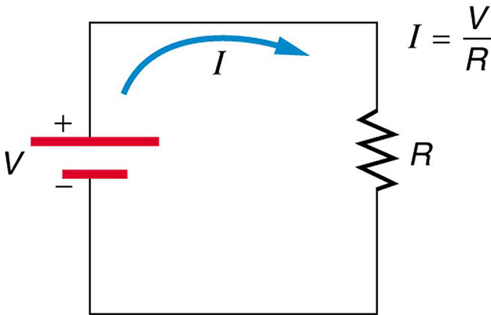
Electricity key facts (6/9)
Ohm’s Law determines the current flowing through a resistance $R$
Resistance is measured in Ohms ($Ω$)
$$I=\frac{V}{R}$$
$$V=I R$$

Slide 35
Electricity key facts (6/9)
Resistances may be combined in series or parallel
$$R_{1}$$
$$R_{2}$$
$$R_{total}=R_{1}+R_{2}$$
[R increases]
$$R_{1}$$
$$\frac{1}{R_{total}}=\frac{1}{R_{1}}+\frac{1}{R_{2}}$$
$$R_{2}$$
[R decreases]

Slide 36
Electricity key facts (7/9)
Electrical energy is dissipated as heat by a resistor
Electrical Power $P=I V=I^{2}R=\frac{V^{2}}{R}$ [unit is W]

Slide 37
Electricity key facts (8/9)
A capacitor is a device to store charge. Its capacitance $C$ measures the amount of charge $Q$ that can be stored for given potential difference $V$
$$+Q$$
$$−Q$$
$$C=\frac{Q}{V}$$
$$Q=C V$$
Capacitance is measured in Farads ($F$)
Capacitors may be combined in series or parallel [see lectures]
$$V$$

Slide 38
Electricity key facts (9/9)
General circuits may be analysed using Kirchoff’s rules
Signs are different for inward/outward current
This rule arises from conservation of charge
$$I_{1}$$
Kirchoff’s junction rule : the sum of currents at any junction is zero
$$I_{1}+I_{2}−I_{3}=0$$
$$I_{2}$$
$$I_{3}$$

Slide 39
Electricity key facts (9/9)
General circuits may be analysed using Kirchoff’s rules
Battery adds potential $V$, resistors subtract potential $IR$
This rule arises from conservation of energy
$$4 Ω$$
$$I_{1}$$
Kirchoff’s loop rule : the sum of voltage changes around a closed loop is zero
$$9 V$$
$$I_{2}$$
$$2 Ω$$
$$9−4 I_{1}−2 I_{2}=0$$

Slide 40
Practice exam questions: Section A
Coulomb’s Law: $F=\frac{k Q_{1} Q_{2}}{r^{2}}$
Double $r→F$ decreases by $\frac{1}{4}$ – option A
Current is the same $→V=I R→$ smaller voltage across smaller $R→$ option B

Slide 41
Practice exam questions: Section A
Decreases – option B

Slide 42
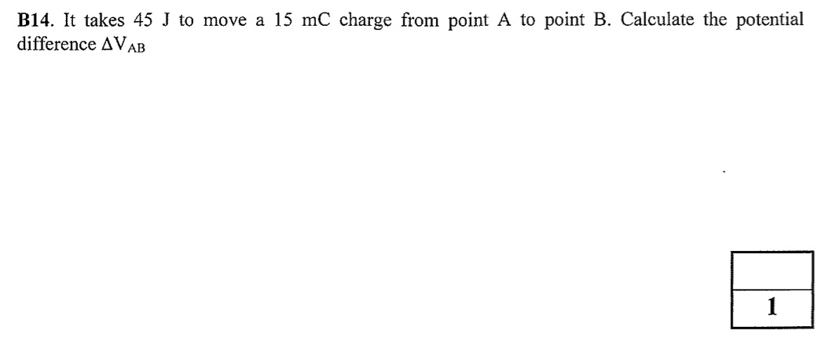
Practice exam questions: Section B
$$W=q {∆V}_{AB}$$
$${∆V}_{AB}=\frac{W}{q}=\frac{45}{15×{10}^{−3}}=3000 V$$

Slide 43
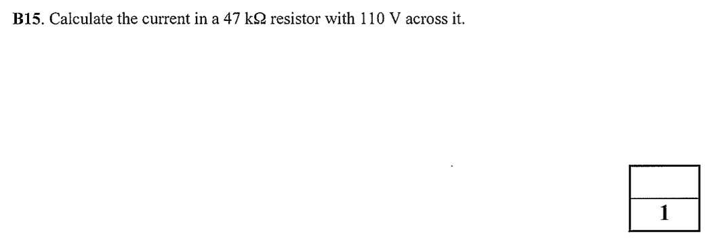
Practice exam questions: Section B
Ohm’s Law: $I=\frac{V}{R}=\frac{110}{47×{10}^{3}}=2.3×{10}^{−3} A$

Slide 44
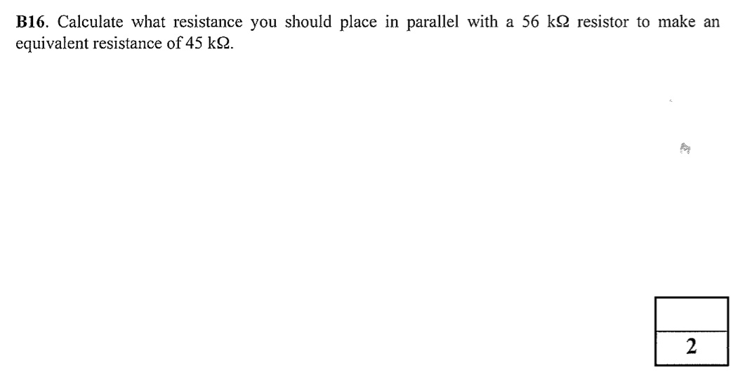
Practice exam questions: Section B
$$\frac{1}{R_{total}}=\frac{1}{R_{1}}+\frac{1}{R_{2}}$$
$$\frac{1}{45}=\frac{1}{56}+\frac{1}{R_{2}}$$
$$R_{2}=230 kΩ$$

Slide 45
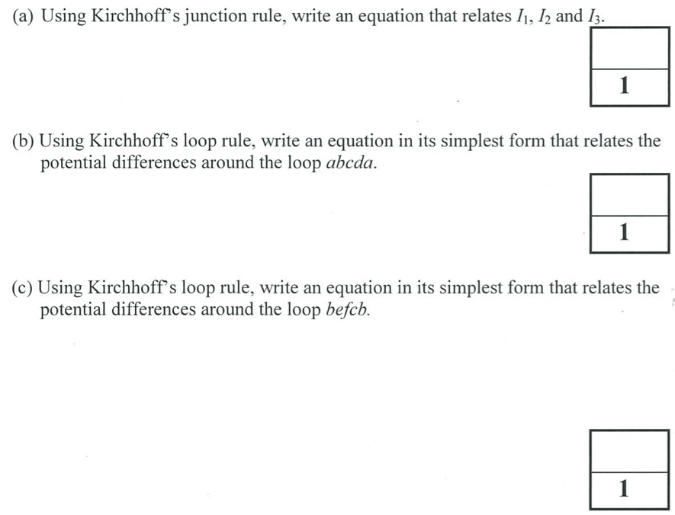
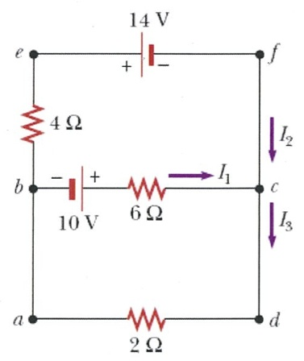
Practice exam questions: Section C
$$I_{1}+I_{2}−I_{3}=0$$
$$10−6I_{1}−2I_{3}=0$$
$$5−3I_{1}−I_{3}=0$$
$$−4I_{2}−14+6I_{1}−10=0$$
$$−2I_{2}−12+3I_{1}=0$$

Slide 46
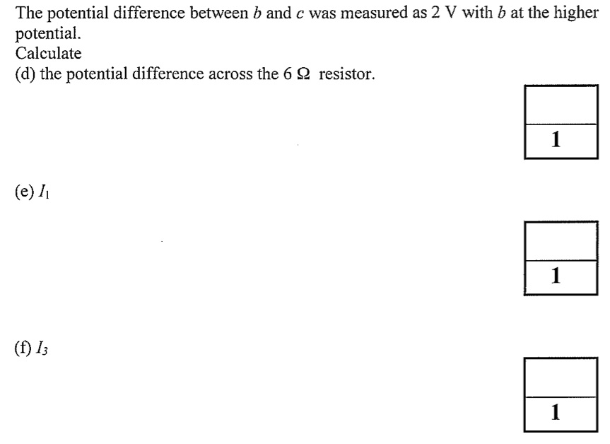
Practice exam questions: Section C
$$V_{bc}=−10+V_{6Ω}=2 V → V_{6Ω}=12 V$$
$$I_{1}=\frac{V}{R}=\frac{12}{6}=2 A$$
From before: $5−3I_{1}−I_{3}=0$
$$I_{3}=5−3I_{1}=5−\left(3×2\right)=−1 A$$

Slide 47
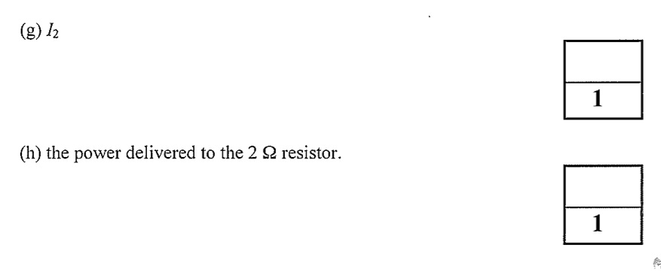
Practice exam questions: Section C
From before:$−2I_{2}−12+3I_{1}=0$
$$I_{2}=\frac{3I_{1}−12}{2}=\frac{−6}{2}=−3 A$$
$$P={I_{3}}^{2}R={\left(−1\right)}^{2}×2=2 W$$

Slide 48
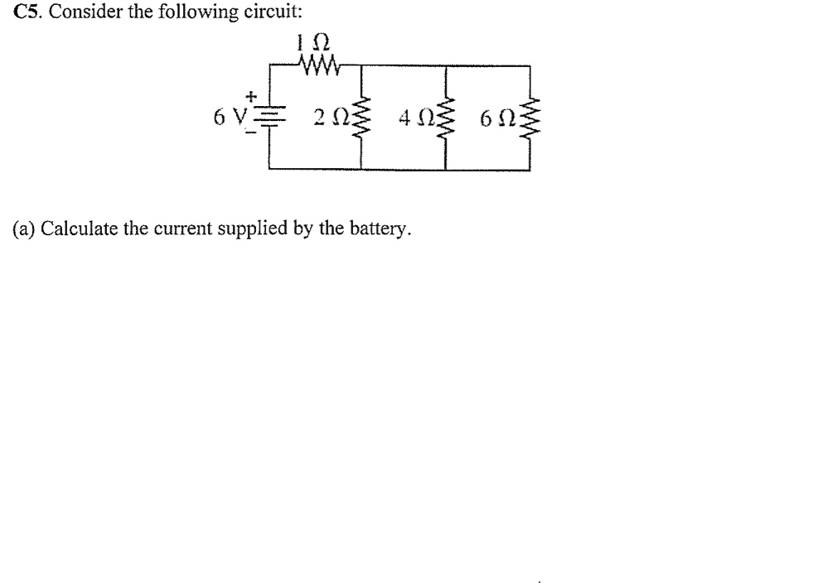
Practice exam questions: Section C
Combine the $2Ω$, $4Ω$, $6Ω$ resistors in parallel
$$\frac{1}{R_{parallel}}=\frac{1}{2}+\frac{1}{4}+\frac{1}{6}→ R_{parallel}=1.1 Ω$$
Combine the $1Ω$, $1.1Ω$ resistors in series $R_{total}=2.1 Ω$
Ohm’s Law: $I=\frac{V}{R_{total}}=\frac{6}{2.1}=2.9 A$

Slide 49
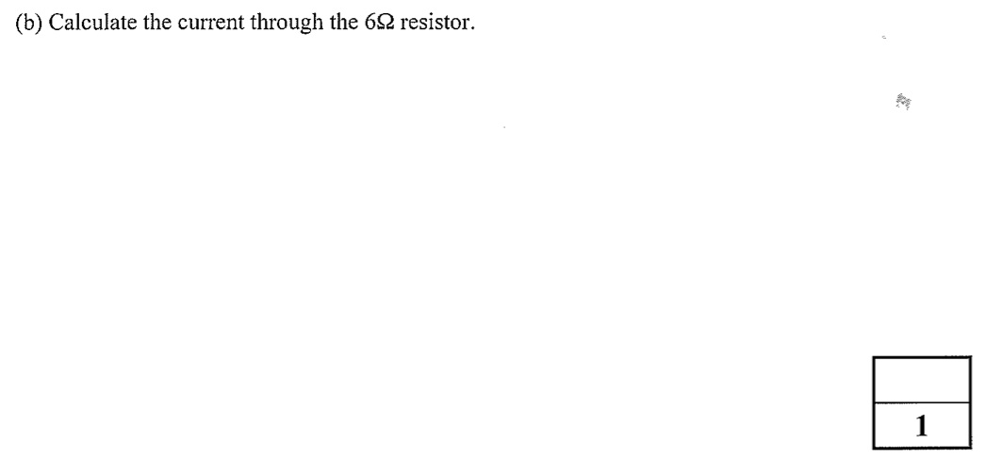
Practice exam questions: Section C
Voltage across parallel combination $=\frac{1.1}{2.1}×6 V=3.1 V$
$$I=\frac{V}{R}=\frac{3.1}{6}=0.52 A$$

Slide 50
Final words
Thanks to all students for their efforts in the Introduction to Physics course
Please fill in feedback surveys!
Good luck in the upcoming exams!

