Slide 1
Revision :
Fluid mechanics

Slide 2
FAQ 1
Can we take other calculators into the exam?
No, sorry that you have to use the “green one” (TI-30XB)

Slide 3
FAQ 2
If your answer to a later part of a question is wrong because of a numerical slip-up in an earlier part, will you lose marks?
No. If you show your working, you will still get the credit for the later part of the question.

Slide 4
FAQ 3
Will you lose marks for not quoting correct numbers of significant figures?
Only in extreme cases. If you quote something similar to the data given in the question, you will not lose marks.

Slide 5
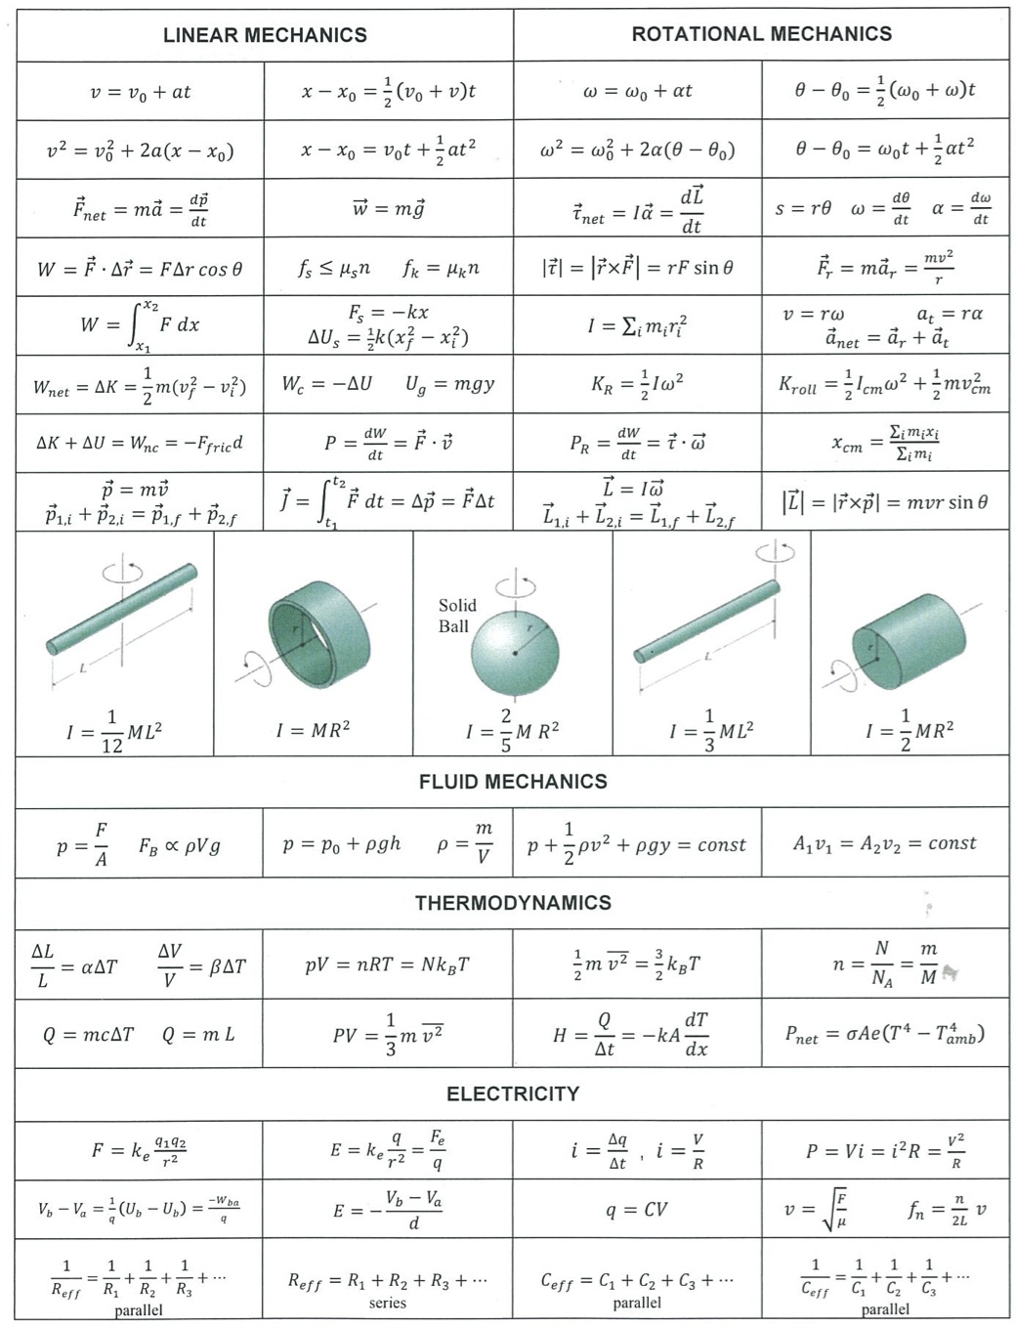
Formula sheet

Slide 6
Formula sheet

Slide 7
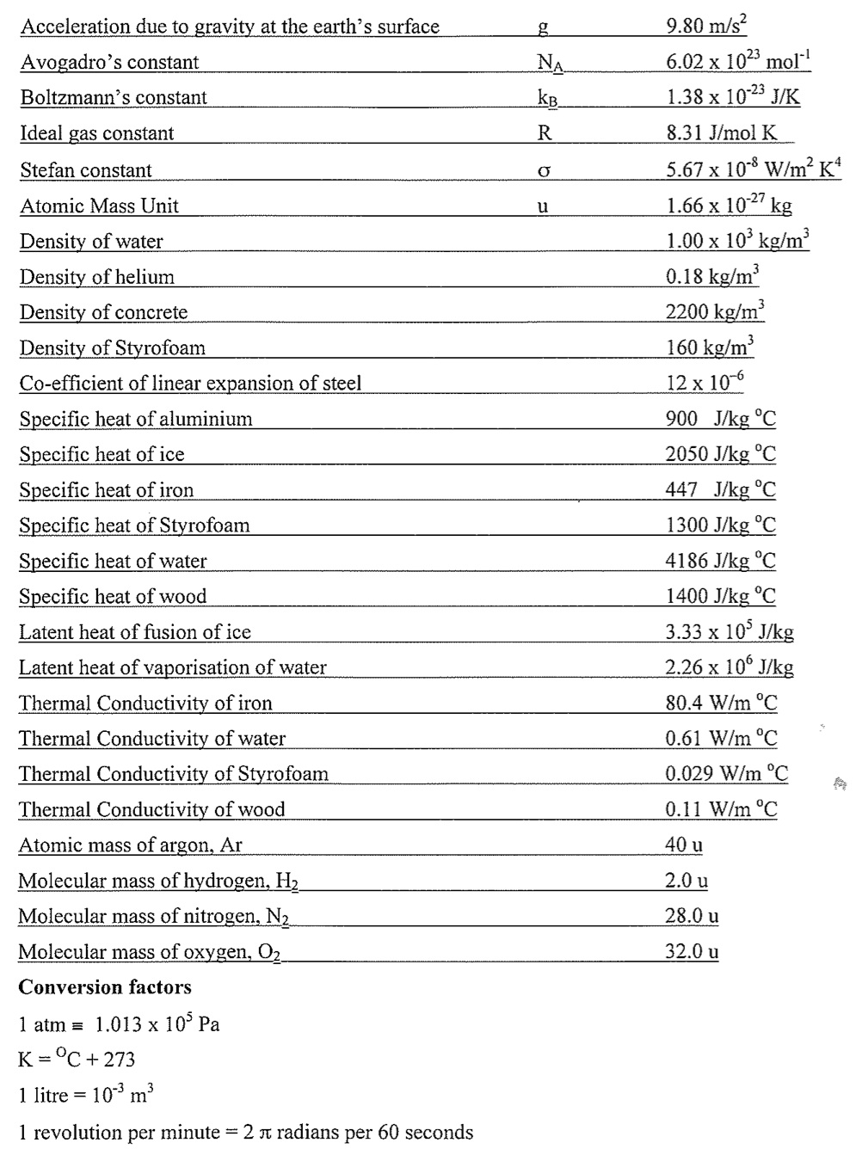
Formula sheet

Slide 8
Fluid Mechanics key facts (1/5)
Basic definitions:
Density $ρ=\frac{Mass}{Volume}$ [units: $kg m^{−3}$]
Pressure $P=\frac{Force}{Area}$ [units: $N m^{−2}$ or $Pa$]
Pressure can also be measured in atmospheres: $1 atm=1.013 ×{10}^{5} Pa$ [on formula sheet]
Gauge pressure means the extra pressure above the atmospheric pressure

Slide 9
Fluid Mechanics key facts (2/5)
A fluid at rest obeys hydrostatic equilibrium - where its pressure increases with depth to balance its weight : $P=P_{0}+ρgh$
Points at the same depth below the surface are all at the same pressure, regardless of the shape
Fluid has density $ρ$
Pressure $P_{0}$
$$h$$
Pressure $P=P_{0}+ρgh$

Slide 10
Fluid Mechanics key facts (3/5)
An object immersed in a fluid will feel a buoyancy force equal to the weight of the fluid displaced
Buoyancy force ${=m}_{fluid}g=ρ_{fluid} V g$
Object has volume $V$
Buoyancy > Weight if $ρ_{object}<ρ_{fluid}$
Weight force ${=m}_{object}g=ρ_{object} V g$

Slide 11
Fluid Mechanics key facts (4/5)
Flow of an incompressible fluid obeys the continuity equation : $v A=constant$ where $v=$ fluid velocity and $A=$ pipe area
This equation results from conservation of mass. It’s the same as saying $volume flow rate=constant$
$$v_{1}$$
$$v_{2}$$
Area $A_{2}$
Area $A_{1}$
$$v_{1} A_{1}=v_{2}{ A}_{2}$$

Slide 12
Fluid Mechanics key facts (5/5)
The pressure in a flowing fluid obeys Bernoulli’s equation : $P+\frac{1}{2}ρv^{2}+ρgh=constant$
This equation results from the conservation of energy
For a horizontal pipe, $P+\frac{1}{2}ρv^{2}=constant$
$P=$ Pressure, $ρ=$ Density, $v=$ Velocity, $h=$ Height

Slide 13
Practice exam questions: Section A
Weight of fluid displaced = weight of boat
Same weight is displaced before and after [A]
Continuity equation $v A=constant$ : velocity increases / constant flow rate
Bernoulli’s equation $P+\frac{1}{2}ρv^{2}=constant$ : pressure decreases [D]

Slide 14
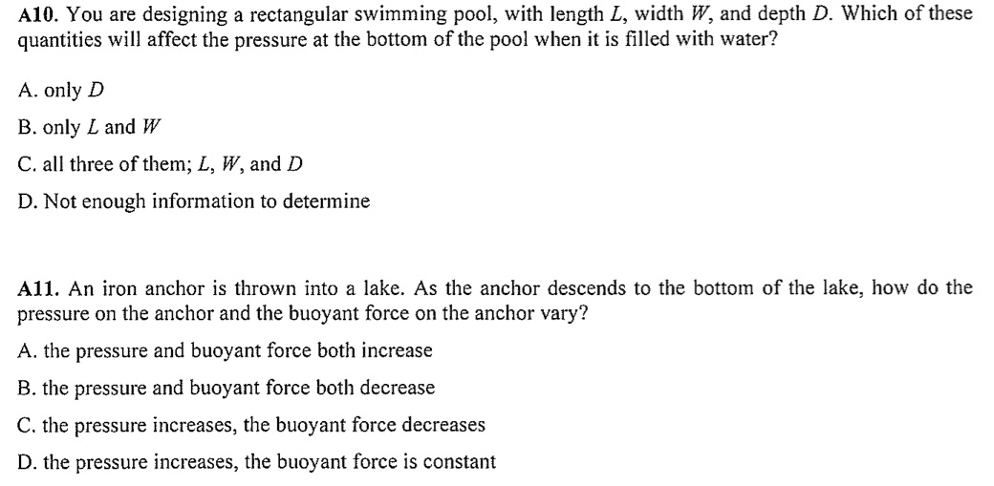
Practice exam questions: Section A
Hydrostatic equilibrium only depends on depth : A
Lake is in hydrostatic equilibrium : pressure increases with depth
Buoyancy force = weight of water displaced = constant : D

Slide 15
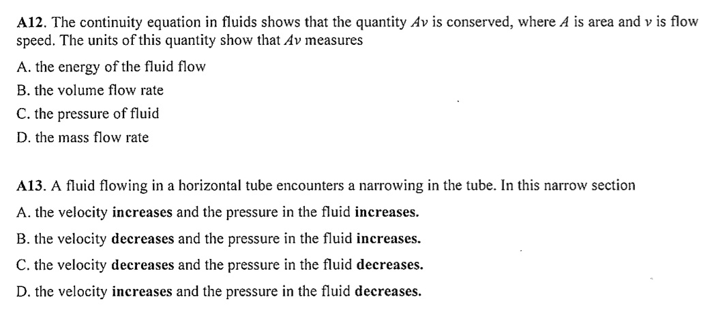
Practice exam questions: Section A
Units of $Av$ are $m^{2}×ms^{−1}=m^{3}s^{−1}$
This is volume/second, or volume flow rate : B
Same question as earlier: velocity increases (continuity equation) and pressure decreases (Bernoulli’s equation) : D

Slide 16
Practice exam questions: Section B
$$Pressure=\frac{Force}{Area}$$
$$Area=πr^{2}=π{\left(\frac{1.5×{10}^{−3}}{2}\right)}^{2}=1.77×{10}^{−6}{ m}^{2}$$
$$Force=Pressure×Area=12×{10}^{6}×1.77×{10}^{−6}=21 N$$

Slide 17
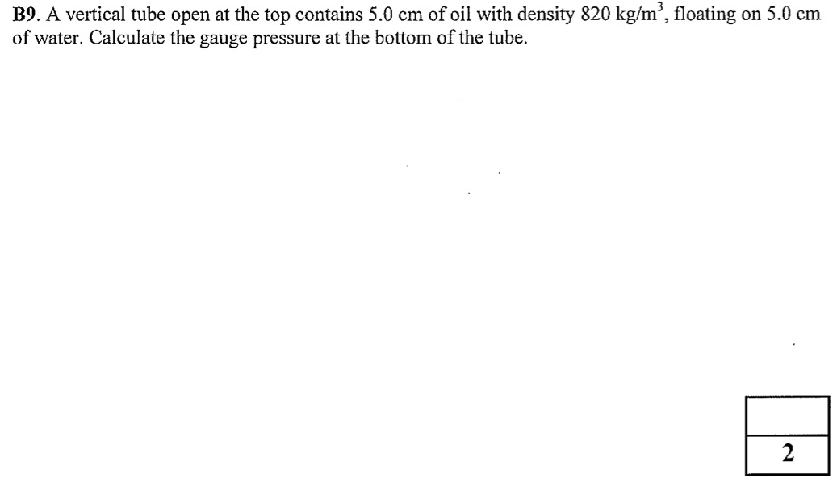
Practice exam questions: Section B
Gauge pressure is the additional pressure above the atmospheric pressure
Hydrostatic equilibrium: $P=P_{0}+ ρgh$
Gauge pressure $=ρ_{oil} g h_{oil}+ρ_{water} g{ h}_{water}=820×9.8×0.05+1000×9.8×0.05=890 Pa$

Slide 18
Practice exam questions: Section B
Weight of drum $=mg=16×9.8=157 N$
Weight of gasoline $=ρ_{gasoline}Vg=860×0.23×9.8=1940 N$
Total weight of drum + gasoline = 2097 N
Buoyancy force = Weight of water displaced $=ρ_{water}Vg=1000×0.23×9.8=2250 N$
Buoyancy force > Total weight, so drum floats

Slide 19
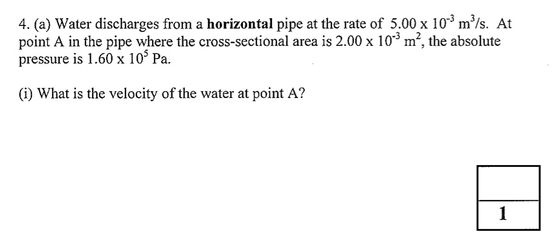
Practice exam questions: Section C
Volume flow rate $=v A=5×{10}^{−3} m^{3} s^{−1}$
$$v=\frac{5×{10}^{−3}}{2×{10}^{−3}}=2.5 m s^{−1}$$

Slide 20
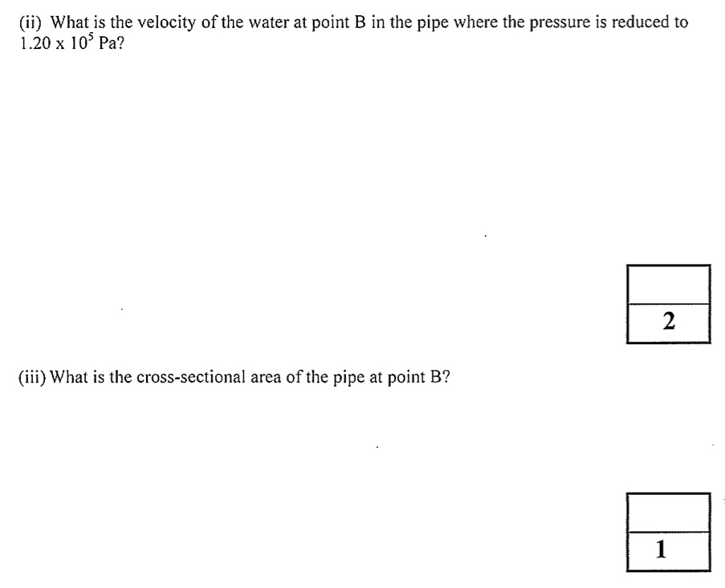
Practice exam questions: Section C
Bernoulli’s equation : $P+\frac{1}{2}ρv^{2}=constant$
$$P_{A}+\frac{1}{2}ρ{v_{A}}^{2}=P_{B}+\frac{1}{2}ρ{v_{B}}^{2}$$
$$P_{A}=1.6×{10}^{5} Pa, P_{B}=1.2×{10}^{5} Pa, v_{A}=2.5 ms^{−1}, ρ=1000 kg m^{−3}$$
$$→v_{B}=9.3 m s^{−1}$$
Continuity equation : $v A=constant$
$$v_{A} A_{A}=v_{B} A_{B}$$
$$A_{B}=\frac{v_{A} A_{A}}{v_{B}}=\frac{2.5×2×{10}^{−3}}{9.3}=5.4×{10}^{−4} m^{2}$$

Slide 21
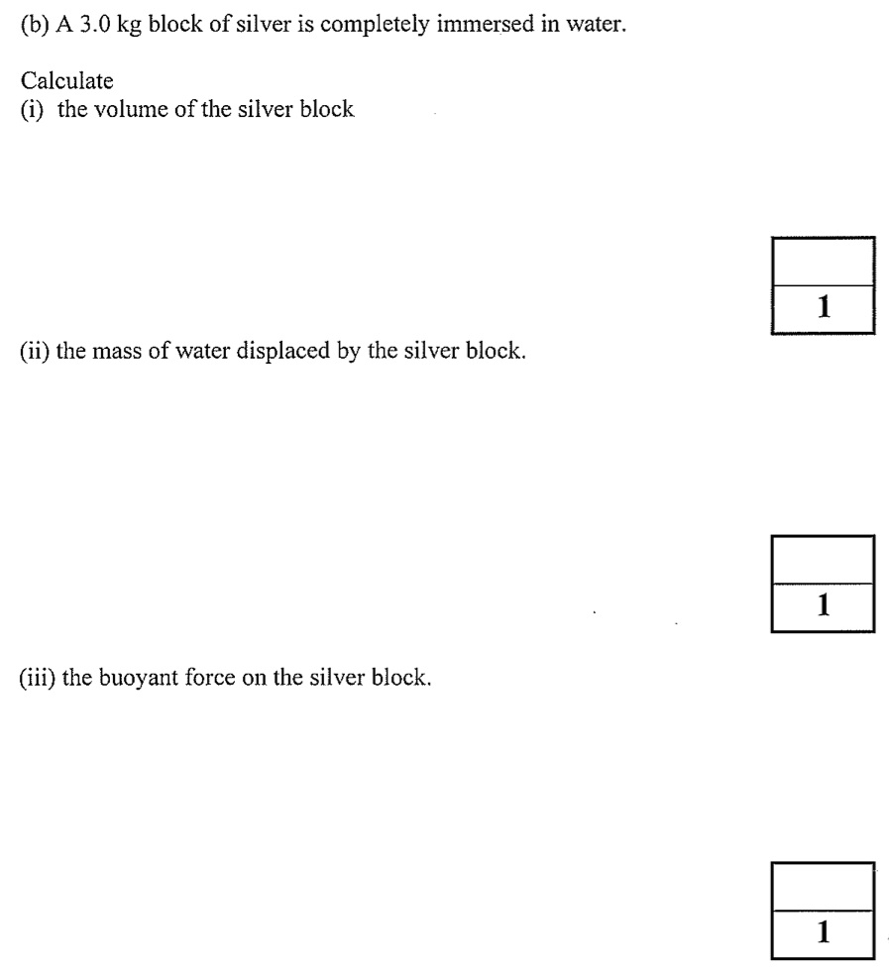
Practice exam questions: Section C
$$Density=\frac{Mass}{Volume}→V=\frac{3.0}{10.5×{10}^{3}}=2.9×{10}^{−4} m^{3}$$
$$m_{water}=ρ_{water} V=1000×2.9×{10}^{−4}=0.29 kg$$
Buoyant force $=m_{water} g=0.29×9.8=2.8 N$

Slide 22
Practice exam questions: Section C
Volume of beaker $= V_{beaker}=πr^{2}h=π{\left(0.025\right)}^{2}\left(0.14\right)=2.7×{10}^{−4} m^{3}$
Buoyancy force when empty = $\frac{1}{3}V_{beaker} ρ_{water} g=\frac{1}{3}×2.7×{10}^{−4}×1000×9.8=0.90 N$ [= weight of beaker]
Buoyancy force when full = $V_{beaker} ρ_{water} g=2.69 N$
Extra buoyancy $=2.69−0.90=1.79=N_{rock} m_{rock} g$
$$→N_{rock}=15$$

Slide 23
Next steps
Make sure you are comfortable with unit conversions (especially Pressure in $Pa$ or $atm$)
Review the fluid mechanics key facts
Familiarize yourself with the fluid mechanics section of the formula sheet
Try questions from the sample exam papers on Blackboard and/or the textbook

