Slide 1
Section 5: The Hydrogen Atom
In these slides we will cover:
The 3D Schrödinger equation
Particle in a box and degenerate quantum states
Radial and angular solutions for central potentials
Identification of the angular piece with the angular momentum eigenfunctions (spherical harmonics)
Infinite spherical well
Solution of the radial equation for the Coulomb potential
Eigenfunctions of the hydrogen atom
Quantum numbers of the hydrogen atom

Slide 2
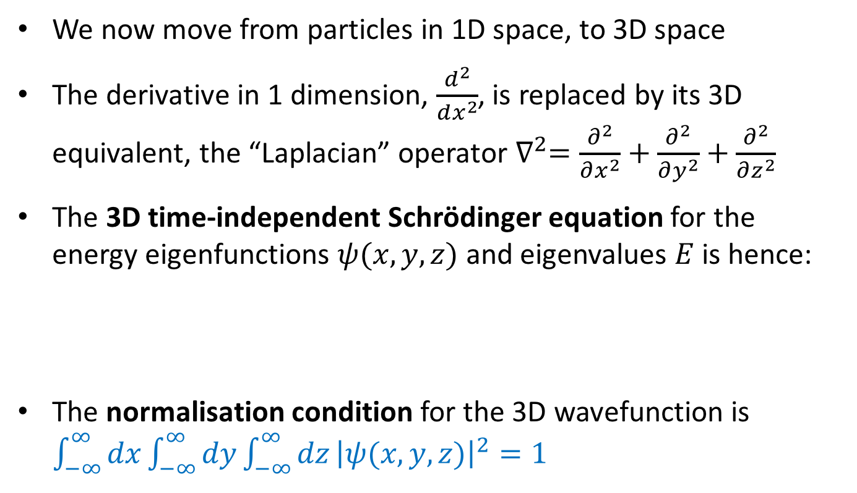
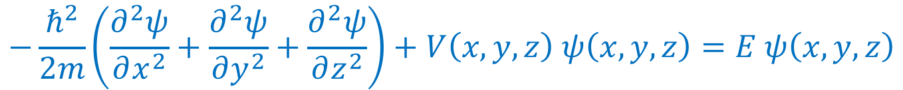
Particle in a box
The 3D Schrödinger Equation
We now move from particles in 1D space, to 3D space
The derivative in 1 dimension, $\frac{d^{2}}{dx^{2}}$, is replaced by its 3D equivalent, the “Laplacian” operator $∇^{2}=\frac{∂^{2}}{∂x^{2}}+\frac{∂^{2}}{∂y^{2}}+\frac{∂^{2}}{∂z^{2}}$
The 3D time-independent Schrödinger equation for the energy eigenfunctions $ψ(x,y,z)$ and eigenvalues $E$ is hence:
The normalisation condition for the 3D wavefunction is $\int_{−∞}^{∞}{dx}\int_{−∞}^{∞}{dy}\int_{−∞}^{∞}{dz}{\left|ψ(x,y,z)\right|}^{2}=1$
$$−\frac{ℏ^{2}}{2m}\left(\frac{∂^{2}ψ}{∂x^{2}}+\frac{∂^{2}ψ}{∂y^{2}}+\frac{∂^{2}ψ}{∂z^{2}}\right)+V\left(x,y,z\right) ψ\left(x,y,z\right)=E ψ\left(x,y,z\right)$$

Slide 3
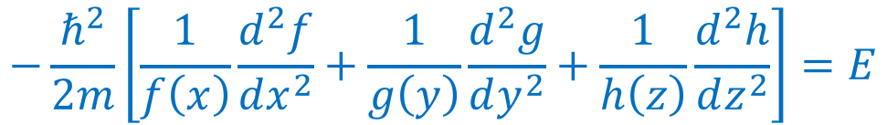
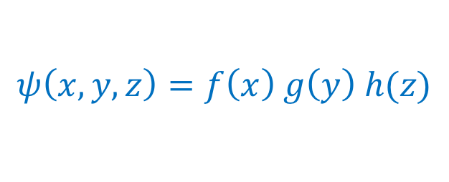
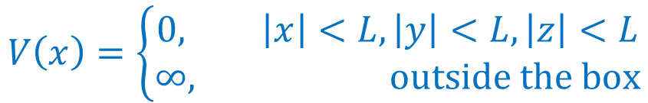
Particle in a box
Particle in a box
A good example is a “particle in a box” with potential
We look for a separable solution
We find, by substituting this trial solution in the 3D Schrödinger equation and re-arranging,
$$V\left(x\right)=\left\{\begin{aligned}0, \left|x\right|<L, \left|y\right|<L,\left|z\right|<L \\ &∞, outside the box\end{aligned}\right.$$
$$ψ\left(x,y,z\right)=f\left(x\right) g\left(y\right) h(z)$$
$$−\frac{ℏ^{2}}{2m}\left[\frac{1}{f\left(x\right)}\frac{d^{2}f}{dx^{2}}+\frac{1}{g\left(y\right)}\frac{d^{2}g}{dy^{2}}+\frac{1}{h\left(z\right)}\frac{d^{2}h}{dz^{2}}\right]=E$$

Slide 4
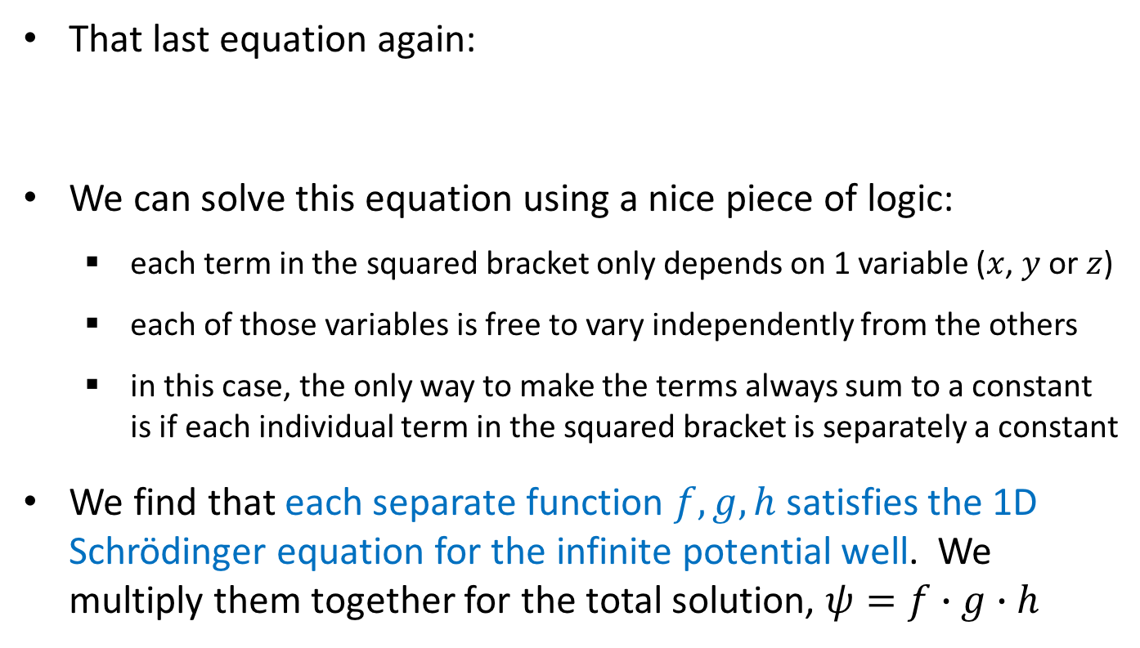
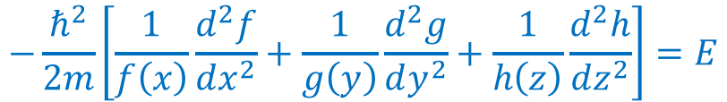
Particle in a box
Particle in a box
That last equation again:
We can solve this equation using a nice piece of logic:
  each term in the squared bracket only depends on 1 variable ($x$, $y$ or $z$)
  each of those variables is free to vary independently from the others
  in this case, the only way to make the terms always sum to a constant is if each individual term in the squared bracket is separately a constant
We find that each separate function $f,g,h$ satisfies the 1D Schrödinger equation for the infinite potential well. We multiply them together for the total solution, $ψ=f∙g∙h$
$$−\frac{ℏ^{2}}{2m}\left[\frac{1}{f\left(x\right)}\frac{d^{2}f}{dx^{2}}+\frac{1}{g\left(y\right)}\frac{d^{2}g}{dy^{2}}+\frac{1}{h\left(z\right)}\frac{d^{2}h}{dz^{2}}\right]=E$$

Slide 5
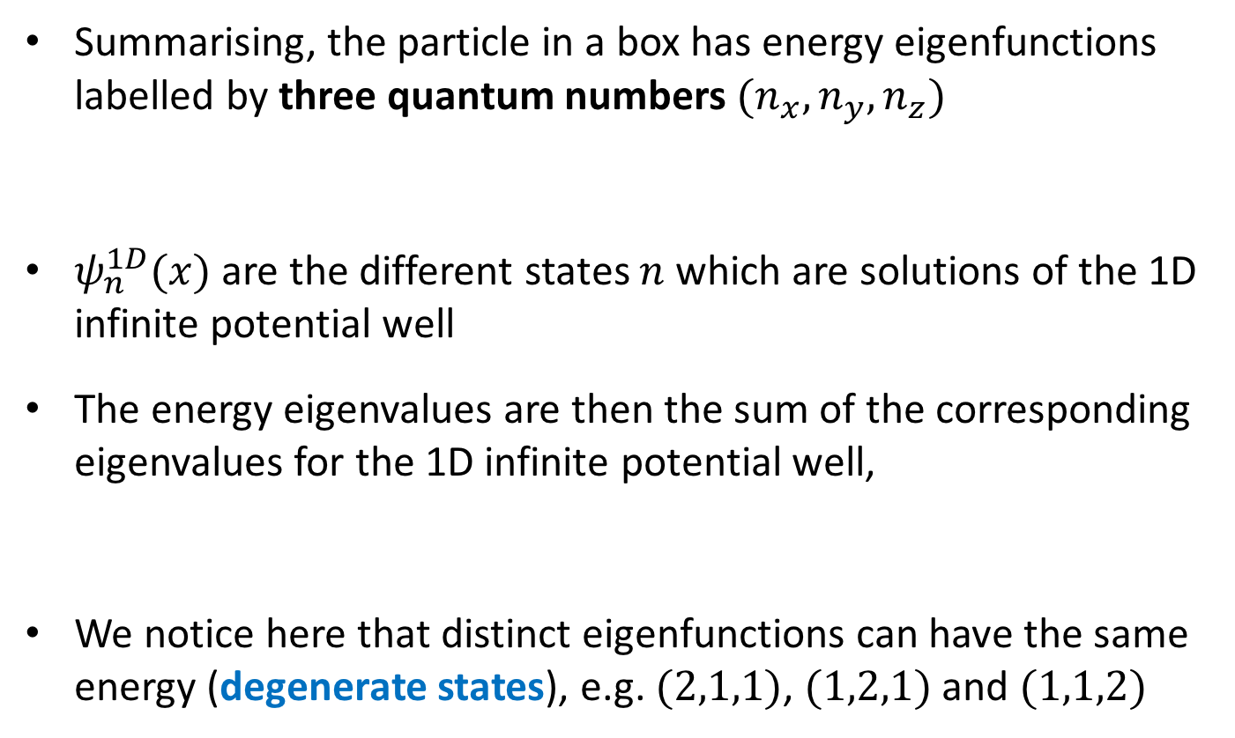
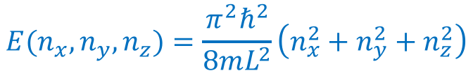
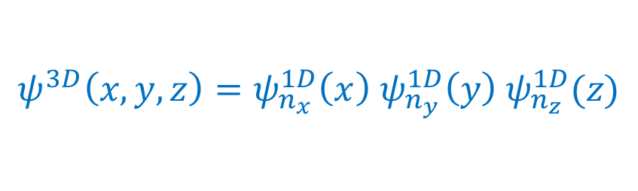
Particle in a box
Particle in a box
Summarising, the particle in a box has energy eigenfunctions labelled by three quantum numbers $(n_{x},n_{y},n_{z})$
$ψ_{n}^{1D}(x)$ are the different states $n$ which are solutions of the 1D infinite potential well
The energy eigenvalues are then the sum of the corresponding eigenvalues for the 1D infinite potential well,
We notice here that distinct eigenfunctions can have the same energy (degenerate states), e.g. $(2,1,1)$, $(1,2,1)$ and $(1,1,2)$
$$ψ^{3D}\left(x,y,z\right)=ψ_{n_{x}}^{1D}\left(x\right) ψ_{n_{y}}^{1D}\left(y\right) ψ_{n_{z}}^{1D}(z)$$
$$E(n_{x},n_{y},n_{z})=\frac{π^{2}ℏ^{2}}{8mL^{2}}\left(n_{x}^{2}+n_{y}^{2}+n_{z}^{2}\right)$$

Slide 6

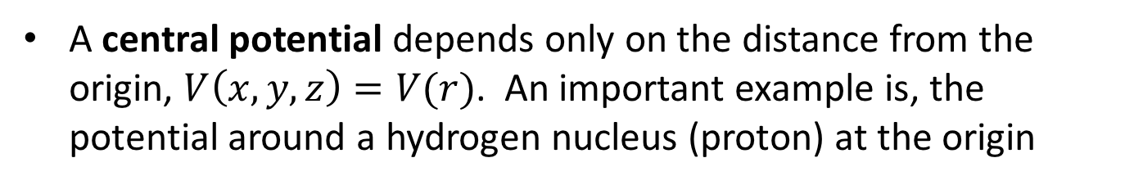





Central potentials
Radial and angular solutions for central potentials
A central potential depends only on the distance from the origin, $V\left(x,y,z\right)=V(r)$. An important example is, the potential around a hydrogen nucleus (proton) at the origin
$$z$$
$$−e$$
(Sorry for the illustration with classical point particles. They are of course probability clouds in QM!)
$$r$$
$$x$$
$$+e$$
$$y$$

Slide 7
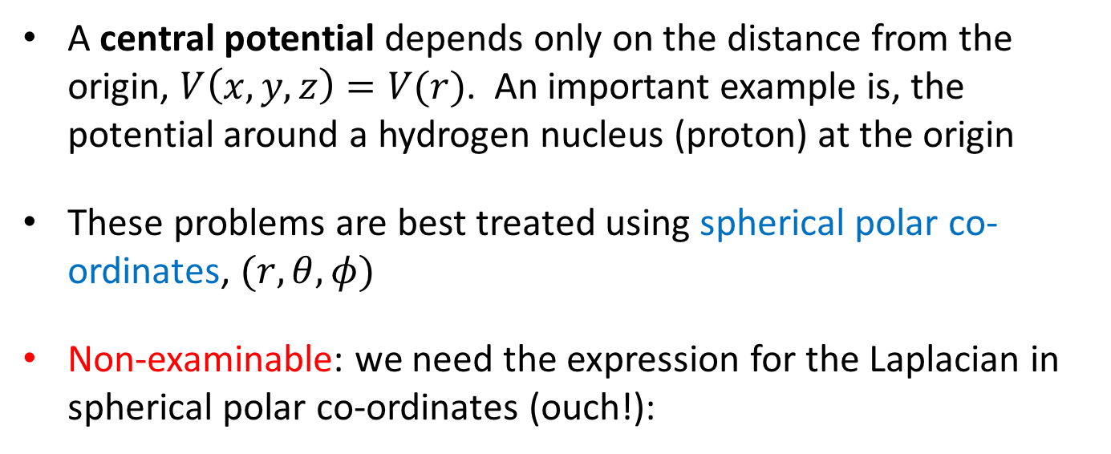
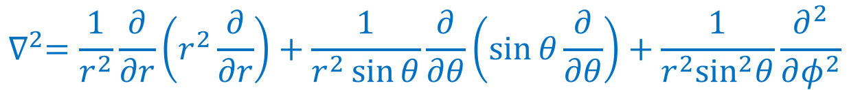
Central potentials
Radial and angular solutions for central potentials
A central potential depends only on the distance from the origin, $V\left(x,y,z\right)=V(r)$. An important example is, the potential around a hydrogen nucleus (proton) at the origin
These problems are best treated using spherical polar co-ordinates, $(r,θ,φ)$
Non-examinable: we need the expression for the Laplacian in spherical polar co-ordinates (ouch!):
$$∇^{2}=\frac{1}{r^{2}}\frac{∂}{∂r}\left(r^{2}\frac{∂}{∂r}\right)+\frac{1}{r^{2}\sin{θ}}\frac{∂}{∂θ}\left(\sin{θ}\frac{∂}{∂θ}\right)+\frac{1}{r^{2}\sin^{2}θ}\frac{∂^{2}}{∂φ^{2}}$$

Slide 8
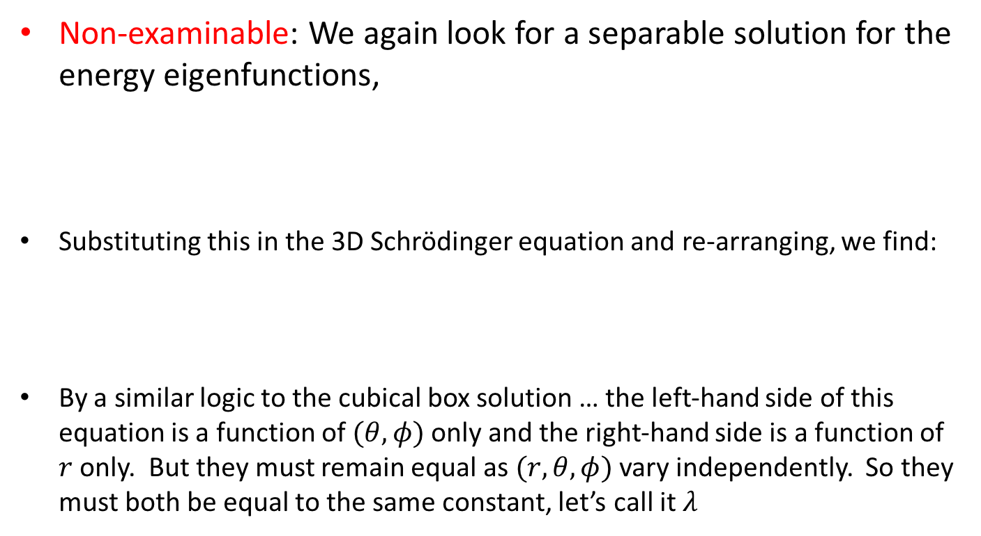
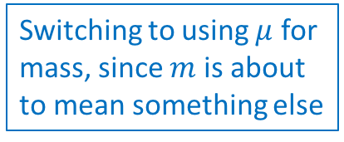
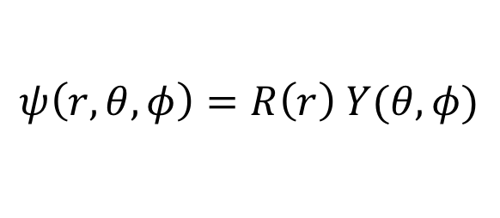
Central potentials
Radial and angular solutions for central potentials
Non-examinable: We again look for a separable solution for the energy eigenfunctions,
Substituting this in the 3D Schrödinger equation and re-arranging, we find:
By a similar logic to the cubical box solution … the left-hand side of this equation is a function of $(θ,φ)$ only and the right-hand side is a function of $r$ only. But they must remain equal as $(r,θ,φ)$ vary independently. So they must both be equal to the same constant, let’s call it $λ$
Switching to using $μ$ for mass, since $m$ is about to mean something else
$$ψ\left(r,θ,φ\right)=R\left(r\right) Y(θ,φ)$$
$$−\frac{ℏ^{2}}{Y}\left[\frac{1}{\sin{θ}}\frac{∂}{∂θ}\left(\sin{θ}\frac{∂Y}{∂θ}\right)+\frac{1}{\sin^{2}θ}\frac{∂^{2}Y}{∂φ^{2}}\right]=\frac{ℏ^{2}}{R}\frac{∂}{∂r}\left(r^{2}\frac{∂R}{∂r}\right)+2μ\left[E−V\left(r\right)\right] r^{2}$$

Slide 9
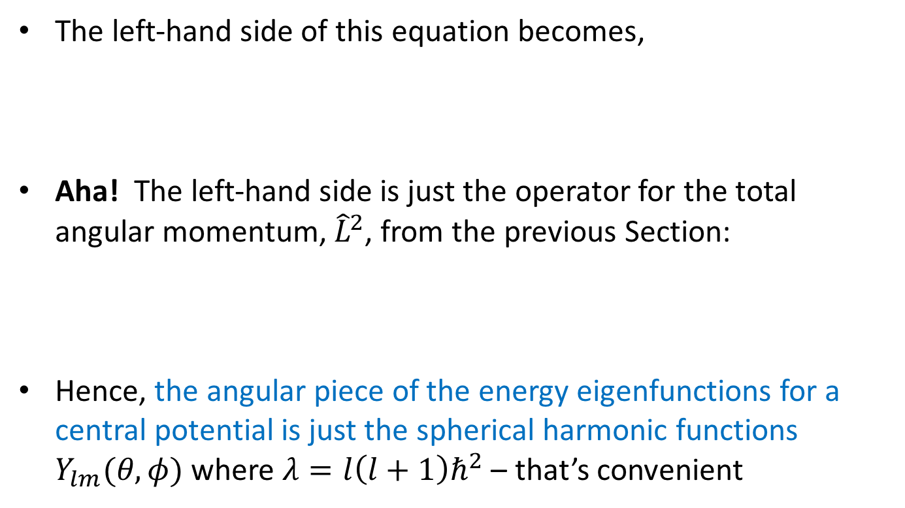
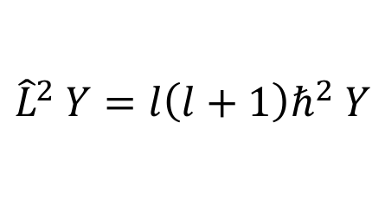
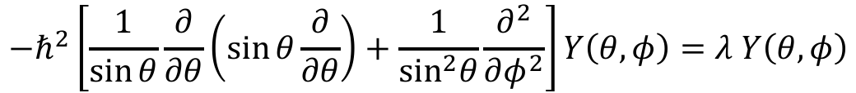
Central potentials
Radial and angular solutions for central potentials
The left-hand side of this equation becomes,
Aha! The left-hand side is just the operator for the total angular momentum, ${\hat{L}}^{2}$, from the previous Section:
Hence, the angular piece of the energy eigenfunctions for a central potential is just the spherical harmonic functions $Y_{lm}(θ,φ)$ where $λ=l\left(l+1\right)ℏ^{2}$ – that’s convenient
$$−ℏ^{2}\left[\frac{1}{\sin{θ}}\frac{∂}{∂θ}\left(\sin{θ}\frac{∂}{∂θ}\right)+\frac{1}{\sin^{2}θ}\frac{∂^{2}}{∂φ^{2}}\right]Y\left(θ,φ\right)=λ Y\left(θ,φ\right)$$
$${\hat{L}}^{2} Y=l\left(l+1\right)ℏ^{2} Y$$

Slide 10
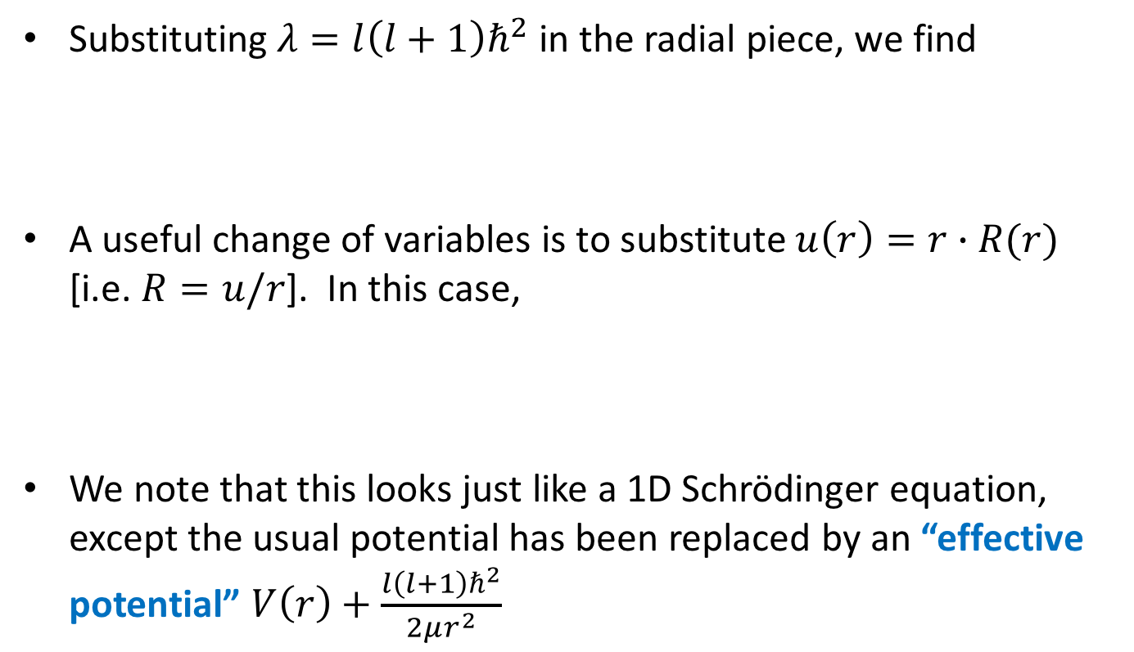
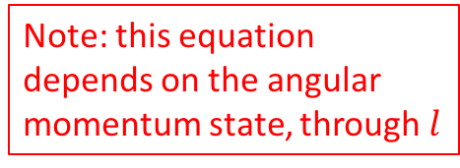
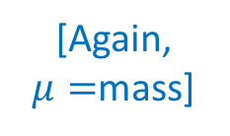
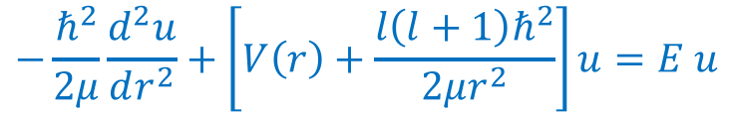
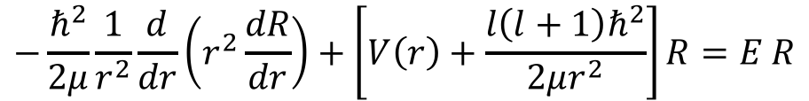
Central potentials
Radial and angular solutions for central potentials
Substituting $λ=l\left(l+1\right)ℏ^{2}$ in the radial piece, we find
A useful change of variables is to substitute $u\left(r\right)=r∙R(r)$ [i.e. $R=u/r$]. In this case,
We note that this looks just like a 1D Schrödinger equation, except the usual potential has been replaced by an “effective potential” $V\left(r\right)+\frac{l\left(l+1\right)ℏ^{2}}{2μr^{2}}$
[Again, $μ=$mass]
$$−\frac{ℏ^{2}}{2μ}\frac{1}{r^{2}}\frac{d}{dr}\left(r^{2}\frac{dR}{dr}\right)+\left[V\left(r\right)+\frac{l\left(l+1\right)ℏ^{2}}{2μr^{2}}\right]R=E R$$
Note: this equation depends on the angular momentum state, through $l$
$$−\frac{ℏ^{2}}{2μ}\frac{d^{2}u}{dr^{2}}+\left[V\left(r\right)+\frac{l\left(l+1\right)ℏ^{2}}{2μr^{2}}\right]u=E u$$

Slide 11
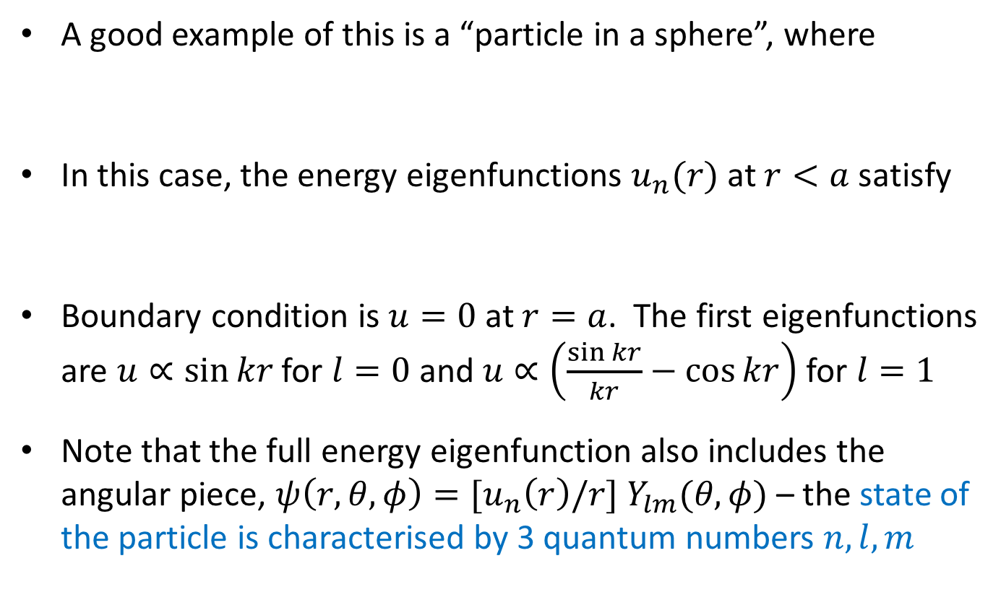
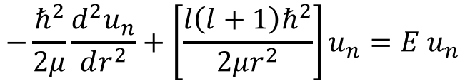
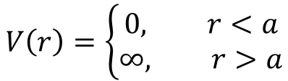
Central potentials
Infinite spherical well
A good example of this is a “particle in a sphere”, where
In this case, the energy eigenfunctions $u_{n}(r)$ at $r<a$ satisfy
Boundary condition is $u=0$ at $r=a$. The first eigenfunctions are $u∝\sin{kr}$ for $l=0$ and $u∝\left(\frac{\sin{kr}}{kr}−\cos{kr}\right)$ for $l=1$
Note that the full energy eigenfunction also includes the angular piece, $ψ\left(r,θ,φ\right)=[u_{n}\left(r\right)/r] Y_{lm}(θ,φ)$ – the state of the particle is characterised by 3 quantum numbers $n,l,m$
$$V\left(r\right)=\left\{\begin{aligned}0, r<a \\ &∞, r>a\end{aligned}\right.$$
$$−\frac{ℏ^{2}}{2μ}\frac{d^{2}u_{n}}{dr^{2}}+\left[\frac{l\left(l+1\right)ℏ^{2}}{2μr^{2}}\right]u_{n}=E u_{n}$$

Slide 12







Central potentials
Infinite spherical well
Here are the first few radial eigenfunctions for two values of $l$:
The probability of finding the particle between $r$ and $r+dr$ is given by $r^{2}{\left|ψ\right|}^{2}∝r^{2}{\left|R\right|}^{2}∝{\left|u\right|}^{2}$ – the extra factor of $r^{2}$ is appearing because of the volume element in spherical polars
$u(r)$ (unnormalised)
$u(r)$ (unnormalised)
$$l=0$$
$$l=1$$
edge
edge
$$r/a$$
$$r/a$$

Slide 13
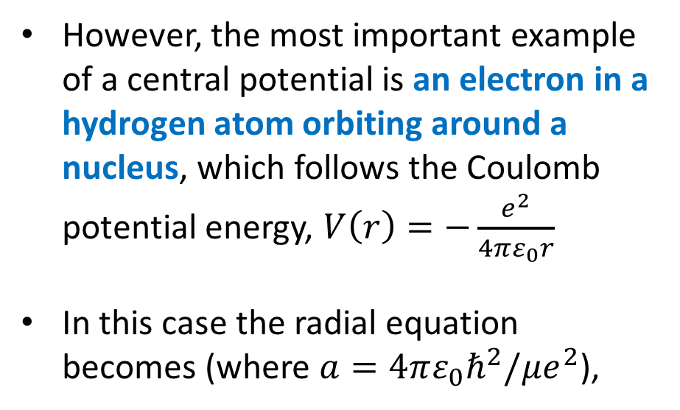


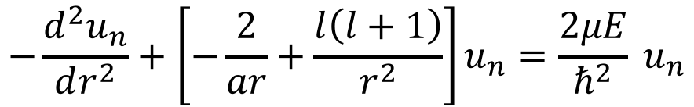
Eigenfunctions of the hydrogen atom
Solution of radial equation for Coulomb potential
However, the most important example of a central potential is an electron in a hydrogen atom orbiting around a nucleus, which follows the Coulomb potential energy, $V\left(r\right)=−\frac{e^{2}}{4πε_{0}r}$
In this case the radial equation becomes (where $a=4πε_{0}ℏ^{2}/μe^{2}$),
$$−e$$
$$r$$
$$+e$$
$$−\frac{d^{2}u_{n}}{dr^{2}}+\left[−\frac{2}{ar}+\frac{l\left(l+1\right)}{r^{2}}\right]u_{n}=\frac{2μE}{ℏ^{2}} u_{n}$$
(Sorry for the illustration with classical point particles. They are of course probability clouds in QM!)

Slide 14
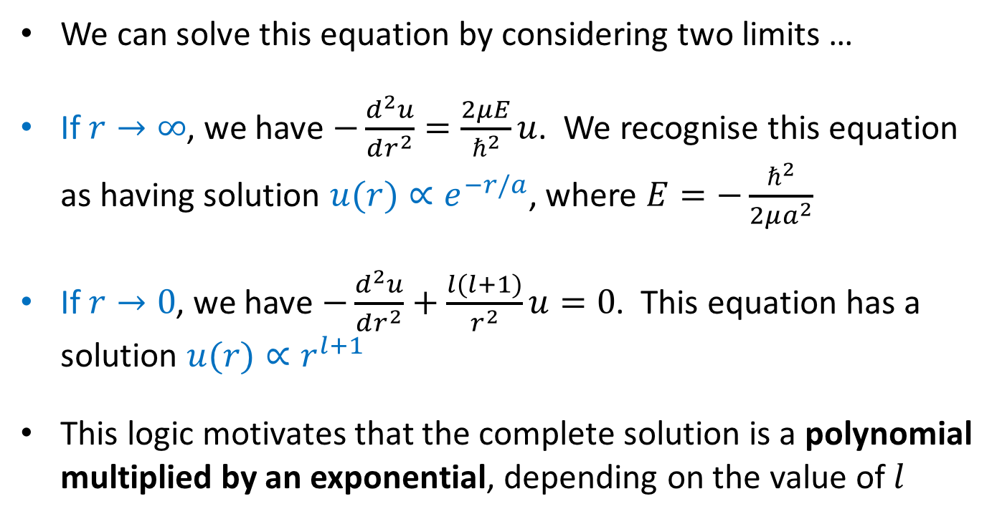
Eigenfunctions of the hydrogen atom
Solution of radial equation for Coulomb potential
We can solve this equation by considering two limits …
If $r→∞$, we have $−\frac{d^{2}u}{dr^{2}}=\frac{2μE}{ℏ^{2}}u$. We recognise this equation as having solution $u(r)∝e^{−r/a}$, where $E=−\frac{ℏ^{2}}{2μa^{2}}$
If $r→0$, we have $−\frac{d^{2}u}{dr^{2}}+\frac{l(l+1)}{r^{2}}u=0$. This equation has a solution $u(r)∝r^{l+1}$
This logic motivates that the complete solution is a polynomial multiplied by an exponential, depending on the value of $l$

Slide 15

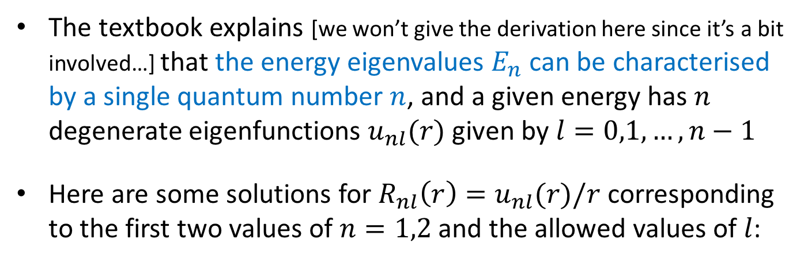



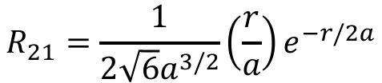

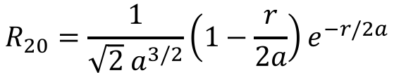
Eigenfunctions of the hydrogen atom
Eigenfunctions for hydrogen atom
The textbook explains [we won’t give the derivation here since it’s a bit involved…] that the energy eigenvalues $E_{n}$ can be characterised by a single quantum number $n$, and a given energy has $n$ degenerate eigenfunctions $u_{nl}(r)$ given by $l=0,1,…,n−1$
Here are some solutions for $R_{nl}\left(r\right)=u_{nl}(r)/r$ corresponding to the first two values of $n=1,2$ and the allowed values of $l$:
$$n=1$$
$$n=2$$
$$l=0$$
$$R_{10}=\frac{2}{a^{3/2}}e^{−r/a}$$
$$R_{20}=\frac{1}{\sqrt{2} a^{3/2}}\left(1−\frac{r}{2a}\right)e^{−r/2a}$$
$$l=1$$
$$R_{21}=\frac{1}{2\sqrt{6}a^{3/2}}\left(\frac{r}{a}\right)e^{−r/2a}$$
(not allowed)

Slide 16
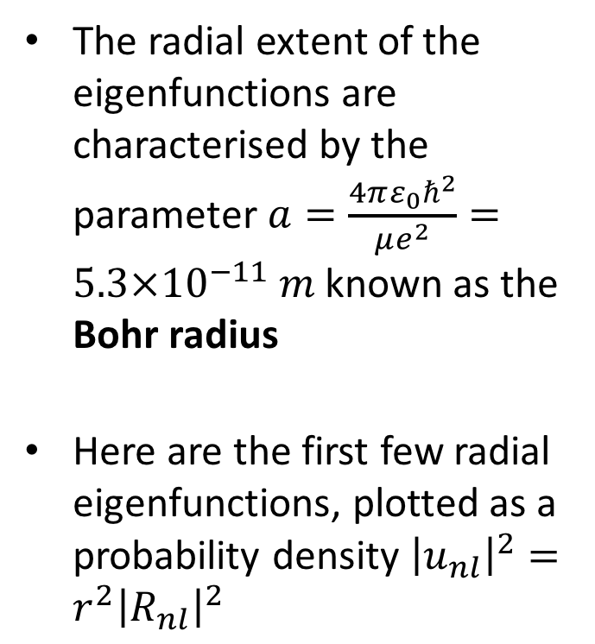
Eigenfunctions of the hydrogen atom
Eigenfunctions for hydrogen atom
The radial extent of the eigenfunctions are characterised by the parameter $a=\frac{4πε_{0}ℏ^{2}}{μe^{2}}=5.3×{10}^{−11} m$ known as the Bohr radius
Here are the first few radial eigenfunctions, plotted as a probability density ${\left|u_{nl}\right|}^{2}=r^{2}{\left|R_{nl}\right|}^{2}$

Slide 17
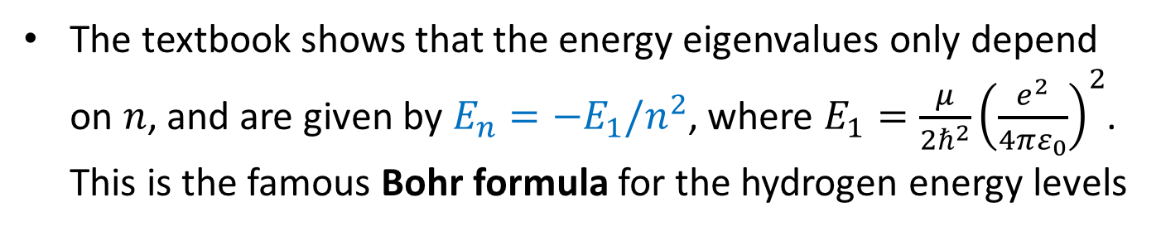
Eigenfunctions of the hydrogen atom
Energy levels and quantum numbers of hydrogen atom
The textbook shows that the energy eigenvalues only depend on $n$, and are given by $E_{n}=−E_{1}/n^{2}$, where $E_{1}=\frac{μ}{2ℏ^{2}}{\left(\frac{e^{2}}{4πε_{0}}\right)}^{2}$. This is the famous Bohr formula for the hydrogen energy levels
Image credit: Hyperphysics

Slide 18
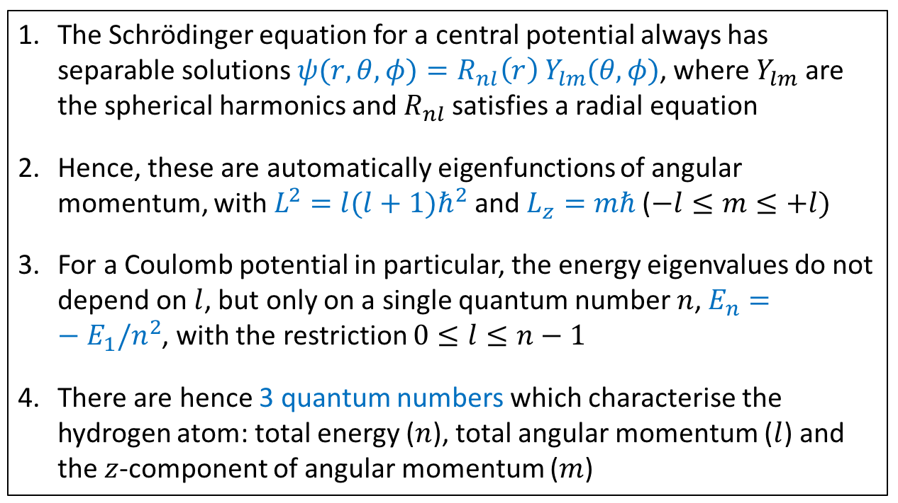
Eigenfunctions of the hydrogen atom
Energy levels and quantum numbers of hydrogen atom
Let’s recap the full argument:
The Schrödinger equation for a central potential always has separable solutions $ψ(r,θ,φ)=R_{nl}\left(r\right) Y_{lm}(θ,φ)$, where $Y_{lm}$ are the spherical harmonics and $R_{nl}$ satisfies a radial equation
Hence, these are automatically eigenfunctions of angular momentum, with $L^{2}=l(l+1)ℏ^{2}$ and $L_{z}=mℏ$ ($−l≤m≤+l)$
For a Coulomb potential in particular, the energy eigenvalues do not depend on $l$, but only on a single quantum number $n$, $E_{n}=−E_{1}/n^{2}$, with the restriction $0≤l≤n−1$
There are hence 3 quantum numbers which characterise the hydrogen atom: total energy ($n$), total angular momentum ($l$) and the $z$-component of angular momentum ($m$)

Slide 19
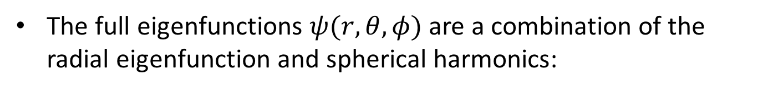
Eigenfunctions of the hydrogen atom
Energy levels and quantum numbers of hydrogen atom
The full eigenfunctions $ψ(r,θ,φ)$ are a combination of the radial eigenfunction and spherical harmonics:

Slide 20

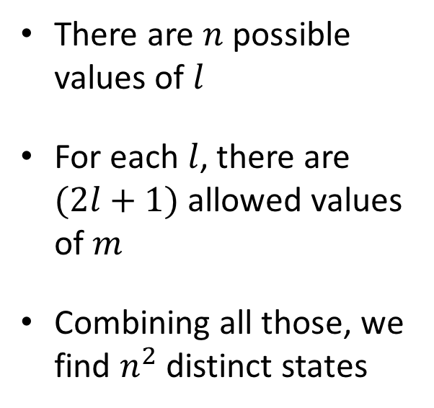
Eigenfunctions of the hydrogen atom
Energy levels and quantum numbers of hydrogen atom
Counting the number of distinct eigenstates associated with a specific energy $n$ …
There are $n$ possible values of $l$
For each $l$, there are $(2l+1)$ allowed values of $m$
Combining all those, we find $n^{2}$ distinct states

Slide 21
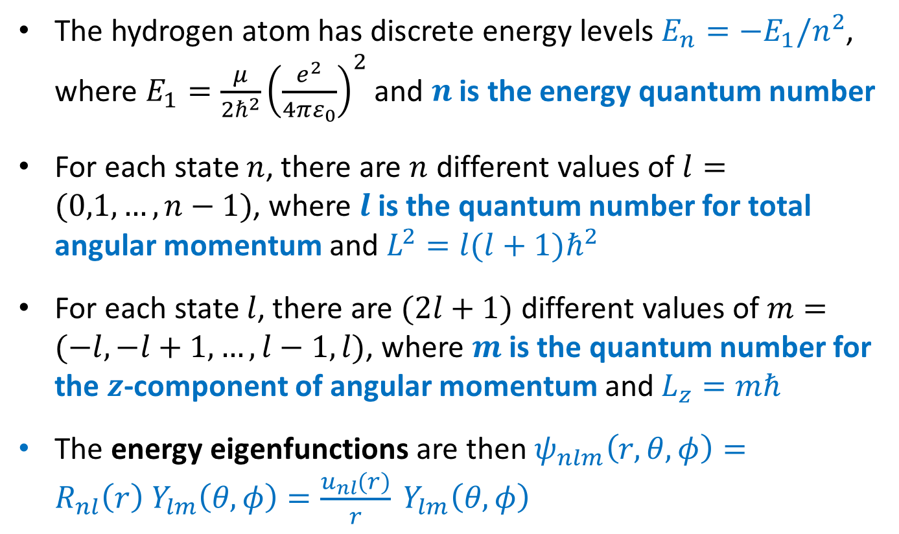
Eigenfunctions of the hydrogen atom
Summary
The hydrogen atom has discrete energy levels $E_{n}=−E_{1}/n^{2}$, where $E_{1}=\frac{μ}{2ℏ^{2}}{\left(\frac{e^{2}}{4πε_{0}}\right)}^{2}$ and $n$ is the energy quantum number
For each state $n$, there are $n$ different values of $l=(0,1,…,n−1)$, where $l$ is the quantum number for total angular momentum and $L^{2}=l(l+1)ℏ^{2}$
For each state $l$, there are $(2l+1)$ different values of $m=(−l,−l+1,…,l−1,l)$, where $m$ is the quantum number for the $z$-component of angular momentum and $L_{z}=mℏ$
The energy eigenfunctions are then $ψ_{nlm}\left(r,θ,φ\right)=R_{nl}\left(r\right) Y_{lm}\left(θ,φ\right)=\frac{u_{nl}(r)}{r} Y_{lm}\left(θ,φ\right)$

Slide 22
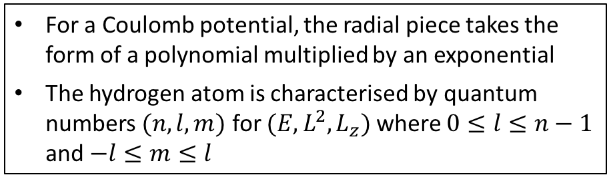
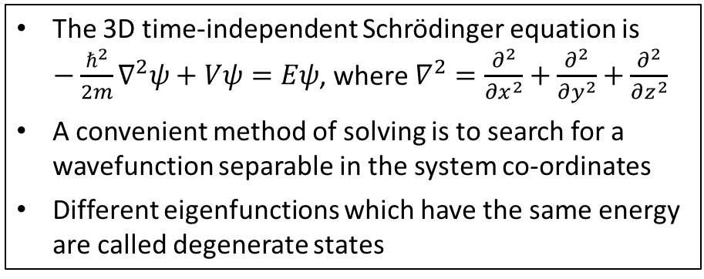
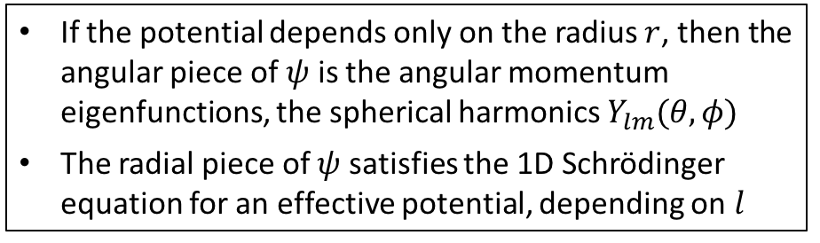
Summary
The 3D time-independent Schrödinger equation is $−\frac{ℏ^{2}}{2m}∇^{2}ψ+Vψ=Eψ$, where $∇^{2}=\frac{∂^{2}}{∂x^{2}}+\frac{∂^{2}}{∂y^{2}}+\frac{∂^{2}}{∂z^{2}}$
A convenient method of solving is to search for a wavefunction separable in the system co-ordinates
Different eigenfunctions which have the same energy are called degenerate states
Particle in a box
If the potential depends only on the radius $r$, then the angular piece of $ψ$ is the angular momentum eigenfunctions, the spherical harmonics $Y_{lm}(θ,φ)$
The radial piece of $ψ$ satisfies the 1D Schrödinger equation for an effective potential, depending on $l$
Central potentials
Eigenfunctions of the hydrogen atom
For a Coulomb potential, the radial piece takes the form of a polynomial multiplied by an exponential
The hydrogen atom is characterised by quantum numbers $(n,l,m)$ for $(E,L^{2},L_{z})$ where $0≤l≤n−1$ and $−l≤m≤l$

