Slide 1
Section 4: Angular Momentum
In these slides we will cover:
Angular momentum operators in QM
Commutation relations for these operators
Implication for the simultaneous measurement of the total angular momentum and its components
Ladder operators for angular momentum
Eigenvalues of angular momentum
Quantum states
Eigenfunctions of angular momentum
Measurement probabilities for angular momentum

Slide 2
Operators for angular momentum
What is angular momentum?
Angular momentum is a confusing concept, so let’s recap!
Angular momentum is motion around an axis!

Slide 3

Operators for angular momentum
What is angular momentum?
Angular momentum is a confusing concept, so let’s recap!
The classical definition of the angular momentum $\vec{L}$ of a particle with momentum $\vec{p}$ at position $\vec{r}$ is, $\vec{L}=\vec{r} × \vec{p}$
Angular momentum is a vector quantity $\vec{L}$ since the axis of rotation is a direction in space (perpendicular to $\vec{r}$ and $\vec{p}$)
Angular momentum corresponds to the momentum multiplied by the perpendicular distance from an axis containing the origin, i.e. it describes motion relative to this axis

Slide 4
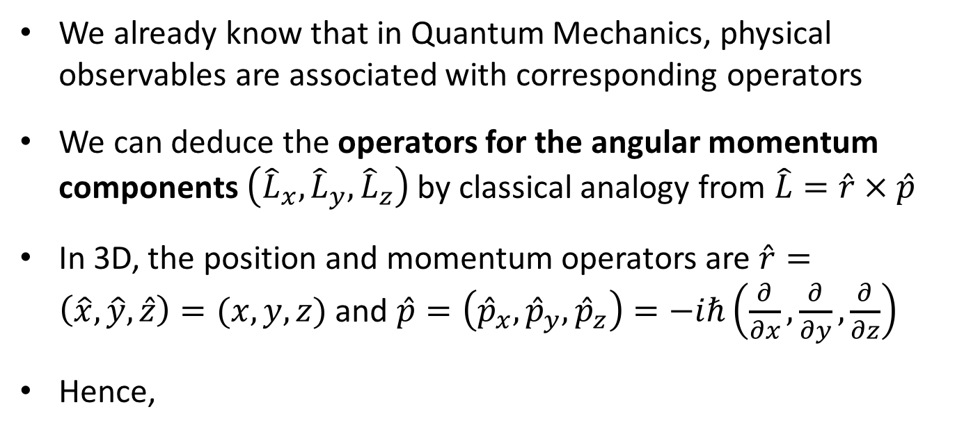
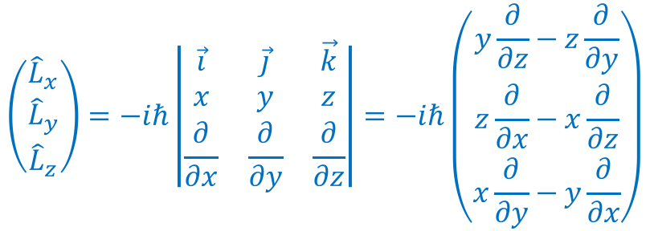
Operators for angular momentum
Angular momentum in quantum mechanics
We already know that in Quantum Mechanics, physical observables are associated with corresponding operators
We can deduce the operators for the angular momentum components $\left({\hat{L}}_{x},{\hat{L}}_{y},{\hat{L}}_{z}\right)$ by classical analogy from $\hat{L}=\hat{r} × \hat{p}$
In 3D, the position and momentum operators are $\hat{r}=\left(\hat{x},\hat{y},\hat{z}\right)=(x,y,z)$ and $\hat{p}=\left({\hat{p}}_{x},{\hat{p}}_{y},{\hat{p}}_{z}\right)=−iℏ\left(\frac{∂}{∂x},\frac{∂}{∂y},\frac{∂}{∂z}\right)$
Hence,
$$\left(\begin{matrix}{\hat{L}}_{x} \\ {\hat{L}}_{y} \\ {\hat{L}}_{z}\end{matrix}\right)=−iℏ\left|\begin{matrix}\vec{i} & \vec{j} & \vec{k} \\ x & y & z \\ \frac{∂}{∂x} & \frac{∂}{∂y} & \frac{∂}{∂z}\end{matrix}\right|=−iℏ\left(\begin{matrix}y\frac{∂}{∂z}−z\frac{∂}{∂y} \\ z\frac{∂}{∂x}−x\frac{∂}{∂z} \\ x\frac{∂}{∂y}−y\frac{∂}{∂x}\end{matrix}\right)$$

Slide 5
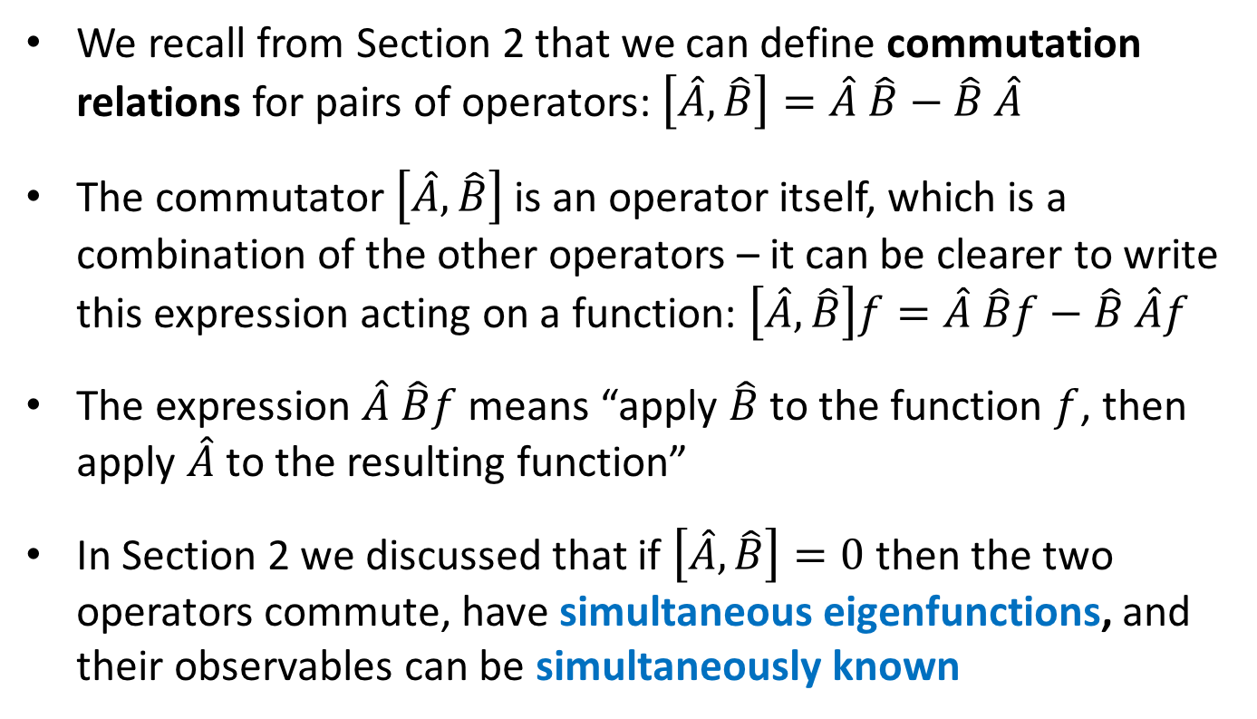
Operators for angular momentum
Recapping commutation relations
We recall from Section 2 that we can define commutation relations for pairs of operators: $\left[\hat{A},\hat{B}\right]=\hat{A} \hat{B}−\hat{B} \hat{A}$
The commutator $\left[\hat{A},\hat{B}\right]$ is an operator itself, which is a combination of the other operators – it can be clearer to write this expression acting on a function: $\left[\hat{A},\hat{B}\right]f=\hat{A} \hat{B}f−\hat{B} \hat{A}f$
The expression $\hat{A} \hat{B}f$ means “apply $\hat{B}$ to the function $f$, then apply $\hat{A}$ to the resulting function”
In Section 2 we discussed that if $\left[\hat{A},\hat{B}\right]=0$ then the two operators commute, have simultaneous eigenfunctions, and their observables can be simultaneously known

Slide 6

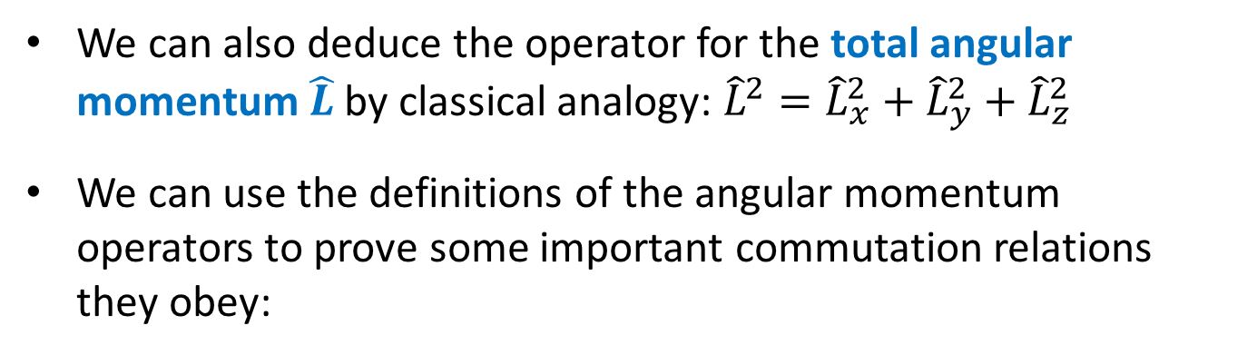






Operators for angular momentum
Commutation relations for angular momentum
We can also deduce the operator for the total angular momentum $\hat{L}$ by classical analogy: ${\hat{L}}^{2}={\hat{L}}_{x}^{2}+{\hat{L}}_{y}^{2}+{\hat{L}}_{z}^{2}$
We can use the definitions of the angular momentum operators to prove some important commutation relations they obey:
Equivalent versions from cyclic permutation of $x,y,z$:
Base relation:
$$\left[{\hat{L}}_{x},{\hat{L}}_{y}\right]=iℏ{\hat{L}}_{z}$$
$$\left[{\hat{L}}_{y},{\hat{L}}_{z}\right]=iℏ{\hat{L}}_{x}$$
$$\left[{\hat{L}}_{z},{\hat{L}}_{x}\right]=iℏ{\hat{L}}_{y}$$
$$\left[{\hat{L}}_{z}, {\hat{L}}^{2}\right]=0$$
$$\left[{\hat{L}}_{x}, {\hat{L}}^{2}\right]=0$$
$$\left[{\hat{L}}_{y}, {\hat{L}}^{2}\right]=0$$

Slide 7
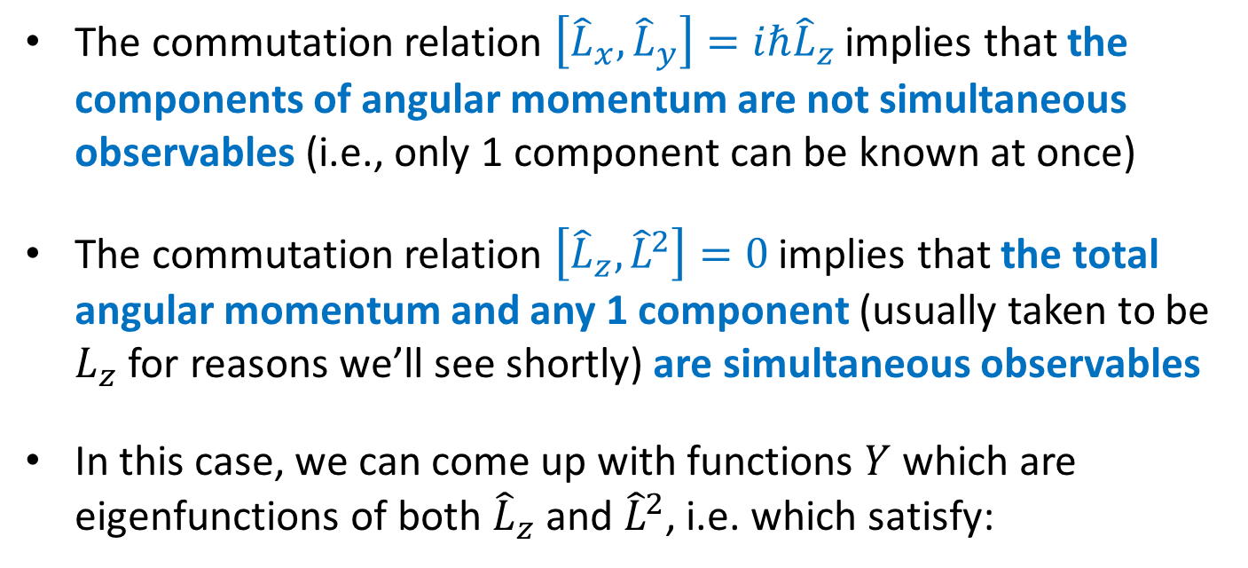
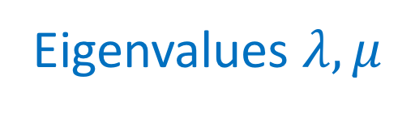


Operators for angular momentum
Implication for simultaneous observables
The commutation relation $\left[{\hat{L}}_{x},{\hat{L}}_{y}\right]=iℏ{\hat{L}}_{z}$ implies that the components of angular momentum are not simultaneous observables (i.e., only 1 component can be known at once)
The commutation relation $\left[{\hat{L}}_{z}, {\hat{L}}^{2}\right]=0$ implies that the total angular momentum and any 1 component (usually taken to be $L_{z}$ for reasons we’ll see shortly) are simultaneous observables
In this case, we can come up with functions $Y$ which are eigenfunctions of both ${\hat{L}}_{z}$ and ${\hat{L}}^{2}$, i.e. which satisfy:
$${\hat{L}}^{2} Y=λ Y$$
$${\hat{L}}_{z} Y=μ Y$$
Eigenvalues $λ,μ$

Slide 8

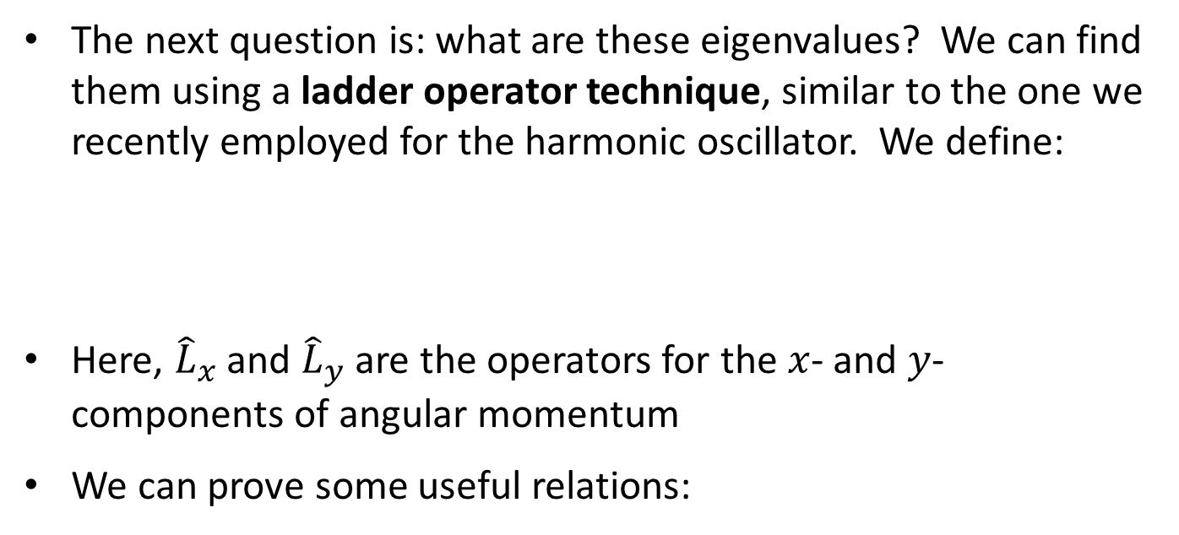





Angular momentum measurements
Ladder operators for angular momentum
The next question is: what are these eigenvalues? We can find them using a ladder operator technique, similar to the one we recently employed for the harmonic oscillator. We define:
Here, ${\hat{L}}_{x}$ and ${\hat{L}}_{y}$ are the operators for the $x$- and $y$-components of angular momentum
We can prove some useful relations:
$${\hat{L}}_{+}={\hat{L}}_{x}+i {\hat{L}}_{y}$$
$${\hat{L}}_{−}={\hat{L}}_{x}−i {\hat{L}}_{y}$$
$$\left[{\hat{L}}_{z},{\hat{L}}_{+}\right]=ℏ {\hat{L}}_{+}$$
$$\left[{\hat{L}}^{2},{\hat{L}}_{+}\right]=0$$
$$\left[{\hat{L}}_{z},{\hat{L}}_{−}\right]=−ℏ {\hat{L}}_{−}$$
$$\left[{\hat{L}}^{2},{\hat{L}}_{−}\right]=0$$

Slide 9
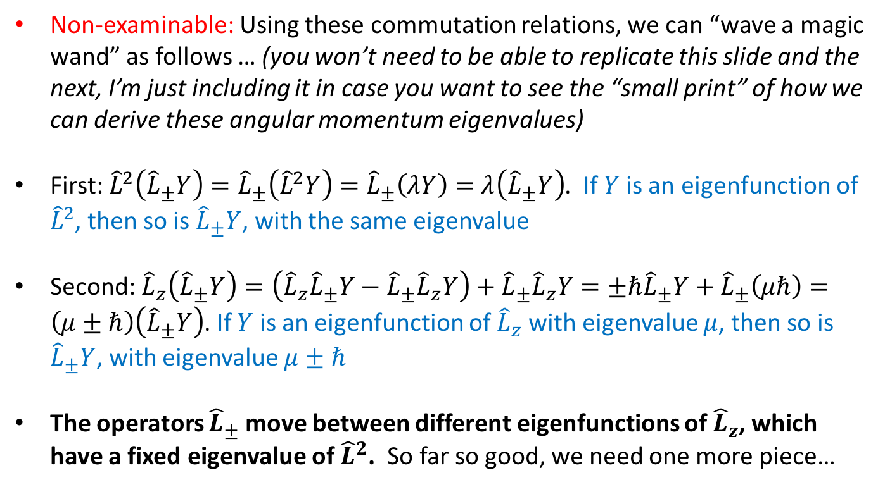
Angular momentum measurements
Ladder operators for angular momentum
Non-examinable: Using these commutation relations, we can “wave a magic wand” as follows … (you won’t need to be able to replicate this slide and the next, I’m just including it in case you want to see the “small print” of how we can derive these angular momentum eigenvalues)
First: ${\hat{L}}^{2}\left({\hat{L}}_{±}Y\right)={\hat{L}}_{±}\left({\hat{L}}^{2}Y\right)=$ ${\hat{L}}_{±}\left(λY\right)=$ $λ\left({\hat{L}}_{±}Y\right)$. If $Y$ is an eigenfunction of ${\hat{L}}^{2}$, then so is ${\hat{L}}_{±}Y$, with the same eigenvalue
Second: ${\hat{L}}_{z}\left({\hat{L}}_{±}Y\right)=\left({\hat{L}}_{z}{\hat{L}}_{±}Y−{\hat{L}}_{±}{\hat{L}}_{z}Y\right)+{\hat{L}}_{±}{\hat{L}}_{z}Y=±ℏ{\hat{L}}_{±}Y+{\hat{L}}_{±}\left(μℏ\right)=\left(μ±ℏ\right)\left({\hat{L}}_{±}Y\right)$. If $Y$ is an eigenfunction of ${\hat{L}}_{z}$ with eigenvalue $μ$, then so is ${\hat{L}}_{±}Y$, with eigenvalue $μ±ℏ$
The operators ${\hat{L}}_{±}$ move between different eigenfunctions of ${\hat{L}}_{z}$, which have a fixed eigenvalue of ${\hat{L}}^{2}$. So far so good, we need one more piece…

Slide 10
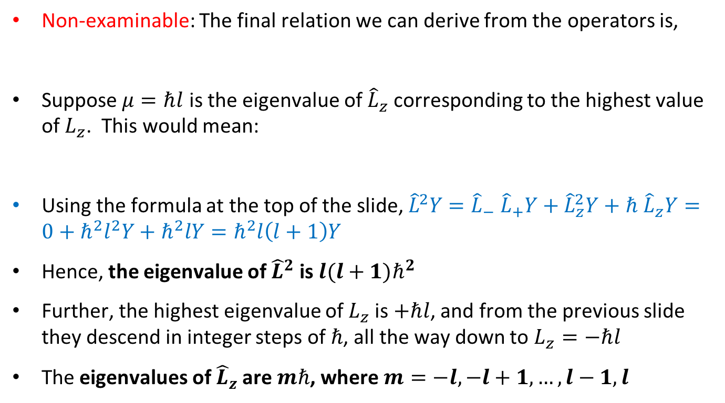



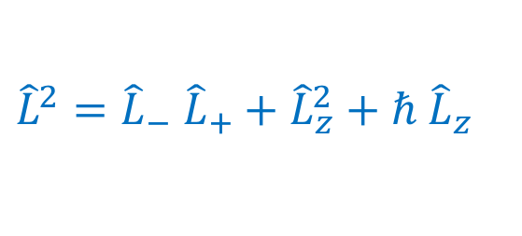
Angular momentum measurements
Ladder operators for angular momentum
Non-examinable: The final relation we can derive from the operators is,
Suppose $μ=ℏl$ is the eigenvalue of ${\hat{L}}_{z}$ corresponding to the highest value of $L_{z}$. This would mean:
Using the formula at the top of the slide, ${\hat{L}}^{2}Y={\hat{L}}_{−} {\hat{L}}_{+}Y+{\hat{L}}_{z}^{2}Y+ℏ {\hat{L}}_{z}Y=0+ℏ^{2}l^{2}Y+ℏ^{2}lY=ℏ^{2}l\left(l+1\right)Y$
Hence, the eigenvalue of ${\hat{L}}^{2}$ is $l(l+1)ℏ^{2}$
Further, the highest eigenvalue of $L_{z}$ is $+ℏl$, and from the previous slide they descend in integer steps of $ℏ$, all the way down to $L_{z}=−ℏl$
The eigenvalues of ${\hat{L}}_{z}$ are $mℏ$, where $m=−l,−l+1,…,l−1,l$
$${\hat{L}}^{2}={\hat{L}}_{−} {\hat{L}}_{+}+{\hat{L}}_{z}^{2}+ℏ {\hat{L}}_{z}$$
$${\hat{L}}_{+}Y=0$$
$${\hat{L}}_{z}Y=ℏlY$$
$${\hat{L}}^{2}Y=λY$$

Slide 11
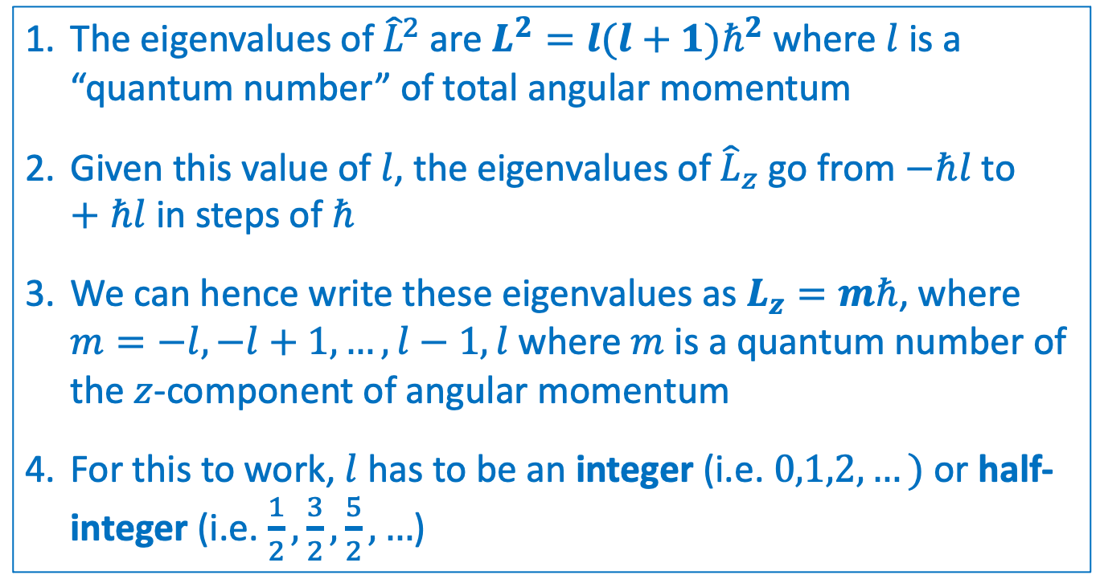
Angular momentum measurements
Angular momentum eigenvalues
What have we actually learned from all these manipulations??
The eigenvalues of ${\hat{L}}^{2}$ are $L^{2}=l(l+1)ℏ^{2}$ where $l$ is a “quantum number” of total angular momentum
Given this value of $l$, the eigenvalues of ${\hat{L}}_{z}$ go from $−ℏl$ to $+ℏl$ in steps of $ℏ$
We can hence write these eigenvalues as $L_{z}=mℏ$, where $m=−l,−l+1,…,l−1,l$ where $m$ is a quantum number of the $z$-component of angular momentum
For this to work, $l$ has to be an integer (i.e. $0,1,2,…)$ or half-integer (i.e. $\frac{1}{2},\frac{3}{2},\frac{5}{2},…$)

Slide 12
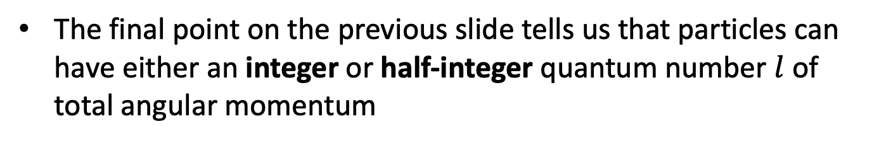
Angular momentum measurements
Angular momentum eigenvalues
The final point on the previous slide tells us that particles can have either an integer or half-integer quantum number $l$ of total angular momentum
Interesting aside: particles also have an intrinsic angular momentum, also known as spin. Particles with integer spin are known as bosons, and particles with half-integer spin are known as fermions. This determines some important properties!

Slide 13
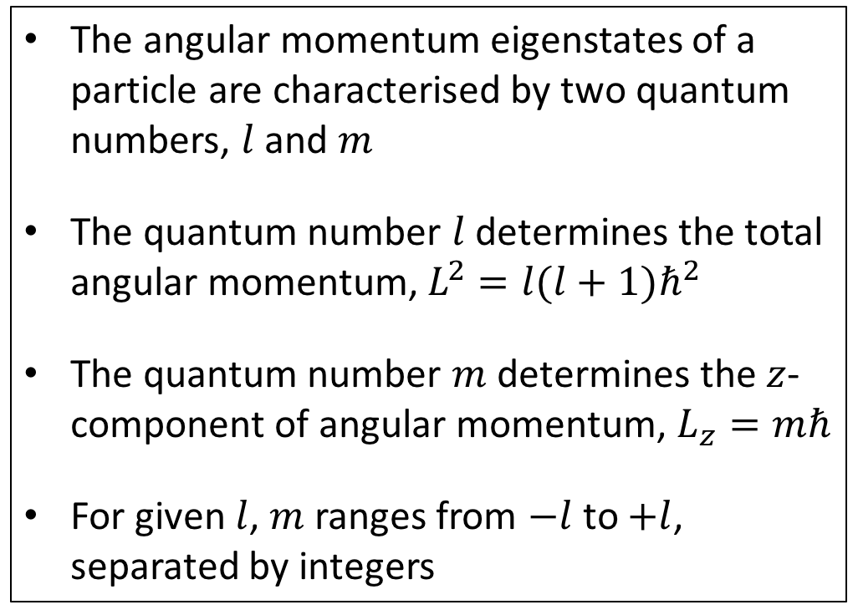
Angular momentum measurements
Summary
The angular momentum eigenstates of a particle are characterised by two quantum numbers, $l$ and $m$
The quantum number $l$ determines the total angular momentum, $L^{2}=l(l+1)ℏ^{2}$
The quantum number $m$ determines the $z$-component of angular momentum, $L_{z}=mℏ$
For given $l$, $m$ ranges from $−l$ to $+l$, separated by integers

Slide 14

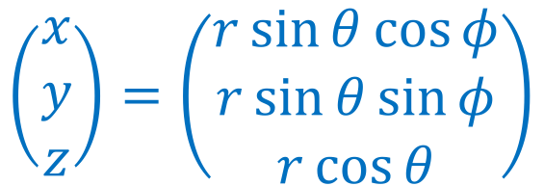
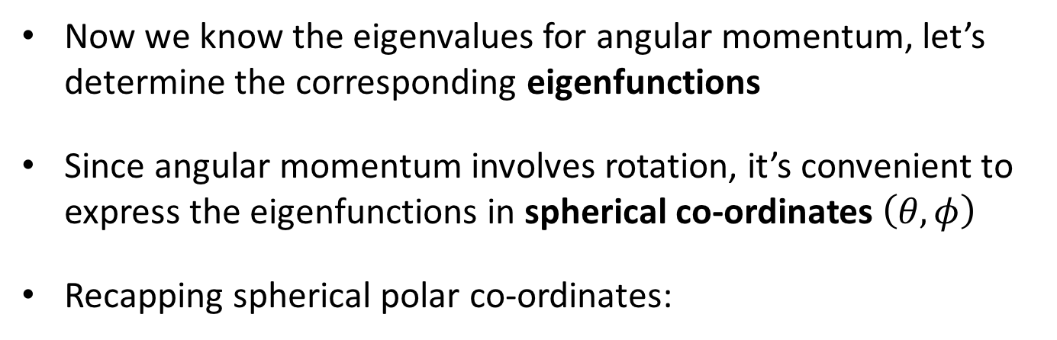
Eigenfunctions of angular momentum
The eigenfunctions of ${\hat{L}}_{z}$
Now we know the eigenvalues for angular momentum, let’s determine the corresponding eigenfunctions
Since angular momentum involves rotation, it’s convenient to express the eigenfunctions in spherical co-ordinates $\left(θ,φ\right)$
Recapping spherical polar co-ordinates:
$$\left(\begin{matrix}x \\ y \\ z\end{matrix}\right)=\left(\begin{matrix}r\sin{θ}\cos{φ} \\ r\sin{θ}\sin{φ} \\ r\cos{θ}\end{matrix}\right)$$

Slide 15
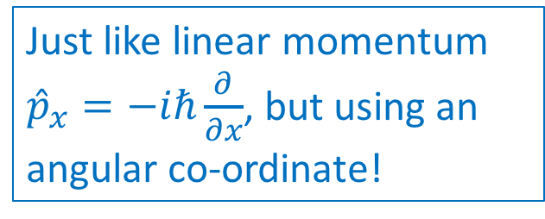
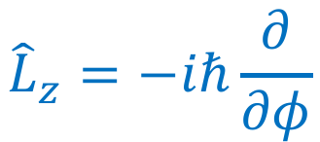
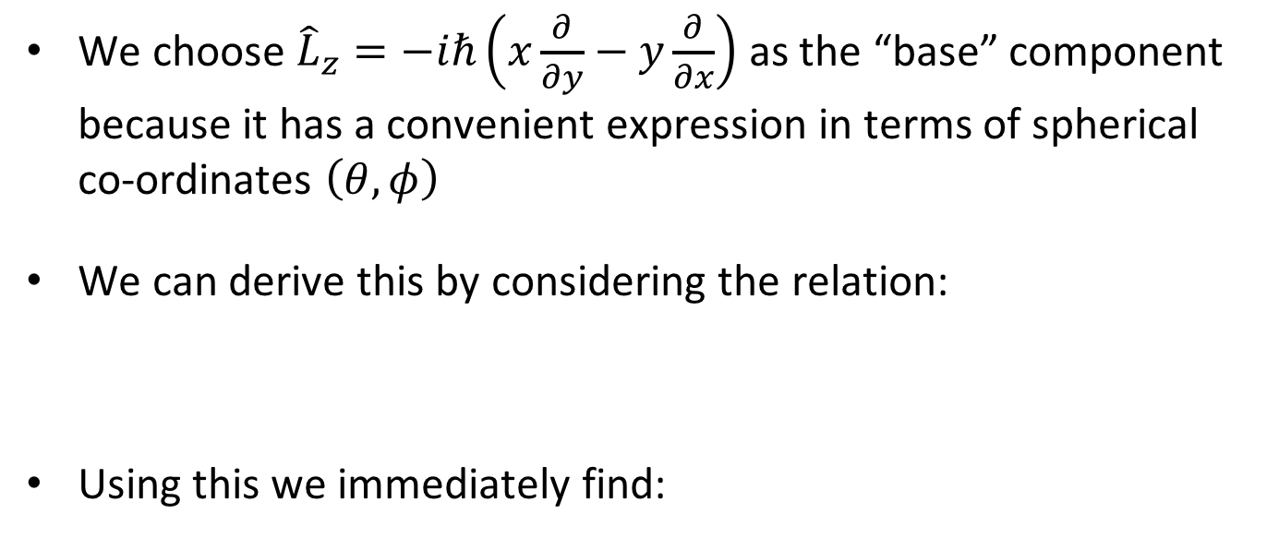
Eigenfunctions of angular momentum
The eigenfunctions of ${\hat{L}}_{z}$
We choose ${\hat{L}}_{z}=−iℏ\left(x\frac{∂}{∂y}−y\frac{∂}{∂x}\right)$ as the “base” component because it has a convenient expression in terms of spherical co-ordinates $\left(θ,φ\right)$
We can derive this by considering the relation:
Using this we immediately find:
$$\frac{∂}{∂φ}=\frac{∂x}{∂φ}\frac{∂}{∂x}+\frac{∂y}{∂φ}\frac{∂}{∂y}+\frac{∂z}{∂φ}\frac{∂}{∂z}=−r\sin{θ}\sin{φ}\frac{∂}{∂x}+r\sin{θ}\cos{φ}\frac{∂}{∂y}=−y\frac{∂}{∂x}+x\frac{∂}{∂y}$$
$${\hat{L}}_{z}=−iℏ\frac{∂}{∂φ}$$
Just like linear momentum ${\hat{p}}_{x}=−iℏ\frac{∂}{∂x}$, but using an angular co-ordinate!

Slide 16
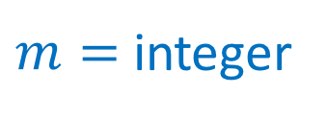


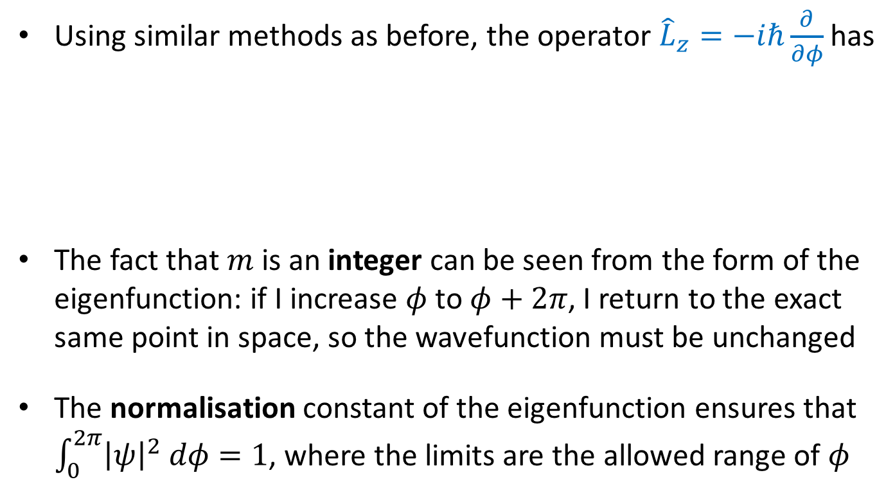
Eigenfunctions of angular momentum
The eigenfunctions of ${\hat{L}}_{z}$
Using similar methods as before, the operator ${\hat{L}}_{z}=−iℏ\frac{∂}{∂φ}$ has
The fact that $m$ is an integer can be seen from the form of the eigenfunction: if I increase $φ$ to $φ+2π$, I return to the exact same point in space, so the wavefunction must be unchanged
The normalisation constant of the eigenfunction ensures that $\int_{0}^{2π}{{\left|ψ\right|}^{2} dφ}=1$, where the limits are the allowed range of $φ$
Eigenfunctions $\frac{1}{\sqrt{2π}}e^{imφ}$
Eigenvalues $mℏ$
$m=$ integer

Slide 17
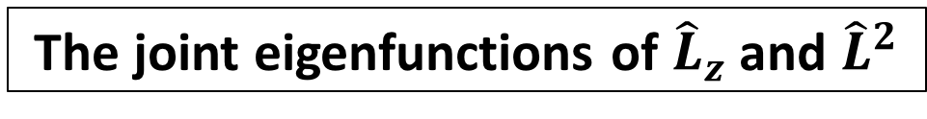
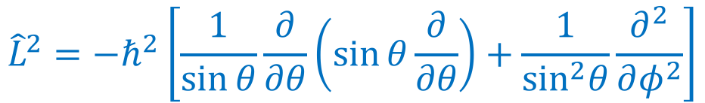
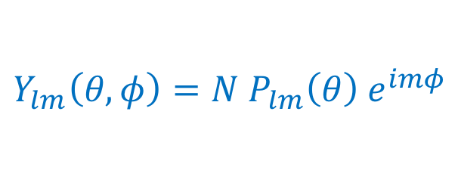
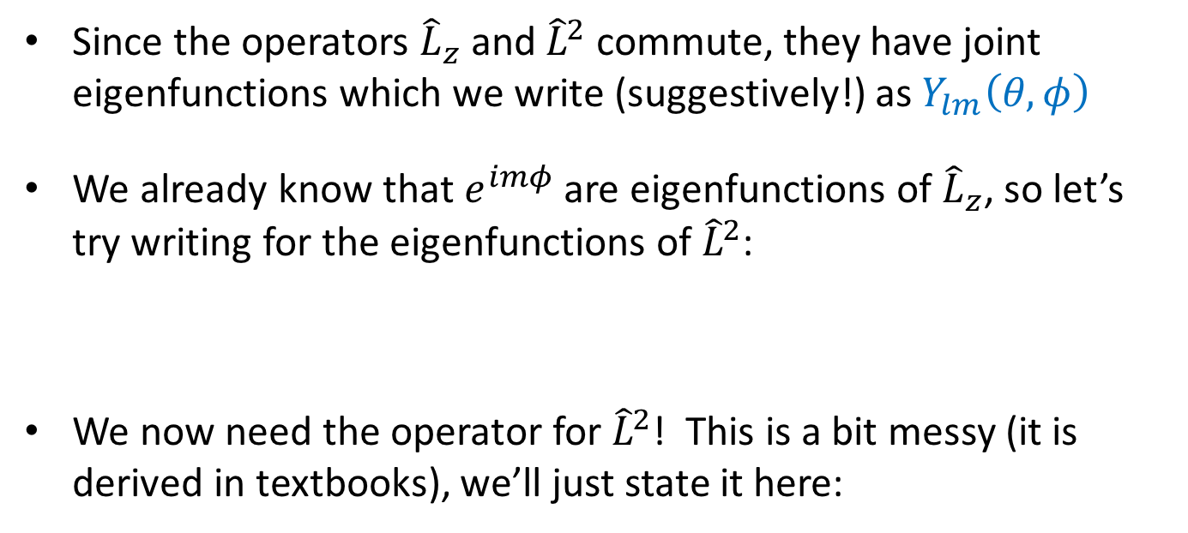
Eigenfunctions of angular momentum
The joint eigenfunctions of ${\hat{L}}_{z}$ and ${\hat{L}}^{2}$
Since the operators ${\hat{L}}_{z}$ and ${\hat{L}}^{2}$ commute, they have joint eigenfunctions which we write (suggestively!) as $Y_{lm}\left(θ,φ\right)$
We already know that $e^{imφ}$ are eigenfunctions of ${\hat{L}}_{z}$, so let’s try writing for the eigenfunctions of ${\hat{L}}^{2}$:
We now need the operator for ${\hat{L}}^{2}$! This is a bit messy (it is derived in textbooks), we’ll just state it here:
$$Y_{lm}\left(θ,φ\right)=N P_{lm}\left(θ\right) e^{imφ}$$
$${\hat{L}}^{2}=−ℏ^{2}\left[\frac{1}{\sin{θ}}\frac{∂}{∂θ}\left(\sin{θ}\frac{∂}{∂θ}\right)+\frac{1}{\sin^{2}θ}\frac{∂^{2}}{∂φ^{2}}\right]$$

Slide 18
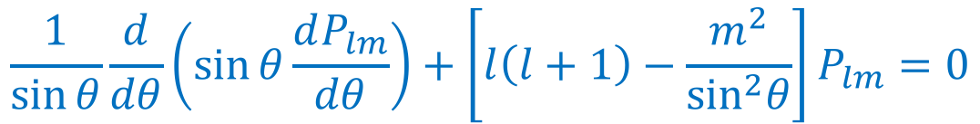
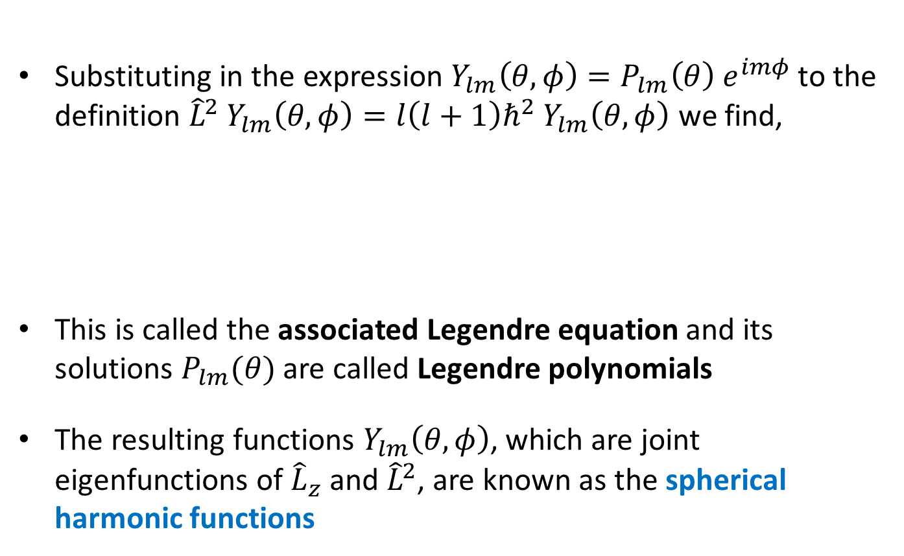
Eigenfunctions of angular momentum
The joint eigenfunctions of ${\hat{L}}_{z}$ and ${\hat{L}}^{2}$
Substituting in the expression $Y_{lm}\left(θ,φ\right)=P_{lm}\left(θ\right) e^{imφ}$ to the definition ${\hat{L}}^{2} Y_{lm}\left(θ,φ\right)=l\left(l+1\right)ℏ^{2} Y_{lm}\left(θ,φ\right)$ we find,
This is called the associated Legendre equation and its solutions $P_{lm}(θ)$ are called Legendre polynomials
The resulting functions $Y_{lm}\left(θ,φ\right)$, which are joint eigenfunctions of ${\hat{L}}_{z}$ and ${\hat{L}}^{2}$, are known as the spherical harmonic functions
$$\frac{1}{\sin{θ}}\frac{d}{dθ}\left(\sin{θ}\frac{dP_{lm}}{dθ}\right)+\left[l\left(l+1\right)−\frac{m^{2}}{\sin^{2}θ}\right]P_{lm}=0$$

Slide 19


















Eigenfunctions of angular momentum
Spherical harmonics
Here are a few spherical harmonic functions $Y_{lm}\left(θ,φ\right)$ for the first few values of $l$ and $m$:
$$l=0$$
$$l=1$$
$$l=2$$
$$m=−2$$
$$Y_{2 −2}=\sqrt{\frac{15}{32π}} \sin^{2}θ e^{−2iφ}$$
$$m=−1$$
$$Y_{1 −1}=\sqrt{\frac{3}{8π}}\sin{θ}e^{−iφ}$$
$$Y_{2 −1}=\sqrt{\frac{15}{8π}}\sin{θ}\cos{θ}e^{−iφ}$$
$$m=0$$
$$Y_{00}=\sqrt{\frac{1}{4π}}$$
$$Y_{10}=\sqrt{\frac{3}{4π}}\cos{θ}$$
$$Y_{20}=\sqrt{\frac{5}{16π}}\left(3 \cos^{2}θ−1\right)$$
$$m=+1$$
$$Y_{11}=−\sqrt{\frac{3}{8π}}\sin{θ}e^{iφ}$$
$$Y_{21}=−\sqrt{\frac{15}{8π}}\sin{θ}\cos{θ}e^{iφ}$$
$$m=+2$$
$$Y_{22}=\sqrt{\frac{15}{32π}} \sin^{2}θ e^{2iφ}$$

Slide 20












Eigenfunctions of angular momentum
Spherical harmonics
Here are some visualisations of $Y_{lm}\left(θ,φ\right)$ for some values of $l$ and $m$ (these all visualise the intensity on a sphere):
$$m=−3$$
$$−2$$
$$−1$$
$$0$$
$$+1$$
$$+2$$
$$+3$$
$$l=0$$
$$l=1$$
$$l=2$$
$$l=3$$

Slide 21
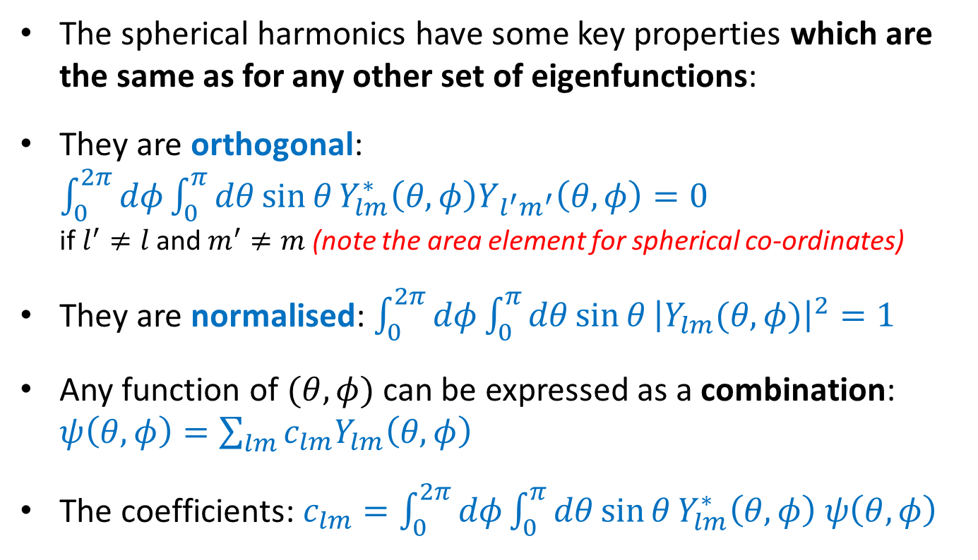
Eigenfunctions of angular momentum
Spherical harmonics
The spherical harmonics have some key properties which are the same as for any other set of eigenfunctions:
They are orthogonal: $\int_{0}^{2π}{dφ}\int_{0}^{π}{dθ\sin{θ}}Y_{lm}^{∗}\left(θ,φ\right)Y_{l^{′}m^{′}}\left(θ,φ\right)=0$ if $l^{′}≠l$ and $m^{′}≠m$ (note the area element for spherical co-ordinates)
They are normalised: $\int_{0}^{2π}{dφ}\int_{0}^{π}{dθ\sin{θ}}{\left|Y_{lm}(θ,φ)\right|}^{2}=1$
Any function of $(θ,φ)$ can be expressed as a combination: $ψ\left(θ,φ\right)=\sum_{lm}{c_{lm}Y_{lm}\left(θ,φ\right)}$
The coefficients: $c_{lm}=\int_{0}^{2π}{dφ}\int_{0}^{π}{dθ\sin{θ}}Y_{lm}^{∗}\left(θ,φ\right) ψ\left(θ,φ\right)$

Slide 22
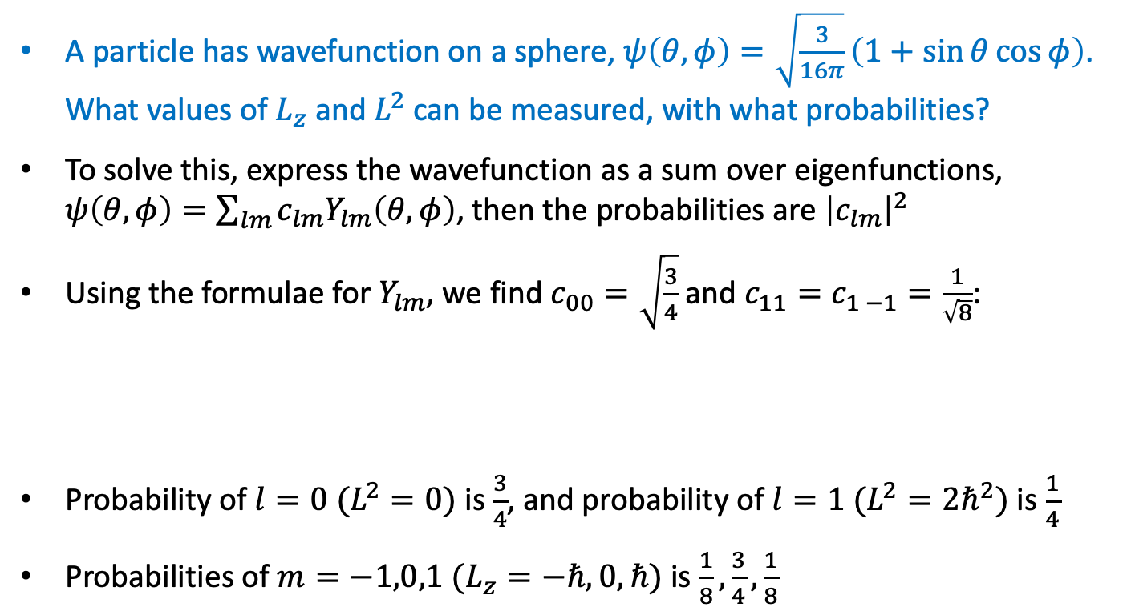
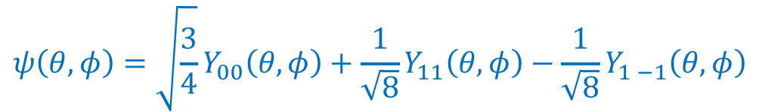
Eigenfunctions of angular momentum
Example of angular momentum measurement
A particle has wavefunction on a sphere, $ψ\left(θ,φ\right)=\sqrt{\frac{3}{16π}}\left(1+\sin{θ}\cos{φ}\right)$. What values of $L_{z}$ and $L^{2}$ can be measured, with what probabilities?
To solve this, express the wavefunction as a sum over eigenfunctions, $ψ\left(θ,φ\right)=\sum_{lm}{c_{lm}Y_{lm}\left(θ,φ\right)}$, then the probabilities are ${\left|c_{lm}\right|}^{2}$
Using the formulae for $Y_{lm}$, we find $c_{00}=\sqrt{\frac{3}{4}}$ and $c_{11}=c_{1 −1}=\frac{1}{\sqrt{8}}$:
Probability of $l=0 (L^{2}=0)$ is $\frac{3}{4}$, and probability of $l=1 (L^{2}={2ℏ}^{2})$ is $\frac{1}{4}$
Probabilities of $m=−1,0,1 (L_{z}=−ℏ,0,ℏ)$ is $\frac{1}{8},\frac{3}{4},\frac{1}{8}$
$$ψ\left(θ,φ\right)=\sqrt{\frac{3}{4}}Y_{00}\left(θ,φ\right)+\frac{1}{\sqrt{8}}Y_{11}\left(θ,φ\right)−\frac{1}{\sqrt{8}}Y_{1 −1}\left(θ,φ\right)$$

Slide 23
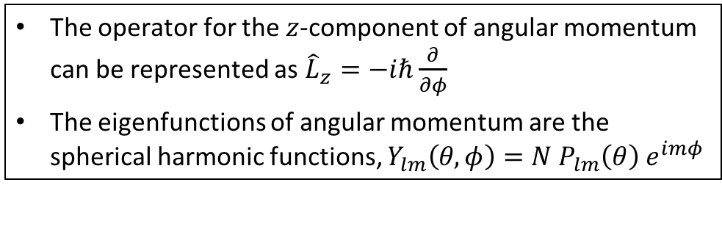
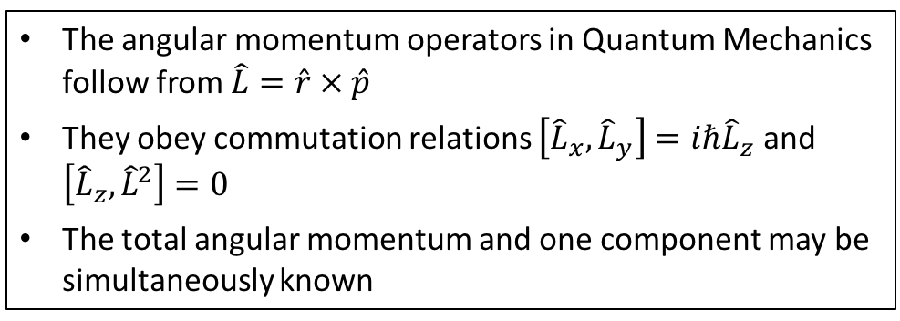
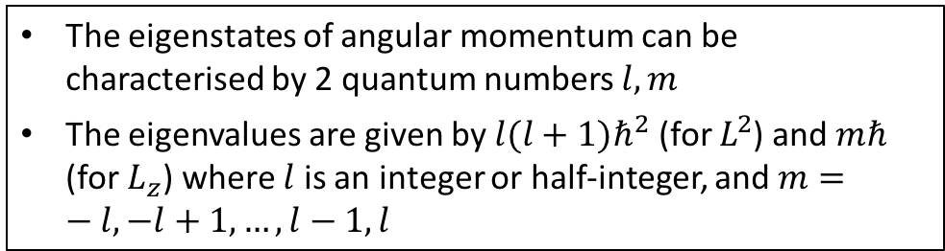
Summary
The angular momentum operators in Quantum Mechanics follow from $\hat{L}=\hat{r} × \hat{p}$
They obey commutation relations $\left[{\hat{L}}_{x},{\hat{L}}_{y}\right]=iℏ{\hat{L}}_{z}$ and $\left[{\hat{L}}_{z}, {\hat{L}}^{2}\right]=0$
The total angular momentum and one component may be simultaneously known
Operators for angular momentum
Angular momentum measurements
The eigenstates of angular momentum can be characterised by 2 quantum numbers $l,m$
The eigenvalues are given by $l(l+1)ℏ^{2}$ (for $L^{2}$) and $mℏ$ (for $L_{z}$) where $l$ is an integer or half-integer, and $m=−l,−l+1,…,l−1,l$
Eigenfunctions of angular momentum
The operator for the $z$-component of angular momentum can be represented as ${\hat{L}}_{z}=−iℏ\frac{∂}{∂φ}$
The eigenfunctions of angular momentum are the spherical harmonic functions, $Y_{lm}\left(θ,φ\right)=N P_{lm}\left(θ\right) e^{imφ}$

