Slide 1
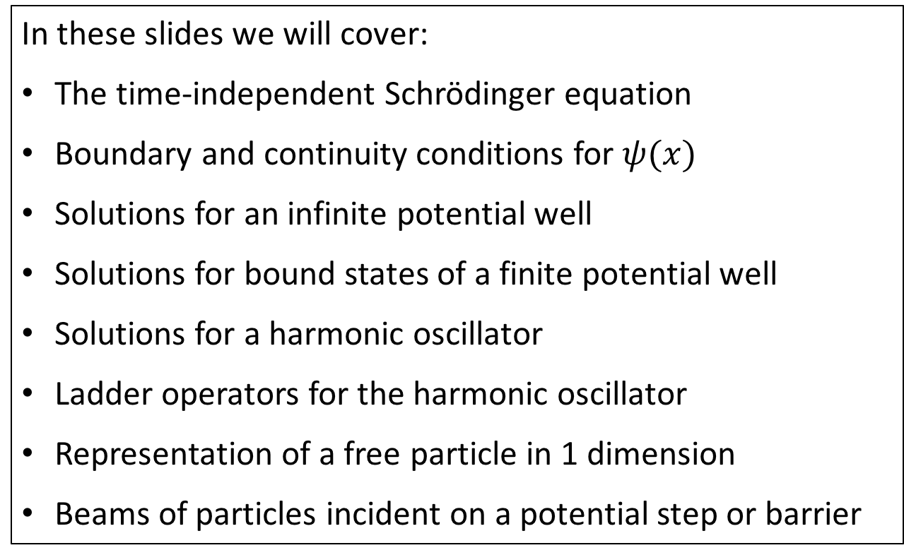
Section 3: 1D Schrödinger Equation
In these slides we will cover:
The time-independent Schrödinger equation
Boundary and continuity conditions for $ψ(x)$
Solutions for an infinite potential well
Solutions for bound states of a finite potential well
Solutions for a harmonic oscillator
Ladder operators for the harmonic oscillator
Representation of a free particle in 1 dimension
Beams of particles incident on a potential step or barrier

Slide 2
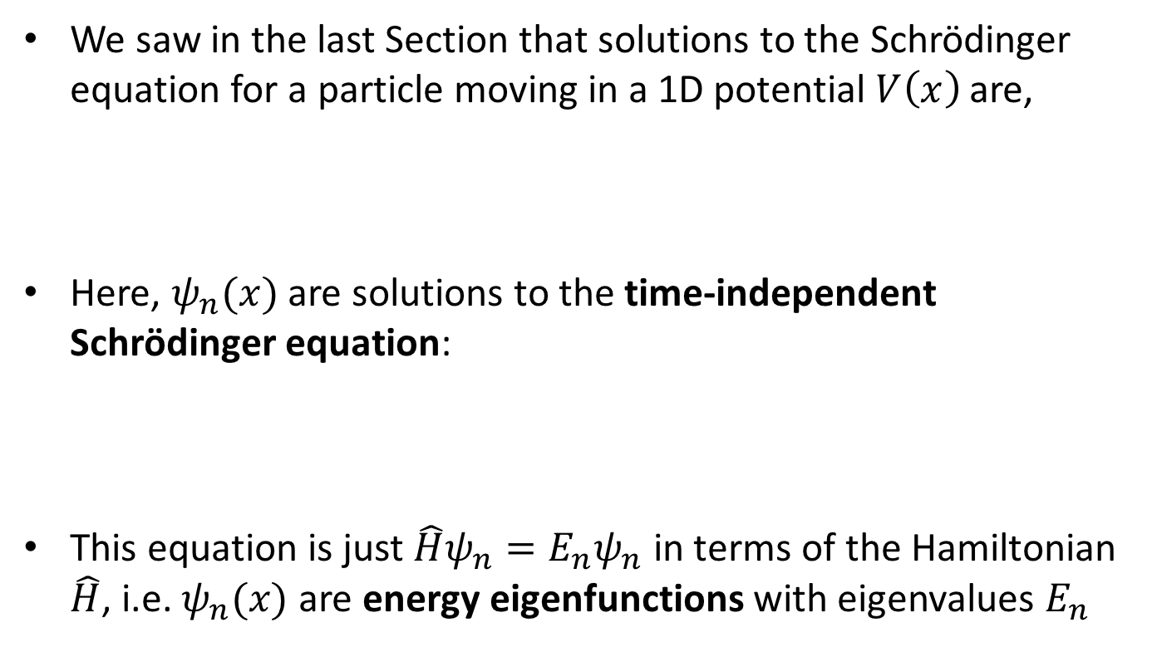
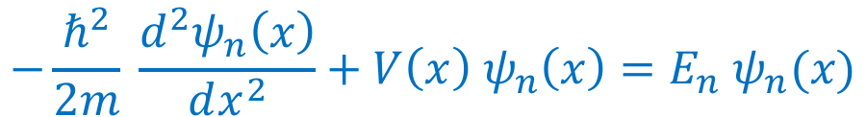
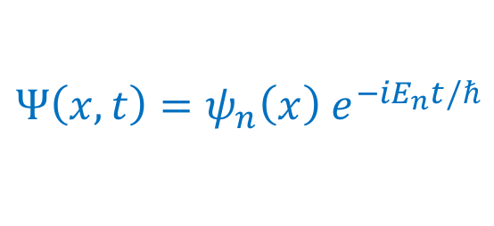
Square potential wells
The time-independent Schrödinger equation
We saw in the last Section that solutions to the Schrödinger equation for a particle moving in a 1D potential $V\left(x\right)$ are,
Here, $ψ_{n}(x)$ are solutions to the time-independent Schrödinger equation:
This equation is just $\hat{H}ψ_{n}=E_{n}ψ_{n}$ in terms of the Hamiltonian $\hat{H}$, i.e. $ψ_{n}(x)$ are energy eigenfunctions with eigenvalues $E_{n}$
$$Ψ\left(x,t\right)=ψ_{n}\left(x\right) e^{−iE_{n}t/ℏ}$$
$$−\frac{ℏ^{2}}{2m} \frac{d^{2}ψ_{n}\left(x\right)}{dx^{2}}+V\left(x\right) ψ_{n}\left(x\right)=E_{n} ψ_{n}(x)$$

Slide 3
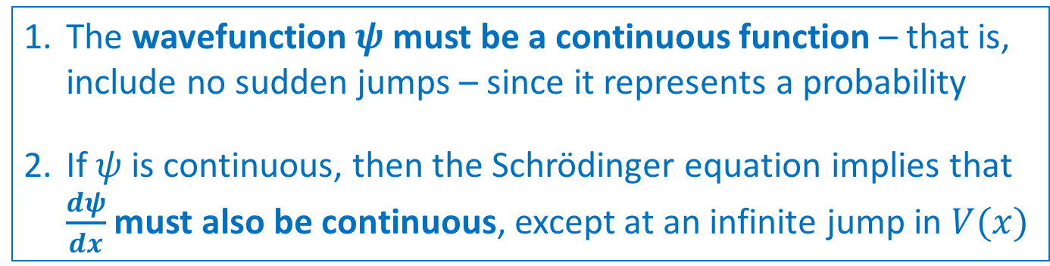

Square potential wells
Boundary and continuity conditions for $ψ$
The solutions of a differential equation (such as the Schrödinger equation) always require boundary conditions
For the Schrödinger equation, there are 2 boundary conditions:
The wavefunction $ψ$ must be a continuous function – that is, include no sudden jumps – since it represents a probability
If $ψ$ is continuous, then the Schrödinger equation implies that $\frac{dψ}{dx}$ must also be continuous, except at an infinite jump in $V(x)$

Slide 4
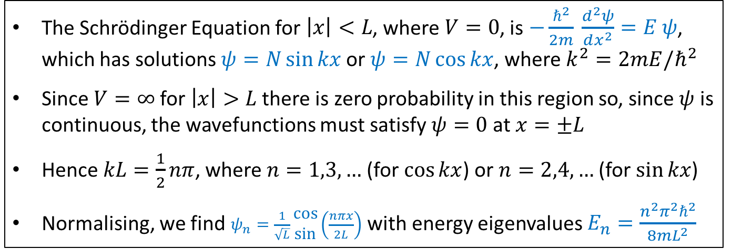







Square potential wells
Infinite square well: eigenfunctions and eigenvalues
The classical example of a potential well is the infinite square well you have met before. Let’s recap it …
$$V(x)$$
$$V=∞$$
$$V=∞$$
$$V=0$$
$$x$$
$$−L$$
$$0$$
$$+L$$
The Schrödinger Equation for $\left|x\right|<L$, where $V=0$, is $−\frac{ℏ^{2}}{2m} \frac{d^{2}ψ}{dx^{2}}=E ψ$, which has solutions $ψ=N\sin{kx}$ or $ψ=N\cos{kx}$, where $k^{2}=2mE/ℏ^{2}$
Since $V=∞$ for $\left|x\right|>L$ there is zero probability in this region so, since $ψ$ is continuous, the wavefunctions must satisfy $ψ=0$ at $x=±L$
Hence $kL=\frac{1}{2}nπ$, where $n=1,3,…$ (for $\cos{kx}$) or $n=2,4,…$ (for $\sin{kx}$)
Normalising, we find $ψ_{n}=\frac{1}{\sqrt{L}}\begin{matrix}cos \\ sin\end{matrix}\left(\frac{nπx}{2L}\right)$ with energy eigenvalues $E_{n}=\frac{n^{2}π^{2}ℏ^{2}}{8mL^{2}}$

Slide 5
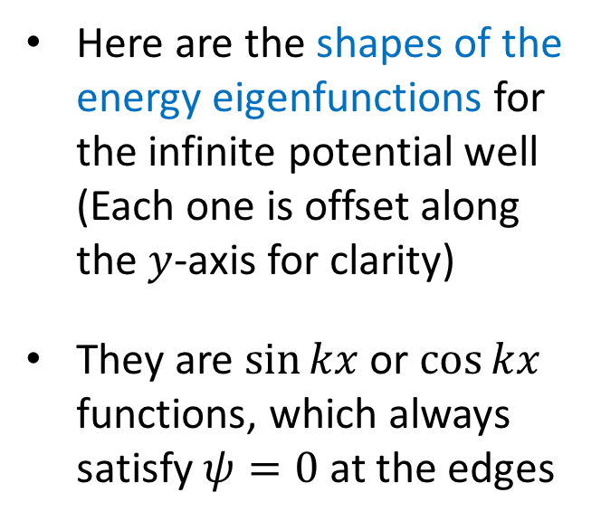
Square potential wells
Infinite square well: eigenfunctions and eigenvalues
Here are the shapes of the energy eigenfunctions for the infinite potential well (Each one is offset along the $y$-axis for clarity)
They are $\sin{kx}$ or $\cos{kx}$ functions, which always satisfy $ψ=0$ at the edges
Image credit: https://opentextbc.ca/universityphysicsv3openstax/chapter/the-quantum-particle-in-a-box/

Slide 6





Square potential wells
Bound states of a finite square well
Now let’s consider a particle with energy $E$ in a finite square potential well of depth $V_{0}$ (where $E<V_{0}$), which looks like:
Classically speaking, the particle would not cross into $\left|x\right|>L$, since $E<V_{0}$. However, this is not true in Quantum Mechanics – particles can appear in the forbidden region!
$$V(x)$$
A “bound state” means that the energy of particle satisfies $E<V_{o}$
$$V_{0}$$
$$x$$
$$−L$$
$$0$$
$$+L$$

Slide 7
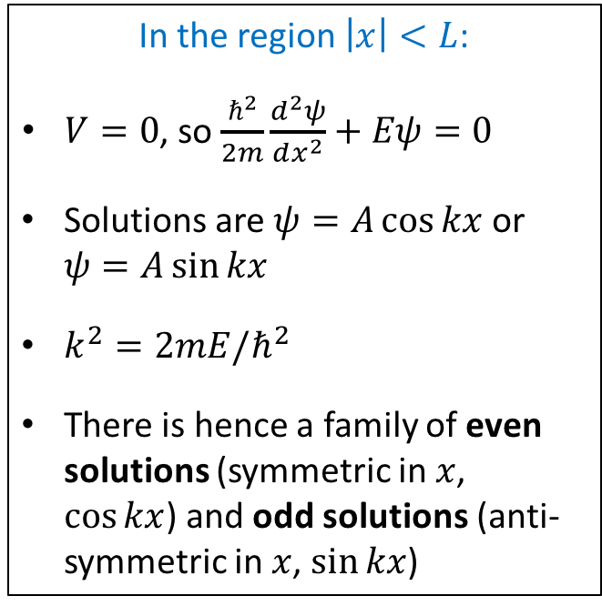
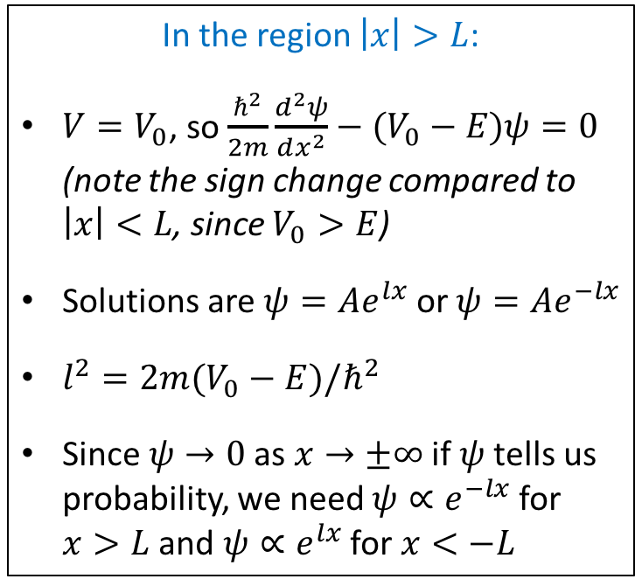
Square potential wells
Bound states of a finite square well
We can determine the wavefunction by solving the Schrödinger equation and applying the boundary conditions
In the region $\left|x\right|<L$:
$V=0$, so $\frac{ℏ^{2}}{2m}\frac{d^{2}ψ}{dx^{2}}+Eψ=0$
Solutions are $ψ=A\cos{kx}$ or $ψ=A\sin{kx}$
$k^{2}=2mE/ℏ^{2}$
There is hence a family of even solutions (symmetric in $x$, $\cos{kx}$) and odd solutions (anti-symmetric in $x$, $\sin{kx}$)
In the region $\left|x\right|>L$:
$V=V_{0}$, so $\frac{ℏ^{2}}{2m}\frac{d^{2}ψ}{dx^{2}}−(V_{0}−E)ψ=0$ (note the sign change compared to $\left|x\right|<L$, since $V_{0}>E$)
Solutions are $ψ=Ae^{lx}$ or $ψ=Ae^{−lx}$
$l^{2}=2m(V_{0}−E)/ℏ^{2}$
Since $ψ→0$ as $x→±∞$ if $ψ$ tells us probability, we need $ψ∝e^{−lx}$ for $x>L$ and $ψ∝e^{lx}$ for $x<−L$

Slide 8
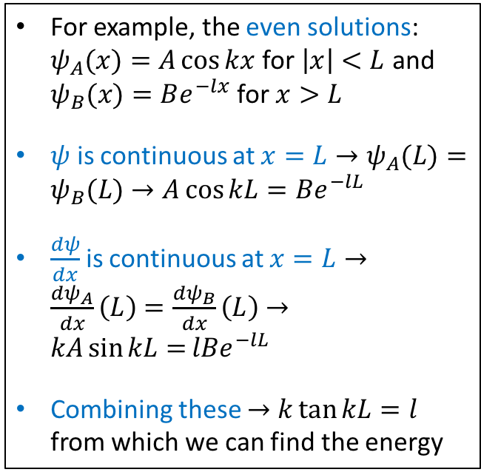

Square potential wells
Bound states of a finite square well
We can determine the wavefunction by solving the Schrödinger equation and applying the boundary conditions
$$V_{0}$$
For example, the even solutions: $ψ_{A}(x)=A\cos{kx}$ for $\left|x\right|<L$ and $ψ_{B}(x)=Be^{−lx}$ for $x>L$
$ψ$ is continuous at $x=L→ψ_{A}(L)=ψ_{B}(L)→A\cos{kL}=Be^{−lL}$
$\frac{dψ}{dx}$ is continuous at $x=L→\frac{dψ_{A}}{dx}\left(L\right)=\frac{dψ_{B}}{dx}\left(L\right)→kA\sin{kL=}lBe^{−lL}$
Combining these $→k\tan{kL}=l$ from which we can find the energy
Comparing the lowest energy eigenfunctions of the infinite potential well and finite potential well (Image credit: http://hyperphysics.phy-astr.gsu.edu)

Slide 9




The harmonic oscillator
Definition of the harmonic oscillator
The harmonic oscillator is a particle moving in a 1D potential $V\left(x\right)=\frac{1}{2}kx^{2}$ – classically, this is like a mass on a spring
Classically, a particle would oscillate to-and-fro with “simple harmonic motion” $x\left(t\right)=A\cos{ωt}$, where $ω^{2}=k/m$, and its motion would be restricted to $\left|x\right|<A$, where $A=\sqrt{2E/k}$
$$V(x)$$
$$m$$
$$x$$

Slide 10
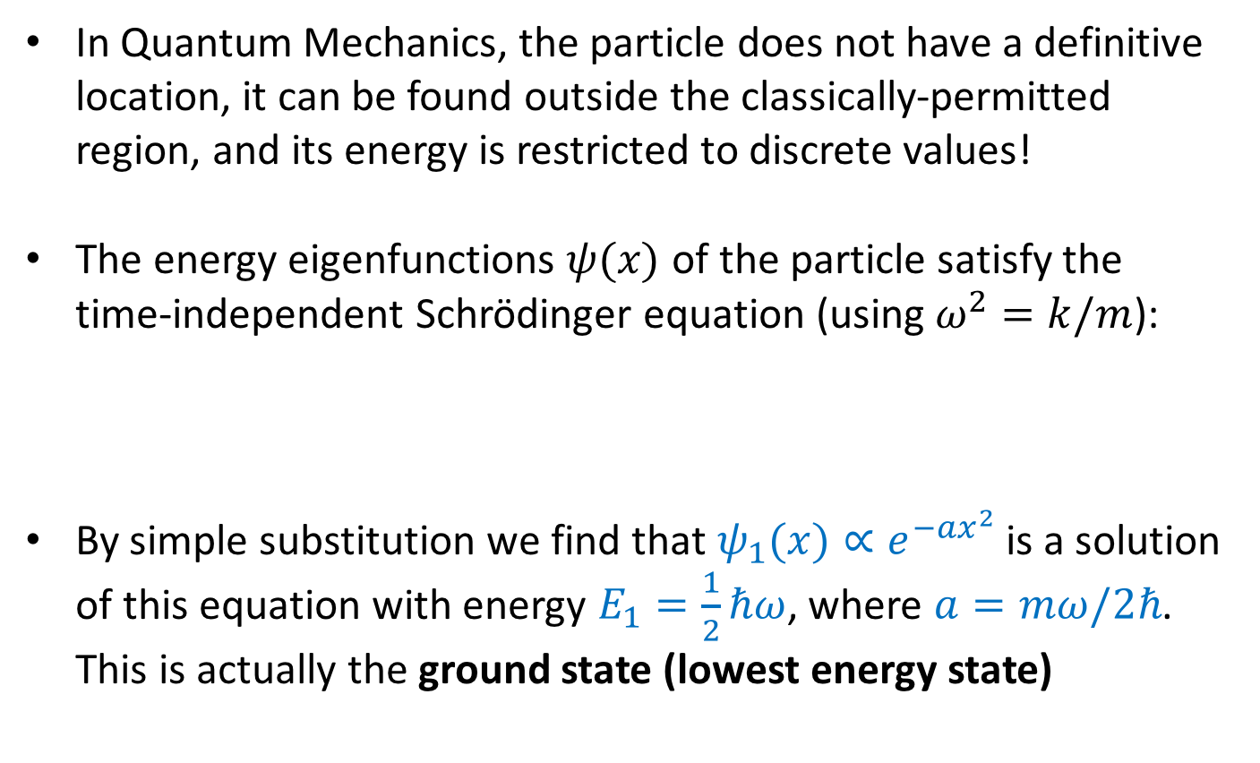
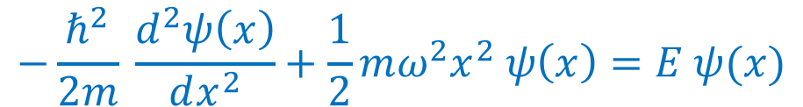
The harmonic oscillator
The Schrödinger equation for the harmonic oscillator
In Quantum Mechanics, the particle does not have a definitive location, it can be found outside the classically-permitted region, and its energy is restricted to discrete values!
The energy eigenfunctions $ψ(x)$ of the particle satisfy the time-independent Schrödinger equation (using $ω^{2}=k/m$):
By simple substitution we find that $ψ_{1}(x)∝e^{−ax^{2}}$ is a solution of this equation with energy $E_{1}=\frac{1}{2}ℏω$, where $a=mω/2ℏ$. This is actually the ground state (lowest energy state)
$$−\frac{ℏ^{2}}{2m} \frac{d^{2}ψ\left(x\right)}{dx^{2}}+\frac{1}{2}mω^{2}x^{2} ψ\left(x\right)=E ψ(x)$$

Slide 11
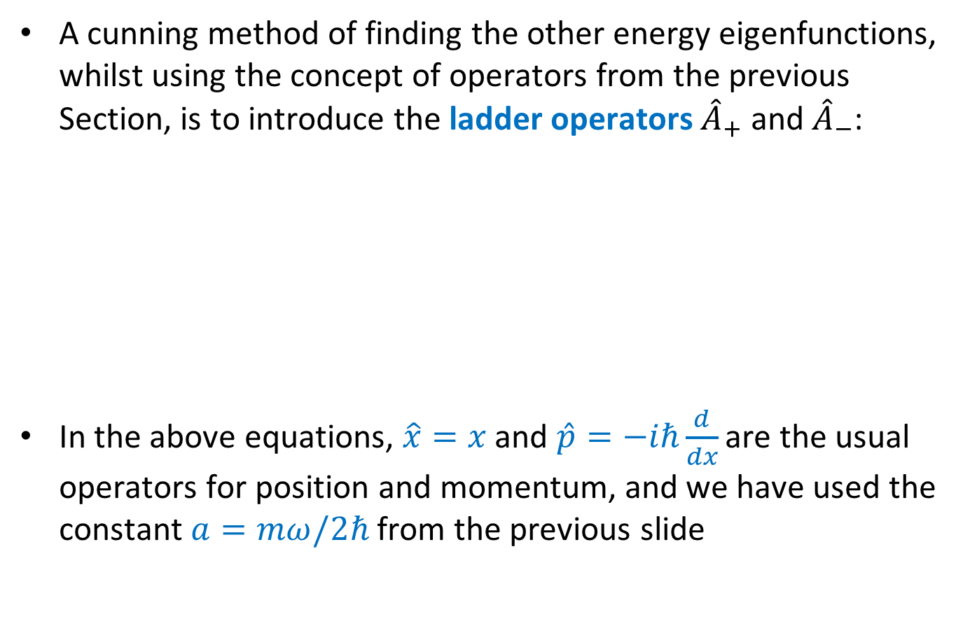
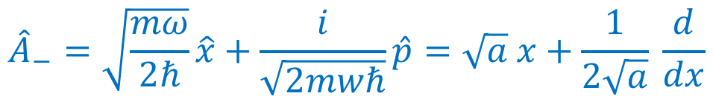
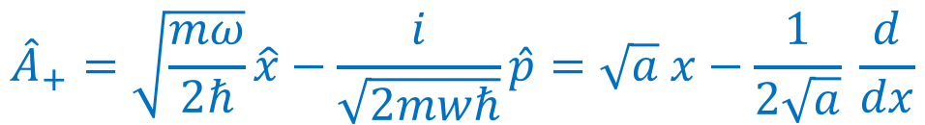
The harmonic oscillator
Ladder operators for the harmonic oscillator
A cunning method of finding the other energy eigenfunctions, whilst using the concept of operators from the previous Section, is to introduce the ladder operators ${\hat{A}}_{+}$ and ${\hat{A}}_{−}$:
In the above equations, $\hat{x}=x$ and $\hat{p}=−iℏ\frac{d}{dx}$ are the usual operators for position and momentum, and we have used the constant $a=mω/2ℏ$from the previous slide
$${\hat{A}}_{+}=\sqrt{\frac{mω}{2ℏ}}\hat{x}−\frac{i}{\sqrt{2mwℏ}}\hat{p}=\sqrt{a} x−\frac{1}{2\sqrt{a}} \frac{d}{dx}$$
$${\hat{A}}_{−}=\sqrt{\frac{mω}{2ℏ}}\hat{x}+\frac{i}{\sqrt{2mwℏ}}\hat{p}=\sqrt{a} x+\frac{1}{2\sqrt{a}} \frac{d}{dx}$$

Slide 12
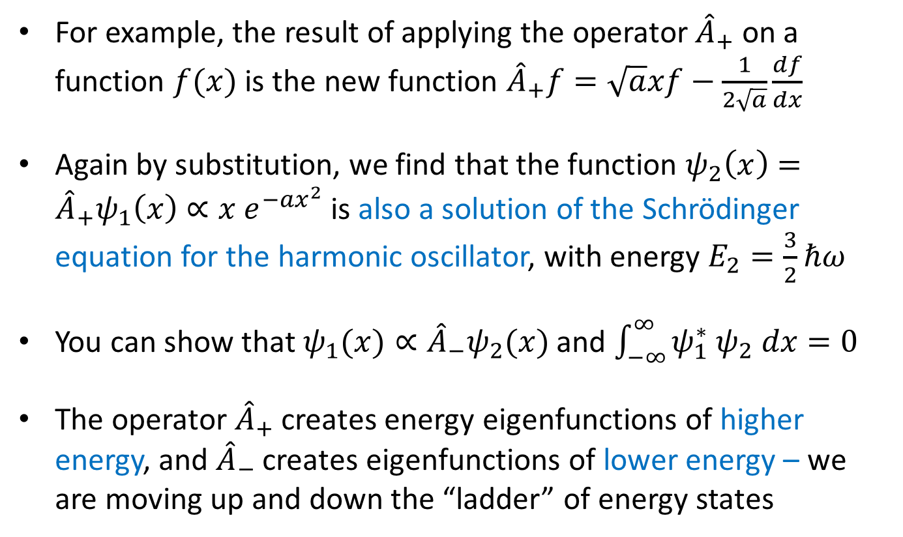
The harmonic oscillator
Ladder operators for the harmonic oscillator
For example, the result of applying the operator ${\hat{A}}_{+}$ on a function $f(x)$ is the new function ${\hat{A}}_{+}f=\sqrt{a}xf−\frac{1}{2\sqrt{a}}\frac{df}{dx}$
Again by substitution, we find that the function $ψ_{2}\left(x\right)={\hat{A}}_{+}ψ_{1}\left(x\right)∝x e^{−ax^{2}}$ is also a solution of the Schrödinger equation for the harmonic oscillator, with energy $E_{2}=\frac{3}{2}ℏω$
You can show that $ψ_{1}(x)∝{\hat{A}}_{−}ψ_{2}(x)$ and $\int_{−∞}^{∞}{ψ_{1}^{∗} ψ_{2} dx=0}$
The operator ${\hat{A}}_{+}$ creates energy eigenfunctions of higher energy, and ${\hat{A}}_{−}$ creates eigenfunctions of lower energy – we are moving up and down the “ladder” of energy states

Slide 13
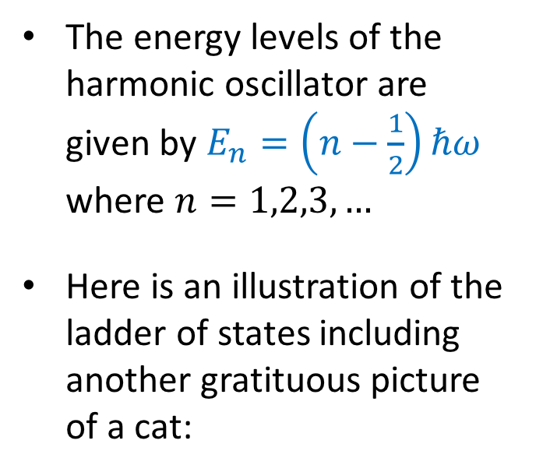
The harmonic oscillator
Ladder operators for the harmonic oscillator
The energy levels of the harmonic oscillator are given by $E_{n}=\left(n−\frac{1}{2}\right)ℏω$ where $n=1,2,3,…$
Here is an illustration of the ladder of states including another gratituous picture of a cat:
Image credit: https://www.lessthanepsilon.net/second-quantization/

Slide 14
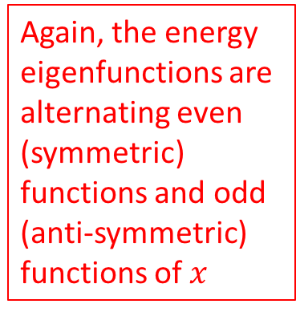
The harmonic oscillator
Harmonic oscillator summary
Here’s a representation of the first few energy eigenfunctions:
Again, the energy eigenfunctions are alternating even (symmetric) functions and odd (anti-symmetric) functions of $x$
Image credit: http://hyperphysics.phy-astr.gsu.edu/hbase/quantum/hosc5.html

Slide 15
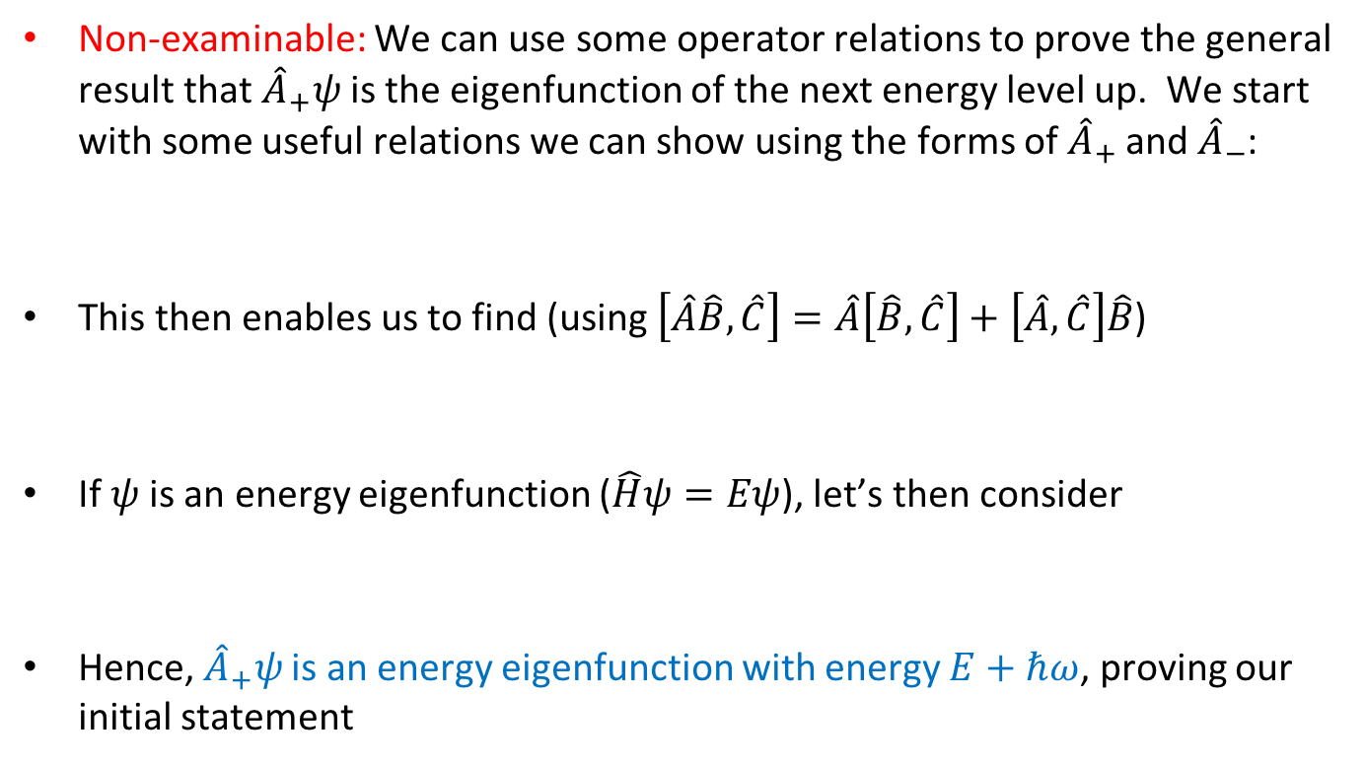


The harmonic oscillator
Commutation relations and energy levels
Non-examinable: We can use some operator relations to prove the general result that ${\hat{A}}_{+}ψ$ is the eigenfunction of the next energy level up. We start with some useful relations we can show using the forms of ${\hat{A}}_{+}$ and ${\hat{A}}_{−}$:
This then enables us to find (using $\left[\hat{A}\hat{B},\hat{C}\right]=\hat{A}\left[\hat{B},\hat{C}\right]+\left[\hat{A},\hat{C}\right]\hat{B}$)
If $ψ$ is an energy eigenfunction ($\hat{H}ψ=Eψ$), let’s then consider
Hence, ${\hat{A}}_{+}ψ$ is an energy eigenfunction with energy $E+ℏω$, proving our initial statement
$$\hat{H}=ℏω\left({\hat{A}}_{+}{\hat{A}}_{−}+\frac{1}{2}\right)$$
$$\left[{\hat{A}}_{−},{\hat{A}}_{+}\right]=1$$
$\left[\hat{H},{\hat{A}}_{+}\right]=ℏω\left[{\hat{A}}_{+}{\hat{A}}_{−},{\hat{A}}_{+}\right]=ℏω\left[{\hat{A}}_{−},{\hat{A}}_{+}\right]{\hat{A}}_{+}=$ $ℏω{\hat{A}}_{+}$
$$\hat{H}\left({\hat{A}}_{+}ψ\right)=\left[\hat{H},{\hat{A}}_{+}\right]ψ+{\hat{A}}_{+}\hat{H}ψ=ℏω{\hat{A}}_{+}ψ+E{\hat{A}}_{+}ψ=\left(E+ℏω\right){\hat{A}}_{+}ψ$$

Slide 16
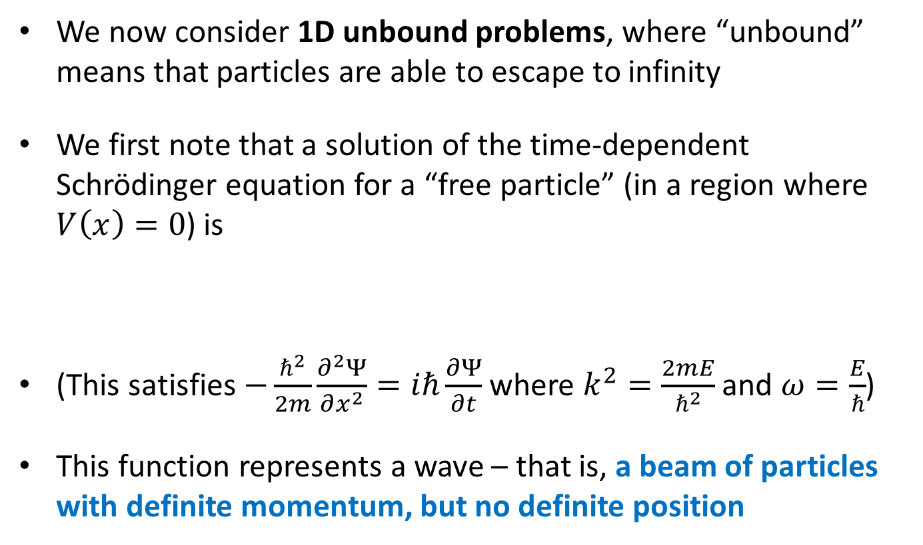
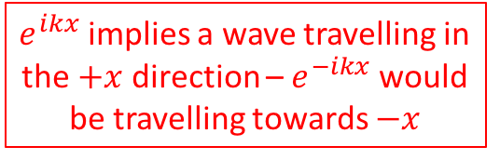

Unbound particles in 1D
Representation of a free particle
We now consider 1D unbound problems, where “unbound” means that particles are able to escape to infinity
We first note that a solution of the time-dependent Schrödinger equation for a “free particle” (in a region where $V\left(x\right)=0$) is
(This satisfies $−\frac{ℏ^{2}}{2m}\frac{∂^{2}Ψ}{∂x^{2}}=iℏ\frac{∂Ψ}{∂t}$ where $k^{2}=\frac{2mE}{ℏ^{2}}$ and $ω=\frac{E}{ℏ}$)
This function represents a wave – that is, a beam of particles with definite momentum, but no definite position
$e^{ikx}$ implies a wave travelling in the $+x$ direction – $e^{−ikx}$ would be travelling towards $−x$
$$Ψ\left(x,t\right)=e^{i(kx−ωt)}$$

Slide 17
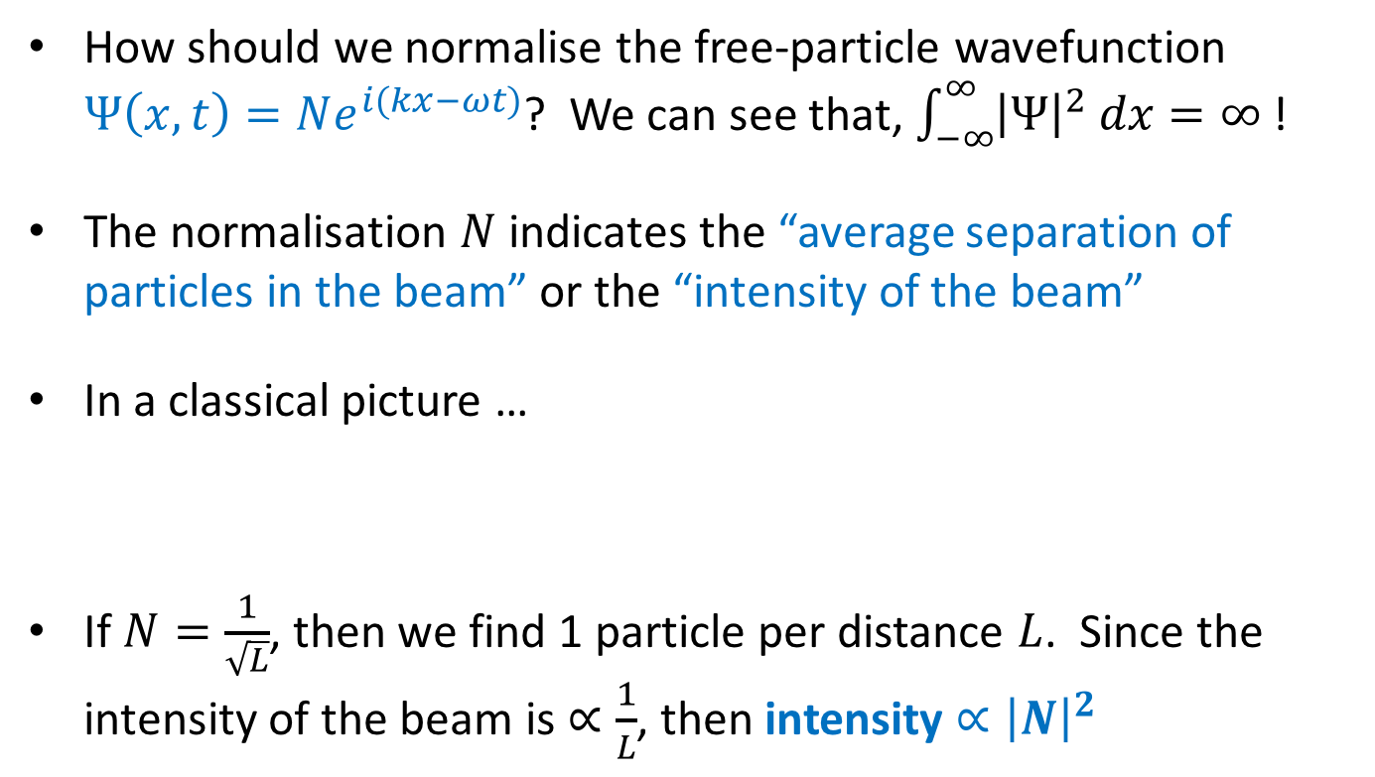

Unbound particles in 1D
Representation of a free particle
How should we normalise the free-particle wavefunction $Ψ\left(x,t\right)=Ne^{i(kx−ωt)}$? We can see that, $\int_{−∞}^{∞}{{\left|Ψ\right|}^{2} dx=∞}$ !
The normalisation $N$ indicates the “average separation of particles in the beam” or the “intensity of the beam”
In a classical picture …
If $N=\frac{1}{\sqrt{L}}$, then we find 1 particle per distance $L$. Since the intensity of the beam is $∝\frac{1}{L}$, then intensity $∝{\left|N\right|}^{2}$
$$L$$

Slide 18


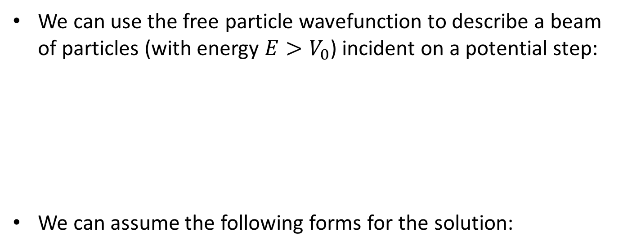








Unbound particles in 1D
Particles incident on a potential step
We can use the free particle wavefunction to describe a beam of particles (with energy $E>V_{0}$) incident on a potential step:
We can assume the following forms for the solution:
$$V(x)$$
Transmitted $Ψ_{T}$
Incident $Ψ_{I}$
$$V_{0}$$
Reflected $Ψ_{R}$
$$x$$
Incident beam:
$$Ψ_{I}\left(x,t\right)=I e^{i\left(kx−ωt\right)}$$
$$k^{2}=\frac{2mE}{ℏ^{2}}$$
Reflected beam:
$$Ψ_{R}\left(x,t\right)=R e^{i\left(−kx−ωt\right)}$$
$$l^{2}=\frac{2m\left(E−V_{0}\right)}{ℏ^{2}}$$
Transmitted beam:
$$Ψ_{T}\left(x,t\right)=T e^{i\left(lx−ωt\right)}$$

Slide 19

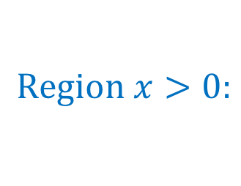
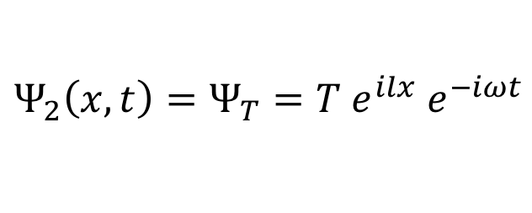
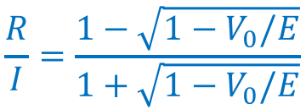
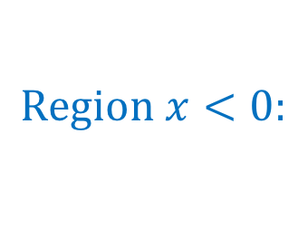
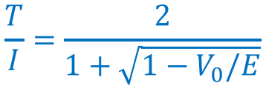
Unbound particles in 1D
Particles incident on a potential step
The general form of the wavefunctions are then,
We now apply the two boundary conditions at $x=0$:
Re-arranging, we obtain the reflected/transmitted amplitudes:
$$Region x<0:$$
$$Ψ_{1}\left(x,t\right)=Ψ_{I}+Ψ_{R}=\left(I e^{ikx}+R e^{−ikx}\right) e^{−iωt}$$
$$Region x>0:$$
$$Ψ_{2}\left(x,t\right)=Ψ_{T}=T e^{ilx} e^{−iωt}$$
$Ψ$ is continuous at $x=0⟹Ψ_{1}\left(0,t\right)=$ $Ψ_{2}\left(0,t\right)⟹I+R=T$
$\frac{∂Ψ}{∂x}$ is continuous at $x=0⟹\frac{∂Ψ_{1}}{∂x}\left(0,t\right)=$ $\frac{∂Ψ_{2}}{∂x}\left(0,t\right)⟹kI−kR=lT$
$$\frac{T}{I}=\frac{2}{1+\sqrt{1−V_{0}/E}}$$
$$\frac{R}{I}=\frac{1−\sqrt{1−V_{0}/E}}{1+\sqrt{1−V_{0}/E}}$$

Slide 20

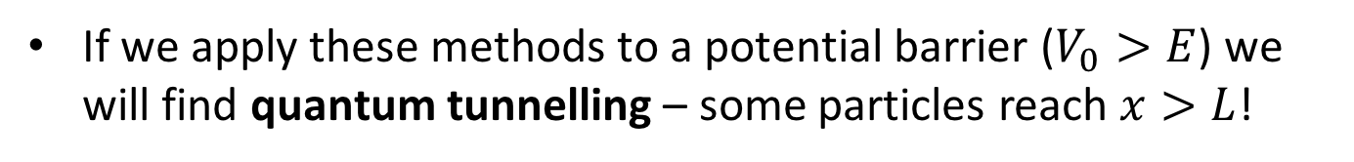

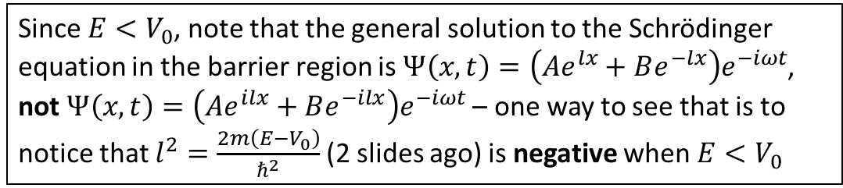


Unbound particles in 1D
Quantum tunnelling
If we apply these methods to a potential barrier ($V_{0}>E$) we will find quantum tunnelling – some particles reach $x>L$!
$$V(x)$$
Classically, no particles would reach here! Quantum Mechanics says differently …
$$V_{0}$$
Particle beam approaching with energy $E<V_{0}$
$$x$$
$$0$$
$$L$$
Since $E<V_{0}$, note that the general solution to the Schrödinger equation in the barrier region is $Ψ\left(x,t\right)=\left(Ae^{lx}+Be^{−lx}\right)e^{−iωt}$, not $Ψ\left(x,t\right)=\left(Ae^{ilx}+Be^{−ilx}\right)e^{−iωt}$ – one way to see that is to notice that $l^{2}=\frac{2m\left(E−V_{0}\right)}{ℏ^{2}}$ (2 slides ago) is negative when $E<V_{0}$

Slide 21
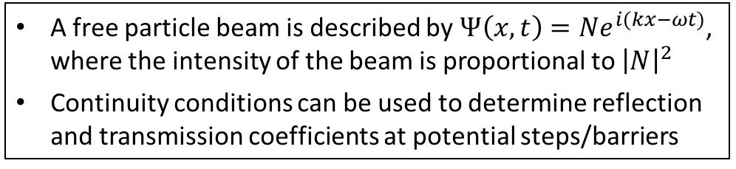
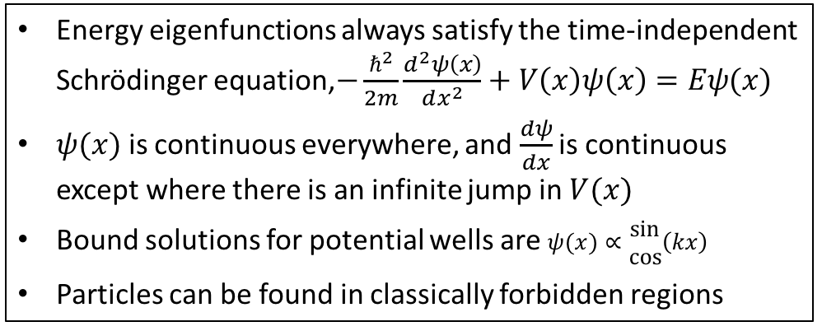
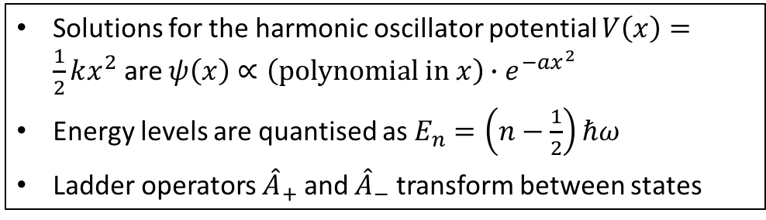
Summary
Energy eigenfunctions always satisfy the time-independent Schrödinger equation,$−\frac{ℏ^{2}}{2m}\frac{d^{2}ψ\left(x\right)}{dx^{2}}+V\left(x\right)ψ\left(x\right)=Eψ(x)$
$ψ(x)$ is continuous everywhere, and $\frac{dψ}{dx}$ is continuous except where there is an infinite jump in $V(x)$
Bound solutions for potential wells are $ψ(x)∝\begin{matrix}sin \\ cos\end{matrix}\left(kx\right)$
Particles can be found in classically forbidden regions
Square potential wells
Solutions for the harmonic oscillator potential $V\left(x\right)=\frac{1}{2}kx^{2}$ are $ψ\left(x\right)∝\left(polynomial in x\right)∙e^{−ax^{2}}$
Energy levels are quantised as $E_{n}=\left(n−\frac{1}{2}\right)ℏω$
Ladder operators ${\hat{A}}_{+}$ and ${\hat{A}}_{−}$ transform between states
The harmonic oscillator
A free particle beam is described by $Ψ\left(x,t\right)=Ne^{i(kx−ωt)}$, where the intensity of the beam is proportional to ${\left|N\right|}^{2}$
Continuity conditions can be used to determine reflection and transmission coefficients at potential steps/barriers
Unbound particles in 1D

