Slide 1
Section 2: How QM Works, Part 2
In these slides we will cover:
The momentum operator and its eigenfunctions
The position and energy operators
The time-independent Schrödinger equation and energy eigenfunctions
Commutation between operators
Implication for simultaneous (or compatible) observables
The uncertainty principle
The time-dependent Schrödinger equation
Solving the time-evolving wavefunction

Slide 2
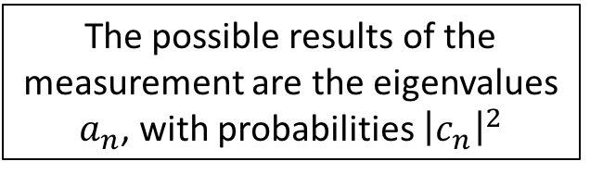
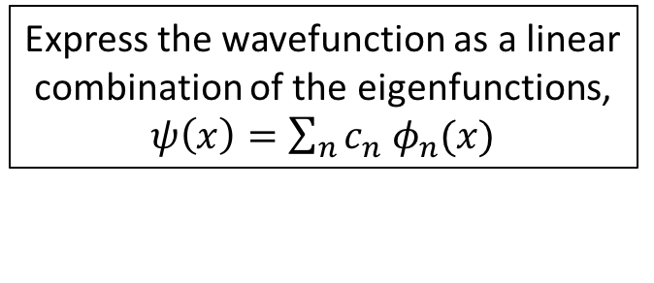
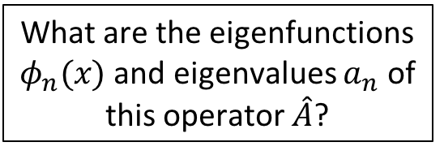

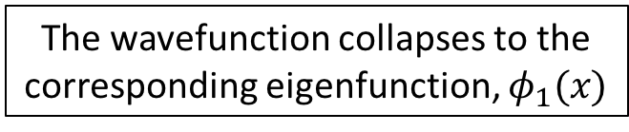


Momentum, position & energy operators
Recipe for measurement in Quantum Mechanics (recap)
The state of the particle is described by its wavefunction $ψ(x)$
We want to measure an observable $A$
What is the operator $\hat{A}$ corresponding to this observable?
What are the eigenfunctions $φ_{n}(x)$ and eigenvalues $a_{n}$ of this operator $\hat{A}$?
Express the wavefunction as a linear combination of the eigenfunctions, $ψ\left(x\right)=\sum_{n}{c_{n} φ_{n}(x)}$
The possible results of the measurement are the eigenvalues $a_{n}$, with probabilities ${\left|c_{n}\right|}^{2}$
Perform the measurement
Obtain one of the eigenvalues, $a_{1}$
The wavefunction collapses to the corresponding eigenfunction, $φ_{1}(x)$

Slide 3
Momentum, position & energy operators
The key observables for a particle
We saw in the last section that observables are represented by operators in Quantum Mechanics. Let’s consider:
Which operators represent these observables, and what does this imply for measurements of these quantities?
Momentum
Position
Energy

Slide 4
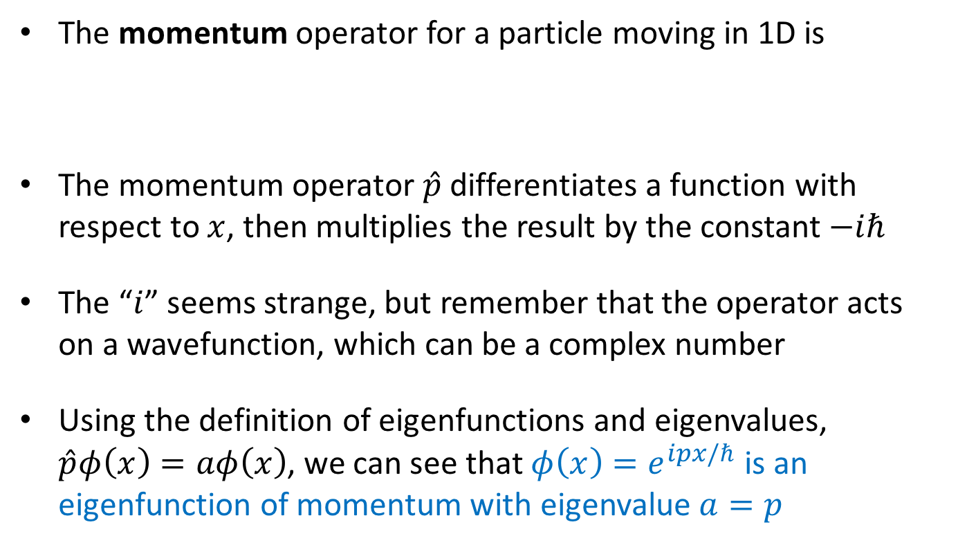

Momentum, position & energy operators
The momentum operator
The momentum operator for a particle moving in 1D is
The momentum operator $\hat{p}$ differentiates a function with respect to $x$, then multiplies the result by the constant $−iℏ$
The “$i$” seems strange, but remember that the operator acts on a wavefunction, which can be a complex number
Using the definition of eigenfunctions and eigenvalues, $\hat{p}φ\left(x\right)=aφ\left(x\right)$, we can see that $φ\left(x\right)=e^{ipx/ℏ}$ is an eigenfunction of momentum with eigenvalue $a=p$
$$\hat{p}=−iℏ\frac{d}{dx}$$

Slide 5
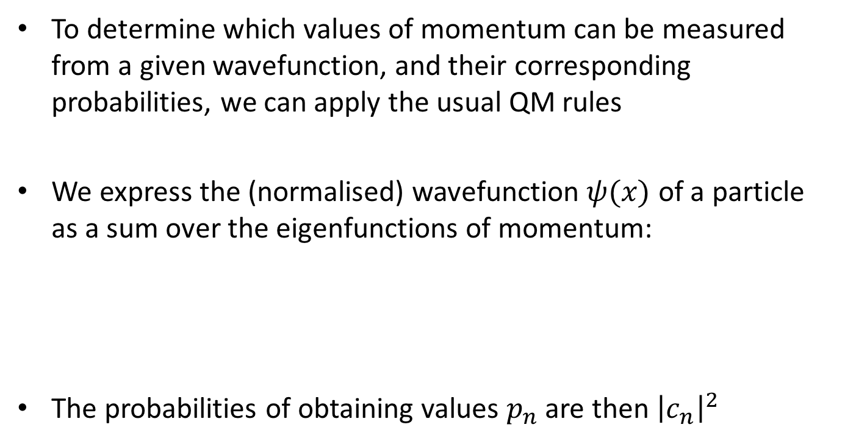
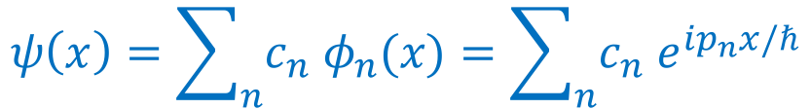
Momentum, position & energy operators
Momentum eigenfunctions
To determine which values of momentum can be measured from a given wavefunction, and their corresponding probabilities, we can apply the usual QM rules
We express the (normalised) wavefunction $ψ(x)$ of a particle as a sum over the eigenfunctions of momentum:
The probabilities of obtaining values $p_{n}$ are then ${\left|c_{n}\right|}^{2}$
$$ψ\left(x\right)=\sum_{n}{c_{n} φ_{n}(x)}=\sum_{n}{c_{n} e^{ip_{n}x/ℏ}}$$

Slide 6
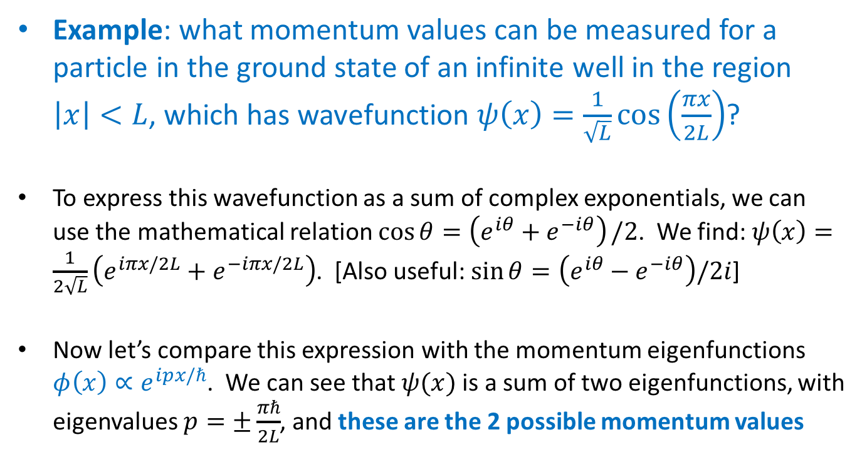
Momentum, position & energy operators
Momentum eigenfunctions
Example: what momentum values can be measured for a particle in the ground state of an infinite well in the region $\left|x\right|<L$, which has wavefunction $ψ\left(x\right)=\frac{1}{\sqrt{L}}\cos\left(\frac{πx}{2L}\right)$?
To express this wavefunction as a sum of complex exponentials, we can use the mathematical relation $\cos{θ=\left(e^{iθ}+e^{−iθ}\right)}/2$. We find: $ψ\left(x\right)=\frac{1}{2\sqrt{L}}\left(e^{iπx/2L}+e^{−iπx/2L}\right)$. [Also useful: $\sin{θ}=\left(e^{iθ}−e^{−iθ}\right)/2i$]
Now let’s compare this expression with the momentum eigenfunctions $φ\left(x\right)∝e^{ipx/ℏ}$. We can see that $ψ(x)$ is a sum of two eigenfunctions, with eigenvalues $p=±\frac{πℏ}{2L}$, and these are the 2 possible momentum values

Slide 7
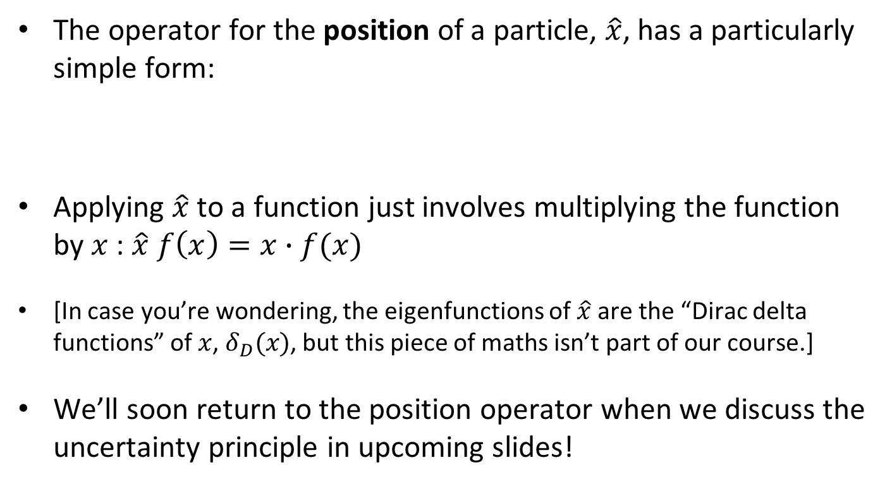

Momentum, position & energy operators
The position operator
The operator for the position of a particle, $\hat{x}$, has a particularly simple form:
Applying $\hat{x}$ to a function just involves multiplying the function by $x$ : $\hat{x} f\left(x\right)=x∙f(x)$
[In case you’re wondering, the eigenfunctions of $\hat{x}$ are the “Dirac delta functions” of $x$, $δ_{D}(x)$, but this piece of maths isn’t part of our course.]
We’ll soon return to the position operator when we discuss the uncertainty principle in upcoming slides!
$$\hat{x}=x$$

Slide 8
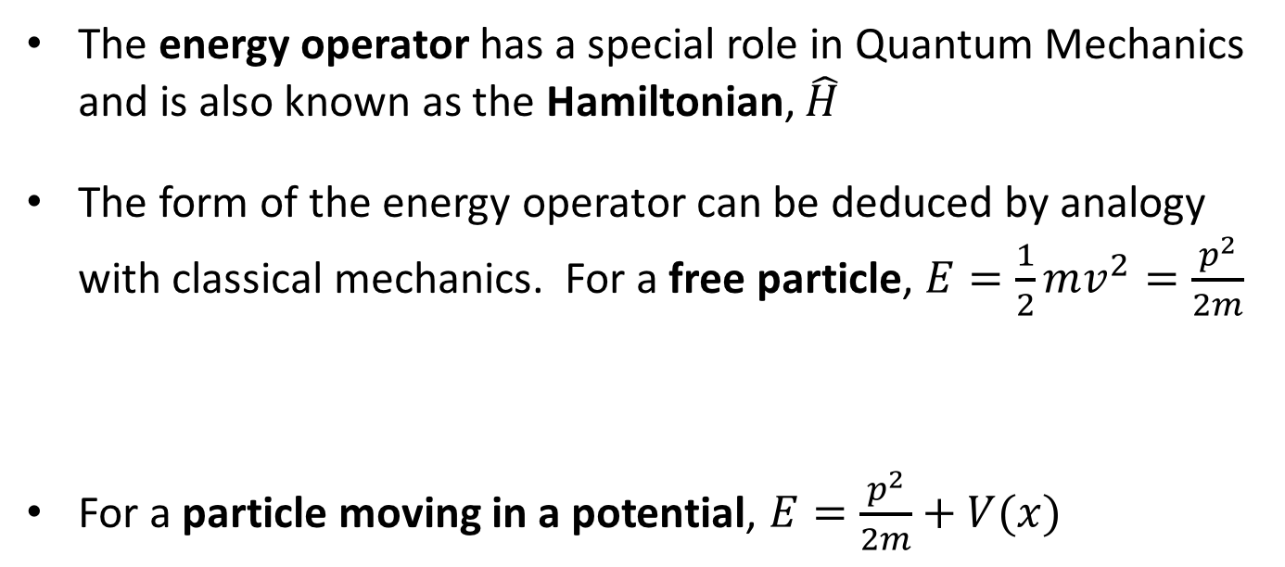
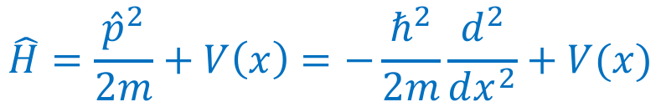
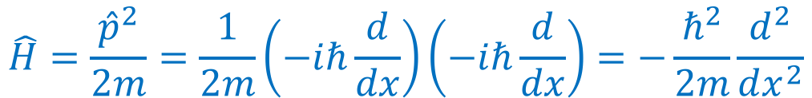
Momentum, position & energy operators
The energy operator
The energy operator has a special role in Quantum Mechanics and is also known as the Hamiltonian, $\hat{H}$
The form of the energy operator can be deduced by analogy with classical mechanics. For a free particle, $E=\frac{1}{2}mv^{2}=\frac{p^{2}}{2m}$
For a particle moving in a potential, $E=\frac{p^{2}}{2m}+V(x)$
$$\hat{H}=\frac{{\hat{p}}^{2}}{2m}=\frac{1}{2m}\left(−iℏ\frac{d}{dx}\right)\left(−iℏ\frac{d}{dx}\right)=−\frac{ℏ^{2}}{2m}\frac{d^{2}}{dx^{2}}$$
$$\hat{H}=\frac{{\hat{p}}^{2}}{2m}+V\left(x\right)=−\frac{ℏ^{2}}{2m}\frac{d^{2}}{dx^{2}}+V(x)$$

Slide 9
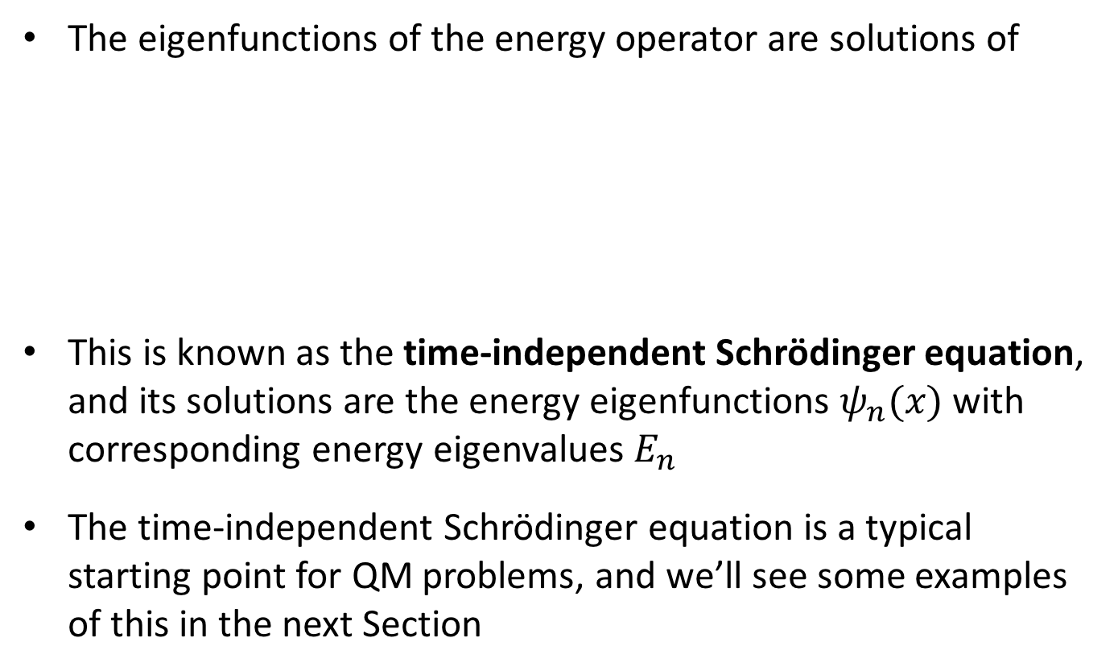
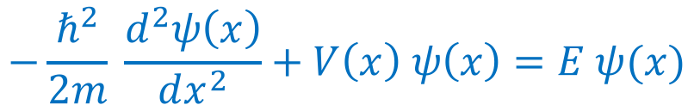
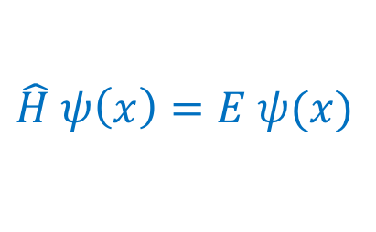
Momentum, position & energy operators
Energy eigenfunctions
The eigenfunctions of the energy operator are solutions of
This is known as the time-independent Schrödinger equation, and its solutions are the energy eigenfunctions $ψ_{n}(x)$ with corresponding energy eigenvalues $E_{n}$
The time-independent Schrödinger equation is a typical starting point for QM problems, and we’ll see some examples of this in the next Section
$$\hat{H} ψ\left(x\right)=E ψ(x)$$
$$−\frac{ℏ^{2}}{2m} \frac{d^{2}ψ\left(x\right)}{dx^{2}}+V\left(x\right) ψ\left(x\right)=E ψ(x)$$

Slide 10
Commuting operators & compatible observables
Compatible observables
We have discussed the rules for measuring a single observable such as the momentum, position or energy of a particle
The outcome of measuring an observable is uncertain, unless the wavefunction is an eigenfunction of the operator – in which case we’ll always measure the corresponding eigenvalue
Can more than one observable be simultaneously known? Can a function be an eigenfunction of multiple operators?
This question will involve a short mathematical detour into the idea of commuting operators

Slide 11
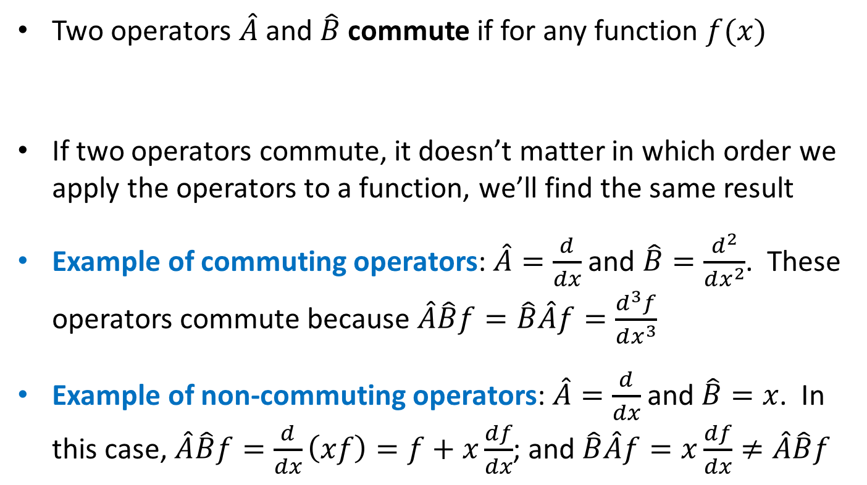

Commuting operators & compatible observables
Commuting operators
Two operators $\hat{A}$ and $\hat{B}$ commute if for any function $f(x)$
If two operators commute, it doesn’t matter in which order we apply the operators to a function, we’ll find the same result
Example of commuting operators: $\hat{A}=\frac{d}{dx}$ and $\hat{B}=\frac{d^{2}}{dx^{2}}$. These operators commute because $\hat{A}\hat{B}f=\hat{B}\hat{A}f=\frac{d^{3}f}{dx^{3}}$
Example of non-commuting operators: $\hat{A}=\frac{d}{dx}$ and $\hat{B}=x$. In this case, $\hat{A}\hat{B}f=\frac{d}{dx}\left(xf\right)=f+x\frac{df}{dx}$; and $\hat{B}\hat{A}f=x\frac{df}{dx}≠\hat{A}\hat{B}f$
$$\hat{A} \hat{B} f\left(x\right)=\hat{B} \hat{A} f(x)$$

Slide 12
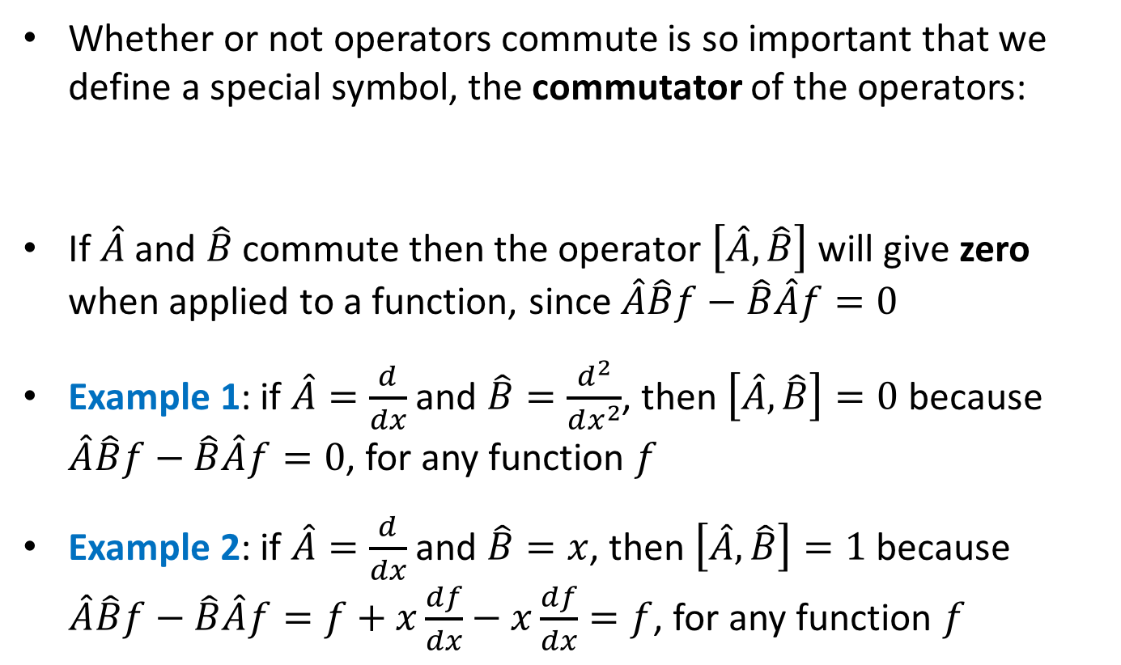

Commuting operators & compatible observables
Commutators
Whether or not operators commute is so important that we define a special symbol, the commutator of the operators:
If $\hat{A}$ and $\hat{B}$ commute then the operator $\left[\hat{A},\hat{B}\right]$ will give zero when applied to a function, since $\hat{A}\hat{B}f−\hat{B}\hat{A}f=0$
Example 1: if $\hat{A}=\frac{d}{dx}$ and $\hat{B}=\frac{d^{2}}{dx^{2}}$, then $\left[\hat{A},\hat{B}\right]=0$ because $\hat{A}\hat{B}f−\hat{B}\hat{A}f=0$, for any function $f$
Example 2: if $\hat{A}=\frac{d}{dx}$ and $\hat{B}=x$, then $\left[\hat{A},\hat{B}\right]=1$ because $\hat{A}\hat{B}f−\hat{B}\hat{A}f=f+x\frac{df}{dx}−x\frac{df}{dx}=f$, for any function $f$
$$\left[\hat{A},\hat{B}\right]=\hat{A} \hat{B} −\hat{B} \hat{A}$$

Slide 13
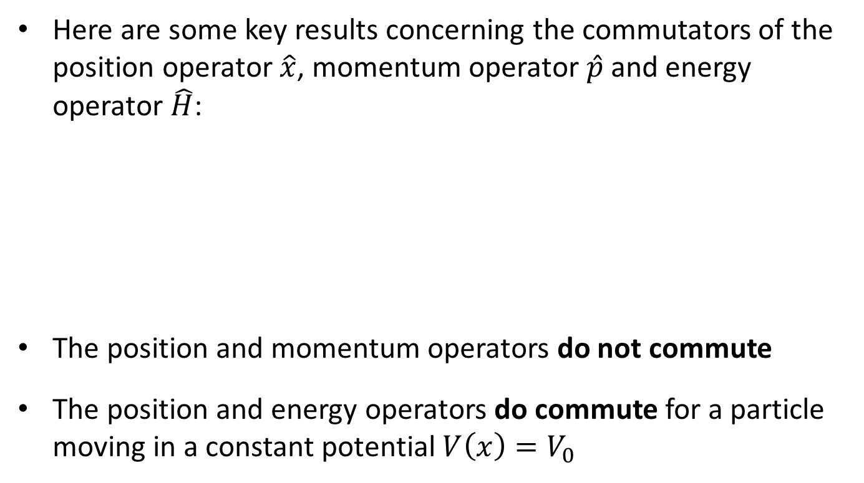


Commuting operators & compatible observables
Commutators
Here are some key results concerning the commutators of the position operator $\hat{x}$, momentum operator $\hat{p}$ and energy operator $\hat{H}$:
The position and momentum operators do not commute
The position and energy operators do commute for a particle moving in a constant potential $V\left(x\right)=V_{0}$
$$\left[\hat{x},\hat{p}\right]=iℏ$$
$\left[\hat{H},\hat{p}\right]=0$ if $V\left(x\right)=constant$

Slide 14
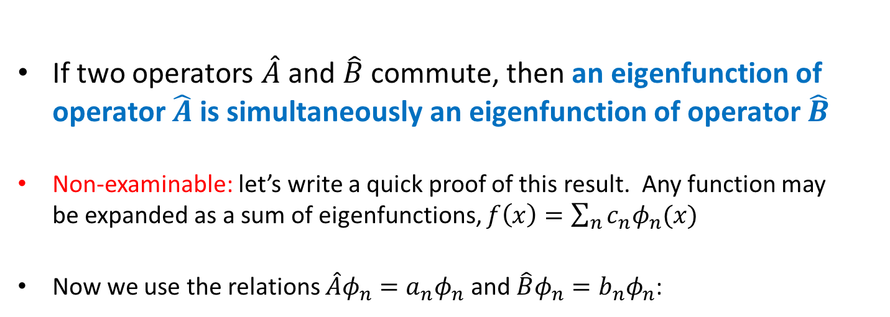
Commuting operators & compatible observables
Simultaneous eigenfunctions and observables
If two operators $\hat{A}$ and $\hat{B}$commute, then an eigenfunction of operator $\hat{A}$ is simultaneously an eigenfunction of operator $\hat{B}$
Non-examinable: let’s write a quick proof of this result. Any function may be expanded as a sum of eigenfunctions, $f\left(x\right)=\sum_{n}{c_{n}φ_{n}(x)}$
Now we use the relations $\hat{A}φ_{n}=a_{n}φ_{n}$ and $\hat{B}φ_{n}=b_{n}φ_{n}$:
$$\left[\hat{A},\hat{B}\right]f=\hat{A}\hat{B}f−\hat{B}\hat{A}f=\hat{A}\hat{B}\sum_{n}{c_{n}φ_{n}\left(x\right)}−\hat{B}\hat{A}\sum_{n}{c_{n}φ_{n}(x)}$$
$$=\sum_{n}{c_{n}}\left[\hat{A}\hat{B}φ_{n}\left(x\right)−\hat{B}\hat{A}φ_{n}\left(x\right)\right]=\sum_{n}{c_{n}}\left[\hat{A}b_{n}φ_{n}\left(x\right)−\hat{B}a_{n}φ_{n}\left(x\right)\right]$$
$$=\sum_{n}{c_{n}}\left[b_{n}\hat{A}φ_{n}\left(x\right)−a_{n}\hat{B}φ_{n}\left(x\right)\right]=\sum_{n}{c_{n}}\left[b_{n}a_{n}φ_{n}\left(x\right)−a_{n}b_{n}φ_{n}\left(x\right)\right]=0$$

Slide 15
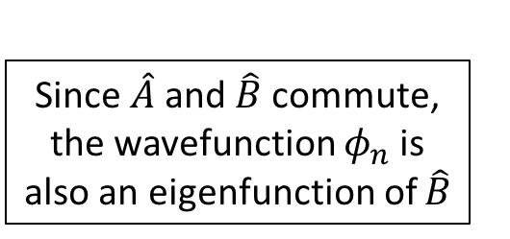


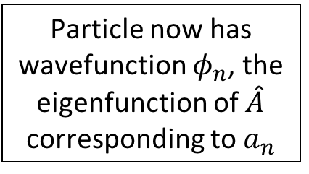

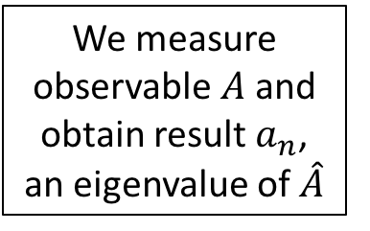

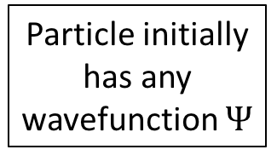
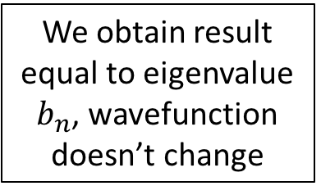
Commuting operators & compatible observables
Simultaneous eigenfunctions and observables
If two operators $\hat{A}$ and $\hat{B}$commute, what happens when we measure their corresponding observables?
We measure observable $A$ and obtain result $a_{n}$, an eigenvalue of $\hat{A}$
Particle now has wavefunction $φ_{n}$, the eigenfunction of $\hat{A}$ corresponding to $a_{n}$
Particle initially has any wavefunction $Ψ$
We obtain result equal to eigenvalue $b_{n}$, wavefunction doesn’t change
Since $\hat{A}$ and $\hat{B}$commute, the wavefunction $φ_{n}$ is also an eigenfunction of $\hat{B}$
Observable $B$ is now measured
We measure observable $A$ again and obtain an unchanged result $a_{n}$
$A$ and $B$ can be simultaneously known

Slide 16


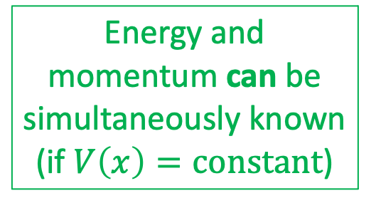
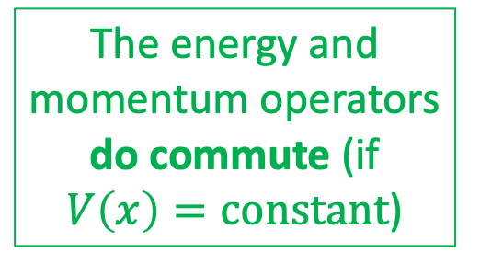

Commuting operators & compatible observables
Simultaneous eigenfunctions and observables
Relating this to our previous examples …
The position and momentum operators do not commute
Position and momentum cannot be simultaneously known
$$\left[\hat{x},\hat{p}\right]=iℏ$$
The energy and momentum operators do commute (if $V\left(x\right)=constant$)
Energy and momentum can be simultaneously known (if $V\left(x\right)=constant$)
$$\left[\hat{H},\hat{p}\right]=0$$
(if $V\left(x\right)=constant)$

Slide 17
Commuting operators & compatible observables
Simultaneous eigenfunctions and observables
We can summarise it as follows:
Certain pairs of observables can be simultaneously known, i.e. repeated measurements will produce the same values
These have commuting operators (are “compatible”)
Certain pairs of observables can’t be simultaneously known, i.e. repeated measurements will produce different values
These observables have non-commuting operators

Slide 18
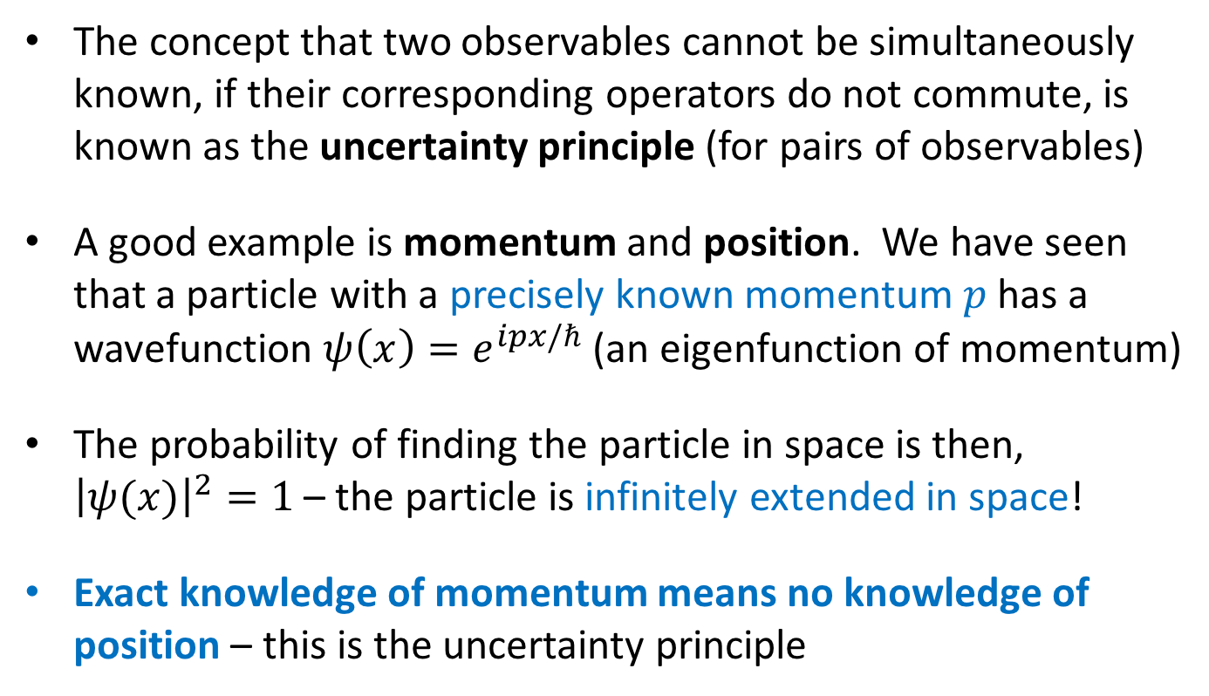
Commuting operators & compatible observables
The uncertainty principle
The concept that two observables cannot be simultaneously known, if their corresponding operators do not commute, is known as the uncertainty principle (for pairs of observables)
A good example is momentum and position. We have seen that a particle with a precisely known momentum $p$ has a wavefunction $ψ\left(x\right)=e^{ipx/ℏ}$ (an eigenfunction of momentum)
The probability of finding the particle in space is then, ${\left|ψ(x)\right|}^{2}=1$ – the particle is infinitely extended in space!
Exact knowledge of momentum means no knowledge of position – this is the uncertainty principle

Slide 19
Commuting operators & compatible observables
The uncertainty principle
The uncertainty principle is sometimes described as the act of measuring a particular property (such as position) causes an uncertainty in another property (such as momentum)
If an electron is prepared in a state of known momentum, the act of measuring its position perturbs its momentum

Slide 20

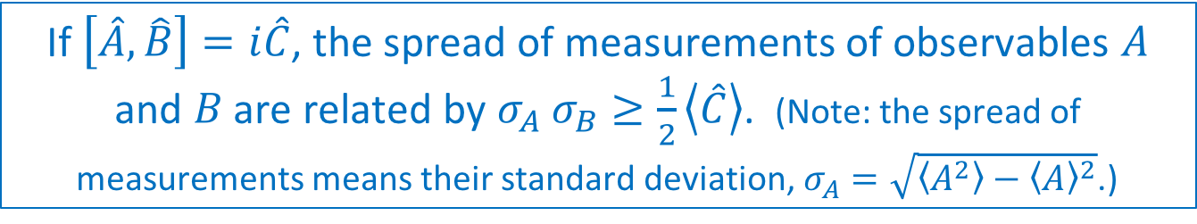
Commuting operators & compatible observables
Relation of the uncertainty principle to commutators
The uncertainty principle can be precisely described mathematically using commutators and expectation values:
For the example of position and momentum: since $\left[\hat{x},\hat{p}\right]=iℏ$, then $σ_{x}σ_{p}≥ℏ/2$, where $σ_{x}=\sqrt{\left\langle x^{2}\right\rangle −{\left\langle x\right\rangle }^{2}}$
If $\left[\hat{A},\hat{B}\right]=i\hat{C}$, the spread of measurements of observables $A$ and $B$ are related by $σ_{A} σ_{B}≥\frac{1}{2}\left\langle \hat{C}\right\rangle$. (Note: the spread of measurements means their standard deviation, $σ_{A}=\sqrt{\left\langle A^{2}\right\rangle −{\left\langle A\right\rangle }^{2}}$.)

Slide 21

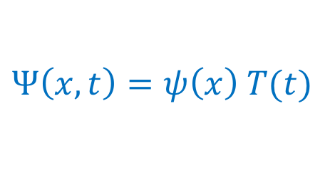
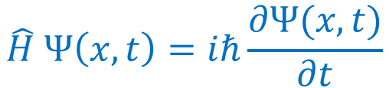
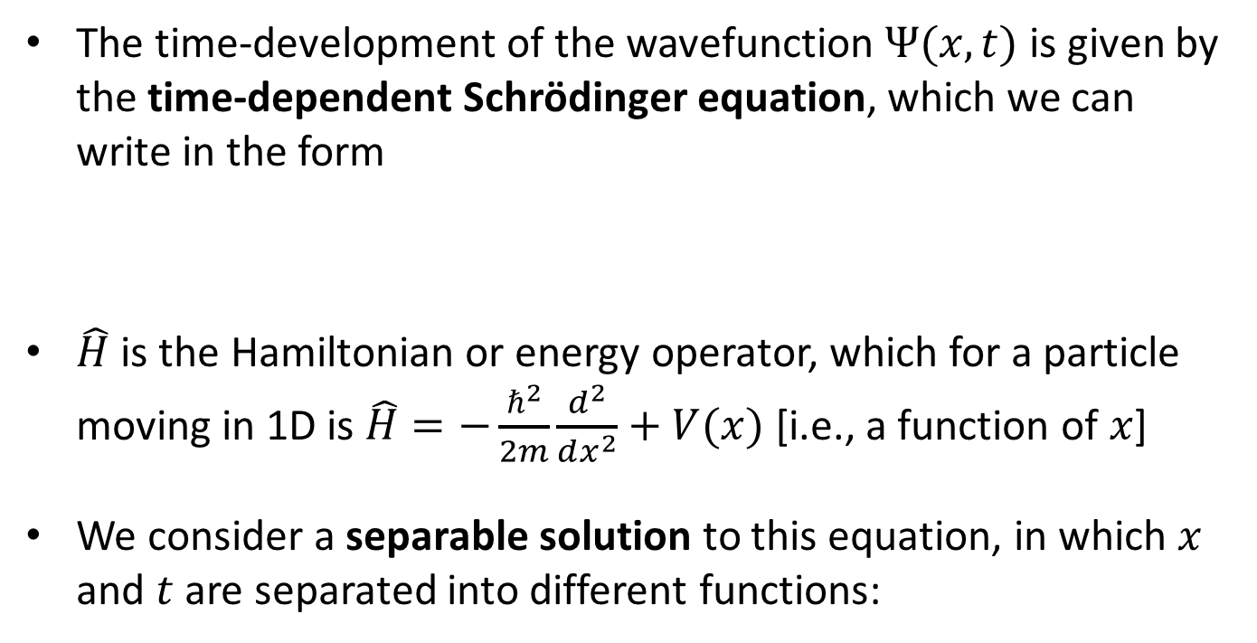
Time-evolution of the wavefunction
Postulate for the time-evolution of $Ψ$
The time-development of the wavefunction $Ψ(x,t)$ is given by the time-dependent Schrödinger equation, which we can write in the form
$\hat{H}$ is the Hamiltonian or energy operator, which for a particle moving in 1D is $\hat{H}=−\frac{ℏ^{2}}{2m}\frac{d^{2}}{dx^{2}}+V(x)$ [i.e., a function of $x$]
We consider a separable solution to this equation, in which $x$ and $t$ are separated into different functions:
$$\hat{H} Ψ\left(x,t\right)=iℏ\frac{∂Ψ(x,t)}{∂t}$$
$$Ψ\left(x,t\right)=ψ\left(x\right) T(t)$$

Slide 22
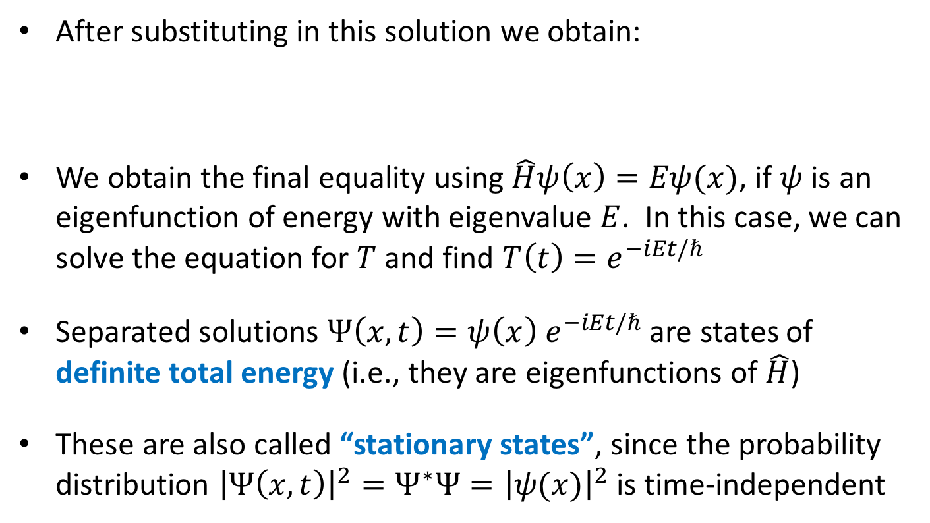
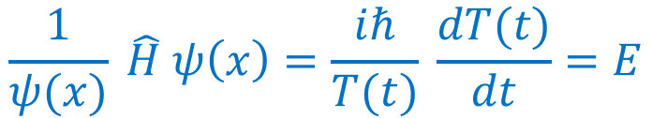
Time-evolution of the wavefunction
Separable solutions and stationary states
After substituting in this solution we obtain:
We obtain the final equality using $\hat{H}ψ\left(x\right)=Eψ(x)$, if $ψ$ is an eigenfunction of energy with eigenvalue $E$. In this case, we can solve the equation for $T$ and find $T\left(t\right)=e^{−iEt/ℏ}$
Separated solutions $Ψ\left(x,t\right)=ψ\left(x\right) e^{−iEt/ℏ}$ are states of definite total energy (i.e., they are eigenfunctions of $\hat{H}$)
These are also called “stationary states”, since the probability distribution ${\left|Ψ\left(x,t\right)\right|}^{2}=Ψ^{∗}Ψ={\left|ψ(x)\right|}^{2}$ is time-independent
$$\frac{1}{ψ(x)} \hat{H} ψ\left(x\right)=\frac{iℏ}{T(t)} \frac{dT(t)}{dt}=E$$

Slide 23
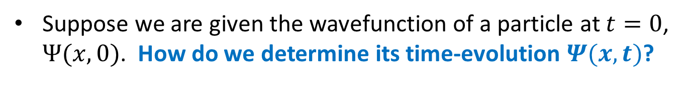
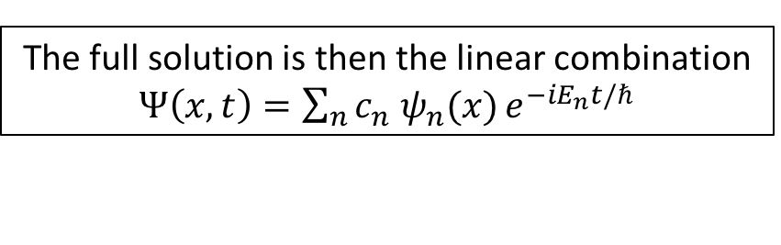
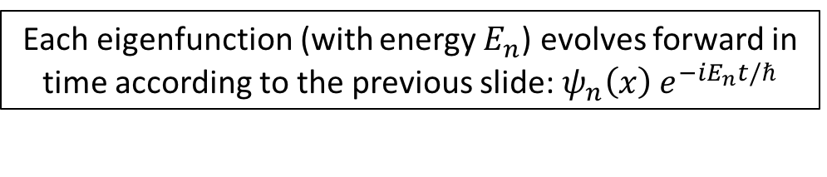
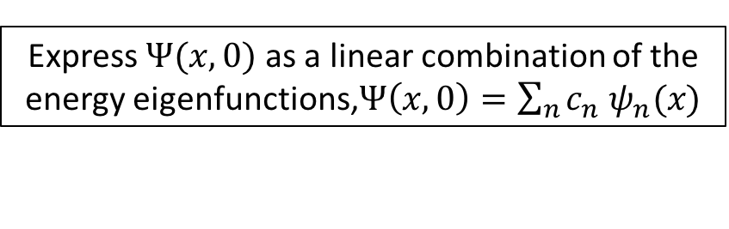
Time-evolution of the wavefunction
The time-evolving wavefunction
Suppose we are given the wavefunction of a particle at $t=0$, $Ψ(x,0)$. How do we determine its time-evolution $Ψ(x,t)$?
Step 1
Express $Ψ(x,0)$ as a linear combination of the energy eigenfunctions,$Ψ\left(x,0\right)=\sum_{n}{c_{n} ψ_{n}(x)}$
Step 2
Each eigenfunction (with energy $E_{n}$) evolves forward in time according to the previous slide: $ψ_{n}\left(x\right) e^{−iE_{n}t/ℏ}$
Step 3
The full solution is then the linear combination $Ψ\left(x,t\right)=\sum_{n}{c_{n} ψ_{n}(x)}e^{−iE_{n}t/ℏ}$

Slide 24
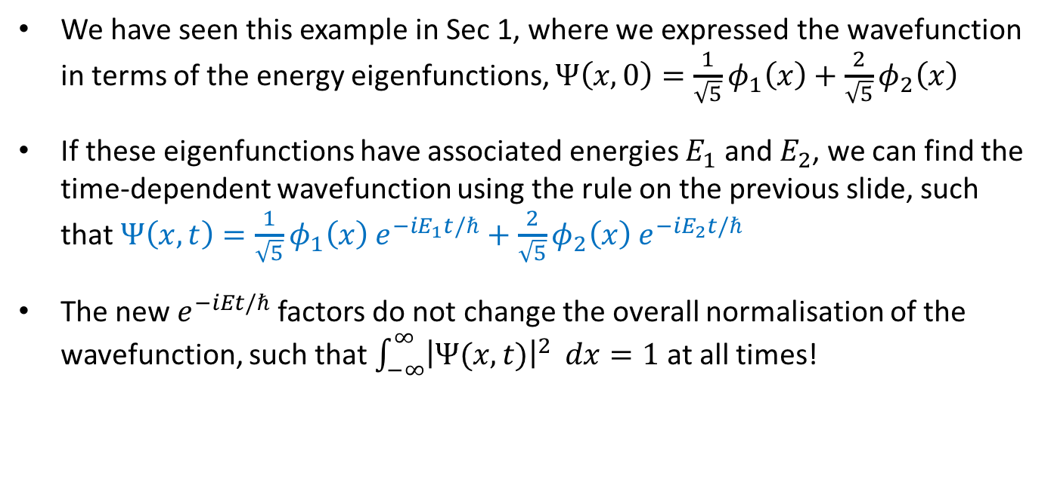
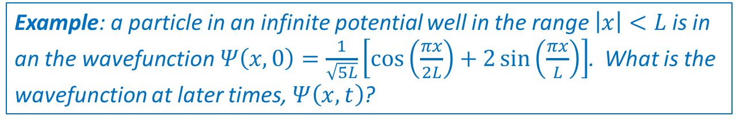
Time-evolution of the wavefunction
The time-evolving wavefunction
Example: a particle in an infinite potential well in the range $\left|x\right|<L$ is in an the wavefunction $Ψ\left(x,0\right)=\frac{1}{\sqrt{5L}}\left[\cos\left(\frac{πx}{2L}\right)+2\sin\left(\frac{πx}{L}\right)\right]$. What is the wavefunction at later times, $Ψ\left(x,t\right)$?
We have seen this example in Sec 1, where we expressed the wavefunction in terms of the energy eigenfunctions, $Ψ\left(x,0\right)=\frac{1}{\sqrt{5}}φ_{1}\left(x\right)+\frac{2}{\sqrt{5}}φ_{2}\left(x\right)$
If these eigenfunctions have associated energies $E_{1}$ and $E_{2}$, we can find the time-dependent wavefunction using the rule on the previous slide, such that $Ψ\left(x,t\right)=\frac{1}{\sqrt{5}}φ_{1}\left(x\right) e^{−iE_{1}t/ℏ}+\frac{2}{\sqrt{5}}φ_{2}\left(x\right) e^{−iE_{2}t/ℏ}$
The new $e^{−iEt/ℏ}$ factors do not change the overall normalisation of the wavefunction, such that $\int_{−∞}^{∞}{{\left|Ψ(x,t)\right|}^{2}} dx=1$ at all times!

Slide 25
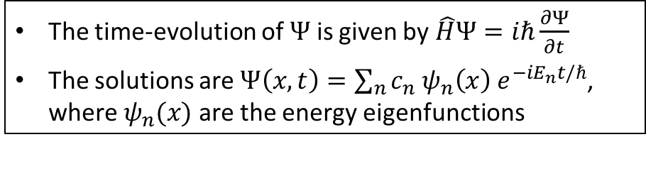
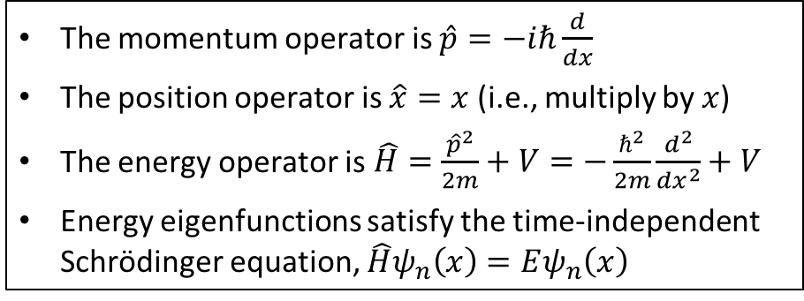
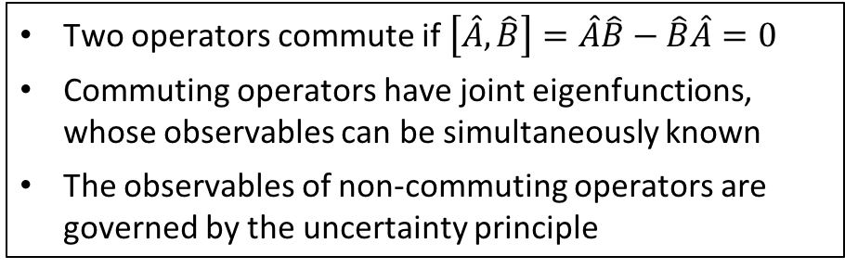
Summary
The momentum operator is $\hat{p}=−iℏ\frac{d}{dx}$
The position operator is $\hat{x}=x$ (i.e., multiply by $x$)
The energy operator is $\hat{H}=\frac{{\hat{p}}^{2}}{2m}+V=−\frac{ℏ^{2}}{2m}\frac{d^{2}}{dx^{2}}+V$
Energy eigenfunctions satisfy the time-independent Schrödinger equation, $\hat{H}ψ_{n}\left(x\right)=Eψ_{n}\left(x\right)$
Momentum, position and energy operators
Commuting operators and compatible observables
Two operators commute if $\left[\hat{A},\hat{B}\right]=\hat{A}\hat{B}−\hat{B}\hat{A}=0$
Commuting operators have joint eigenfunctions, whose observables can be simultaneously known
The observables of non-commuting operators are governed by the uncertainty principle
Time evolution of the wavefunction
The time-evolution of $Ψ$ is given by $\hat{H}Ψ=iℏ\frac{∂Ψ}{∂t}$
The solutions are $Ψ\left(x,t\right)=\sum_{n}{c_{n} ψ_{n}\left(x\right) e^{−iE_{n}t/ℏ}}$, where $ψ_{n}(x)$ are the energy eigenfunctions

