Slide 1
Section 1: How QM Works, Part 1
In these slides we will cover:
The Schrödinger Equation
The probability interpretation of the wavefunction
The discrete nature of observables
The correspondence between observables and operators
Eigenfunctions, eigenvalues and their properties
Measurement in Quantum Mechanics
Expectation values

Slide 2
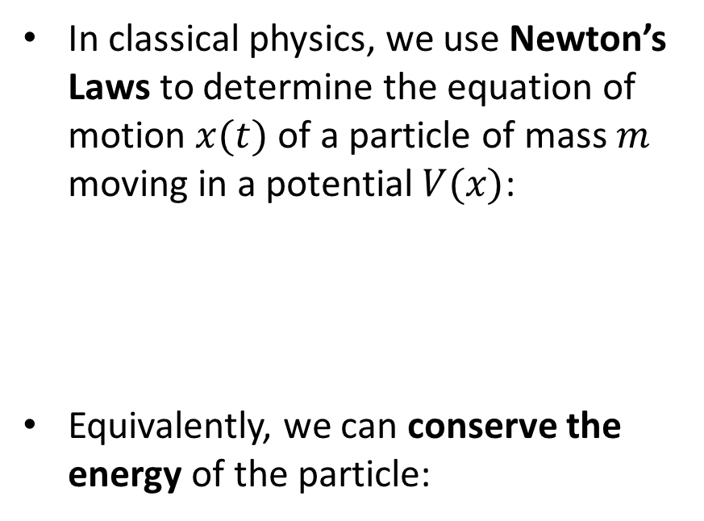

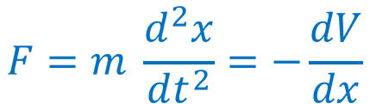
The wavefunction
Particles and waves
In classical physics, we use Newton’s Laws to determine the equation of motion $x(t)$ of a particle of mass $m$ moving in a potential $V(x)$:
Equivalently, we can conserve the energy of the particle:
$$F=m \frac{d^{2}x}{dt^{2}}=−\frac{dV}{dx}$$
$$\frac{1}{2}mv^{2}+V\left(x\right)=Energy$$

Slide 3
The wavefunction
Particles and waves
This picture cannot apply in the Quantum world, because particles behave like waves (see: the double-slit experiment)
Since a wave is an object extended in space, we need to change how we describe a particle

Slide 4
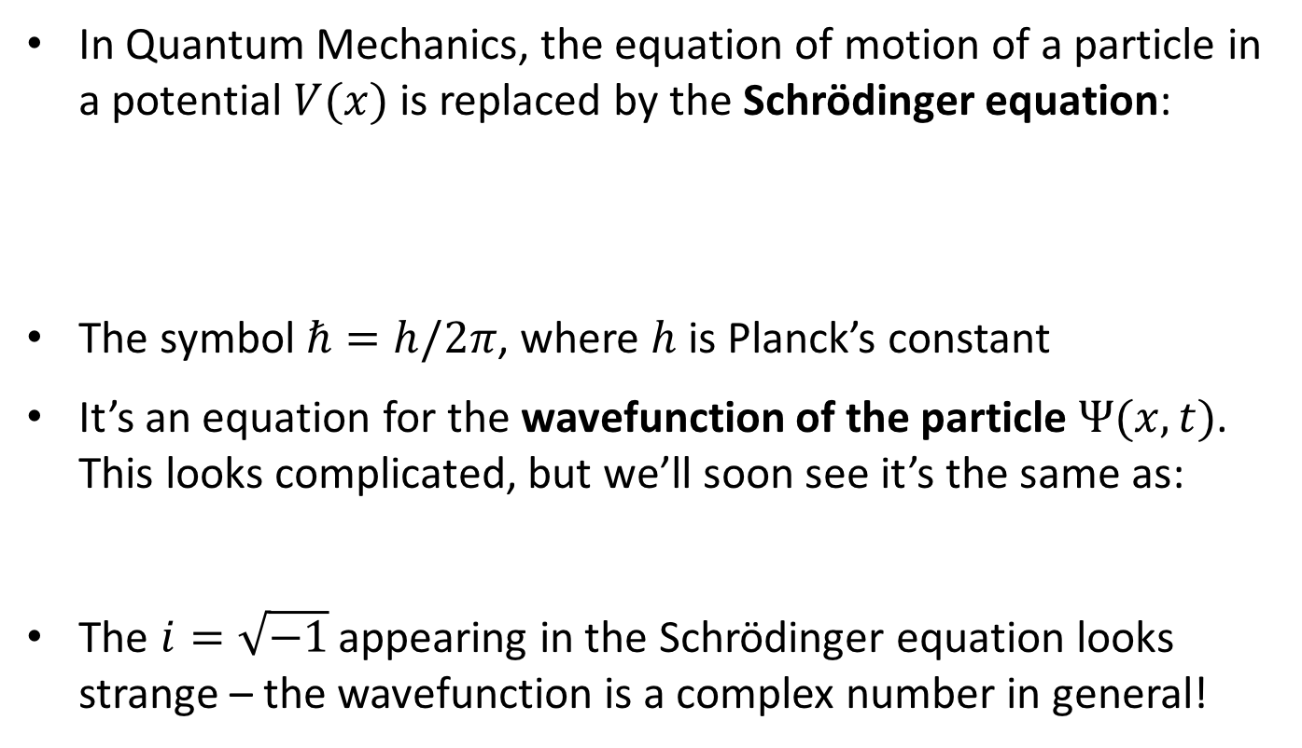

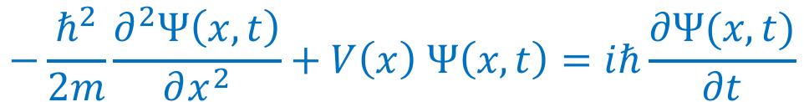
The wavefunction
The Schrödinger equation
In Quantum Mechanics, the equation of motion of a particle in a potential $V(x)$ is replaced by the Schrödinger equation:
The symbol $ℏ=h/2π$, where $h$ is Planck’s constant
It’s an equation for the wavefunction of the particle $Ψ(x,t)$. This looks complicated, but we’ll soon see it’s the same as:
The $i=\sqrt{−1}$ appearing in the Schrödinger equation looks strange – the wavefunction is a complex number in general!
$$−\frac{ℏ^{2}}{2m}\frac{∂^{2}Ψ\left(x,t\right)}{∂x^{2}}+V\left(x\right) Ψ\left(x,t\right)=iℏ\frac{∂Ψ(x,t)}{∂t}$$
$$Kinetic energy+Potential energy=Total energy$$

Slide 5
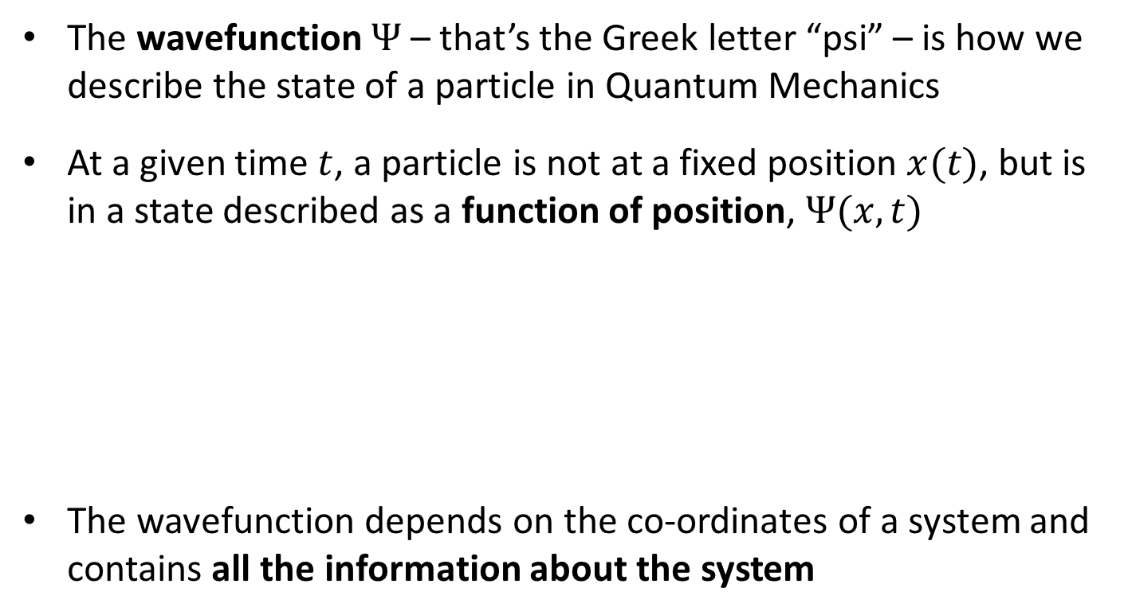
The wavefunction
The wavefunction
The wavefunction $Ψ$ – that’s the Greek letter “psi” – is how we describe the state of a particle in Quantum Mechanics
At a given time $t$, a particle is not at a fixed position $x(t)$, but is in a state described as a function of position, $Ψ(x,t)$
The wavefunction depends on the co-ordinates of a system and contains all the information about the system
Classical:
Quantum:
becomes

Slide 6

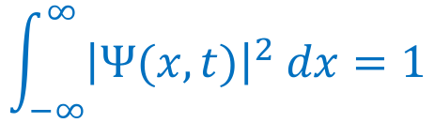
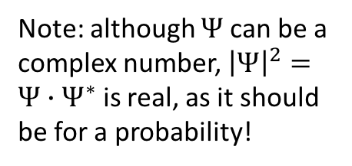


The wavefunction
Probability interpretation of the wavefunction
What does the wavefunction mean? It’s connected to the probability of the particle being in a particular position:
The particle must be somewhere! Hence, these probabilities must sum to $1.0$, which is known as the normalisation of $Ψ$:
The probability interpretation of the wavefunction implies that Quantum Mechanics has a statistical or indeterminate nature
Probability of finding a particle in a range $x→x+dx$
Note: although $Ψ$ can be a complex number, ${\left|Ψ\right|}^{2}=Ψ∙Ψ^{∗}$ is real, as it should be for a probability!
$$={\left|Ψ\right|}^{2} dx$$
$$\int_{−∞}^{∞}{{\left|Ψ(x,t)\right|}^{2} dx}=1$$

Slide 7
Operators, eigenfunctions & eigenvalues
Discrete nature of observables
In Quantum Mechanics, a measurement of a quantity can only produce discrete (specific) outcomes, not any value
You have previously studied a particle in an infinite potential well, which has certain allowed energy levels (see recap on next slide)
Another example is poor Schrödinger’s cat, which only has 2 possible states …

Slide 8
Operators, eigenfunctions & eigenvalues
Discrete nature of observables
In Physics 2A QM, you studied that a particle enclosed in an infinite potential well has discrete energies and wavefunctions
We’ll see this example again in Section 3!
Image credit: https://opentextbc.ca/universityphysicsv3openstax/chapter/the-quantum-particle-in-a-box/

Slide 9
Operators, eigenfunctions & eigenvalues
Discrete nature of observables
Physics is described in the language of mathematics; so we need a mathematical structure in which discrete values appear
Welcome to the world of operators, eigenfunctions and eigenvalues! Please do not turn back!
We can describe the mathematical framework of Quantum Mechanics by the following statement:
What do these words mean??
Each quantity we can observe is represented by a corresponding operator. If we measure that observable, we will always obtain a result which is one of the eigenvalues of the operator

Slide 10
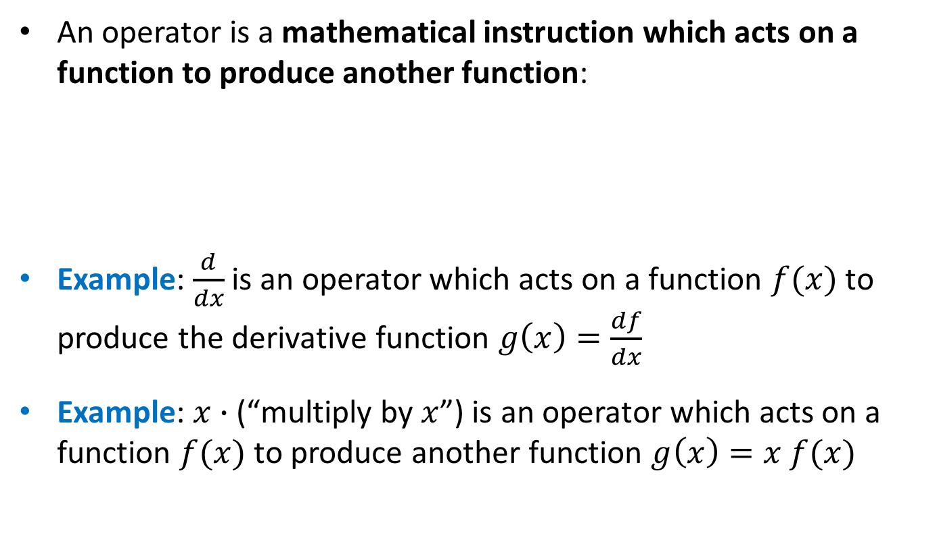


Operators, eigenfunctions & eigenvalues
What is an operator?
An operator is a mathematical instruction which acts on a function to produce another function:
Example: $\frac{d}{dx}$ is an operator which acts on a function $f(x)$ to produce the derivative function $g\left(x\right)=\frac{df}{dx}$
Example: $x∙$ (“multiply by $x$”) is an operator which acts on a function $f(x)$ to produce another function $g\left(x\right)=x f(x)$
Operator
acts on
Function $f(x)$
to produce
Function $g(x)$

Slide 11

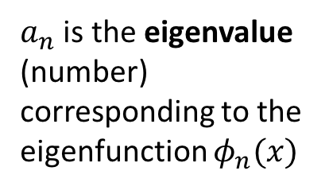
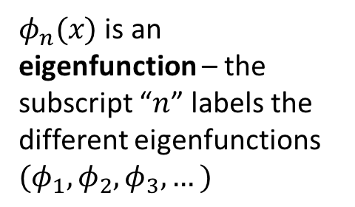

Operators, eigenfunctions & eigenvalues
Eigenfunctions and eigenvalues
When an operator acts on some special functions – called the eigenfunctions of the operator – it returns the same function, scaled by a number – called an eigenvalue
$$\hat{A} φ_{n}\left(x\right)=a_{n} φ_{n}(x)$$
$\hat{A}$ is an operator – these are usually written with little hats!
$a_{n}$ is the eigenvalue (number) corresponding to the eigenfunction $φ_{n}(x)$
$φ_{n}(x)$ is an eigenfunction – the subscript “$n$” labels the different eigenfunctions $(φ_{1},φ_{2},φ_{3},…)$

Slide 12
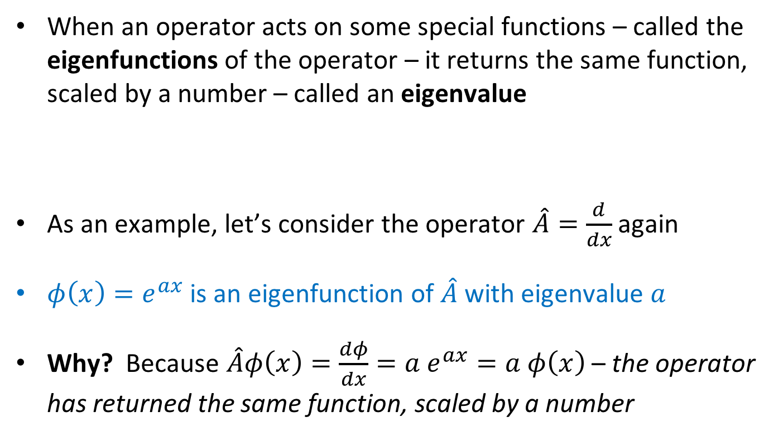
Operators, eigenfunctions & eigenvalues
Eigenfunctions and eigenvalues
When an operator acts on some special functions – called the eigenfunctions of the operator – it returns the same function, scaled by a number – called an eigenvalue
As an example, let’s consider the operator $\hat{A}=\frac{d}{dx}$ again
$φ\left(x\right)=e^{ax}$ is an eigenfunction of $\hat{A}$ with eigenvalue $a$
Why? Because $\hat{A}φ\left(x\right)=\frac{dφ}{dx}=a e^{ax}=a φ\left(x\right)$ – the operator has returned the same function, scaled by a number
$$\hat{A} φ_{n}\left(x\right)=a_{n} φ_{n}(x)$$

Slide 13
Operators, eigenfunctions & eigenvalues
Properties of the operators representing observables
Each quantity we can observe is represented by a corresponding operator. If we measure that observable, we will always obtain a result which is one of the eigenvalues of the operator
Momentum
Position
Represented by mathematical operator
Represented by mathematical operator
Energy
Angular momentum
Represented by mathematical operator
Represented by mathematical operator

Slide 14
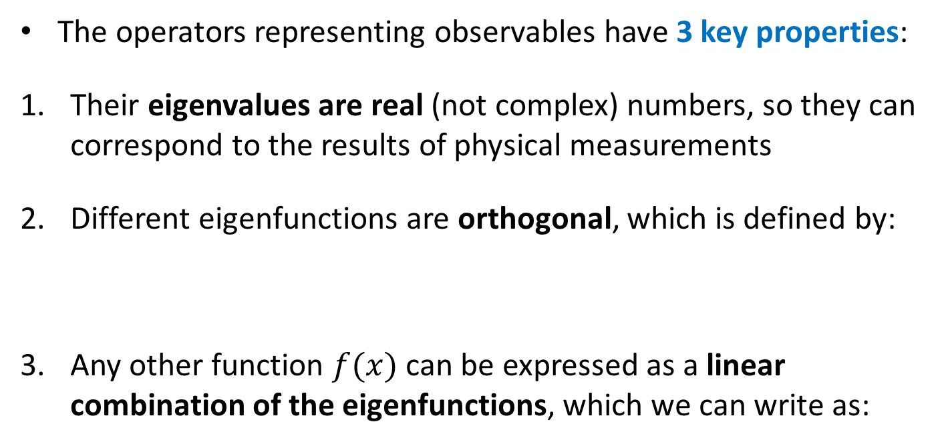
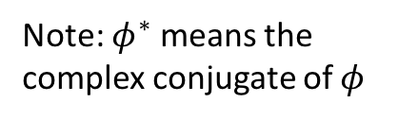
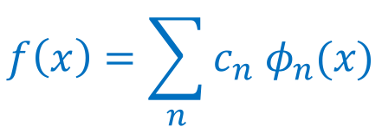
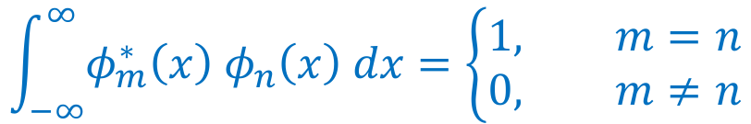
Operators, eigenfunctions & eigenvalues
Properties of the operators representing observables
The operators representing observables have 3 key properties:
Their eigenvalues are real (not complex) numbers, so they can correspond to the results of physical measurements
Different eigenfunctions are orthogonal, which is defined by:
Any other function $f(x)$ can be expressed as a linear combination of the eigenfunctions, which we can write as:
$$\int_{−∞}^{∞}{φ_{m}^{∗}\left(x\right) φ_{n}\left(x\right) dx}=\left\{\begin{aligned}1, m=n \\ &0, m≠n\end{aligned}\right.$$
Note: $φ^{∗}$ means the complex conjugate of $φ$
$$f\left(x\right)=\sum_{n}{c_{n} φ_{n}(x)}$$

Slide 15
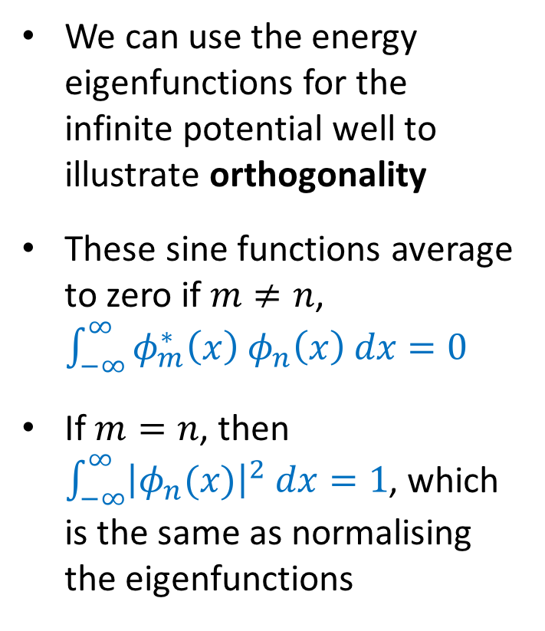
Operators, eigenfunctions & eigenvalues
Properties of the operators representing observables
We can use the energy eigenfunctions for the infinite potential well to illustrate orthogonality
These sine functions average to zero if $m≠n$, $\int_{−∞}^{∞}{φ_{m}^{∗}\left(x\right) φ_{n}\left(x\right) dx}=0$
If $m=n$, then $\int_{−∞}^{∞}{{\left|φ_{n}(x)\right|}^{2} dx}=1$, which is the same as normalising the eigenfunctions

Slide 16
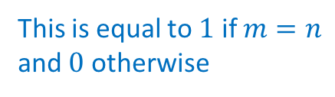
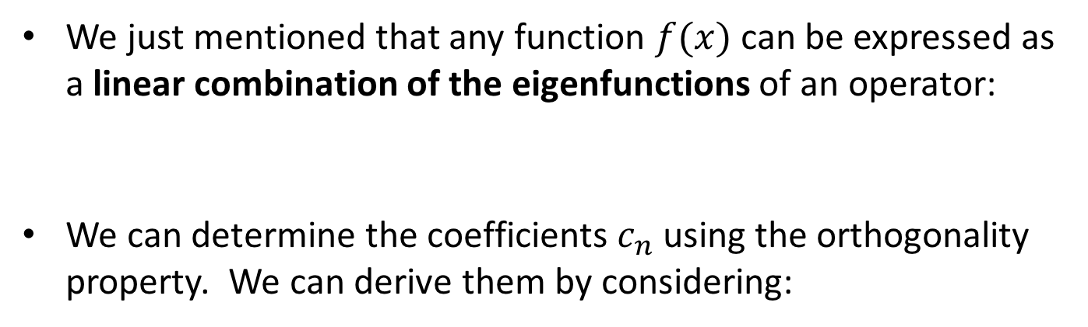



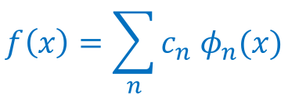
Operators, eigenfunctions & eigenvalues
Linear combinations of eigenfunctions
We just mentioned that any function $f(x)$ can be expressed as a linear combination of the eigenfunctions of an operator:
We can determine the coefficients $c_{n}$ using the orthogonality property. We can derive them by considering:
$$f\left(x\right)=\sum_{n}{c_{n} φ_{n}(x)}$$
$$\int_{−∞}^{∞}{φ_{m}^{∗}\left(x\right) f\left(x\right) dx=}\int_{−∞}^{∞}{φ_{m}^{∗}\left(x\right) \sum_{n}{c_{n} φ_{n}(x)}dx}$$
Changing the order of the integral and sum …
$$=\sum_{n}{c_{n}}\int_{−∞}^{∞}{φ_{m}^{∗}\left(x\right) φ_{n}\left(x\right) dx}$$
This is equal to $1$ if $m=n$ and $0$ otherwise
$$=c_{m}$$

Slide 17

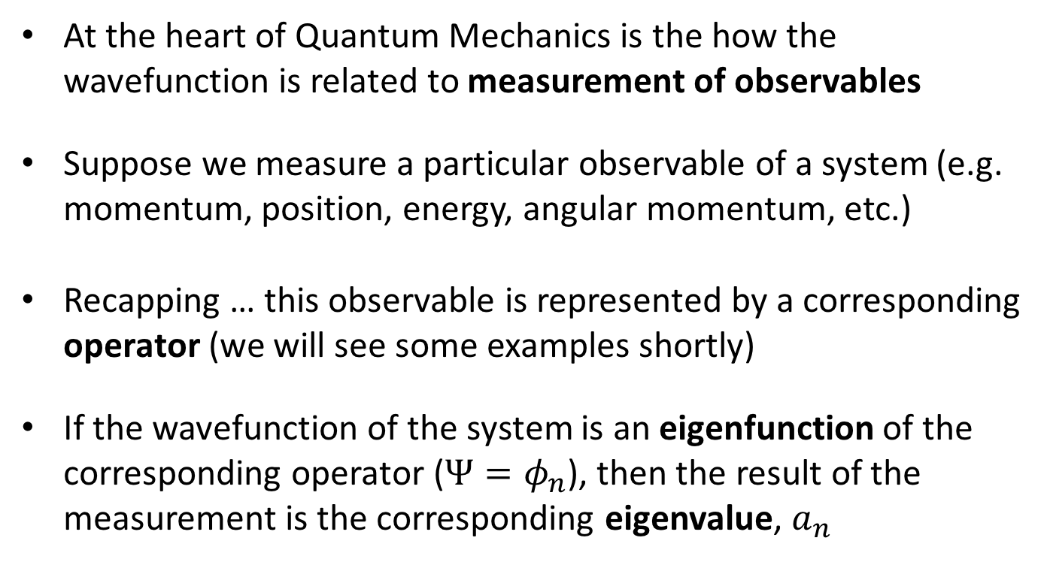
Measurement in Quantum Mechanics
Measurement if $Ψ$ is an eigenfunction
At the heart of Quantum Mechanics is the how the wavefunction is related to measurement of observables
Suppose we measure a particular observable of a system (e.g. momentum, position, energy, angular momentum, etc.)
Recapping … this observable is represented by a corresponding operator (we will see some examples shortly)
If the wavefunction of the system is an eigenfunction of the corresponding operator ($Ψ=φ_{n}$), then the result of the measurement is the corresponding eigenvalue, $a_{n}$

Slide 18

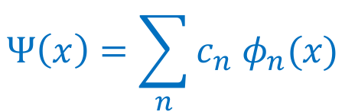
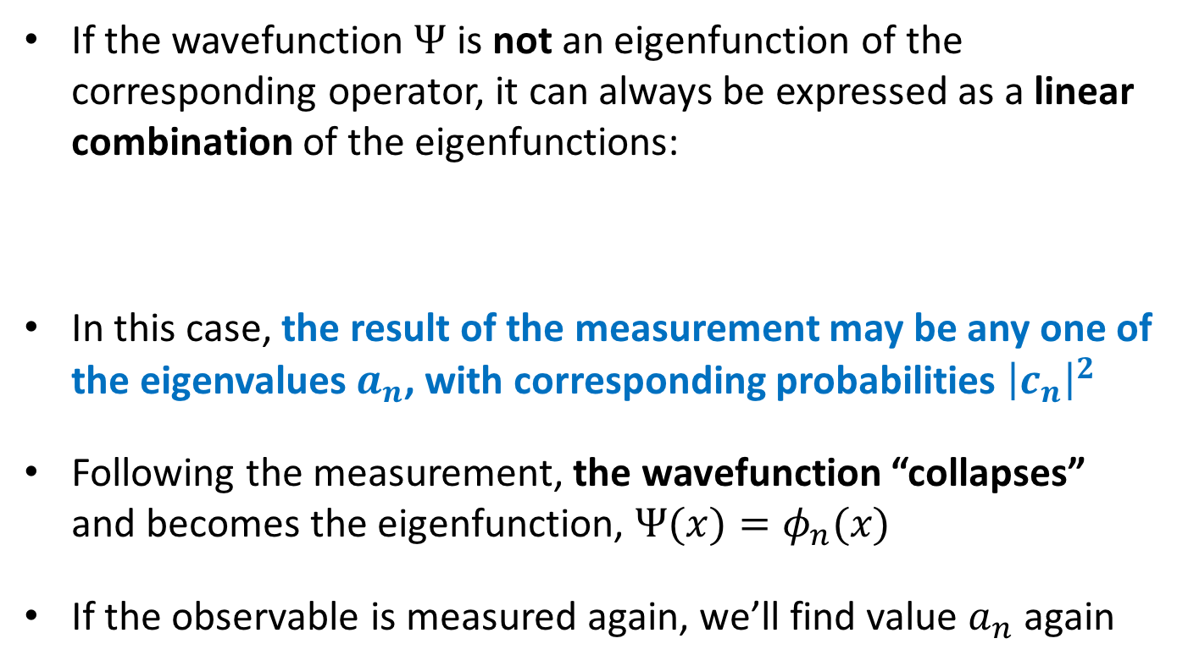
Measurement in Quantum Mechanics
Measurement if $Ψ$ is not an eigenfunction
If the wavefunction $Ψ$ is not an eigenfunction of the corresponding operator, it can always be expressed as a linear combination of the eigenfunctions:
In this case, the result of the measurement may be any one of the eigenvalues $a_{n}$, with corresponding probabilities ${\left|c_{n}\right|}^{2}$
Following the measurement, the wavefunction “collapses” and becomes the eigenfunction, $Ψ(x)=φ_{n}(x)$
If the observable is measured again, we’ll find value $a_{n}$ again
$$Ψ\left(x\right)=\sum_{n}{c_{n} φ_{n}(x)}$$

Slide 19
Measurement in Quantum Mechanics
Measurement if $Ψ$ is not an eigenfunction
Measurement changes the wavefunction, causing it to “collapse” into the eigenfunction corresponding to the result of the measurement. This ensures that future measurements of the quantity produce the same result.
It is equivalent to opening the box containing Schrödinger’s cat, and seeing the result!
[Yes, cat photos are an occupational hazard here.]

Slide 20
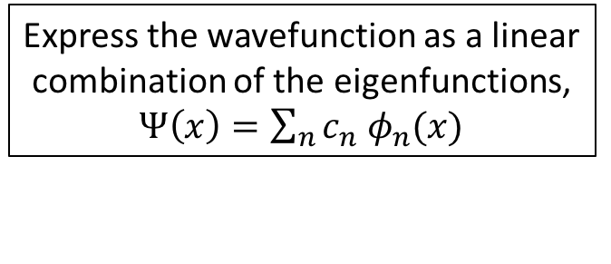
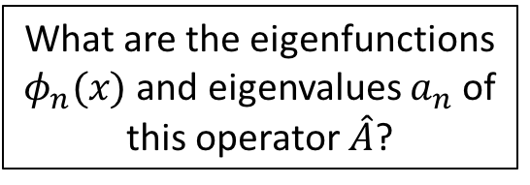
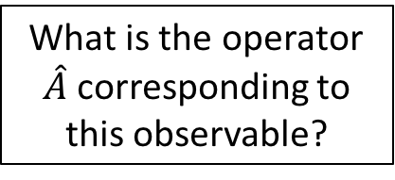
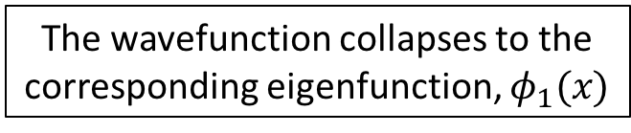
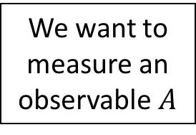
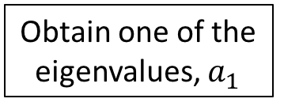
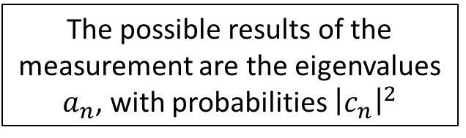
Measurement in Quantum Mechanics
Measurement if $Ψ$ is not an eigenfunction
This gives us the recipe for measurement in Quantum Mechanics, represented by the following flow chart!
The state of the particle is described by its wavefunction $Ψ(x)$
We want to measure an observable $A$
What is the operator $\hat{A}$ corresponding to this observable?
What are the eigenfunctions $φ_{n}(x)$ and eigenvalues $a_{n}$ of this operator $\hat{A}$?
Express the wavefunction as a linear combination of the eigenfunctions, $Ψ\left(x\right)=\sum_{n}{c_{n} φ_{n}(x)}$
The possible results of the measurement are the eigenvalues $a_{n}$, with probabilities ${\left|c_{n}\right|}^{2}$
Perform the measurement
Obtain one of the eigenvalues, $a_{1}$
The wavefunction collapses to the corresponding eigenfunction, $φ_{1}(x)$

Slide 21
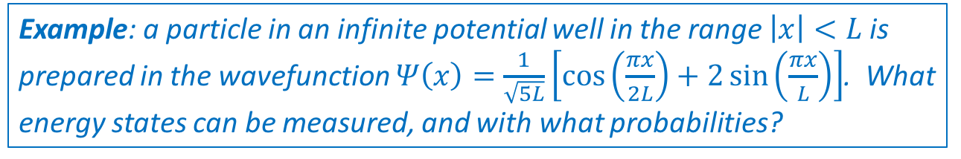
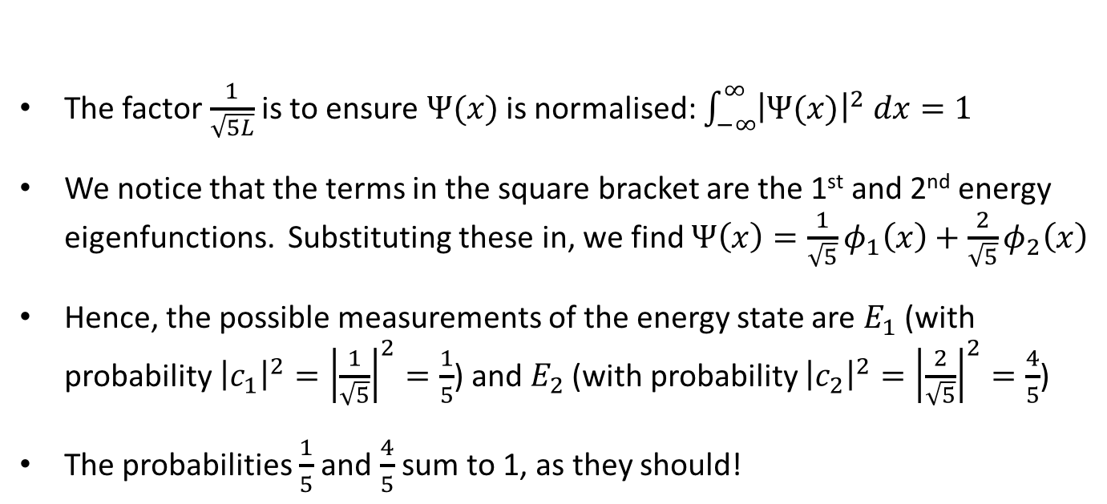
Measurement in Quantum Mechanics
Measurement if $Ψ$ is not an eigenfunction
Example: a particle in an infinite potential well in the range $\left|x\right|<L$ is prepared in the wavefunction $Ψ\left(x\right)=\frac{1}{\sqrt{5L}}\left[\cos\left(\frac{πx}{2L}\right)+2\sin\left(\frac{πx}{L}\right)\right]$. What energy states can be measured, and with what probabilities?
The factor $\frac{1}{\sqrt{5L}}$ is to ensure $Ψ(x)$ is normalised: $\int_{−∞}^{∞}{{\left|Ψ(x)\right|}^{2} dx}=1$
We notice that the terms in the square bracket are the 1st and 2nd energy eigenfunctions. Substituting these in, we find $Ψ\left(x\right)=\frac{1}{\sqrt{5}}φ_{1}\left(x\right)+\frac{2}{\sqrt{5}}φ_{2}\left(x\right)$
Hence, the possible measurements of the energy state are $E_{1}$ (with probability ${\left|c_{1}\right|}^{2}={\left|\frac{1}{\sqrt{5}}\right|}^{2}=\frac{1}{5}$) and $E_{2}$ (with probability ${\left|c_{2}\right|}^{2}={\left|\frac{2}{\sqrt{5}}\right|}^{2}=\frac{4}{5}$)
The probabilities $\frac{1}{5}$ and $\frac{4}{5}$ sum to 1, as they should!

Slide 22
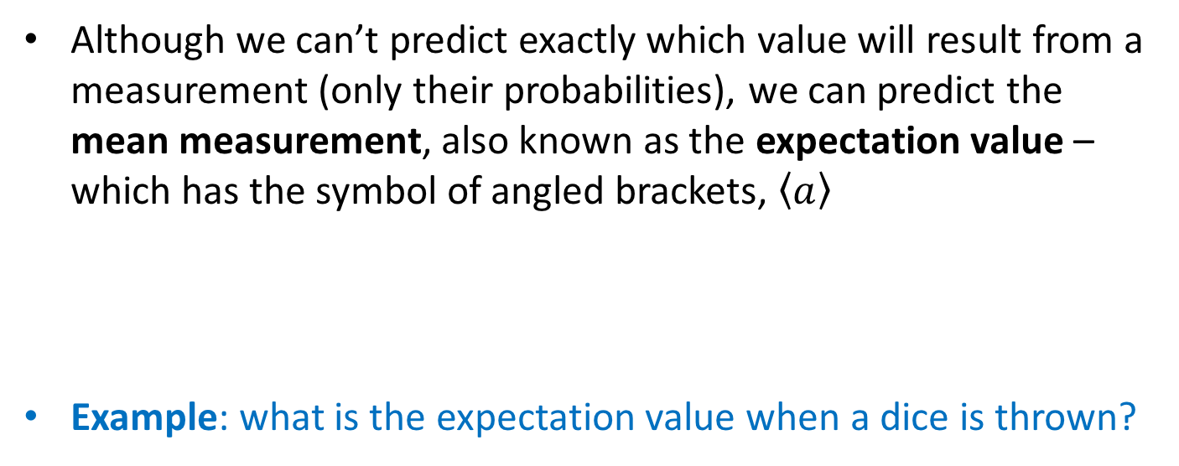

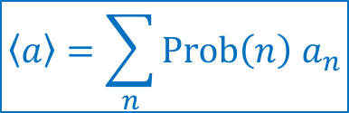
Measurement in Quantum Mechanics
Expectation values
Although we can’t predict exactly which value will result from a measurement (only their probabilities), we can predict the mean measurement, also known as the expectation value – which has the symbol of angled brackets, $\left\langle a\right\rangle$
Example: what is the expectation value when a dice is thrown?
$$\left\langle a\right\rangle =\sum_{n}{Prob\left(n\right) a_{n}}$$
$$\left\langle a\right\rangle =\frac{1}{6}∙1+\frac{1}{6}∙2+\frac{1}{6}∙3+\frac{1}{6}∙4+\frac{1}{6}∙5+\frac{1}{6}∙6=3.5$$
[Note: the value $3.5$ cannot be obtained for any individual throw of the dice, but is the average over many throws!]

Slide 23
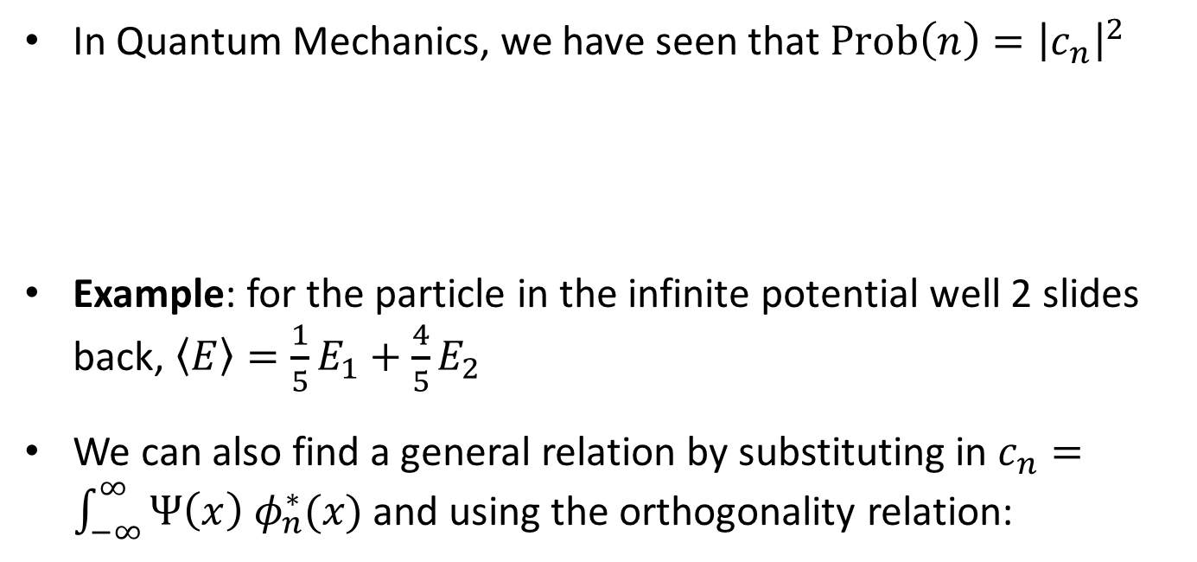
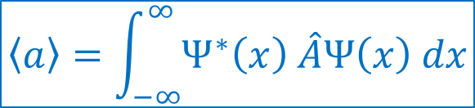
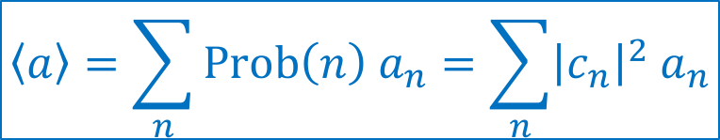
Measurement in Quantum Mechanics
Expectation values
In Quantum Mechanics, we have seen that $Prob\left(n\right)={\left|c_{n}\right|}^{2}$
Example: for the particle in the infinite potential well 2 slides back, $\left\langle E\right\rangle =\frac{1}{5}E_{1}+\frac{4}{5}E_{2}$
We can also find a general relation by substituting in $c_{n}=\int_{−∞}^{∞}{Ψ\left(x\right) φ_{n}^{∗}(x)}$ and using the orthogonality relation:
$$\left\langle a\right\rangle =\sum_{n}{Prob\left(n\right) a_{n}}=\sum_{n}{{\left|c_{n}\right|}^{2} a_{n}}$$
$$\left\langle a\right\rangle =\int_{−∞}^{∞}{Ψ^{∗}\left(x\right) \hat{A}Ψ\left(x\right) dx}$$

Slide 24
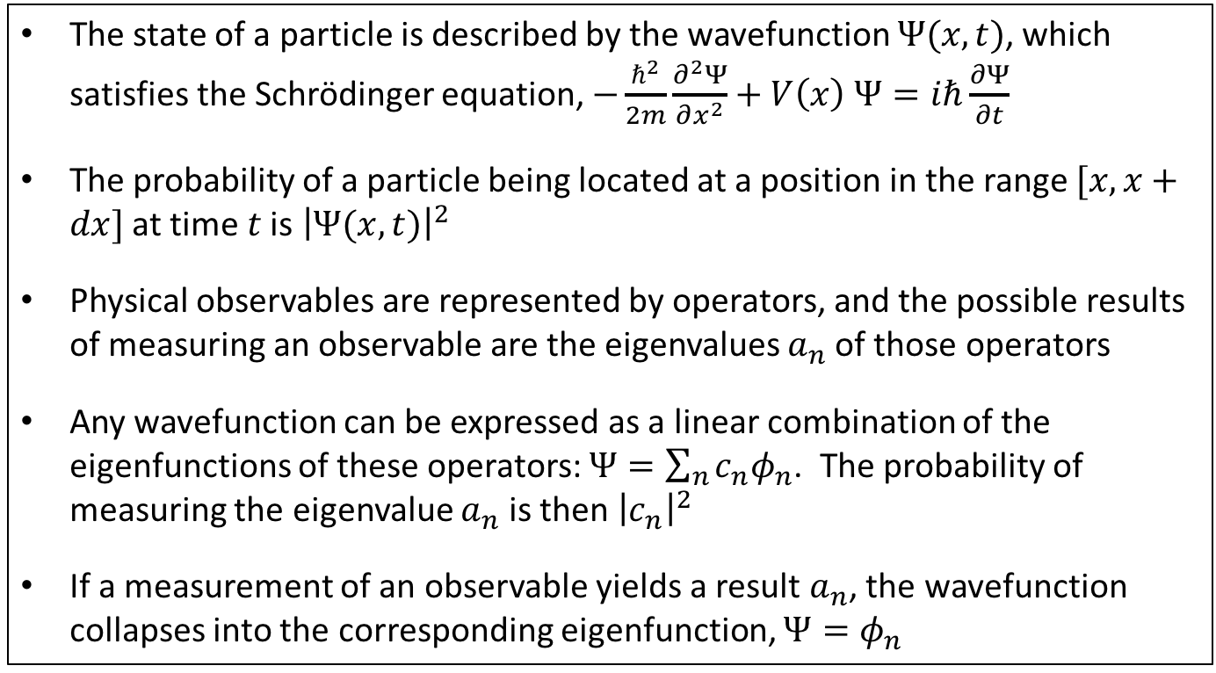
Summary
The rules of Quantum Mechanics
The state of a particle is described by the wavefunction $Ψ(x,t)$, which satisfies the Schrödinger equation, $−\frac{ℏ^{2}}{2m}\frac{∂^{2}Ψ}{∂x^{2}}+V\left(x\right) Ψ=iℏ\frac{∂Ψ}{∂t}$
The probability of a particle being located at a position in the range $[x,x+dx]$ at time $t$ is ${\left|Ψ(x,t)\right|}^{2}$
Physical observables are represented by operators, and the possible results of measuring an observable are the eigenvalues $a_{n}$ of those operators
Any wavefunction can be expressed as a linear combination of the eigenfunctions of these operators: $Ψ=\sum_{n}{c_{n}φ_{n}}$. The probability of measuring the eigenvalue $a_{n}$ is then ${\left|c_{n}\right|}^{2}$
If a measurement of an observable yields a result $a_{n}$, the wavefunction collapses into the corresponding eigenfunction, $Ψ=φ_{n}$

