Slide 1
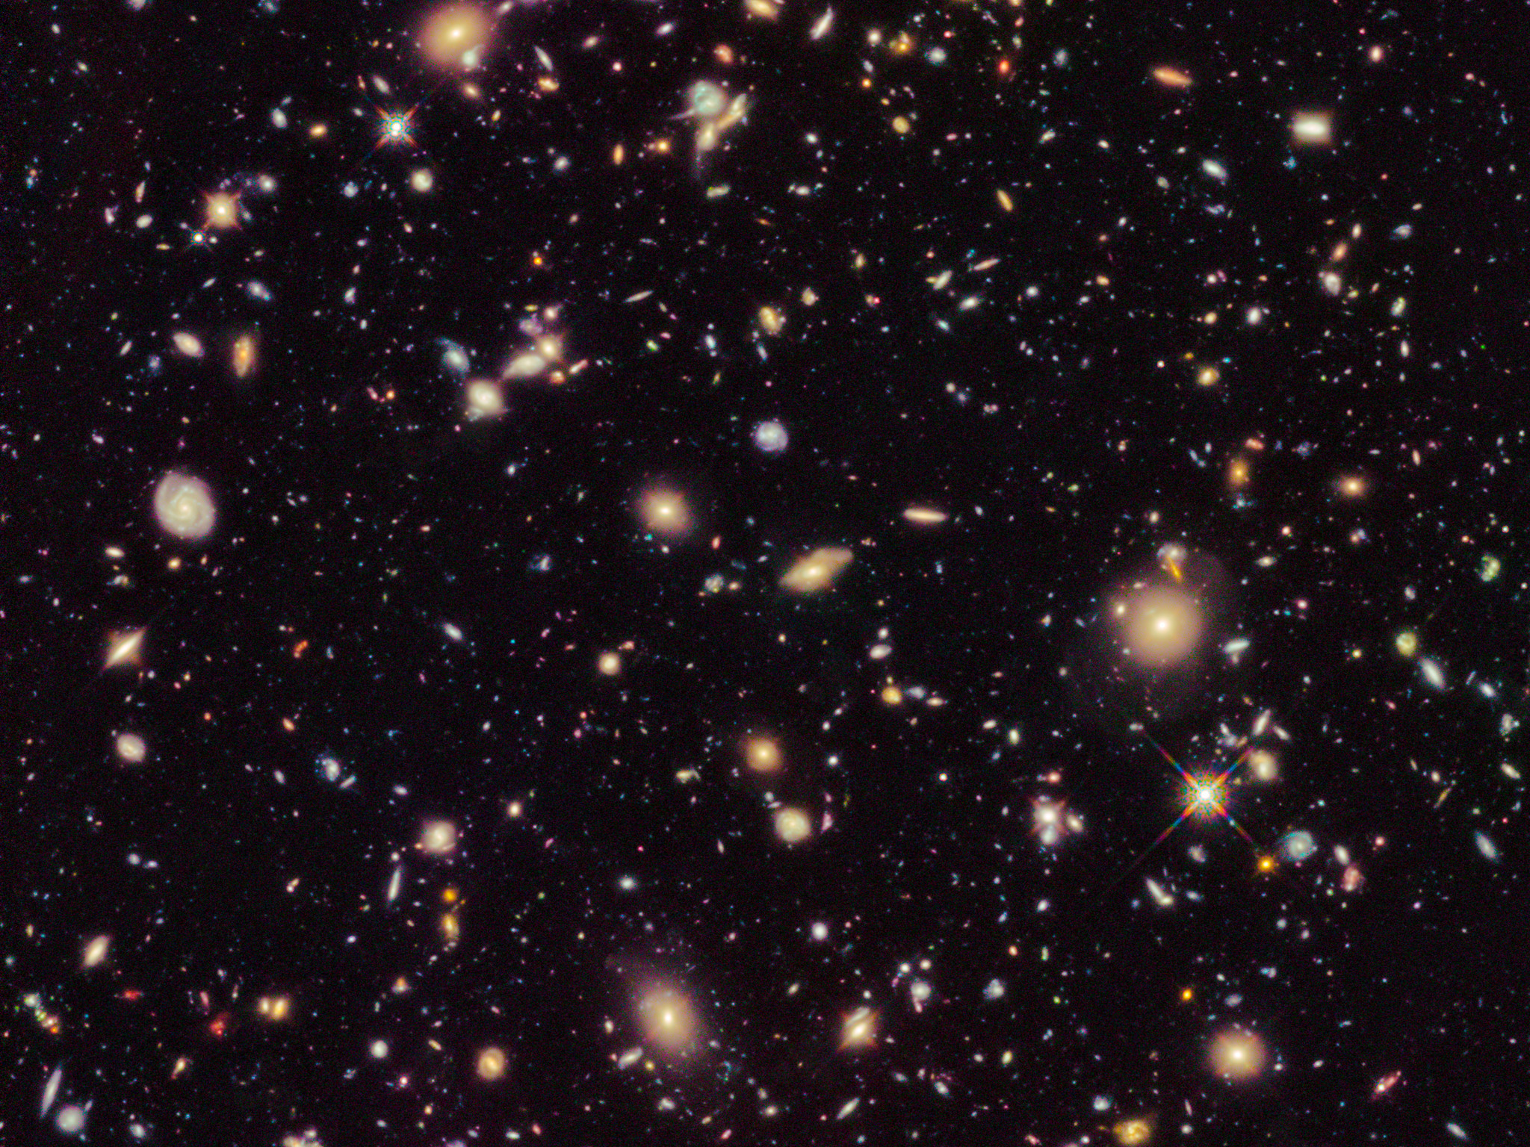
Researching dark energy
(and the life of an astronomer!)

Slide 2
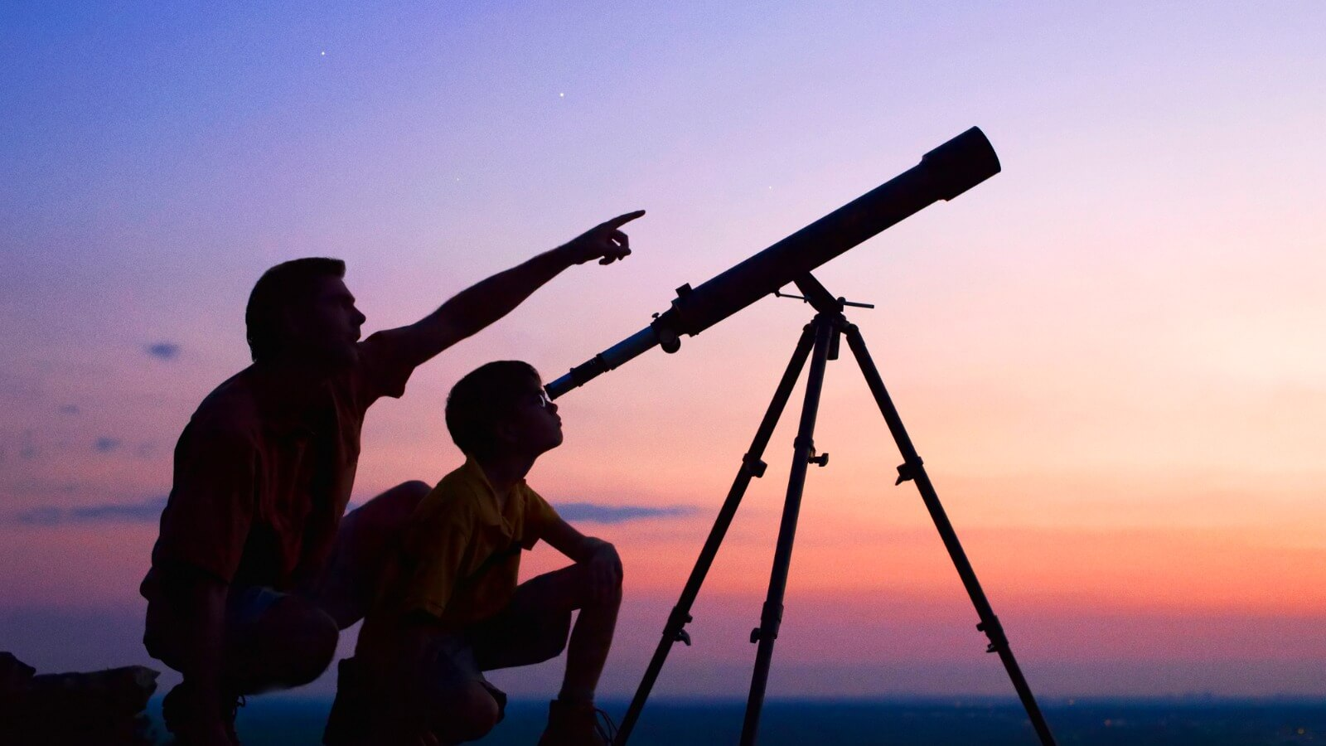
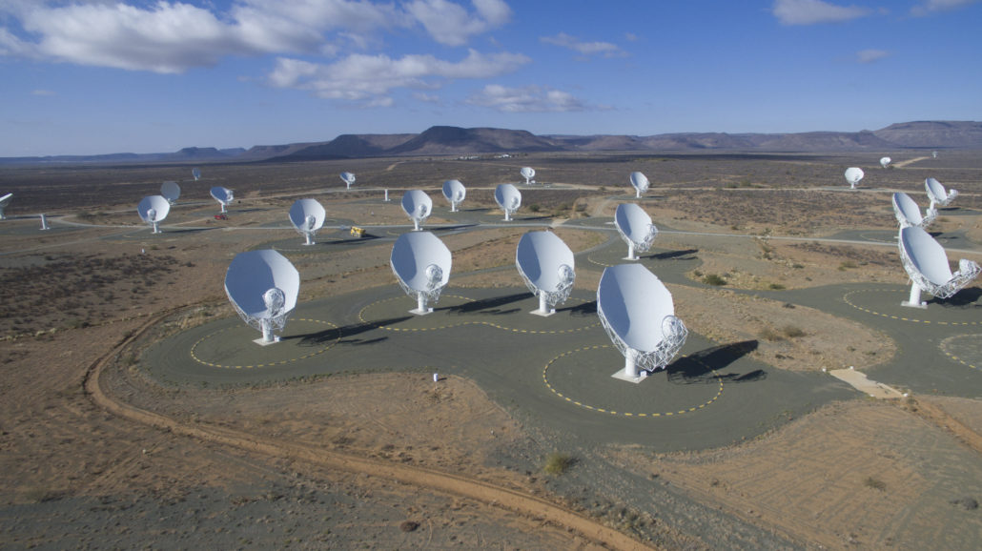
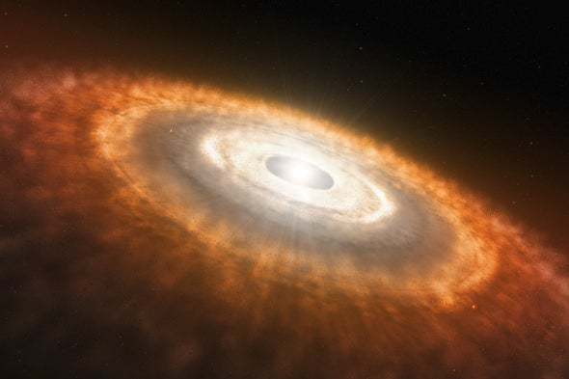
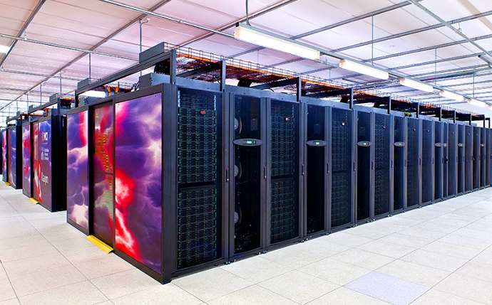
I’m an astronomy researcher!
We are scientists who study planets, stars, galaxies … and the Universe as a whole!
We gather data on the Universe … using the best technologies!
We process and analyse data using computer codes, maths, statistics
We use these results to improve our theory of how the Universe formed and evolved

Slide 3

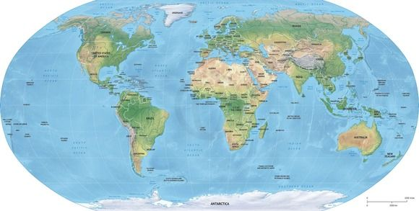
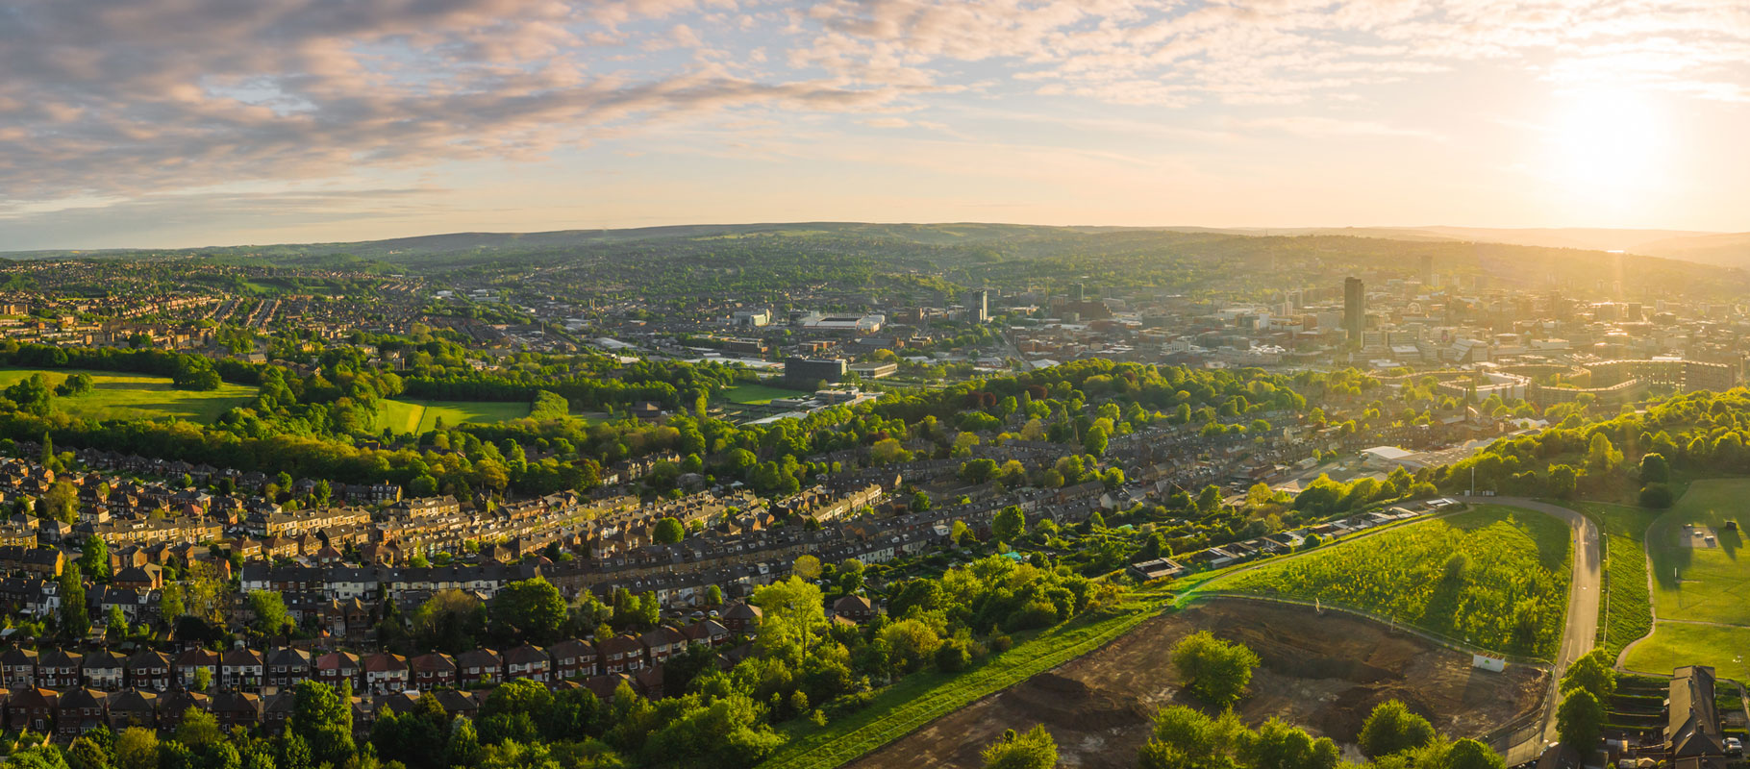
A bit about me!
Where am I from?
I come from Sheffield, a town in the north of England …

Slide 4
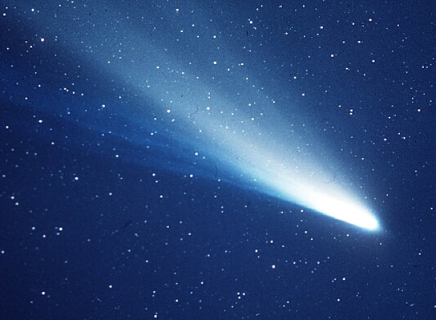
A bit about me!
My first memory of being interested in astronomy was in 1986 when I saw…
Put 28 July, 2061 in your diaries!

Slide 5
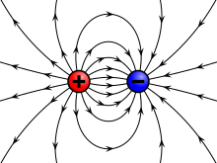
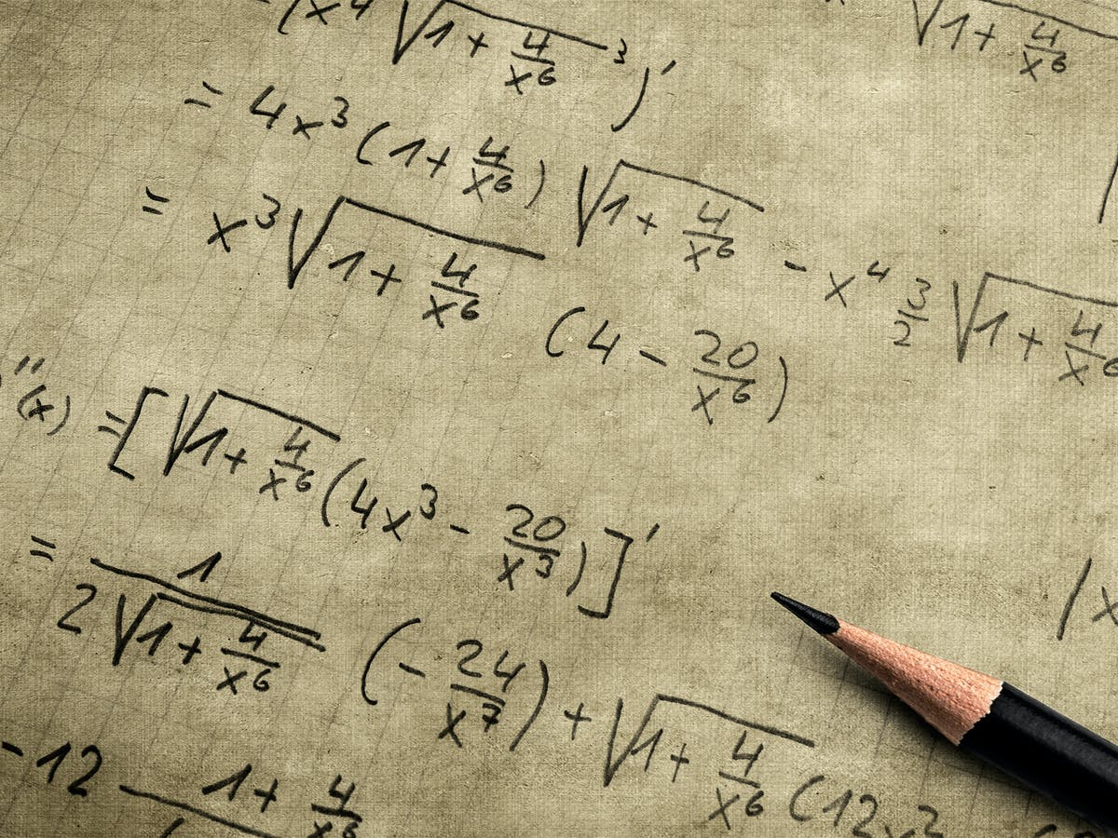


What I liked to study …
Physics
Maths
History
I got the chance to go to University and chose to study physics
I didn’t know anything about research!

Slide 6
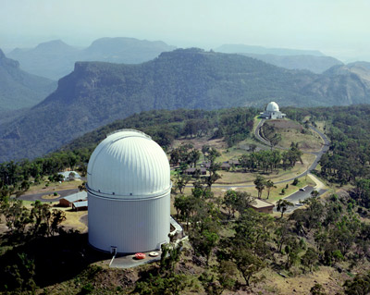
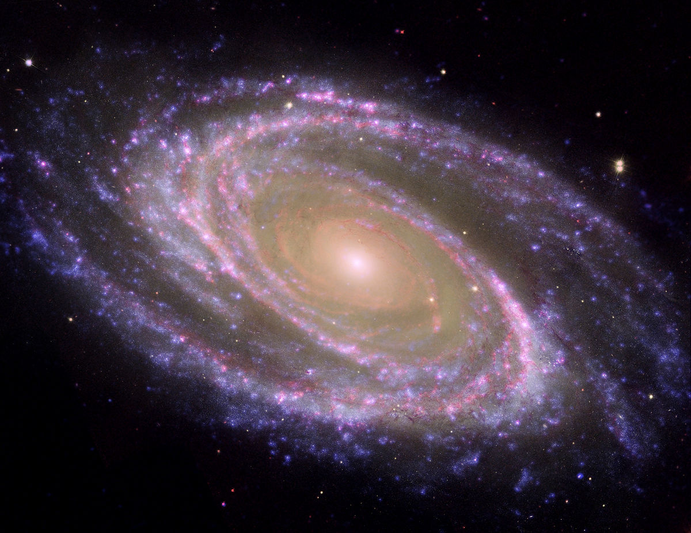

I got interested in astronomy!
In 1996 I had a very lucky opportunity to visit …
After my degree I started PhD research in astronomy
I realized the Universe is the greatest physics laboratory of them all!

Slide 7

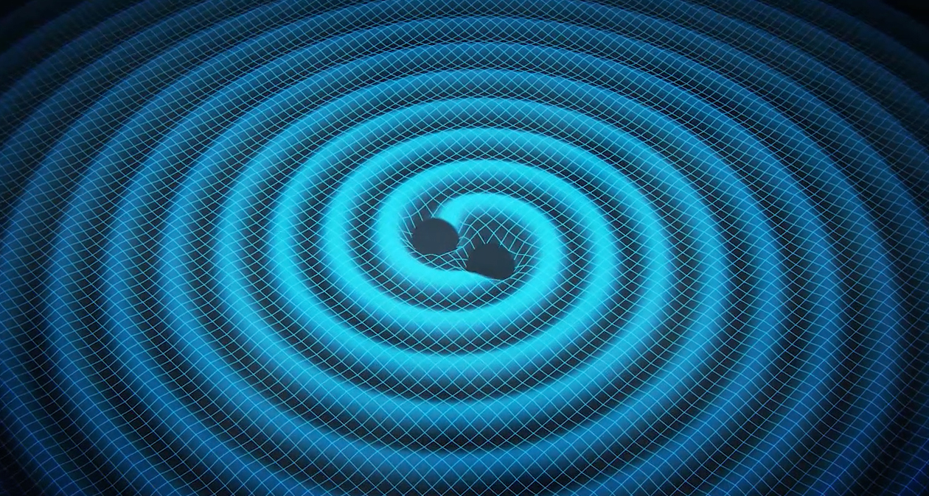
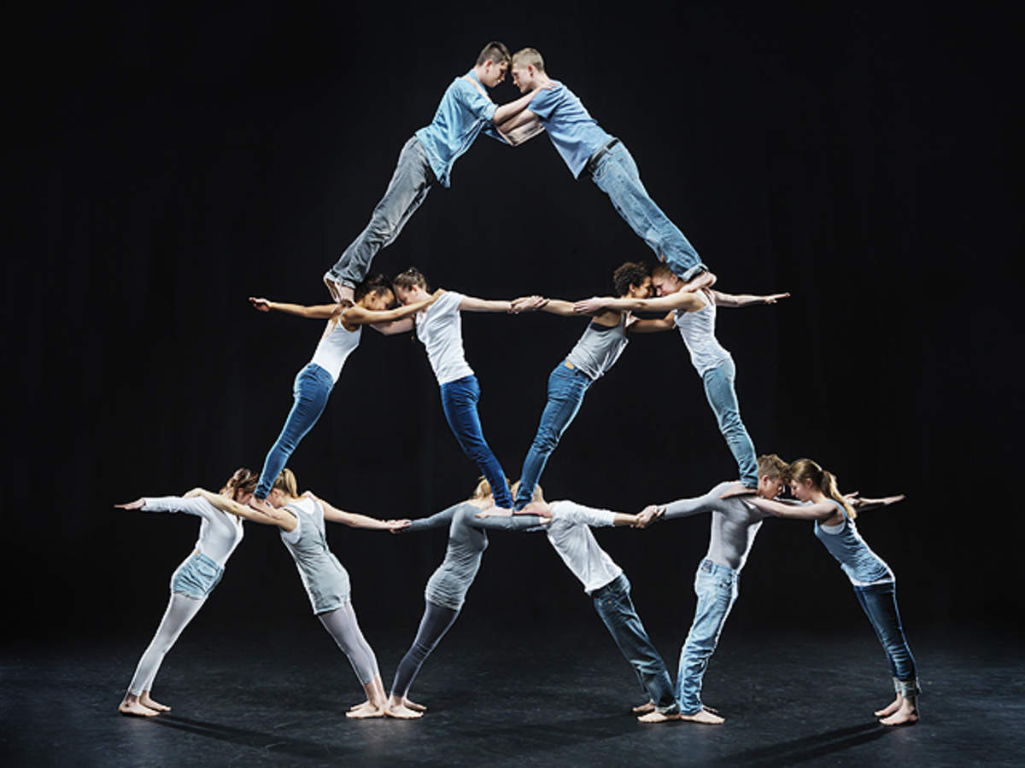

Why research is fun …?
Discovering things which no-one has seen before
Creative process
Team work
Challenging yourself

Slide 8

My research field of cosmology aims to build a physical model of the contents and history of the Universe …
Image credit: D.Aguilar, Harvard CFA

Slide 9
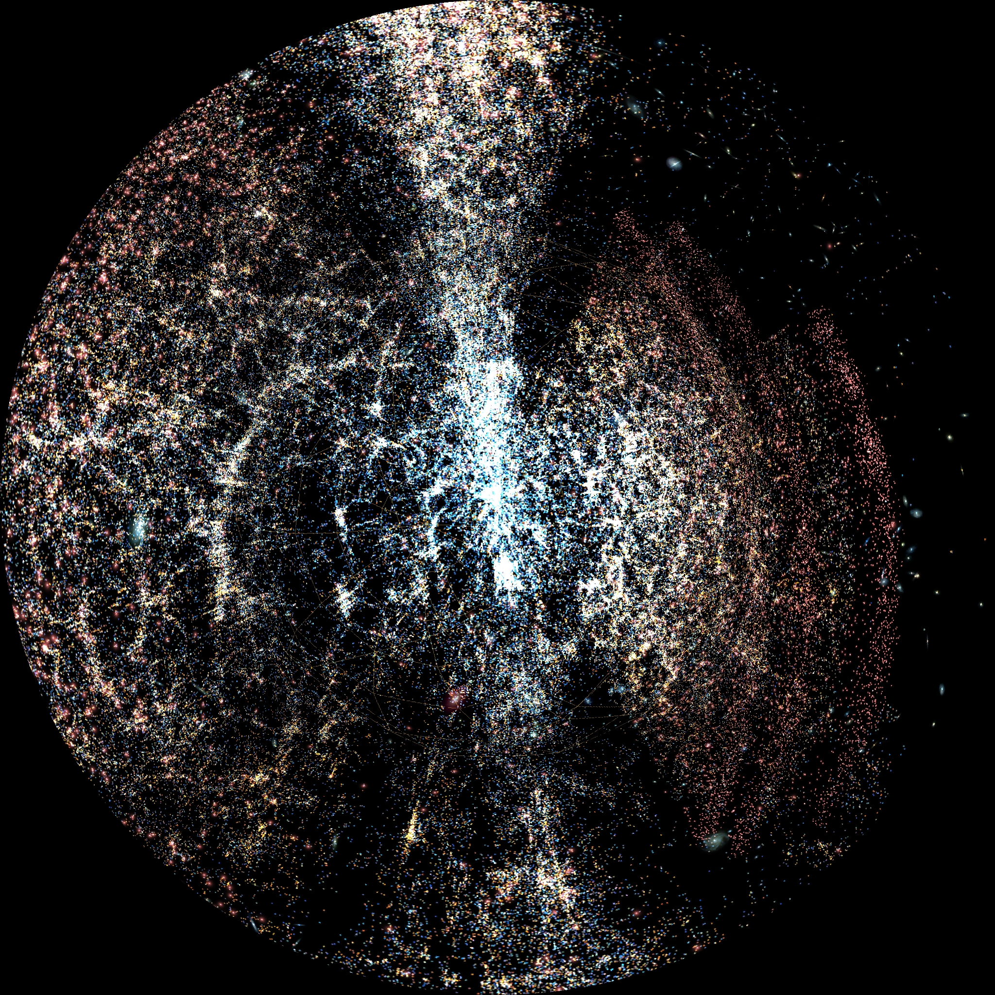
… and has been transformed by a remarkable growth in data over the past 2 decades!

Slide 10
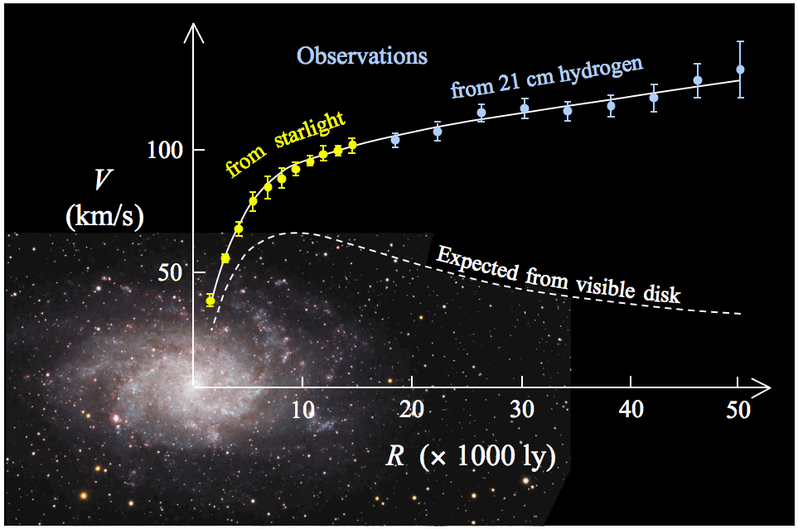
We have learned galaxies are full of invisible dark matter …
Rotation speed (km/s)
Dark matter causes this!
Distance from centre of galaxy (1000s light year)

Slide 11
… but the most startling discovery is that the cosmic expansion seems to be accelerating!
Image credit: The Cosmic Perspective

Slide 12
This is the “dark energy problem”: the attempt to understand the physics of cosmic acceleration, and its implications

Slide 13
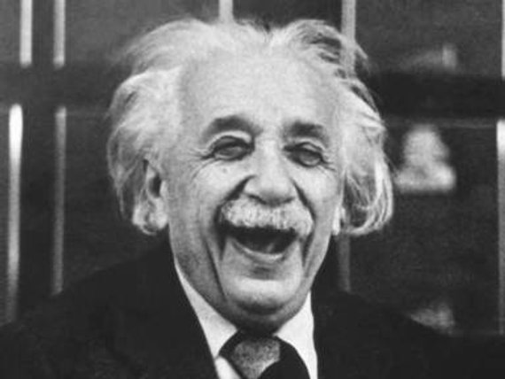
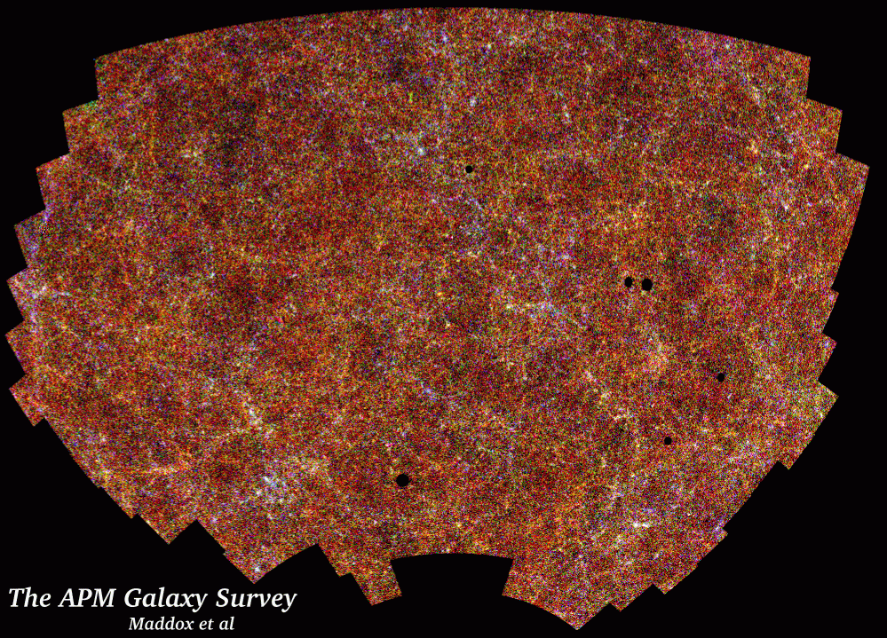
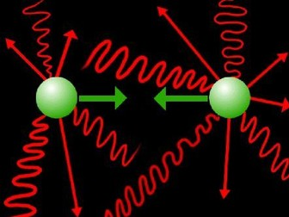
The dark energy problem
$$G_{μν}=\frac{8πG}{c^{4}}T_{μν}$$
The accelerating cosmic expansion cannot be produced by applying General Relativity to a homogeneous and isotropic Universe containing matter and radiation

Slide 14
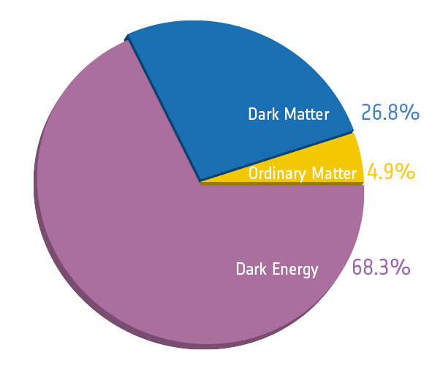
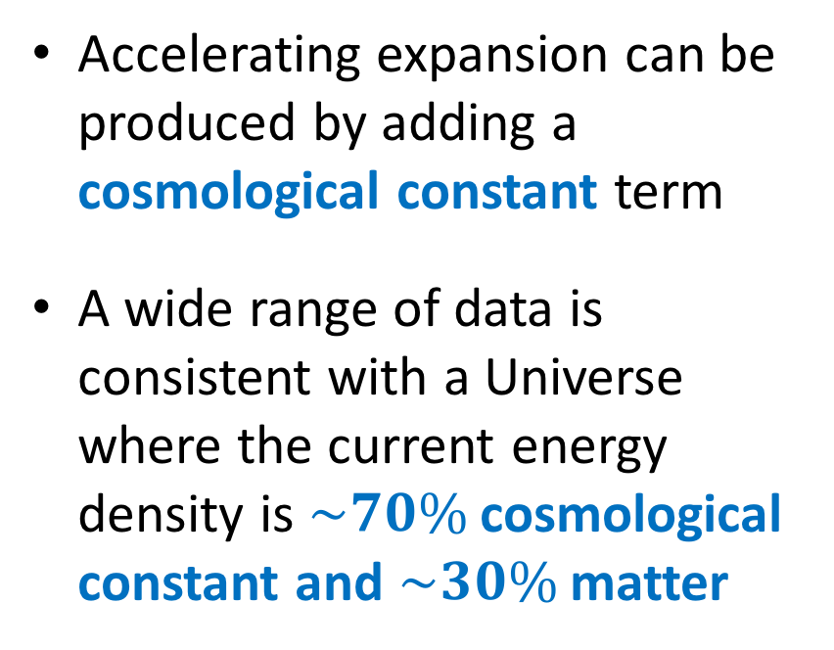
The dark energy problem
$$G_{μν}=\frac{8πG}{c^{4}}T_{μν}−Λg_{μν}$$
Accelerating expansion can be produced by adding a cosmological constant term
A wide range of data is consistent with a Universe where the current energy density is $\sim 70\%$ cosmological constant and $\sim 30\%$ matter

Slide 15
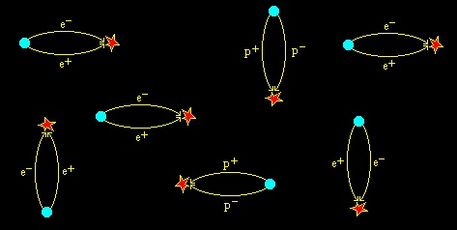
Why is this a problem?
$$Λ_{obs}\sim {\left({10}^{−30} M_{Planck}\right)}^{4}$$
In physics we seek a microscopic explanation of what the terms in an equation mean
Unfortunately, this energy scale is many tens of orders of magnitude lower than expected from quantum mechanical processes involving standard particles
Is the cosmological constant a sign of new physics?

Slide 16
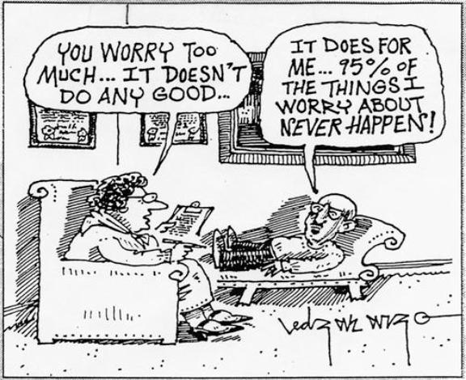
Other explanations?
Let’s seek another solution!
“Accelerating cosmic expansion cannot be produced applying GR to a homogeneous/isotropic Universe containing matter and radiation”
Modify gravitational physics? [e.g. Einstein-Hilbert action]
Allow for effects of inhomogeneity? [very hard!]
Add extra “source”? [e.g. dynamical scalar field]

Slide 17
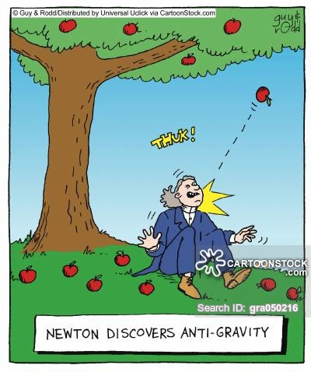
What does it mean to “modify gravity”?
Add some kind of “fifth force” [to the four we already have]
But we have extremely accurate laboratory and solar system tests of General Relativity!
Add a “screening mechanism” which allows the fifth force to vary with environment

Slide 18
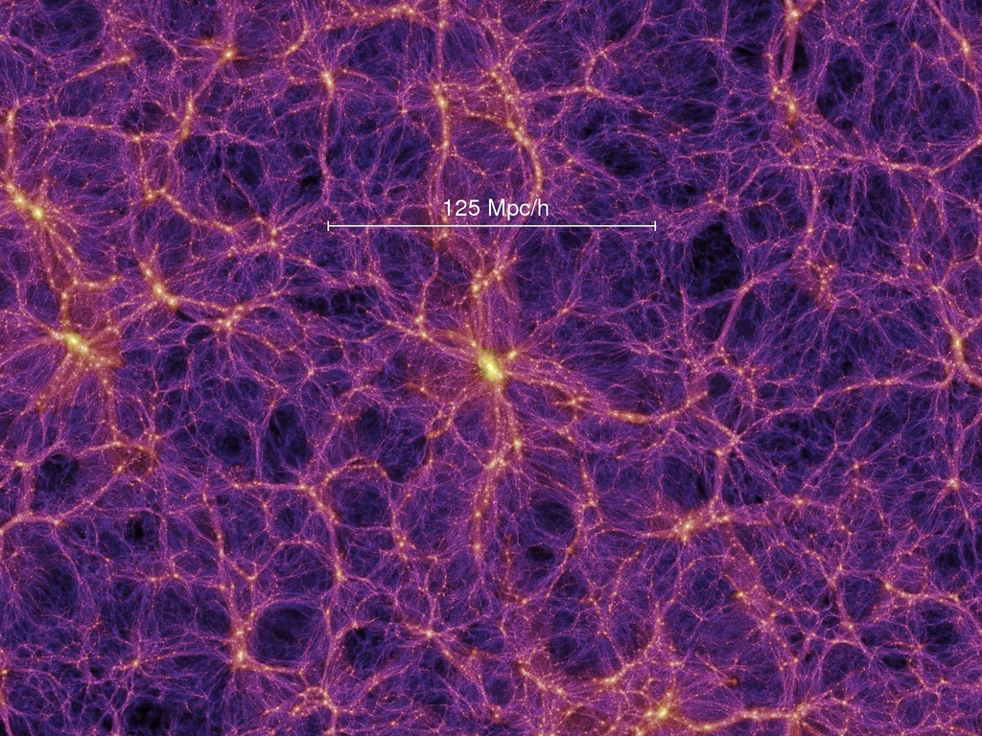
Cosmological observations
Image credit: Millennium simulation
Homogeneous expansion of the Universe
Growth of perturbations within the expanding background

Slide 19
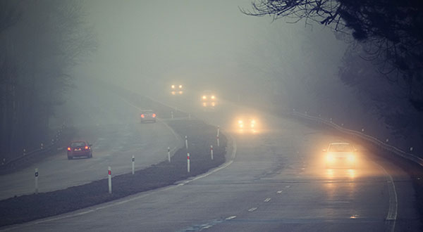
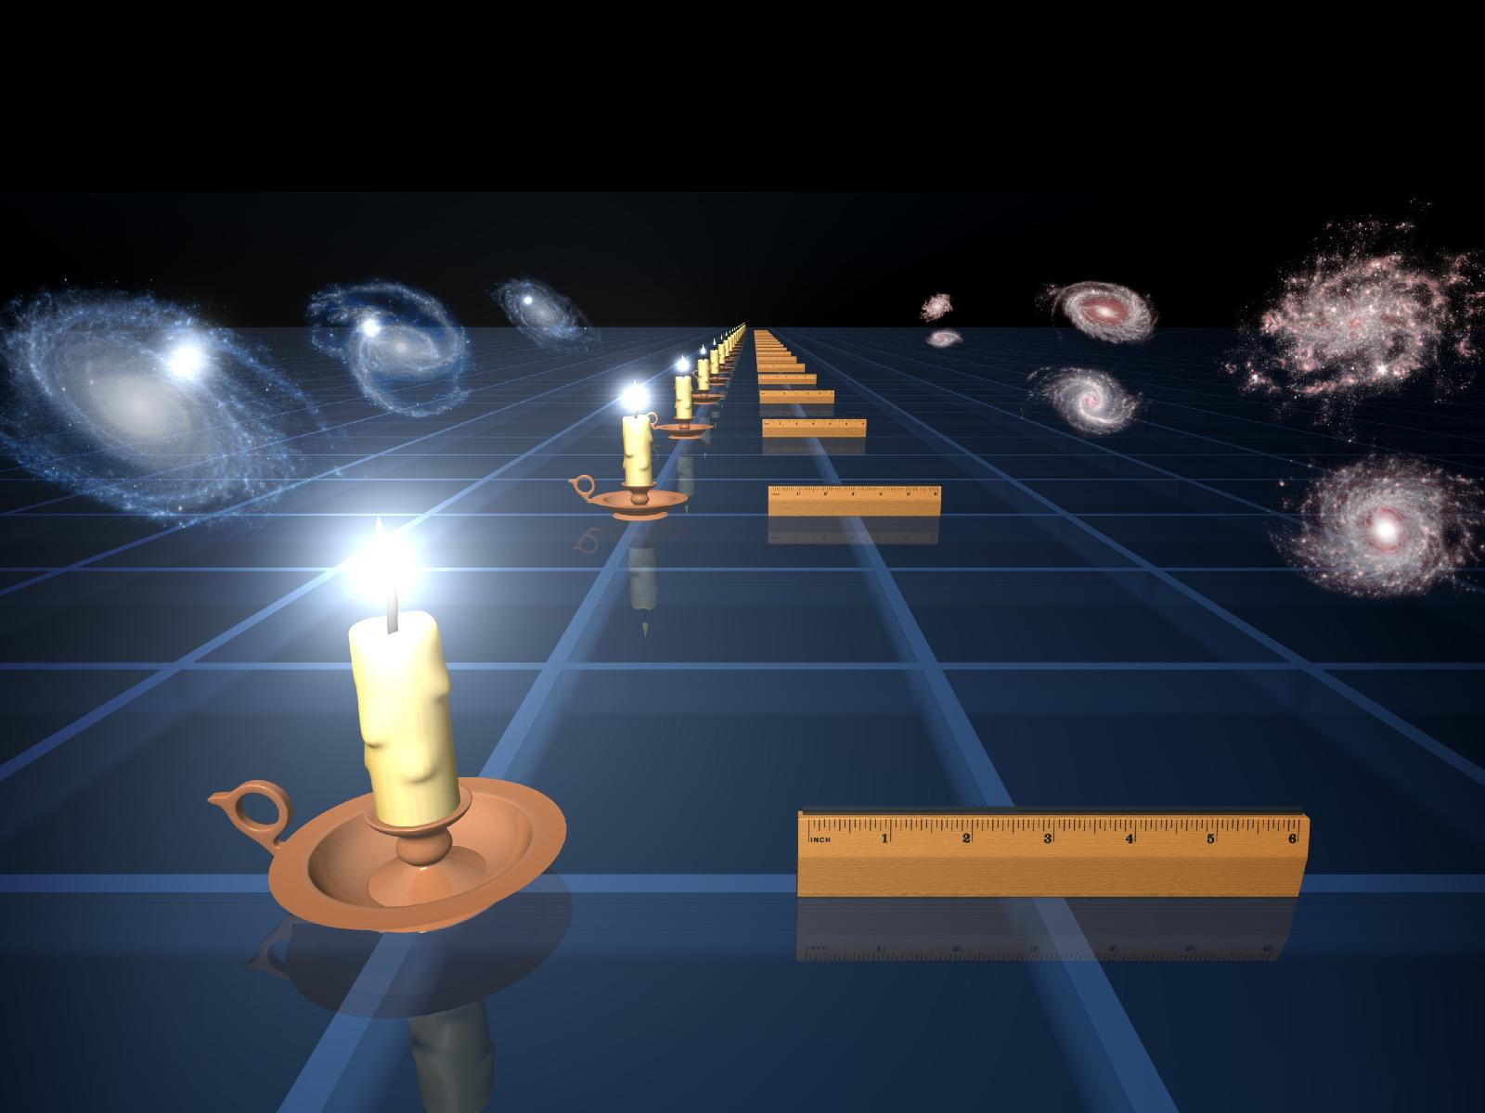
Cosmological observations
To do the first, we need to measure distances …
Cars getting further away …
We can tell the distance of cars from the observed separation of the headlights and their brightness
In astronomy we do this with standard candles and standard rulers!

Slide 20
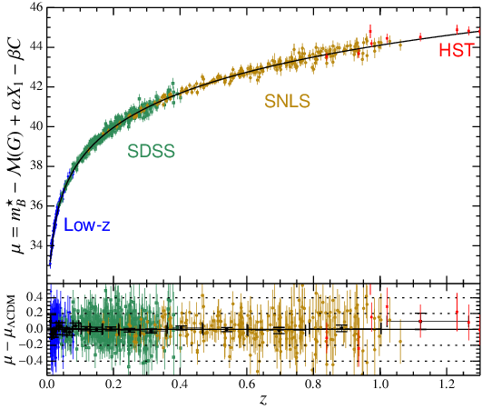
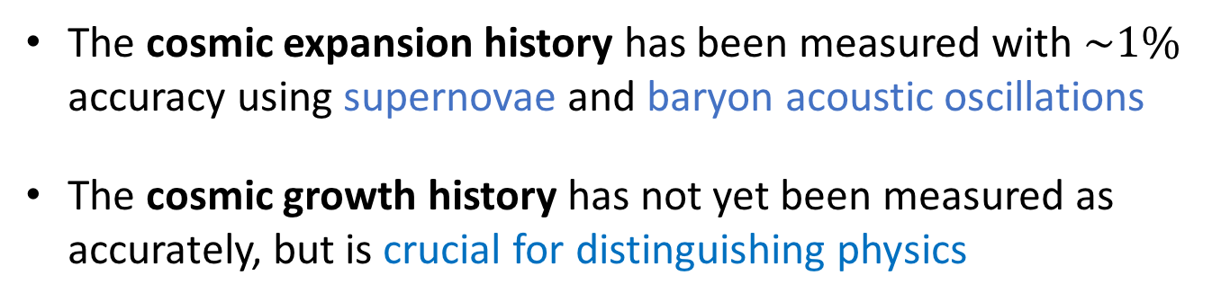
Cosmological observations
Credit: Alam et al. (2017)
Credit: Betoule et al. (2014)
The cosmic expansion history has been measured with $\sim 1\%$ accuracy using supernovae and baryon acoustic oscillations
The cosmic growth history has not yet been measured as accurately, but is crucial for distinguishing physics

Slide 21
Measuring cosmic structure
There are a rich variety of observable signatures of the clumpy Universe …
Clustering of galaxies
Velocities of objects
Gravitational lensing
Abundance/properties of objects
Image credit: Sloan Digital Sky Survey

Slide 22

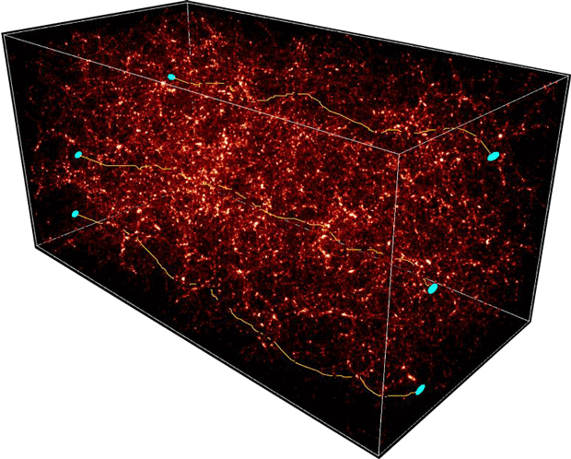
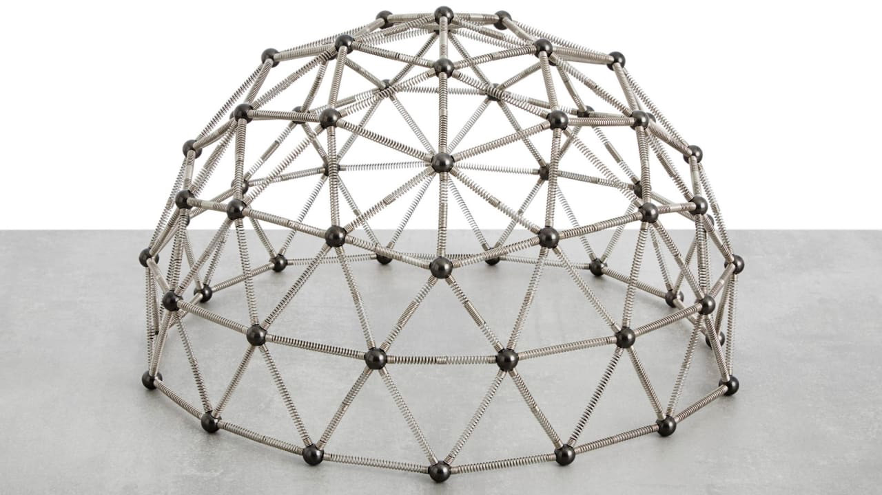
Measuring cosmic structure
Clustering
Gravitational lensing
Galaxy velocities
Building models

Slide 23
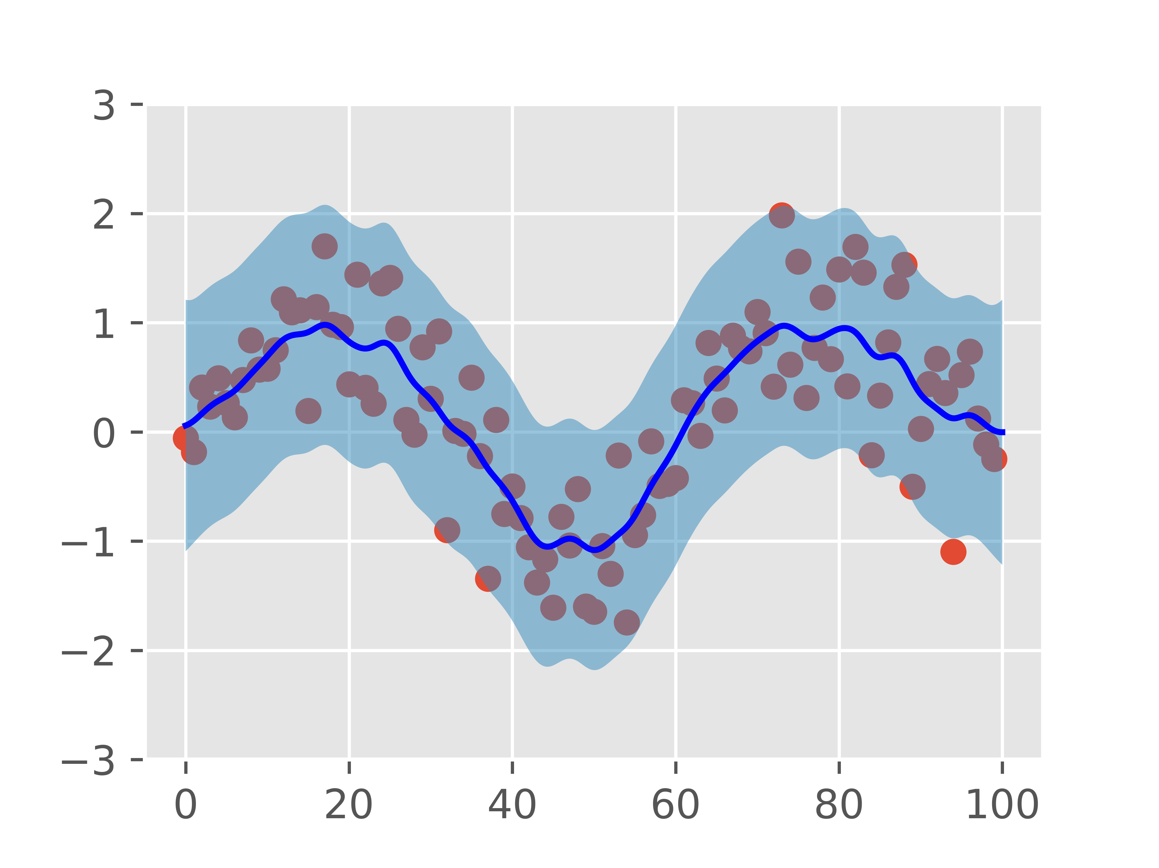
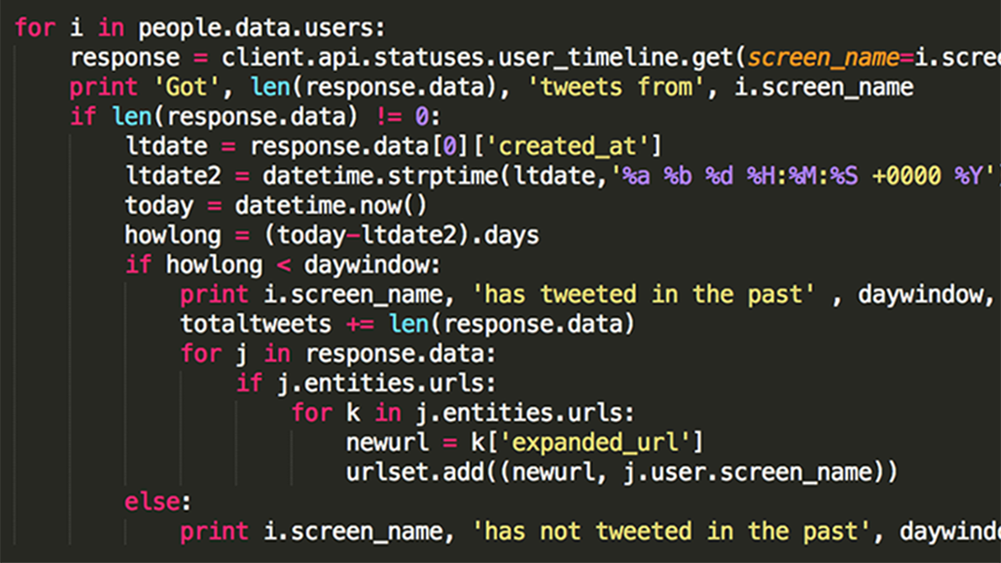


Research skills
Data science skills
Computing skills
Communication skills
Challenging yourself

Slide 24

Opportunities for research at Swinburne
Activity | Unit code | When?
R&D Project 1 | NPS10002 | Summer after 1st/2nd year
R&D Project 2 | NPS20006 | Winter of 2nd/3rd year
Grand Challenge | NPS30003 | 3rd year
Vacation Projects | - | Summer after 2nd/3rd year
Honours | NPS40009 | 4th year undergraduate
PhD | DR-SCI | 3.5-4 year program

Slide 25
Good luck with your research and I’m very happy to answer your questions!

