Slide 1
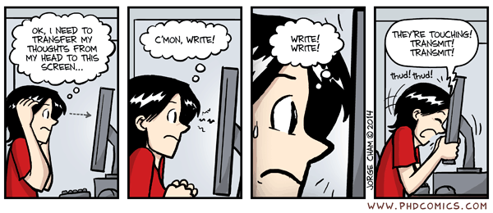
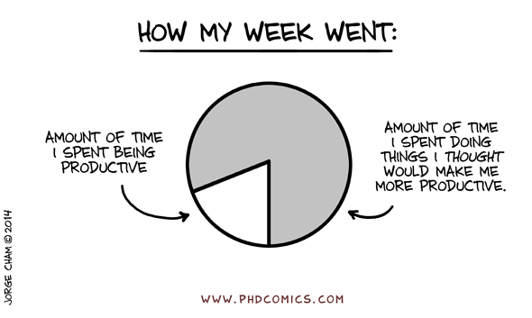
Tips for Writing Papers
OzGrav retreat, November 2025

Slide 2
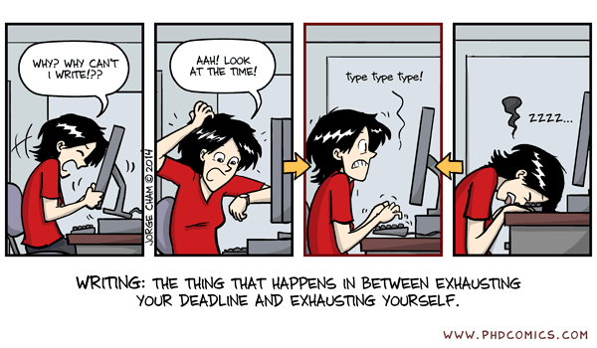
Opening words …
Writing papers is one of the most important aspects of being a researcher
It can, unfortunately, be one of the least enjoyable for many people *
In this session we’ll discuss some approaches and tips to minimize the pain!
* Based on my experience of helping with 53 papers led by PhD students and postdocs in the group ☺

Slide 3
Take a few minutes to discuss with
your neighbours any challenges you
find with writing, and any approaches
that work well for you!

Slide 4
My top tips!
Tip 1:
Read other papers!
Tip 2:
Know when your work is publishable
Tip 3:
Know your storyline
Tip 4:
Plan the paper structure in advance
Tip 5:
Develop an effective writing routine
Tip 6:
Don’t underestimate figures!

Slide 5
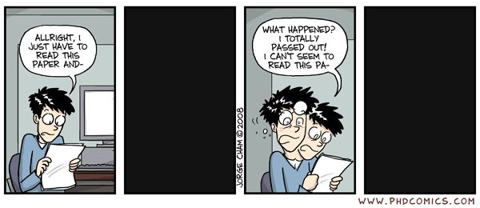
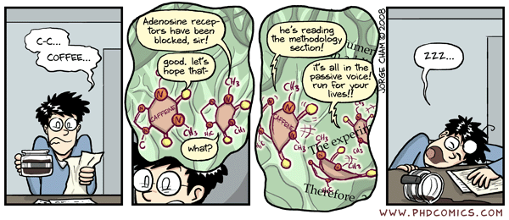
Tip 1: Read other papers!
Reading papers … the only activity more annoying than writing? ☺
Read actively (notes, highlighting) and review with a critical eye
Use software tools (e.g. Zotero, Obsidian) to collect notes & refs
You don’t need to understand everything in a paper
Don’t read a paper from beginning to end! Focus on key aspects
Re-read key papers as your project develops

Slide 6

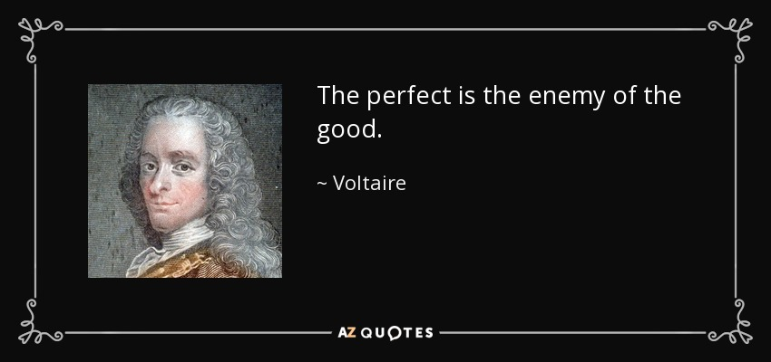

Tip 2: Know when your work is publishable
A piece of research is always abandoned and never completed
We can always do more tests and refine our analysis, and researchers are great at coming up with suggestions for this!
However, at some point there is an opportunity cost of the time we are spending!

Slide 7
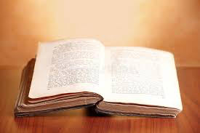
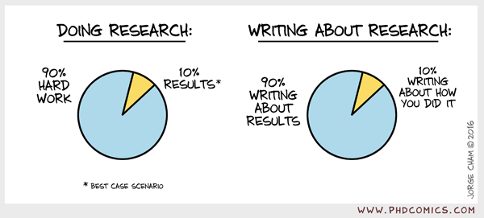
Tip 3: Know your storyline
Don’t describe everything you did; identify the key message
Don’t be afraid to delete things that don’t contribute to the key message or necessary context !!
Everything should flow in a logical order; aim for clarity
Having a storyline in mind is particularly important for the introduction and discussion sections

Slide 8
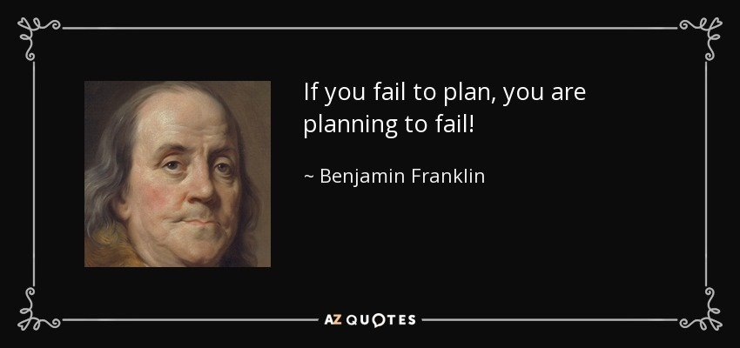
Tip 4: Plan the paper structure in advance
Skeleton outline including section headings and planned figures
Develop the skeleton into a roadmap (bullet point notes)
Develop the roadmap into complete sentences
Critically review the draft and re-write
Planning is useful because it sets the scope and divides the work into chunks
Don’t be afraid to revise the skeleton if necessary!

Slide 9
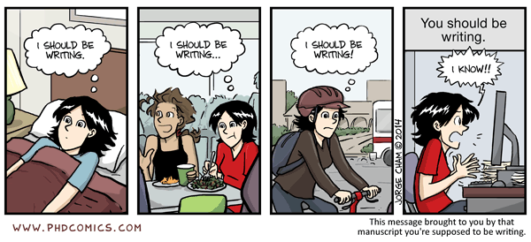
Tip 5: Develop an effective writing routine
Aim for steady progress not a sprint
Take regular breaks
Try and avoid rabbit-holes! (You can add missing information later)
Try and find “The Writing Zone”
“Stop, Go Back, Read, Write, Repeat”
Writing is always an iterative process of drafting and re-drafting

Slide 10
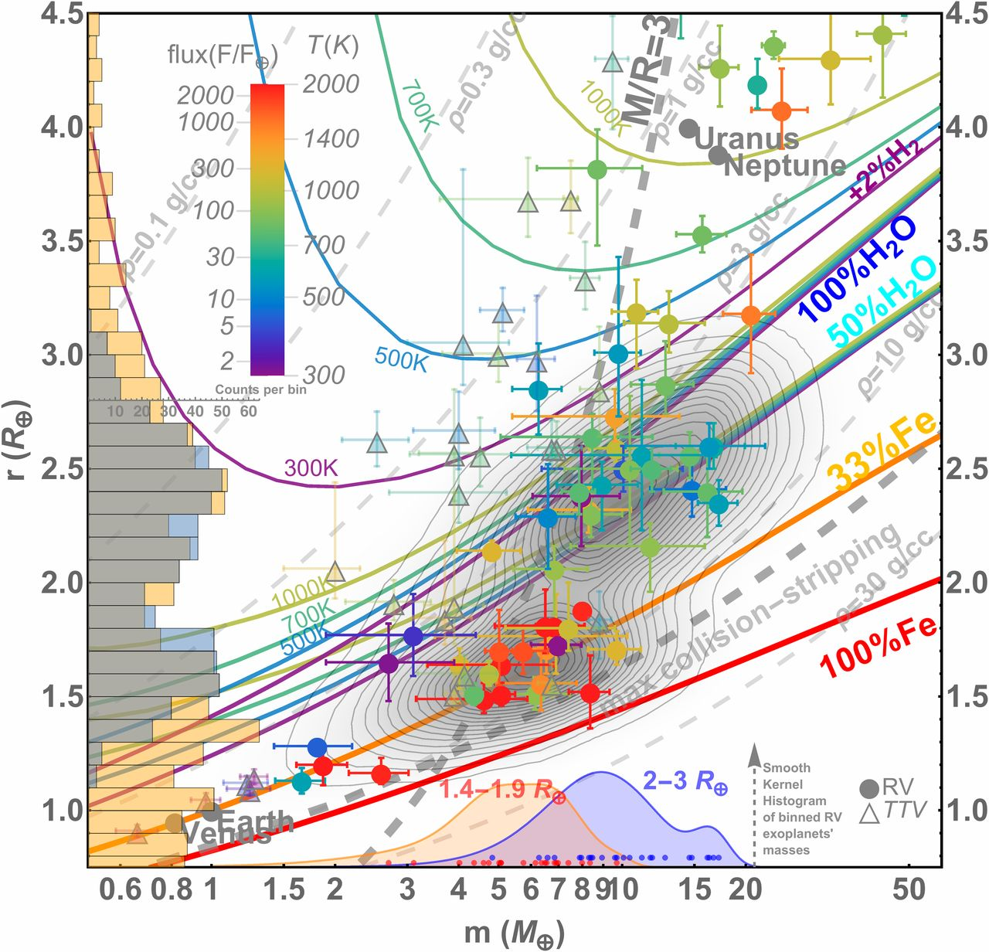
Tip 6: Don’t under-estimate figures
The only takeaway for many readers will be your figures
Basics: figures should have legible axes, not too crowded, clear labels
Higher level: good figures tell your story and could be re-used by others
Helping yourself: getting the figures in place early can help clarify your paper structure and message

Slide 11
Any reflections on these tips?

Slide 12
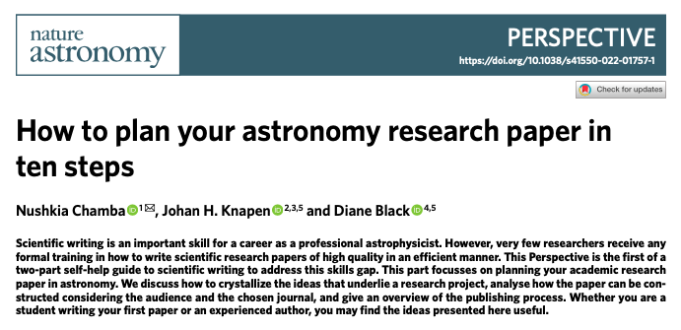
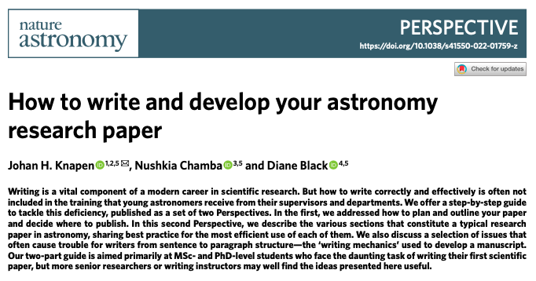
Papers about writing papers!
Some useful recent perspectives and tips in Nature Astronomy …
https://arxiv.org/abs/2207.12959
https://arxiv.org/abs/2110.05503

Slide 13
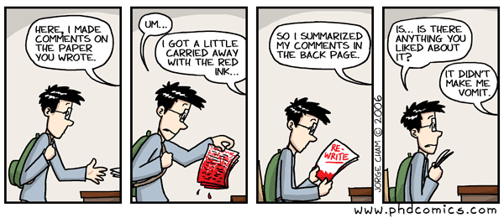
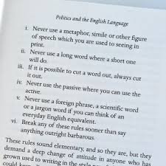
Other considerations?
Feedback:
Writing style: some people have feelings about the passive tense!
Make sure you allow time to work through it, and you don’t need to incorporate all suggestions
Where to submit papers?
Watch out for article processing charges!
How to use Generative AI as a useful tool?

Slide 14
Take a few minutes to discuss with
your neighbours any ways in which
you find generative AI useful in
your writing process

Slide 15
That’s all for today!

