Slide 1
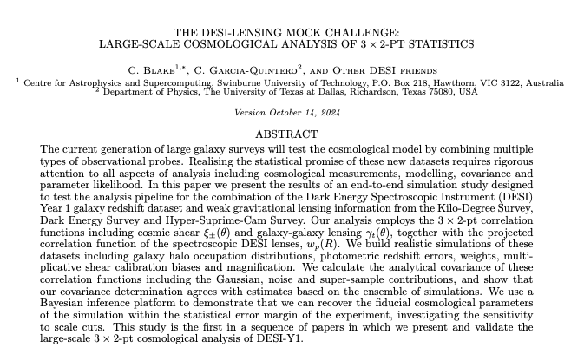
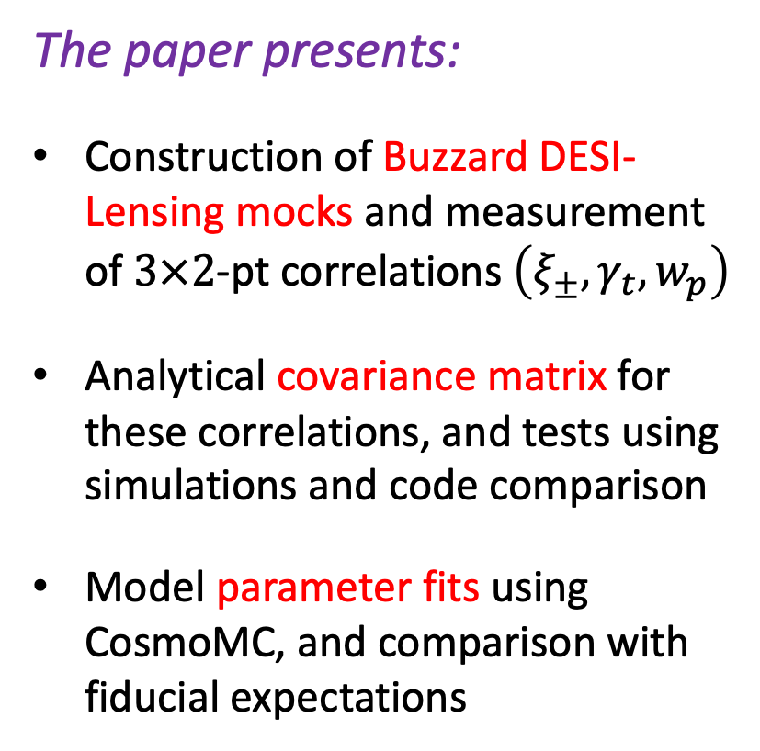
$3×2$-pt mock challenge paper
Currently in working group circulation period – please see e-mail/Slack message with link to the paper and section-by-section comments document
New statistic used in this context
The paper presents:
Construction of Buzzard DESI-Lensing mocks and measurement of $3×2$-pt correlations $\left(ξ_{±},γ_{t},w_{p}\right)$
Analytical covariance matrix for these correlations, and tests using simulations and code comparison
Model parameter fits using CosmoMC, and comparison with fiducial expectations

Slide 2
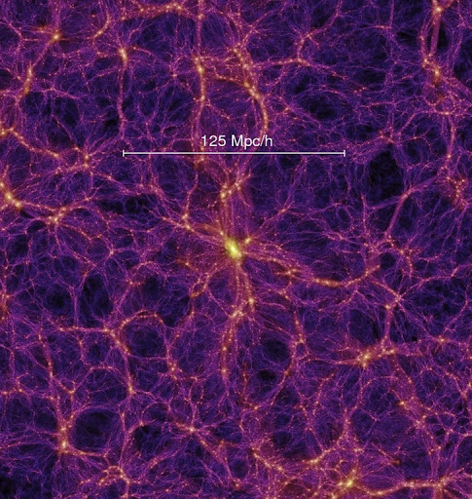

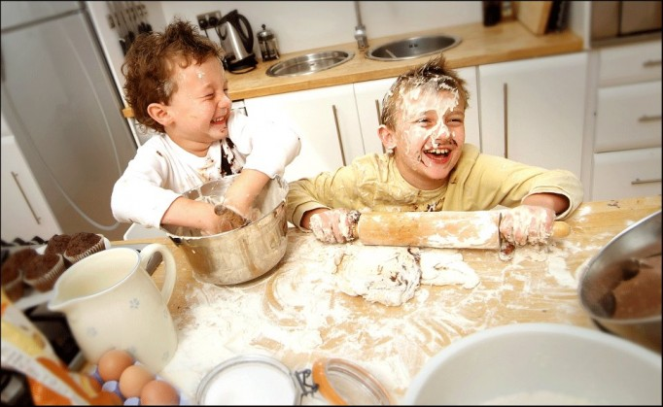
Validation of $3×2$-pt methodology
Test covariance or parameter recovery with realistic complexity, but may not fully capture all astrophysical or observational effects
Simulation-based tests
Propagate model variations to changes in fitted parameters; choosing scale cuts to minimize the impact of modeling assumptions
“Analytical” tests
Consider analysis variations in fits to real data vectors, but severely limited by blinding data to avoid confirmation bias
Tests on the data itself

Slide 3
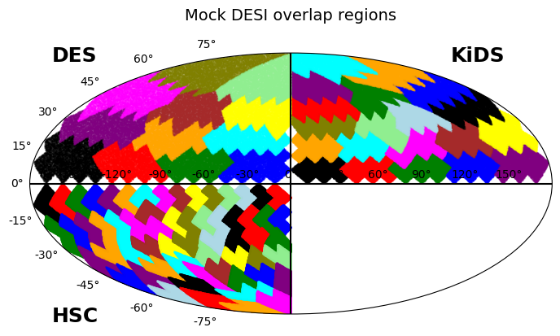
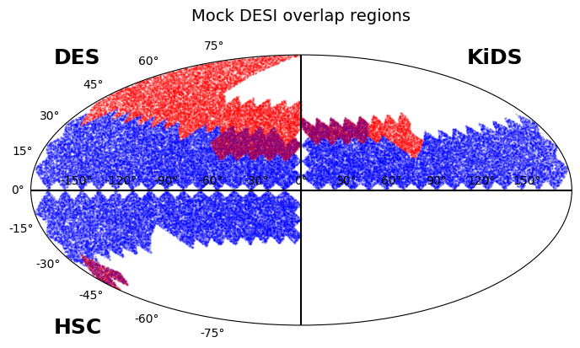
Buzzard simulations
We’ve constructed DESI + (KiDS-1000, DES-Y3, HSC-Y1) mocks from the Buzzard simulations
Lensing catalogues match redshift distributions, shape noise, weights, shear calibration
DESI catalogues match clustering and number density of EDR samples
We use 5 lens samples: BGS (0.1-0.2, 0.2-0.3, 0.3-0.4) and LRG (0.4-0.6, 0.6-0.8)
We divide the catalogues into regions for covariance testing and cosmology testing
lensing
clustering
GGL
These regions, with size approximating the overlaps with DESI, are used for covariance testing
The regions are combined into representative DESI, lensing and overlapping areas for cosmology testing

Slide 4
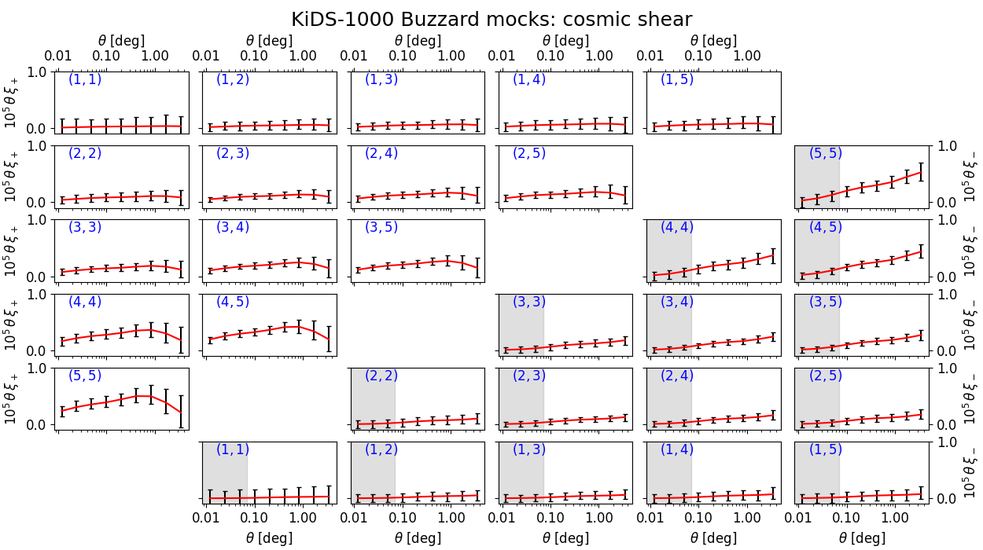
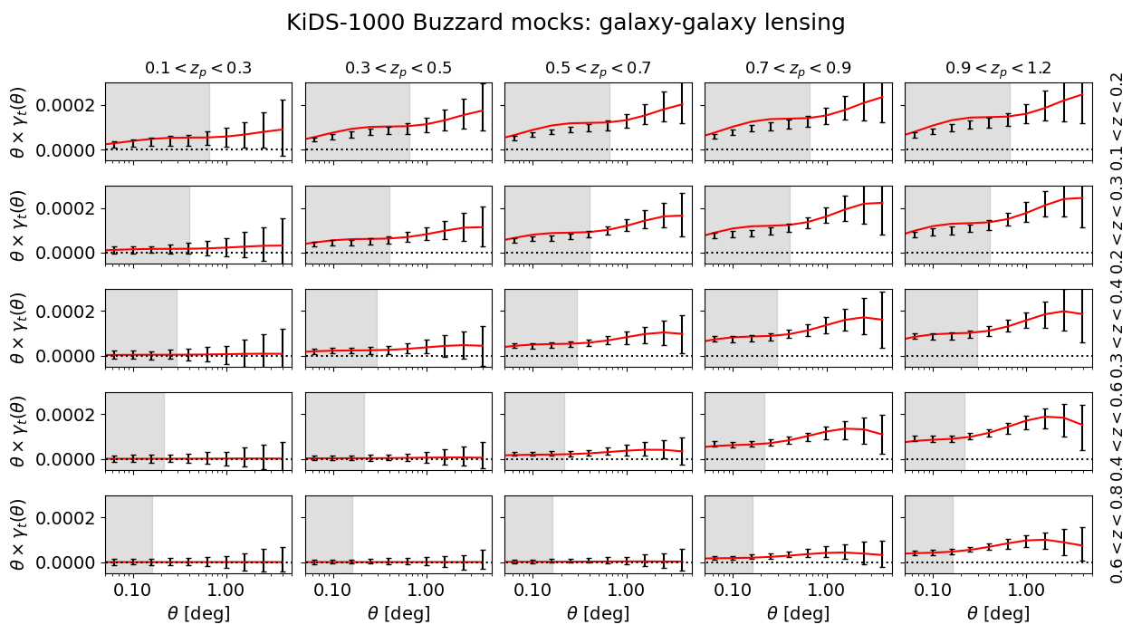
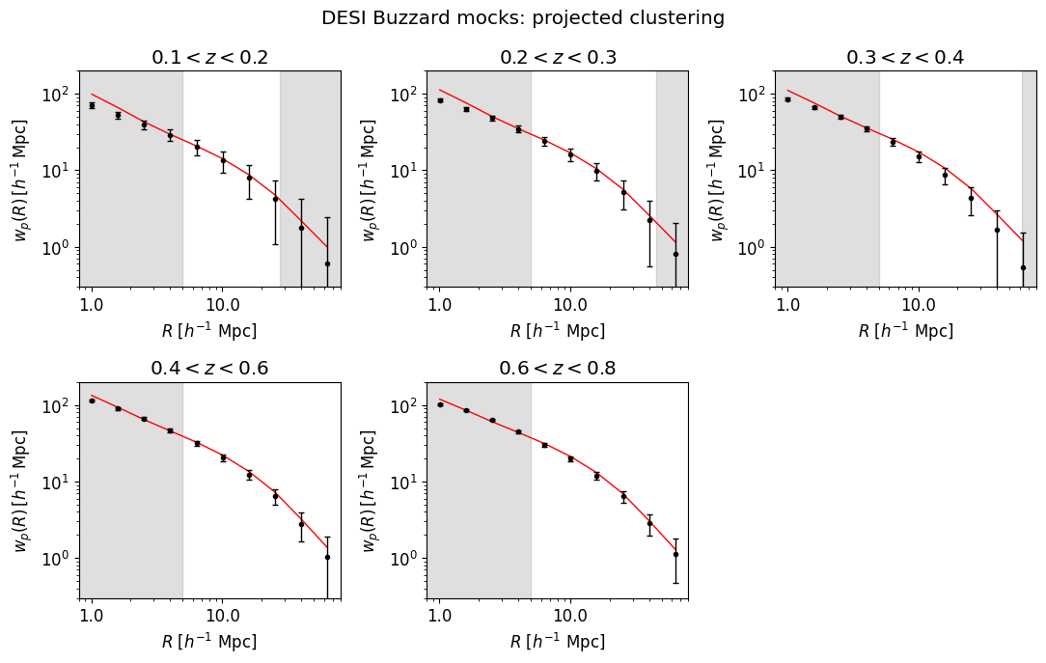
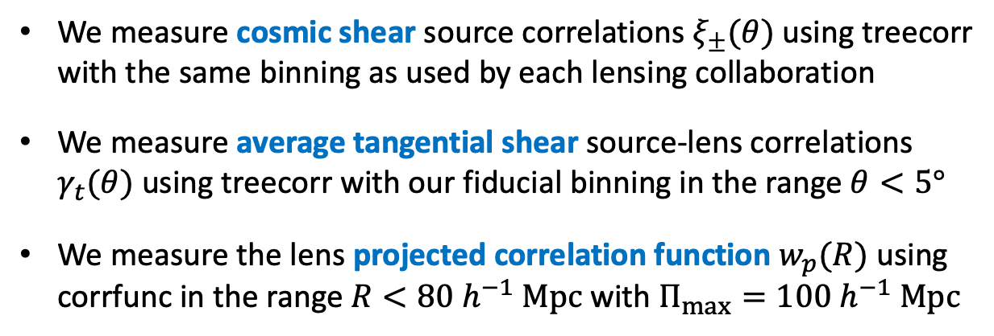
Correlation function measurements
We measure cosmic shear source correlations $ξ_{±}(θ)$ using treecorr with the same binning as used by each lensing collaboration
We measure average tangential shear source-lens correlations $γ_{t}(θ)$ using treecorr with our fiducial binning in the range $θ<5°$
We measure the lens projected correlation function $w_{p}(R)$ using corrfunc in the range $R<80 h^{−1} Mpc$ with $Π_{max}=100 h^{−1} Mpc$

Slide 5
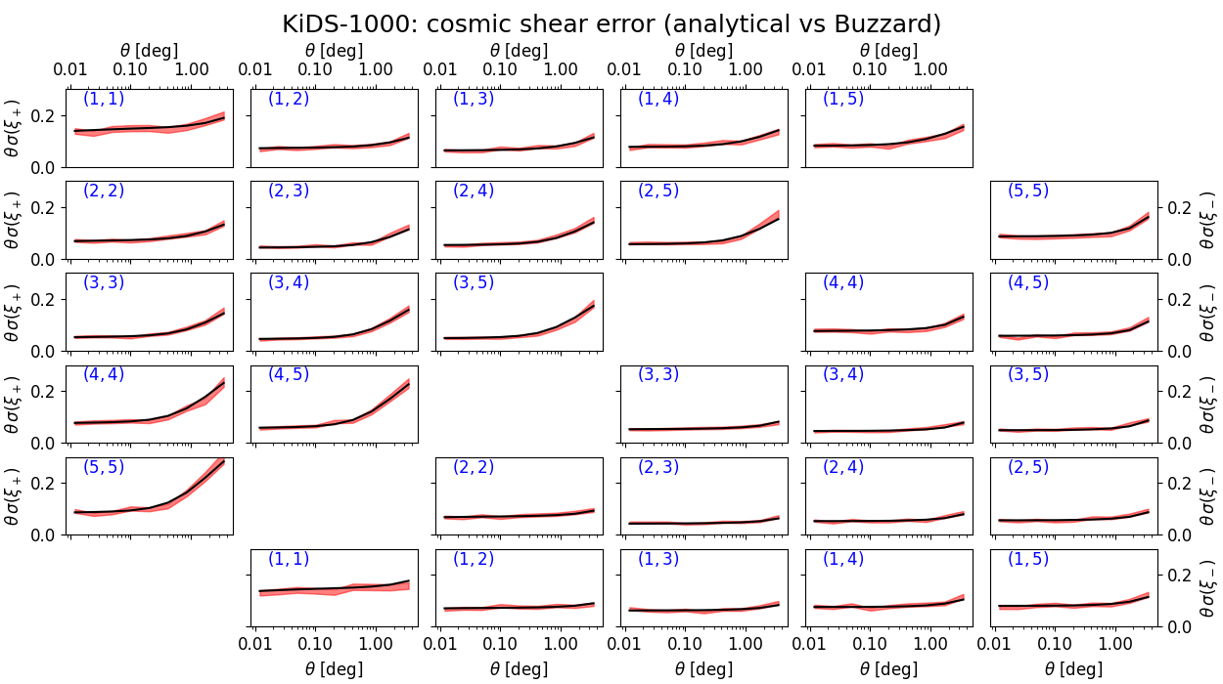
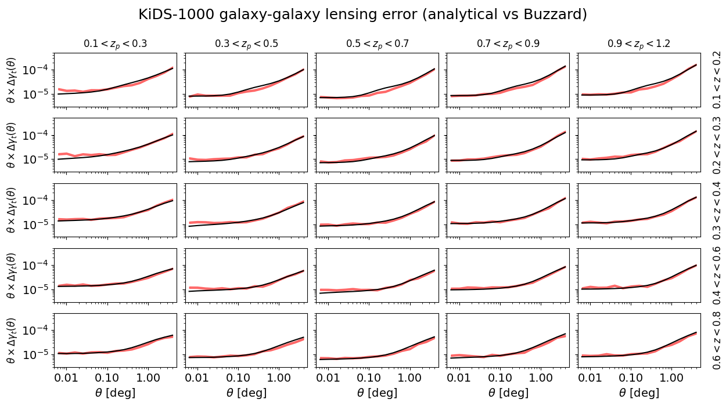
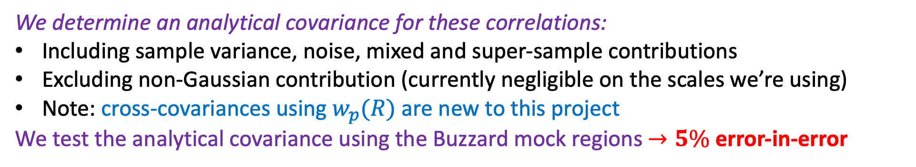
Analytical covariance
We determine an analytical covariance for these correlations:
Including sample variance, noise, mixed and super-sample contributions
Excluding non-Gaussian contribution (currently negligible on the scales we’re using)
Note: cross-covariances using $w_{p}(R)$ are new to this project
We test the analytical covariance using the Buzzard mock regions $→5\%$ error-in-error
Analytical vs mock covariance tests for $ξ_{±}(θ)$
Analytical vs mock covariance tests for $γ_{t}(θ)$

Slide 6
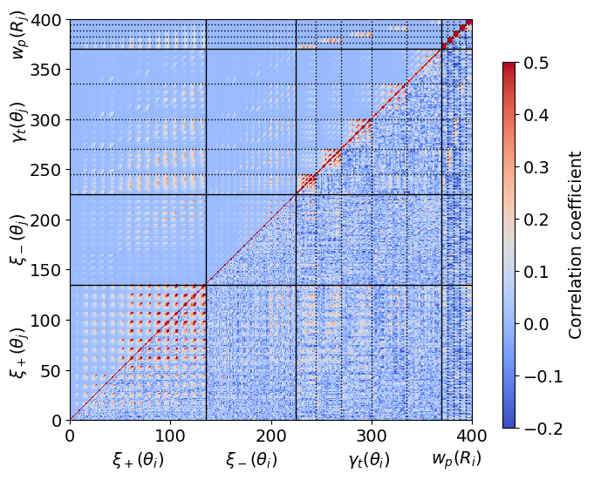
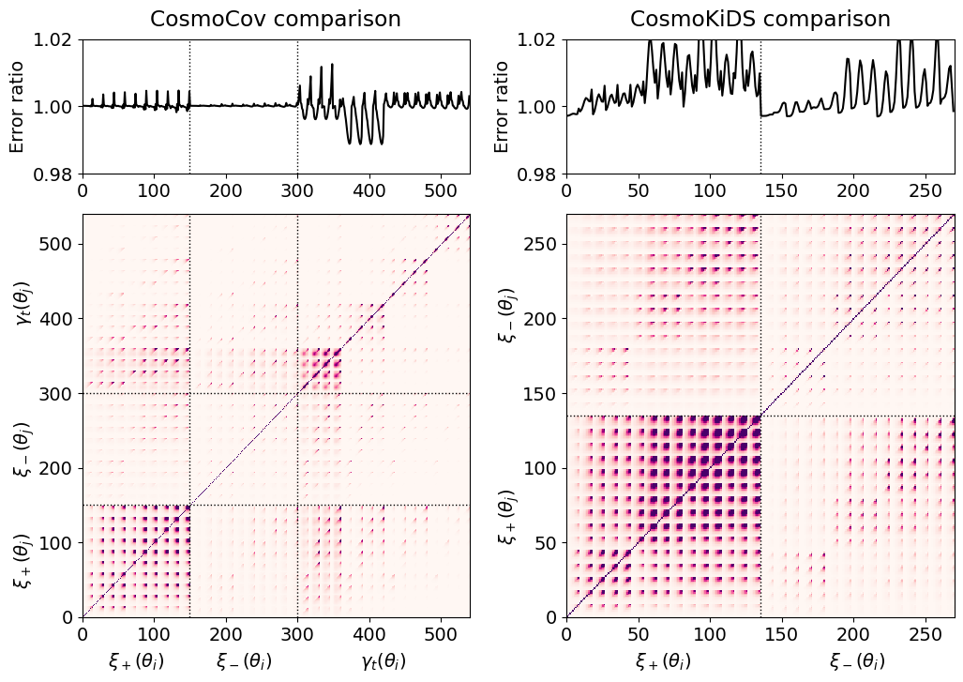
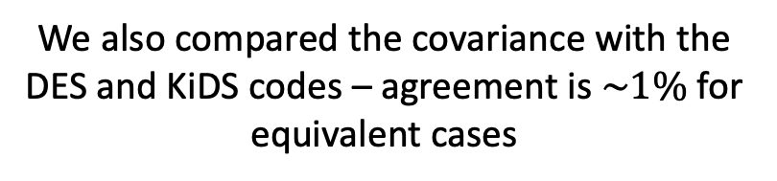
Analytical covariance
Not enough mock realizations for accurate off-diagonal tests, but “qualitative comparison” looks reasonable
We also compared the covariance with the DES and KiDS codes – agreement is $\sim 1\%$ for equivalent cases

Slide 7
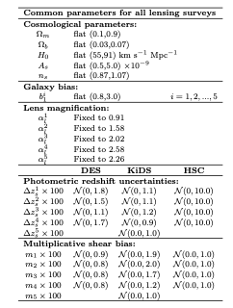
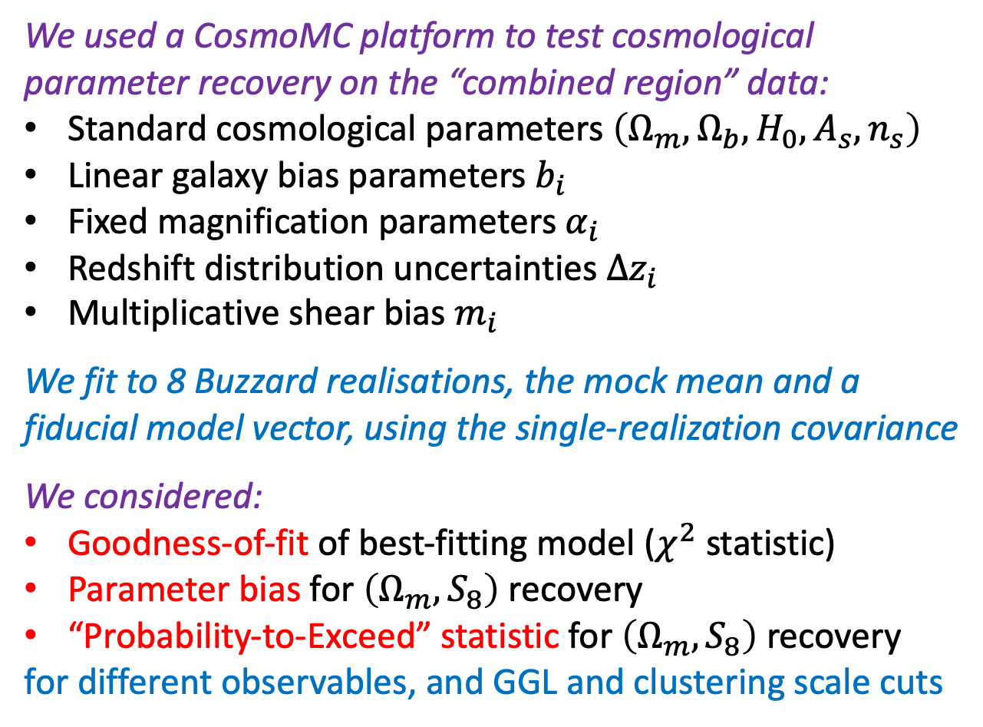
Model fitting
We used a CosmoMC platform to test cosmological parameter recovery on the “combined region” data:
Standard cosmological parameters $\left(Ω_{m},Ω_{b},H_{0},A_{s},n_{s}\right)$
Linear galaxy bias parameters $b_{i}$
Fixed magnification parameters $α_{i}$
Redshift distribution uncertainties ${∆z}_{i}$
Multiplicative shear bias $m_{i}$
We fit to 8 Buzzard realisations, the mock mean and a fiducial model vector, using the single-realization covariance
We considered:
Goodness-of-fit of best-fitting model ($χ^{2}$ statistic)
Parameter bias for $\left(Ω_{m},S_{8}\right)$ recovery
“Probability-to-Exceed” statistic for $\left(Ω_{m},S_{8}\right)$ recovery
for different observables, and GGL and clustering scale cuts

Slide 8
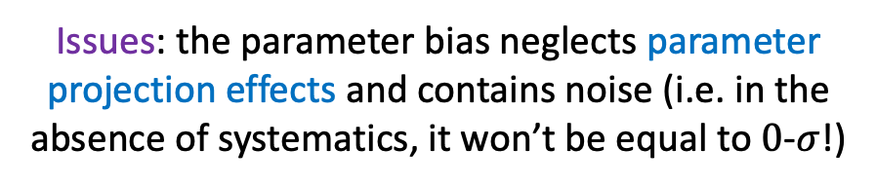

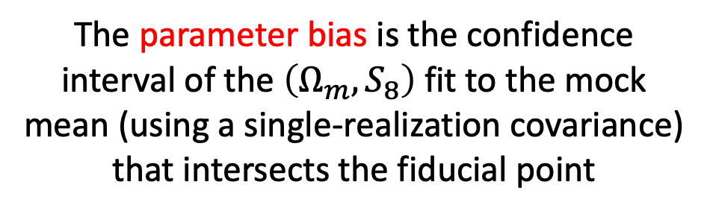
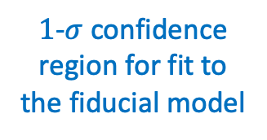





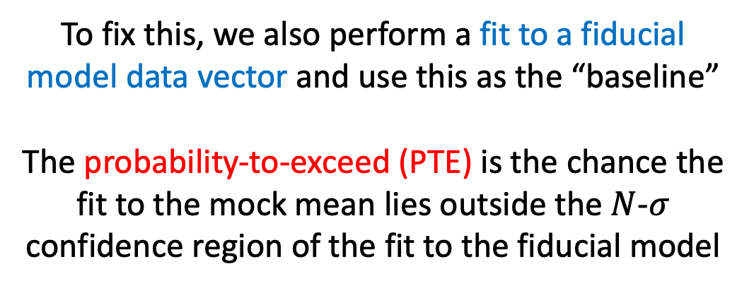
Metrics for cosmological parameter recovery
The parameter bias is the confidence interval of the $\left(Ω_{m},S_{8}\right)$fit to the mock mean (using a single-realization covariance) that intersects the fiducial point
To fix this, we also perform a fit to a fiducial model data vector and use this as the “baseline”
The probability-to-exceed (PTE) is the chance the fit to the mock mean lies outside the $N$-$σ$ confidence region of the fit to the fiducial model
$$S_{8}$$
$$1σ$$
$$0.5σ$$
PTE is the integrated orange probability outside the blue region
$$S_{8}$$
Confidence regions for fit to the mock mean
Fiducial values
$$Ω_{m}$$
$1$-$σ$ confidence region for fit to the fiducial model
Issues: the parameter bias neglects parameter projection effects and contains noise (i.e. in the absence of systematics, it won’t be equal to $0$-$σ$!)
$$Ω_{m}$$

Slide 9
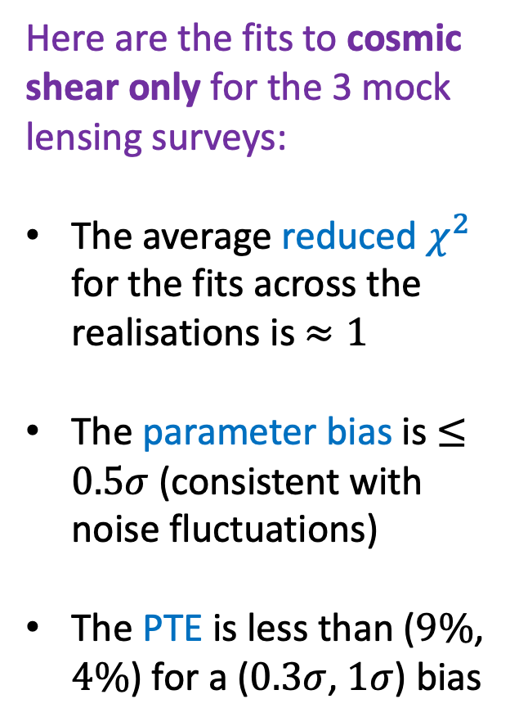
Parameter fits to cosmic shear only
Here are the fits to cosmic shear only for the 3 mock lensing surveys:
The average reduced $χ^{2}$ for the fits across the realisations is $≈1$
The parameter bias is $≤0.5σ$ (consistent with noise fluctuations)
The PTE is less than ($9\%$, $4\%$) for a ($0.3σ$, $1σ$) bias
Note: PTE calculation uses re-scaled covariance for mock mean

Slide 10
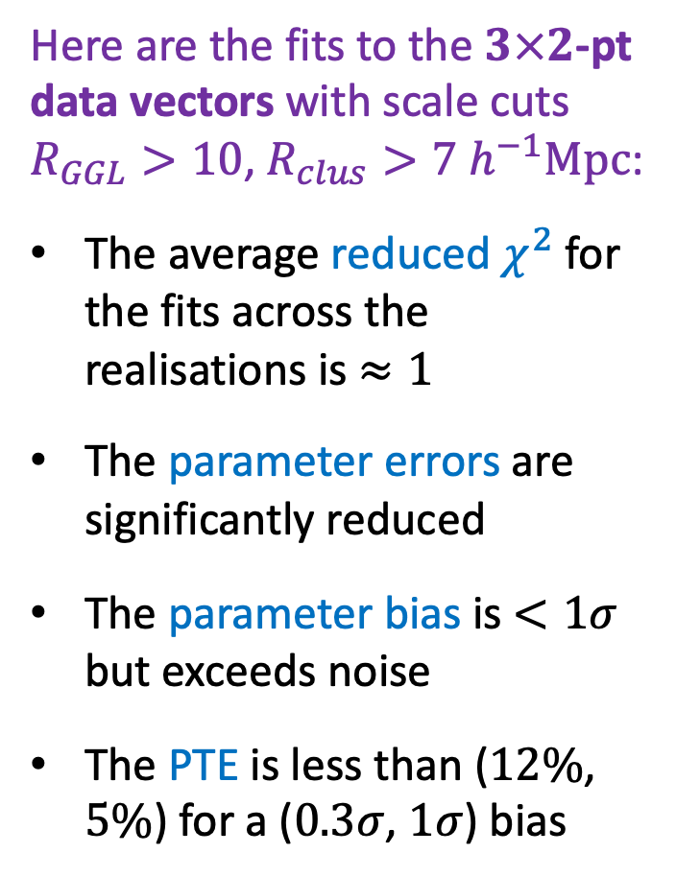
Parameter fits to full $3×2$-pt correlations
Here are the fits to the $3×2$-pt data vectors with scale cuts $R_{GGL}>10$, $R_{clus}>7 h^{−1}Mpc$:
The average reduced $χ^{2}$ for the fits across the realisations is $≈1$
The parameter errors are significantly reduced
The parameter bias is $<1σ$ but exceeds noise
The PTE is less than ($12\%$, $5\%$) for a ($0.3σ$, $1σ$) bias
Note: PTE calculation uses re-scaled covariance for mock mean

Slide 11
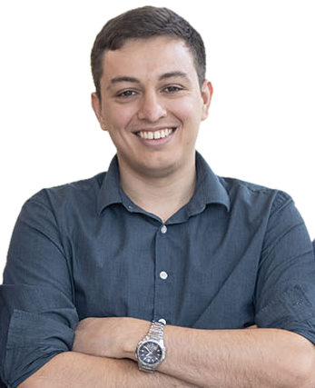
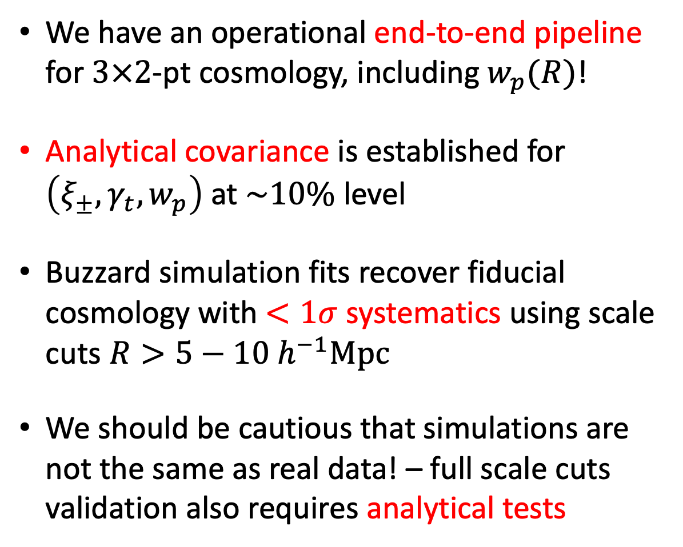
Conclusions
We have an operational end-to-end pipeline for $3×2$-pt cosmology, including $w_{p}(R)$!
Analytical covariance is established for $\left(ξ_{±},γ_{t},w_{p}\right)$ at $\sim 10\%$ level
Buzzard simulation fits recover fiducial cosmology with $<1σ$ systematics using scale cuts $R>5−10 h^{−1}Mpc$
We should be cautious that simulations are not the same as real data! – full scale cuts validation also requires analytical tests
Great thanks/praise due to:

