Slide 1
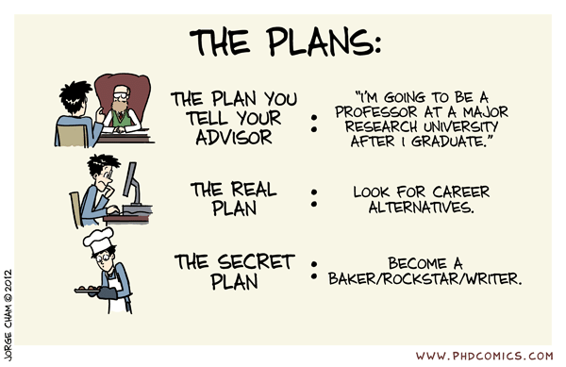
Postdoc job applications: the “don’t panic” guide!
https://phdcomics.com/comics/archive.php?comicid=1527

Slide 2
Welcome to your job hunt!
You are all incredibly employable people! About half of our PhD students go onto postdoc jobs, half to industry
Today we’ll discuss the typical postdoc application process. Knowing how the system works will help you plan your applications effectively.
Writing effective job applications is a new skill you’ll need to learn. This presentation will provide some tips!
Disclaimer: some of these views are subject to my own bias, other faculty and postdocs will also give you great info!

Slide 3
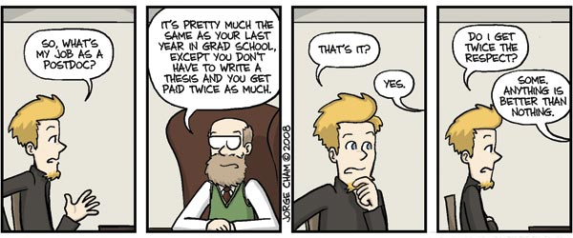
What?? When?? Why??
(the basics)
https://phdcomics.com/comics/archive.php?comicid=1004

Slide 4
What is a postdoc position?
Typically, a fixed-term 2-year or 3-year research position
Some are independent research positions (“fellowships”) offered by a university or institute
Some are “research associates” tied to specific projects or investigators (although there is often freedom)
Some are observatory, software or teaching positions (often with some fractional allocation for research)
Can also apply for research council funding (e.g. ARC prize fellowships), but this is very competitive

Slide 5
How can I find available positions?
Most jobs are advertized on the AAS job register (http://jobregister.aas.org)
Jobs are also advertised on e-mail lists and Slack channels (e.g., ASA, your collaborations)
You can also find openings by word-of-mouth in your networks
Your dream job!
If you have specific idea(s) of places where you might like a postdoc job, reach out to faculty there and ask if there are any upcoming opportunities

Slide 6
Which jobs should I apply for?
Your life and personal goals are obviously the most important thing. What are your criteria? (location, environment, type of work, collaboration access, type of institution, academia vs industry)
Because of competition, you will need to apply for multiple positions (typically 10-20, sometimes more or less)
Don’t rule out things too quickly, since flexibility is often required, and you cannot count on your “dream job”
However, don’t apply for jobs you don’t want
Focus on positions for which you are a “good fit”

Slide 7
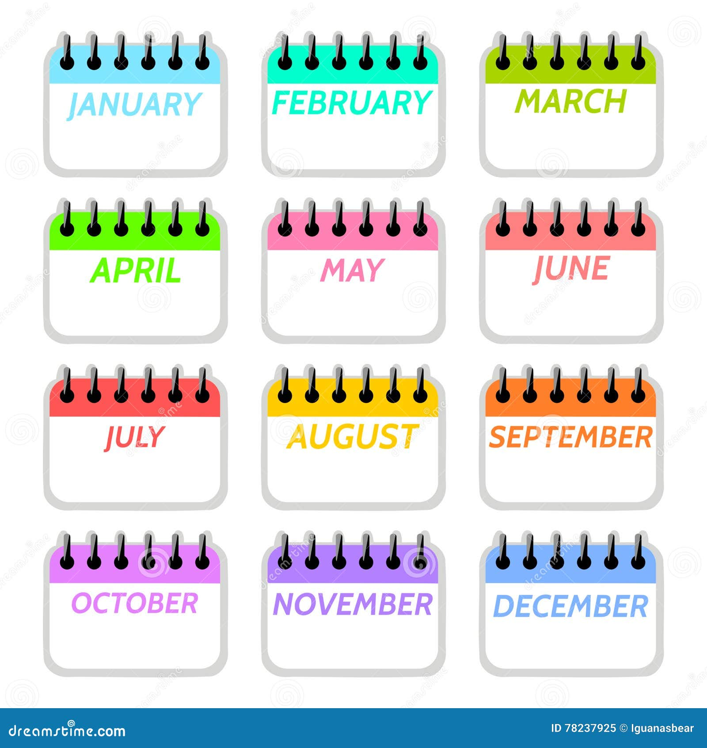
When should I apply?
Many variations are possible, but typically you would:
Apply for postdocs Oct-Jan (75% of jobs)
Receive interviews/offers Dec-Mar
Start new positions Jul-Nov
Where are you in your PhD, and when will you realistically finish?
Are you a competitive applicant? Is it worth waiting until you submit a particular paper?

Slide 8
What you should know (the basics)
Postdoc job applications are very time-consuming! (1 month’s work in total? Start preparing early!)
Each position is very competitive, rejection is normal
More opportunities to find a position if you are able to move (internationally), but is that what you want?
Communication from employers to applicants during the process is usually very poor
It is easy to increase your chances of success by following some simple tips and guidelines!!

Slide 9
How to write a postdoc job application

Slide 10
How to write a postdoc job application
For most jobs, you will need to prepare 3 documents! (yes, academia is very old-fashioned)
“Covering letter”
“CV” or “Resume”
“Research statement”
You will also need to identify some reference writers
Some jobs require a response to selection criteria

Slide 11
Covering letter
What is this?? A 1-page formal letter introducing yourself and explaining why you are a good fit for the position
Make sure you get the contact details right ☺
Paragraph 1: introduce yourself, your current position, and what position you are applying for
Paragraph 2: briefly, what are your top skills and research achievements you would like the panel to know about
Paragraph 3: why you want to move to this organization, and how yourself and your research would enhance it (include specific details, not just hollow platitudes!)

Slide 12
CV (also known as Resume)
2 pages, but can be longer if needed (short is good!)
Contact details at the top
Short bullet point lists of academic record, research experience/skills, publications, awards/prizes, talks, conferences, teaching, outreach, roles/responsibilities
Skills include computing, statistics, management …
Leave out hobbies, photo, pre-university record
Do not pad publication list with “in prep” papers. Highlight your name in long author lists, give astro-ph links
Restrict to specific examples, not generalities
Hints

Slide 13
Research statement
What is this?? A 2-3 page document describing your science plans and why you’re the best person to do them
This is a sales pitch not a research paper!
Clearly state aims and significance at the beginning
Not too dense: include spaces, sub-headings, figures, images, bullet points, timelines
Demonstrate you can carry out future science plans by describing your successful past and current research
Has to impress both expert and non-expert astronomers

Slide 14
Research statement
Here is a potential layout of a 3-page research statement:
Eye-catching science title
Nice image or figure
Project 2 of your proposal
Opening paragraph explaining the importance of your science to a non-expert astronomer
Project 3 of your proposal
Your vision of the current state of the field, and how this motivates your work
Concluding statement summarizing how this research benefits the field
Bullet-point summary of the aims of your proposal
Why you are positioned to address these questions (collaborations, tools)
Describe your previous research outcomes as evidence of success
References
Project 1 of your proposal

Slide 15
Should I tailor each individual application?
Yes, in a limited way – tailor one paragraph of your covering letter and a small part of the research statement
Explain why you are good match to this specific job
Explain why you want to join the specific organization
Provide a science plan fitting to the position
Tailoring the application, even in a small way, helps the job committee rank you highly since it demonstrates to them that you have thought about these questions!

Slide 16
How to choose referees
Usually nominate 3 referees to write recommendations
As well as supervisors, you can ask national or international collaborators from other institutions
People familiar with you who will write a good letter ☺
Academics are very comfortable with receiving requests to write references, so don’t worrying about asking.
It is O.K. to have the conversation “are you able to write me a good reference for job X?”
Share your CV and application materials with your referees and give them plenty of time to prepare a reference
Hints

Slide 17
How do I make my application stand out?

Slide 18
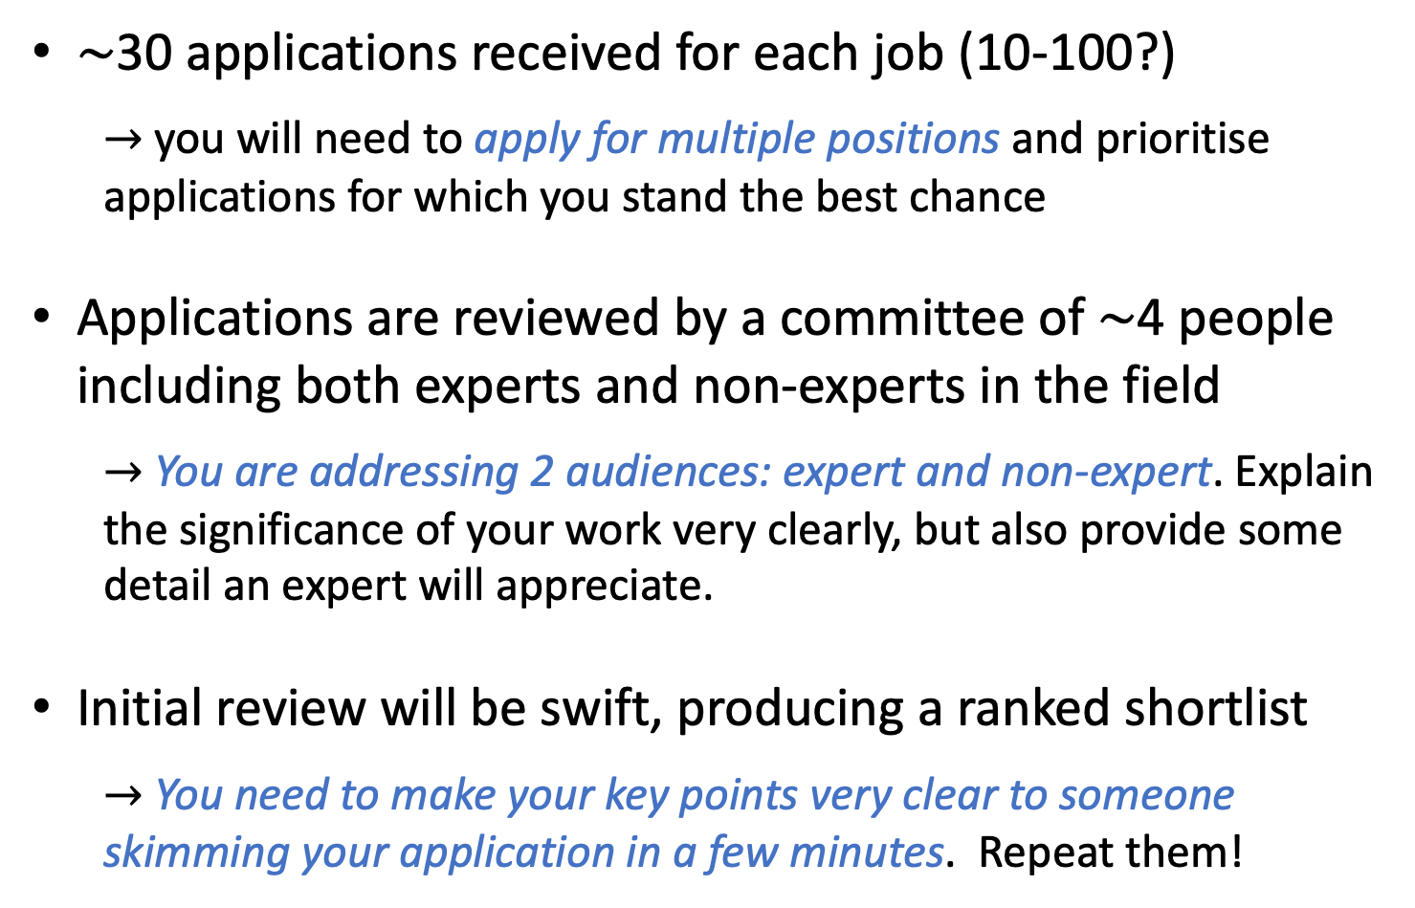
What happens in an application process?
$\sim$30 applications received for each job (10-100?)
$→$ you will need to apply for multiple positions and prioritise applications for which you stand the best chance
Applications are reviewed by a committee of $\sim$4 people including both experts and non-experts in the field
$→$ You are addressing 2 audiences: expert and non-expert. Explain the significance of your work very clearly, but also provide some detail an expert will appreciate.
Initial review will be swift, producing a ranked shortlist
$→$ You need to make your key points very clear to someone skimming your application in a few minutes. Repeat them!

Slide 19
How do you improve your chances?
Be a good fit to the position if possible (this can be in terms of skills as much as the precise science topic)
Write a good application tailored for each position (stating why you’re a good fit – do not assume the reader knows)
Contact your prospective boss with sensible questions
Use your network of existing collaborators and contacts, are any of them offering positions?
Increase your profile by presenting at useful conferences
Get papers submitted or on astro-ph before applications

Slide 20
Am I competitive for a particular job?
Don’t be put off too easily, but do realistically consider your chances of success (“gumption and self-awareness”)
For example: is this position a prize fellowship with 200 applicants? Is this position well outside my field with many better-matched applicants?
Papers count – need to demonstrate a publication record for a research position – but papers are not everything
Skills and fit to position are equally or more important
Competition for U.S. postdoc positions can be tougher for students from 3-year vs. 6-year PhDs

Slide 21
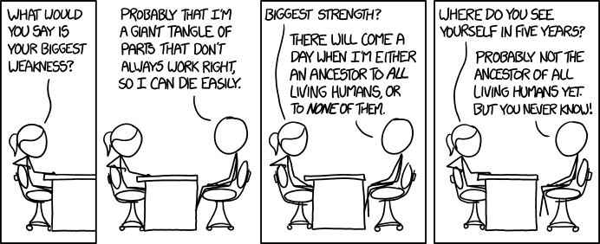
Preparing for job interviews
https://xkcd.com/1545/

Slide 22
Key points about interviews
Good news, you got shortlisted for an interview!
Usually, you’ll have a 20-30m video interview with a panel using a set of fixed questions (talk not usually required)
Preparation is key! Interview questions are highly predictable (see next slide)
Rehearse answers to typical questions – but do not read from a script
Use these answers to tell the panel why you are the best candidate for the position. Give informative but concise answers, try not to waffle
Ask sensible questions demonstrating your knowledge. For example: independent research, collaboration access, computer/travel funding
Arrange a practice interview beforehand!
Hints

Slide 23
List of predictable interview questions
Why did you apply for this position? Why do you want to move to university X / country Y?
Tell us about your PhD / biggest research achievement
[If the position is tied to an existing project:] What skills and experience do you have in area X?
[If there is some research freedom:] What independent science plans do you have for the position?
How will this position help with your career ambitions?
What are your strengths/weaknesses as a researcher?
In your opinion, how can we make academia / collaborations / research groups a better place to work?

Slide 24
If you get a job offer!
Hurray!! Typically, you might first receive an “informal offer” by e-mail, contract follows later
You are in a strong negotiating position. It is fine to take some time deciding and negotiate on the start date.
Get in touch with existing postdocs / PhD students in the group (ask potential employer for contact details)
Clarify the plans for the position
Clarify the financial side: salary and benefits? travel funding? funds for computers? relocation expenses?

Slide 25
Concluding thoughts
A postdoc can lead to a rewarding career path in academia or elsewhere, opportunities to travel etc.
Postdoc job applications are daunting and time-consuming. Uncertainty about life and the future.
It is not easy to write good applications or compelling research proposals. Do seek advice and feedback.
Your current supervisors and mentors can give you feedback on your plans – ask them!
There are simple steps of preparation you can take to increase your chances of success

Slide 26
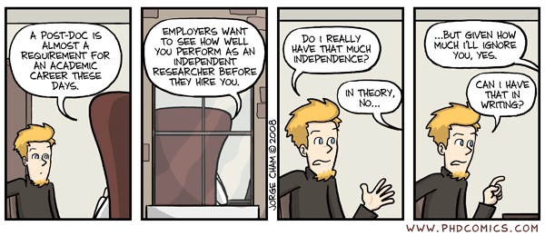
Good luck!

