Slide 1
Welcome to CAS !

Slide 2

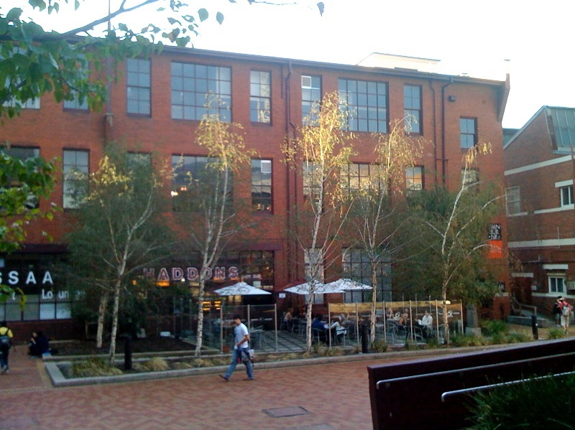
Centre of Astrophysics and Supercomputing
Founded in 1998
Currently 106 people (including 40 PhD students, 22 faculty)
One of the top 3 astronomy research groups in the country (with ANU, USyd)
Large astronomy software group, Astronomy Data and Computing Services (20 engineers)
Strong outreach and 3D animation capability
Active in undergraduate teaching and research (including space science!)

Slide 3
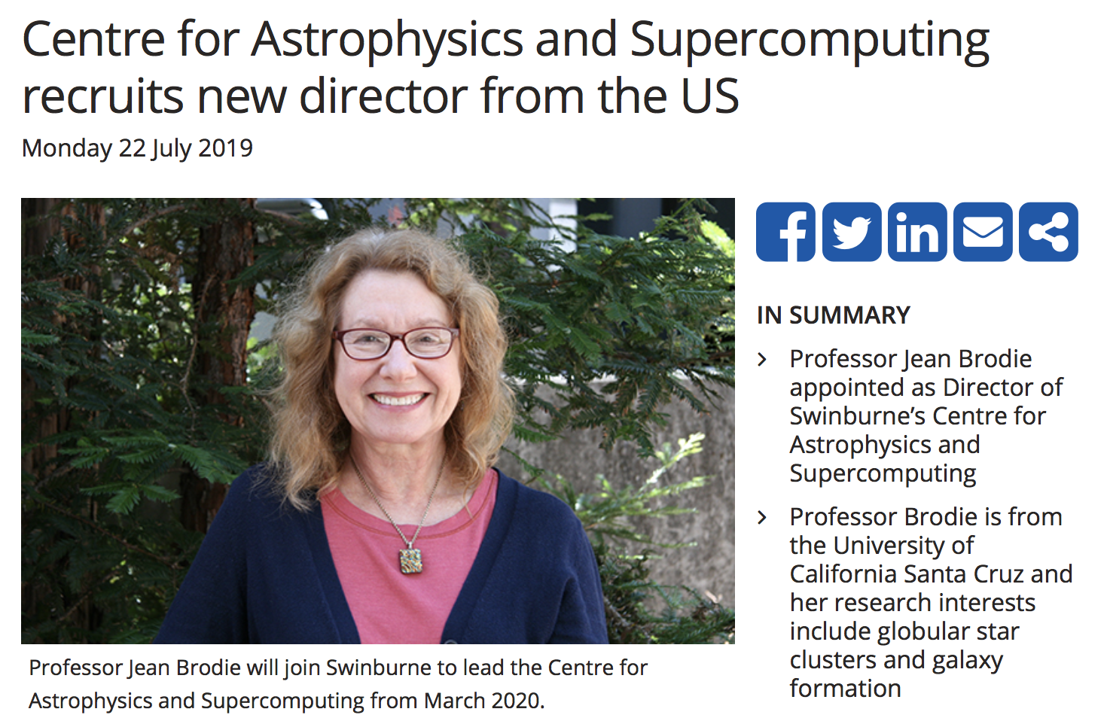

Our new director!

Slide 4
Research
Galaxy evolution
Cosmology
Planet formation
Pulsars & transient Universe
HPC/GPU
100–120 A/A* publications a year, ~2 in Nature or Science

Slide 5
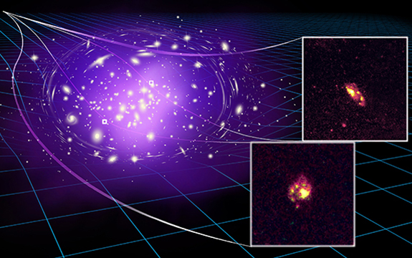
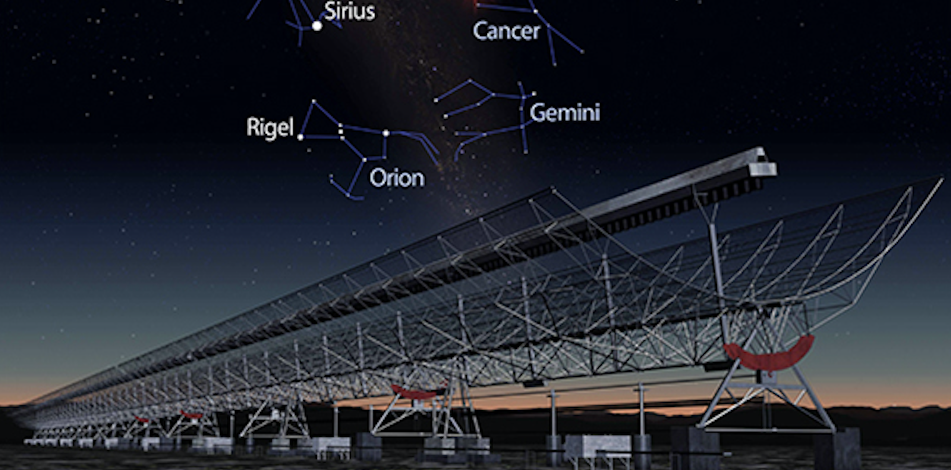
Highest redshift spiral galaxy
Yuan et al. (ApJ)
The monster galaxy that grew up too fast
Glazebrook et al. (Nature)
Galaxy murder mystery
Brown et al. (MNRAS)
Mysterious bursts of energy do come from outer space
Caleb et al. (MNRAS)

Slide 6

Australian Research Council Centres
We have two ARC-funded Centres of Excellence in CAS
ARC Centre of Excellence for Astronomy in 3D
~$2.5M p.a. in research funding from these centres!

Slide 7
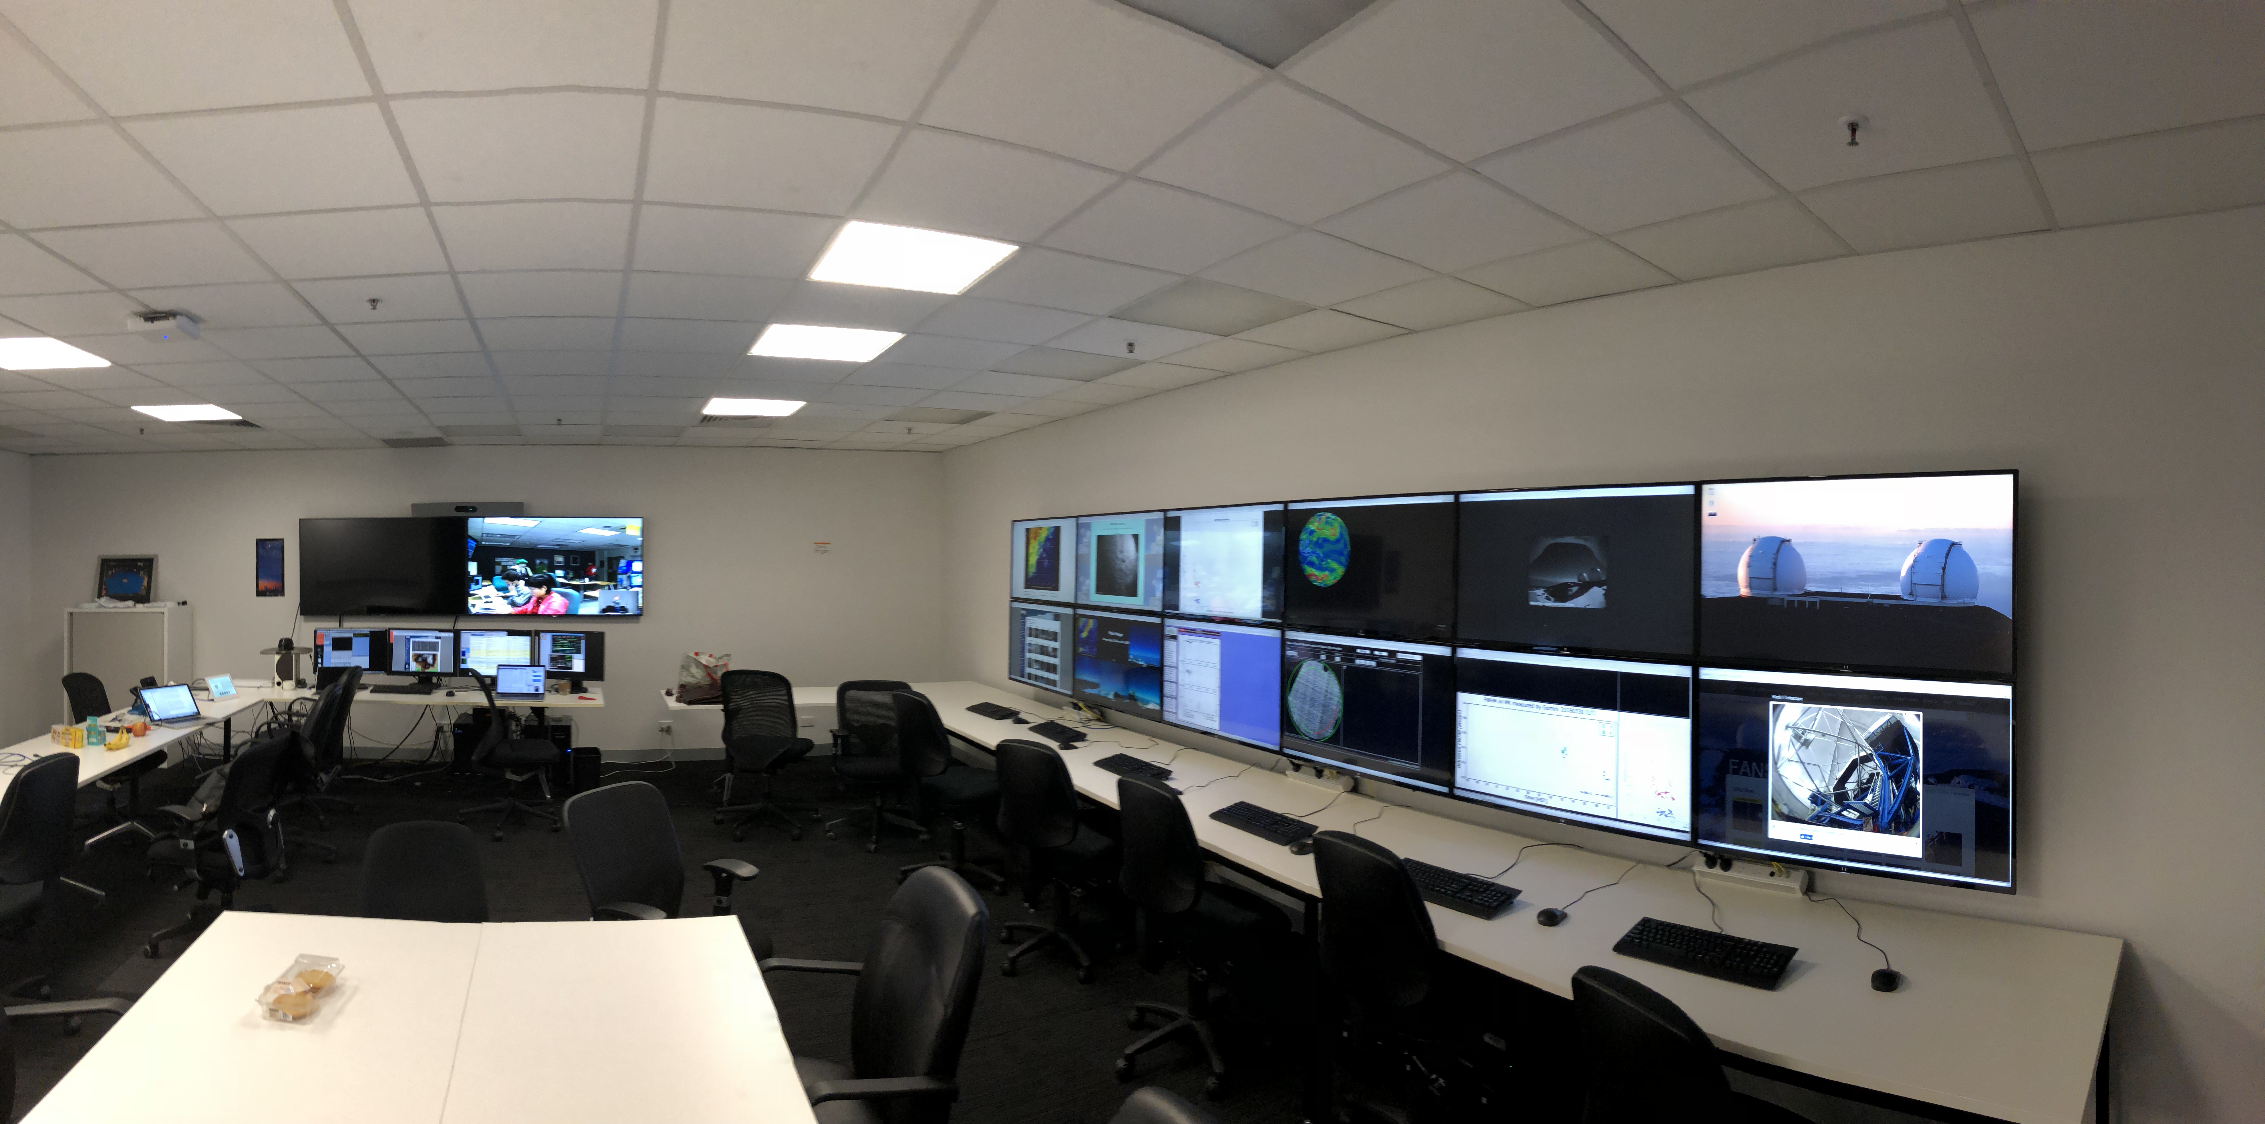
Facilities – Telescopes!
Access to Keck Observatory twin 10m telescopes (10 nights/yr) via Caltech is one of Swinburne’s premier international relations
Best/largest Optical/IR telescope in the world: transformative in areas such as Adaptive Optics & Laser Guide stars
Full remote operation from Hawthorn campus
+ESO (4x8m) national access, AAT national 4m, etc.

Slide 8
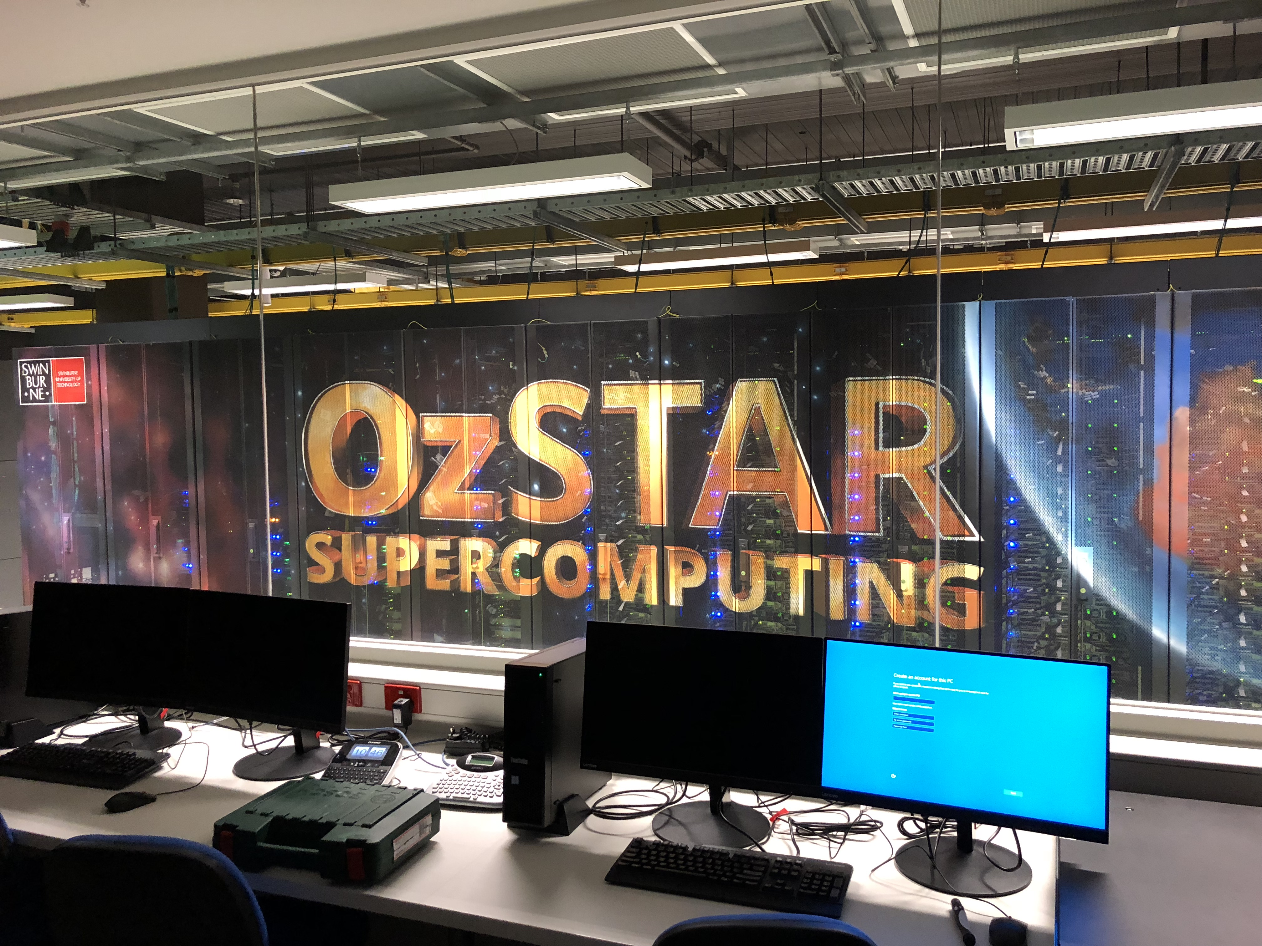
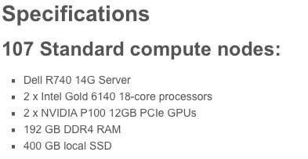
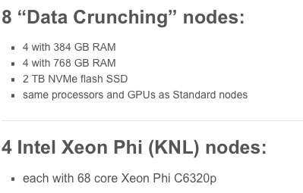
Facilities – Computers!

Slide 9
We are a very active place!
Weekly centre meeting (Director’s pizza lunch)
Weekly student talks, science colloquiua
Weekly journal club
Cookies and code!
Weekly art sessions!
Many outreach opportunities
Astronomy club
Many learning/research opportunities
Honours students very welcome to get involved!

Slide 10
2020 CAS Honours
Projects Showcase

Slide 11
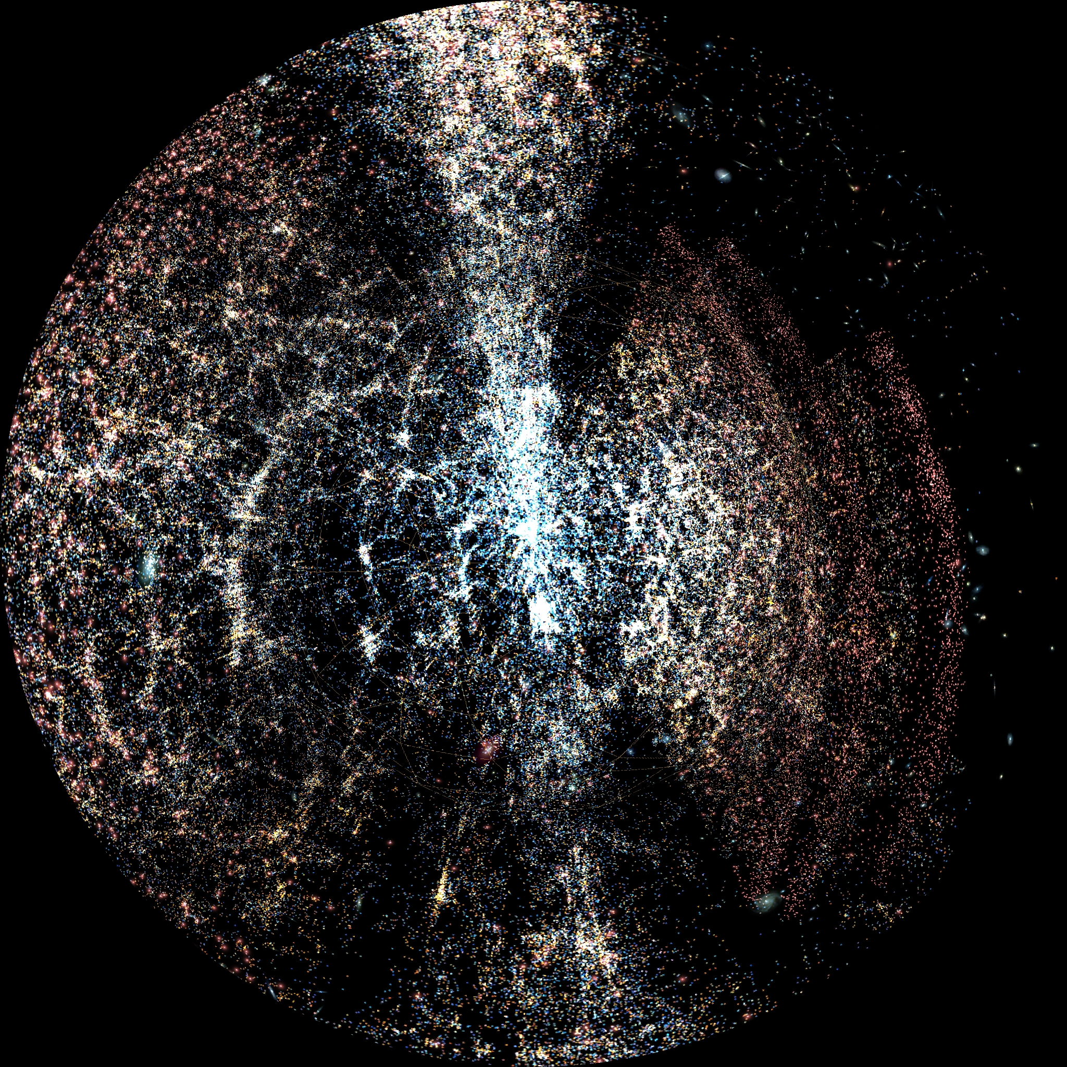
Do the laws of gravity depend on cosmological environment?
Chris Blake (cblake@swin.edu.au)
The distribution of galaxies forms a network of clusters, filaments, sheets and voids
In this project, we’ll make a topological map using the largest existing galaxy survey
We’ll compare the gravitational force exerted by these regions, using the manner in which they lens background light
This project will develop your skills in programming, statistics and maths

Slide 12
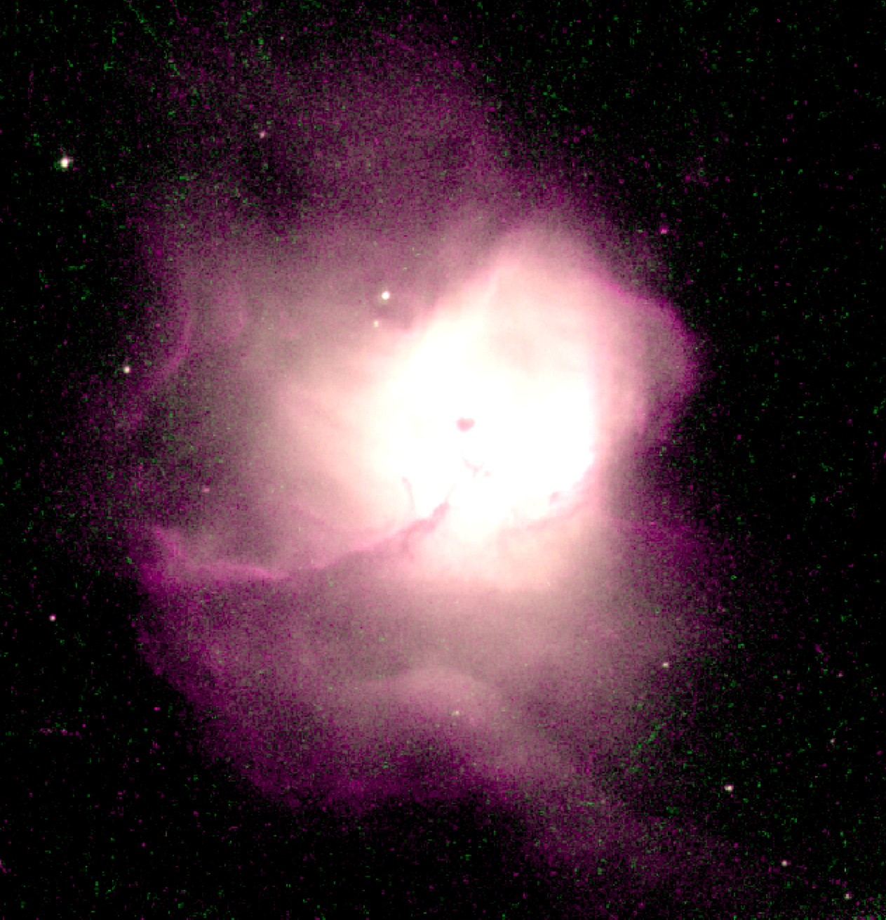
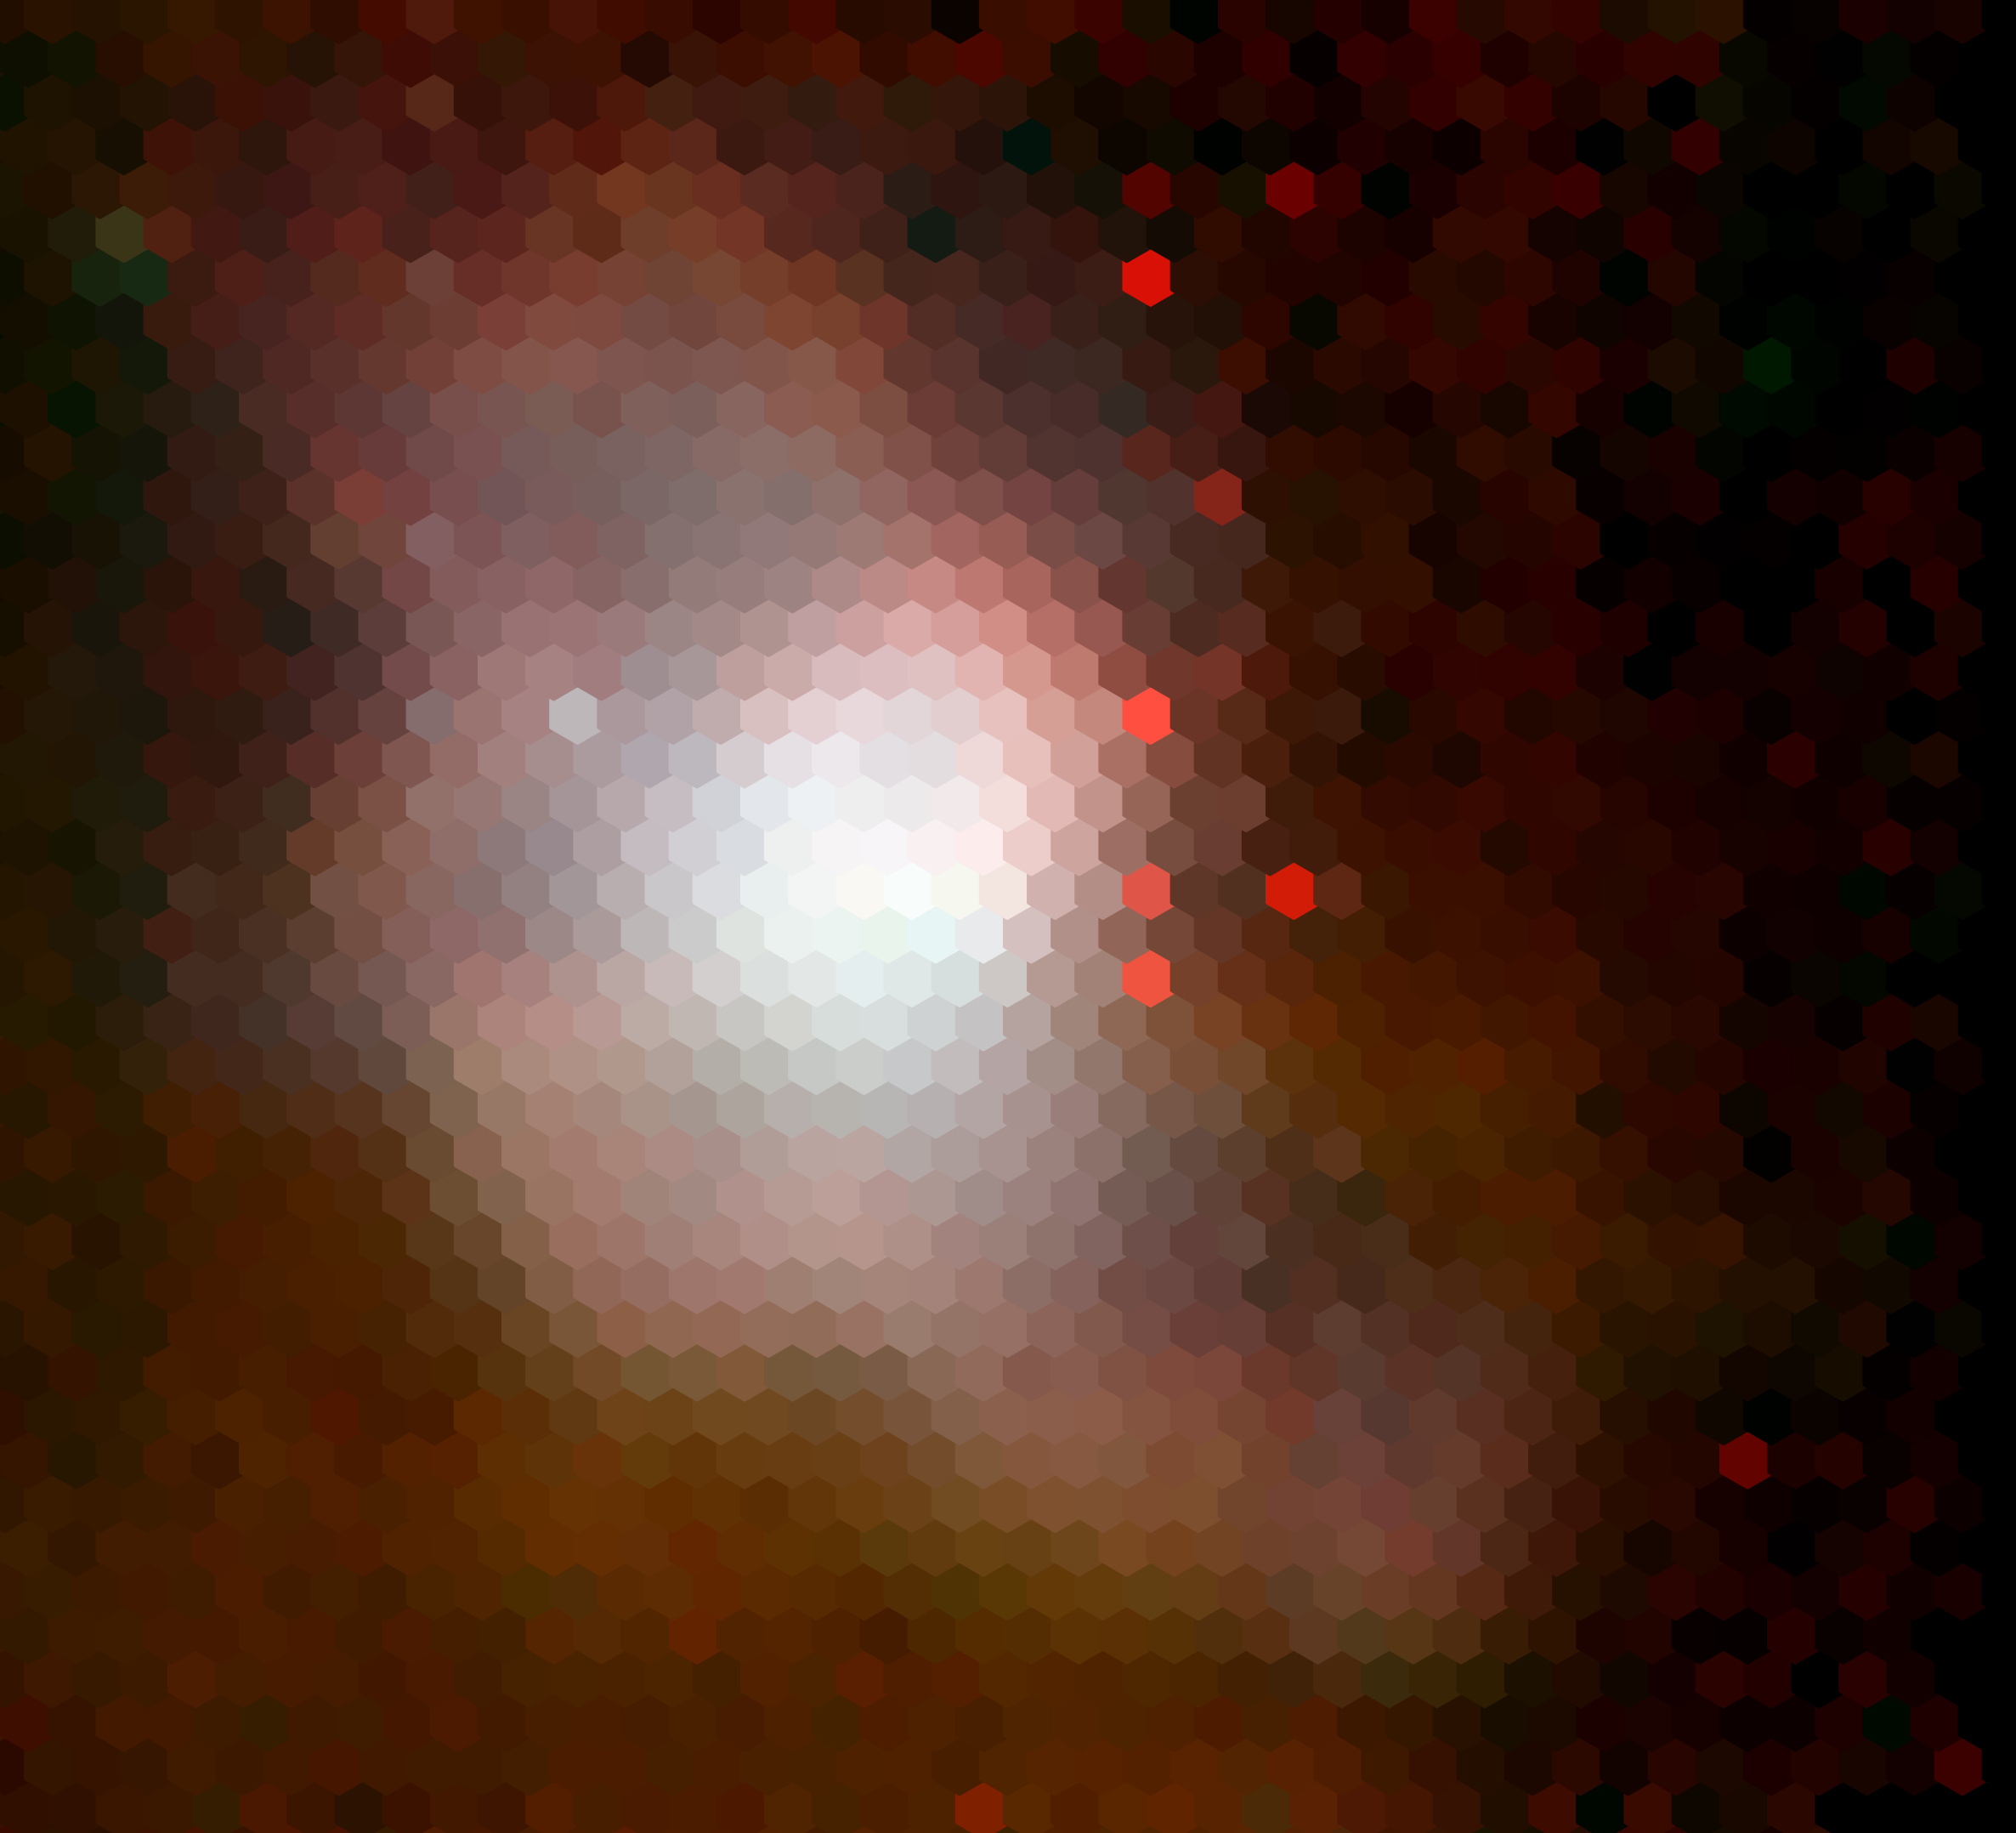
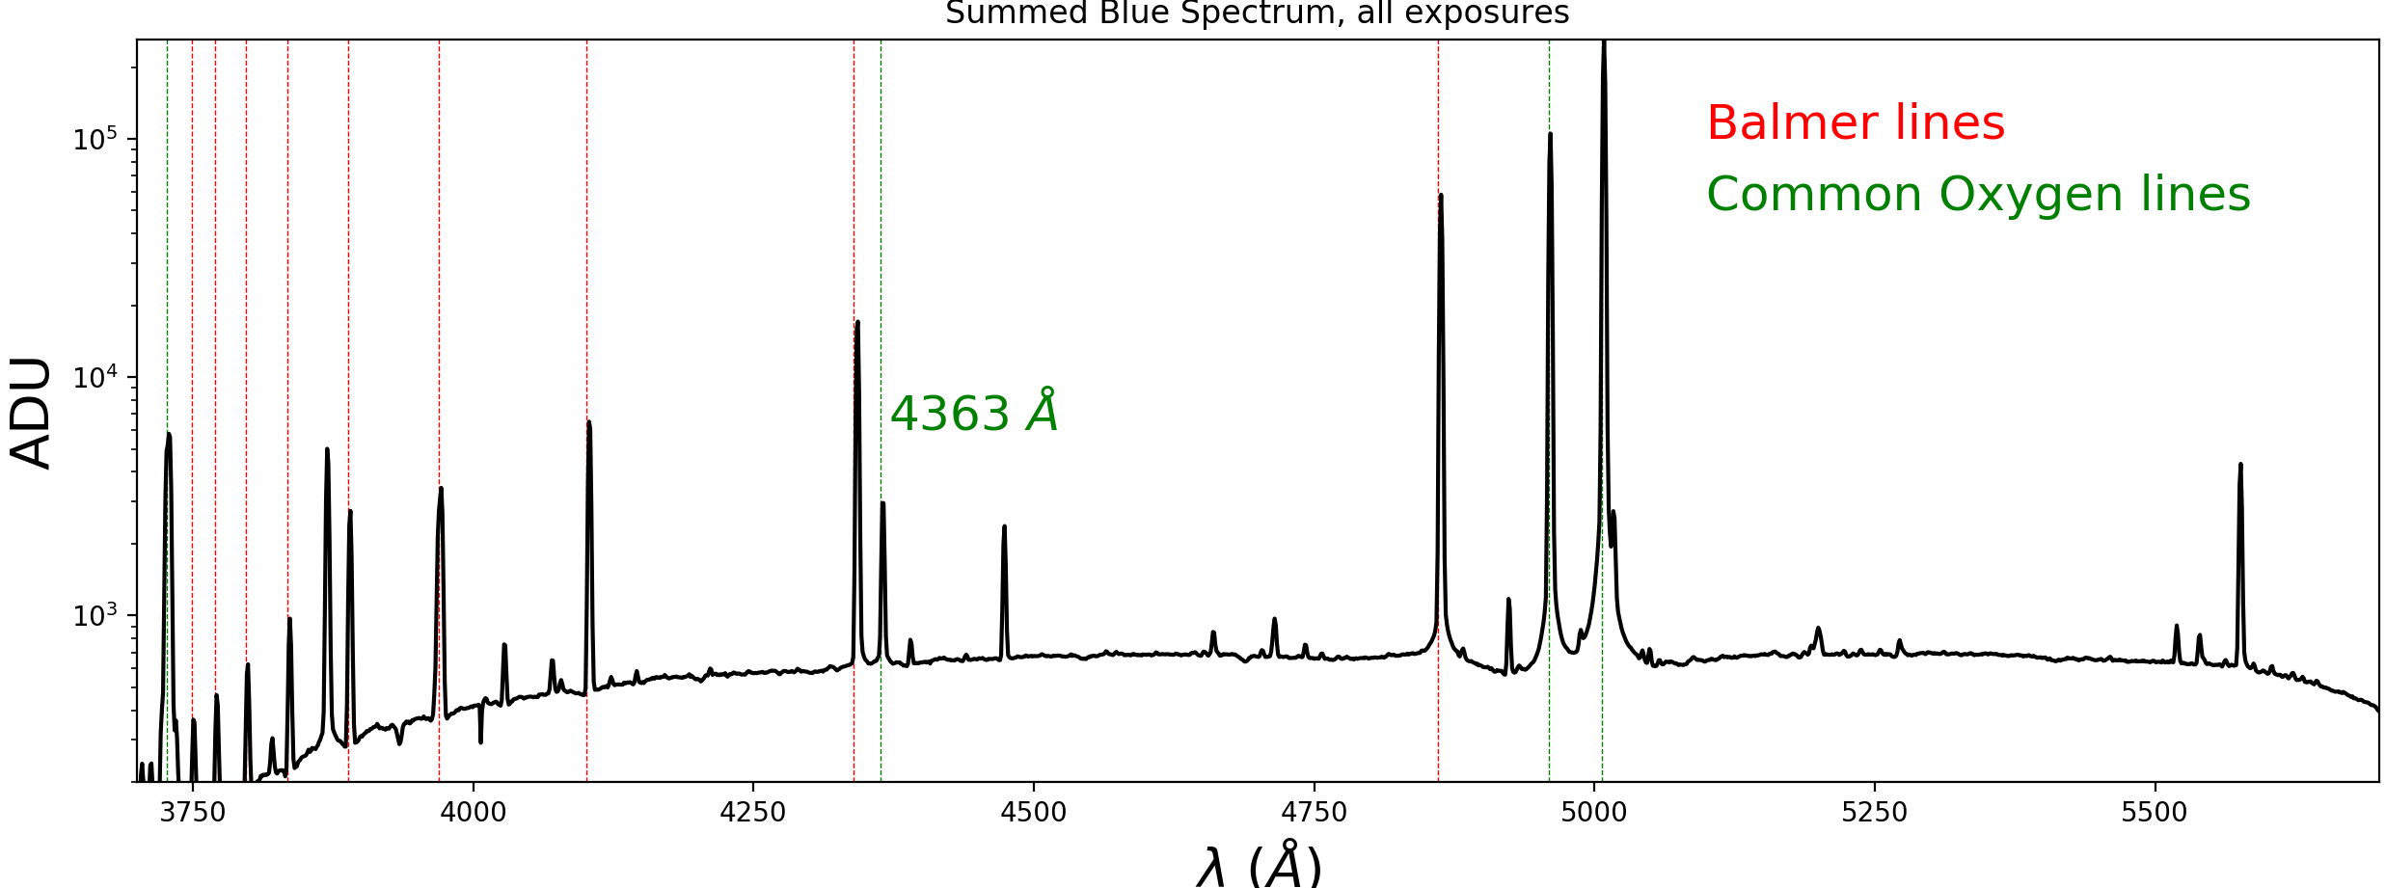
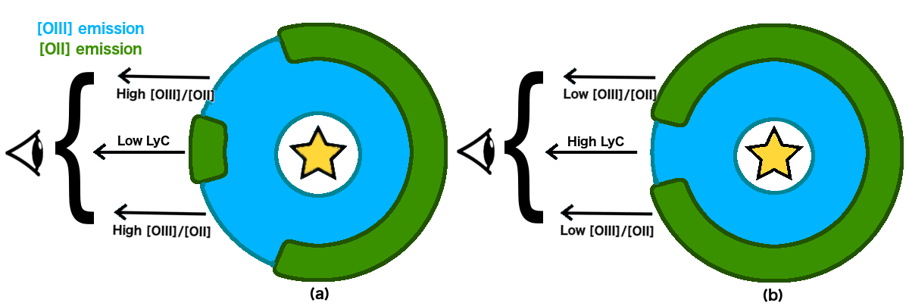
How do ionizing photons leak through the interstellar medium?
Supervisors: Emma Ryan-Weber & Rob Bassett
1/13
By combining spectroscopic data of nearby star-forming regions taken with the Anglo Australian Telescope with radio observations of neutral Hydrogen, the student will explore the connection between leaking ionizing radiation and neutral hydrogen covering fraction.
Q: Do star-forming regions that leak lots of ionizing radiation correspond to regions with low neutral hydrogen content?
Hubble Space Telescope Anglo Australian Telescope
Brightness
Wavelength

Slide 14
Edward Taylor (entaylor@swin.edu.au)

Slide 15
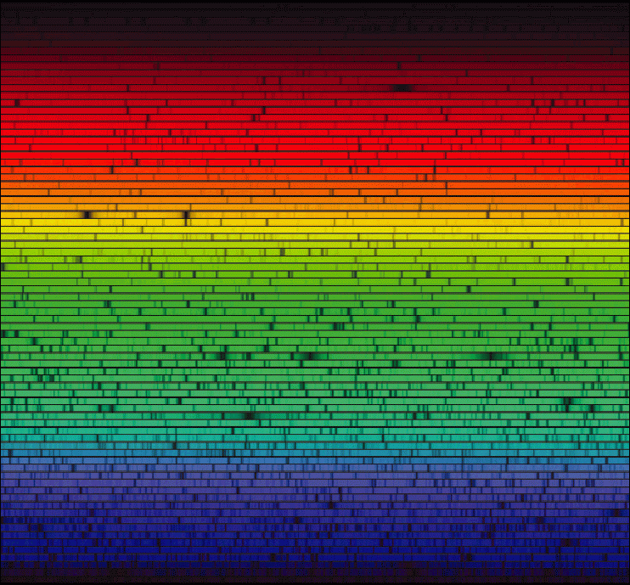
Quasar absorption lines
Michael Murphy (mmurphy@swin.edu.au)

Slide 16
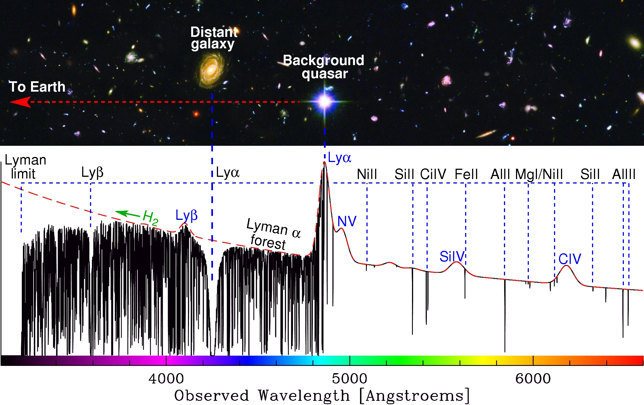
2 projects:
Rare, heavy metals in the world’s best spectral data
Possible cosmological variations in the electromagnetism

Slide 17
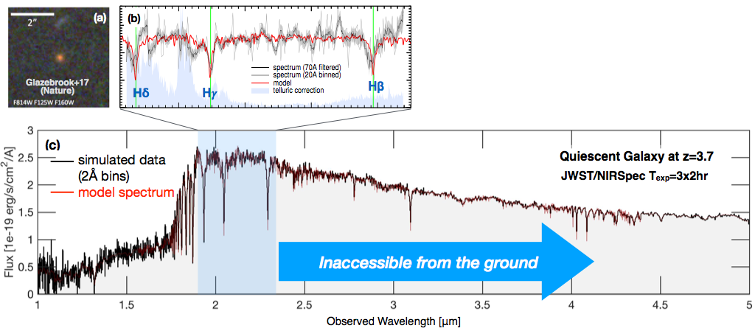
The nature of the first stellar populations in the Universe
Karl Glazebrook (kglazebrook@swin.edu.au)
Massive quiescent galaxy
z=4, 1.6 Gyr after Big Bang
Abundances, star-formation histories, stellar populations, ionised gas, binary populations, Pop III?,…

Slide 18
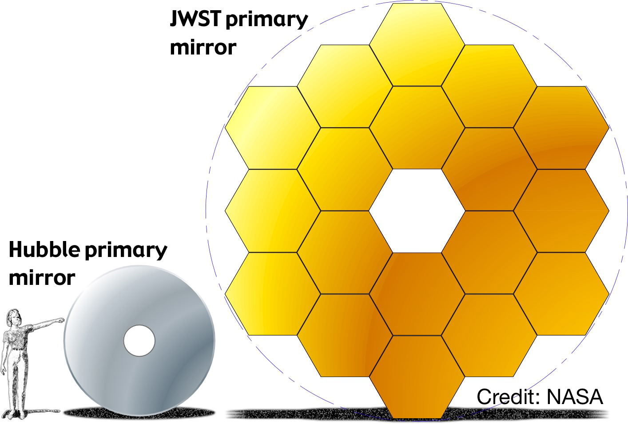
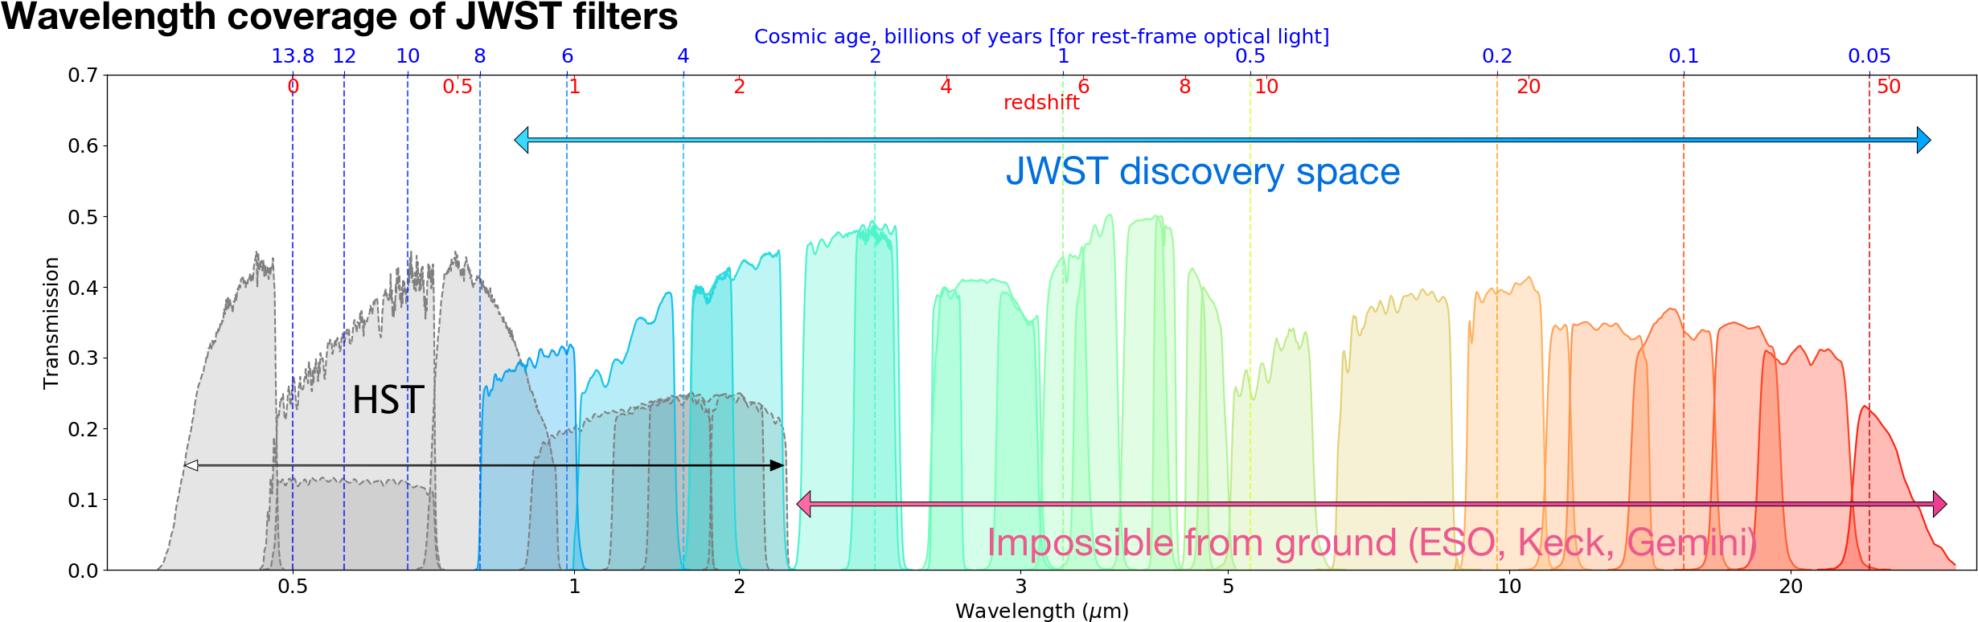
Machine Learning for discovering High-Redshift and Exotic Objects
Karl Glazebrook (kglazebrook@swin.edu.au)
Deep fields with dozens of NIR filters, – can we use ALL the information in a ROBUST fashion?

Slide 19
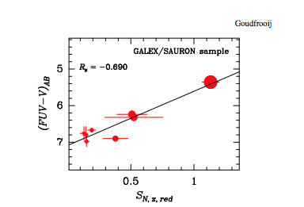
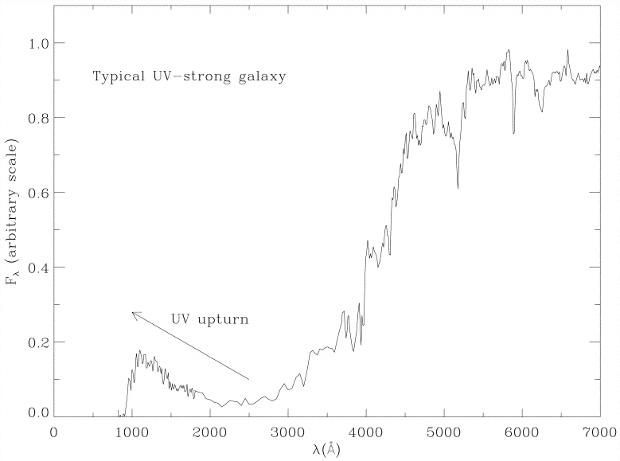
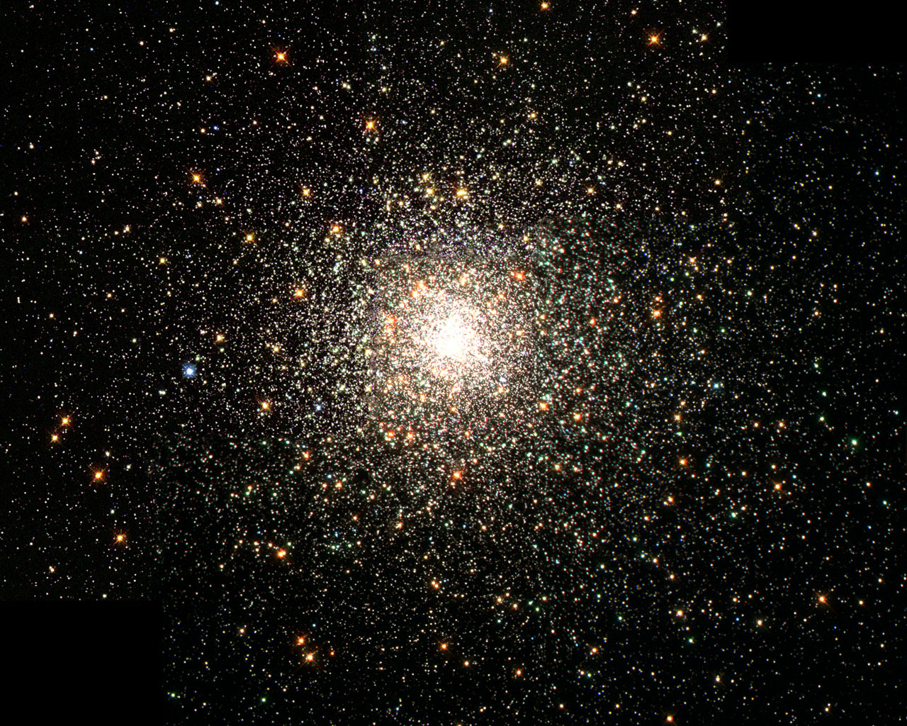
What is the origin of the UV upturn in elliptical galaxies?
Duncan Forbes (dforbes@swin.edu.au)

Slide 22
2020 CAS Honours
Projects Showcase

