Slide 1
Forecasting lensing-clustering analyses with DESI
Chris Blake (Swinburne)
July 2019

Slide 2
Goals
Investigate potential and practicality of joint lensing and clustering analyses in DESI
How accurately can such analyses constrain cosmology, what do they add to clustering alone? (Science cases: testing gravity, photo-z by cross-correlation, halo studies…)
What weights should be applied to reduce systematic bias or optimize statistical error? (Examples: FKP weights, fibre collision, completeness, redshift kernels/weights?)
What are the key systematics to address?

Slide 3
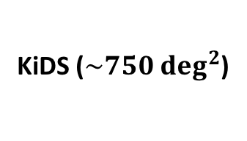
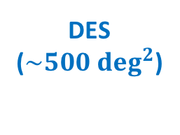
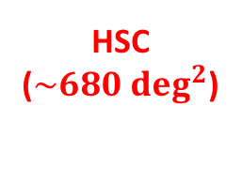
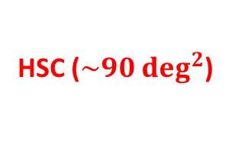
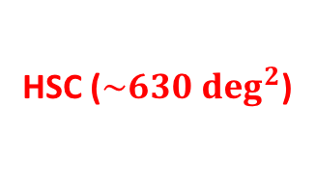
Methods
DESI will overlap with several current weak lensing surveys (KiDS, DES, HSC) and future surveys (e.g. CFIS, LSST)
HSC ($\sim 90 \deg^{2}$)
HSC ($\sim 630 \deg^{2}$)
DES ($\sim 500 \deg^{2}$)
KiDS ($\sim 750 \deg^{2}$)
HSC ($\sim 680 \deg^{2}$)

Slide 4
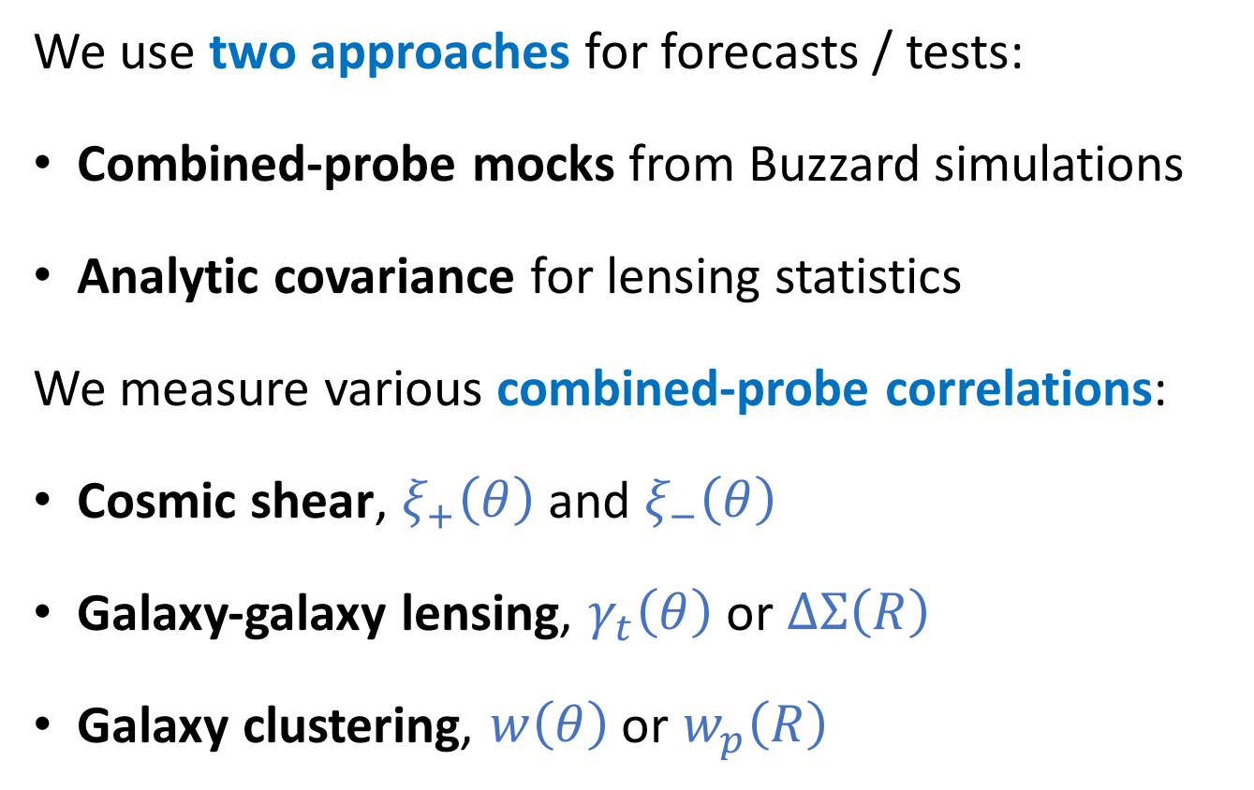
Methods
We use two approaches for forecasts / tests:
Combined-probe mocks from Buzzard simulations
Analytic covariance for lensing statistics
We measure various combined-probe correlations:
Cosmic shear, $ξ_{+}\left(θ\right)$ and $ξ_{−}\left(θ\right)$
Galaxy-galaxy lensing, $γ_{t}\left(θ\right)$ or $∆Σ\left(R\right)$
Galaxy clustering, $w\left(θ\right)$ or $w_{p}\left(R\right)$

Slide 5
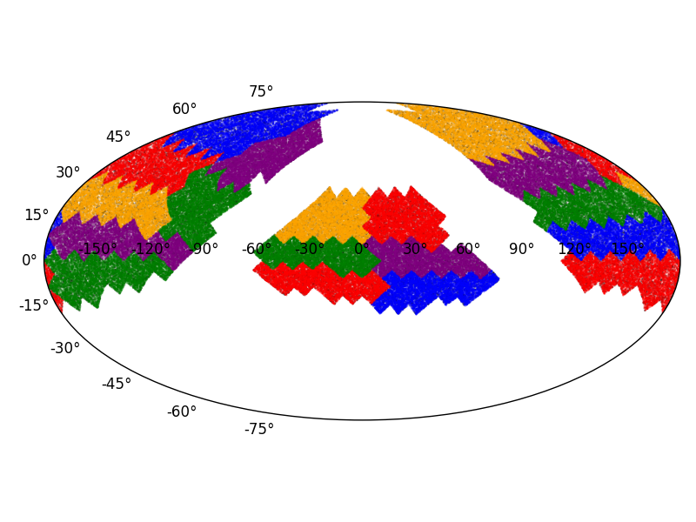

DESI-HSC mocks
Use Buzzard mocks on NERSC to construct 18 “HSC-like” simulations (each with area $\sim 1000 \deg^{2}$)
Each mock consists of sources with shapes, and DESI lenses (I will show here, LRGs $0.4<z<0.6$)

Slide 6
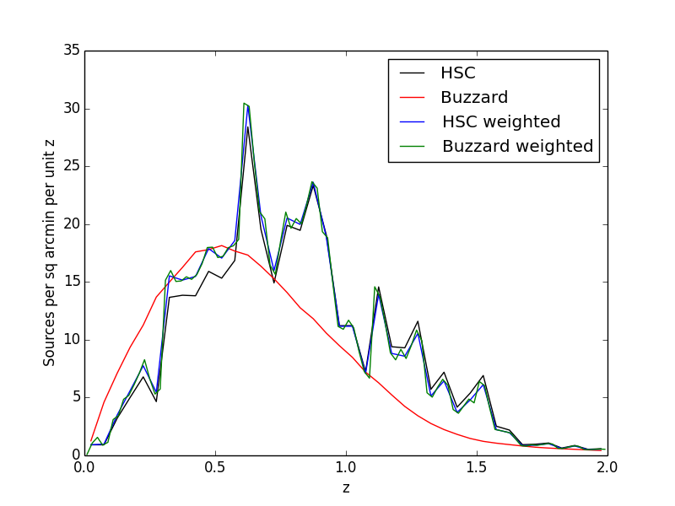
DESI-HSC mocks
Modulate the shape noise applied to the Buzzard sources to match the “effective number density” of the HSC source redshift distribution

Slide 7
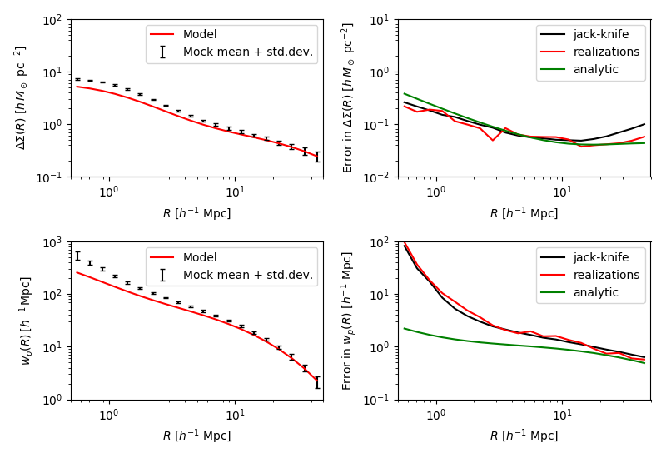



Mock correlations ($1000 \deg^{2}$)
Mock mean and (halofit) model
Errors (JK vs mock vs analytic)
Galaxy-galaxy lensing $∆Σ$
Projected clustering $w_{p}$

Slide 8
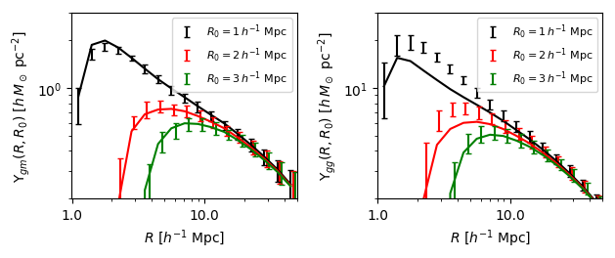
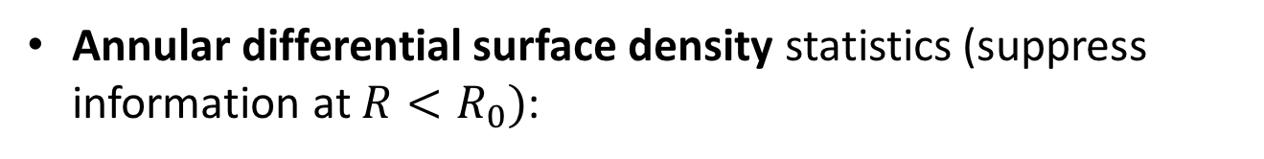
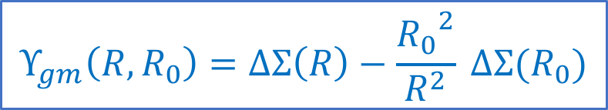
Mock correlations ($1000 \deg^{2}$)
Annular differential surface density statistics (suppress information at $R<R_{0})$:
$$Υ_{gm}\left(R,R_{0}\right)=ΔΣ\left(R\right)−\frac{{R_{0}}^{2}}{R^{2}} ΔΣ(R_{0})$$

Slide 9
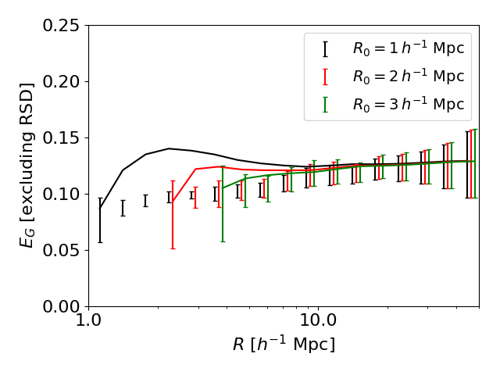
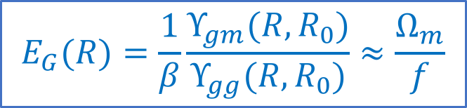
Mock correlations ($1000 \deg^{2}$)
$$E_{G}(R)=\frac{1}{β}\frac{Υ_{gm}(R,R_{0})}{Υ_{gg}(R,R_{0})}≈\frac{Ω_{m}}{f}$$
Gravitational slip statistic:

Slide 10
Mock correlations ($1000 \deg^{2}$)
Cosmic shear statistics (just one bin for now, in practice would split into tomographic bins)

Slide 11
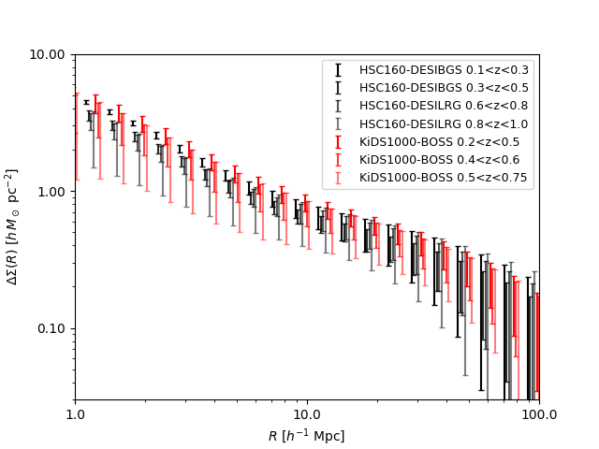

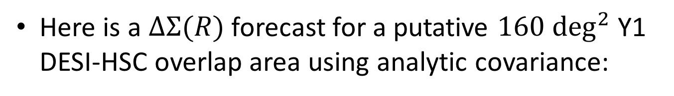
DESI-HSC Y1 forecast ($160 \deg^{2}$)
Here is a $∆Σ(R)$ forecast for a putative $160 \deg^{2}$ Y1 DESI-HSC overlap area using analytic covariance:
Note: this dataset would not be competitive on large scales with current KiDS/DES datasets

Slide 12
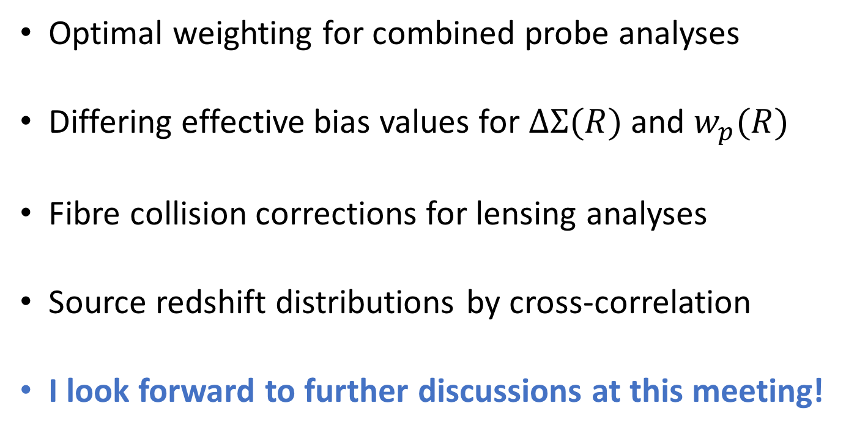
Rossana and I are working on …
Optimal weighting for combined probe analyses
Differing effective bias values for $∆Σ(R)$ and $w_{p}(R)$
Fibre collision corrections for lensing analyses
Source redshift distributions by cross-correlation
I look forward to further discussions at this meeting!

