Slide 1
Welcome to the
Astrophysics Honours stream!

Slide 2
Astrophysics Honours stream
We’re very excited to be launching an Astrophysics Honours stream for the first time in 2025!
Astrophysics Honours students will now have focussed Astrophysics coursework and research skills classes during Semester 1
You don’t need to have studied any previous Astrophysics or Space units to join our team!

Slide 3
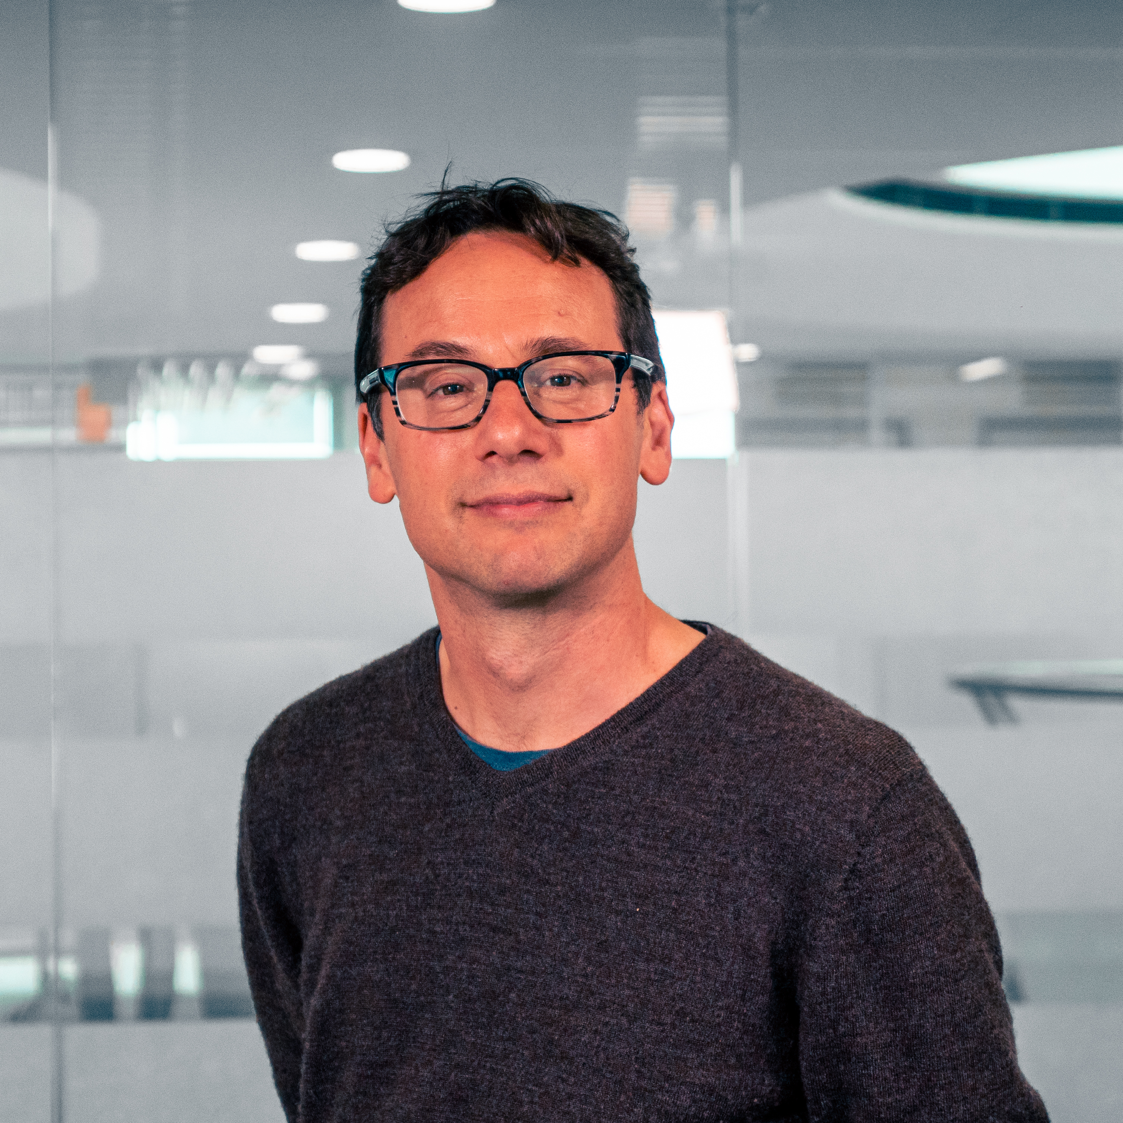
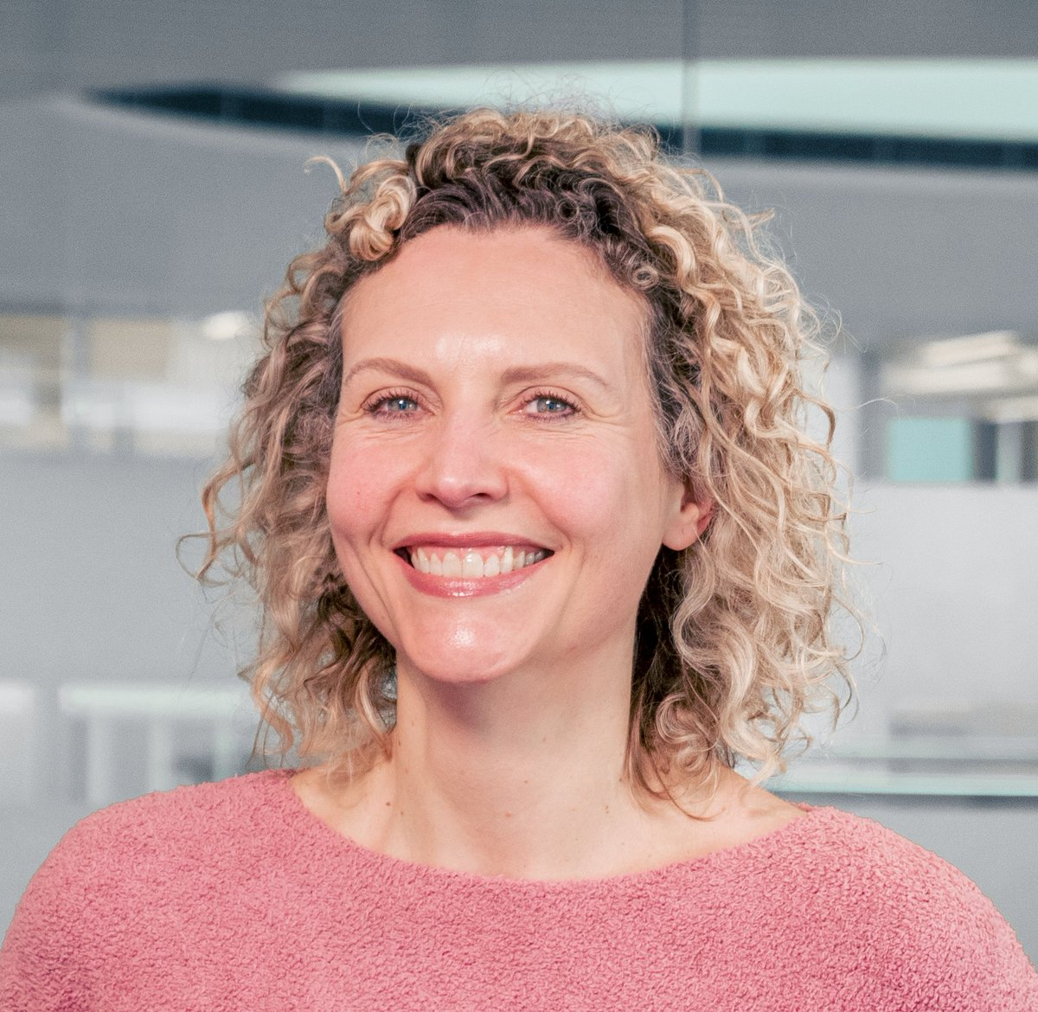
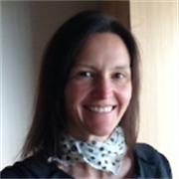
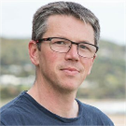
Meet your teaching team!
Chris Blake
(Astrophysics Honours
coordinator)
Michelle Cluver
Emma
Ryan-Weber
Adam
Deller
Ryan
Shannon

Slide 4
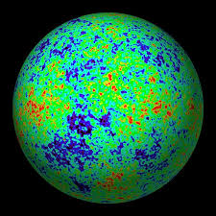
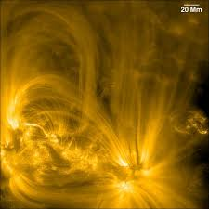
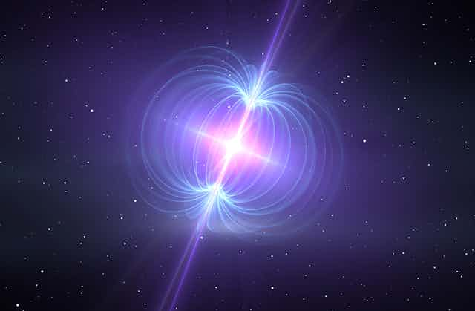
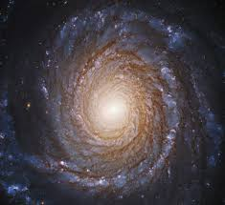
Astrophysics Honours Coursework
1 – Cosmology
2 – Astrophysical
Processes
3 – Compact Objects
4 – Galaxies

Slide 5
Astrophysics Honours Coursework
Cosmology | Physics of the expanding Universe, contents of the Universe, Big Bang physics, cosmic structure, cosmological observations
Astrophysical Processes | Formation of spectral lines, absorption and emission processes, radiative transfer, accretion
Compact Objects | Formation and evolution of neutron stars and black holes, radio pulsars, gravitational wave sources, use as astrophysical probes
Galaxies | Astrophysical components of a galaxy, physical processes of galaxy evolution, observing galaxies, active galactic nuclei

Slide 6
Astrophysics Honours Research Skills
We’re arranging weekly classes in Semester 1 to train the research skills of an astrophysicist!
You’ll complete a portfolio of tasks relevant to your literature review and project planning
Project management | How to find your key references | How to read a paper | Strategies for writing
Good coding practice | Useful tools in statistics | Presentation skills | Use of AI tools in research

Slide 7
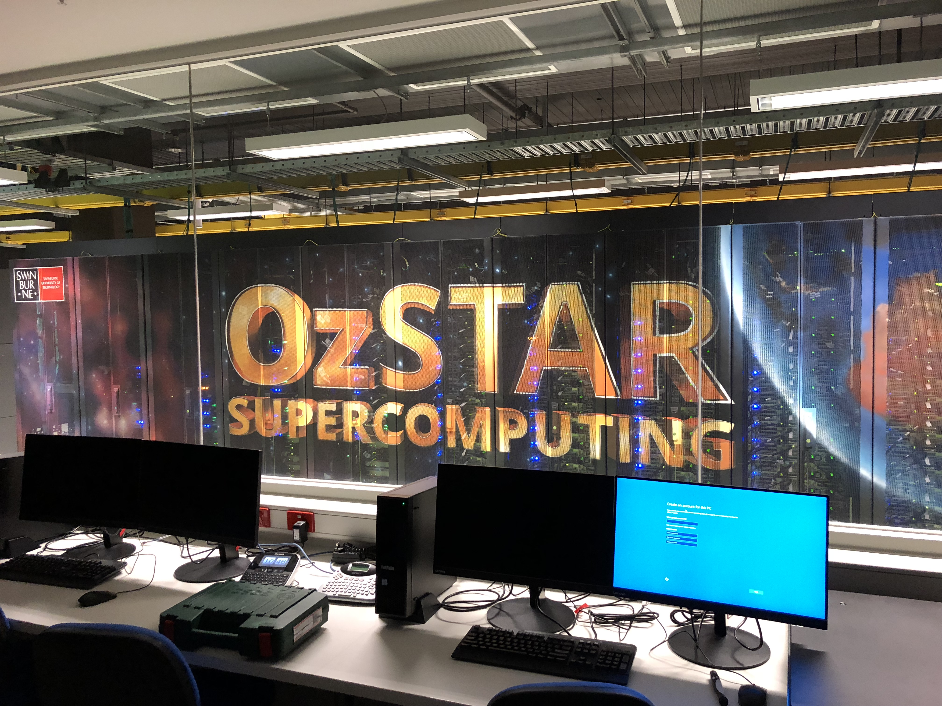
Centre for Astrophysics and Supercomputing
Astrophysics Honours students become members of the Centre for Astrophysics and Supercomputing (CAS)
We have many weekly activities and events you can join to enrich your research journey
Many CAS Honours students gain PhD scholarships in our centre

Slide 8
Please come along to the presentation from our Astrophysics research supervisors, 1pm-1.30pm!

Slide 9
Message from Physics & Outer-Space Club …

