Slide 1
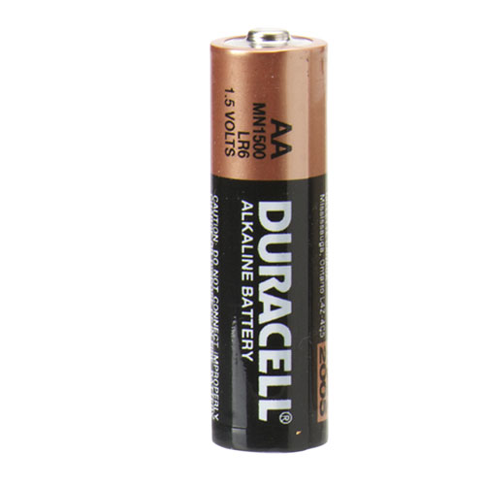
Chapter 22 : Electric potential
What is electric potential?
How does it relate to potential energy?
How does it relate to electric field?
Some simple applications

Slide 2
Electric potential
What does it mean when it says “1.5 Volts” on the battery?
The electric potential difference between the ends is 1.5 Volts

Slide 3
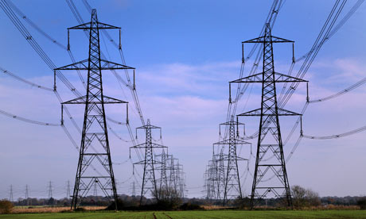
Electric potential
1.5 V
230 V
100,000 V
So what is a volt?

Slide 4
Electric potential
The electric potential difference $∆V$in volts between two points is the work in Joules needed to move 1 C of charge between those points
$∆V$ is measured in volts [V] : 1 V = 1 J/C
$$\boxed{W=q×∆V}$$
W = work done [in J]
q = charge [in C]
$∆$V = potential difference [in V]

Slide 5
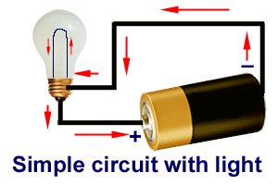
Electric potential
The electric potential difference $∆V$in volts between two points is the work in Joules needed to move 1 C of charge between those points
$$\boxed{W=q×∆V}$$
The 1.5 V battery does 1.5 J of work for every 1 C of charge flowing round the circuit

Slide 6
Potential energy
What is this thing called “potential”?
Potential energy crops up everywhere in physics

Slide 7
Potential energy
Potential energy U is the energy stored in a system (when work is done against a force)
e.g. force of gravity …
$$F=mg$$
Work = Force x Distance
$$W=F×h$$
$$F$$
$$=mgh$$
$$h$$
$$→U=mgh$$

Slide 8
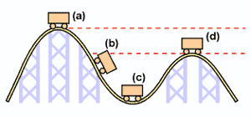
Potential energy
Potential energy may be released and converted into other forms (such as kinetic energy)
Work is done, increasing the potential energy

Slide 9
Potential energy
Potential energy difference is the only thing that matters – not the reference (or zero) level
For example, applying conservation of energy to a mechanics problem:
Final energy = Initial energy
$${KE}_{final}+{PE}_{final}={KE}_{initial}+{PE}_{initial}$$
$${KE}_{final}={KE}_{initial}+{(PE}_{initial}−{PE}_{final})$$
Difference in potential energy

Slide 10
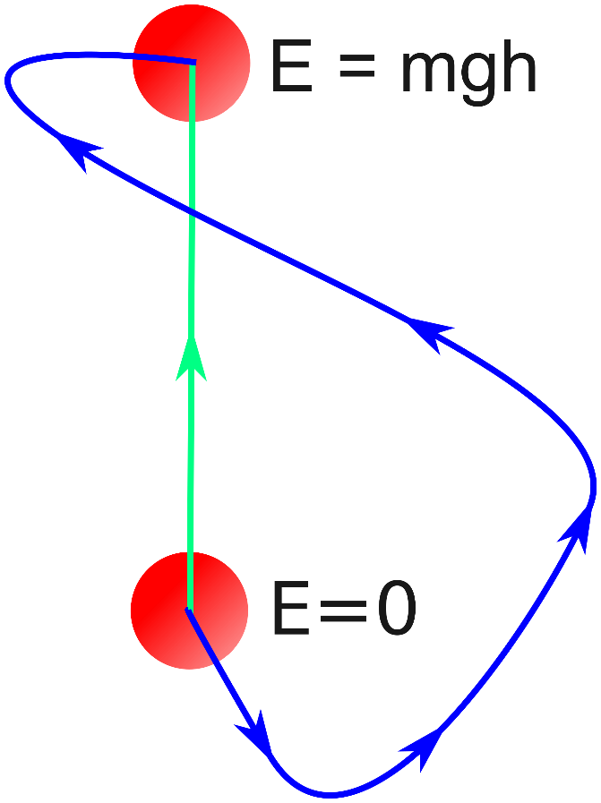
Potential energy
Potential energy difference doesn’t depend on the path – only on the two points A and B

Slide 11
Potential energy
Potential energy U is the energy stored in a system – second example
e.g. stretching a spring …
$$F=kx$$
Work = Force x Distance
Force is varying with distance!
$$F$$
$$W=\int{kx dx}$$
$$=\frac{1}{2}kx^{2}$$
$$x$$
$$→U=\frac{1}{2}kx^{2}$$

Slide 12
Electric potential
e.g. moving a charge through an electric field…
$$F$$
$$F=−qE$$
$$q$$
$$E$$
(minus sign because the force is opposite to E)
$$∆x$$
Work = Force x Distance
$$W=F ∆x$$
$$=−qE ∆x$$
Potential difference $∆V$ is work needed to move 1C of charge: $W=q ∆V$
Equate: $q ∆V=−qE ∆x$
$$E=−\frac{∆V}{∆x}$$

Slide 13
Electric potential
Electric field is the gradient of potential $E=−\frac{∆V}{∆x}$
High V
Low V
$$V$$
$$E$$
$$x$$
Positive charges feel a force from high to low potential
Negative charges feel a force from low to high potential
$$x$$

Slide 14
Two parallel plates have equal and opposite charge. Rank the indicated positions from highest to lowest electric potential.
•
- - - - - - - - - - - - -
A
•
•
B
D
•
C
+ + + + + + + + + + + + + + + +
A=C, B=D
A, B, C, D
C, D=B, A
A, B=D, C

Slide 15
Electric potential
Analogy with gravitational potential
Gravitational potential difference exerts force on mass
$$V$$
$$q$$
Electric potential difference exerts force on charge
$$x$$

Slide 16
Electric potential
Electric field is the gradient of potential $E=−\frac{∆V}{∆x}$
High V
Low V
The dashed lines are called equipotentials (lines of constant V)
Electric field lines are perpendicular to equipotentials
It takes no work to move a charge along an equipotential (work done = $dW= \vec{F}.\vec{dx}=q\vec{E}.\vec{dx}=0$)
$$E$$

Slide 17
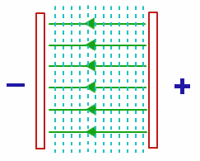
Electric potential
Summary for two plates at potential difference V
$$E$$
Electric field is the potential gradient
Work W to move charge q from –ve to +ve plate
$$E=\frac{V}{d}$$
$$W=q V$$
$$d$$

Slide 18
Link to potential energy
The electric potential difference $∆V$between two points is the work needed to move 1 C of charge between those points
This work is also equal to the potential energy difference $∆U$ between those points
Potential V = potential energy per unit charge U/q
$$\boxed{W=q×∆V}$$
$$\boxed{∆U=q×∆V}$$

Slide 19
An electron is placed at “X” on the negative plate of a pair of charged parallel plates. For the maximum work to be done on it, which point should it be moved to?
•
•
- - - - - - - - - - - - -
X
D
•
B
•
A
•
C
+ + + + + + + + + + + + + + + +
A
B
C
D
A or C
C or D

Slide 20
Electric potential
What is the electric potential near a charge +Q?
Work = Force x Distance
$$F=\frac{k Q q}{x^{2}}$$
Force is varying with distance, need integral!
$$W=\int_{∞}^{r}{F dx}=\int_{∞}^{r}{−\frac{k Q q}{x^{2}} dx}=\frac{k Q q}{r}$$
+q
Potential energy $U=\frac{k Q q}{r}$
$$x$$
+Q
+
Electric potential $V=\frac{U}{q}=\frac{k Q}{r}$

Slide 21
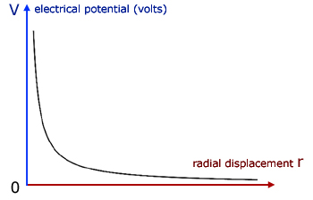
Electric potential
What is the electric potential near a charge +Q?
+q
$$r$$
+Q
+
Electric potential $V=\frac{k Q}{r}$

Slide 22
Electric potential
Exercise: a potential difference of 200 V is applied across a pair of parallel plates 0.012 m apart. (a) calculate E and draw its direction between the plates.
The electric field is the gradient in potential
$$E= \frac{∆V}{∆x}$$
$$=\frac{200}{0.012}$$
$$=1.7×{10}^{4} V m^{−1} [or N C^{−1}]$$
$$V=200$$
+ve plate
$$E$$
$$V=0$$
-ve plate

Slide 23
Electric potential
Exercise: a potential difference of 200 V is applied across a pair of parallel plates 0.012 m apart. (b) an electron is placed between the plates, next to the negative plate. Calculate the force on the electron, the acceleration of the electron, and the time it takes to reach the other plate.
Force $F=qE$
$$=(−1.6×{10}^{−19})×(1.7×{10}^{4})$$
$$=−2.7×{10}^{−15} N$$
$$=\frac{2.7×{10}^{−15}}{9.1×{10}^{−31}}$$
$$F=ma$$
Acceleration $a=\frac{F}{m}$
$$=3.0×{10}^{15} m s^{−2}$$
+ve plate
Time $t=\sqrt{\frac{2d}{a}}$
$$d=\frac{1}{2}at^{2}$$
$$E$$
$$−e$$
$$t=\sqrt{\frac{2×0.012}{3.0×{10}^{15}}}$$
-ve plate
$$=2.8×{10}^{−9} s$$
e = 1.6 x 10⁻¹⁹ C; m_{e} = 9.1 x 10⁻³¹ kg

Slide 24
Electric potential
Exercise: a potential difference of 200 V is applied across a pair of parallel plates 0.012 m apart. (c) calculate the work done on the electron as it travels between the plates.
The potential difference is the work done on 1C charge
Work $W=qV$
$$=\left(1.6×{10}^{−19}\right)×200$$
$$=3.2×{10}^{−17} J$$
+ve plate
$$E$$
$$−e$$
-ve plate
e = 1.6 x 10⁻¹⁹ C; m_{e} = 9.1 x 10⁻³¹ kg

Slide 25
Chapter 22 summary
Electric potential difference V is the work done when moving unit charge: $W=qV$
The electric potential energy is therefore also given by: $U=qV$
The electric field is the gradient of the potential: $E=−∆V/∆x$
Charges feel a force from high electric potential to low potential

