Slide 1
This week in the physics course
Lectures will cover Chapter 20 (Electric Charge) and start Chapter 22 (Electric Potential)
Please note: lecture slides and scans of the textbook chapters are available on Blackboard
Tutorial class will practise problems from last week’s lectures on Chapter 16 (Temperature and Heat)
Physics help available in MASH centre (Chris Blake, Tues 10.30-12.30 and Wayne Rowlands Thurs 2.30-4.30)
Don’t hesitate to get in touch with any questions – cblake@swin.edu.au

Slide 2
Chapter 20 : Electric charge, force, field
What is electric charge and how do we measure it?
Coulomb’s Force Law between charges
How an electric field can be used to describe electrostatic forces
Some simple applications of these principles

Slide 3
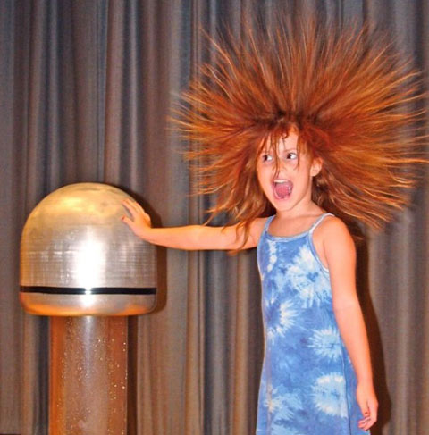
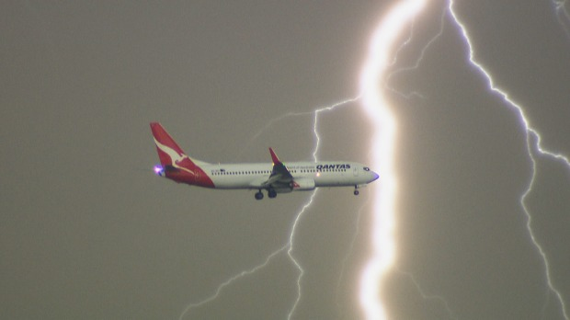
Electric charge
Intrinsic property of the particles that make up matter

Slide 4
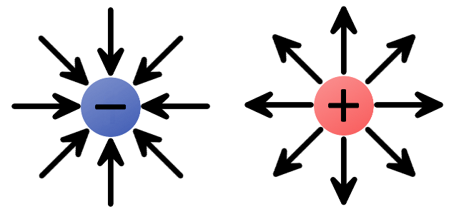
Electric charge
Charge can be positive or negative

Slide 5
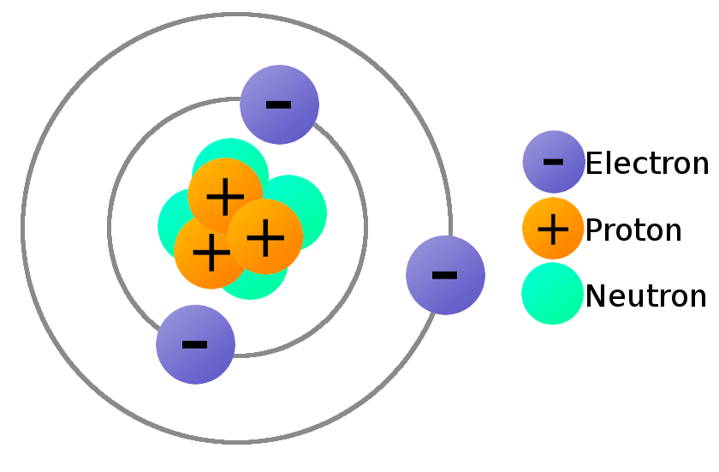
Electric charge
Atoms are composed of negatively-charged electrons and positively-charged protons

Slide 6
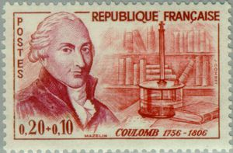
Electric charge
Charge is measured in Coulombs [unit: C]

Slide 7
Electric charge
Charge is measured in Coulombs [unit: C]
Proton and electron have equal and opposite elementary charge = 1.6 x 10⁻¹⁹ C
Charge on proton = +1.6 x 10⁻¹⁹ C
Charge on electron = -1.6 x 10⁻¹⁹ C

Slide 8
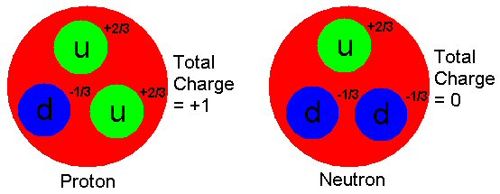
Electric charge
We now know that protons and neutrons are made up of quarks with 2/3 and -1/3 charges (electrons are still fundamental)

Slide 9
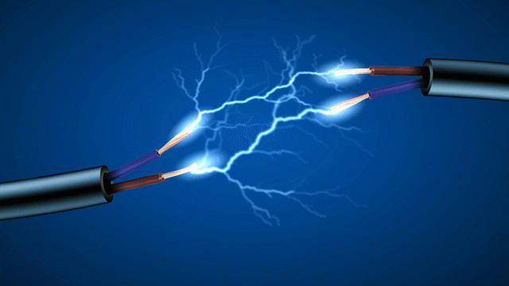
Electric charge
Charge cannot be created or destroyed (it is conserved) but it can be moved around

Slide 10
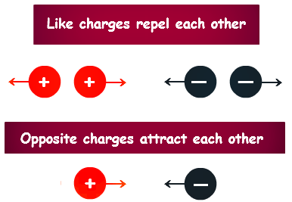
Electric charge
Charges feel electrostatic forces

Slide 11
A balloon is rubbed against a nylon jumper, and it is then found to cause a force of attraction to human hair. From this experiment it can be determined that the electrostatic charge on the balloon is
positive
negative
Impossible to determine

Slide 12
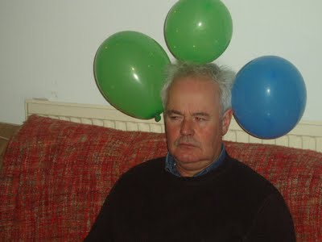
Electric charge
Rub a balloon on your hair and it will stick to things! Why??

Slide 13
Electric charge
Rub a balloon on your hair and it will stick to things! Why??
Friction moves electrons from your hair to the balloon
The balloon therefore becomes negatively charged, so your hair becomes positively charged (charge conservation)
Your hair will stand on end (like charges repel), and the balloon will stick to your hair (opposite charges attract)
Now move the balloon near a wall. The wall’s electrons are repelled, so the wall becomes positively charged.
The balloon will stick to the wall! (opposite charges attract)

Slide 14
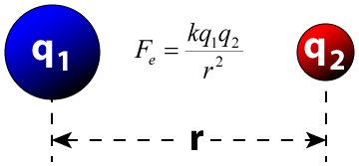
Electrostatic force
The strength of the electrostatic force between two charges q₁ and q₂ is given by Coulomb’s law
The direction of the force is along the joining line
$$F_{e}$$
$$F_{e}$$
$$k=9×{10}^{9} N m^{2} C^{−2}$$

Slide 15
Electrostatic force
The electrostatic force is a vector, written $\vec{F}$
Vectors have a magnitude and a direction. This may be indicated by components $\vec{F}=(F_{x},F_{y},F_{z})$
The magnitude is sometimes written as $\left|\vec{F}\right|$. It can be evaluated as $|\vec{F}|=\sqrt{{F_{x}}^{2}+{F_{y}}^{2}+{F_{z}}^{2}}$
The direction can be indicated by a unit vector

Slide 16
Electrostatic force
Example
Two 0.5 kg spheres are placed 25 cm apart. Each sphere has a charge of 100 μC, one of them positive and the other negative. Calculate the electrostatic force between them, and compare it to their weight.
$$\left|F\right|=\frac{k {|q}_{1}| |q_{2}|}{r^{2}}$$
Coulomb’s Law:
$$k=9×{10}^{9} N m^{2} C^{−2}$$
$${|q}_{1}|=|q_{2}|=100 μC={100×{10}^{−6} C=10}^{−4} C$$
$$r=25 cm=0.25 m$$
$$F_{electrostatic}=\frac{9×{10}^{9}×{10}^{−4}×{10}^{−4}}{{0.25}^{2}}=1440 N$$
$$F_{weight}=mg=0.5×9.8=4.9 N$$

Slide 17
Electrostatic force
Where multiple charges are present, the forces sum as vectors (“principle of superposition”)
+ve
What is the combined force on the blue charge from the two red charges?
+ve
+ve

Slide 18
Electrostatic force
Where multiple charges are present, the forces sum as vectors (“principle of superposition”)
+ve
$$\vec{F_{1}}$$
$$\vec{F_{total}}=\vec{F_{1}}+\vec{F_{2}}$$
+ve
$$\vec{F_{2}}$$
+ve

Slide 19
Electrostatic force
Where multiple charges are present, the forces sum as vectors (“principle of superposition”)
+ve
$$\vec{F_{1}}$$
+ve
$$\vec{F_{2}}$$
+ve

Slide 20
|-
Electrostatic force
Example
Two protons are 3.6 nm apart. What is the total force on an electron located on the line between them, 1.2 nm from one of the protons? (elementary charge e=1.6 x 10⁻¹⁹ C)
q=+e
q=-e
q=+e
r₁=1.2 nm=r
r₂=2.4 nm=2r
$${|F}_{1}|=\frac{{k |q}_{1 }||q_{2}|}{{r_{1}}^{2}}=\frac{k e^{2}}{r^{2}}$$
$${|F}_{2}|=\frac{{k |q}_{1 }||q_{2}|}{{r_{2}}^{2}}=\frac{k e^{2}}{{(2r)}^{2}}$$
$$\left|F_{1}\right|−\left|F_{2}\right|=\frac{ke^{2}}{r^{2}}−\frac{ke^{2}}{4r^{2}}$$
$$=\frac{3ke^{2}}{4r^{2}}$$
$$=\frac{3×9×{10}^{9}×{\left(1.6×{10}^{−19}\right)}^{2}}{4×{\left(1.2×{10}^{−9}\right)}^{2}}$$
$$=0.12 nN$$

Slide 21
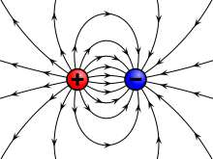
Electric field

Slide 22
Electric field
The electric field at a point is the force a unit charge (q = +1 C) would experience if placed there
It is a vector and its direction can be represented by electric field lines
Let’s look at some simple examples!
$$\vec{E}=\frac{\vec{F}}{q}$$
$$\vec{F}=q \vec{E}$$
(Units of E are N/C)

Slide 23
Electric field
Electric field around a positive charge +Q
Test charge +q at separation r feels an outward force
+q
|$F|=\frac{k Q q}{r^{2}}$
+
Electric field is also outward
|$E|=\frac{|F|}{q}=\frac{k Q}{r^{2}}$
Now imagine placing the test charge at many different places to map out the whole electric field

Slide 24
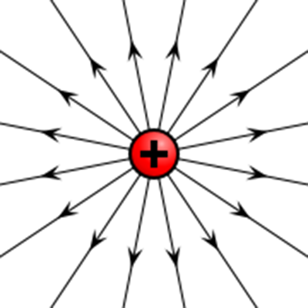
Electric field
Electric field around a positive charge +Q
Magnitude of electric field at any point:
|$E|=\frac{|F|}{q}=\frac{k Q}{r^{2}}$
Direction of electric field is radially outward

Slide 25
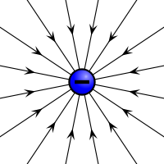
Electric field
Electric field around a negative charge -Q
Magnitude of electric field at any point:
|$E|=\frac{|F|}{q}=\frac{k Q}{r^{2}}$
Direction of electric field is radially inward

Slide 26
Electric field
Electric field lines start on positive charges and end on negative charges
The more closely spaced the field lines, the stronger the force

Slide 27
Electric field
The direction of the field lines show how a positive charge would move if placed at that point. A negative charge would move the opposite way.
$$\vec{E}$$
+q
$$\vec{F}=\vec{E}/q$$
$$\vec{F}=−\vec{E}/q$$
-q

Slide 28
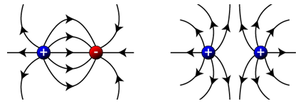
Electric field
Electric field lines between two charges
Unlike charges
Like charges

Slide 29
Electric field
Electric field lines between charged plates

Slide 30
Electric field
Electric field lines between charged plates
A constant electric field is obtained (see later material on capacitors)
$$\vec{E}$$

Slide 31
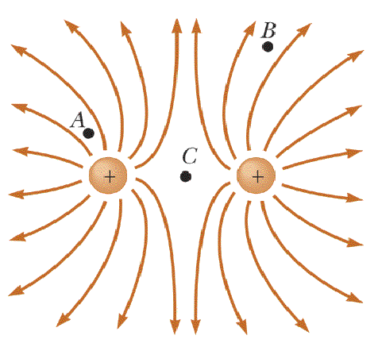
Consider an electron placed near a pair of identical positive charges, as in the field diagram. If the electron is at position “A” the direction of the force on it is best indicated by which of the following arrows?
↑
↖
↘
→
What is the force at location “C”?
Notes:
3 is correct (negative charge of electron means force opposite to field line tangent)

Slide 32
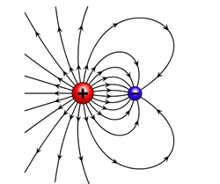
Electric field
Example A +5.0 μC charge is located at the origin, and a -2.0 μC charge is 0.74 m away on the x-axis. Calculate the electric field at point P, on the y-axis 0.6 m above the positive charge. If a +1.5 μC was placed at P, what force would it experience?
P
0.6
0
0.74
Electric field is superposition of 2 charges
E= kq/r² along joining line, k=9x10⁹
Electric field at P due to green charge q = +5x10⁻⁶ C
P
0.6
$$E=\frac{k q}{r^{2}}=\frac{9×{10}^{9}×5×{10}^{−6}}{{0.6}^{2}}=3.5×{10}^{5} N/C$$
Direction is along y-axis:
$$\left(E_{x},E_{y}\right)=(0, 3.5×{10}^{5})$$
0

Slide 33
Electric field
Example A +5.0 μC charge is located at the origin, and a -2.0 μC charge is 0.74 m away on the x-axis. Calculate the electric field at point P, on the y-axis 0.6 m above the positive charge. If a +1.5 μC was placed at P, what force would it experience?
P
0.6
0
0.74
Electric field is superposition of 2 charges
E= kq/r² along joining line, k=9x10⁹
Electric field at P due to purple charge q = -2x10⁻⁶ C
P
0.6
$$E=\frac{k |q|}{r^{2}}$$
Pythagoras: r² = 0.6² + 0.74² = 0.91 m²
r = 0.95 m
0.74

Slide 34
Electric field
Example A +5.0 μC charge is located at the origin, and a -2.0 μC charge is 0.74 m away on the x-axis. Calculate the electric field at point P, on the y-axis 0.6 m above the positive charge. If a +1.5 μC was placed at P, what force would it experience?
P
0.6
0
0.74
Electric field is superposition of 2 charges
E= kq/r² along joining line, k=9x10⁹
Electric field at P due to purple charge q = -2x10⁻⁶ C
P
0.6
$$E=\frac{k |q|}{r^{2}}=\frac{9×{10}^{9}×2×{10}^{−6}}{{0.95}^{2}}=0.20×{10}^{5} N/C$$
0.74

Slide 35
Electric field
Example A +5.0 μC charge is located at the origin, and a -2.0 μC charge is 0.74 m away on the x-axis. Calculate the electric field at point P, on the y-axis 0.6 m above the positive charge. If a +1.5 μC was placed at P, what force would it experience?
P
0.6
0
0.74
Electric field is superposition of 2 charges
E= kq/r² along joining line, k=9x10⁹
Electric field at P due to purple charge q = -2x10⁻⁶ C
$$E=\frac{k |q|}{r^{2}}=\frac{9×{10}^{9}×2×{10}^{−6}}{{0.95}^{2}}=0.20×{10}^{5} N/C$$
0.6
0.74
$$\left(E_{x},E_{y}\right)=(0.16×{10}^{5}, −0.13×{10}^{5})$$

Slide 36
Electric field
Example A +5.0 μC charge is located at the origin, and a -2.0 μC charge is 0.74 m away on the x-axis. Calculate the electric field at point P, on the y-axis 0.6 m above the positive charge. If a +1.5 μC was placed at P, what force would it experience?
P
0.6
0
0.74
Electric field is superposition of 2 charges
Green charge:
$$\left(E_{x},E_{y}\right)=(0, 3.5×{10}^{5})$$
Purple charge:
$$\left(E_{x},E_{y}\right)=(0.16×{10}^{5}, −0.13×{10}^{5})$$
Total:
$$\left(E_{x},E_{y}\right)=(0.16×{10}^{5}, 3.37×{10}^{5})$$
$$E= \sqrt{{E_{x}}^{2}+{E_{y}}^{2}}=3.38×{10}^{5} N/C$$
Electric field strength at P:
Force:
$$F=qE=1.5×{10}^{−6}×3.38×{10}^{5}=0.51 N$$

Slide 37
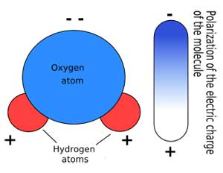
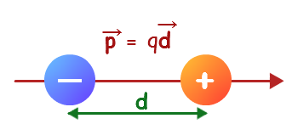
Electric dipole
A pair of positive and negative charges together form an electric dipole
An example in nature is the water molecule H₂0
Dipole moment

Slide 38
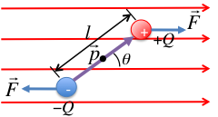
Electric dipole
A dipole in an electric field will feel a torque but no net force
$$\vec{E}$$
$$\left|τ\right|=Fl\sin{θ}=EQl\sin{θ}$$
$$\vec{τ}=\vec{E}×\vec{p}$$

Slide 39
Two particles move into the region between charged parallel plates, moving as shown in the diagram. Which of the following combinations is possible?
A
E
A and B are both electrons
A and B are both protons
A is a proton, B an electron
A is an electron, B a proton
No way to determine
B

Slide 40
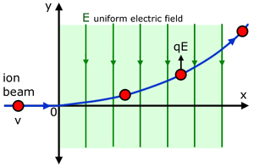
Electrostatic analyzer
Charged particles will experience a force in an electric field F=qE, hence acceleration a=F/m=qE/m

Slide 41
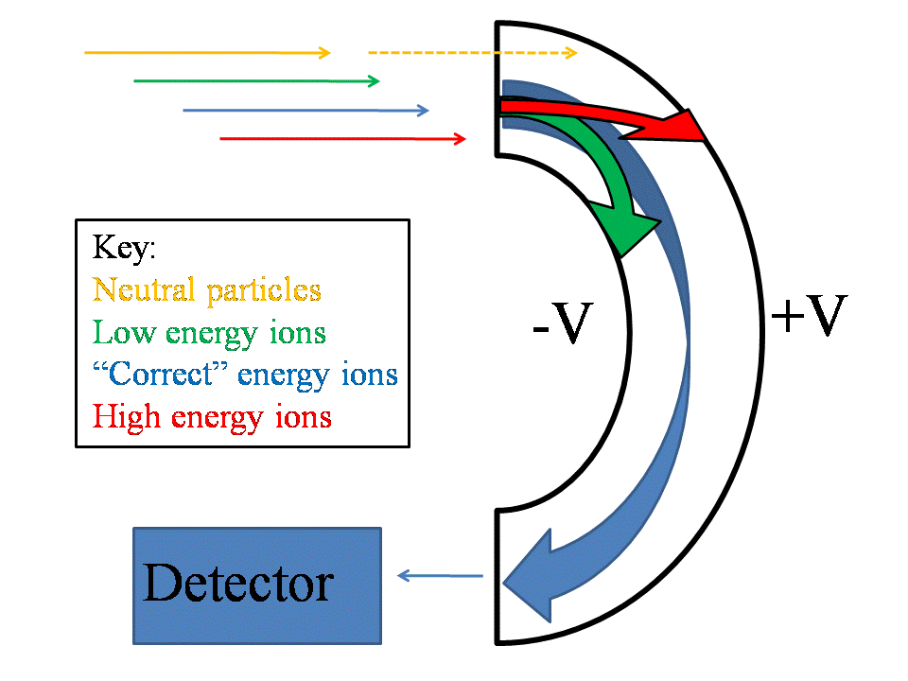
Electrostatic analyzer
An electrostatic analyzer selects velocities
Uniform electric field E applied between curved surfaces
Acceleration a is given by:
r
$$a= \frac{F}{m}=\frac{qE}{m}$$
$$a=\frac{v^{2}}{r}$$
$$\frac{v^{2}}{r}=\frac{qE}{m}→v=\sqrt{\frac{qEr}{m}}$$

Slide 42
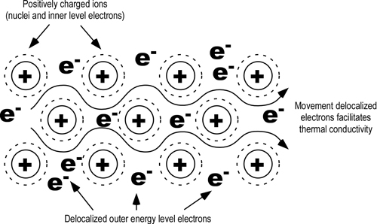
Conductors and Insulators
In metals (e.g. copper, iron) some electrons are weakly held and can move freely through the metal, creating an electric current. Metals are good conductors of electricity.

Slide 43
Conductors and Insulators
In metals (e.g. copper, iron) some electrons are weakly held and can move freely through the metal, creating an electric current. Metals are good conductors of electricity.
In non-metals (e.g. glass, rubber, plastic) electrons are strongly held and are not free to move. Non-metals are poor conductors of electricity, or insulators.
Semi-conductors (e.g. germanium, silicon) are half-way between conductors and insulators.
Freely moving electrons make metals good conductors of electricity and heat

Slide 44
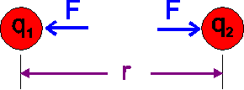
Chapter 20 : Summary
Matter is made up of positive and negative charges. Electrons/protons carry the elementary charge 1.6 x 10⁻¹⁹ C
Forces between charges are described by Coulomb’s Law
Forces from multiple charges sum as vectors
Electric field describes the force-field around charges
$$F= \frac{{k q}_{1}{ q}_{2}}{r^{2}}$$
$$k=9×{10}^{9} N m^{2} C^{−2}$$
$$\vec{E}=\frac{\vec{F}}{q}$$
$$\vec{F}=q \vec{E}$$

