Slide 1
Hello!
I’m Chris Blake, your lecturer for the rest of semester
We’ll cover: fluid motion, thermal physics, electricity, revision
MASH centre in AMDC 503 - 09.30-16.30 daily
My consultation hours: Tues 10.30-12.30
Wayne’s consultation hours: Thurs 2.30-4.30
cblake@swin.edu.au
03 9214 8624

Slide 2
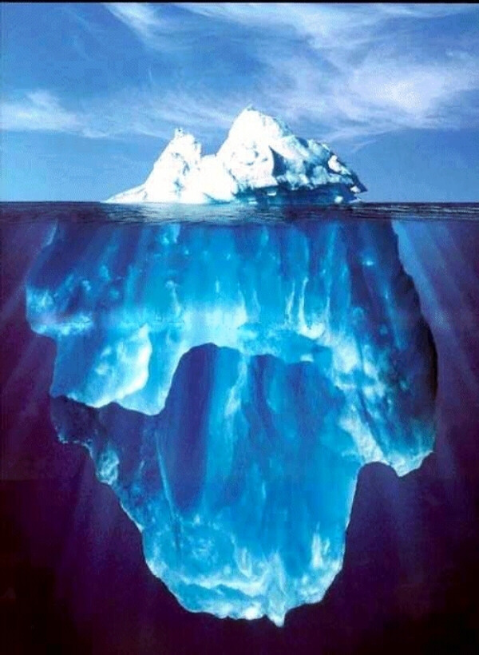
Fluid Motion
Density and Pressure
Hydrostatic Equilibrium and Pascal’s Law
Archimedes' Principle and Buoyancy
Fluid Dynamics
Conservation of Mass: Continuity Equation
Conservation of Energy: Bernoulli’s Equation
Applications of Fluid Dynamics

Slide 3
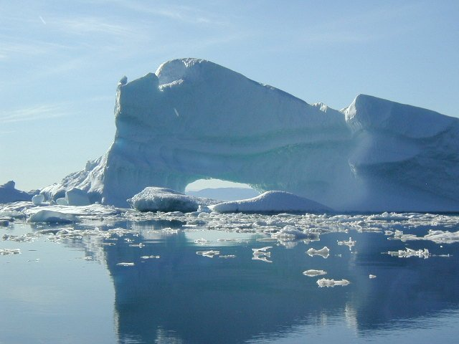
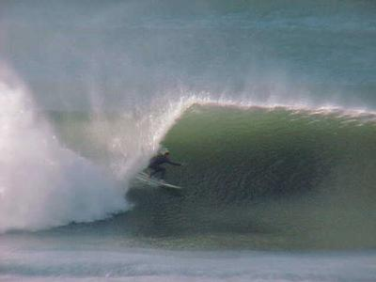
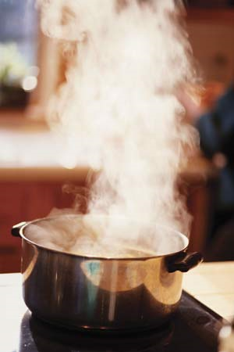
A microscopic view
Solid
rigid body
Liquid
Fluid
Incompressible
Gas
Fluid
compressible

Slide 4
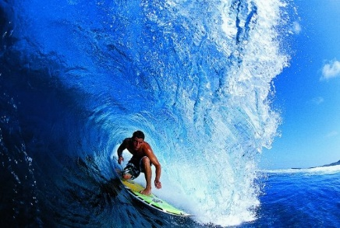
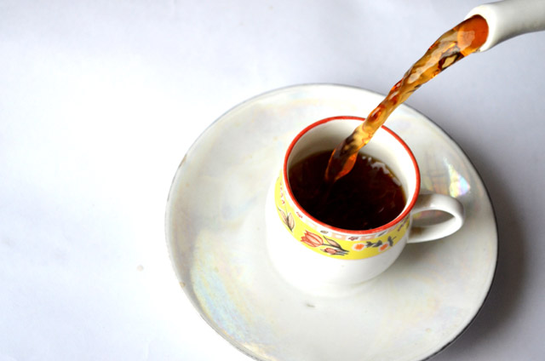
What new physics is involved?
Fluids can flow from place-to-place
Their density can change if they are compressible (for example, gasses)
Fluids are pushed around by pressure forces
An object immersed in a fluid experiences buoyancy

Slide 5
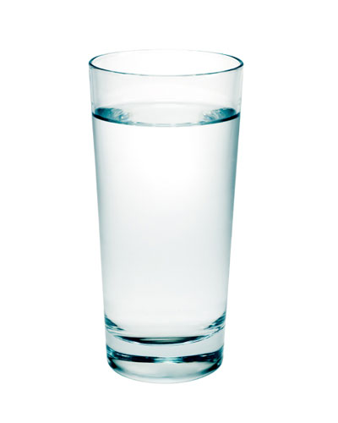
Density
The density of a fluid is the concentration of mass
$$density= \frac{mass}{volume}$$
$$ρ=\frac{m}{V}$$
$$Units are \frac{kg}{m^{3}}$$
Mass = 100 g = 0.1 kg
Volume = 100 cm³ = 10⁻⁴ m³
Density = 1 g/cm³ = 1000 kg m³

Slide 6
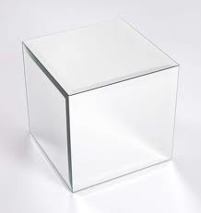
The shown cubic vessels contain the stated matter. Which fluid has the highest density ?
$$1.$$
$$2.$$
$1 kg$of water at $73°C$
$1 kg$of water at $273°C$
.
.
.
.
.
$$1 m$$
$$1 m$$
$$3.$$
$$4.$$
$1 kg$of water at $273°K$
$1 kg$of water at $373°C$
$$1 m$$
$$3 m$$
Notes:
1 is the correct answer as it is a fluid.
2 is a solid
2 and 4 are both gases but there density is the same and less than that of water.
Density is temperature independent in a fixed vessel if a gas. Note later in thermo talk about how volumes of liquids can change with temperature.

Slide 7
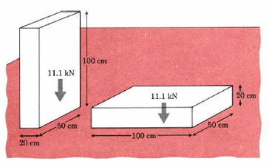
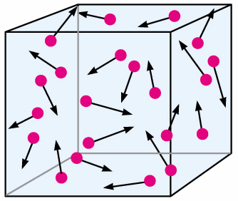
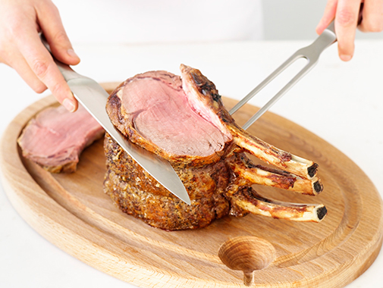
Pressure
Pressure is the concentration of a force – the force exerted per unit area
Exerts a pressure on the
sides and through the fluid
Greater pressure!
(same force, less area)

Slide 8
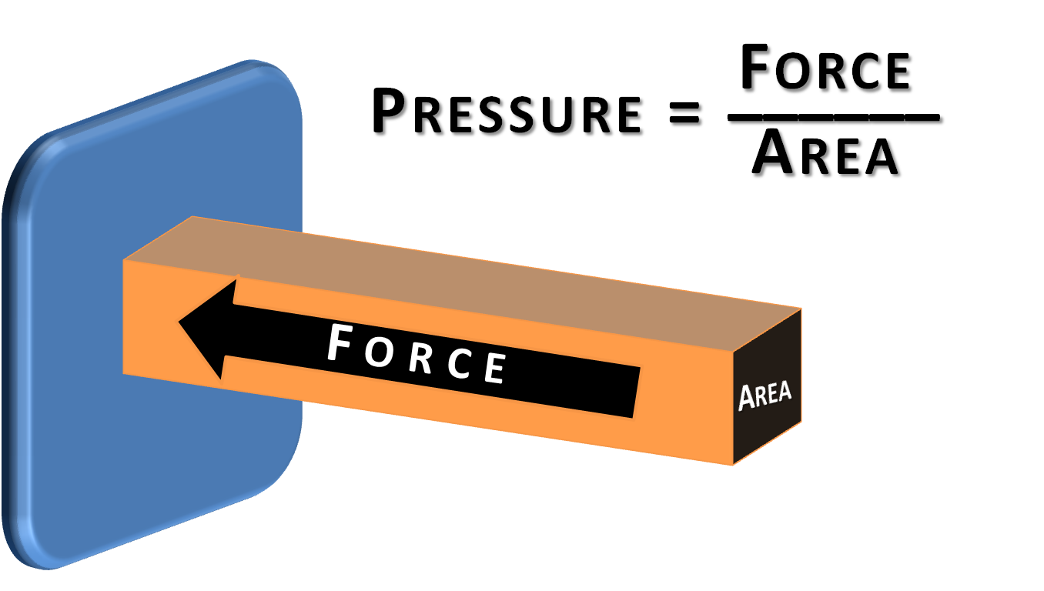
Pressure
$$p=\frac{F}{A}$$
Units of pressure are N/m² or Pascals (Pa) – 1 N/m² = 1 Pa
Atmospheric pressure = 1 atm = 101.3 kPa = 1 x 10⁵ N/m²

Slide 9
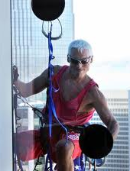
What is responsible for the force which holds urban climber B in place when using suction cups.
$$vacuum$$
A
B
The force of friction
Vacuum pressure exerts a pulling force
Atmospheric pressure exerts a pushing force
The normal force of the glass.
Notes:
Is A any different to B (yes, the glass surface must have some friction, however very small since n is quite large) 1atm = 101.k kPa

Slide 10
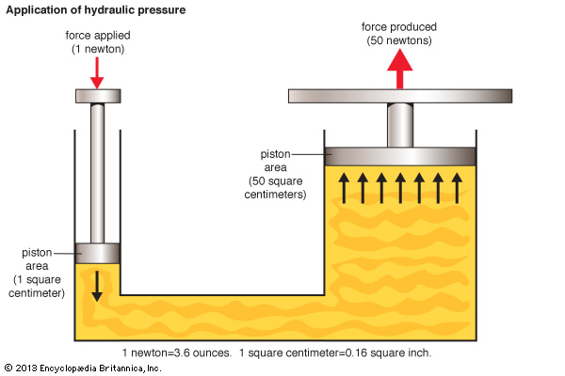
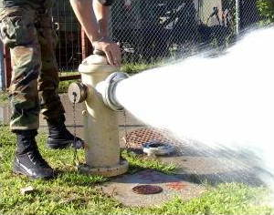
Hydrostatic Equilibrium
Pressure differences drive fluid flow
If a fluid is in equilibrium, pressure forces must balance
Pascal’s law: pressure change is transmitted through a fluid

Slide 11
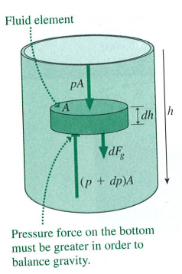
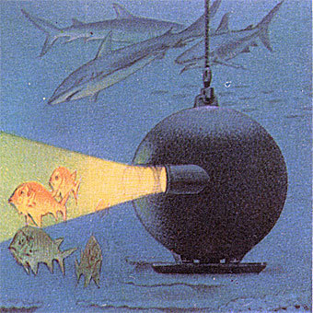
Hydrostatic Equilibrium with Gravity
Derivation:
$$\left(P+dP\right)A −pA=mg$$
$$dP A= ρ A dh g$$
$$\frac{dP}{dh}=ρg$$
$$P=P0+ρgh$$
Pressure in a fluid is equal to the weight of the fluid per unit area above it:
$${P=P}_{0}+ρgh$$
Notes:
Derive Free body diagram on fluid element

Slide 12
Consider the three open containers filled with water. How do the pressures at the bottoms compare ?
A.
B.
C.
$P_{A}=P_{B}=P_{C}$
$P_{A}<P_{B}=P_{C}$
$P_{A}<P_{B}<P_{C}$
$P_{B}<P_{A}<P_{C}$
Not enough information

Slide 13
The three open containers are now filled with oil, water and honey respectively. How do the pressures at the bottoms compare ?
honey
A.
B.
C.
oil
water
$P_{A}=P_{B}=P_{C}$
$P_{A}<P_{B}=P_{C}$
$P_{A}<P_{B}<P_{C}$
$P_{B}<P_{A}<P_{C}$
Not enough information
Notes:
Density of honey is 1.36 kg/litre, Density of water is 1kg/litre, Density of oil is 0.92 kg/litre

Slide 14
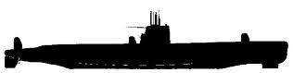
Calculating Crush Depth of a Submarine
Q. A nuclear submarine is rated to withstand a pressure difference of $70 atm$before catastrophic failure. If the internal air pressure is maintained at $1 atm$, what is the maximum permissible depth ?
$$P=P0+ρgh$$
$$P−P0=70 atm=7.1 ×106 Pa ; ρ=1×103 kg/m3$$
$$h=\frac{P−P0}{ρg} =\frac{7.1×106}{1×103×9.8} =720 m$$
Notes:
Note: what other factors at play, temperature, salinity, equilbrium ?

Slide 15
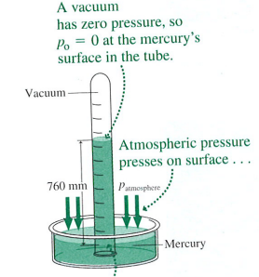
Measuring Pressure
Q. What is height of mercury (Hg) at $1 atm$?
$$ρ_{Hg}=13.6 g/{cm}^{3}$$
$$P=P0+ρgh→h=P/ρg$$
$$h= \frac{1×105}{1.36×104×9.8}=0.75 m$$
Atmospheric pressure can support a 10 meters high column of water. Moving to higher density fluids allows a table top barometer to be easily constructed.
$$p=p_{0}+ρgh$$
Notes:
Do by hand.

Slide 16
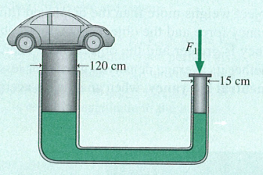
Pascal’s Law
Pressure force is transmitted through a fluid
Q. A large piston supports a car. The total mass of the piston and car is $3200 kg$. What force must be applied to the smaller piston ?
A₂
F₂
A₁
Pressure at the same height is the same! (Pascal’s Law)
$$\frac{F1}{A1}=\frac{F2}{A2}$$
$$F1=\frac{A1}{A2} mg= \frac{π×0.152}{π×1.202}×3200×9.8=490 N$$
Notes:
Force applied. Does this conserve energy. What if you lift car by 10 cm ? Conservation of mass ?

Slide 17
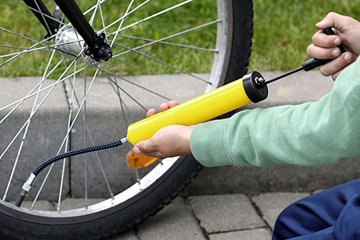
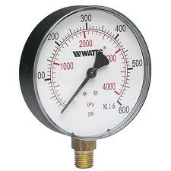
Gauge Pressure
Gauge Pressure is the pressure difference from atmosphere. (e.g. Tyres)
$$P_{absolute}=P_{atmosphere}+P_{gauge}$$
Notes:
Do by hand.

Slide 18
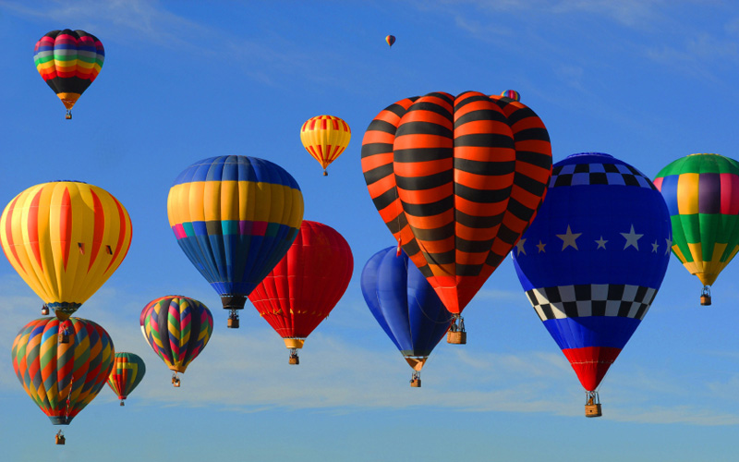
Archimedes’ Principle and Buoyancy
Why do some things float and other things sink ?

Slide 19
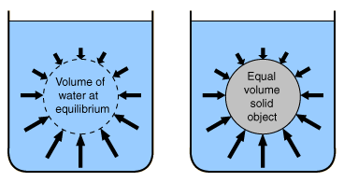
Archimedes’ Principle and Buoyancy
Objects immersed in a fluid experience a Buoyant Force!
$$FB=mwater g=ρwaterVg$$
$$W=msolid g=ρsolidVg$$
The Buoyant Force is equal to the weight of the displaced fluid !
Notes:
Fluid element, sum forces acting on element (resolve to net upwards force). Hydrostatic, weight fluid = buoyant force
Replace fluid element with same sized object. Net force is different due only to weight of object (lighter)
Now heavier.

Slide 20
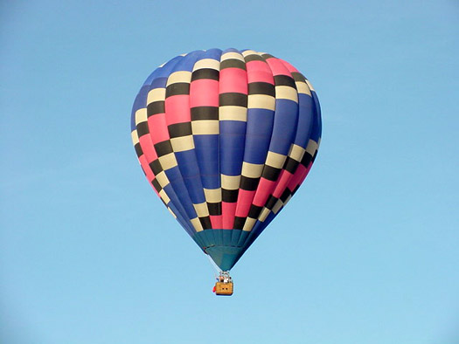
Archimedes’ Principle and Buoyancy
The hot-air balloon floats because the weight of air displaced (= the buoyancy force) is greater than the weight of the balloon
The Buoyant Force is equal to the weight of the displaced fluid !

Slide 21
Which of the three cubes of length $l$ shown below has the largest buoyant force ?
water
stone
wood
water
F_{B}
F_{B}
F_{B}
m₁g
m₂g
m₃g
A.
B.
C.
$water$
$stone$
$wood$
$the buoyant force is the same$
Not enough information

Slide 22
Example Archimedes’ Principle and Buoyancy
Q. Find the apparent weight of a $60 kg$ concrete block when you lift it under water, $ρ_{concrete}=2200 kg/m3$
Evaluate
Interpret
Water provides a buoyancy force
Apparent weight should be less
Develop
Assess
The Buoyant Force is equal to the weight of the displaced fluid.
Notes:
Fluid element, sum forces acting on element (resolve to net upwards force). Hydrostatic, weight fluid = buoyant force
Replace fluid element with same sized object. Net force is different due only to weight of object (lighter)
Now heavier.

Slide 23
Floating Objects
Q. If the density of an iceberg is 0.86 that of seawater, how much of an iceberg’s volume is below the sea?
$$Buoyancy force FB=weight of water displaced$$
$$Vsub=submerged volume$$
$$FB=mwater g=ρwater Vsub g$$
$$In equilibrium, FB=weight of iceberg$$
$$FB=mice g=ρice Vice g$$
$$ρwaterVsub g= ρiceVice g→\frac{Vsub}{Vice}=\frac{ρwater}{ρice}=0.86$$

Slide 24
A beaker of water weighs $w_{1}$. A block weighting $w_{2}$ is suspended in the water by a spring balance reading $w_{3}$. Does the scale read
$w_{1}$
$w_{1}+w_{2}$
$w_{1}+w_{3}$
$w_{1}+w_{2}−w_{3}$
$w_{1}+w_{3}−w_{2}$
scale
Notes:
4 is correct answer: Look at limiting cases or Newtons 3rd law pair for forces acting on water or pressure from weight of displaced water.

Slide 25
Centre of Buoyancy
The Centre of Buoyancy is given by the Centre of Mass of the displaced fluid. For objects to float with stability the Centre of Buoyancy must be above the Centre of Mass of the object. Otherwise Torque yield Tip !

Slide 26
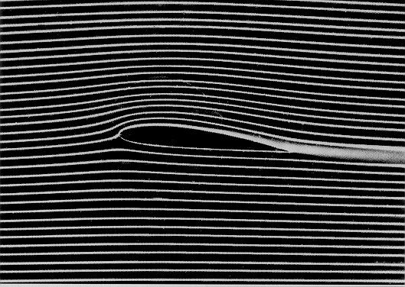
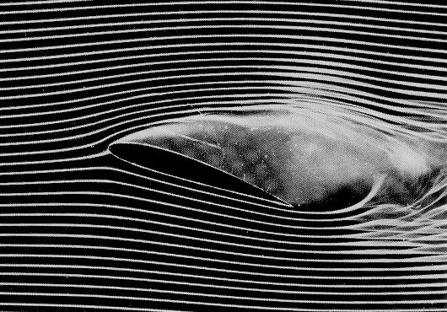
Fluid Dynamics
Laminar (steady) flow is where each particle in the fluid moves along a smooth path, and the paths do not cross.
Streamlines spacing measures velocity and the flow is always tangential, for steady flow don’t cross. A set of streamlines act as a pipe for an incompressible fluid
Non-viscous flow – no internal friction (water OK, honey not)
Turbulent flow above a critical speed, the paths become irregular, with whirlpools and paths crossing. Chaotic and not considered here.

Slide 27
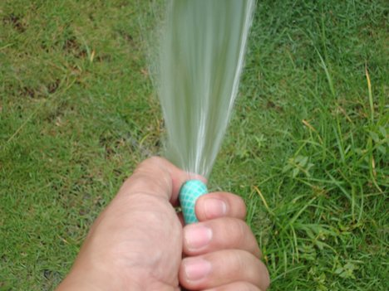
Conservation of Mass: The Continuity Eqn.
“The water all has to go somewhere”
The rate a fluid enters a pipe must equal the rate the fluid leaves the pipe. i.e. There can be no sources or sinks of fluid.

Slide 28
Conservation of Mass: The Continuity Eqn.
A₁
A₂
fluid in →
fluid out →
v₁
v₂
Q. How much fluid flows across each area in a time $∆t$:
v₂Δt
v₁Δt
A₁
A₂

Slide 29
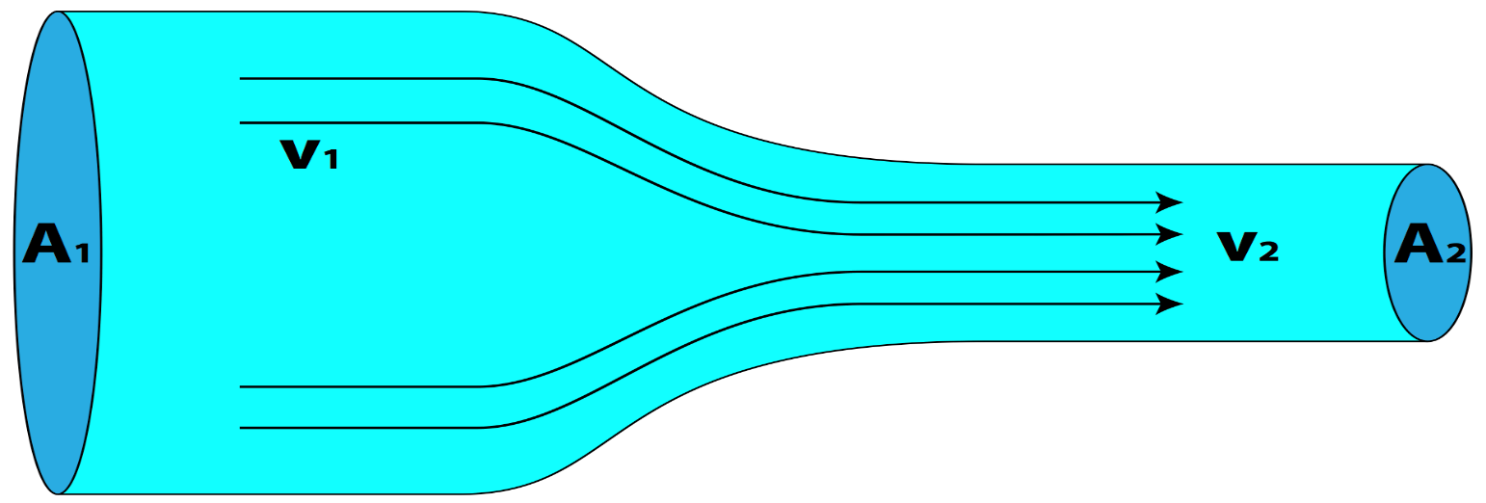
Conservation of Mass: The Continuity Eqn.
Q. A river is 40m wide, 2.2m deep and flows at 4.5 m/s. It passes through a 3.7-m wide gorge, where the flow rate increases to 6.0 m/s. How deep is the gorge?
$$A2=w2d2$$
$$A1=w1d1$$
$$Continuity equation :A1v1=A2v2→w1d1v1=w2d2v2$$
$$d2=\frac{w1d1v1}{w2v2} =\frac{40×2.2×4.5}{3.7×6.0} =18 m$$

Slide 30
Conservation of Energy: Bernoulli’s Eqn.
What happens to the energy density of the fluid if I raise the ends ?
v₁Δt
y₂
y₁
v₂Δt
Energy per unit volume
Total energy per unit volume is constant at any point in fluid.

Slide 31
Conservation of Energy: Bernoulli’s Eqn.
Q. Find the velocity of water leaving a tank through a hole in the side 1 metre below the water level.
$$P+ \frac{1}{2}ρv2+ρgy=constant$$
$$At the top: P=1 atm, v=0, y=1 m$$
$$At the bottom: P=1 atm, v=?, y=0 m$$
$$P+ρgy=P+\frac{1}{2}ρv2$$
$$v= \sqrt{2gy}= \sqrt{2×9.8×1}=4.4 m/s$$

Slide 32
Which of the following can be done to increase the flow rate out of the water tank ?
$$h$$
$$H$$
Raise the tank $(↑H)$
Reduce the hole size
Lower the water level $(↓h)$
Raise the water level $(↑h)$
None of the above

Slide 33
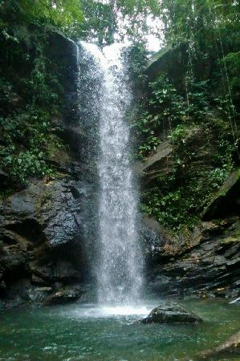
Summary: fluid dynamics
Continuity equation: mass is conserved!
$$ρ×v×A=constant$$
For liquids:
$$ρ=constant→v×A=constant$$
$$(Density ρ, velocity v, pipe area A)$$
Bernoulli’s equation: energy is conserved!
$$P+ \frac{1}{2}ρv2+ρgy=constant$$
$$(Pressure P, density ρ, velocity v, height y)$$

Slide 34
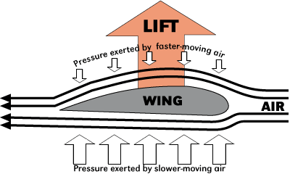
Bernoulli’s Effect and Lift
Newton’s 3rd law
(air pushed downwards)
$$P+ \frac{1}{2}ρv2+ρgy=constant$$
Lift on a wing is often explained in textbooks by Bernoulli’s Principle: the air over the top of the wing moves faster than air over the bottom of the wing because it has further to move (?) so the pressure upwards on the bottom of the wing is smaller than the downwards pressure on the top of the wing.
Is that convincing? So why can a plane fly upside down?

Slide 35
Chapter 15 Fluid Motion Summary
Density and Pressure describe bulk fluid behaviour
Pressure in a fluid is the same for points at the same height
In hydrostatic equilibrium, pressure increases with depth due to gravity
The buoyant force is the weight of the displaced fluid
Fluid flow conserves mass (continuity eq.) and energy (Bernoulli’s equation)
A constriction in flow is accompanied by a velocity and pressure change.
Reread, Review and Reinforce concepts and techniques of Chapter 15
Examples 15.1 , 15.2 Calculating Pressure and Pascals Law
Examples 15.3 , 15.4 Buoyancy Forces: Working Underwater + Tip of Iceberg
Examples 15.5 Continuity Equation: Ausable Chasm
Examples 15.6, 15.7 Bernoulli's Equation – Draining a Tank and Venturi Flow

