Slide 1
Revision :
exam tips

Slide 2
Introduction to Physics exam
180 minutes – 60% of course assessment
Section A : 20 multiple choice questions for 15 marks – circle responses on answer sheet
Section B : 16 basic problems for 30 marks – write answers in the spaces provided
Section C : 5 advanced problems for 15 marks – write answers in the spaces provided

Slide 3
Introduction to Physics exam
Only allowed to take in Standard Exam Calculator (“TI-30XB”)
Formula sheet provided (see next slide)
Make sure you show all working for Sections B and C
Note : all exam questions are taken from the textbook!

Slide 4
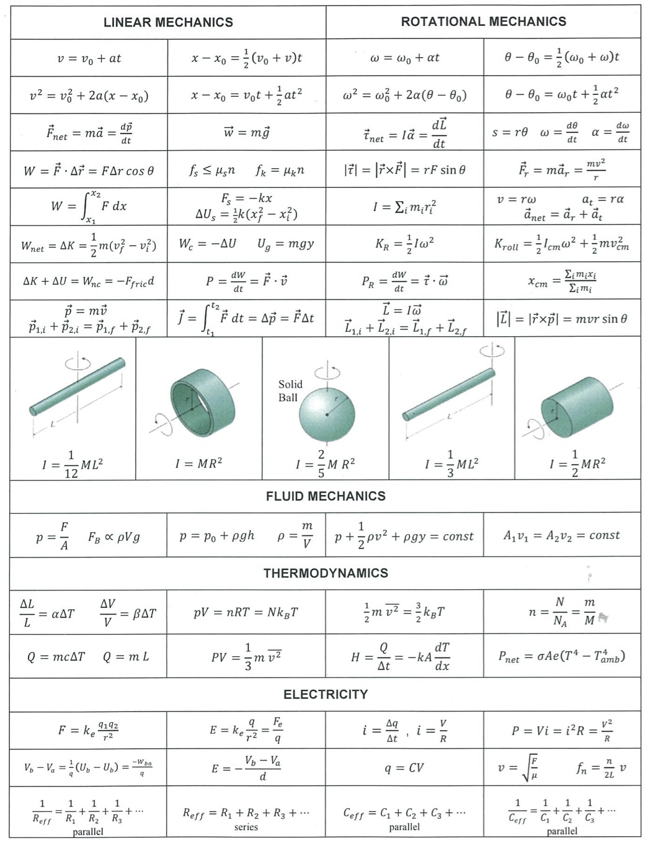
Formula sheet

Slide 5
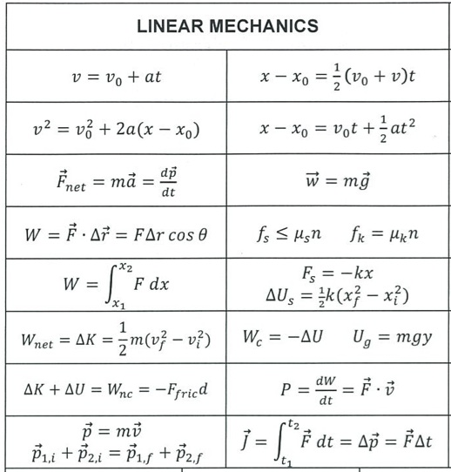
Formula sheet

Slide 6
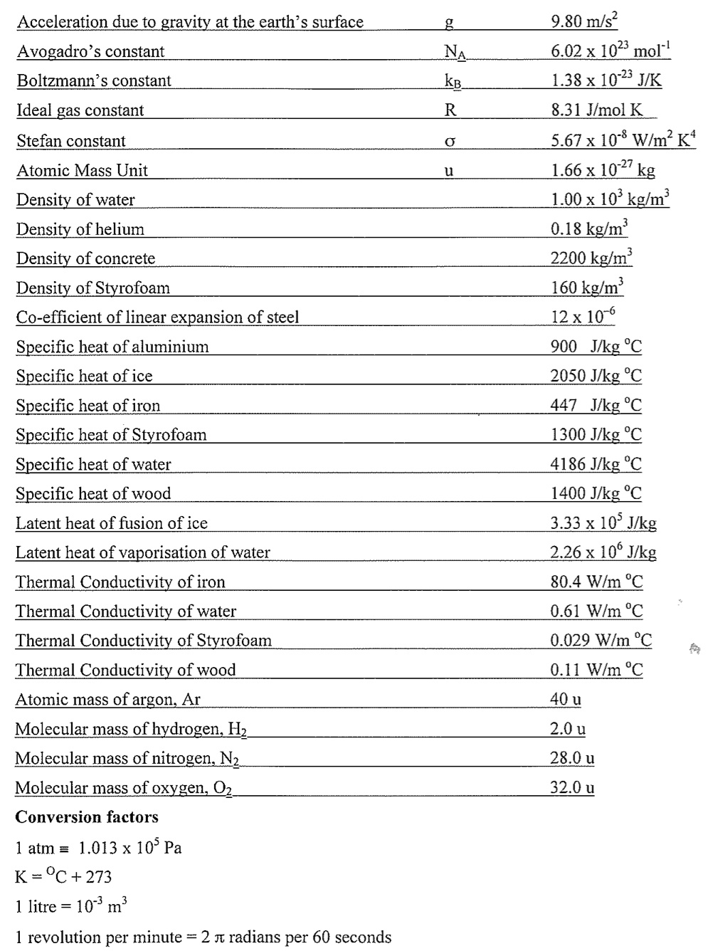
Formula sheet

Slide 7
Problem-solving tips (1/4)
Convert all numbers to S.I. units!
e.g. Distance = $m$, Time = $s$, Mass = $kg$, Force = $N$, Energy = $J$, Angle = $rad$, Pressure = $Pa$, Temperature = $K$, Charge = $C$, Current = $A$, Resistance = $Ω$, etc.
Watch out for unit prefixes and powers!
$8 cm=8 ×{10}^{−2} m=0.08 m$
$0.1 g=0.1×{10}^{−3} kg={10}^{−4} kg$
$2 kPa=2×{10}^{3} Pa$
$100 mA=100 ×{10}^{−3} A=0.1 A$
$5 {cm}^{2}=5×{10}^{−4} m^{2}$ (because $1 cm= {10}^{−2} m$)
1 litre $\left(L\right)=1000 {cm}^{3}={1000×{10}^{−6} m^{3}=10}^{−3} m^{3}$

Slide 8
Problem-solving tips (1/4)
e.g. you are given a speed of $100 km/h$
This is not an S.I. unit so we need to convert!
$1 km=1000 m$
$1 h=3600 s$
$100\frac{km}{h}=100×\frac{1000 m}{3600 s}=27.8 m/s$
e.g. you are given a rotation rate of $21 rpm$
This is not an S.I. unit so we need to convert!
1 revolution $=2π rad=6.28 rad$
$1 m=60 s$
$21 rpm=21×\frac{6.28 rad}{60 s}=2.2 rad/s$

Slide 9
Problem-solving tips (2/4)
Determine what topic the problem is about
This will help identify the appropriate section of the formula sheet
This will help with symbol confusion, e.g. in mechanics p=momentum, in fluids p=pressure
Linear mechanics
Rotational mechanics
Fluid mechanics
Thermodynamics
Electricity

Slide 10
Problem-solving tips (3/4)
Draw a simple diagram
Subconscious starts working on the problem!
Before:
After:
$$u_{A}$$
$$u_{B}$$
$$v$$
$$m$$
$$m$$
$$m$$
$$m$$
$$u_{A}=4 m s^{−1}, u_{B}=3 m{ s}^{−1}$$
$$v= ??$$

Slide 11
Problem-solving tips (4/4)
Do as much algebra as possible before substituting in numbers
Entering numbers in the calculator is prone to error!
Sometimes variables will cancel, so produce as simple an expression as you can
e.g. conservation of energy problem $mgh=\frac{1}{2}mv^{2}$ , you are given $m$ and $h$ and asked to find the speed $v$
Can first re-arrange to give $v=\sqrt{2gh}$, no need to evaluate the total energy

Slide 12
Problem-solving tips (summary)
Watch out that all numbers are in S.I. units
What topic is the problem about? (linear / rotational / fluids / thermodynamics / electricity)
Draw a diagram! Which variables have you been given and which are unknown?
Do as much algebra as possible before substituting in numbers

Slide 13
Revision :
linear mechanics

Slide 14
Linear Mechanics key facts (1/8)
Displacement $x$ [unit is $m$]
Velocity $v=\frac{Displacement change}{Time}=\frac{∆x}{∆t}$ [unit is $m s^{−1}$]
Acceleration $a=\frac{Velocity change}{Time}=\frac{∆v}{∆t}$ [unit is $m s^{−2}$]
Instantaneous velocity = rate of change of $x$ at a given $t$
Average velocity = (Total displacement)/(Total time)
Can be vectors e.g. $\vec{v}=\left(v_{x},v_{y}\right) → \left|\vec{v}\right|=\sqrt{{v_{x}}^{2}+{v_{y}}^{2}}$

Slide 15
Linear Mechanics key facts (2/8)
1D motion with constant acceleration $a$ : what is the displacement $x$ and velocity $v$ at time $t$?
$$x=x_{0}+v_{0} t+\frac{1}{2} a t^{2}$$
$x_{0}=$ initial displacement
$$v=v_{0}+a t$$
$v_{0}=$ initial velocity
$$v^{2}={v_{0}}^{2}+2 a (x−x_{0})$$
Sometimes $a=$ acceleration due to gravity $g=9.8 m s^{−2}$
Acceleration will be negative if it’s in the direction opposite $x$

Slide 16
Linear Mechanics key facts (3/8)
Newton’s Laws define the concept of force, measured in Newtons [N]
Forces balance in equilibrium
Net force causes mass $m$ to accelerate : $F=m a$
Forces arranged in action/reaction pairs
Force under gravity (weight) : $W=m g$
Force from a stretched spring $=k x$

Slide 17
Linear Mechanics key facts (4/8)
Motion in 2D : apply equations of motion, or $F=ma$, to both components
$$v=v_{0}+a t$$
e.g. projectile motion …
$$y$$
$$v_{x}=u\cos{θ}$$
$$u$$
$$v_{y}=u\sin{θ}−g t$$
$$g$$
$$x=x_{0}+v_{0} t+\frac{1}{2} a t^{2}$$
$$θ$$
$$x=(u\cos{θ}) t$$
$$x$$
$$y=\left(u\sin{θ}\right) t−\frac{1}{2} g t^{2}$$
Acceleration $a_{x}=0, { a}_{y}=−g$

Slide 18
Linear Mechanics key facts (4/8)
Motion in 2D : apply equations of motion, or $F=ma$, to both components
e.g. inclined plane …
$$y$$
$$N$$
x-direction:
$$a$$
$$mg\sin{θ}=ma$$
y-direction:
$$θ$$
$$mg\cos{θ}−N=0$$
$$x$$
$$mg$$

Slide 19
Linear Mechanics key facts (5/8)
Motion in a circle :
$$m$$
Centripetal acceleration $a=\frac{v^{2}}{r}$
$$v$$
$$r$$
$$a$$
Centripetal force $F=\frac{{m v}^{2}}{r}$

Slide 20
Linear Mechanics key facts (6/8)
Friction force opposes relative motion of surfaces in contact $=μ×$ Normal Force
$$N$$
$μ=$ coefficient of friction
$$T$$
$$μ N$$
$$mg$$

Slide 21
Linear Mechanics key facts (7/8)
Conservation of energy is a quick way of solving many problems. Energy is measured in Joules [J]
Energy of work done = Force x Distance $=\vec{F}.\vec{∆x}$
Kinetic energy $=\frac{1}{2}mv^{2}$
Gravitational potential energy $=mgh$
Energy of stretching a spring $=\frac{1}{2}kx^{2}$
Power is rate of doing work $=\frac{∆W}{∆t}=\frac{F ∆x}{∆t}=F v$

Slide 22
Linear Mechanics key facts (8/8)
Momentum of a particle $p=mv$
Collisions of particles (1) : momentum is always conserved
Collisions of particles (2) : kinetic energy is only conserved for elastic collisions (otherwise lost)
$$u$$
$$v$$
$$m_{1}$$
$$m_{2}$$
$$m_{1}$$
$$m_{2}$$
$$m_{1}u+0=\left(m_{1}+m_{2}\right) v$$

Slide 23
Practice exam questions
$$u_{A}$$
$$u_{B}$$
$$v$$
$$m$$
$$m$$
$$m$$
$$m$$
Conservation of momentum : $mu_{A}−mu_{B}=2mv$
$$v=\frac{1}{2}\left(u_{A}−u_{B}\right)=\frac{1}{2}\left(4−3\right)=0.5 m s^{−1} [B]$$

Slide 24
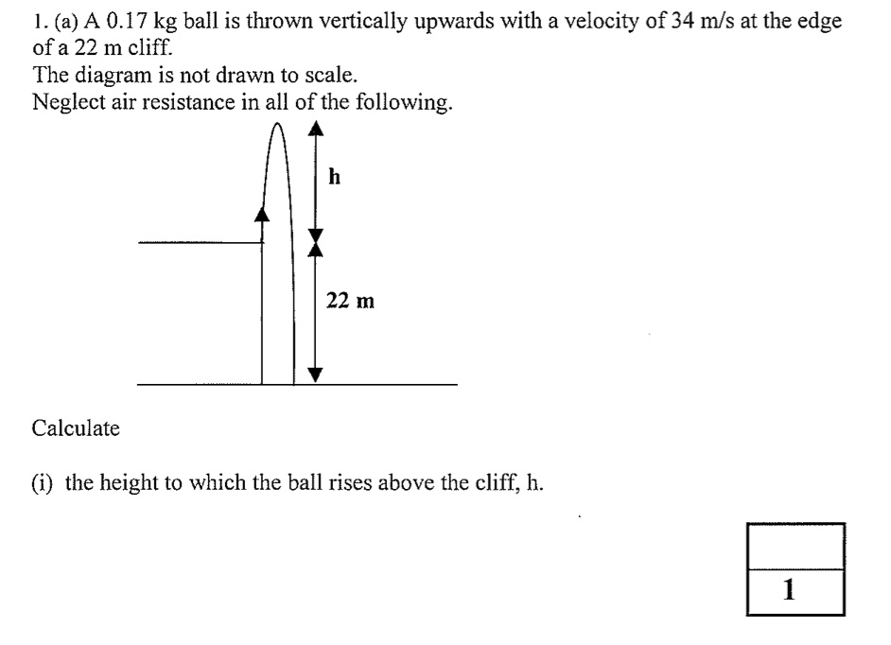
Practice exam questions
$$v_{0}$$
Conservation of energy: $\frac{1}{2}m{v_{0}}^{2}=mgh$
$$→h=\frac{{v_{0}}^{2}}{2g}=\frac{{34}^{2}}{2×9.8}=59 m$$

Slide 25
Practice exam questions
$$x_{0}=22 m , v_{0}=34 ms^{−1} , a=−9.8 ms^{−2}$$
Final position: $x=0 m$ , what is $v$ and $t$?
$$v^{2}={v_{0}}^{2}+2a(x−x_{0})$$
$$v=\sqrt{{34}^{2}+2×(−9.8)×(−22)}=−39.8 ms^{−1}$$
$$v=v_{0}+at$$
Re-arrange: $t=\frac{v−v_{0}}{a}=\frac{−39.8 −34}{−9.8}=7.5 s$
See working above: $39.8 ms^{−1}$ downwards

Slide 26
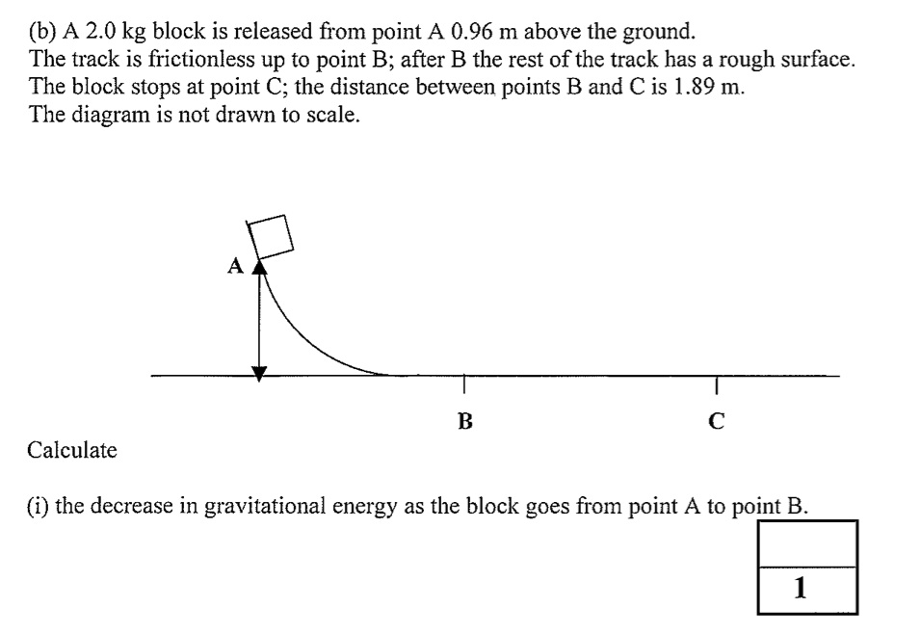
Practice exam questions
$$mgh=2×9.8×0.96=18.8 J$$

Slide 27
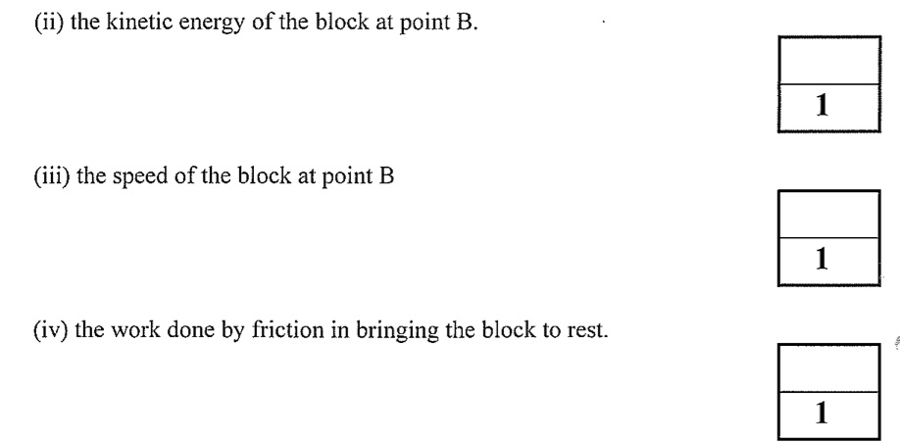
Practice exam questions
Kinetic energy gained = Potential energy lost $=18.8 J$
$$KE=\frac{1}{2}mv^{2} → v=\sqrt{\frac{2 KE}{m}}=\sqrt{\frac{2×18.8}{2}}=4.34 m s^{−1}$$
Work done = Kinetic energy lost $=18.8 J$

Slide 28
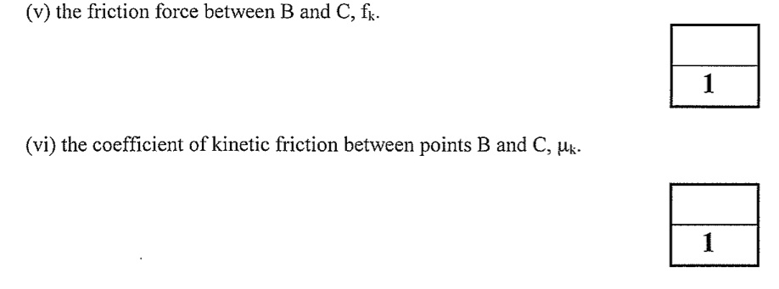
Practice exam questions
Work = Force x Distance $→ f_{k}=\frac{Work}{Distance}=\frac{18.8}{1.89}=9.96 N$
$$f_{k}=μ_{k} N=μ_{k} mg$$
$$μ_{k}=\frac{f_{k}}{mg}=\frac{9.96}{2×9.8}=0.51$$

Slide 29
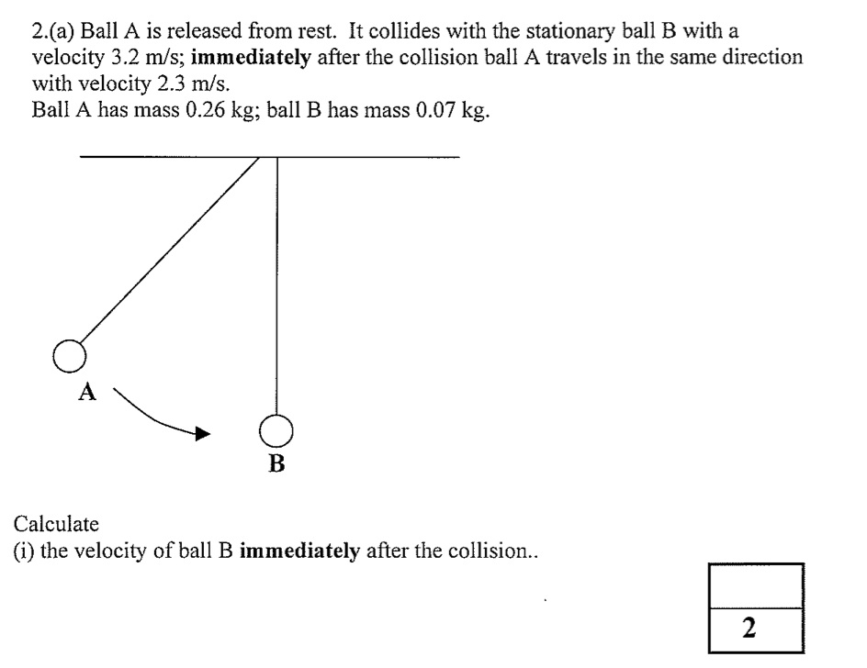
Practice exam questions
$$u_{A}$$
$$m_{A}$$
$$m_{B}$$
$$v_{A}$$
$$v_{B}$$
$$m_{A}$$
$$m_{B}$$
Conservation of momentum : $m_{A}u_{A}=m_{A}v_{A}+m_{B}v_{B}$
$$v_{B}=\frac{m_{A}(u_{A}−v_{A})}{m_{B}}=\frac{0.26(3.2−2.3)}{0.07}=3.34 m s^{−1}$$

Slide 30
Practice exam questions
Conservation of energy : $\frac{1}{2}m_{B}{v_{B}}^{2}=m_{B}gh$
$$h=\frac{{v_{B}}^{2}}{2g}=\frac{{(3.34)}^{2}}{2×9.8}=0.57 m$$

Slide 31
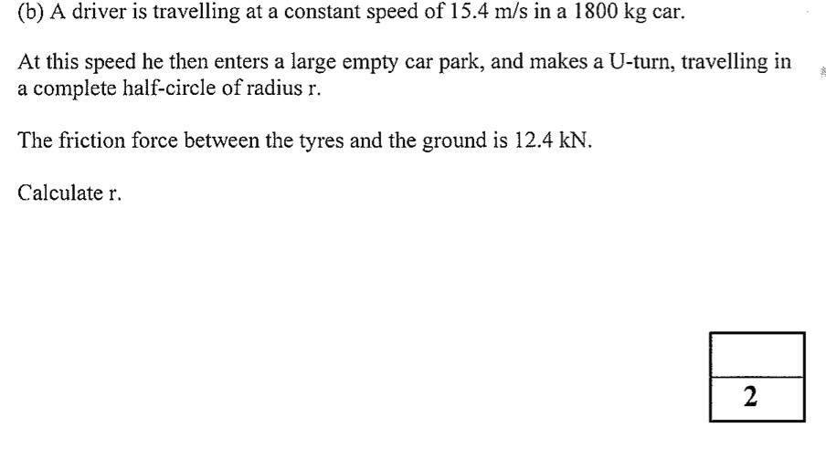
Practice exam questions
Centripetal f$orce F=\frac{mv^{2}}{r}$
$$v=15.4 ms^{−1}, m=1800 kg, F=12.4 kN=12400 N$$
$$r=\frac{m v^{2}}{F}=\frac{1800×{(15.4)}^{2}}{12400}=34.4 m$$

Slide 32
Next steps
Make sure you are comfortable with unit conversions
Review the linear mechanics key facts
Familiarize yourself with the linear mechanics section of the formula sheet
Try questions from the sample exam papers on Blackboard and/or the textbook

Slide 33
Revision :
rotational mechanics

Slide 34
Formula sheet

Slide 35
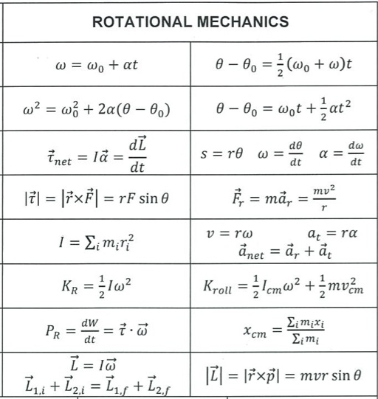
Formula sheet

Slide 36
Formula sheet

Slide 37
Formula sheet

Slide 38
Rotational Mechanics key facts (1/8)
Analogous formulae to linear mechanics apply, where linear quantities are replaced by rotational quantities
Displacement $x$ is equivalent to angle swept out $θ$
Angle is measured in radians, where $2π$ is a complete circle
1 revolution = 360 degrees = $2π$ radians
$$θ$$

Slide 39
Rotational Mechanics key facts (1/8)
Analogous formulae to linear mechanics apply, where linear quantities are replaced by rotational quantities
$$v$$
Angular velocity $ω=\frac{∆θ}{∆t}$ [units : $rad s^{−1}$]
Angular acceleration $α=\frac{∆ω}{∆t}$ [units : $rad s^{−2}$]
Linear velocity $v=rω$
$$r$$
$$θ$$

Slide 40
Rotational Mechanics key facts (1/8)
Analogous formulae to linear mechanics apply, where linear quantities are replaced by rotational quantities
Angular velocity $ω=\frac{∆θ}{∆t}$ [units : $rad s^{−1}$]
Angular acceleration $α=\frac{∆ω}{∆t}$ [units : $rad s^{−2}$]
Linear velocity $v=\frac{∆x}{∆t}$ [units : $m s^{−1}$]
Linear acceleration $a=\frac{∆v}{∆t}$ [units : $m s^{−2}$]

Slide 41
Rotational Mechanics key facts (2/8)
Equations of constant angular acceleration
They are all on the formula sheet, or you can remember them by analogy with the linear case with $θ→x$, $ω→v$ and $α→a$.
$$θ=θ_{0}+ω_{0} t+\frac{1}{2} α t^{2}$$
Analogous to linear case:
$$x=x_{0}+v_{0} t+\frac{1}{2} a t^{2}$$
$$ω=ω_{0}+α t$$
$$v=v_{0}+a t$$
$$ω^{2}={ω_{0}}^{2}+2 α (θ−θ_{0})$$
$$v^{2}={v_{0}}^{2}+2 a (x−x_{0})$$

Slide 42
Rotational Mechanics key facts (3/8)
In linear motion, force causes acceleration
In rotational motion, the torque of a force causes angular acceleration about an axis/pivot
$$F$$
Torque $τ$ = force x perpendicular distance to the axis
axis
$$r$$
$$τ=F r$$
The units of torque are $N m$

Slide 43
Rotational Mechanics key facts (4/8)
In linear motion, the acceleration is determined by the mass $m$ : $F=ma$
In rotational motion, the role of mass is played by the rotational inertia $I$ of the body about the axis
$$F=ma→$$
$$τ=I α$$
torque = rotational inertia x angular acceleration

Slide 44
Rotational Mechanics key facts (5/8)
What is the rotational inertia about an axis?
Different bodies have different rotational inertia depending on their mass $M$ and radius $R$ / length $L$
General formula for a system of particles: $I=\sum_{i}{m_{i} {r_{i}}^{2}}$

Slide 45
Rotational Mechanics key facts (5/8)
For a composite system, the rotational inertia about an axis is the sum of the components
$$I_{total}=I_{1}+I_{2}+…$$
e.g. particle sitting on a disk …
$$r$$
Disk of mass $M$
$$m$$
$$I_{total}=\frac{1}{2}MR^{2}+mr^{2}$$
$$R$$

Slide 46
Rotational Mechanics key facts (6/8)
Rotational energy
In linear motion, kinetic energy $=\frac{1}{2}mv^{2}$
In rotational motion, kinetic energy $=\frac{1}{2}Iω^{2}$
$$ω$$
axis
rotational inertia about axis $=I$

Slide 47
Rotational Mechanics key facts (6/8)
Rotational energy
In linear motion, kinetic energy $=\frac{1}{2}mv^{2}$
In rotational motion, kinetic energy $=\frac{1}{2}Iω^{2}$
$$ω$$
$$m$$
Energy of rolling object $=\frac{1}{2}mv^{2}+\frac{1}{2}Iω^{2}$
$$v$$

Slide 48
Rotational Mechanics key facts (7/8)
Angular momentum $L$
In linear motion, momentum is conserved if there is no external force (e.g. colliding particles)
In rotational motion, angular momentum is conserved if there is no external torque
$$p=mv→$$
Angular momentum $L=I ω$

Slide 49
Rotational Mechanics key facts (8/8)
Rotational equilibrium
In linear motion, a system is in equilibrium when the forces balance in all directions
In rotational motion, a system is in equilibrium when the torques balance
$$D_{1}$$
$$D_{2}$$
$$M_{1}g×D_{1}=M_{2}g×D_{2}$$
$$M_{1}g$$
$$M_{2}g$$

Slide 50
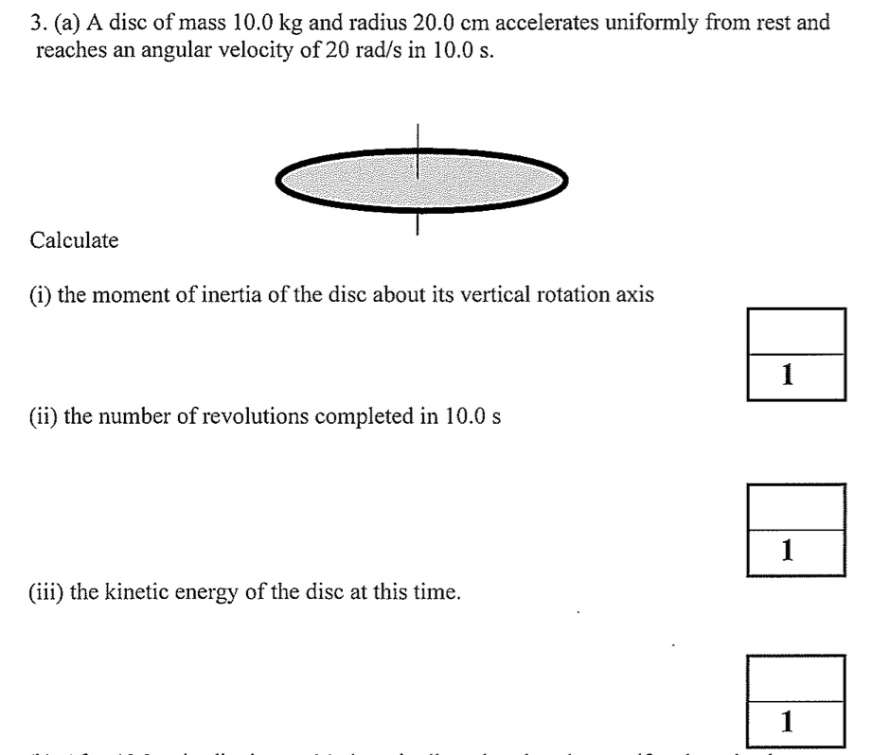
Practice exam questions
$$I=\frac{1}{2}MR^{2}=\frac{1}{2}×10×{(0.2)}^{2}=0.2 kg m^{2}$$
$$α=\frac{∆ω}{∆t}=\frac{20}{10}=2 rad s^{−2}$$
$$θ=\frac{1}{2}αt^{2}=\frac{1}{2}×2×{10}^{2}=100 rad$$
$$\frac{100}{2π}=15.9 rev$$
$$KE=\frac{1}{2}Iω^{2}=\frac{1}{2}×0.2×{20}^{2}=40 J$$

Slide 51
Practice exam questions
$$α=\frac{∆ω}{∆t}=\frac{−20}{120}=−0.167 rad s^{−2}$$
$$τ=I α=0.2×0.167=0.033 N m$$

Slide 52
Practice exam questions
The tension is providing the centripetal force $F=\frac{mv^{2}}{r}$
$$v=rω$$
Double $ω→$ Double $v→$ Factor 4 increase in $F →$ Option D
Impossible to say because it depends on the axis – Option D

Slide 53
Practice exam questions
Option C is correct

Slide 54
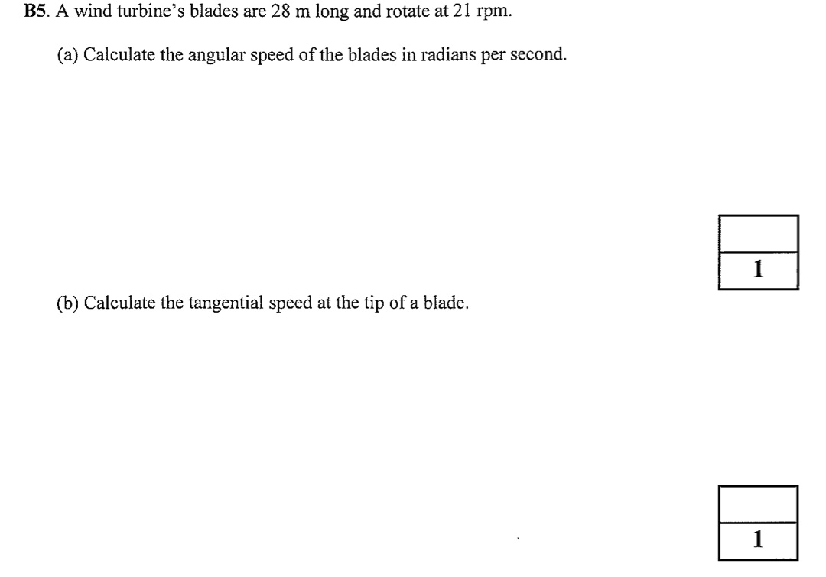
Practice exam questions
$$ω=21 rpm= \frac{21×2π rad}{60 s}=2.2 rad s^{−1}$$
$$v=r ω=28×2.2=62 m s^{−1}$$

Slide 55
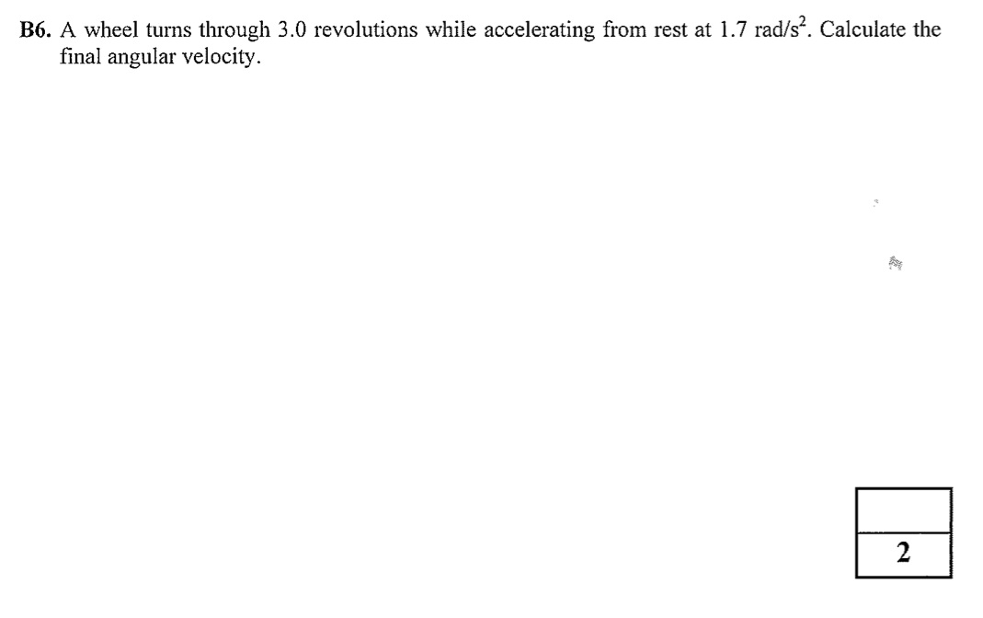
Practice exam questions
$$θ−θ_{0}=3 rev=3×2π rad=18.8 rad$$
$$α=1.7 rad s^{−2}$$
$$ω_{0}=0 rad s^{−1}$$
What is $ω$?
$$ω^{2}={ω_{0}}^{2}+2α(θ−θ_{0})$$
$$ω=\sqrt{2×1.7×18.8}=8.0 rad s^{−1}$$

Slide 56
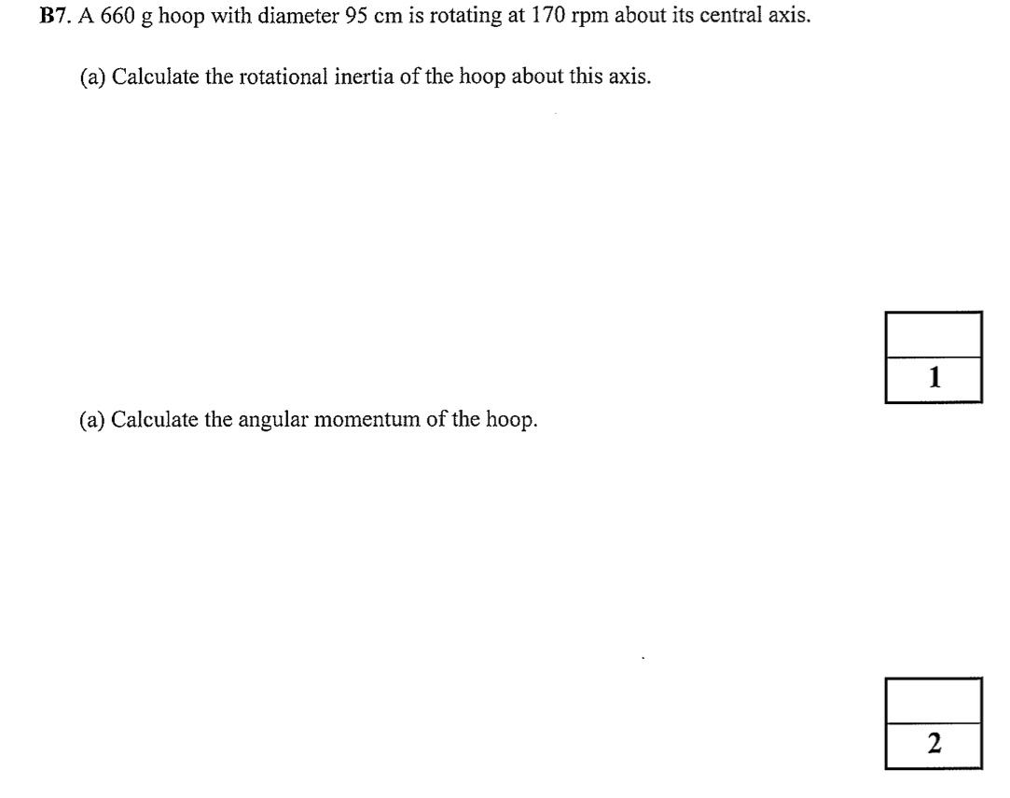
Practice exam questions
$$I=M{ R}^{2}=0.66×{(\frac{0.95}{2})}^{2}=0.15 kg m^{2}$$
$$L=I ω$$
$$ω=170 rpm= \frac{170×2π rad}{60 s}=17.8 rad s^{−1}$$
$$L=I ω=0.15×17.8=2.7 kg m^{2} s^{−1}$$

Slide 57
Practice exam questions
In equilibrium, torques about pivot balance
$$T$$
Torque = Force x perpendicular distance to pivot
$$15 m$$
$$Mg$$
$$T×15\sin{50=Mg×15\cos{50}+mg×5\cos{50}}$$
$$5 m$$
Using $M=2500 kg, m=700 kg$ and re-arranging the equation …
$$mg$$
$$15\cos{50}$$
$$→T=22500 N$$

Slide 58
Next steps
Make sure you are comfortable with unit conversions, especially for radians/revolutions
Review the rotational mechanics key facts
Familiarize yourself with the rotational mechanics section of the formula sheet, including the rotational inertia panel
Try questions from the sample exam papers on Blackboard and/or the textbook

